Slide 1
WASH news & resources : a starter
RNTC Multimedia Journalism & Water Course presentation
  11 November 2014

Slide 2
Content
  How do you stay-up-to date?
  News services
  International WASH news services
  IRC News and Information Resources
  Characteristics of WASH sector news
  Key international organisations
  Key WASH resources

Slide 3
How do you stay-up-to date?
Subscriptions: (paid/free): news services, magazines, journals, newsletters
News aggregators and alert services (commercial/free): e.g. Meltwater, Feedly, Google alerts
Social media tools: Twitter / Twitter lists, Paper.li, Scoop.it
Events (F2F/livestreaming): conferences/side events, seminars, workshops, webinars
Networks (personal/professional)/ Communities of Practice
Online discussion forums

Slide 4
News services (1)
Mass Media News aggregators
  News pre-selection
  Reputation monitoring, effectiveness of mass media campaigns, trend monitoring
Social Media Aggregators
Reputation monitoring, effectiveness of social media campaigns, hype monitoring

Slide 5
News services (2)
News Selectors
select and present most relevant news by region, topic etc
Added Value News Services
Summarise news, provide links to related news and resources, include new events and funding opportunities, user interaction (share, comment, submit news

Slide 6
International WASH news services
IRIN – water and sanitation
IISD – Water Policy & Practice - http://water-l.iisd.org
Circle of Blue - www.circleofblue.org
International Decade for Action 'Water for Life' 2005-2015 – Decade’s Weekly - www.un.org/waterforlifedecade/decade_weekly.shtml
Science Daily - Water News - www.sciencedaily.com/news/earth_climate/water
OOSKAnews / aquaNOW - www.ooskanews.com
Global Water Intelligence - www.globalwaterintel.com

Slide 7
IRC News and Information Resources
IRC web site – themes | news | blog | resources (WASH Library)
Sanitation Updates (USAID/IRC)
E-Source Sanitation News
WASH Services that Last

Slide 8
Characteristics of WASH sector news
Low profile in mass media
Professional media incIude a lot of PR aimed at mass media, funders/sponsors and supporters
No independent, critical WASH media
Debates in social media and corridors

Slide 9

WASH Resources: key international organisations
UN-Water members (1)

Slide 10
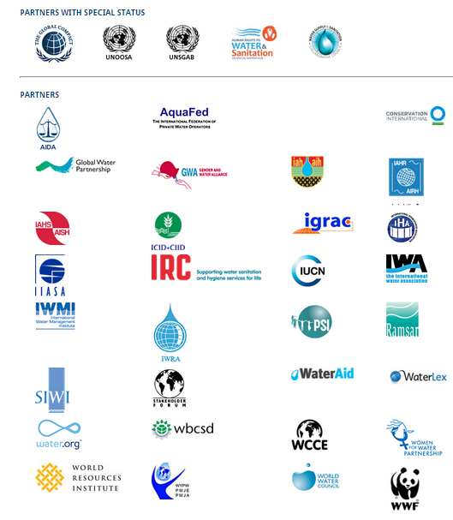
WASH Resources: key international organisations
UN-Water members (2)

Slide 11
WASH Resources: Key events
World Water Forum (Mar)
SWA High Level Meeting (Apr)I
WEDC Conference (Jul)
nternational Water Week in Stockholm (Aug/Sept)
UNC Water and Health Conference (Oct)
IWA World Water Conference (Sep)

Slide 12
WASH Resources – Key Journals
Journal of Water, Sanitation and Hygiene for Development
Waterlines

Slide 13
WASH Resources – topic starting points (1)
Advocacy – WSSCC | End Water Poverty
Economics - World Bank – Water
Funding – WASHfunders.org
Gender – Gender and Water Alliance
Health – WHO - Water Sanitation Health
Human Rights - Human Rights to Water and Sanitation - UN Special Rapporteur
Hygiene – LSTHM – Hygiene Central
Integrity / anti-corruption – Water Integrity Network

Slide 14
WASH Resources – topic starting points (2)
Monitoring – WASHwatch | WHO/UNICEF JMP
Policy – Sanitation and Water for All
Rural Water Supply - RWSN
Sanitation – SuSanA
Statistics – UN-Water – Statistics | WHO/UNICEF JMP | Improve International - Failures
Sustainable services - IRC | Water for People | WSUP
Technology – Akvopedia
Water Resource s Management - Global Water Partnership

Slide 15
WASH Resources – examples from the South (3)
BRAC WASH Programme
India Water Portal
IWMI – Sri Lanka
Water Research Commission (WRC) – South Africa

