Slide 1



Slide 2
Amplifying voices
Locally led approaches to improve water management

Slide 3
Content
Welcome and warm-up
Approaches to amplify local voices
    Right2Grow
    Water Flow Diagram
    MUISKA
Campfire discussion
  How can we better listen to the local voices?
Wrap-up
Notes:
We will begin with a warm-up exercise, followed by short presentations of different approaches which all focus on amplify local voices. In our view the local voices are already strong enough, but we need to give them the right platform or stage to be heard. The main part of the session will be the campfire discussion. Elisabeth will record our discussion graphically and will present her illustration to wrap up our session. So let’s get started!

Slide 4
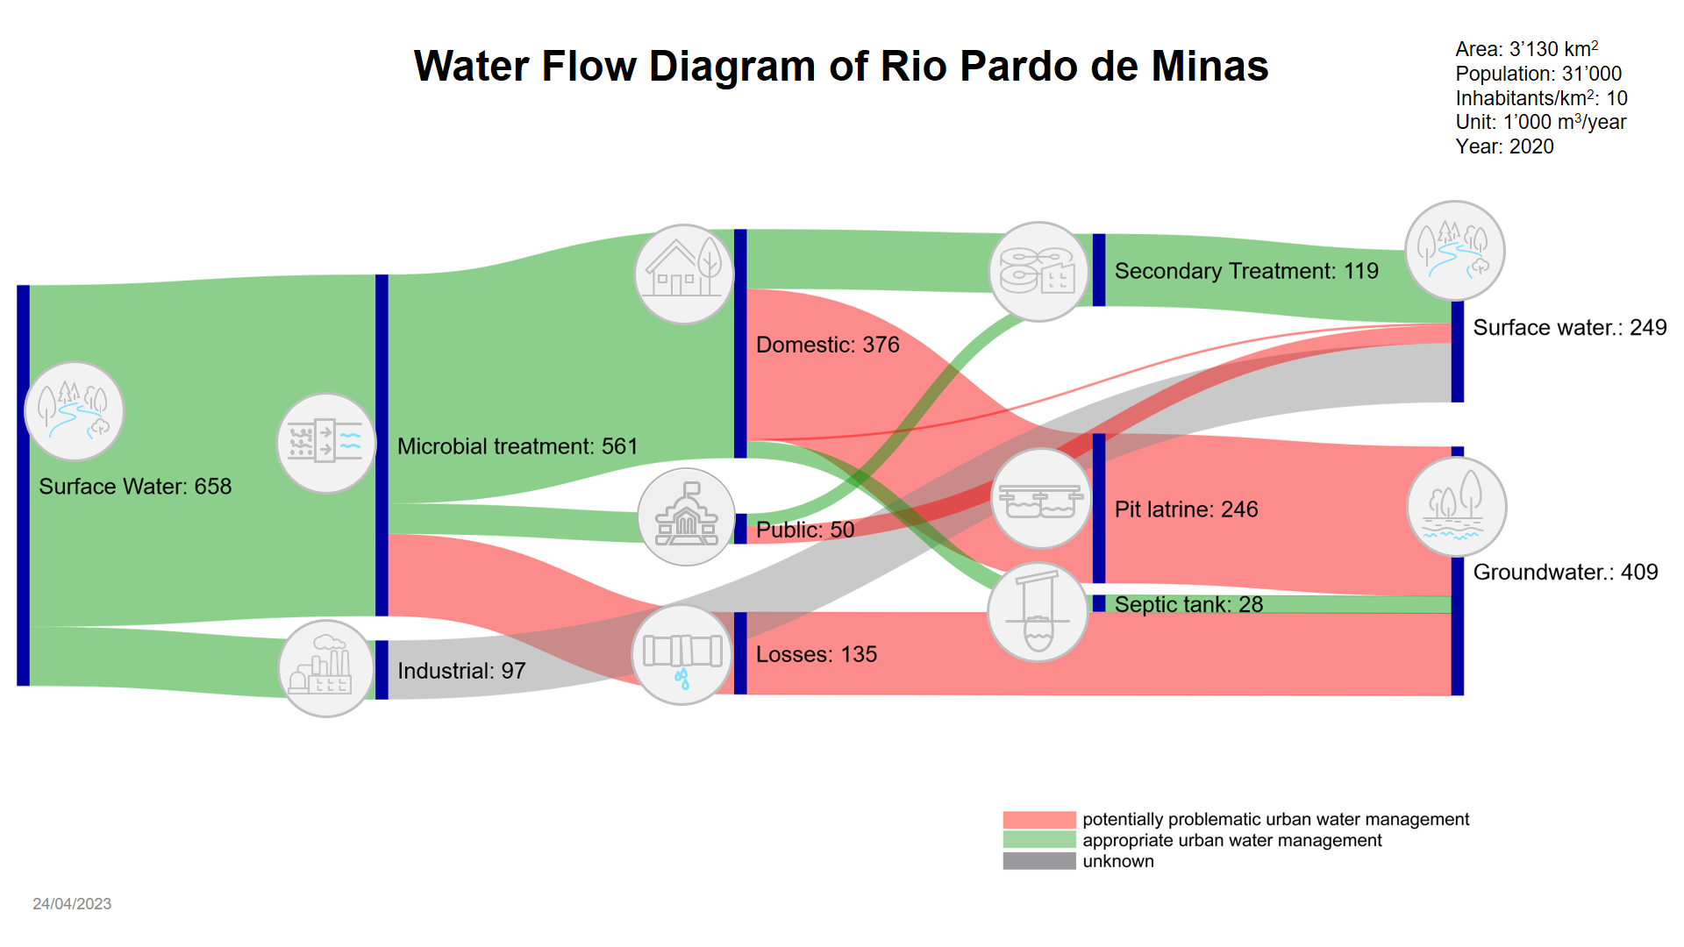
Water Flow Diagram puzzle
Warm-up
Water sources to the left, water discharges to the right
Overlaps are possible
Notes:
In the next 5 minutes, we ask you to put together the pieces of a simplified version of the WFD of Taltali. It’s a municipality in Bangladesh, where Right2Grow is active and which will be referred to in the next presentation. You can see here an example of a WFD from a city in Brazil. A WFD describes the water flows of a city from source to discharge. Red highlights problematic water management practices and green appropriate ones, grey means unknown. The width of the flow is proportional to the volumen of water. 2 hints: Make sure that the water sources are on the left side and the discharges on the right. Secondly, overlaps of flows are possible, as you can see in the diagram here.

Slide 5
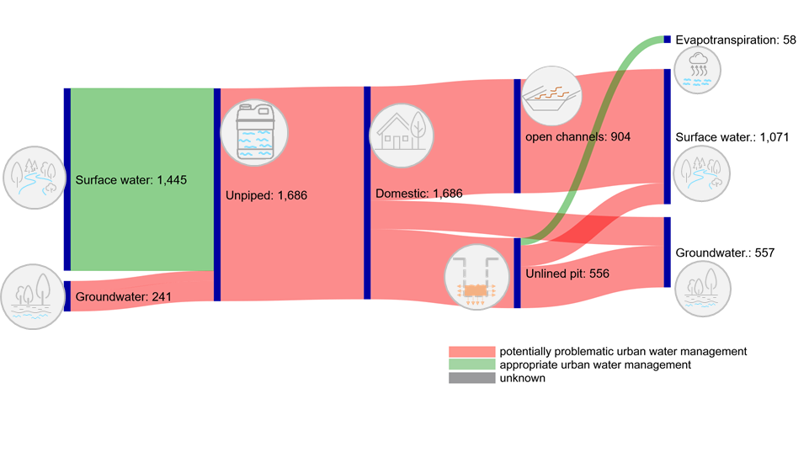

Simplified WFD of Taltali
Notes:
That’s the solution of the simplified WFD diagram. It’s a simplified version because it only considers the domestic water use.

Slide 6
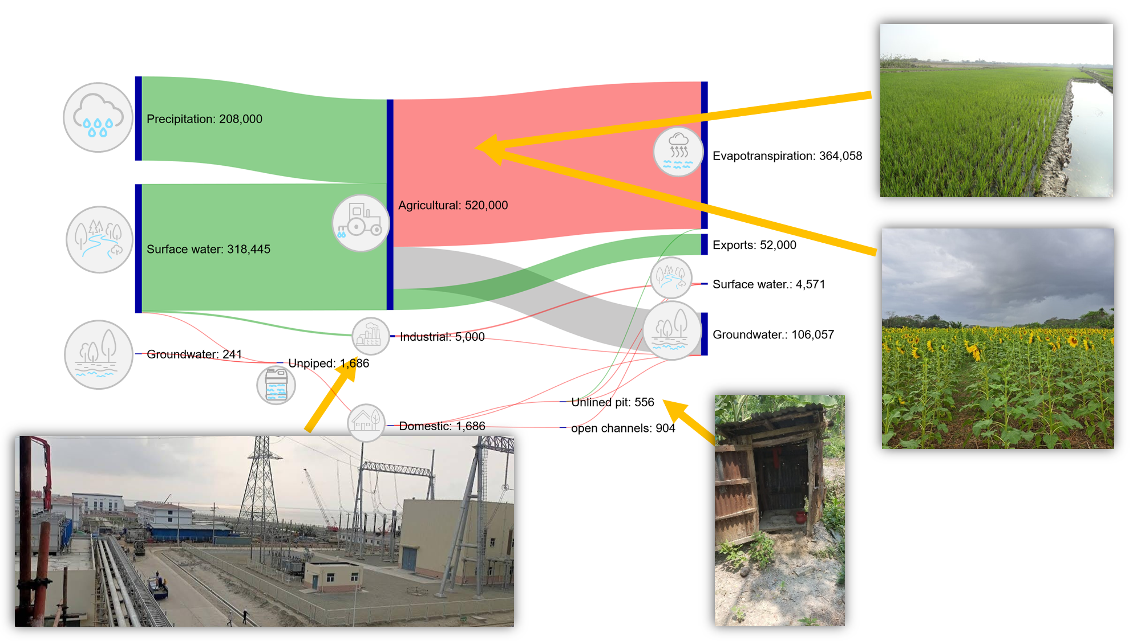
Complete WFD of Taltali
Notes:
This is the complete WFD. You can see that the large part is used in agriculture, and evaporates, because inefficient irrigation methods are used. Another challenge is the coal powered power plant: It pollutes the surrounding surface and groundwaters. Before you will learn more about Taltali, Irene from the Ministry of foreign affairs will give a quick introduction to the donor perspective for approaches to amplify local voices.

Slide 7
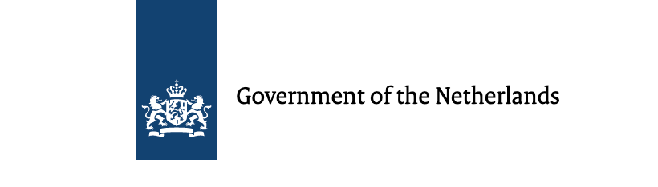
Strengtening Civil Society: Power of Voices

Slide 8



Slide 9


Slide 10
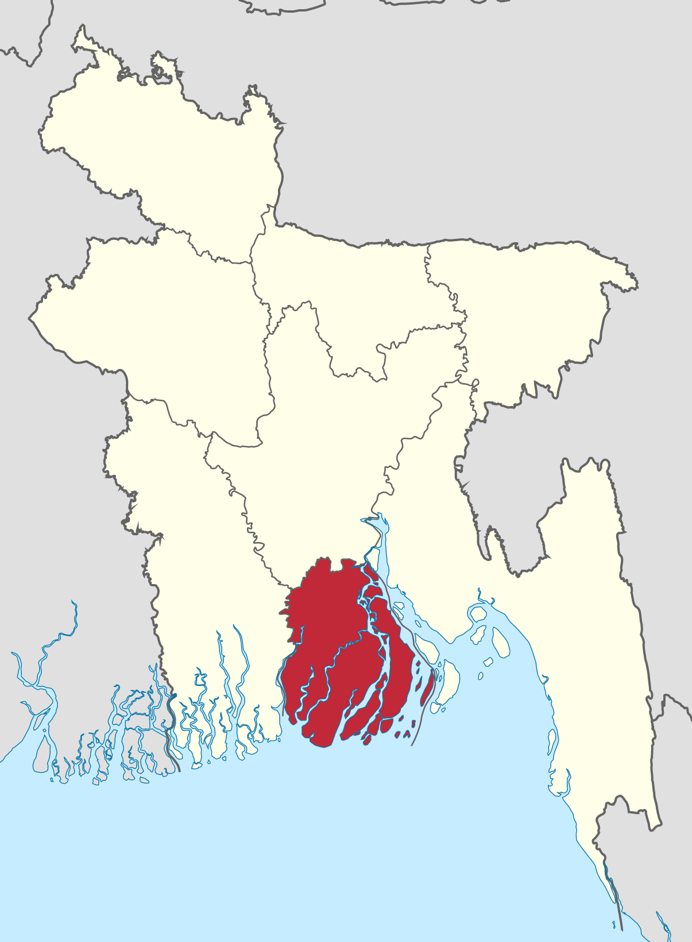
Taltali
Notes:
Picture with the map of Taltoli

Slide 11
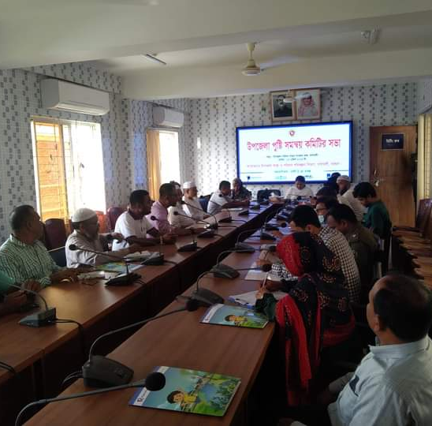
•Upazila level = municipality level
•Nutrition Coordination Committee: Government, Civil society, and NGOs.
•Taltali Upazila: Right2Grow and CSOs active
Notes:
ADD a visual on the concrete example we want to bring forward to describe what Right2Grow is doing? (see SharePoint file for further explanation?)

Slide 12
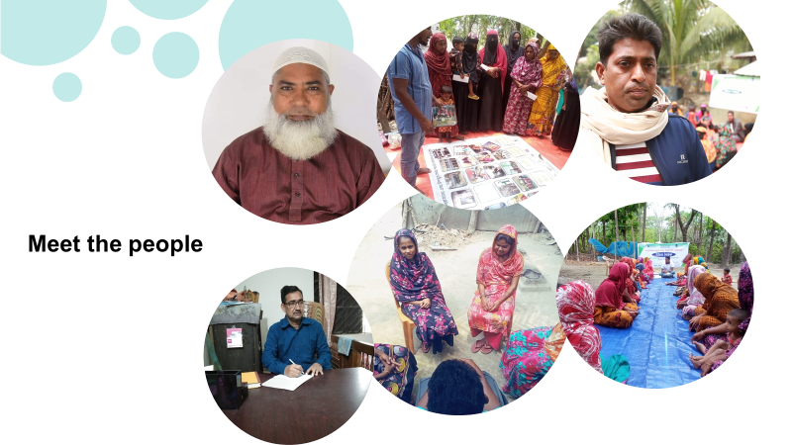
Amplifying Voices from Taltali

Slide 13
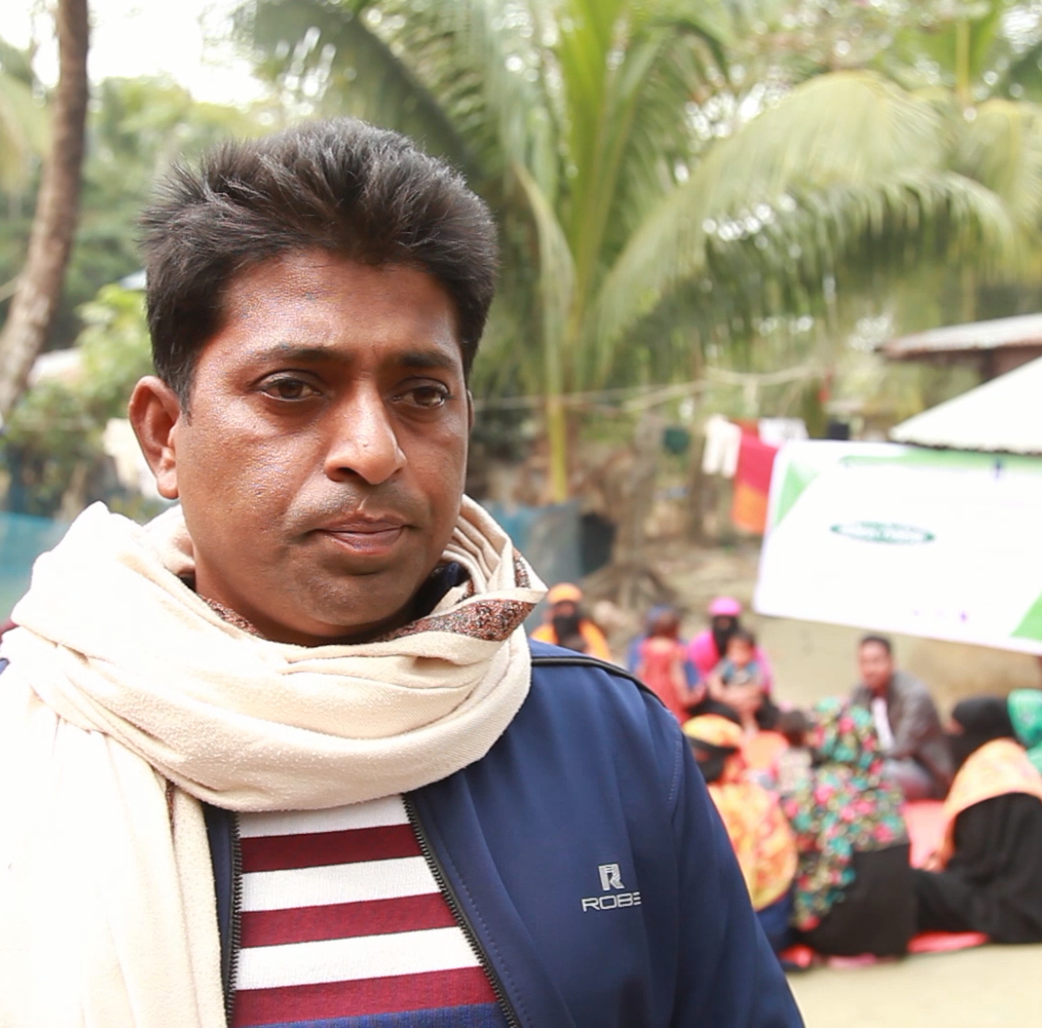
" We live in river erosion-affected areas, most people are very poor and can't afford good food and sanitation. That's why children suffer from malnutrition and people suffer from lack of safe drinking water and improved sanitation."
Kamruzzaman Bacchu, Chairman, NishanBaria Union Parishad, Taltali
Notes:
Picture + quote of a person describing WASH + nutrition challenges and how to cope / mitigate this

Slide 14
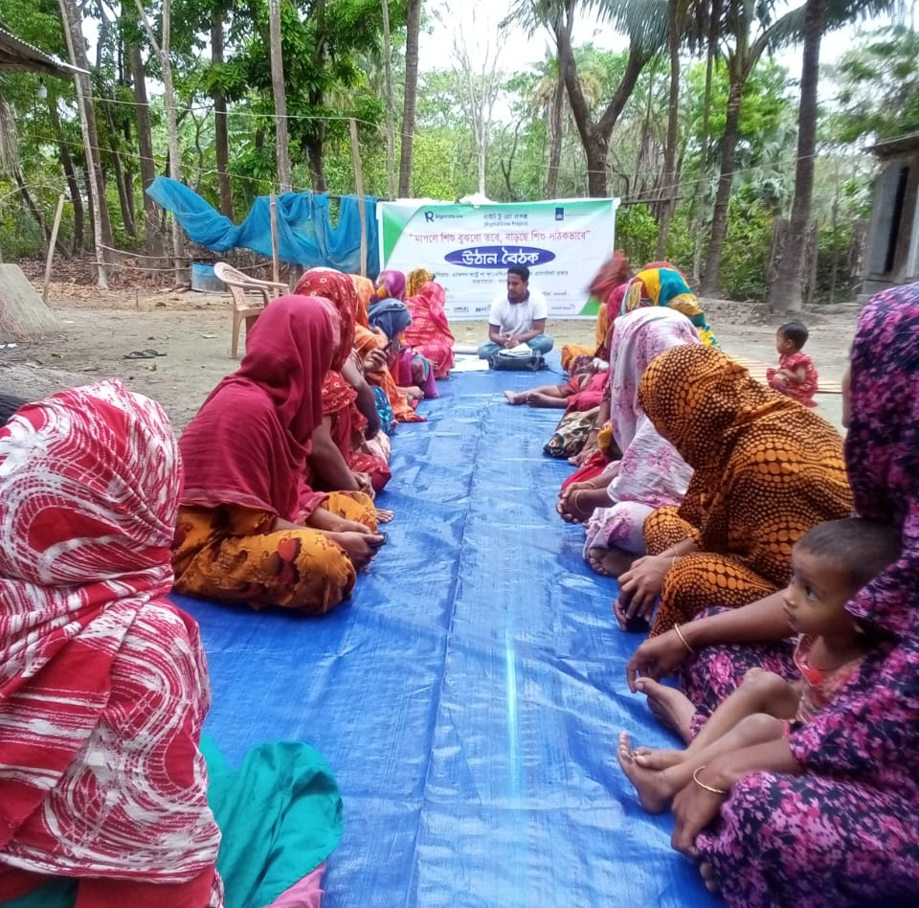
"
Most of the people in Taltali make a living by farming and fishing. Natural calamities are more common. And for disaster damages, no permanent measures have been taken by the government
"
Moanidra CSO Commitee, Taltali
Notes:
Picture + quote of a person describing WASH + nutrition challenges and how to cope / mitigate this

Slide 15
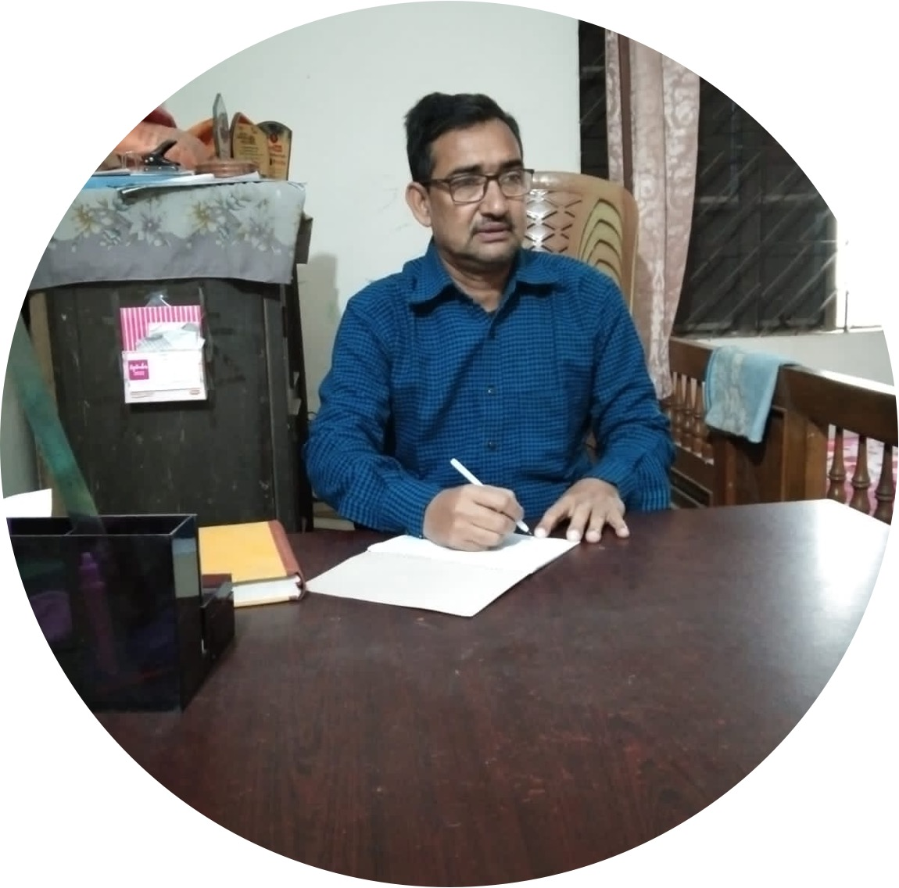
"For the Water and health problems solution, We think the government should install more deep tube wells, dig more ponds & canals, and, construct culverts, switch gates, make some more shelters, and sub-health centers."

Slide 16
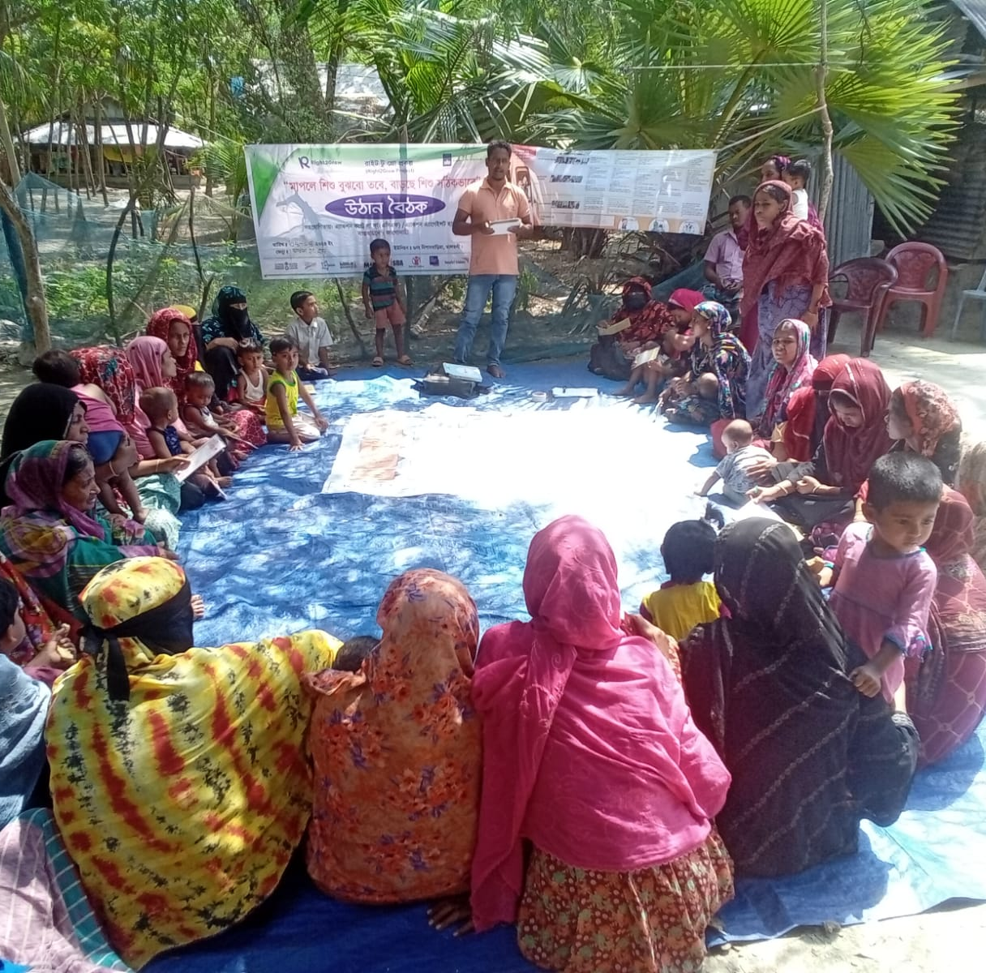
R2G in the community:
●Training
●Negotiation at local level
●Evidence-based advocacy

Slide 17
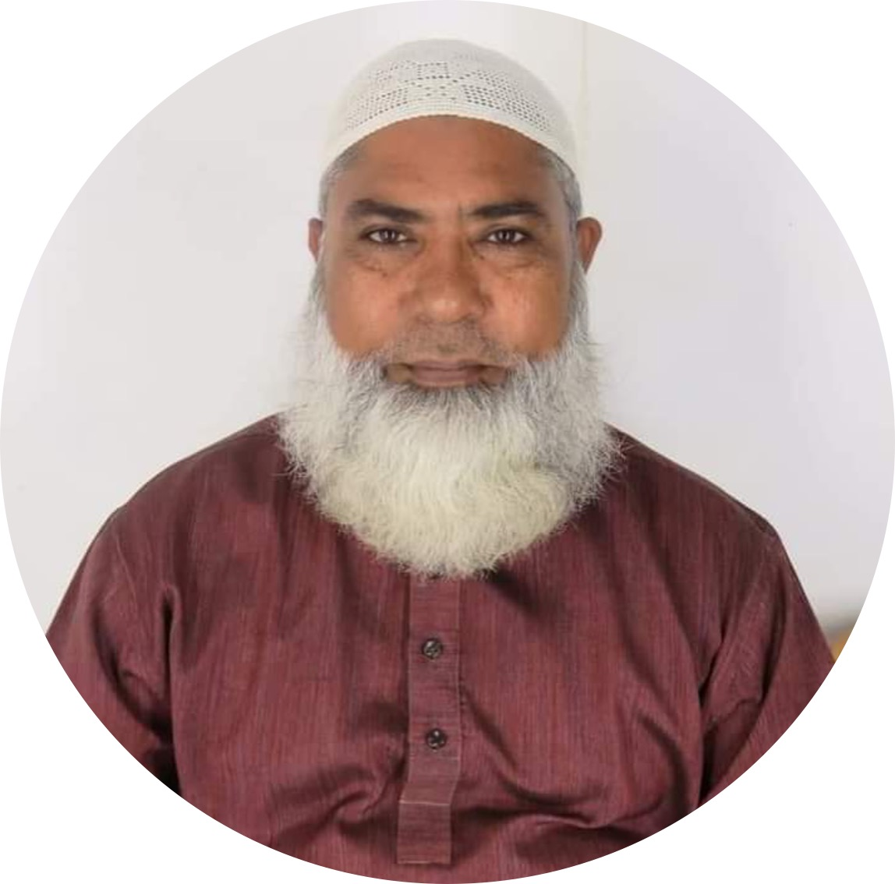
"In my Union, WATSAN (Water and Sanitation) committee we- with the facilitation of Right2Grow added a representative from the community. And now we are conducting meeting bi-monthly. We arrange it and identify all the problems coming from the community and monitor the solutions. "
Notes:
Water flow management -> pictures + quotes of community members

Slide 18
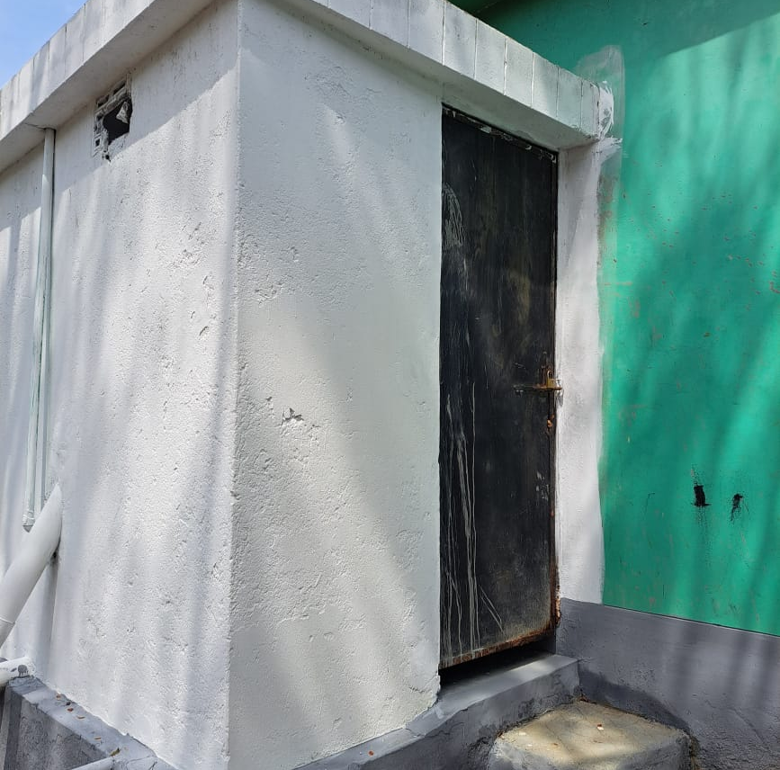
Example of results:
Allocated WASH & Nutrition specific budget of 100,000 taka (847EUR).
Spent 30,000 taka (254 Euro) on hygiene corner.
Union of Barabagi

Slide 19
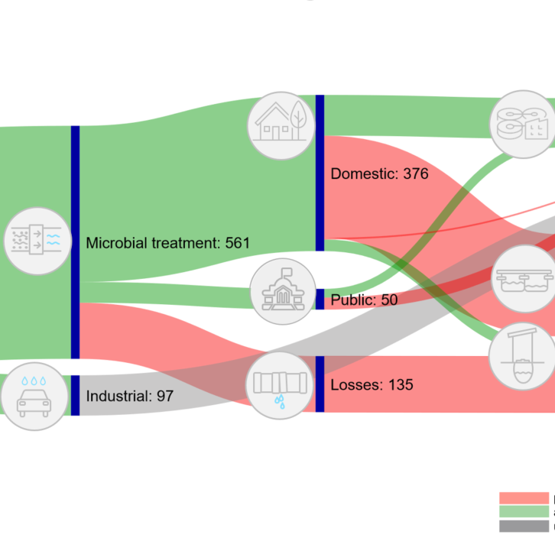
Water Flow Diagram

Slide 20
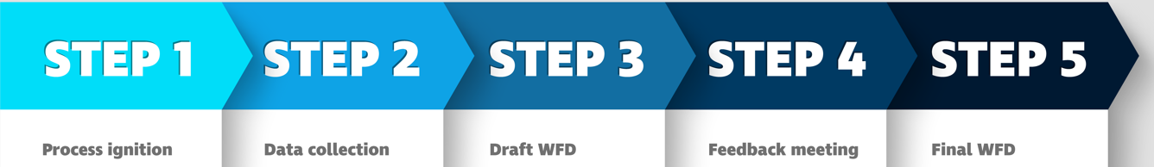
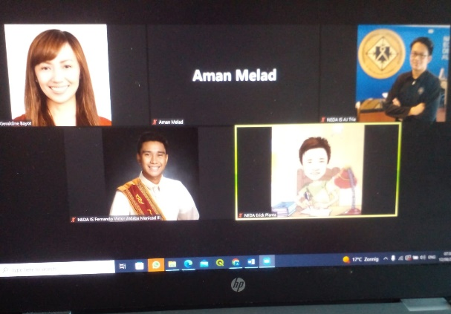
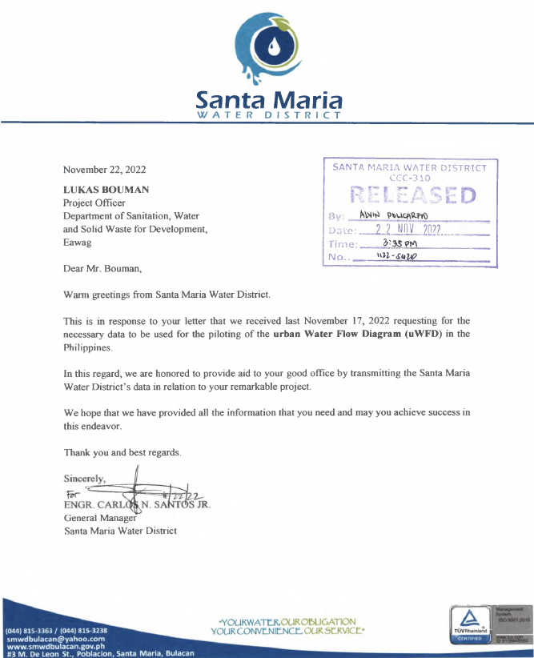
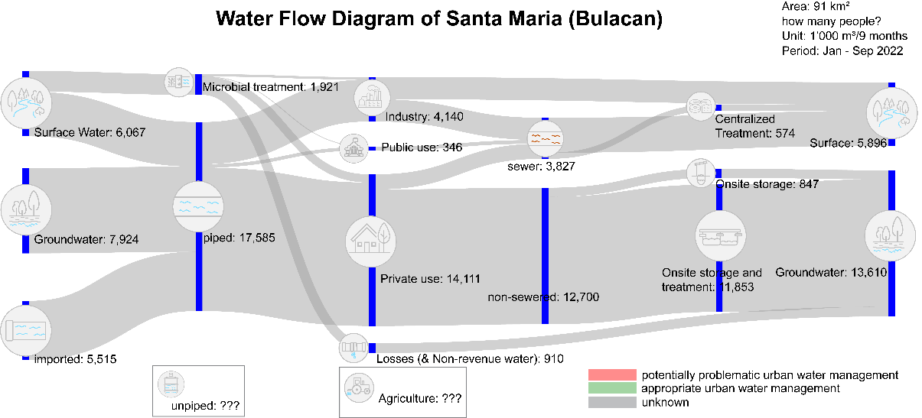
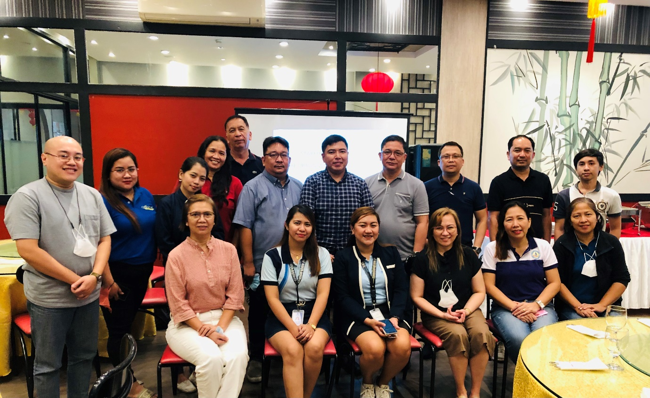
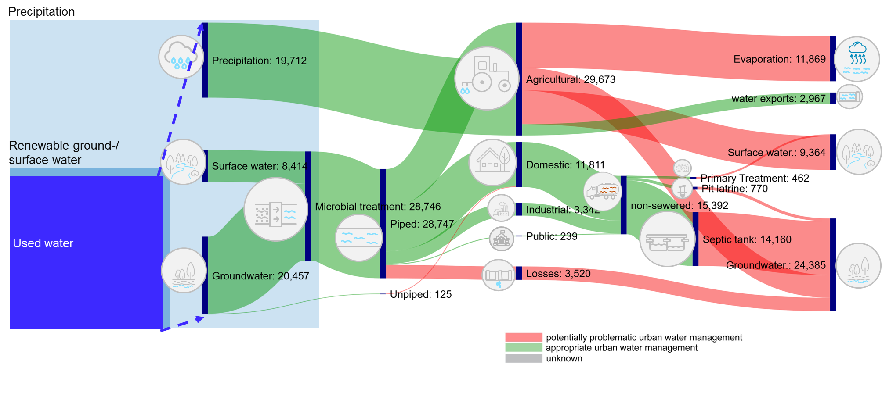
Experiences from the Philippines

Slide 21
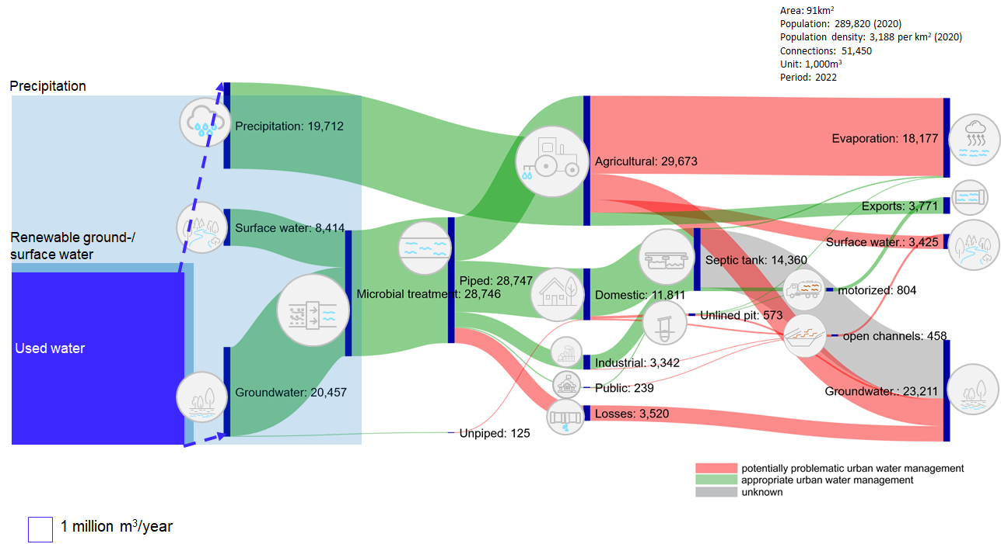
Santa Maria, Philippines

Slide 22
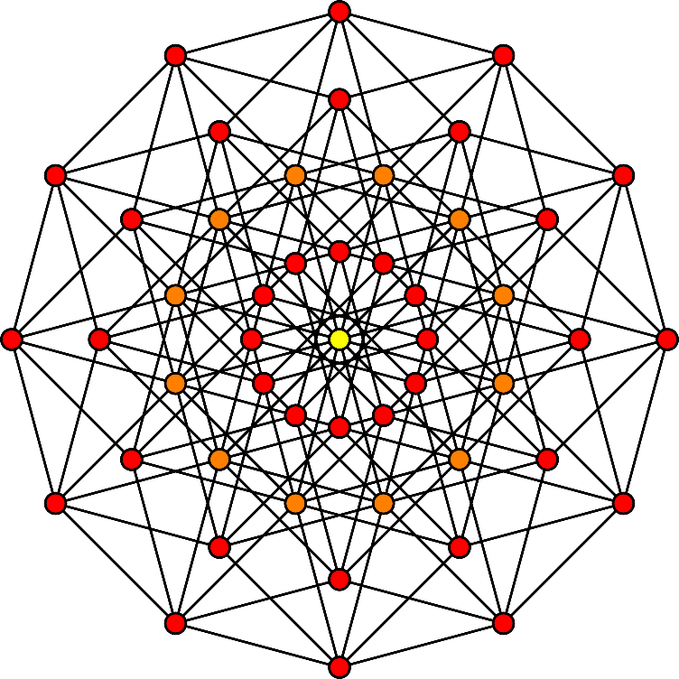
MUltidimensional
rISK
Assessment

Slide 23


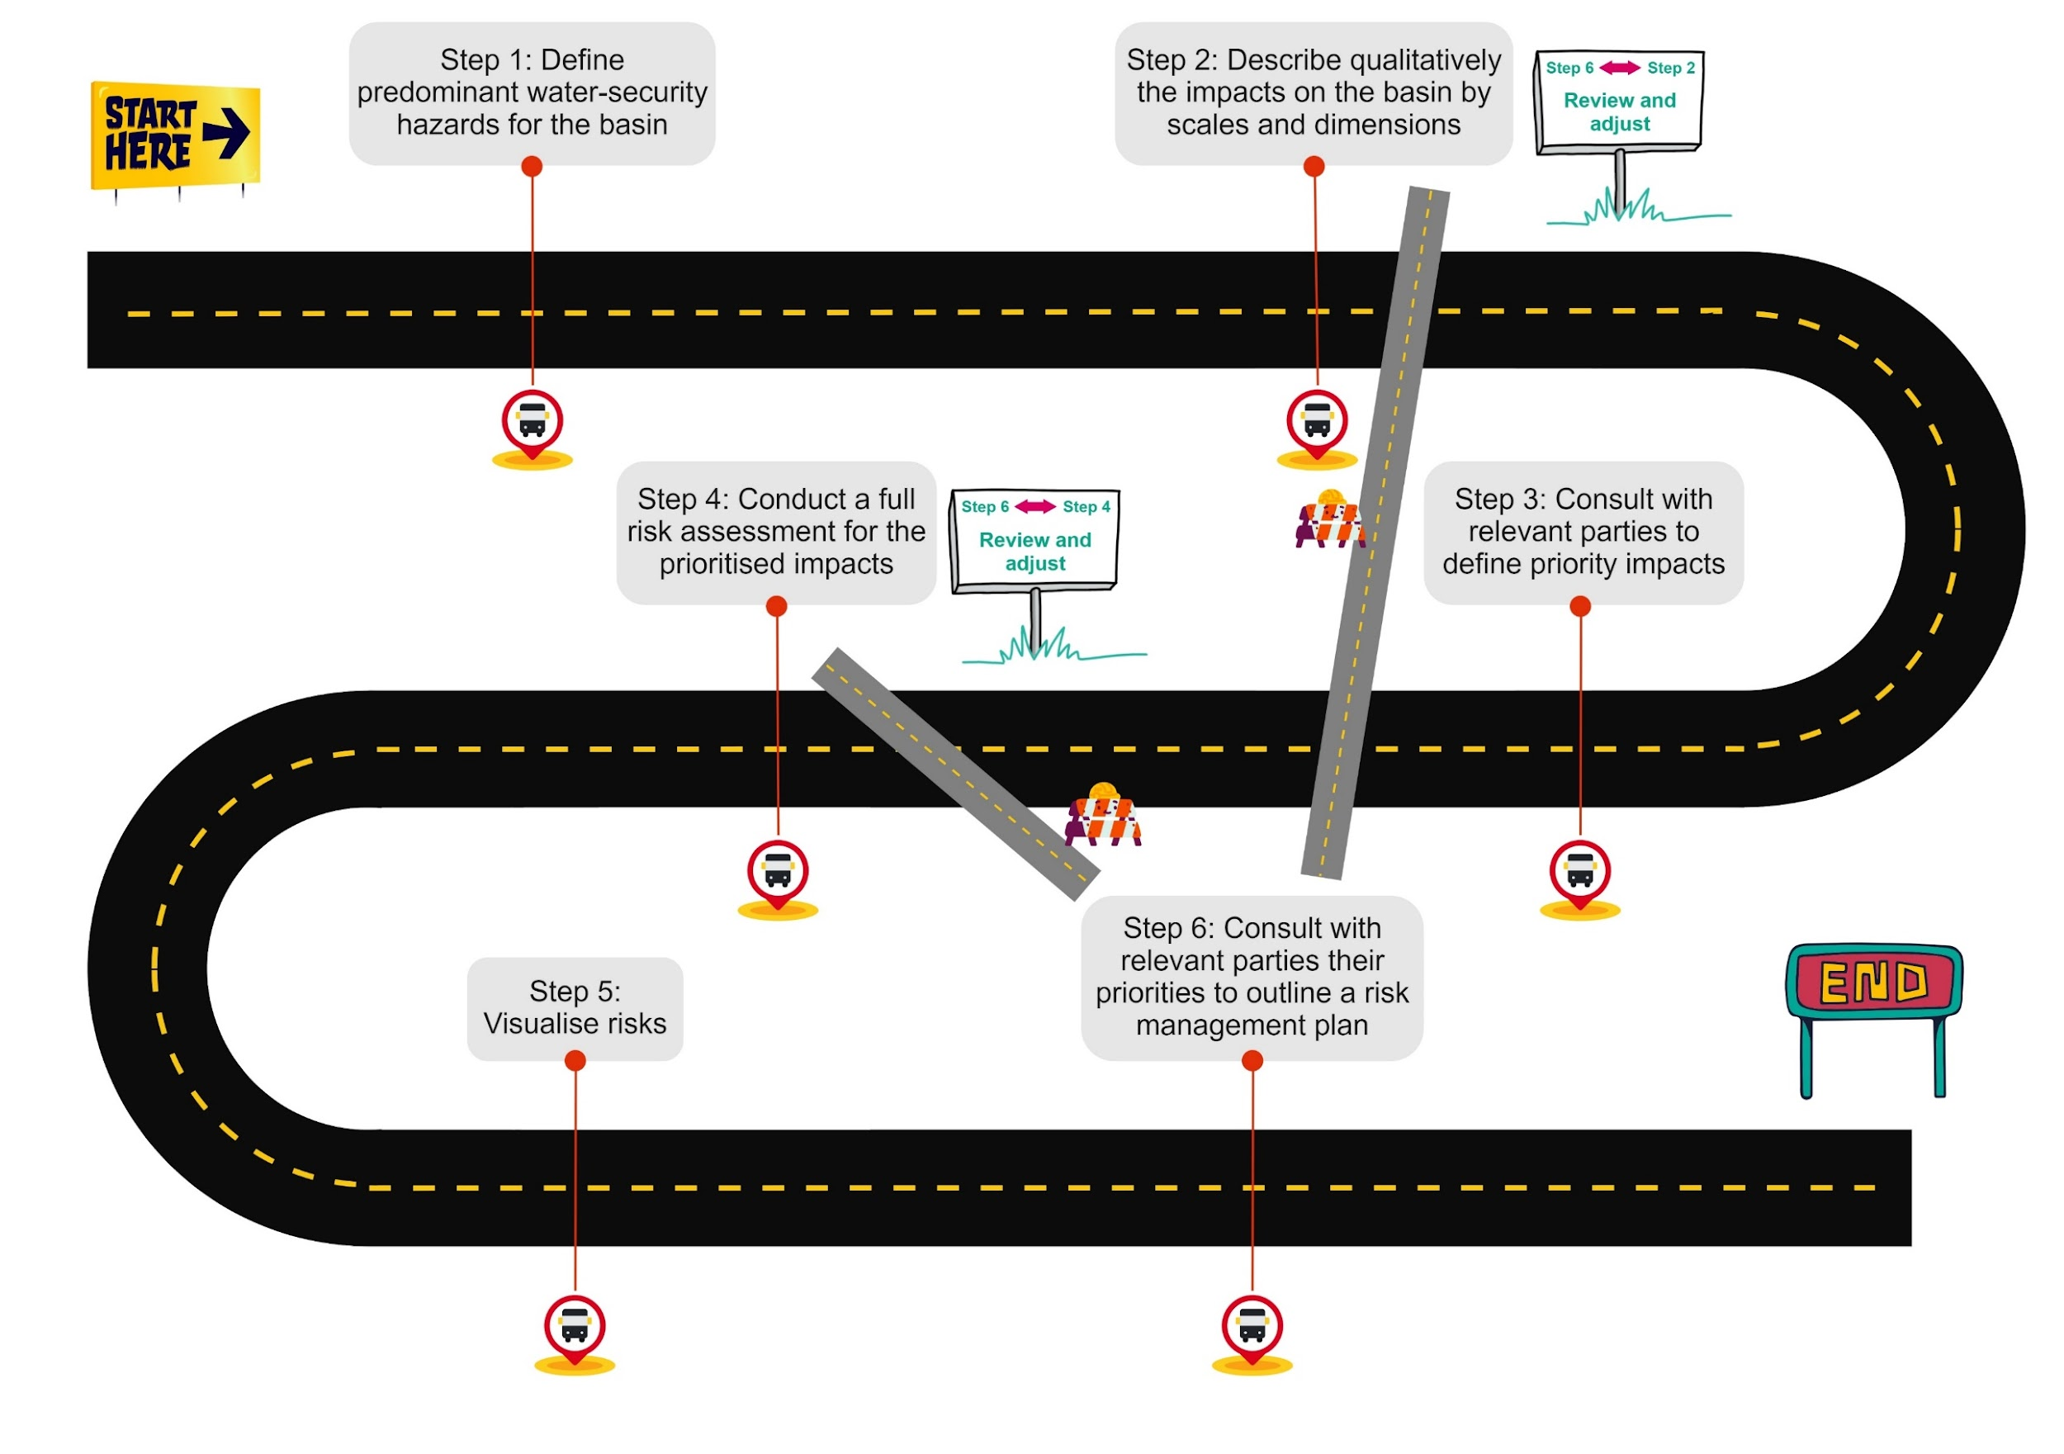






Systems perspective
Prioritisation
Water security
Hydrocomplexity
Risk science
Stakeholder engagement
Identification of water security risks in terms of hazards, exposed entities, vulnerabilities, uncertainties, and judgements of strength of knowledge (Montoya-Pachongo et al., 2022).

Slide 24
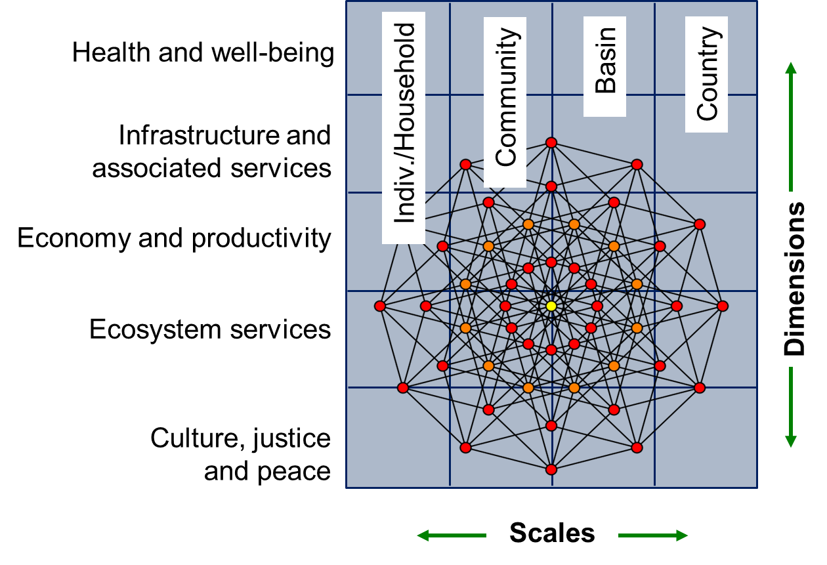
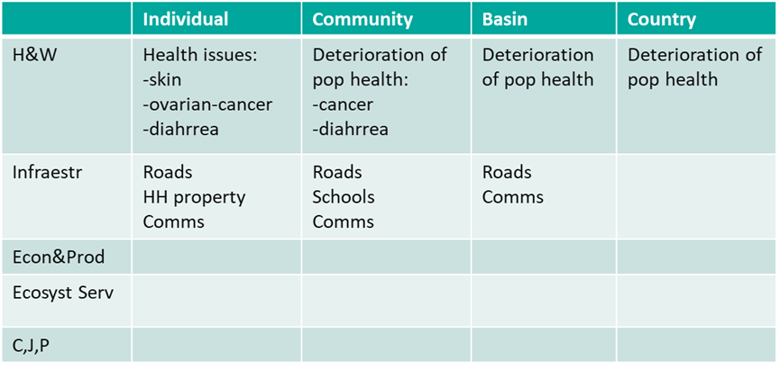
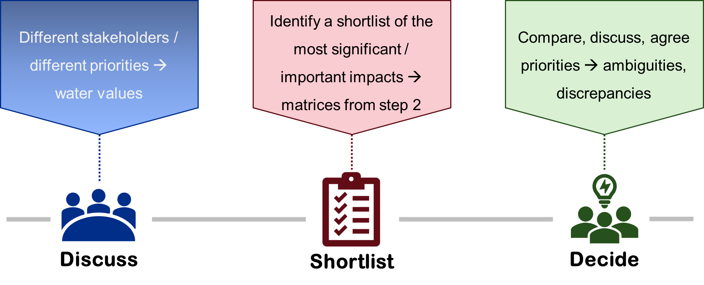
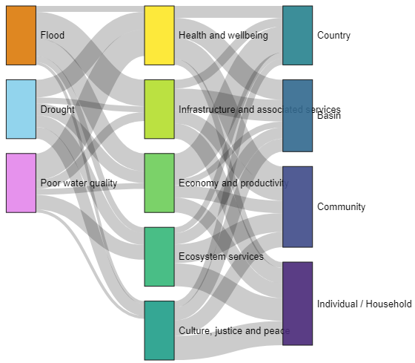
Define the predominant hazard for your basin: for example droughts.
Qualitative description of possible impacts: 1.In Taltali’s case floods->scarcity->little access to water -> deteriorated WQ -> adoption of unsafe health&hygiene practices
3. Consult to define priority impacts:
4. Full risk assessment: loss of DALY’s/year
5. Visualisation
6. Risk Management Plan

Slide 25

Campfire discussion
How can we better listen to the local voices?

Slide 26

Wrap up
Notes:
Thank you Elisabeth for this graphical wrap up and thank you all for your great contributions! To close our session, we as the organizing organisations really would like to encourage you to apply inclusive and participatory approaches that make use of the local knowledge and priorities expressed by locals, use easy-to-understand visuals to communicate and give local voices the adequate platform. We are convinced that this will improve the quality of planning and decision-making in our projects!
We will stay around a bit and are happy to exchange with you further. You can also contact us via e-mail.
So again, thank you for your active participation and enjoy the rest of the conference!

Slide 27
Contacts and links
Amancio Melad III, TU Delft / Eawag
ame007@un-ihe.org
Angela Bayona-Valderrama, University of Leeds cnab@leeds.ac.uk
Laurence Caron, Right2Grow
Laurence.Caron@savethechildren.nl
Lukas Bouman, Eawag
lukas.bouman@eawag.ch
Sumiya Mim, Right2Grow sumiya.mim@savethechildren.org
Right2Grow:
www.right2grow.org/
Water Flow Diagram:
www.sandec.ch/wfd

