Slide 1




Freshwater Conservation and Wash Advocacy Strategy Workshop
FRESHWATER CONSERVATION AND WASH
ADVOCACY STRATEGY
WORKSHOP
REPLACE W/LOCATION
REPLACE WITH WORKSHOP DATES
© SL_PHOTOGRAPHY

Slide 2
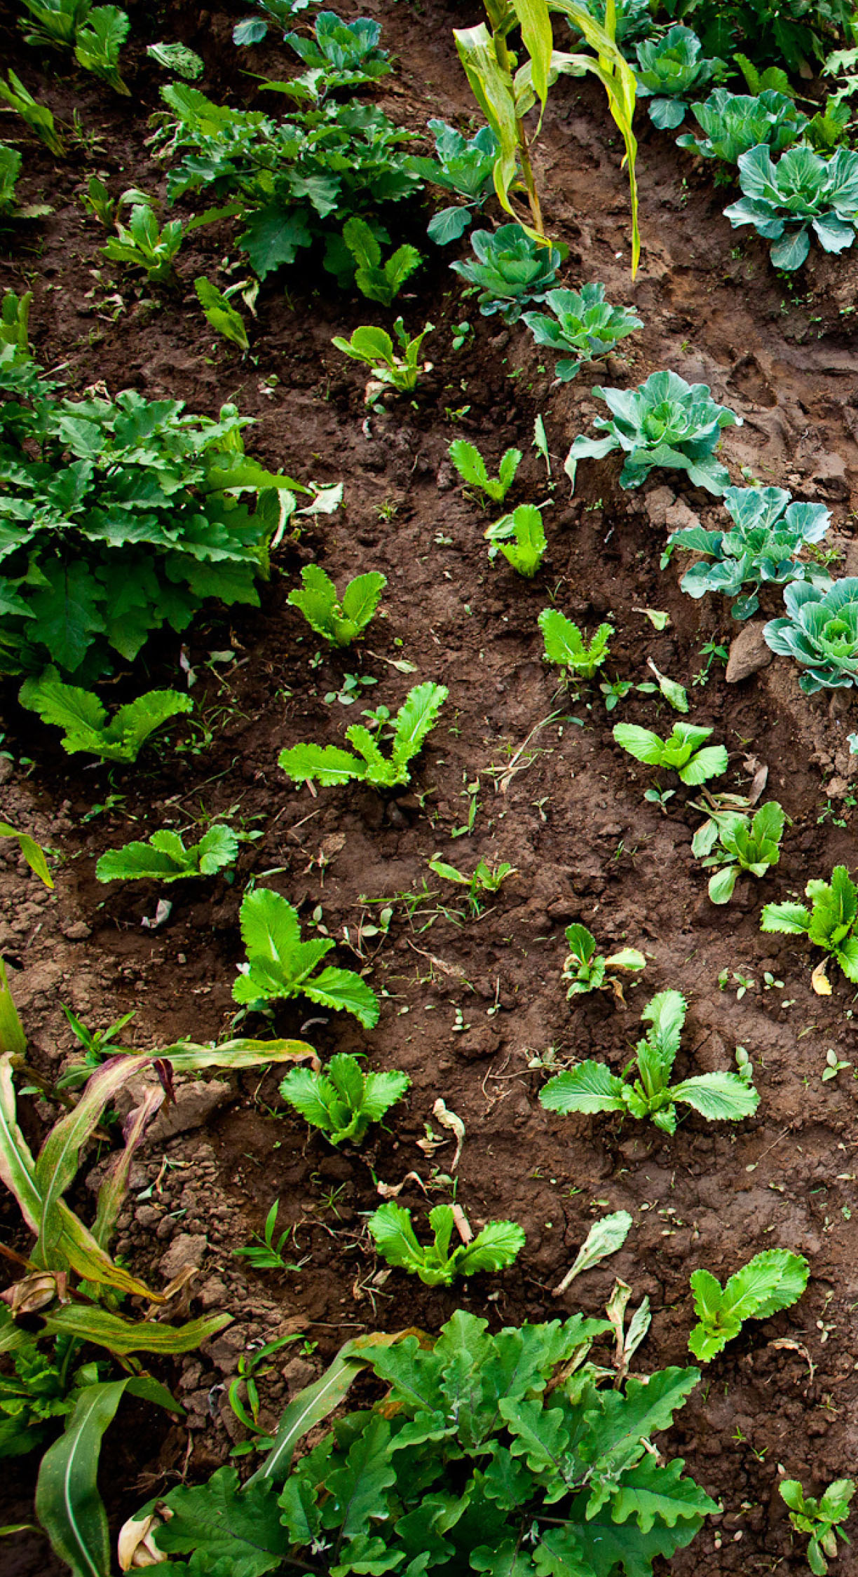
Workshop Objectives
Workshop Objectives
Introduce advocacy and create a foundation of knowledge and understanding of advocacy concepts and approaches.
Understand current advocacy priorities for your organization’s integrated Freshwater/WASH portfolio.
Understand and apply the key elements of advocacy strategy design — specifically identifying the advocacy issue, goal
and objectives; decision-maker and influencer identification; and message design and execution — tailoring messages to target audiences.
Build upon and learn from existing advocacy and influencing experiences and expertise.
©Benjamin Drummond

Slide 3



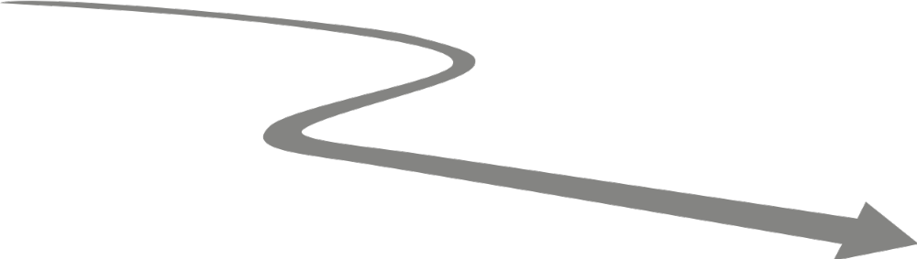





Advocacy Strategy Roadmap
Step 3
Decision-makers and Influencers
Advocacy
Strategy
Roadmap
Step 2
Advocacy Goals and Objectives
Step 6
Advocacy Approaches and Activities
Step 8
Measuring Advocacy Progress and Adaptive Management
Step 1
Advocacy Issue, Root Causes and Identifying Your Evidence Base
Step 4
Opposition
and Obstacles
Step 5
Advocacy Strengths, Limitations and Partnerships
Step 7
Crafting Advocacy Messages

Slide 4
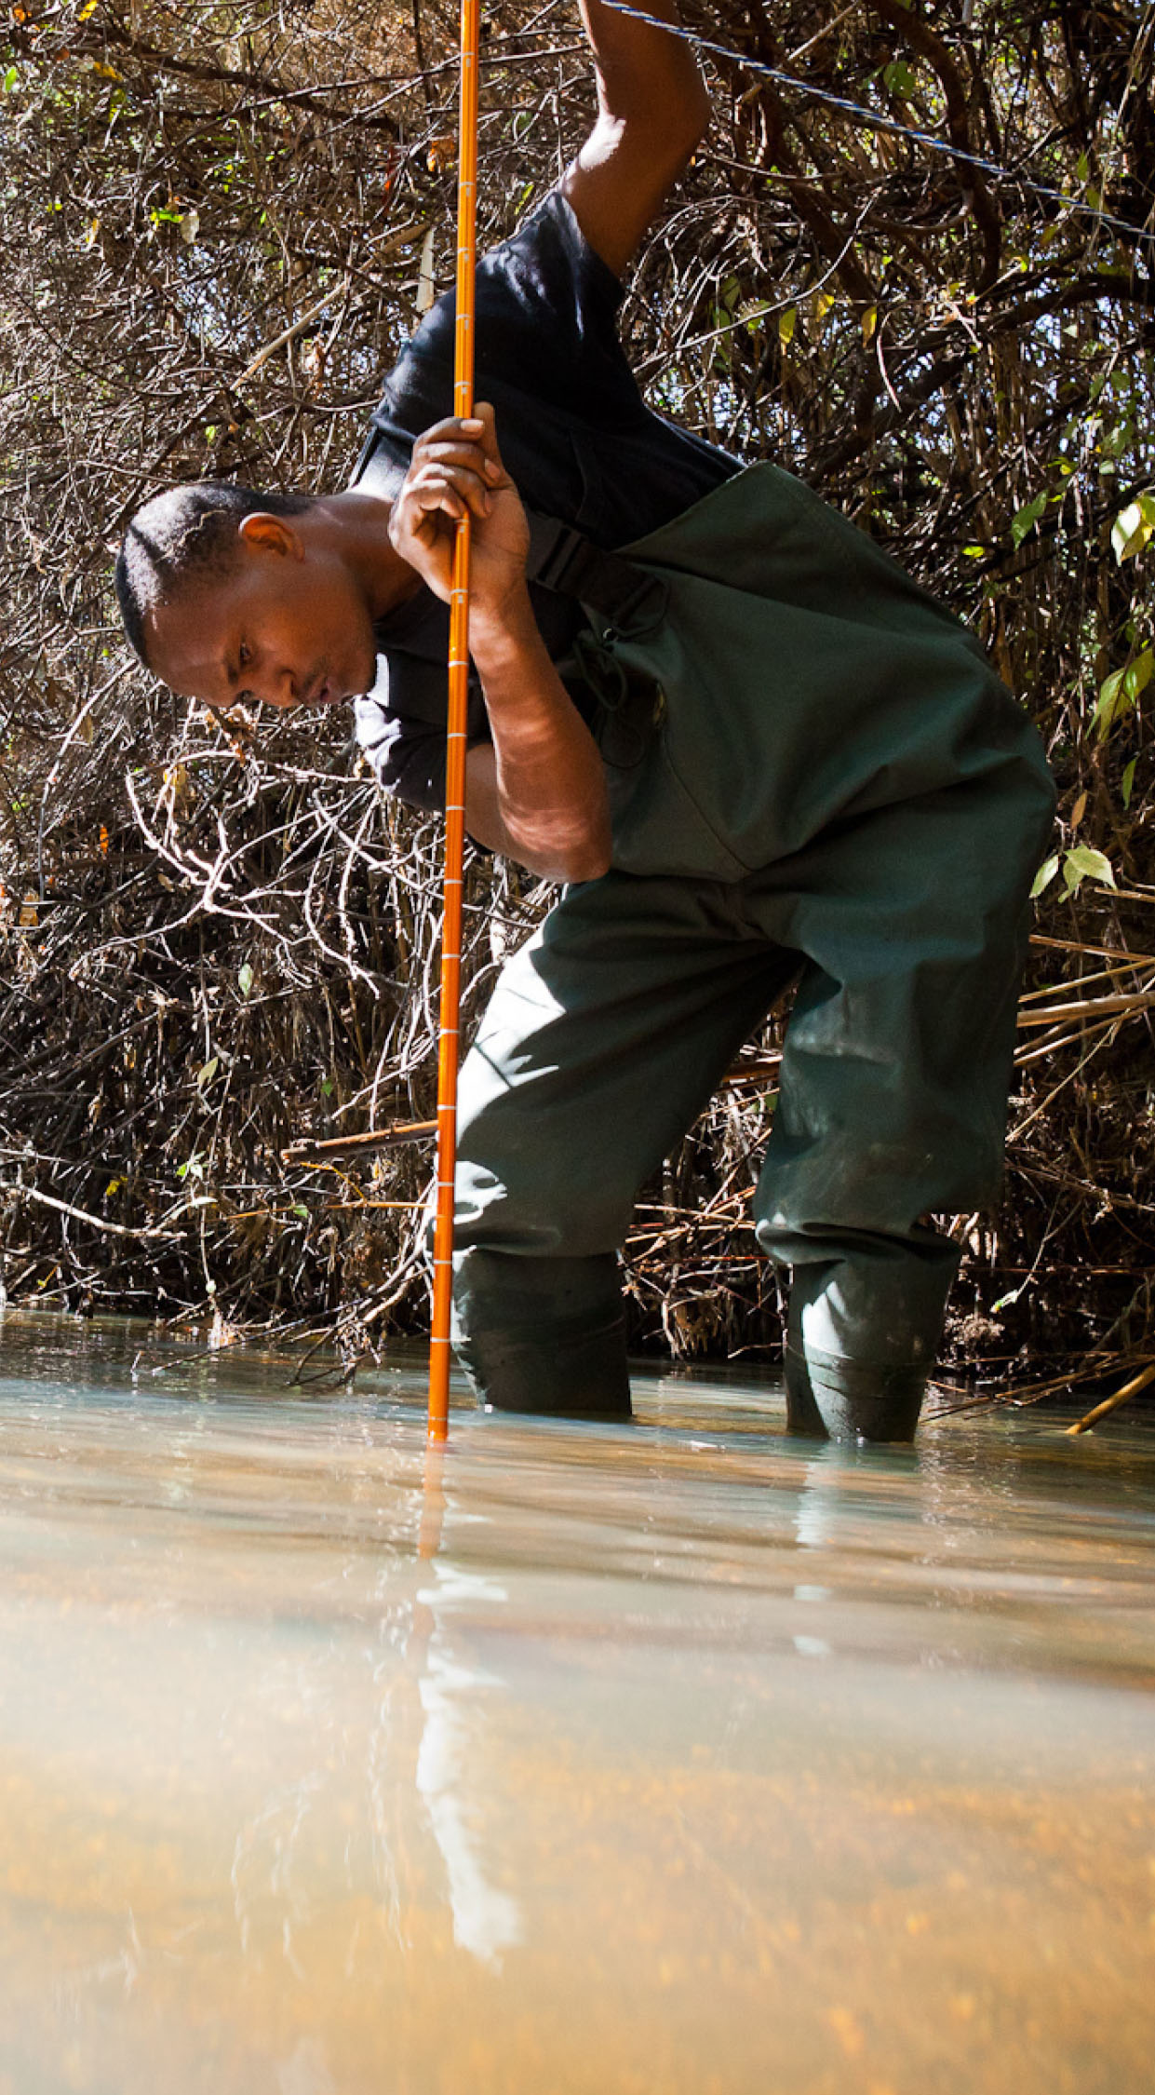

Agenda
Agenda
DAY1: Introductions, advocacy terminology and elements, advocacy issues, root causes and evidence base
DAY2: Advocacy goals and objectives, stakeholder mapping
DAY3: Advocacy strengths, limitations and partnerships, advocacy work planning, messaging
Day 4: Measuring advocacy progress and adaptive management, next steps
©Benjamin Drummond
Write a definition of advocacy on the cards provided

Slide 5
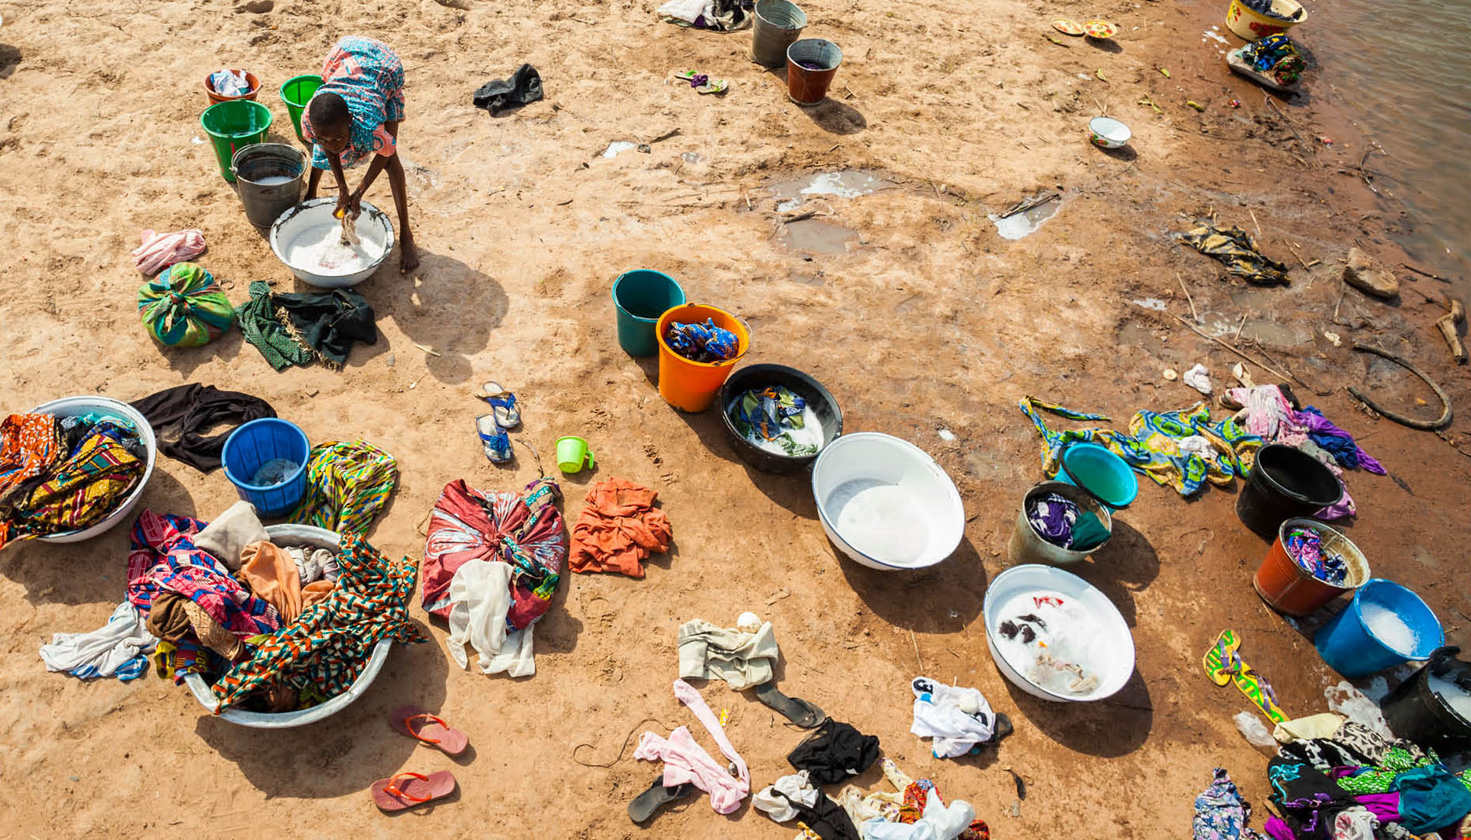
Defining Advocacy (1)
Defining Advocacy
Advocacy is the process of strategically managing and sharing knowledge to change and/or influence policies and practices that affect people’s lives
Advocacy
Is a deliberate process
Aims to inform and influence decision-makers
Seeks to changes that are evidence-based
©Benjamin Drummond

Slide 6

Defining Advocacy (2)
Defining Advocacy
Advocacy is the practical use of knowledge for purposes of social changes directed to government policies, laws, and procedures.
Advocacy supports an issue and persuades the decision-makers on how to act in order to support that issue.
Advocacy is a process, not a one-way activity.
Advocacy is about motivating and mobilizing the community. It starts with a small group of people who share concerns about a specific problem and are willing to devote time, their experience and resources available to reach the desired change.
©Benjamin Drummond

Slide 7

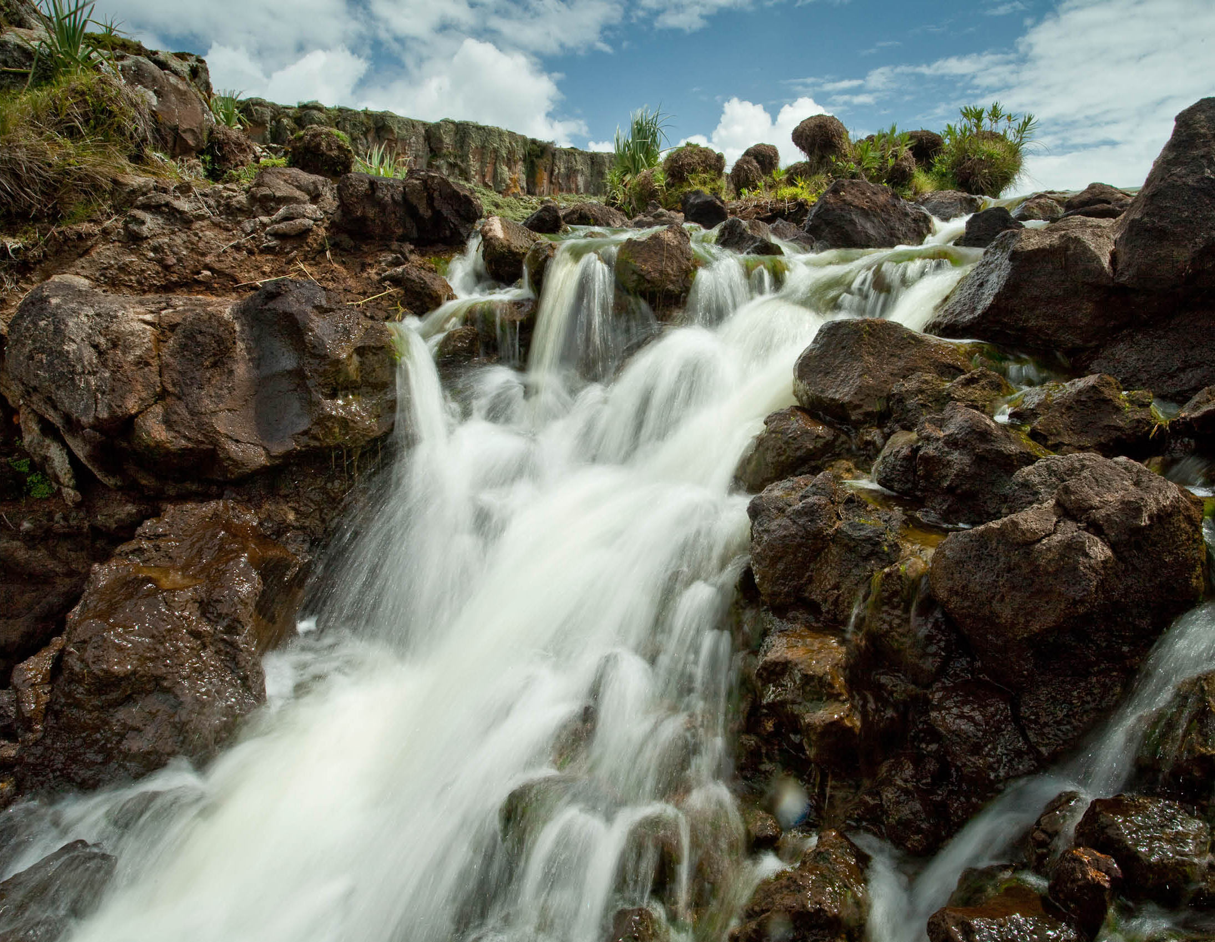
Advocacy Approaches
Advocacy Approaches
Advocacy approaches include but are
not limited to
Lobbying
Campaigns
Meetings with government officials
Translation of research
Education/influencing events
Consensus building and/or
Creating champions
©Robin Moore/iLCP

Slide 8

Lobbying
Lobbying
Lobbying is a form of advocacy that involves directly engaging with decision-makers, particularly a politician or public official who has control or significant influence over a policy, piece of legislation or regulation.
Examples of lobbying:
Asking your Member of Parliament or representative to introduce, amend or vote for or against particular legislation
Direct citizen outreach to parliamentarians, representatives or other government officials asking them support or oppose specific legislation or regulations
Online or written petitions asking for legislators to support or oppose particular legislation

Slide 9

Experience with Advocacy
Experiences with Advocacy
Based on
the definitions
What have you done in the last 6 months or year that you would consider advocacy?
©Benjamin Drummond

Slide 10
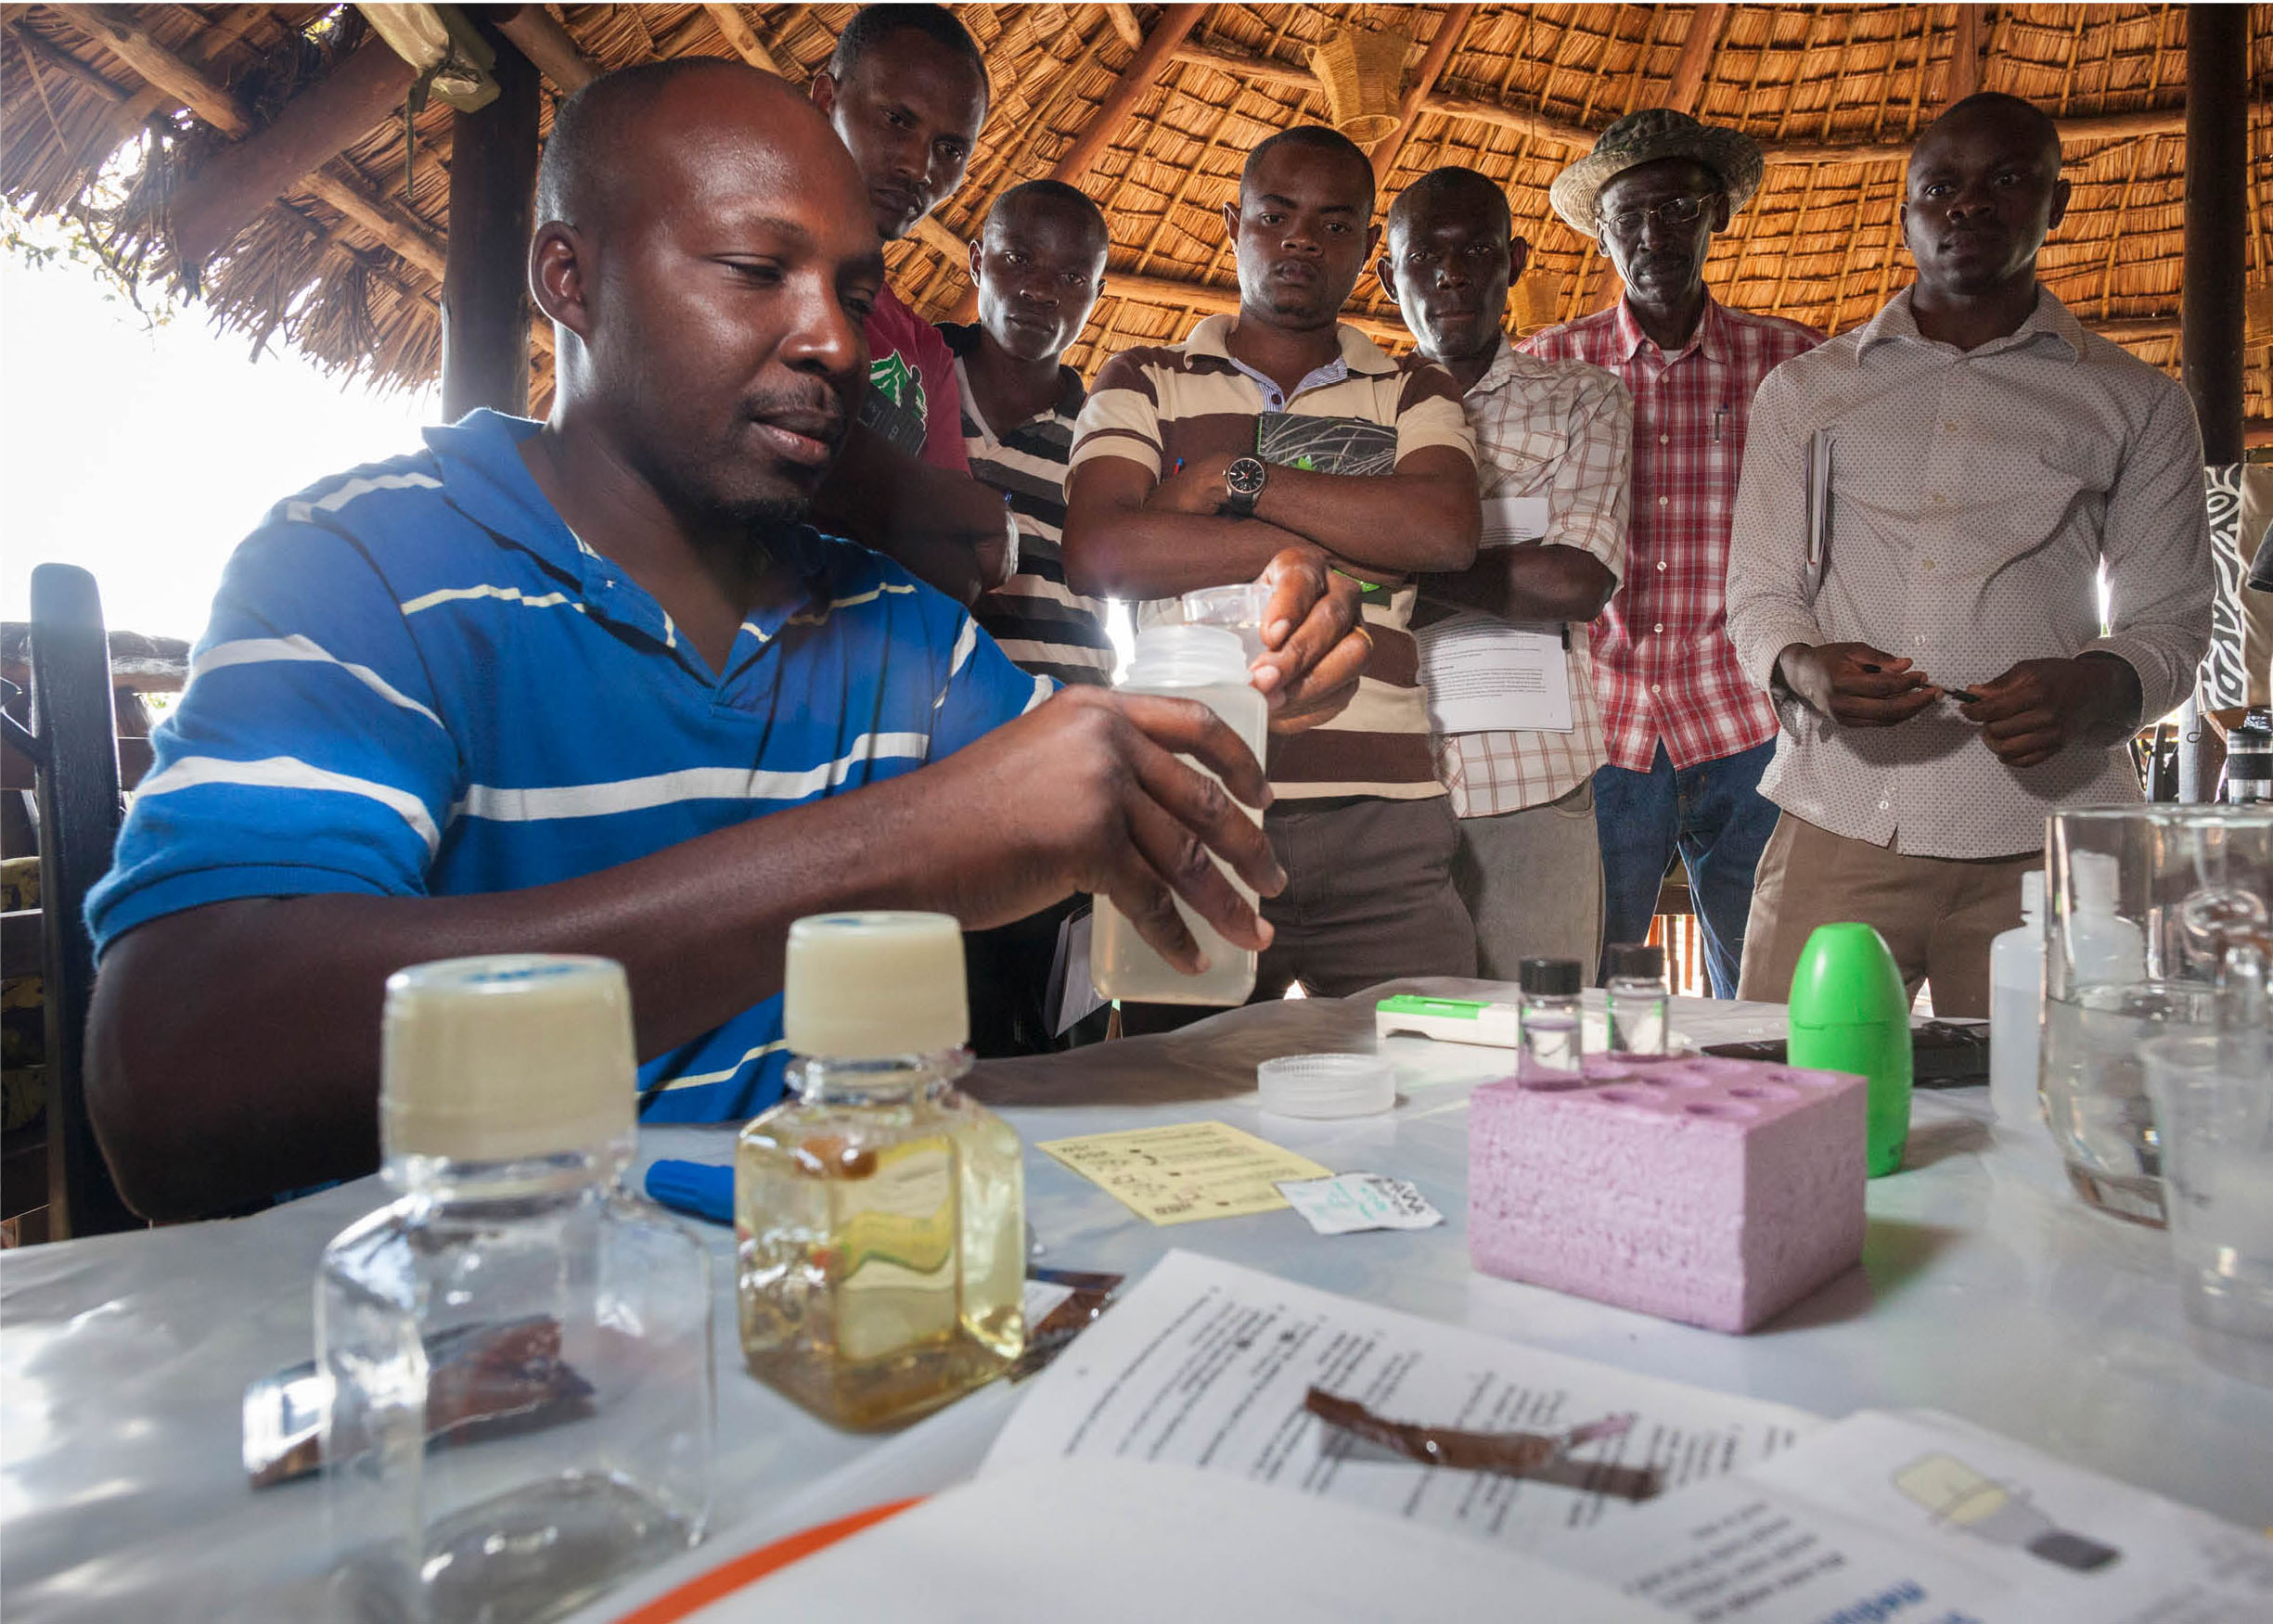
Advocacy Strategies
Advocacy Strategies
Differences between ad hoc and formal advocacy
Advantages of collective voice
Cohesive messaging to inform policy and practice
Building strong grassroots movements
Changes in policies
and budgets
Implementation of policies
and laws
©Benjamin Drummond

Slide 11





Parts of an Advocacy Strategy
Parts of an Advocacy Strategy
Part 1 Advocacy Issue, Root
Causes and Identifying
your Evidence Base
Part 5 Advocacy Strengths,
Limitations and Partnerships
Part 6 Advocacy Approaches
and Activities
Part 2 Advocacy Goals
and Objectives
Part 7 Advocacy
Messages
Part 3 Decision-makers and
Influencers
Part 8 Measuring Progress and
Adaptive Management
Part 4 Opposition and Obstacles

Slide 12
Country Context Presentation
Country Context Presentation
First Name
Last Name
title/affiliation
(Insert name(s) and title/affiliation of who will deliver the country context presentation(s).)

Slide 13
Implementation v. Advocacy
Implementation v. Advocacy
 | Decision-maker (Target) of the message | Associated source of the content
Design | Focused on key conservation targets and focus on threat reduction | Focused on advocacy issues and focus on addressing root causes
Goals | Tied to conservation targets | Tied to advocacy issues and root cause
Objectives | SMART – Specific, Measurable, Attainable, Realistic, and Timely | Designed around Who? What? How? When?
Activities | Developed with the focus on addressing threats and achieving set objectives/intermediate results reflected in the activity’s Theory of Change | Developed with the focus on influencing target decision-maker
M&E | Aimed at measuring the progress toward expected change | Aimed at measuring the process and incremental changes along the way

Slide 14
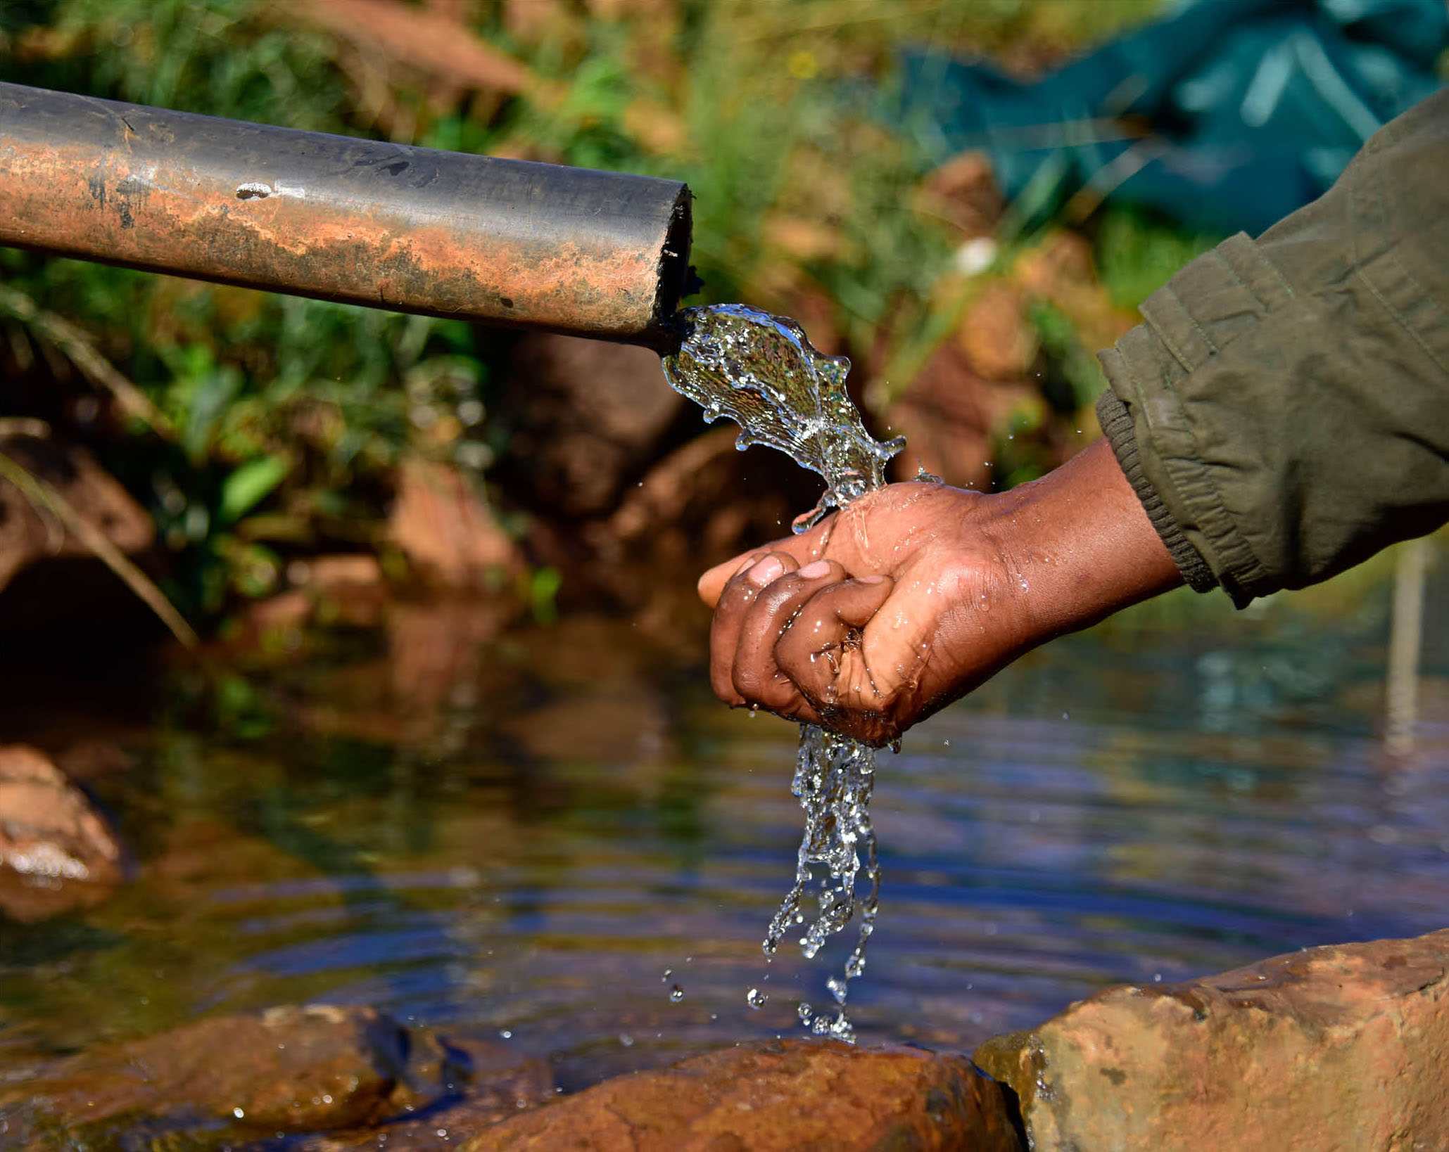
Advocacy Issues and Root Causes (1)
Advocacy Issues and Root Causes
A good issue for advocacy is…
A current objective or focus area
of your program’s work
Based in evidence
Can be improved with advocacy
(a change in policy, implementation of
an existing policy, change in budget, etc.)
Possible to do in 3 – 5 years
Specific and clear
©Trond Larsen

Slide 15
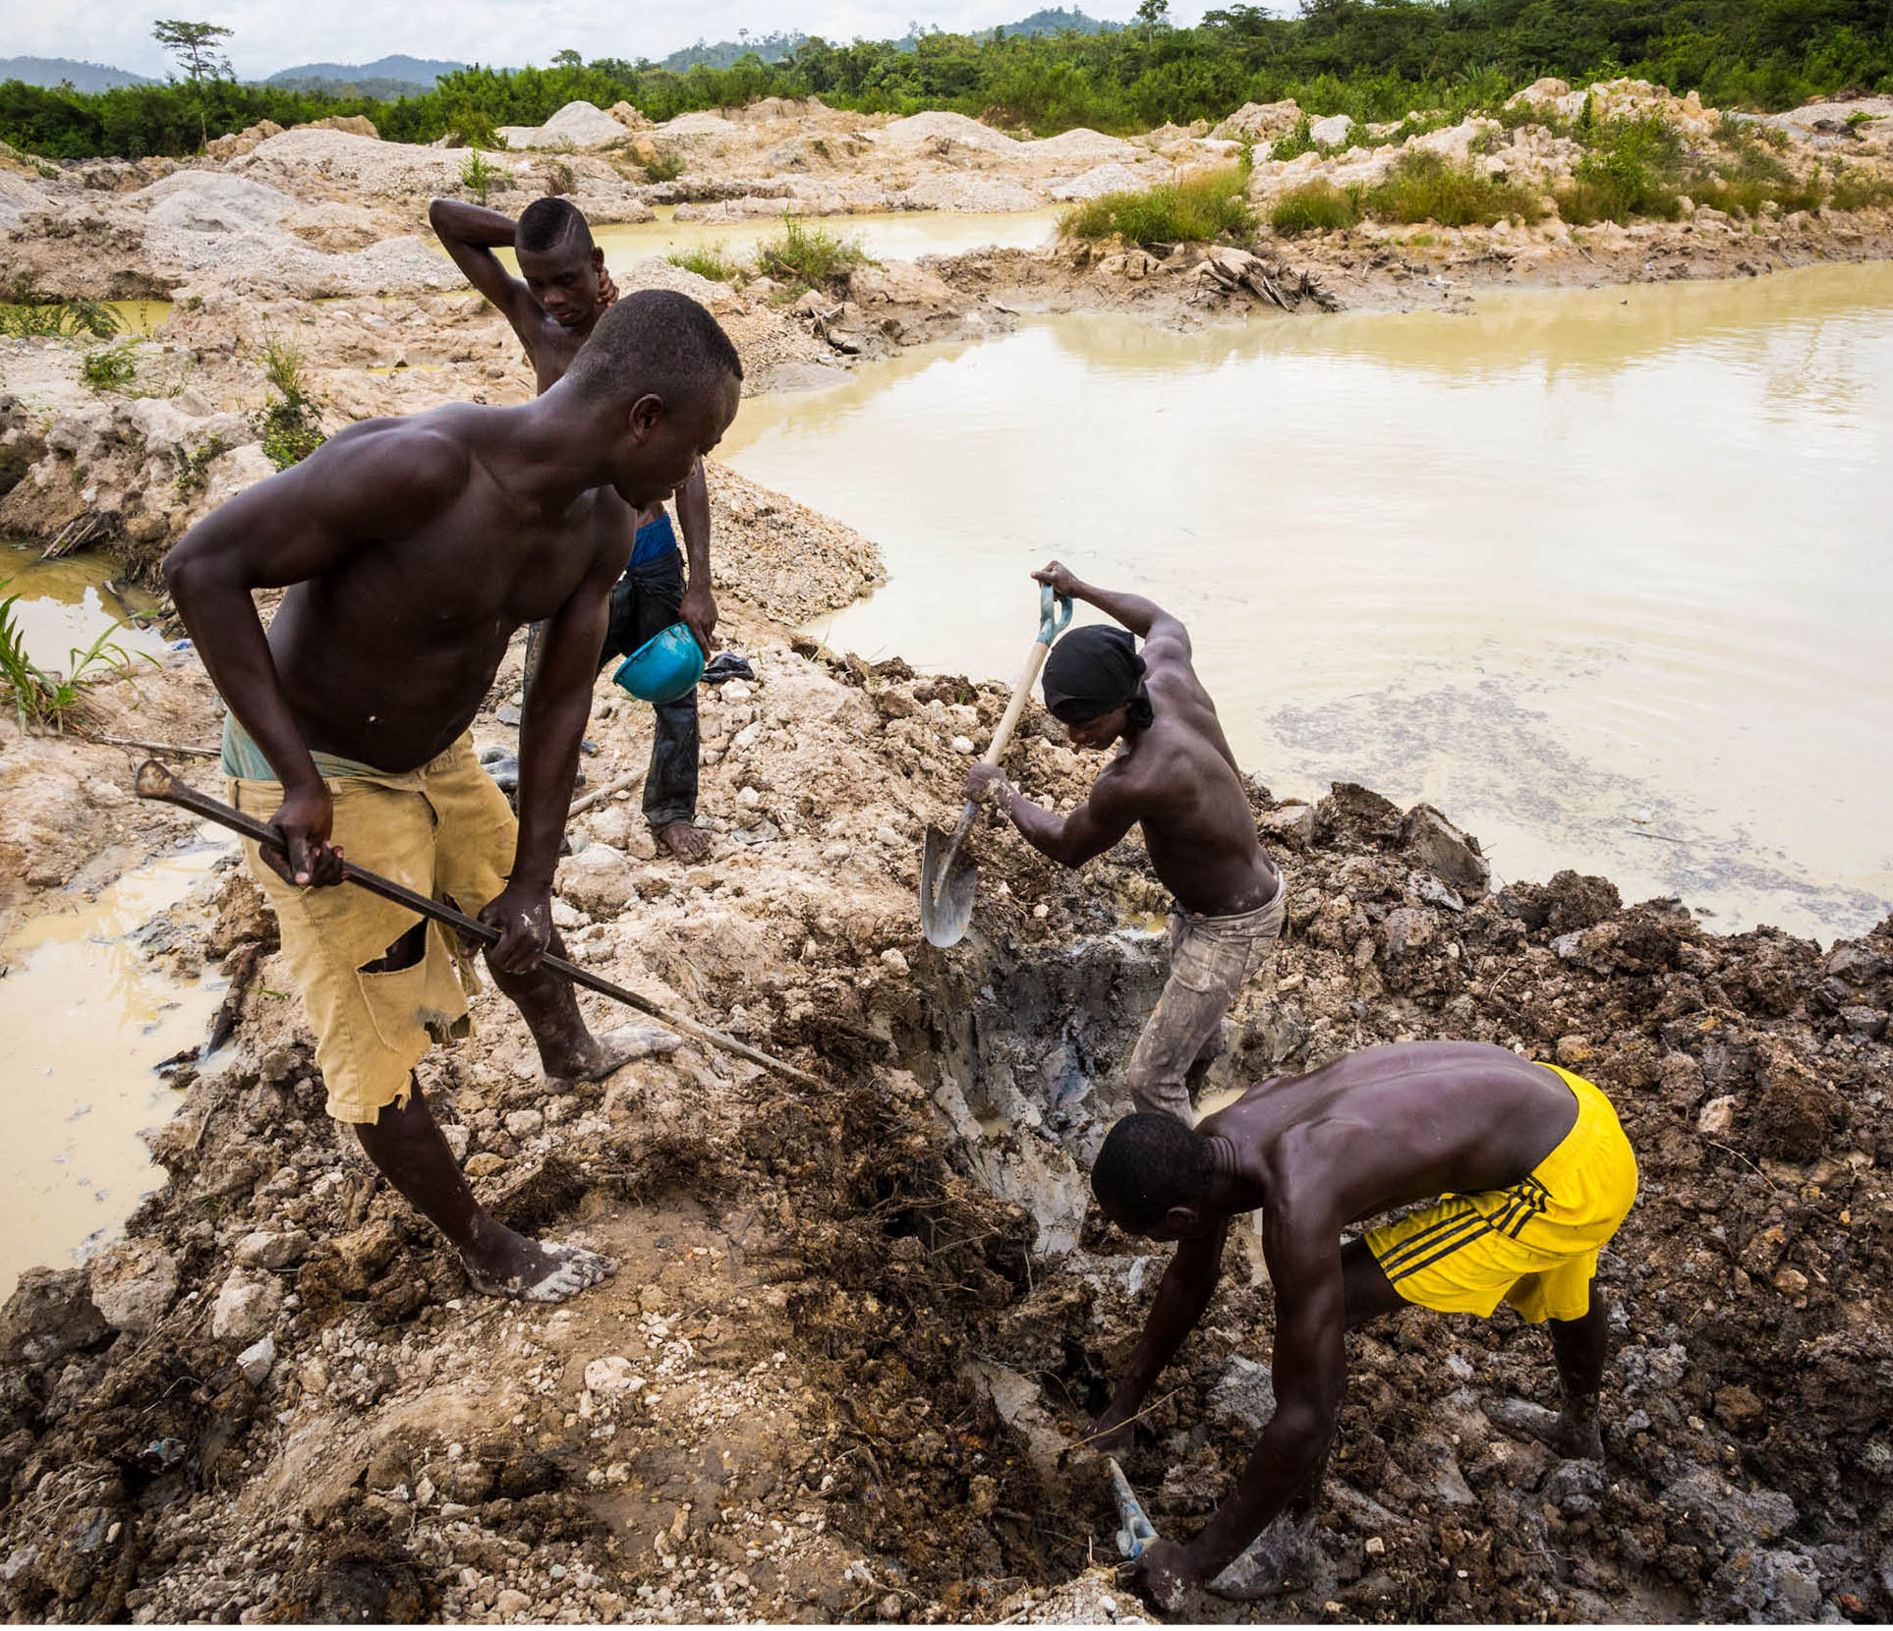
Advocacy Issues and Root Causes (2)
Advocacy Issues and Root Causes
Questions about
root causes
Can a policy change or implementation
of an existing policy help improve
the root cause?
Does your organization have programmatic experience with this root cause?
Do you have any evidence that this is
a root cause?
Can the problem be addressed
in 3-5 years?
©Benjamin Drummond

Slide 16
Advocacy Issues and Root Causes (3)
Advocacy Issues and Root Causes
Criteria for prioritizing an advocacy issue
Specificity and clarity
Amount of evidence to prove the problem
Potential for partnership to address
the issue
Amount of political will to address the issue
Organization has unique experience and expertise to contribute to addressing
the issue
Availability of resources (time, money,
and influence) to address the issue
Risk to your organization to address
the issue
Likelihood the policy change or action
will significantly impact the problem
Feasibility of success in 3-5 years

Slide 17
Issue
Issue
Use this slide to document participant brainstorm of potential advocacy issues to be addressed via the strategy drafted in this workshop – or – use flipchart paper to document brainstorm and delete this slide.

Slide 18
Evidence Base
Evidence Base
Critical programmatic or technical documents or research
that could support your position on the issue
Type of document or evidence | Source

Slide 19

Day 2: Advocacy Goals and Objectives and Stakeholder Mapping
Day 2
Advocacy goals and objectives and stakeholder mapping
©Benjamin Drummond

Slide 20
Goal and Objectives (1)
Goal and Objectives
Goal (Long-term, higher level)
Objective (Shorter-term, steps to achieve goal)
Components
WHO: the decision-making institution with the power to take action
on your advocacy issue.
WHAT: the change you would like to see relative to your advocacy issue.
HOW: the specific action the decision-making institution can take
to accomplish the change.
WHEN: a time frame for the action to occur (often between six months
and three to five years depending on the particular advocacy effort).

Slide 21
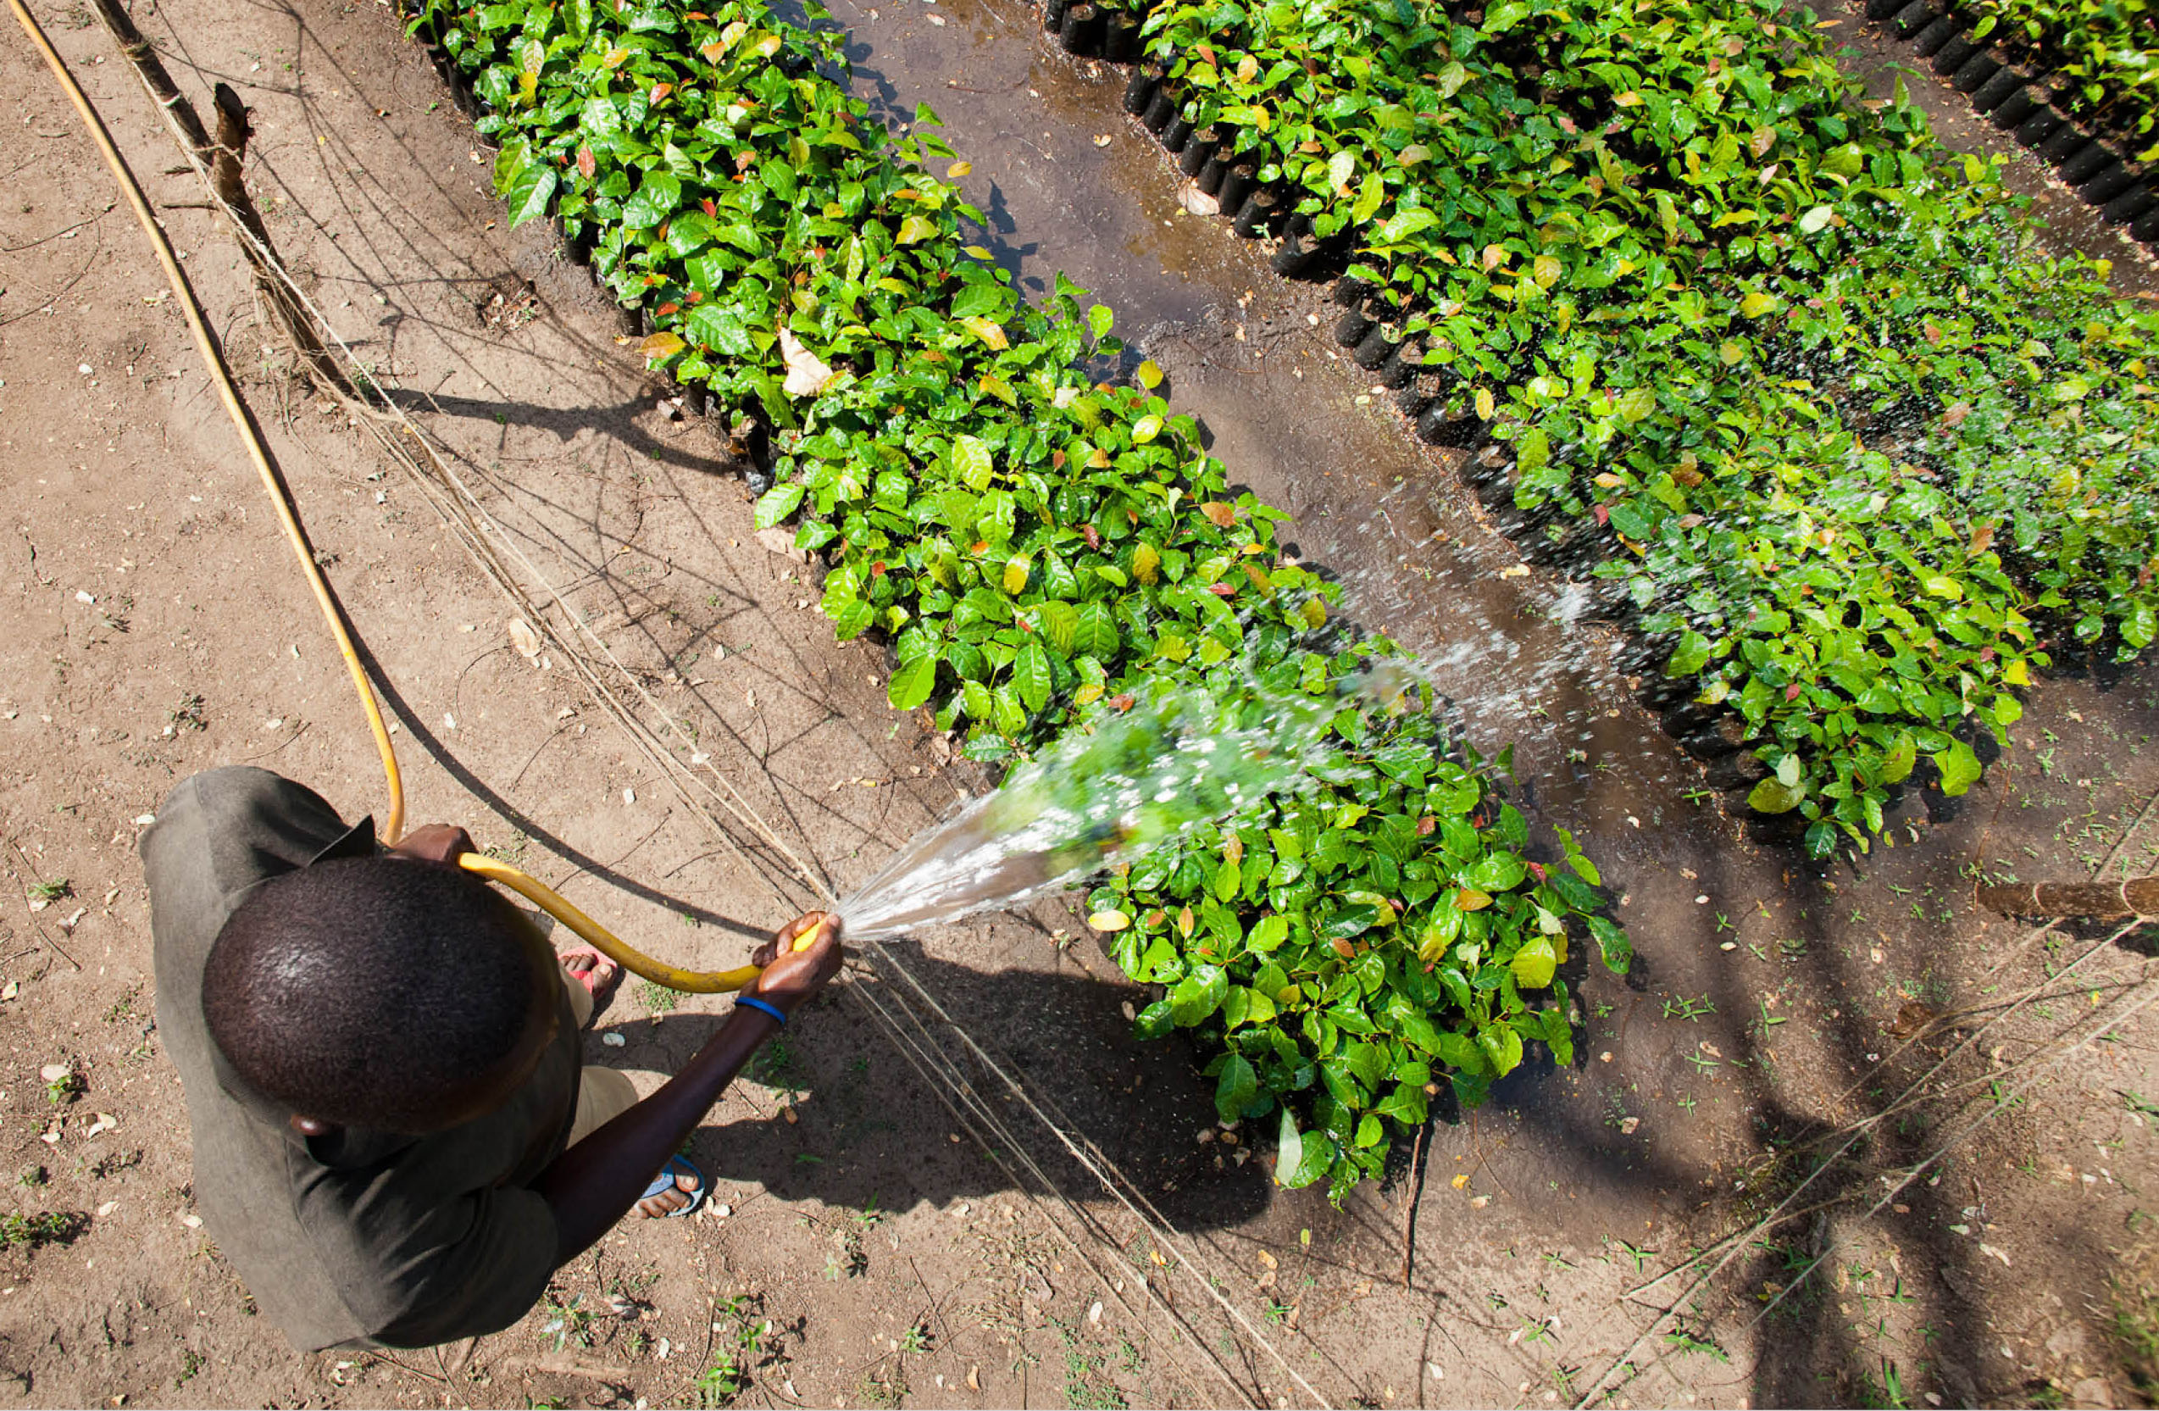
Goal and Objectives (2)
Goal and Objectives
SMART goals
and objectives
Specific
Measurable
Achievable
Relevant
Time-based
©Benjamin Drummond

Slide 22
Examples of Objectives
Examples of Objectives
Example 1
Non-SMART Objective: Conduct a pilot project on the importance of freshwater ecosystems.
Example SMART Objective: The Ministry of the Environment conducts a pilot project that will train community health workers to educate 80 villages about the relationship between healthy, freshwater ecosystems and healthy people by January 2021.
Example 2
Non-SMART Objective: Get media coverage highlighting habitat restoration.
Example SMART Objective: A major national newspaper runs a series of articles about the importance of restoring riverine habitat along the Umzimvubu to protect human, livestock and ecosystem health by November 2020.

Slide 23
Goal and Objectives (3)
Goal and Objectives
Goal group brainstorming activity
Small group objective work

Slide 24
Decision-makers and Influencers (1)
Decision-makers and
Influencers
Definitions
Decision-makers: People with the formal power or authority to take the desired policy action and/or their key advisors or staff.
Influencer: People or groups who can have a compelling force on the actions, opinions, or behavior of decision-makers.
Alignment, Interest and Influence Matrix (AIIM)

Slide 25
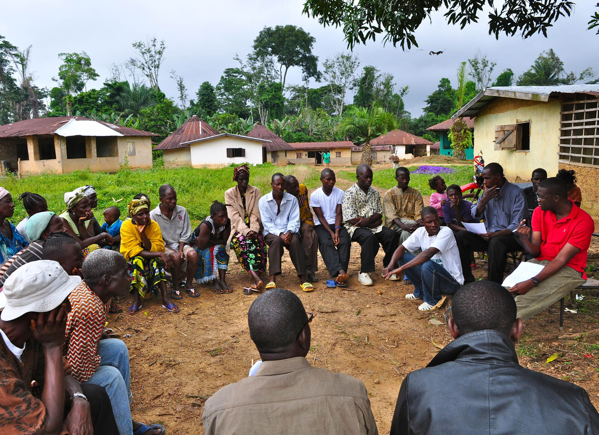
Decision-makers and Influencers (2)
Decision-makers and
Influencers
Key questions
What are their priorities?
What motivates them?
What is their background?
How supportive are they
of your issue?
How aware are they of your issue?
©Conservation International/photo by Bailey Evans

Slide 26
Opposition and Obstacles
Opposition and Obstacles
Key terminology
Opposition: a group of adversaries or competitors, especially a rival political party
Obstacle: Something that blocks one’s way or prevents or hinders progress
Resistance: the refusal to accept or comply with something; the attempt to prevent
something by action or argument
Influence: the capacity to have an effect on the character, development, or behavior of
someone or something, or the effect itself
Mitigation: Reducing the severity of the problem, issue and/or obstacles

Slide 27
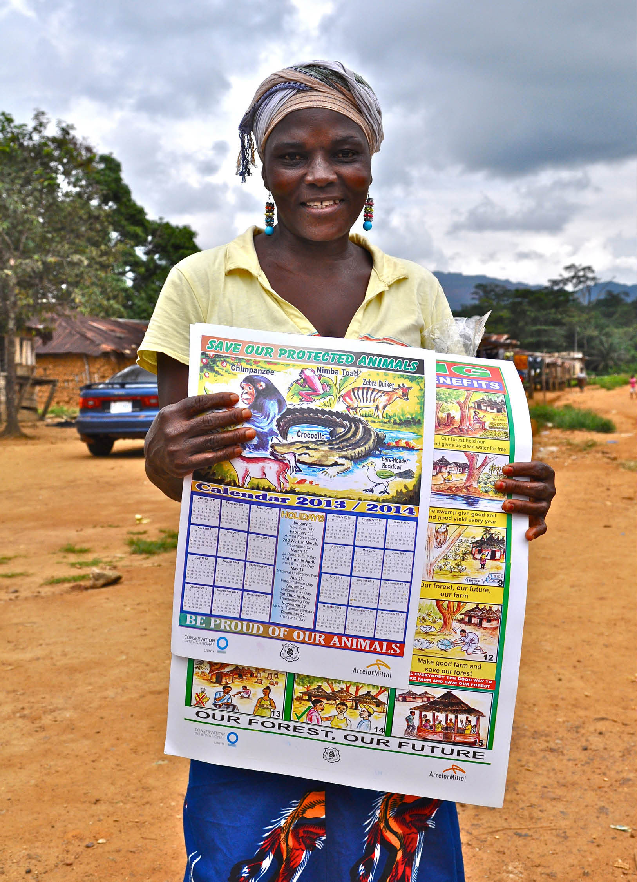
Day 3: Advocacy Strengths, Limitations and Partnerships, Advocacy Work Planning, Messagung
Day 3
Advocacy strengths, limitations and partnerships, advocacy work planning, messaging
© Conservation International/photo by Bailey Evans

Slide 28
Staheholders, Limitations and Partnerships
Stakeholders, Limitations
and Partnerships
Key Advocacy Skills
Passion, commitment
Ability to communicate
verbally and written (articulate)
Ability to work in a team
Likeable
Understand protocols/
context and behave
appropriately within them
Respectful
Persistent
Good at research and
evidence creation
Translating evidence
into messages
Well connected
Listening
Ability to read people/discern the
situation/identifying cues/knowing
when to and not to push
Policy writing and analysis
Realism
Negotiation skills
Motivation skills
Presentable/good physical appearance

Slide 29
Partnerships (1)
Partnerships
Strategic reasons to partner
Adds to the number of organizations actively working on the issue.
Brings together new constituents demonstrating wide-scale and diverse
support for the issue.
Demonstrates benefit to multiple sectors of importance.
Improves ability to reach and persuade a wider set of decision-makers and influencers.
Helps to mitigate the influence of the opposition.
Yields additional expertise, skills, and resources.
Helps fill an organization’s advocacy gaps.

Slide 30
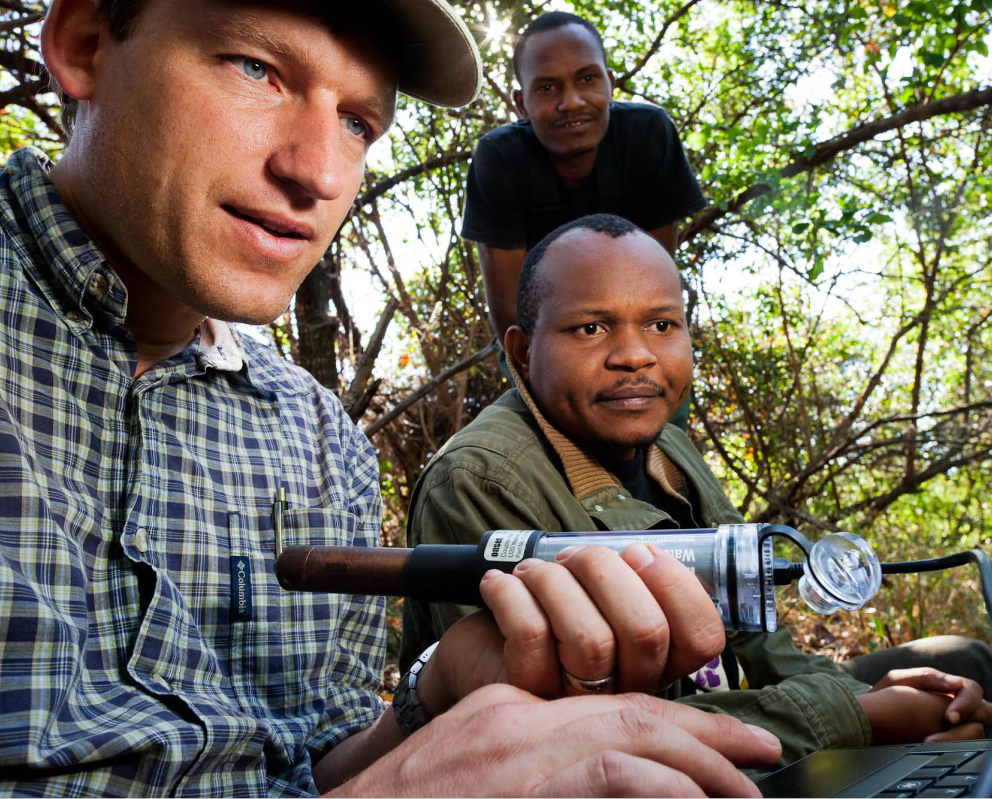
Partnerships (2)
Partnerships
Effective partnerships
Bring resources to the
advocacy effort.
Are generally easy to work with.
Are aligned with your
advocacy goal.
Bring few risks.
©Benjamin Drummond

Slide 31
Partnerships (3)
Partnerships
Qualities of an effective partner
Swift attention to
problems
Shared power
Clear expectations
Mutual responsibility
Ample recognition,
thanks, and praise
Inspiration and celebration
Strategic thinking
Persistence
Personal and regular
contact
Regular flow of
information
(bi-directional)
Focused goal-setting
Common goal/purpose
Complementary skill
sets and networks
Mutual respect
Money, resources
Demonstration of
performance –
track record of success

Slide 32
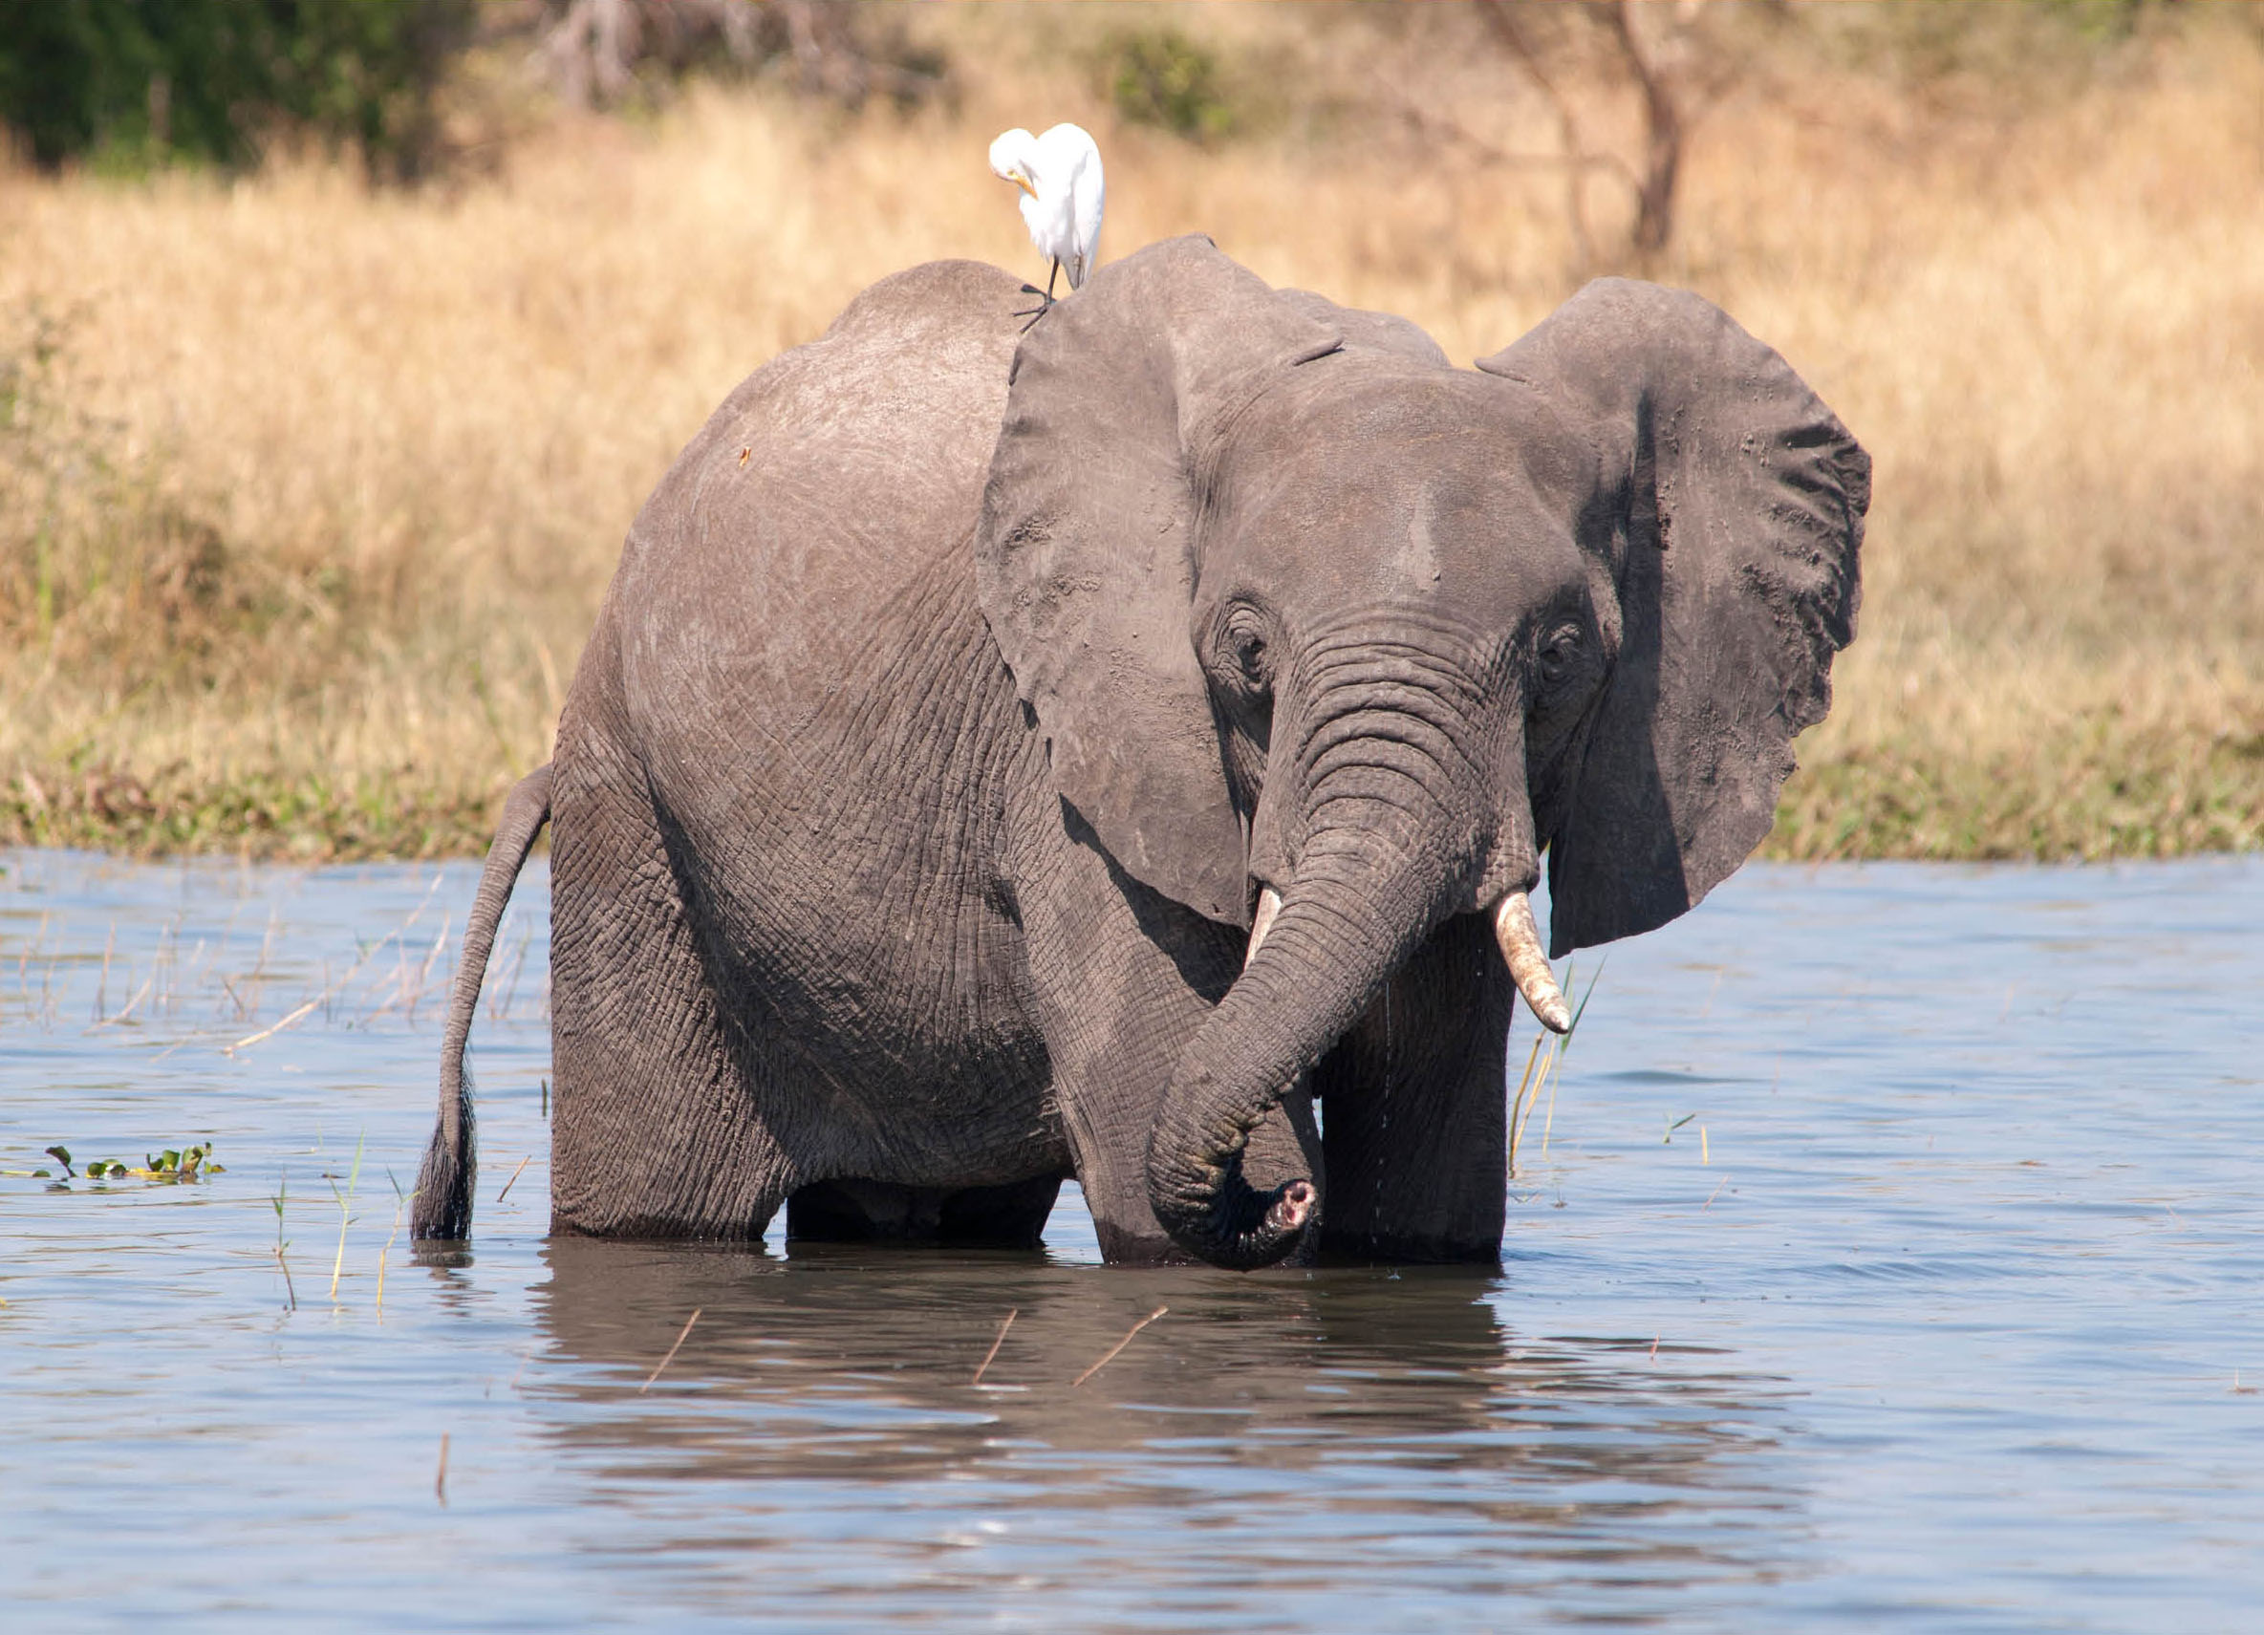
Partnerships (4)
Partnerships
Types/Forms of
collaboration
Information and data sharing
Developing common messages
Mutual consultation
Joint planning and strategizing
Coalitions and alliances
© Rod Mast

Slide 33
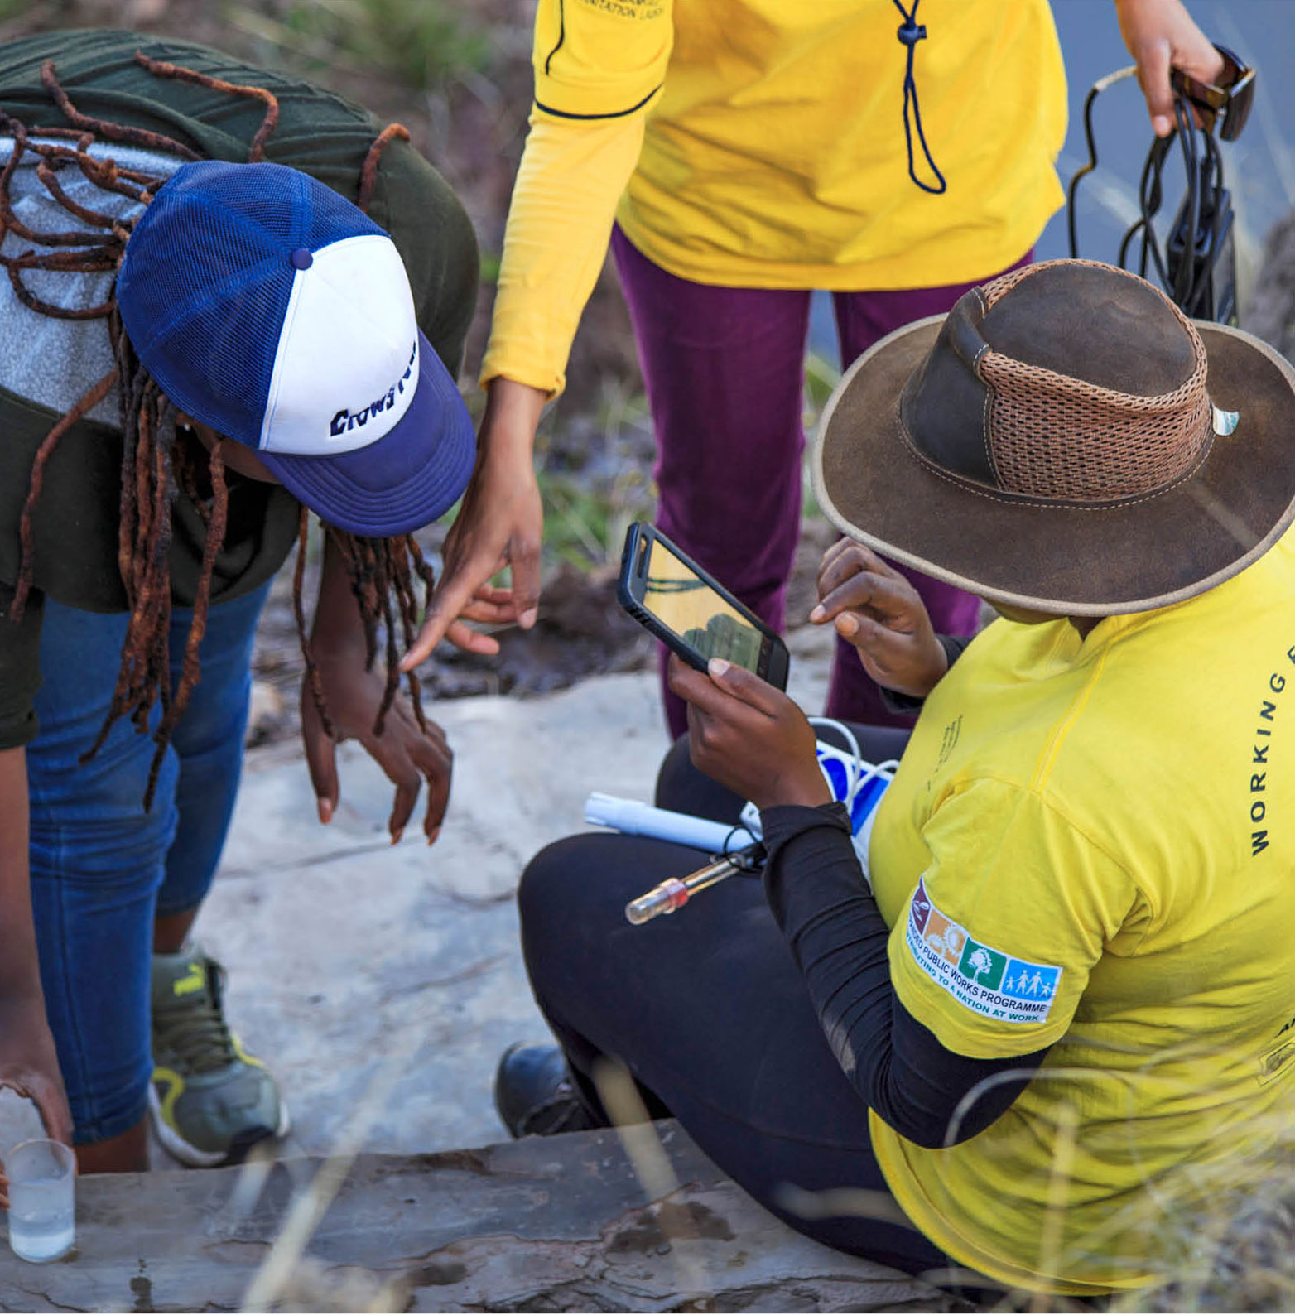
Types of Collaboration (1)
Types of collaboration
Information and
data sharing
Individuals and organizations agree to freely share information and data based on their contacts and what they learn in their work. There is no joint decision-making or requirement to use the information in a certain way.
© Conservation International/Photo by Patrick Nease

Slide 34
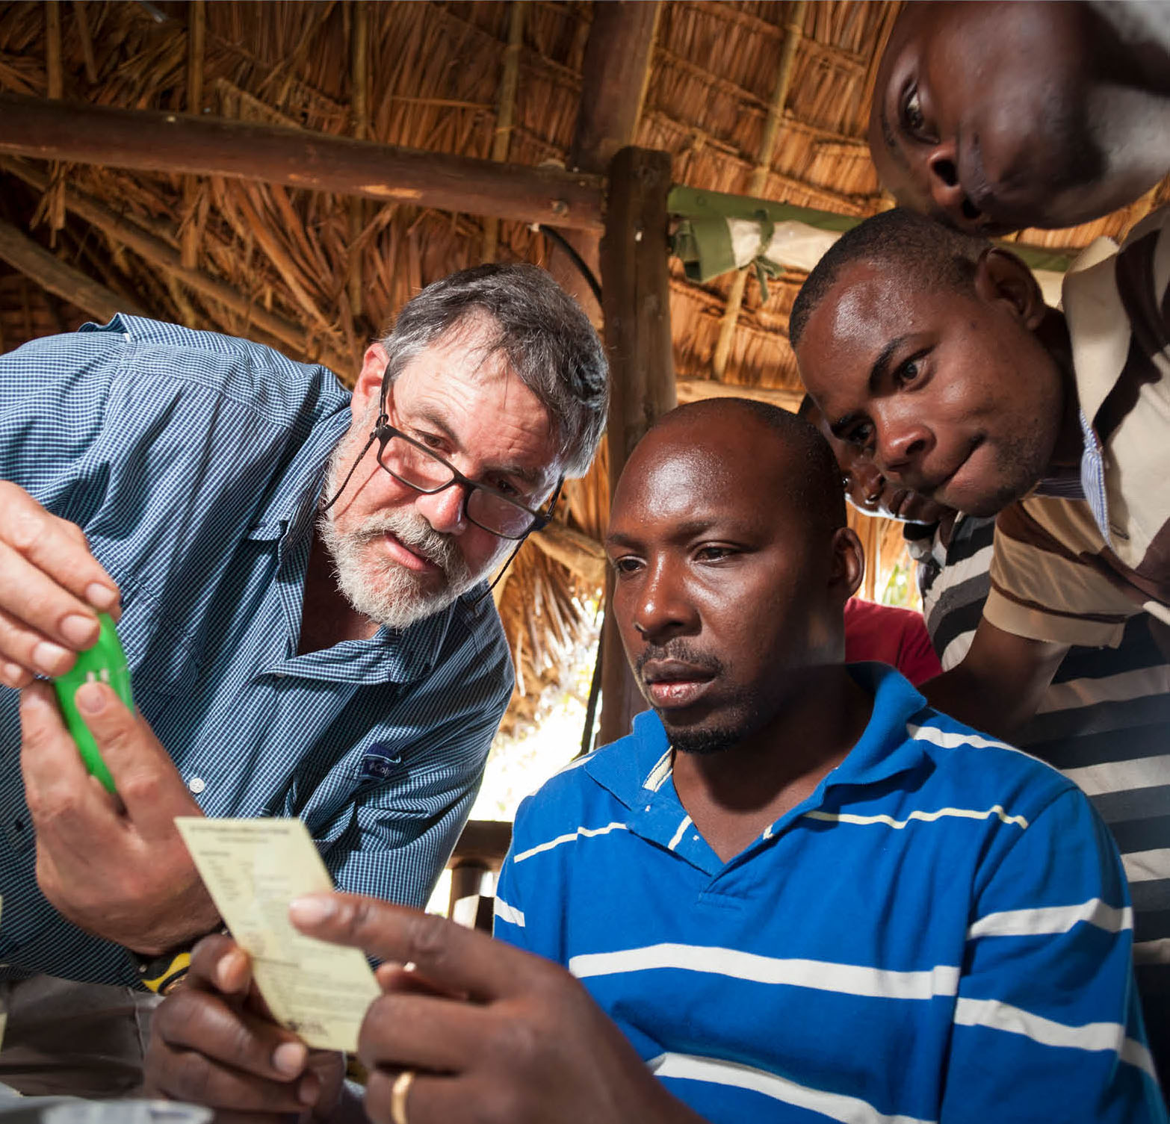
Types of Collaboration (2)
Types of collaboration
Developing common messages
Partners agree to share information and then analyze it together to identify trends and develop shared messages. Each organization will use these messages as they see fit within their own advocacy and not necessarily in coordination with each other.
©Benjamin Drummond

Slide 35
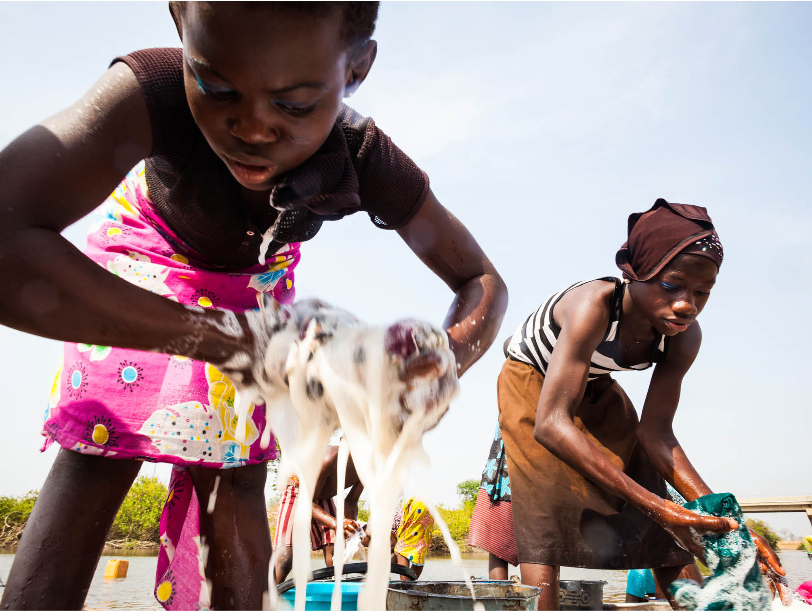
Types of Collaboration (3)
Types of collaboration
Mutual consultation
Partners use one another as a resource to develop their own individual plans to achieve policy advocacy goals. They get ideas from each other but still do separate work.
©Benjamin Drummond

Slide 36
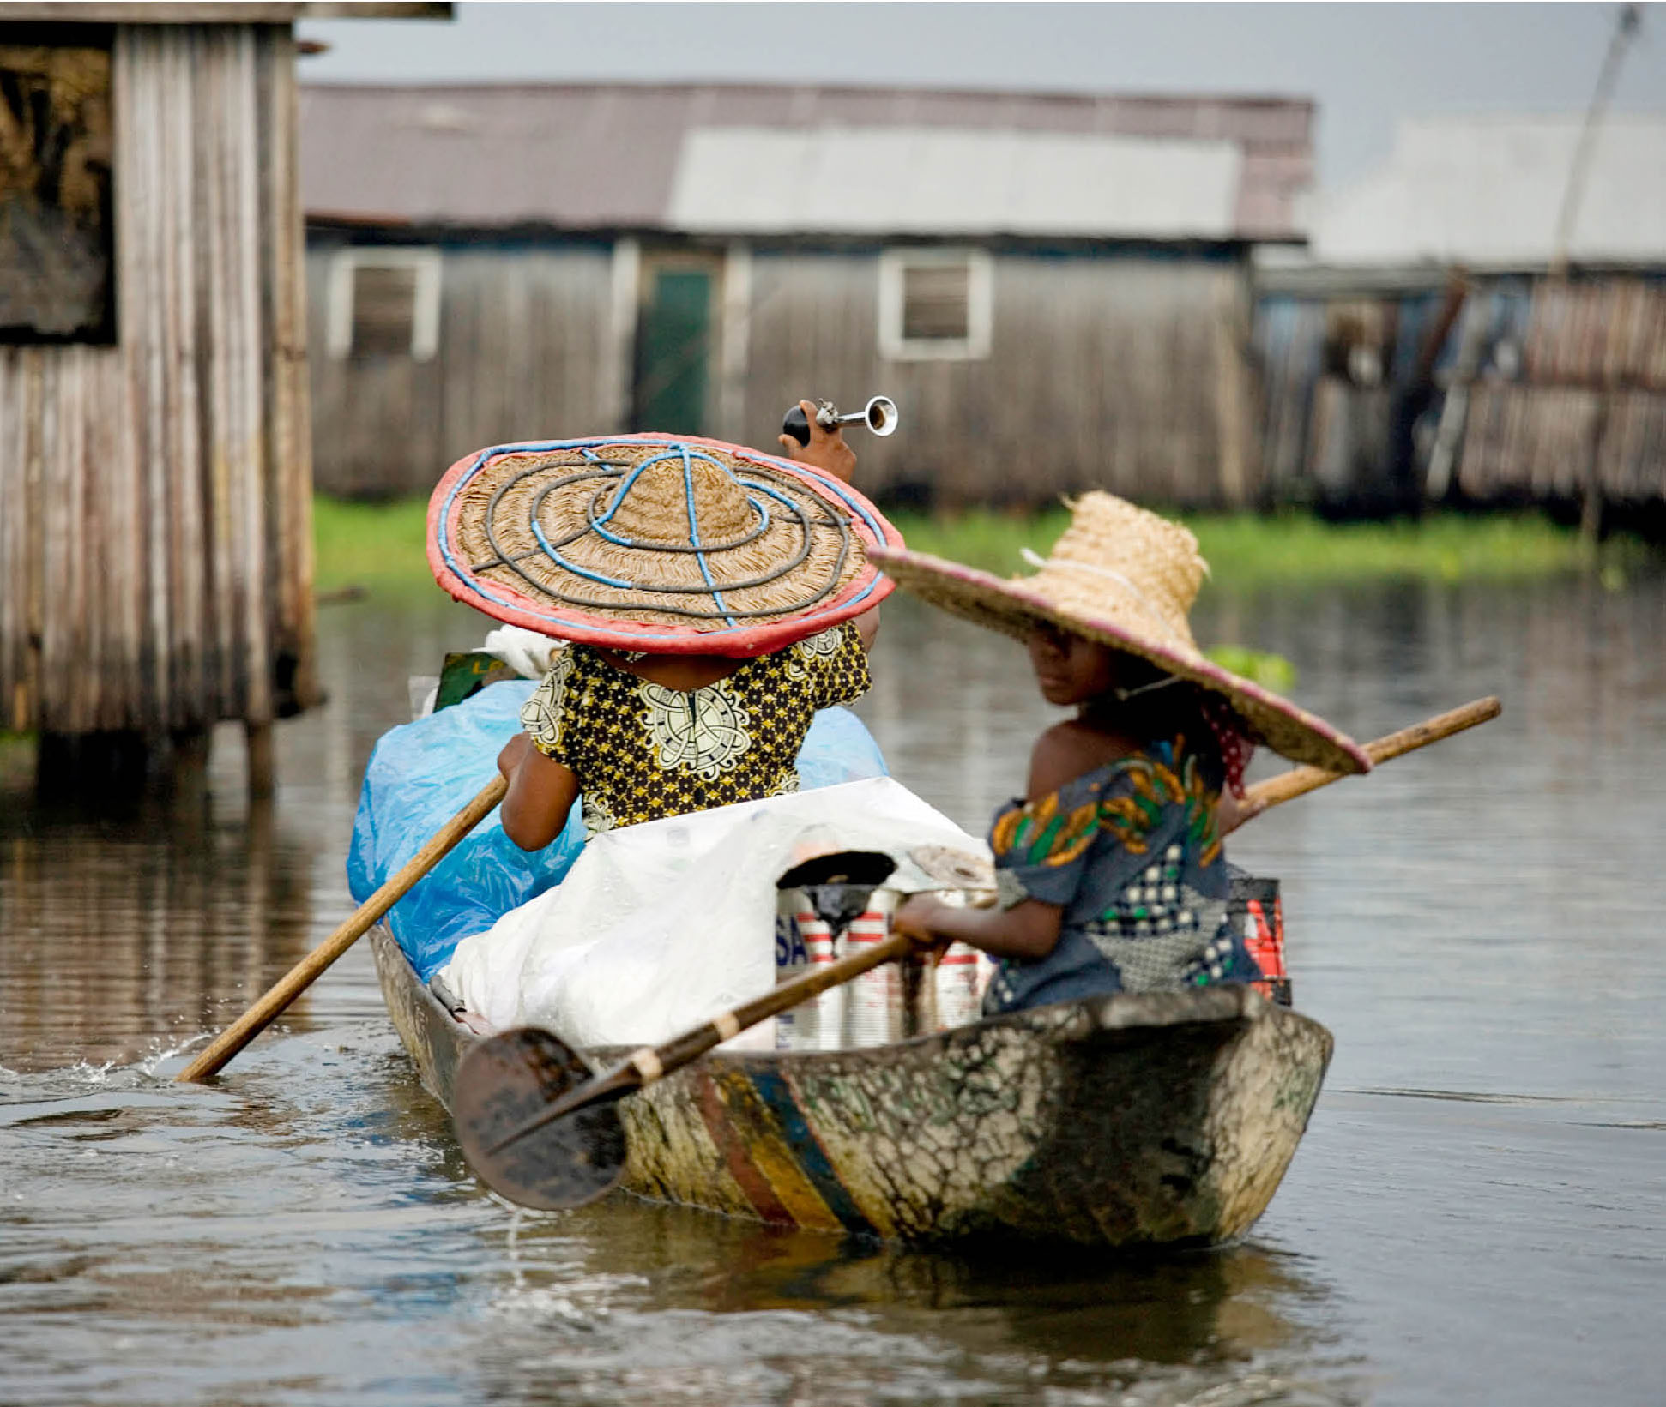
Types of Collaboration (4)
Types of collaboration
Joint planning and
strategizing
Partners identify similar challenges and develop mutually reinforcing plans and strategies to address them. Each partner does its own work but holds the other accountable for agreed-upon actions.
© Art Wolfe / artwolfe.com

Slide 37
Types of Collaboration (5)
Types of collaboration
Coalitions and alliances
The most formal type of collaboration where individuals
and organizations work together on a shared plan of action.
They are committed to supporting the plan and each other.
Some coalitions are temporary, and the partners disband after they reach their common goal. Other coalitions are like a long-term alliance, with a permanent structure and organization.

Slide 38
Activities and Approaches (1)
Activities and Approaches
Activity
categories
Events and meetings
Materials and publications
Generating or collating
data and evidence
Media and communications
©Conservation International/photo by Bailey Evans

Slide 39
Activities and Approaches (2)
Activities and Approaches
Key questions to consider
Will the activity address our decision-makers’ key interests?
Will the activities catch the interest of our decision-makers and/or their influencers?
Will the activity lessen the influence of any opposing groups or counter their messages?
Do we have the expertise and resources to carry out the activity?
What upcoming events, significant dates, or government decisions could be opportunities for mobilization and advocacy? (Opportunistic)
Does the activity pose any risk to our organization?

Slide 40
Objective:
Objective:
Activity | Responsible Staff | Partner(s) | Costs (staff days and out of pocket costs) | Timeline (frequency and by when)

Slide 41
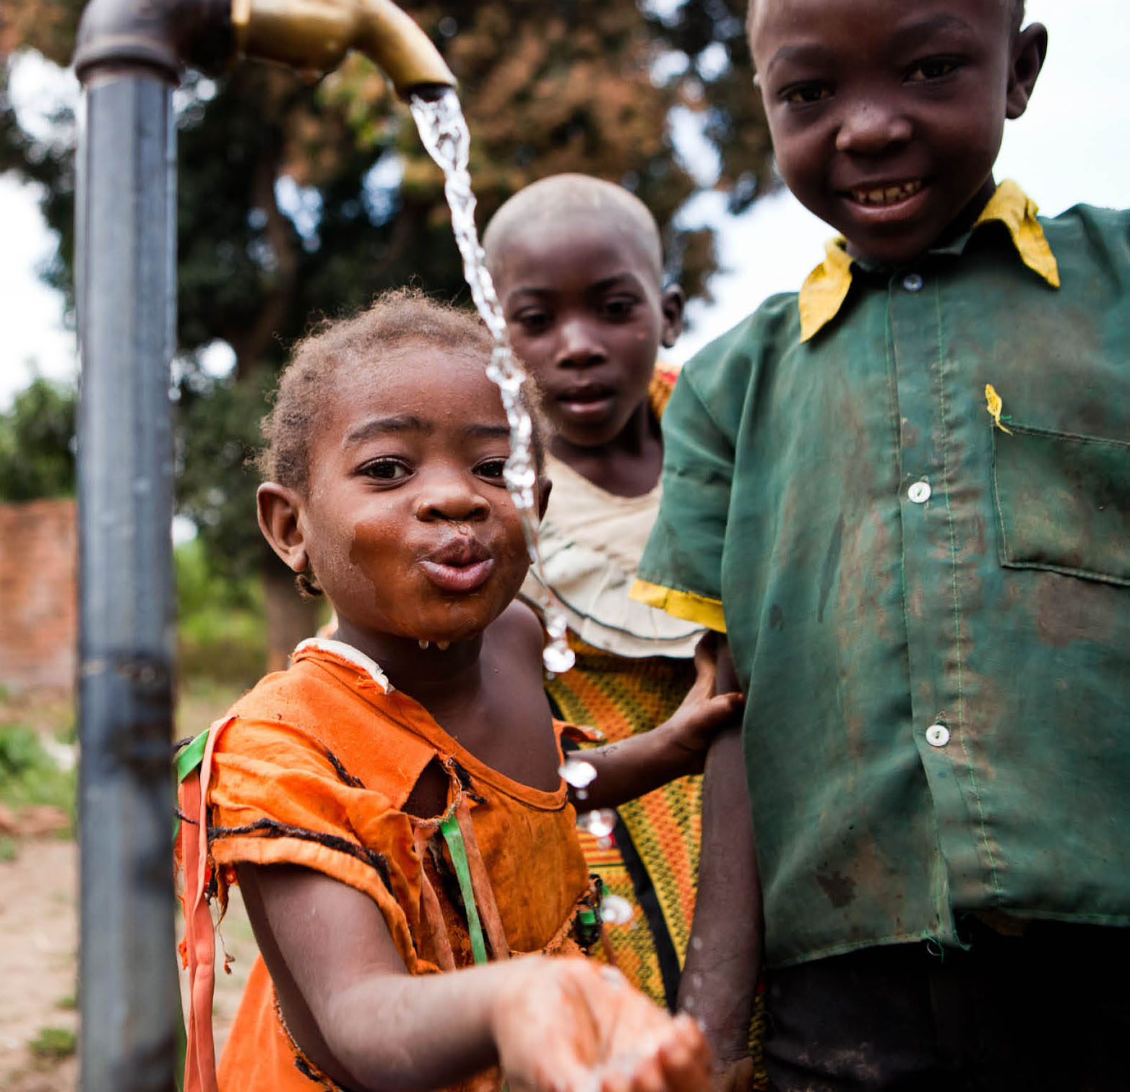
Qualities of a Compelling Message
Qualities of a
Compelling Message
Brief
Focused
Solution-oriented
Supported by evidence
Targets key interests
of the decision-maker
Uses non-technical language
Optimistic and hopeful
Has a clear request
©Benjamin Drummond

Slide 42
Four Parts of an Advocacy Message
Four parts of an
advocacy message
1. What is the issue?
2. Why should the decision-maker care about the issue?
3. What is the proposed solution and how will it impact the problem?
4. What do you want the decision-maker to specifically
do following your interaction?

Slide 43
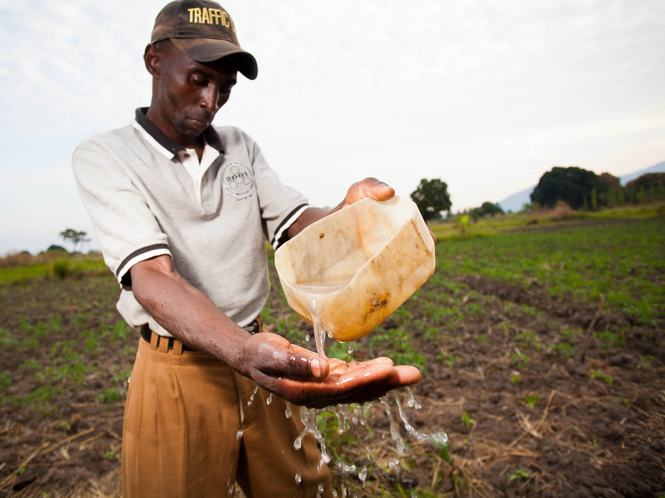
Ideal Messengers
Ideal messengers
Messengers should be diverse.
Messengers should represent
a range of seniority.
Messengers should be effective public speakers.
Messengers should support
your advocacy goal.
©Benjamin Drummond

Slide 44
Messaging
Messaging
Message | Decision-maker (Target) of the message | Associated source of the content

Slide 45

Day 4: Measuring Advocacy Progress and Adaptive Management, Next Steps
Day 4
Measuring advocacy progress and
adaptive management, next steps
©Benjamin Drummond

Slide 46
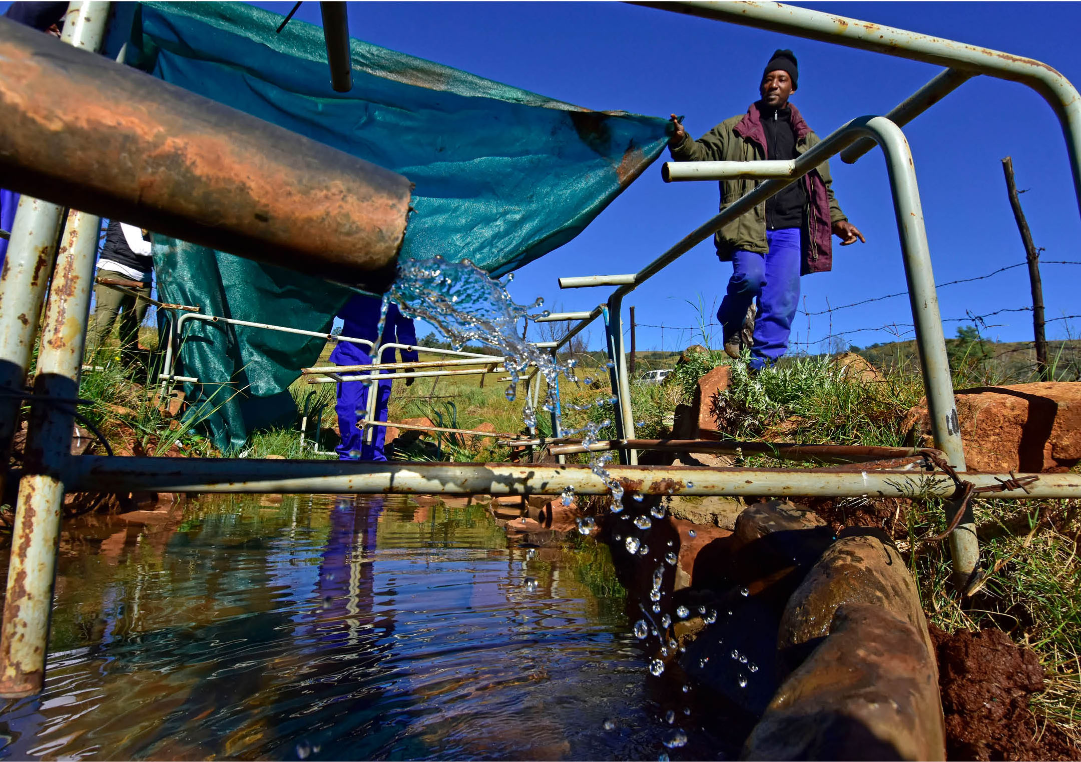
Measuring Progress
Measuring progress
Measure small
incremental change
Changes in language
Public statements
Tools: outcome harvesting, language measurement
©Trond Larsen

Slide 47
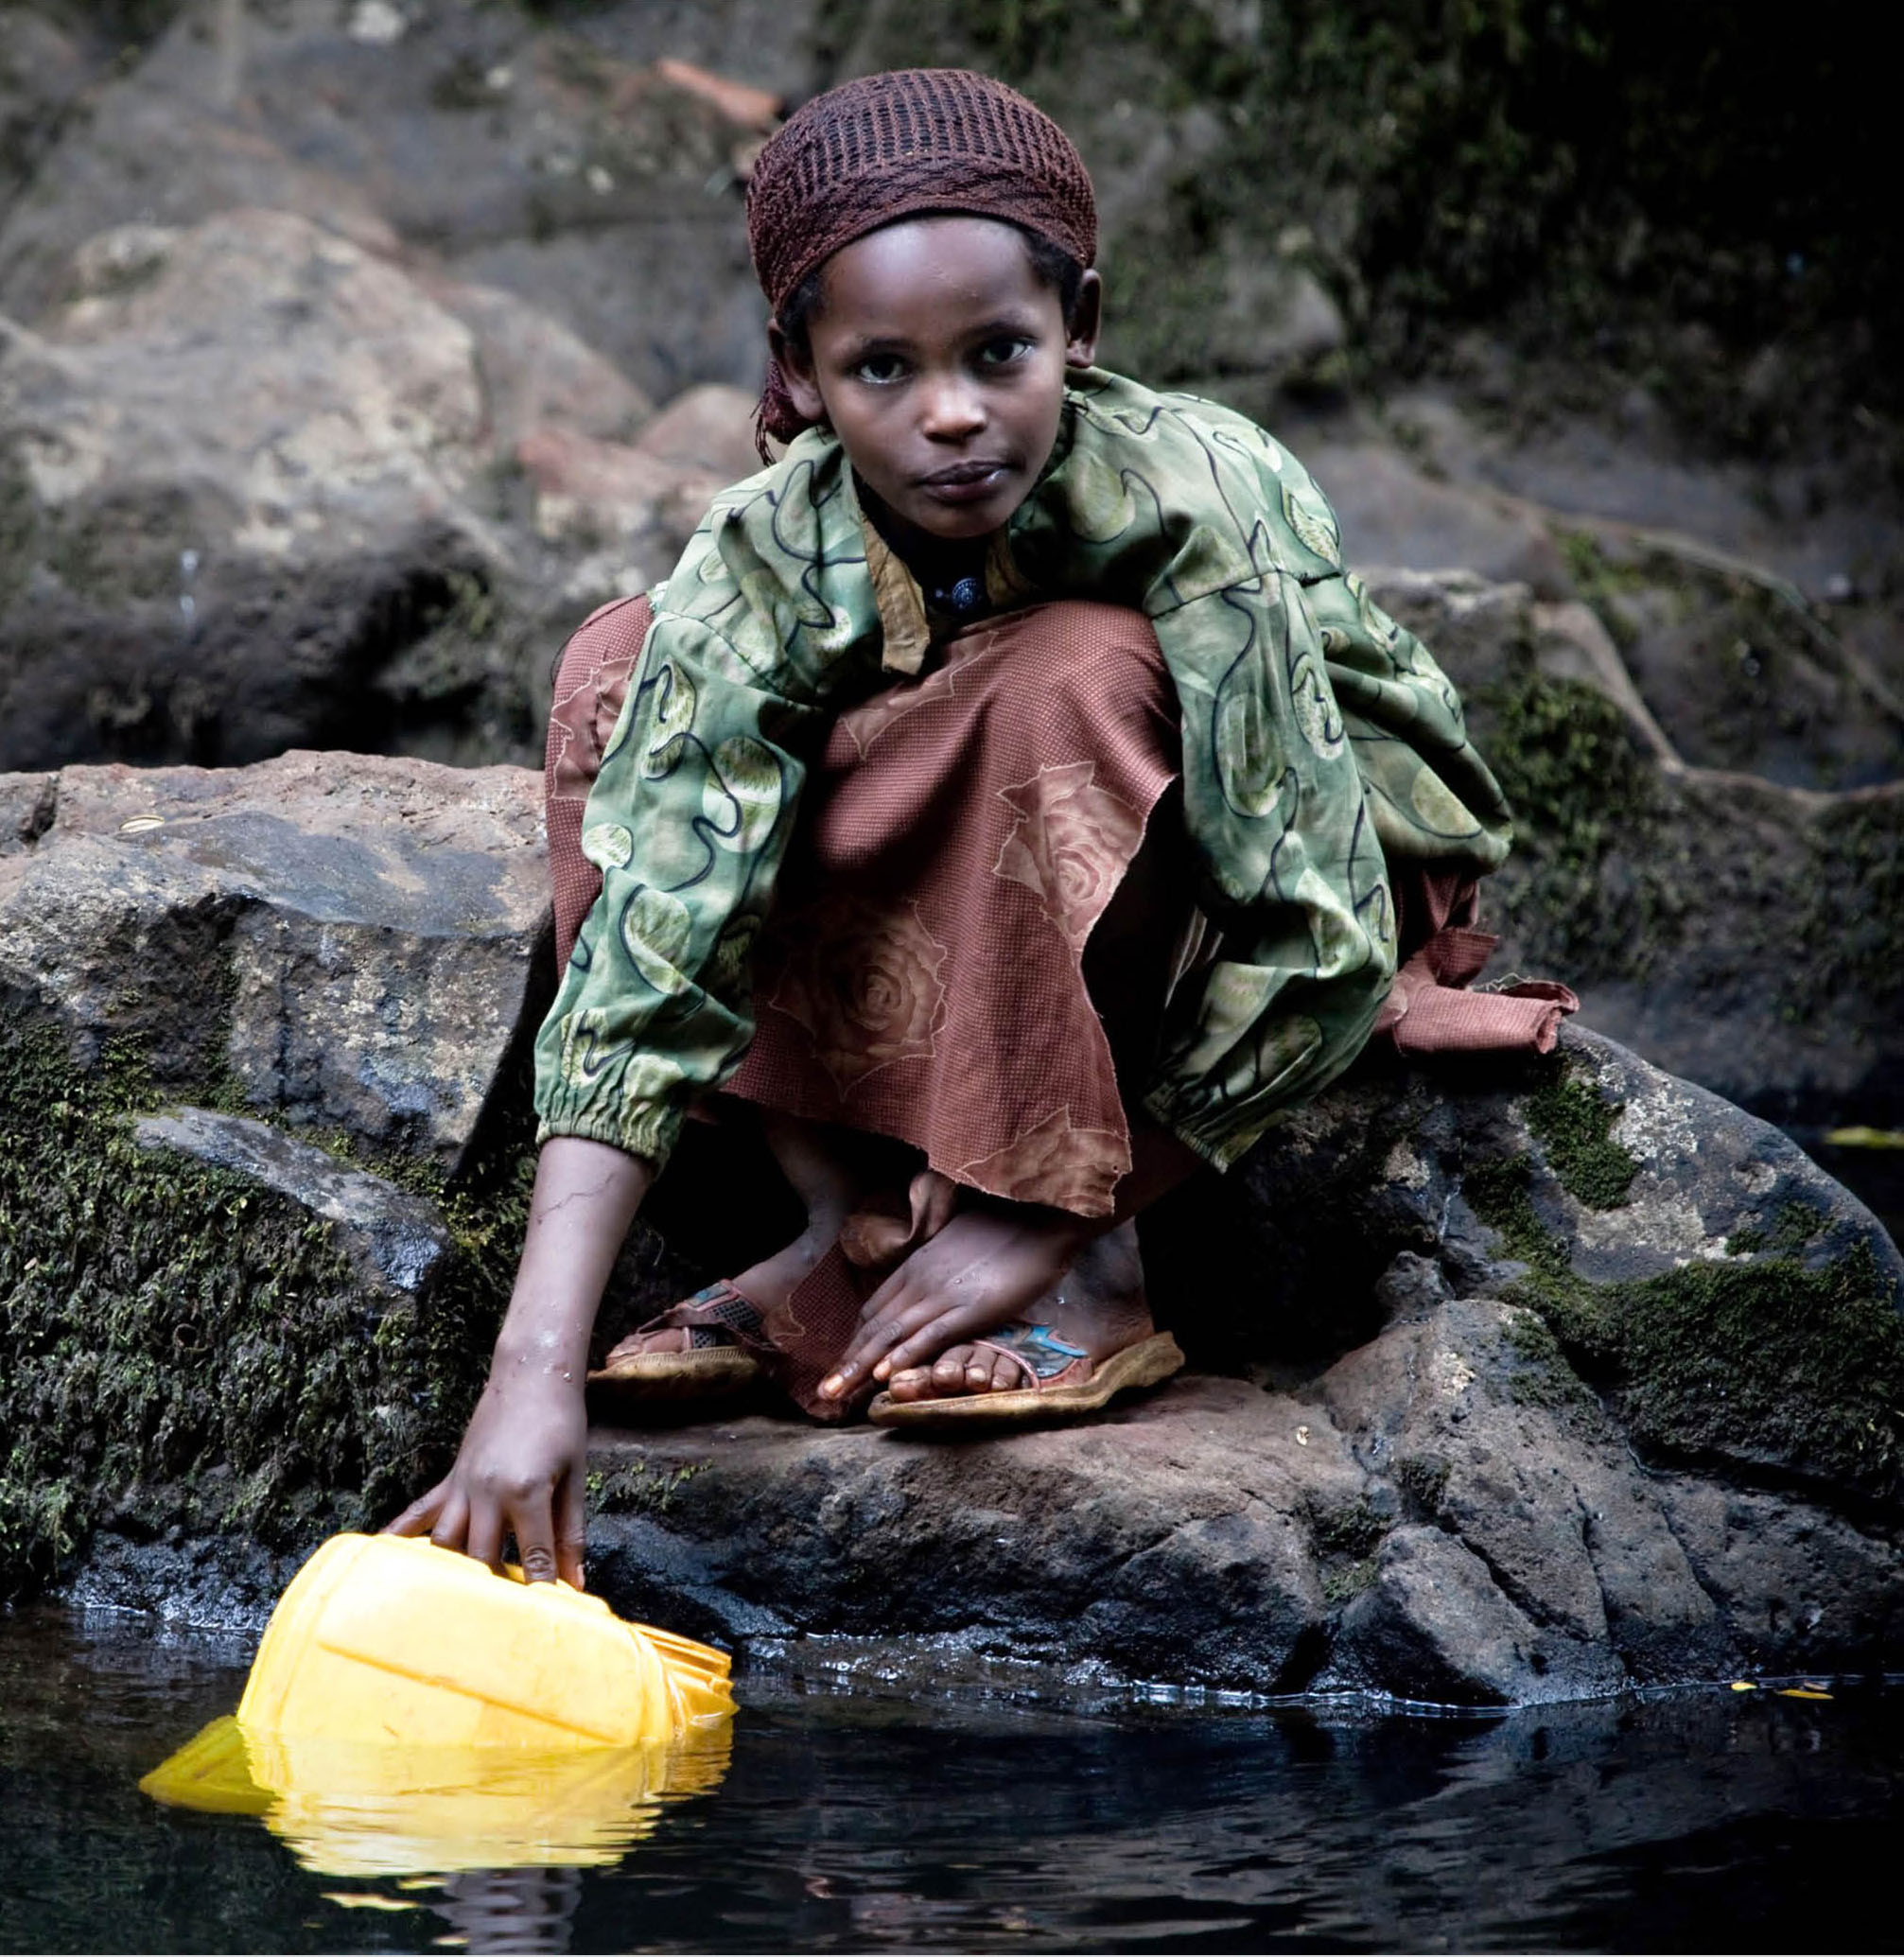
Next Steps
Next steps
Before you leave the room today, what are the next steps required for finalizing the strategy?
Who might need to review/approve
the draft?
What are the roles/responsibility of those who contributed to the draft strategy in this workshop? What about those not involved in the drafting?
When will contributors to the strategy re-convene to check in on progress?
© Robin Moore/ILCP

Slide 48
Congratulations on the completion of your draft advocacy strategy!
Congratulations on the completion
of your draft advocacy strategy!
Best of luck as you advocate for the integration of FW-WASH
to protect water resources for people and nature.
© SL_PHOTOGRAPHY

