Slide 1


Slide 2
Increasing compliance of manual and semi mechanized fecal sludge emptying and disposal services

Slide 3
From the perspective of the city level mandated authority, aiming for safe emptying and disposal of fecal sludge…
What are the main challenges for increasing compliance of front-line service providers?
What can we learn from sectors with similar challenges?

Slide 4
Key challenge to building compliance in fecal sludge emptying and disposal
Notes:
Split into multiple slides

Slide 5
What sector, facing the same challenge to building compliance, might be relevant?
Notes:
Split into multiple slides

Slide 6
What examples from this sector might be useful for fecal sludge emptying and disposal?
Notes:
Split into multiple slides

Slide 7
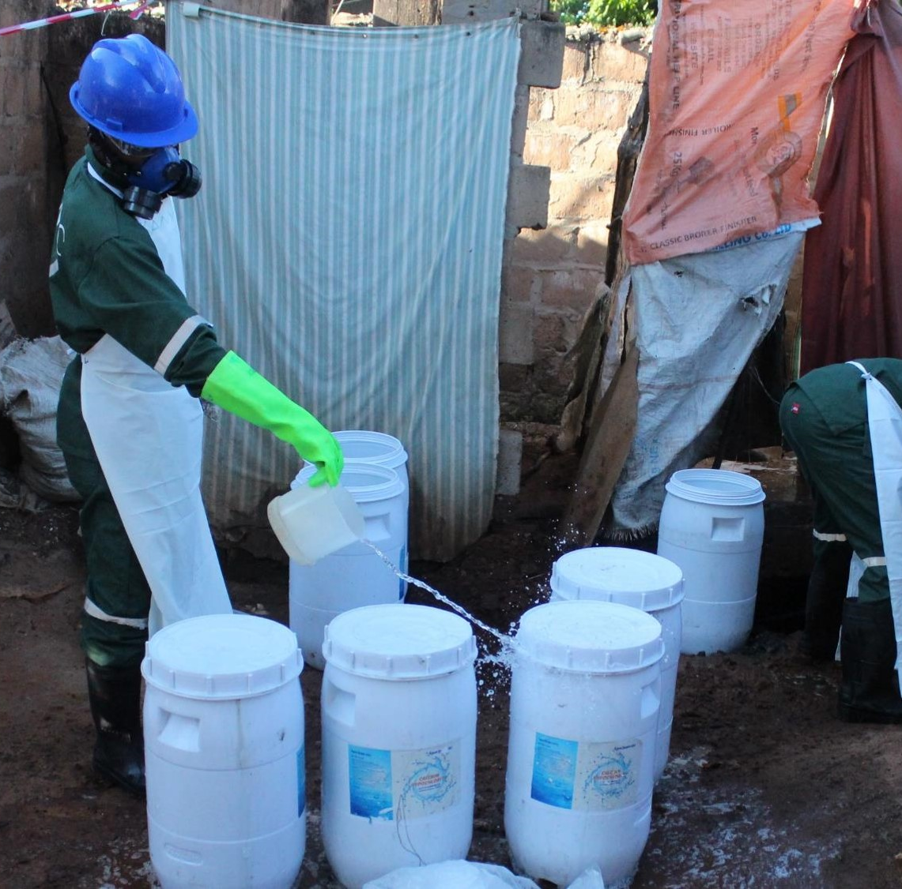
Safe transport and disposal of fecal sludge is expensive. Unsafe disposal is cheap and hard to detect.
Notes:
Split into multiple slides

Slide 8
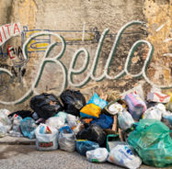
Construction waste management: fly tipping
Notes:
Split into multiple slides

Slide 9
Using satellite imagery to track less visible safe practices.
Aligning threats and penalty levels with enforcement capacity (excessive threats reduce compliance).
Notes:
Split into multiple slides

Slide 10

Low levels of trust between the authorities and workers or enterprises providing affordable, unsafe services.

Slide 11

Taxation of small and medium enterprises

Slide 12
Making compliance easier, both actual and perceived ease.
Importance of trust: more localized governance structures and linked investment.

Slide 13

Now over to you!
Linked sectors – are they relevant?
Related learning – is it useful?
What have we missed?

