Slide 1


Broadening the definition of "resilience": approaches to WASH and climate systems strengthening
Water resource management: finding systemic solutions: W3.1
Session organisers: Eline Boelee (Deltares), Sean Furey (Skat Foundation)

Slide 2
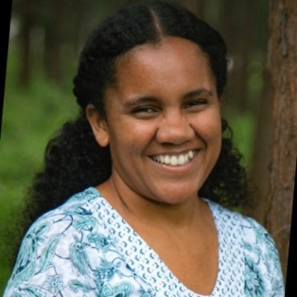
Agenda
& SPEAKERS
Opening Panel Discussion 15 mins
Pitches 6 x 2 mins
Poster Discussions 30 mins
Closing Remarks 10 mins
Chair
Dr Aline Saraiva Okello
RWSN Network Manager
Skat Foundation

Slide 3
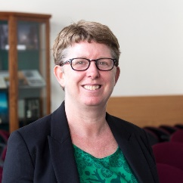
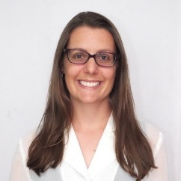
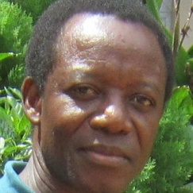
1. Opening panel
& SPEAKERS
Introducing REAL-Water
Opening Panel Discussion
  What do “resilient” WASH services look like?
  What is the relationship between systems strengthening and resilience?
  What role does research and evidence play?
Prof. Katrina Charles
REACH Programme Co-director
University of Oxford
Dr Rachel Peletz
Executive Director
Aquaya Institute
Dr Lucien Damiba
Regional Research and Knowledge Manager
WaterAid West Africa

Slide 4
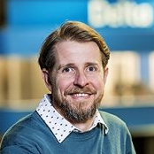
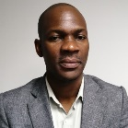

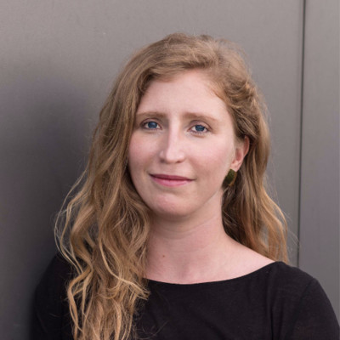

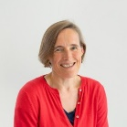
Pitches
& POSTERS
Andrew Warren Climate adaptation, resilience and planning expert, Deltares | WASH in a wider context: Planning resilient WASH services | Abilio Cuamba WASH Policy Advisor, SNV Mozambique | Eng. Teresa Miguel Pedro António, Head of Water Supply Department, Government of Mozambique | Successful systems strengthening for delivering climate resilient government WASH services in rural Mozambique
Lara Lambert Sr. Program Development Director, WASH, Water Mission | Looking at rural water service delivery for their systematic strengths and resilience | Lauren Cusuna, Senior Manager, Innovations & MEL, Safe Water Network |  | Safe Water Resilience Toolkit in Ghana
Dr Lucien Damiba Regional Research and Knowledge Manager, WaterAid | Strengthening national systems for improved water resource management and climate resilience in West Africa | Dr Lucy Stevens Head of Cities Fit for People, Practical Action |  | Climate, community resilience, WASH systems connections in Lake Basin Towns in Kenya

Slide 5

Pitches
& POSTERS
Instructions
30 minutes to circulate around to whichever posters and presenters you wish
If you like a poster-presentation, give it a vote using a dot sticker

Slide 6
Closing remarks
& Feedback
Go to https://www.menti.com/
Enter the code 1598 4255
What is ONE takeaway for you from this session?

Slide 7
globalwaters.org/real-water
Thank you to all the speakers and the organisers

