Slide 2
Enabling private sector participation in hand hygiene to reach everyone
Sanitation and hygiene in Tanzania

Slide 3
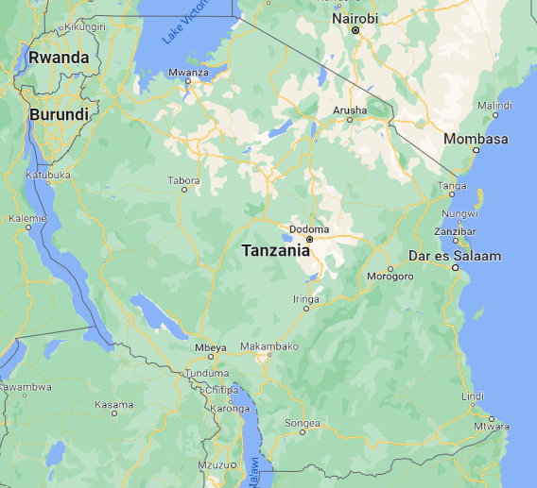
Sanitation and hygiene in Tanzania
Source: Google Maps

Slide 4
Sanitation and hygiene roadmap
Launch of National Sanitation Campaign
More focus on sanitation, some focus on hygiene
Planned launch of National Sanitation Campaign’s phase three
2012
2020
2023
1973
Launch of Mtu ni Afya
By Pres. Mwalimu Julius Nyerere
Developed National Strategy for Sanitation and Hygiene
Notes:
The government is implementing the Water Sector Development Program (WSDP). The Program has been split into phases
Phase I (2006-2015)
Phase II (2016-2021)
Phase III (2022-2026)
With regard to sanitation and hygiene, the National Sanitation Campaign (NSC) was introduced in 2012 to lead the country in accelerating access to improved sanitation and eliminated open defecation.
In 2019, the Government of Tanzania introduced the Sustainable Rural Water Supply and Sanitation (PforR) to accelerate access to rural water supply and sanitation.

Slide 5
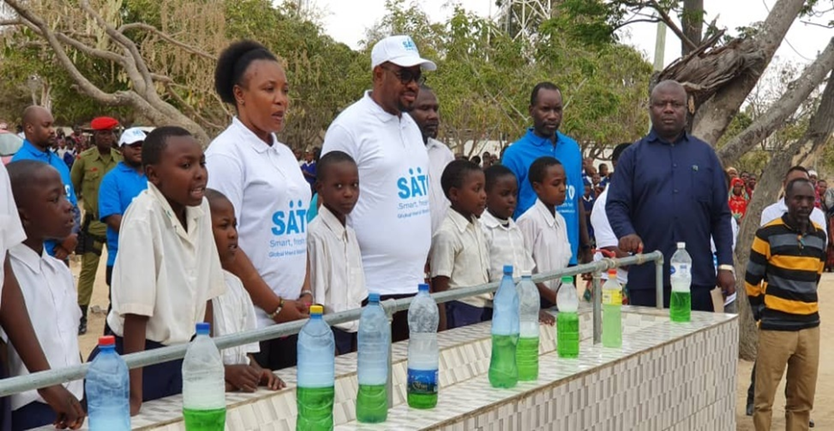
Hand hygiene approach in Tanzania
Notes:
Demand Creation
Government supporting and strengthening demand creation in communities and institutions (schools and HCFs) with support from WASH donor partners and NGOs.
Government creating space for private sector partners and faith groups to activate and accelerate demand for universal hand hygiene.
Organising inter-village sanitation and hygiene competitions and annual sanitation week where winners are awarded
Consistent engagement and advocacy WASH donor groups and private sector for capacity strengthening support to the last mile.
Hand hygiene as key to village ODF certification under the CLTS approach.
Supply
Strengthening private sector engagement and innovation in WASH.
Government support and incentivize innovation in schools and communities. Has created innovation and marketing of durable handwashing facilities – the Ndoo Chirizi (bib-taps installed to buckets), which is replacing the Tippy Tap.
Lixil providing Sato pans and Sato taps. UNICEF, SNV and partners promoting other sanitation and hygiene supplies

Slide 6
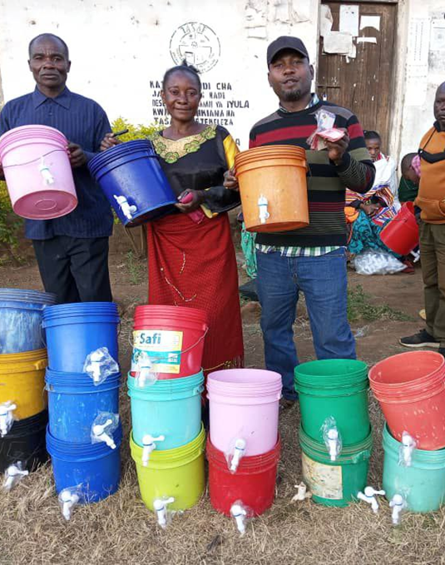
Household Level Hand Hygiene Economics
Hand hygiene can be a significant expense. In Iringa, it may be over 3% of a typical household’s annual income
Household Hand Hygiene Economics (Iringa)*
 | TSH | USD
Annual household income | 690,000 | 300.00
Hand hygiene device | 7,000 | 3.04
Soap | 6,000 | 2.61
Water for hand hygiene | 10,000 | 4.34
Total | 23,000 | 9.99
Percent of income | 3.3% | 9.7%
* Assumes a household of five people using 2 bars of soap and replacing their handwashing device annually.

Slide 7
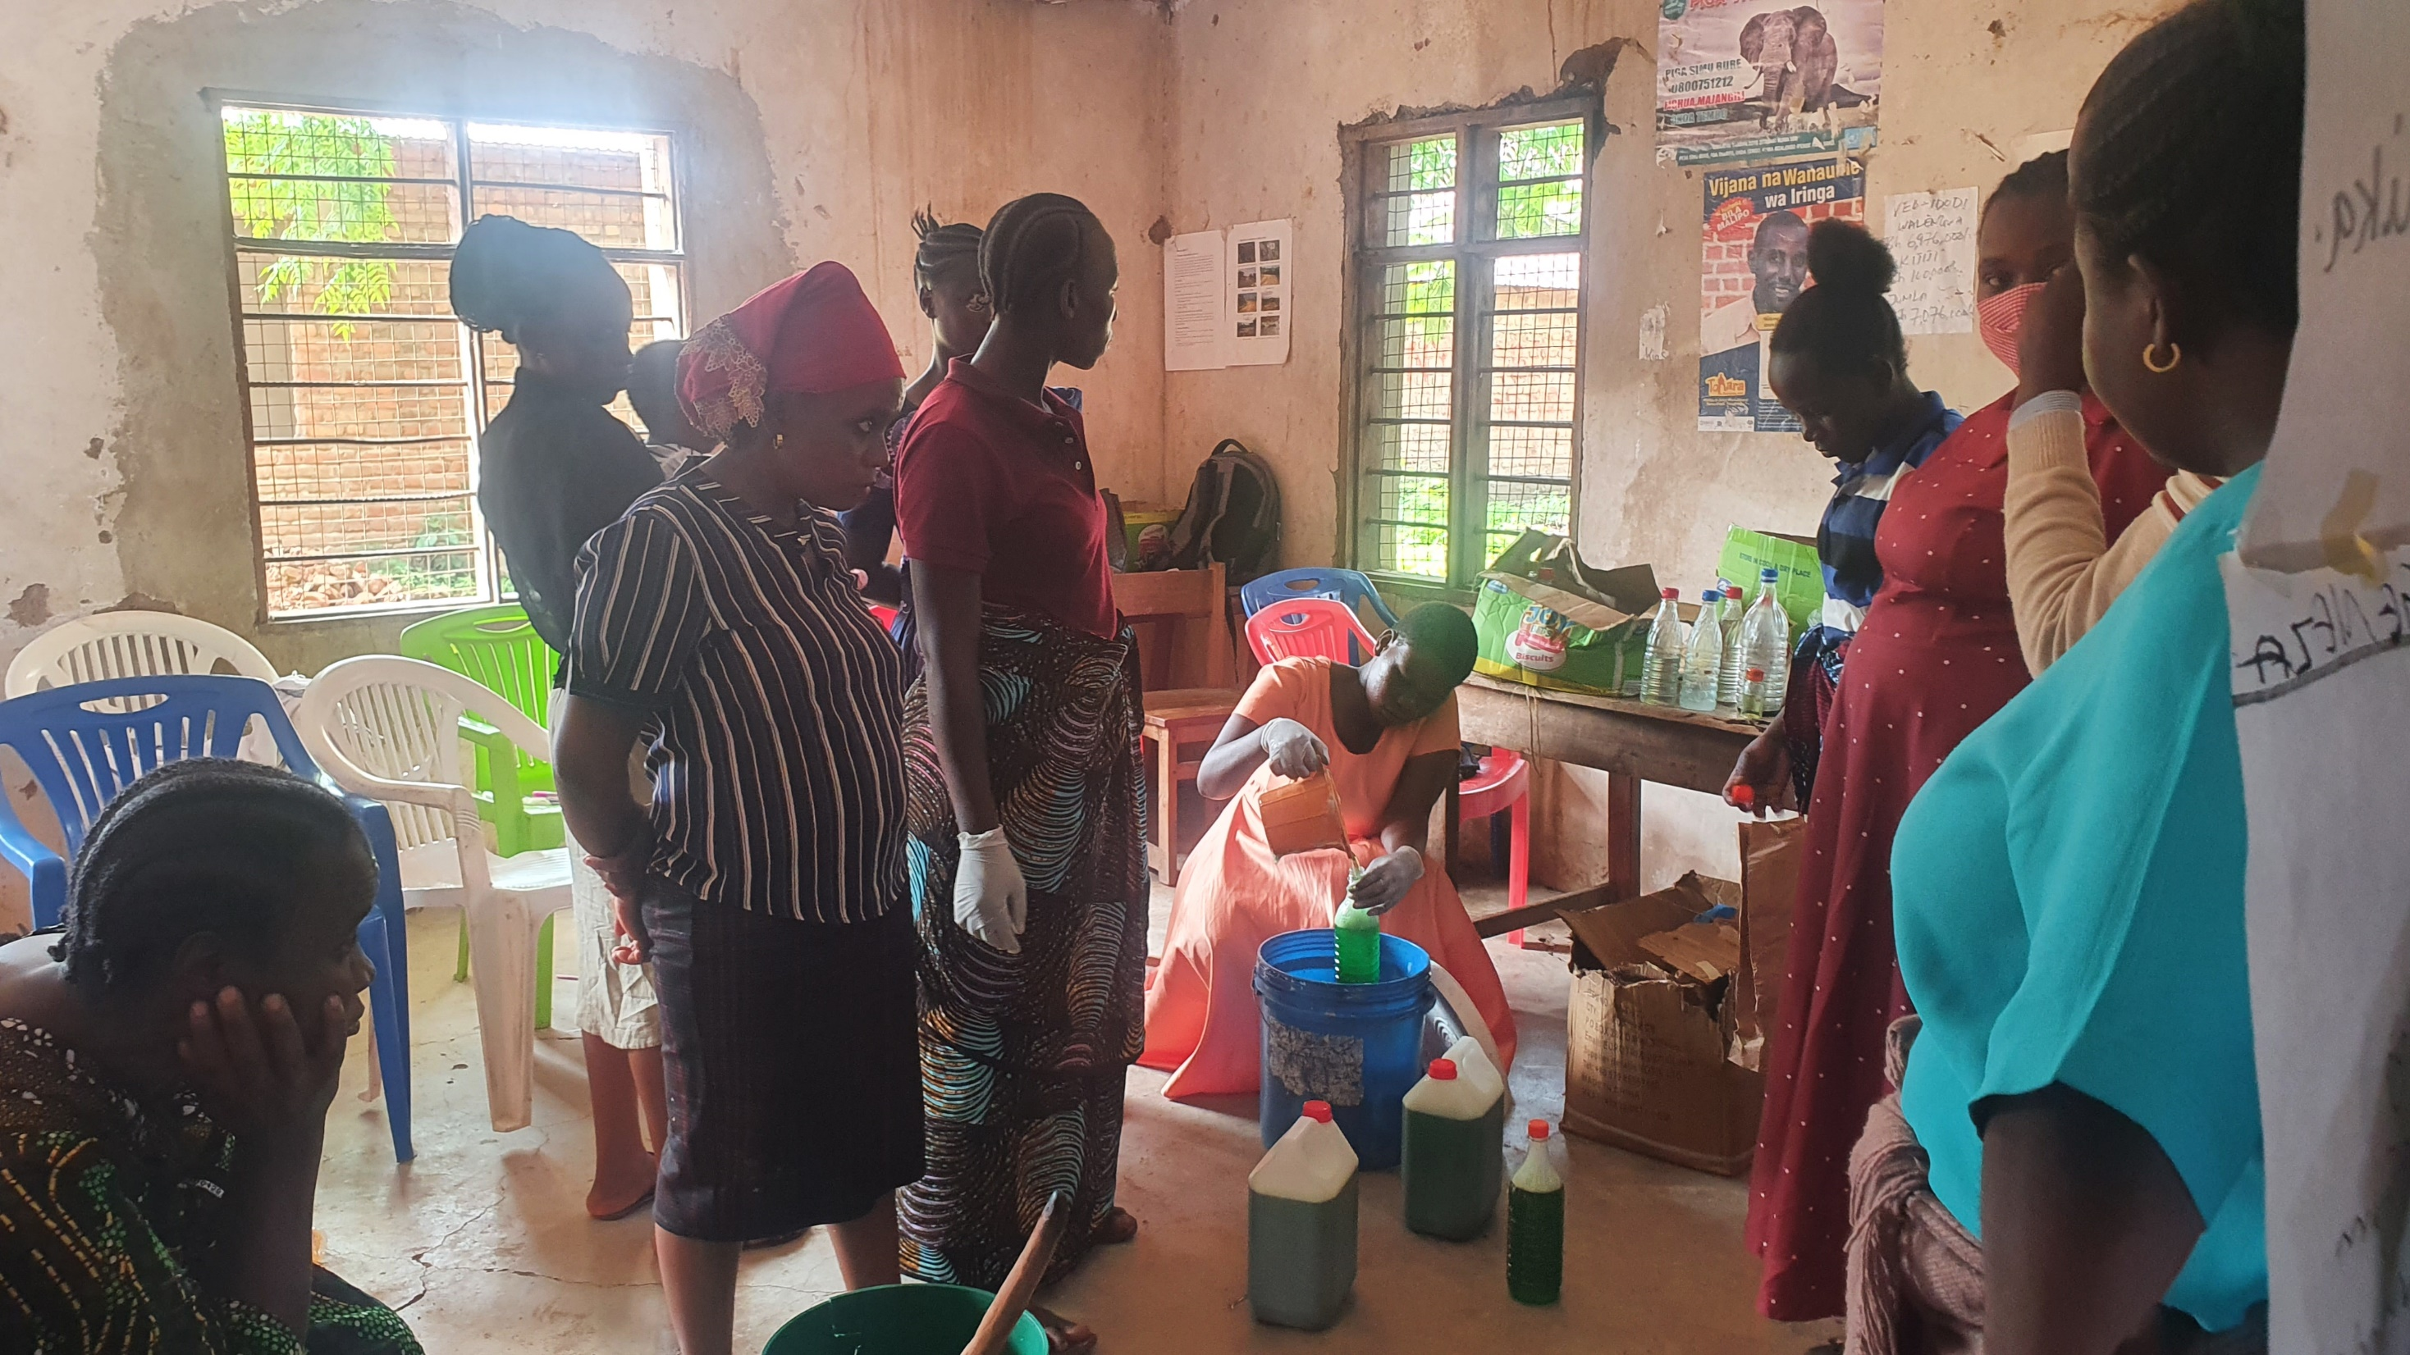
The Private Sector Engagement
To reduce the cost of hand hygiene, the Government of Tanzania works at the national level to increase efficiencies and at the sub-national level to localise the hand hygiene market.
National Private Sector Activities
Strengthening supply chains by providing enabling environment for private sector participation and expand hygiene marketing services, products and reach.
Improving efficiency of the manufacturer-distributer-retailer network.
Enabling last-mile delivery by exempting the local soap manufacturer from taxes
Local Private Sector Activities
Training fundis to manufacture hand hygiene devices
Piloting increasing access to finance for fundis and households
Training local manufacturers of liquid soap
Village hardware shop mobilized to stock and sell hygiene product based on need
Result: An 42.8% reduction in the price of liquid soap and a 33% reduction in the price of handwashing devices since 2020.

Slide 8
Anticipated challenges for the Private Sector
  Access to financing (including innovative financing) mechanisms to take hand hygiene to scale and effect quality control
  Social norms that impact uptake of hand hygiene
  Willingness of financial institutions to invest in hygiene and sanitation due to high taxes and tariffs on sanitation and hygiene products
  Level of poverty – the affordability of hygiene and sanitation products (Despites Tanzania’s middle-income status)
  No Stand-alone policy. Hand hygiene policy included in National
  Health Policy
  No stand-alone national hygiene strategy. Included in Southern African Development Community (SADC) Hygiene strategy

Slide 9
Looking forward
  Government to create an enabling environment for private sector to invest in sanitation and hygiene
    Create access to (innovative) financing
    Reduce/remove taxes and tariffs on sanitation and hygiene products
    LGAs to prioritise universal hand hygiene in respective regions
    Encourage more private sector partners to invest in sanitation and hygiene businesses
    Advocate for development of stand-alone hygiene policy
    Nationalize the SADC hygiene policy and develop a clear implementation plan

Slide 10
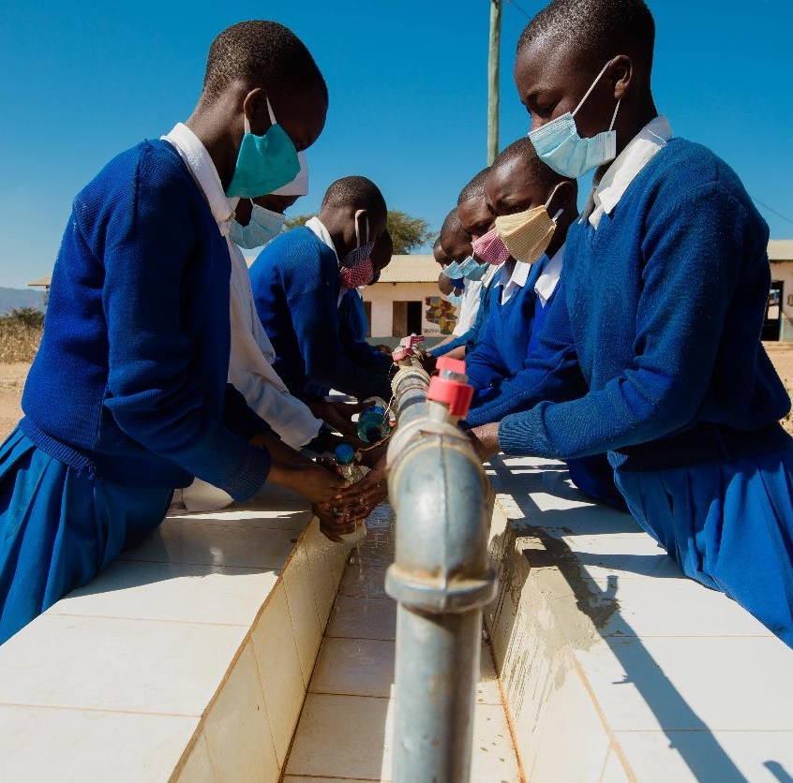
Asante Sana!
© UNICEF/UN0628796/Studio 19

