Slide 1



Bangladesh & the Dutch WASH sector
Objective of the meeting
to know more about the cooperation between the Netherlands and Bangladesh in the field of WASH
and for Ms Nameerah Khan (BRAC WASH) to meet the Dutch organizations active in Bangladesh in this area.
This meeting is set up as part of the Dutch Visitors Programme (DVP) organised by RVO/Ministry of Foreign Affairs.

Slide 2
PROGRAMME
14.00 Welcome by the hosts of the afternoon
14.15 Short introduction round of the parties at the table
Name/organisation and main objective of your work in Bangladesh
14.30 Introduction & short presentation by Nameerah
14.45 Interactive discussion with the sector parties
15.30 – 16.00 Wrap-up – conclusions and potential follow-up
16.00 – (…) Networking drinks

Slide 3
WHO ARE YOU?
WHAT IS THE MAIN OBJECTIVE OF YOUR WORK IN BANGLADESH?

Slide 4
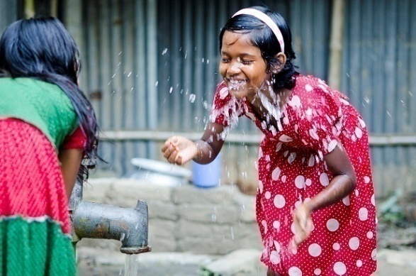
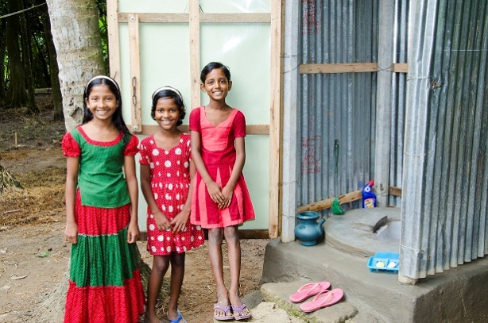
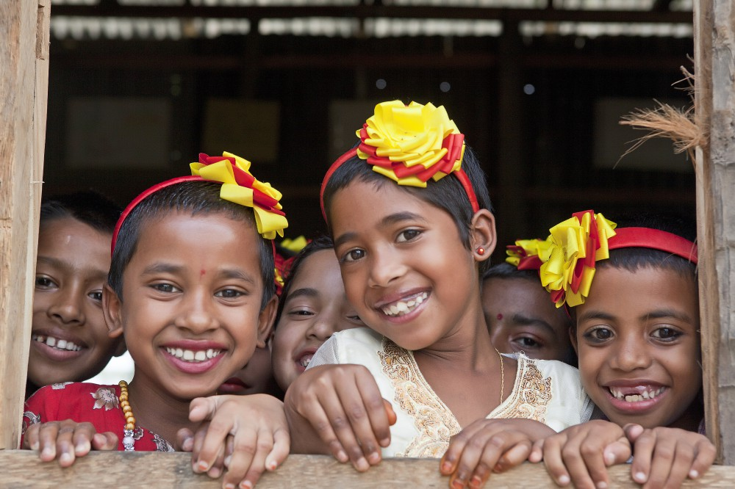
Water, Sanitation and Hygiene (WASH)
Programme

Slide 5
BRAC
BRAC, one of the largest NGOs globally, started operating in Bangladesh in 1972 to empower the poor and alleviate poverty
A holistic development approach geared toward inclusion, using tools like microfinance, health, education, community empowerment, water and sanitation, etc.
BRAC’s work now reaches an estimated 138 million people, a global movement bringing change to 12 low-income countries in Asia and Africa
BRAC works together with the community, government, development partners and other organisations such as NGOs, CSOs, etc.

Slide 6
BRAC WASH History
BRAC’s involvement in WASH began in 1970s, as a component in its overall development activities
Later WASH component was placed under health programme in 1991
Separate programme for WASH started in 2006
Reduction in open defecation in Bangladesh – 34% in 1990 to 1%
2015: BRAC strengthened integration of WASH with other development programmes in order to sustain the gains
1991
2002
2006
2011
2012
2015
Part of Health
WASH Pilot
Separate WASH Programme within BRAC
WASH Component
13 sub-districts
152 sub-districts
25 (new) sub-districts
73 (new) sub-districts

Slide 7
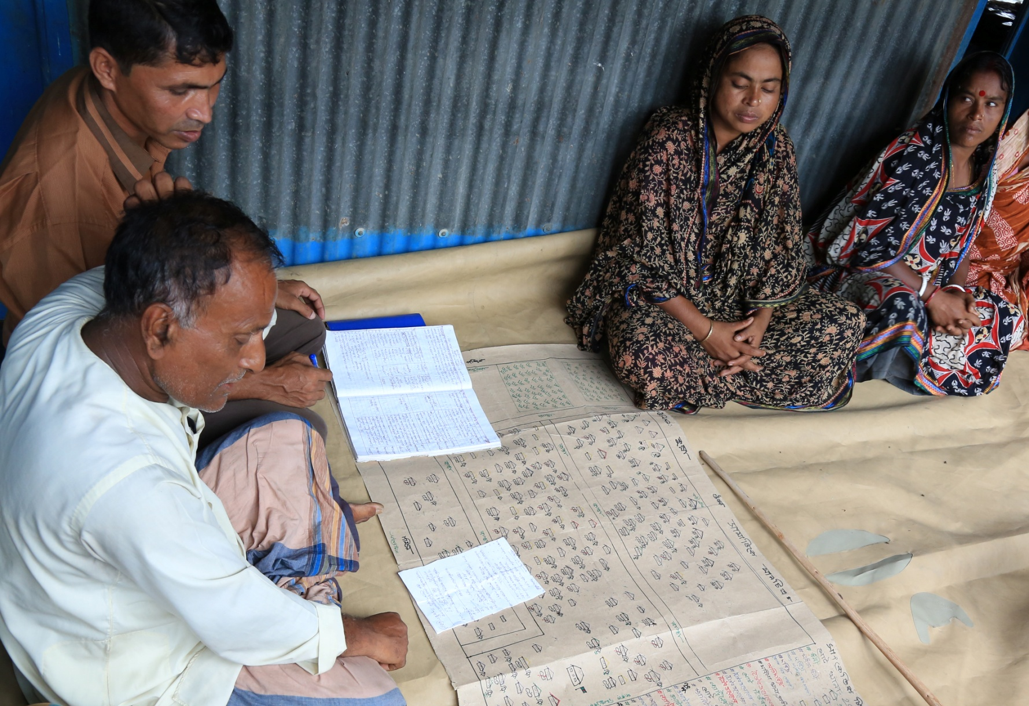
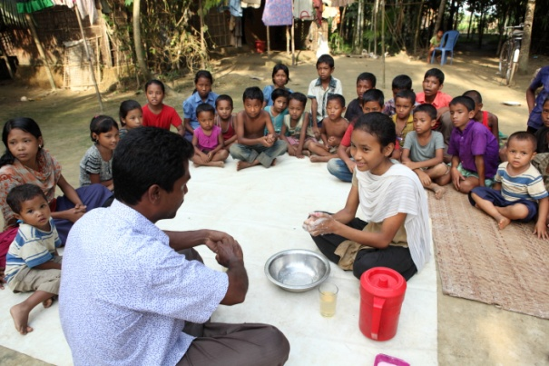
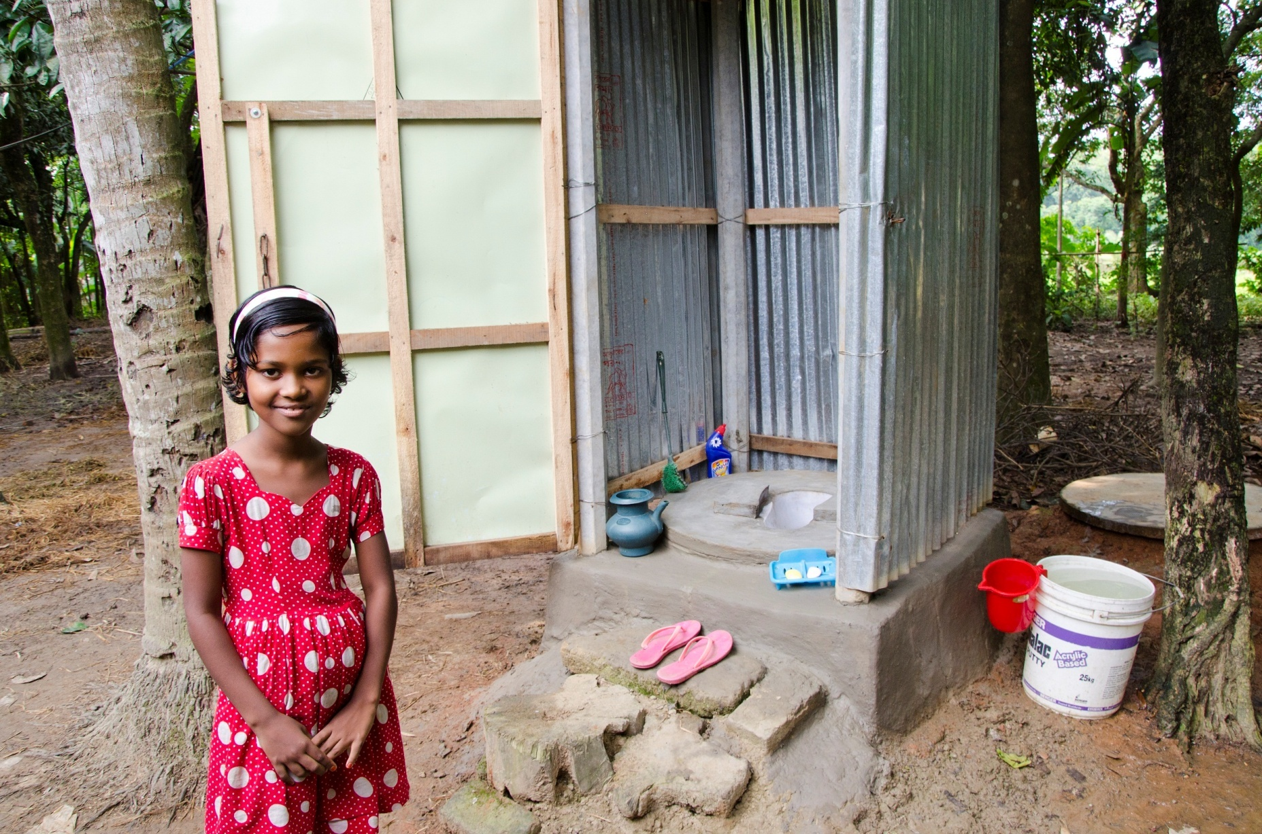
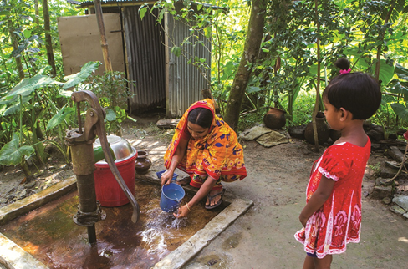
Photos: BRAC

Slide 8
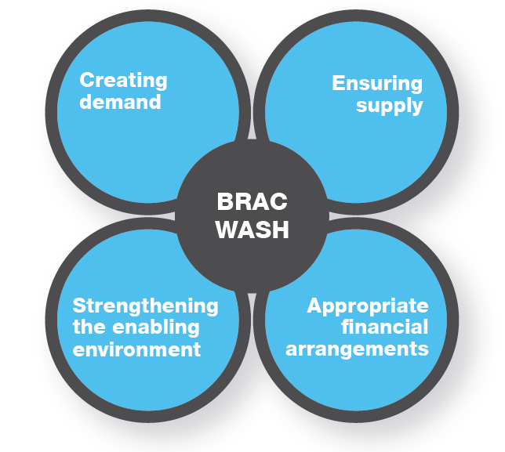
Building blocks of the BRAC WASH service
delivery approach

Slide 9
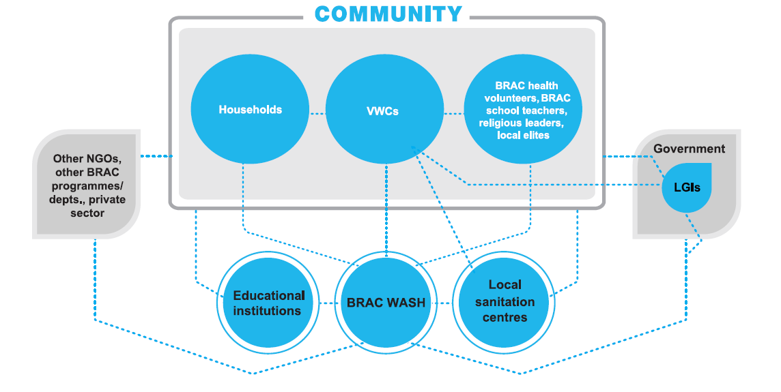
Linkages between BRAC WASH, the community and
other stakeholders

Slide 10
BRAC WASH scale at a glance
(May 2006 – June 2015)
Working area | Total 250 sub-districts
Total population in working area | 66.4 million
Number of people who received hygiene education from BRAC WASH | 13.9 million per year in communities 2.9 million per year in schools
Number of people who gained access to hygienic latrines | 39.4 million
Number of people who gained access to safe water (direct support only) | 2.3 million
Established Village WASH Committees | 65,566
Schools provided with WASH support | 5,550

Slide 11
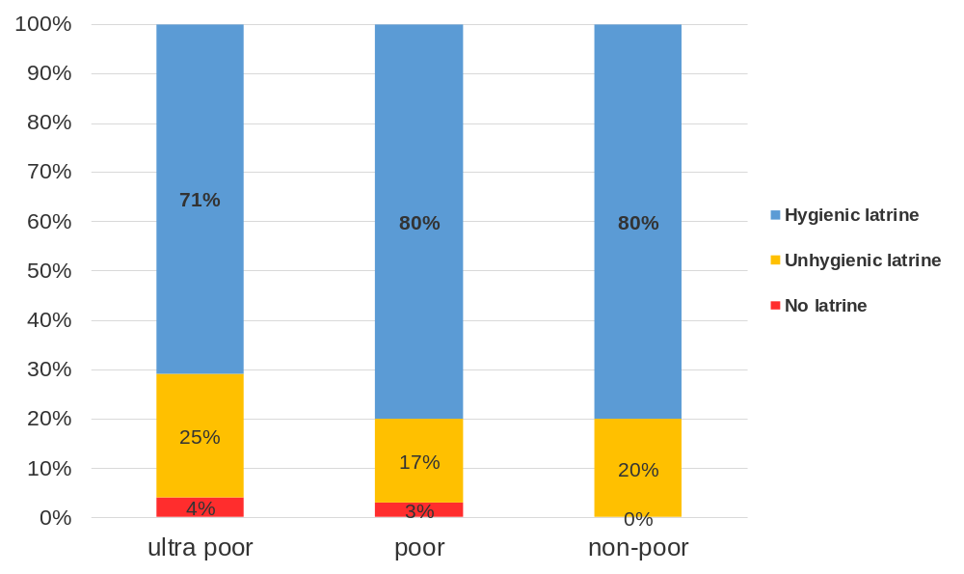
Equity in Sanitation
Equal access to toilets by poor and non-poor

Slide 12
Challenges & remaining issues
  Services for urban areas
  Safe solutions for faecal sludge management
  Sustainable but low-cost technologies for hard-to-reach and vulnerable areas
  Greater focus on menstrual hygiene management
  Ensuring financial sustainability while still ensuring equity in services provided

Slide 13
Way forward
Recognising that different organisations have different strengths, and therefore it will be important to:
  Forge partnerships and collaborations with other actors in the WASH sector
  Share knowledge and experiences for mutual learning

Slide 14
Thank you.

