Slide 1



Slide 2
Can collaboration on disease prevention increase the impact and equity of WASH services?

Slide 3
Creating and sustaining collaboration between WASH and disease control programmes
Introduction

Slide 4
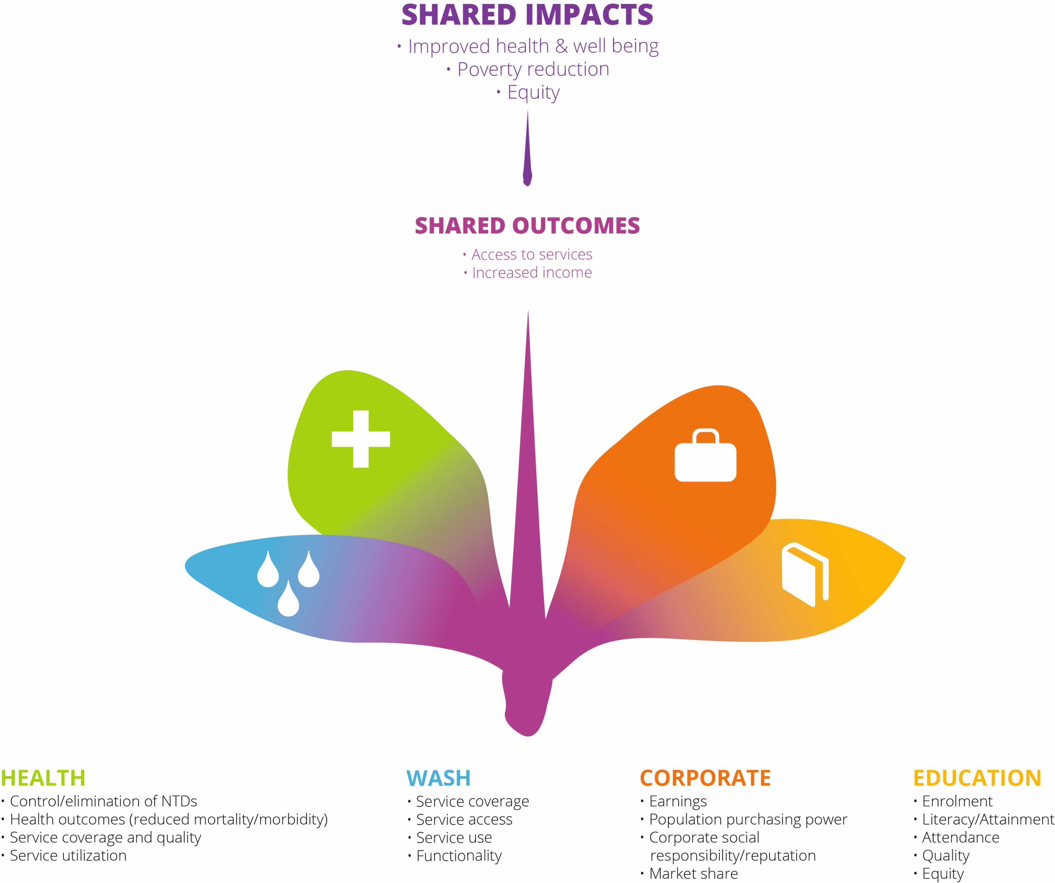
Collaboration makes sense

Slide 5
Unlocking Collaborations Through Data for Decision-Making
Ethiopia case study (recorded)

Slide 6


Slide 7
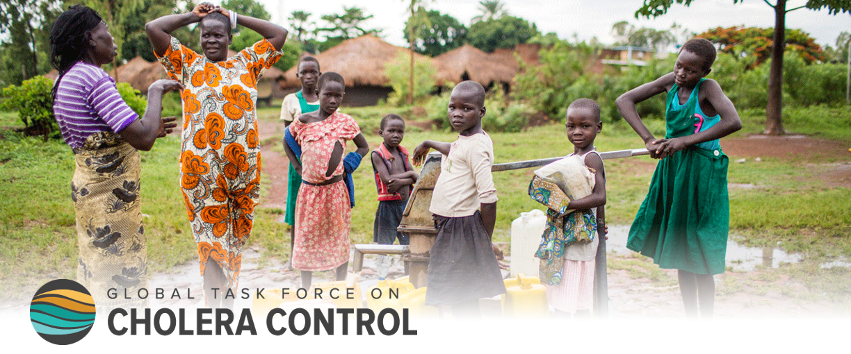
Working alongside disease-specific health programming – Cholera

Slide 8
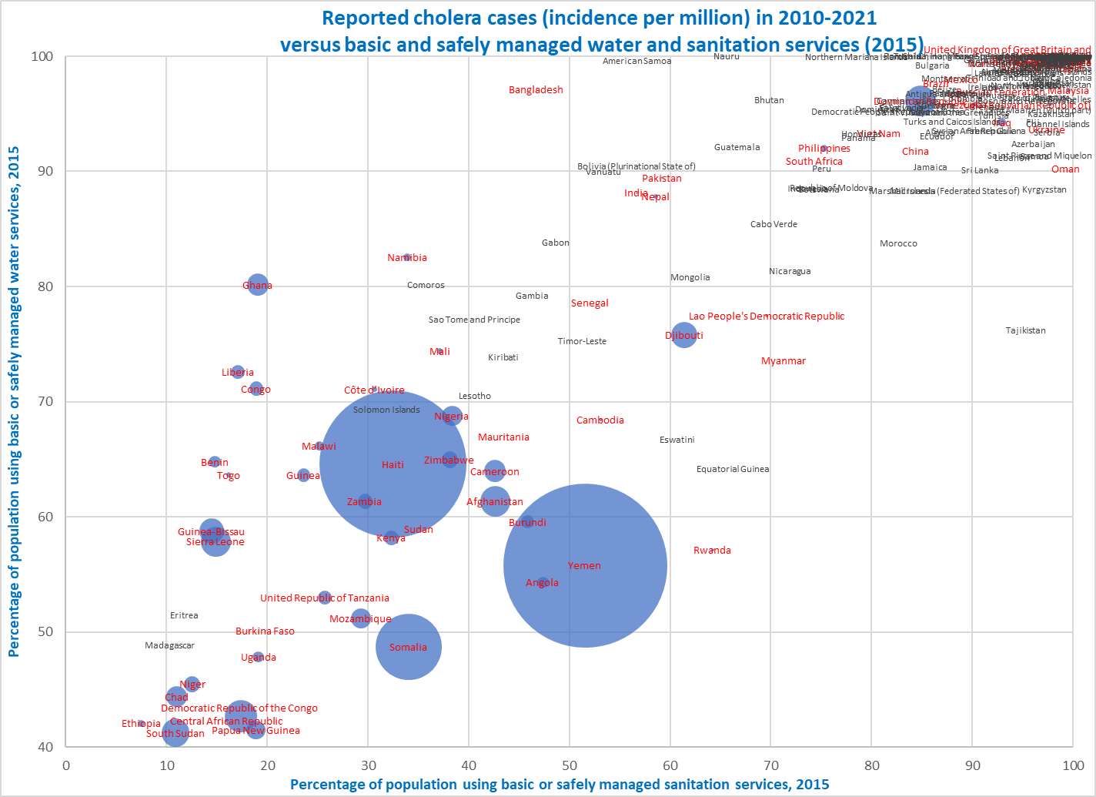
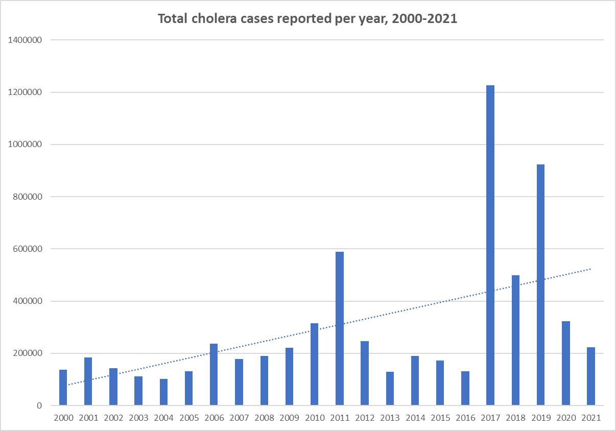
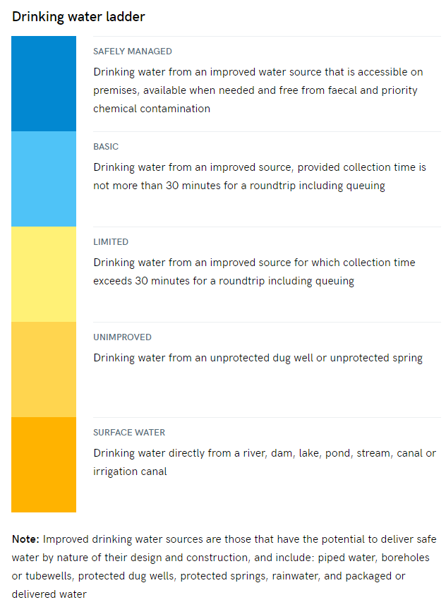
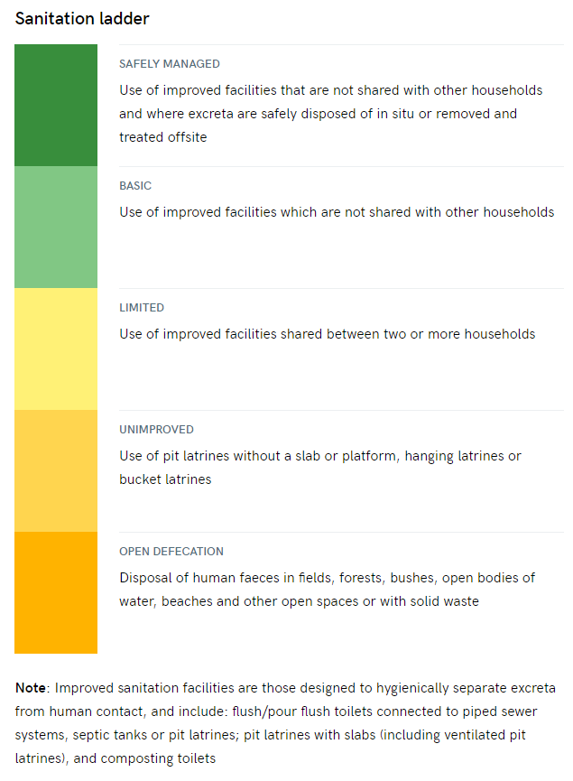
Background information: reported cholera cases (2010-2021) and WASH services levels
Analysis of 4,970,328 cholera cases reported over the period 2010-2021 and WASH services in 234 countries and territories (JMP 2015):
98.0% of all reported cases are from countries (39) with basic+ water services lower than or equal to 80% and basic+ sanitation services lower than 65%
96.7% of all cases reported come from 31 of the 34 countries with lowest water and sanitation combined service levels (basic+ water services less than 70% and basic+ sanitation services less than 55%)
Only 3 countries with less than 70% basic+ water service and less than 55% basic+ sanitation services do not report cholera cases over the period, including 2 islands (Madagascar and Salomon Island)
Only 5 countries with more than 80% basic+ water and more than 60% basic+ sanitation reported significant number of cholera cases, with local transmissions (Dominican Republic, Iran, Iraq, Malaysia and Philippines)
98.0%
96.7%
Basic+: basic and safely managed services in JMP Water and Sanitation ladders

Slide 9
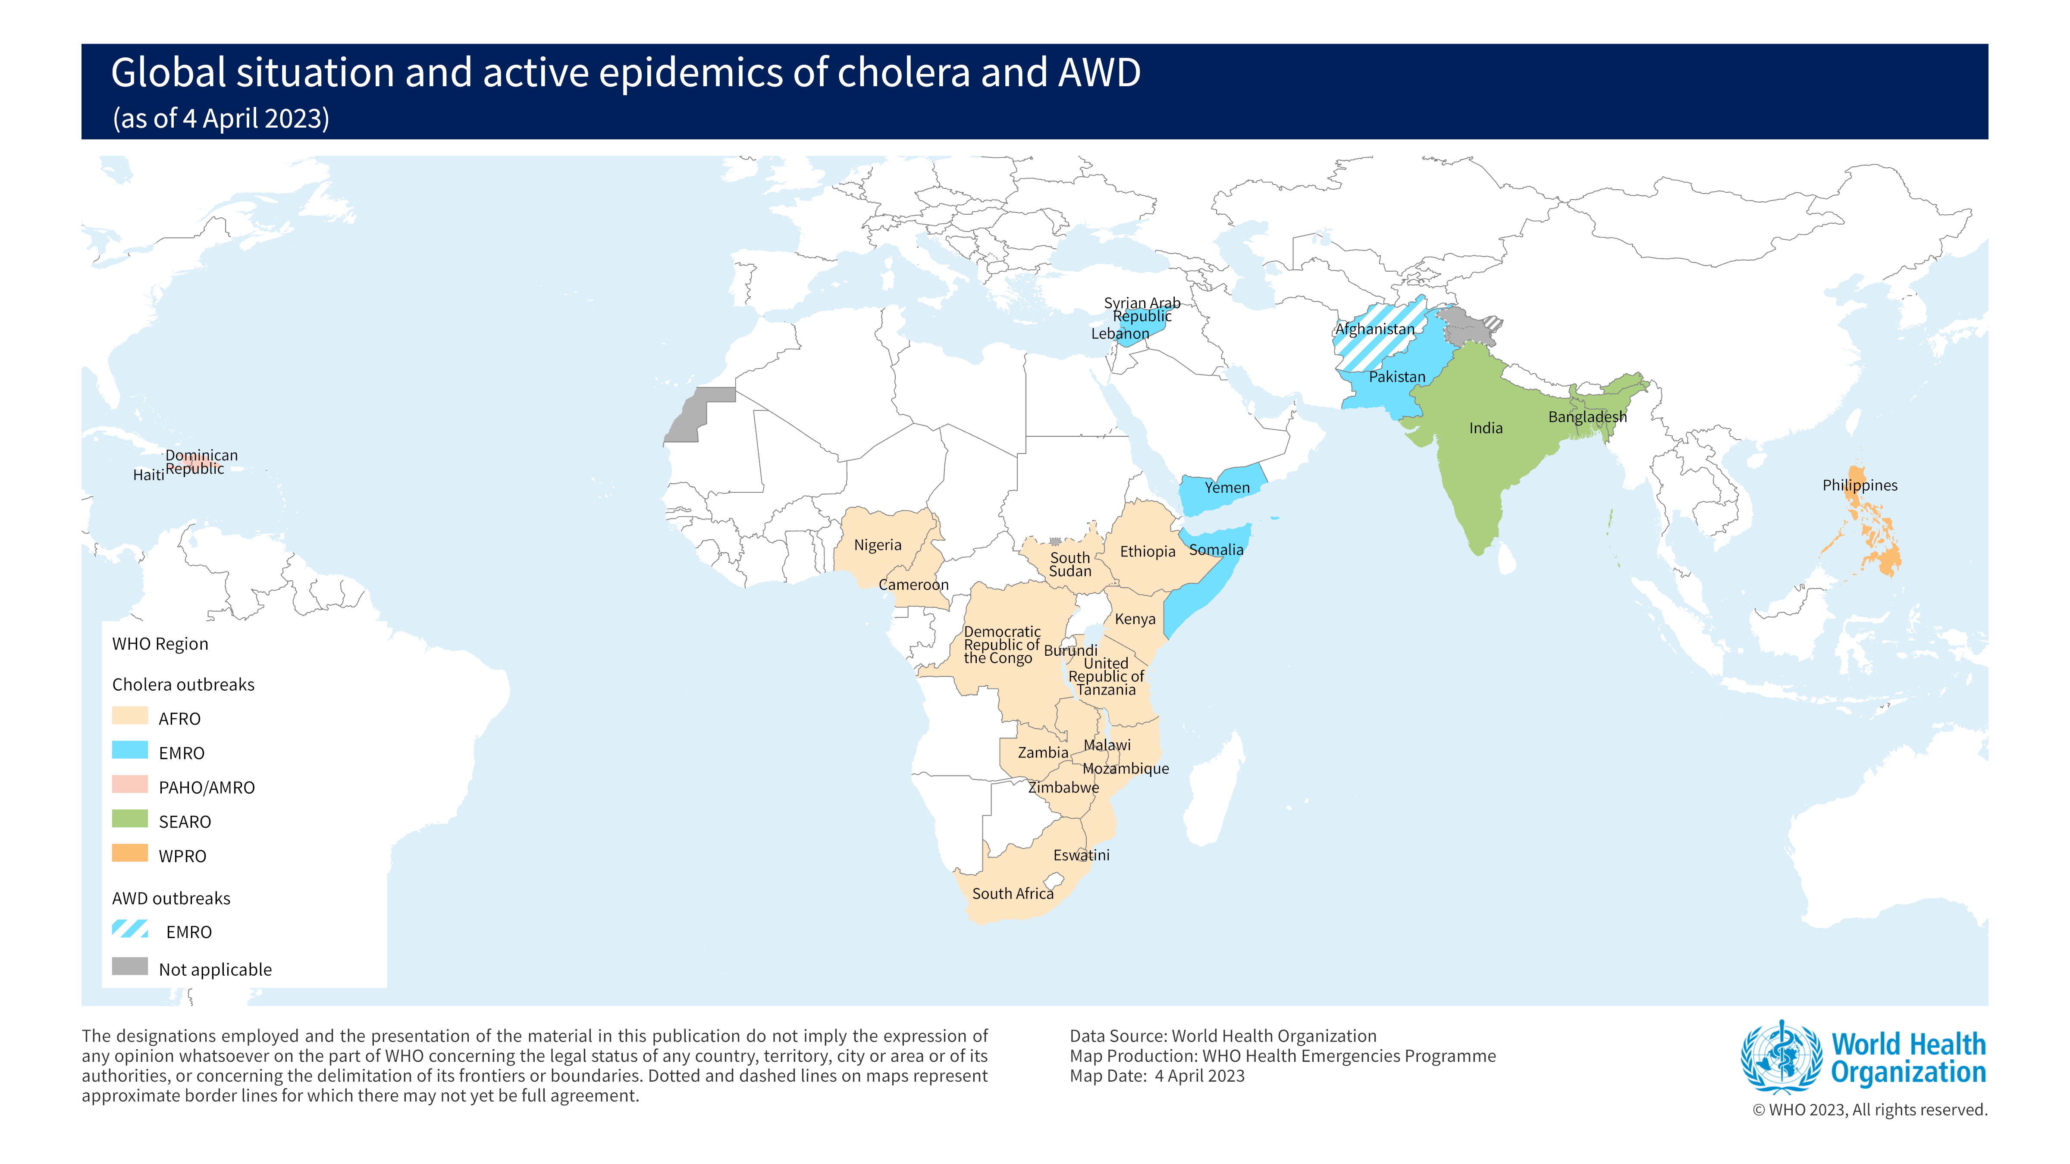
  2023 to date :
    30 countries with cases/outbreak
    2 cross-border outbreak spreads
  Largest outbreaks in years/decade
    Austral Africa
    Indian sub-continent
    Middle East
  Countries re-affected after years/decade
    Lebanon, South Africa

Slide 10

Key elements from the Global Roadmap
Examples of WASH and HEALTH approach strengthen the system to prevent cholera outbreaks
AXIS 1
Early detection and quick
Response to contain outbreak
SURVEILLANCE (epidemiological and environmental) and LABORATORY (case confirmation)
CATI (Case Area Targeted Intervention ): Multisectoral approach (WASH, Health, RCCE, OCV) to cut Cholera transmission at outbreak early stage
CASE MANAGEMENT, IPC AND WASH activities in outbreak response
Bridging emergency and development: use the opportunity of field response (momentum) to start WASH surveys for middle to long term investments.
Preventive Oral Cholera Vaccine (OCV) requests are related to WASH investment in the protocol.
AXIS 2
A targeted prevention strategy
in cholera hotspots
GTFCC Guidelines: Cholera Outbreaks (Case management), Environmental Surveillance…
Cholera Support Platform (CSP): technical and resource support at country level
AXIS 3
GTFCC support and
coordination of human,
technical and financial
resources

Slide 11
Challenges in the cholera response
Current situation (multiple outbreaks) do not give time for middle to long term implementation strategies
Reduced availability of OCV at global level
Lack of evidence-based for innovation and strategies
National Cholera Plan (NCP) systemic approach (including funding)
Cross-border spread of the disease
Community engagement
Bridge between emergency and development (actors, donors)
Climate change (acute events, water resource availability)…

Slide 12


Slide 13
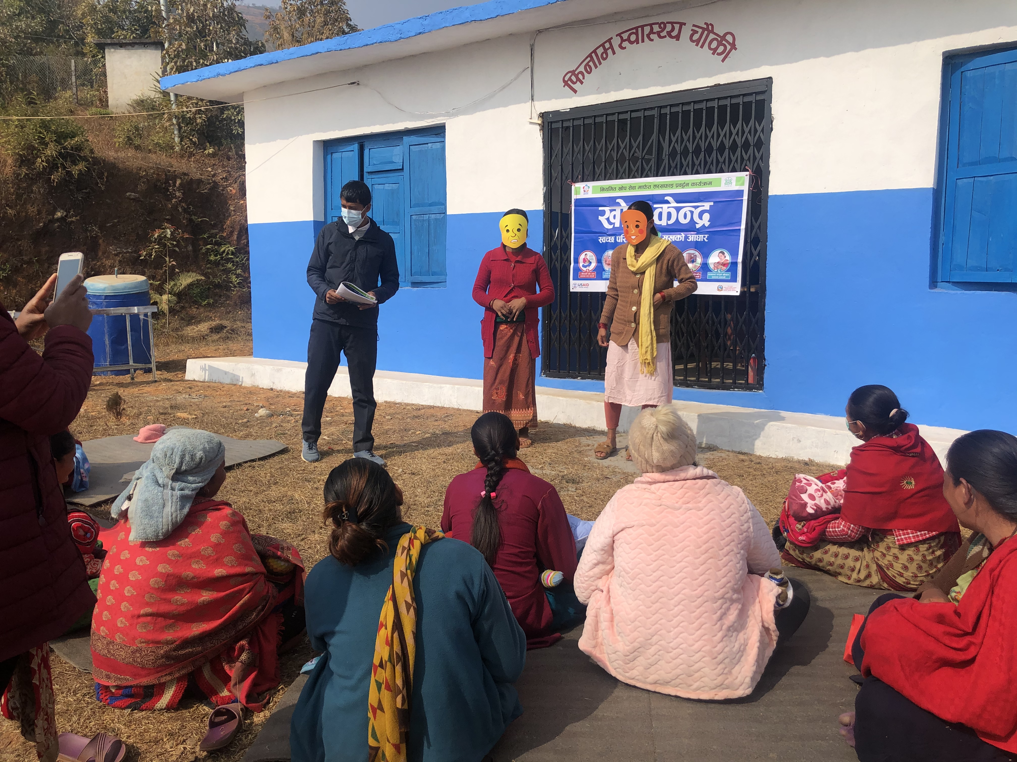

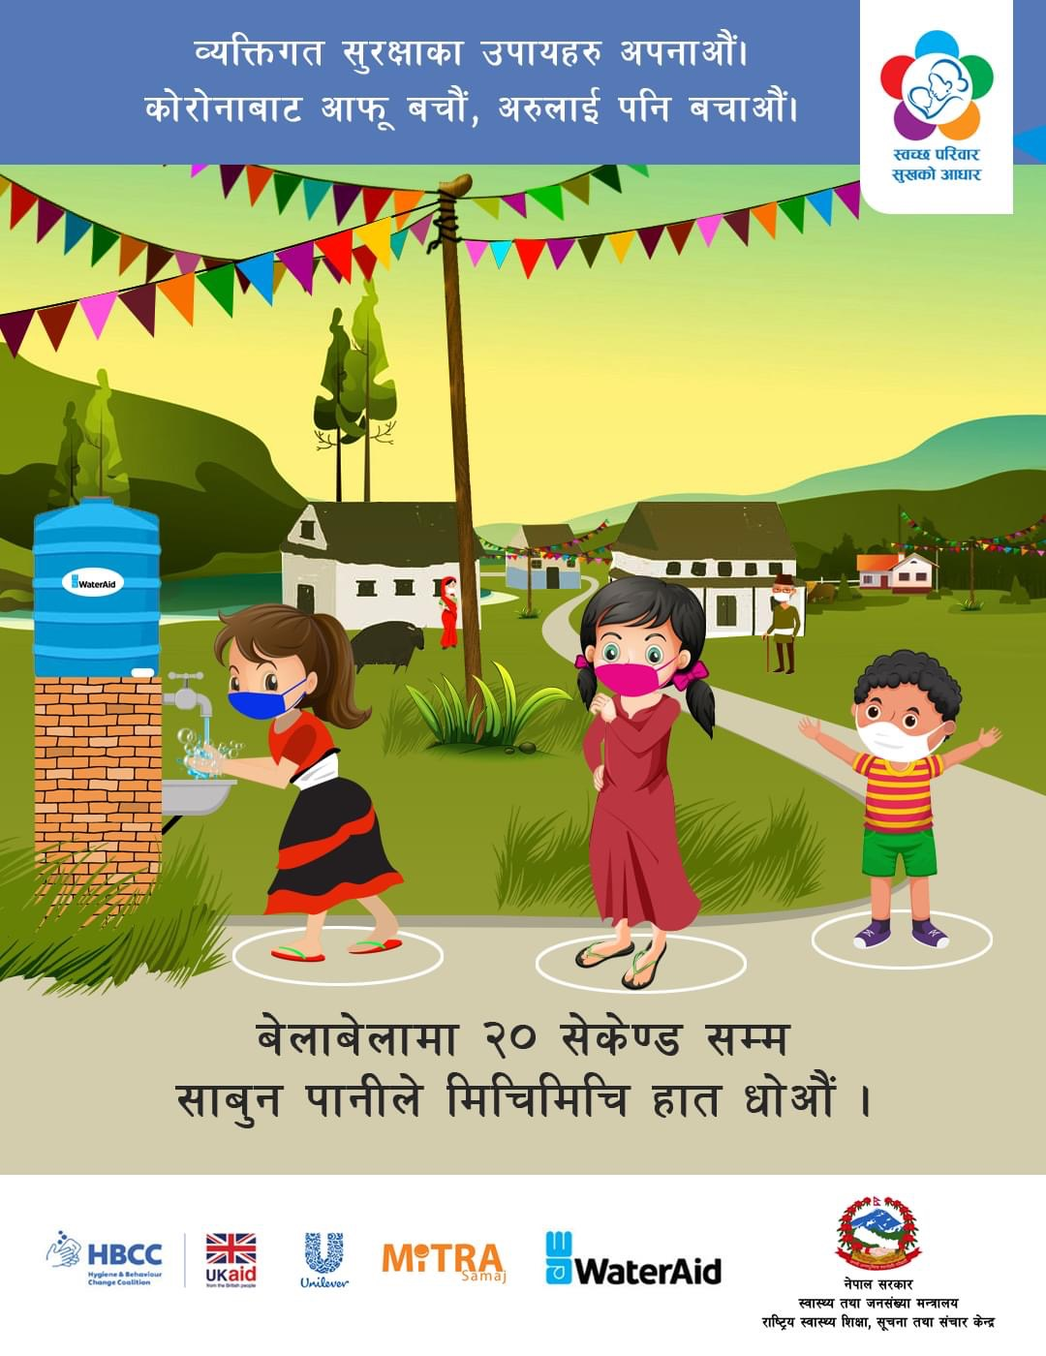
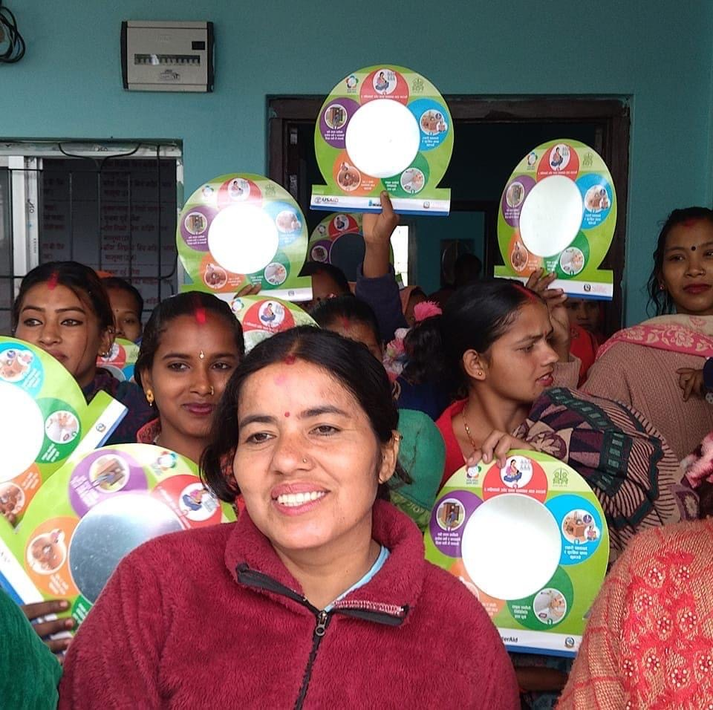

Disease Sensitive Integrated Hygiene Behaviour Change Programme
at Scale
Dr Om Prasad Gautam, PhD, MPH, MA
Senior WASH Manager – Hygiene
(Global Technical Lead)
WaterAid UK
Source: Dr Om Prasad Gautam

Slide 14
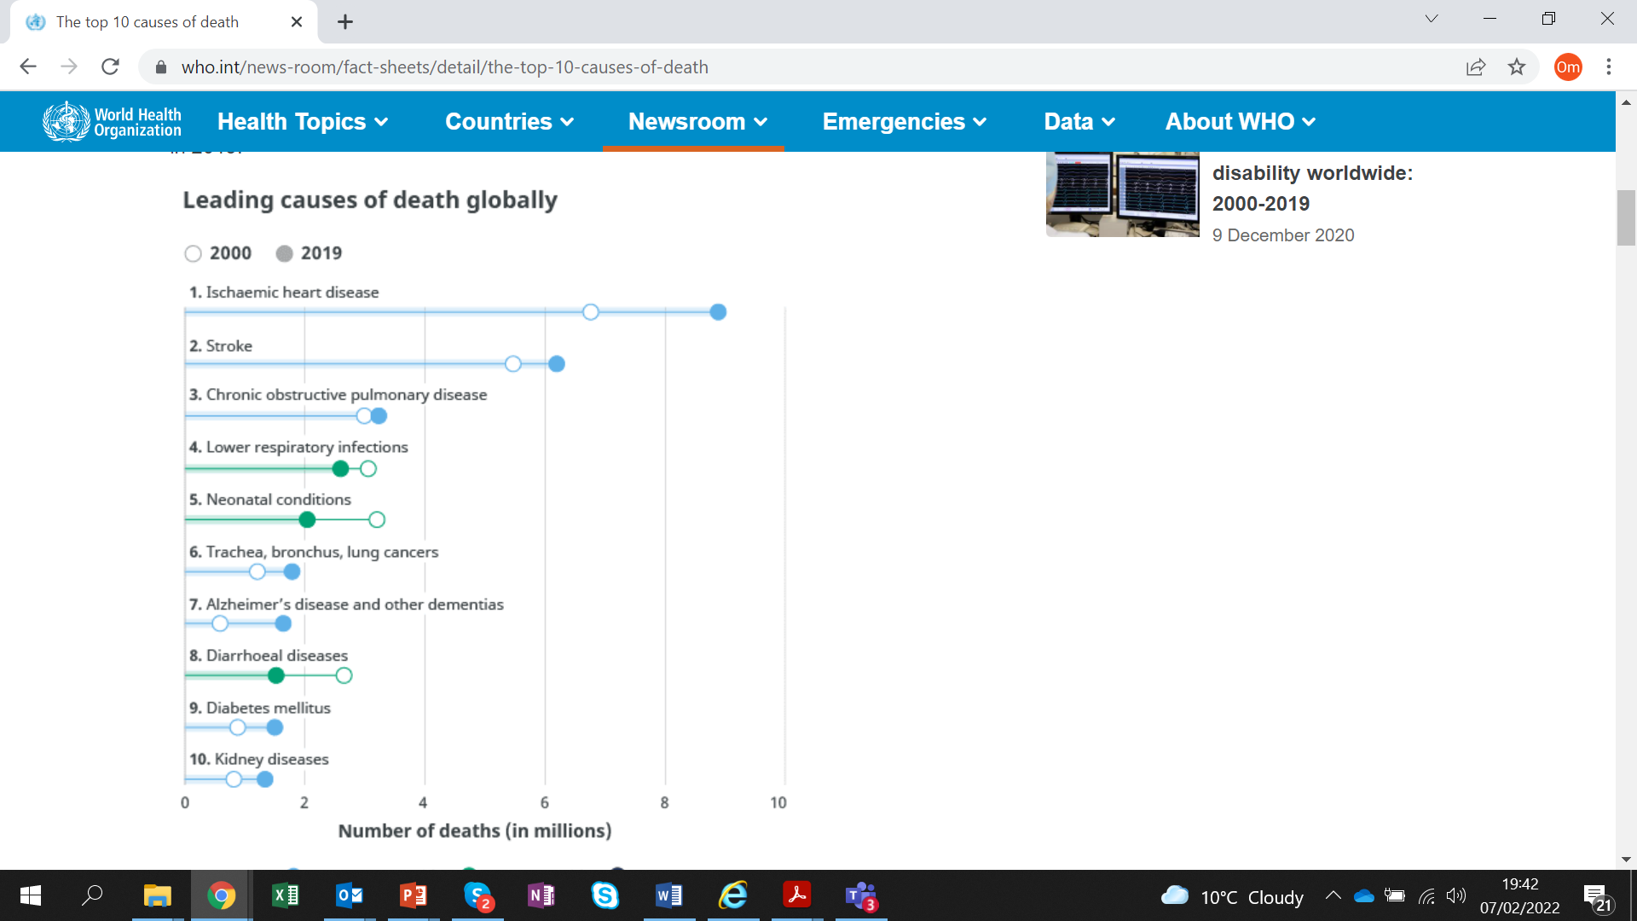
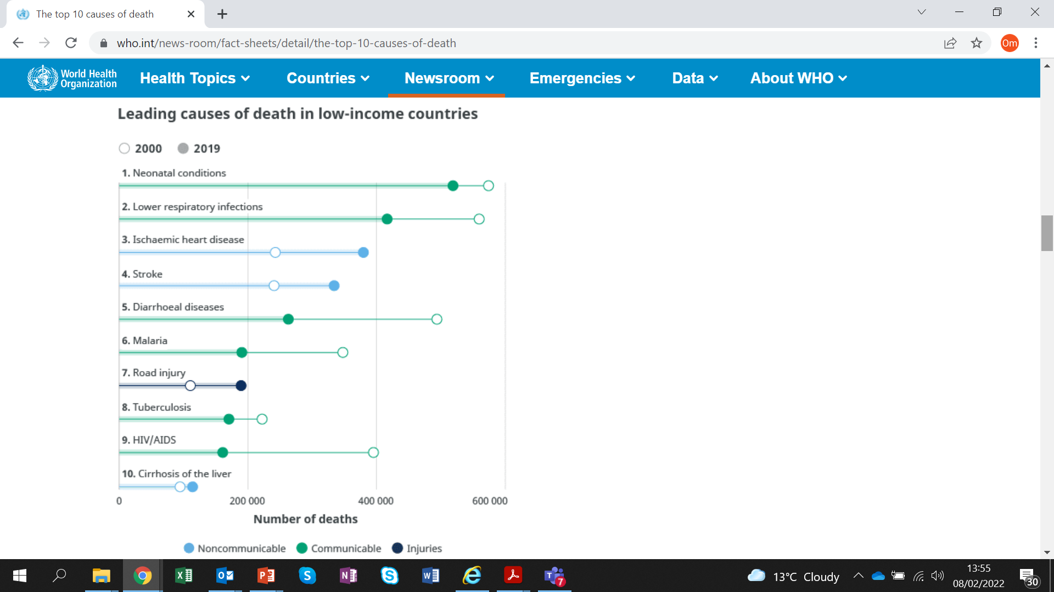
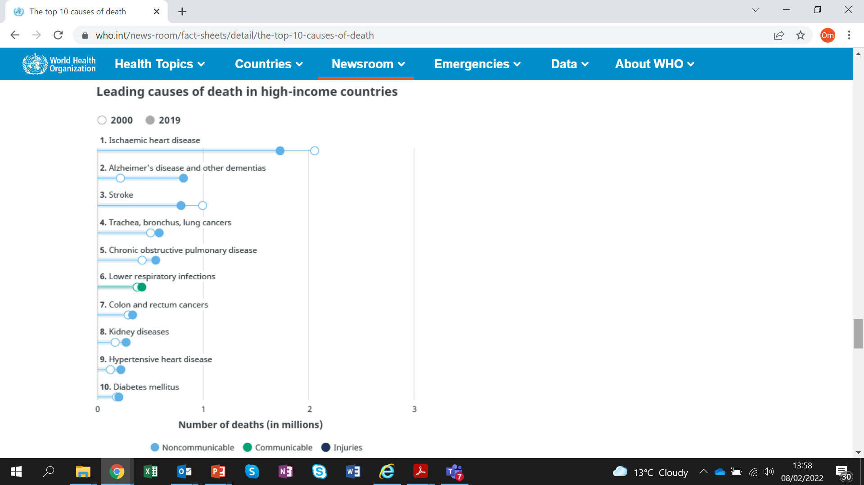
Leading causes of death globally, 2019
https://www.thelancet.com/journals/lancet/issue/vol396no10258
At a global level, 7 of the 10 leading causes of deaths in 2019 were noncommunicable diseases
In low-income countries, 6 of the 10 leading causes of deaths in 2019 were communicable diseases
In high-income countries, 9 of the 10 leading causes of deaths in 2019 were non-communicable diseases
Notes:
https://www.who.int/news-room/fact-sheets/detail/the-top-10-causes-of-death

Slide 15
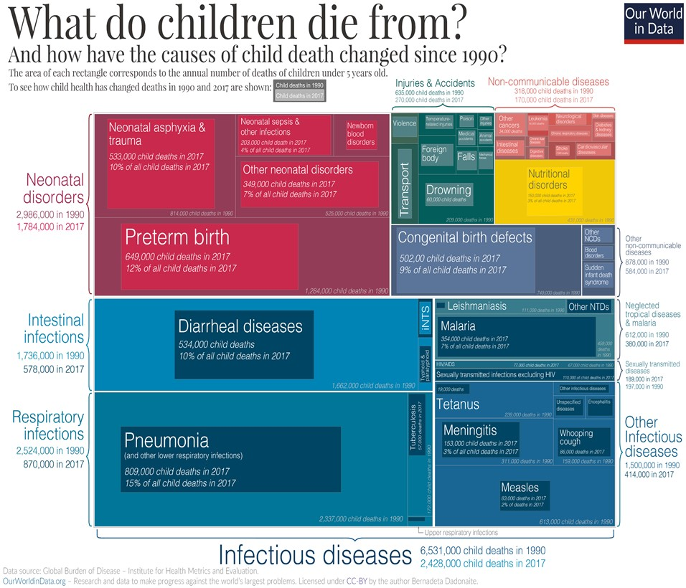
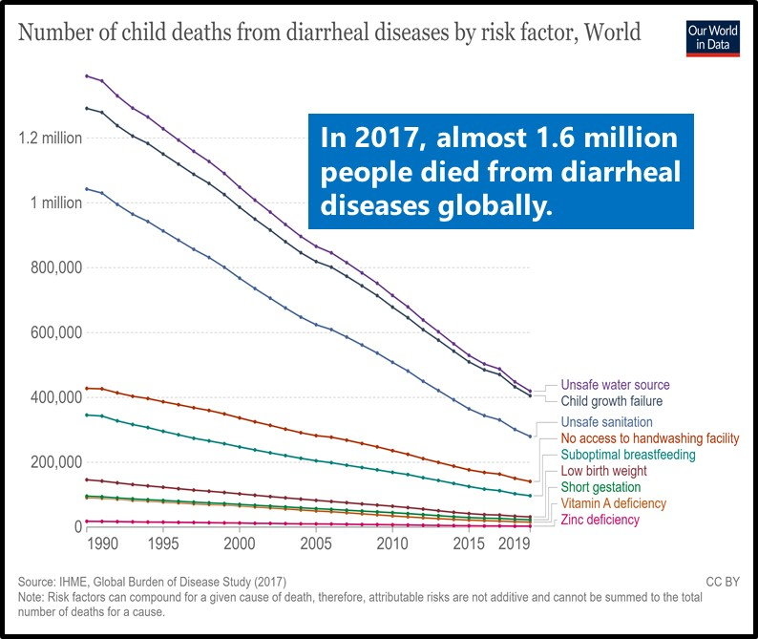
1.6 million people died from diarrhoea and diarrhoeal disease is the second leading cause of death in children under five years old, and was responsible for the deaths of 370,000 children in 2019.
Risk Factors

Slide 16
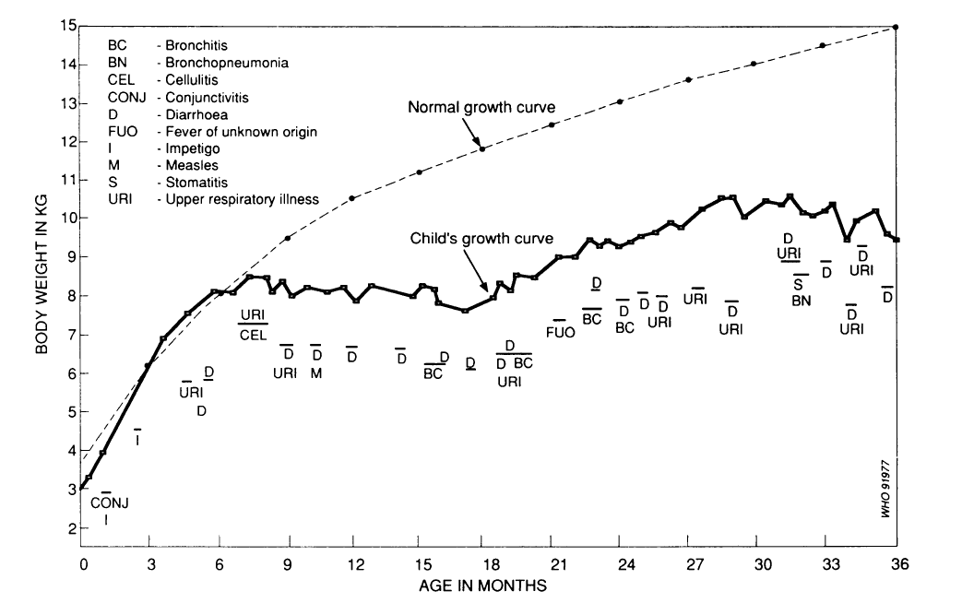
Nutrition: complex determinants & outcomes
25% of stunting is caused by repeated diarrhoea early in life
Growth faltering
Poor WASH
Fecal-oral/soil exposure
Poor nutritional outcomes (stunting)
Helminths
Diarrhoea
EED
  References: Mata, L., Nutrition and infection. Protein Advisory Group bulletin, 1971

Slide 17
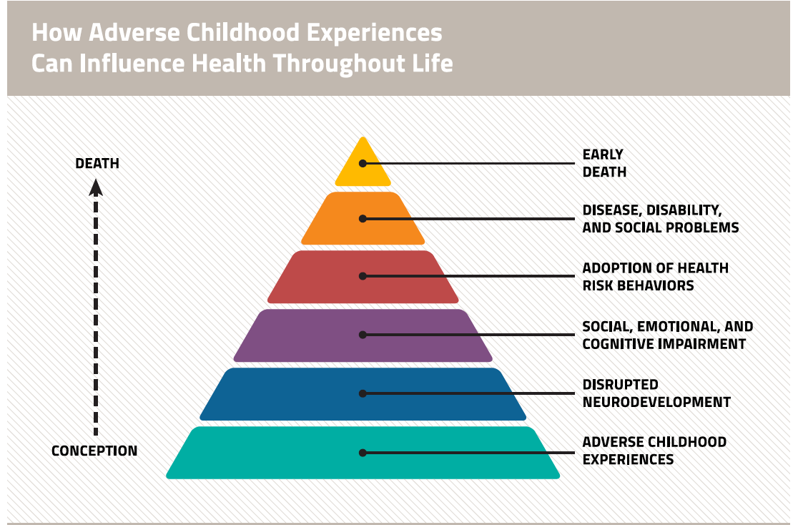
How adverse childhood experiences can in fluence health throughout life

Slide 18
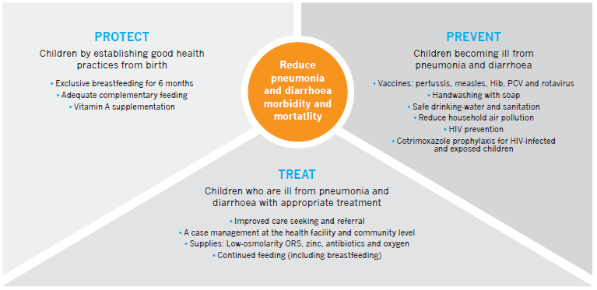
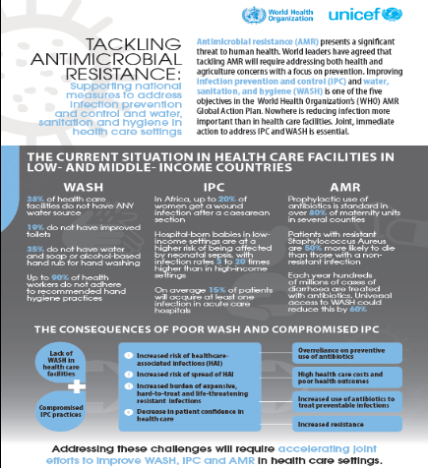
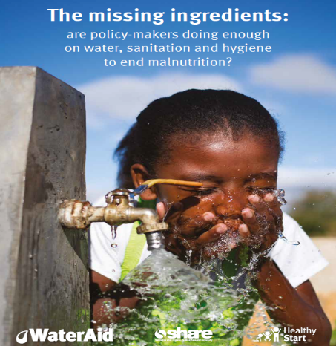
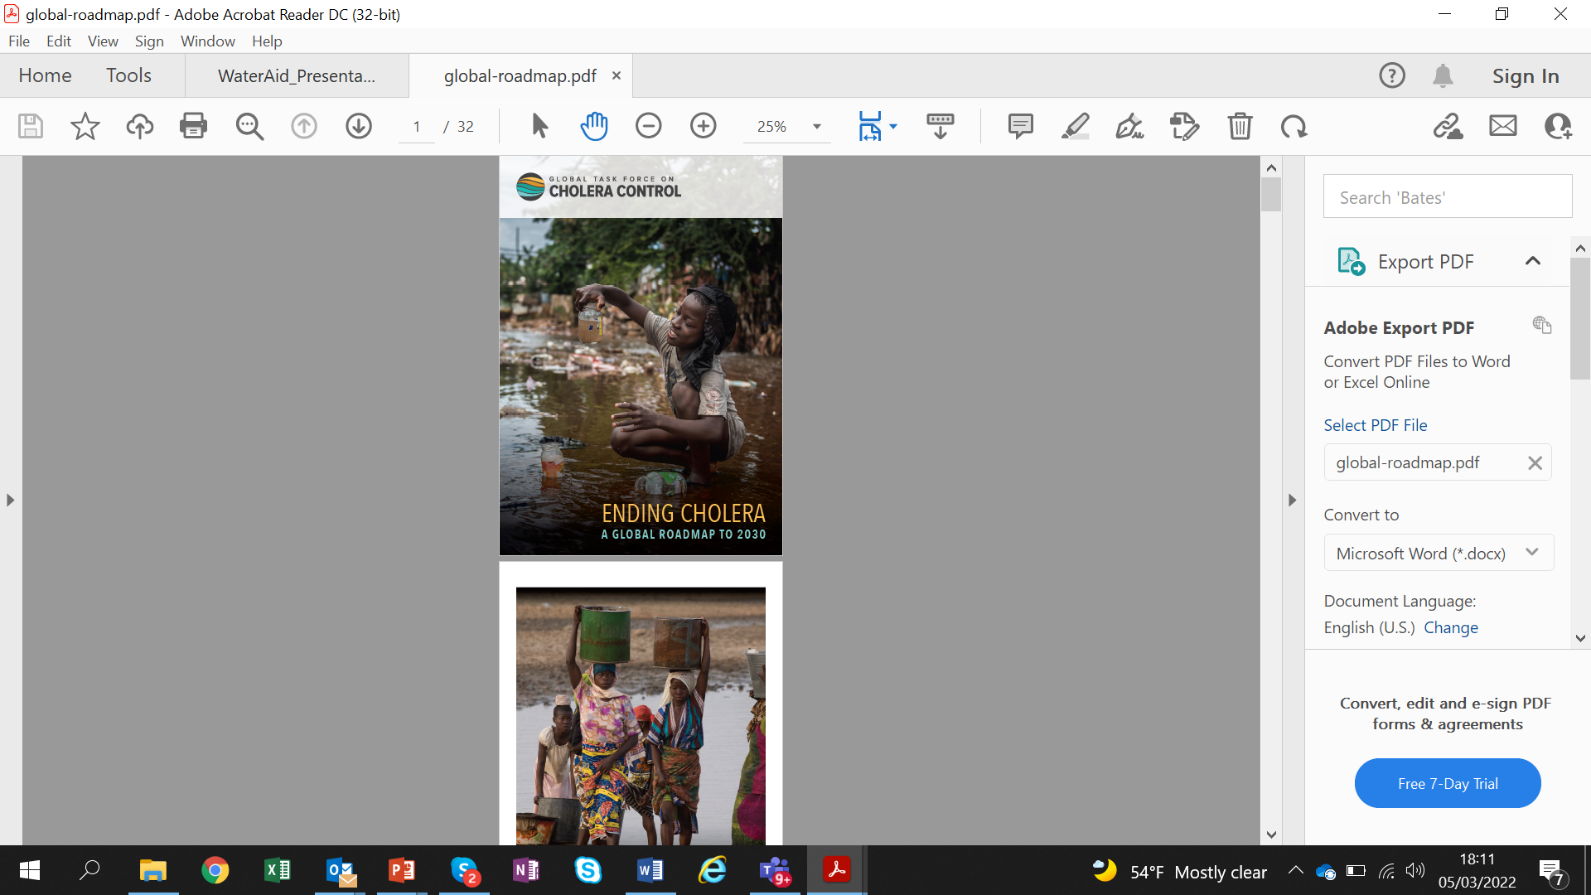
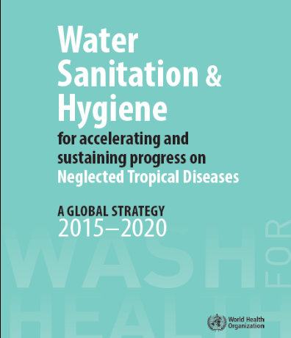
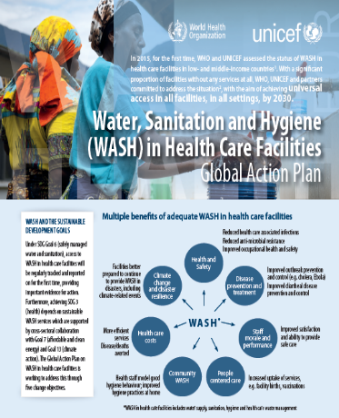
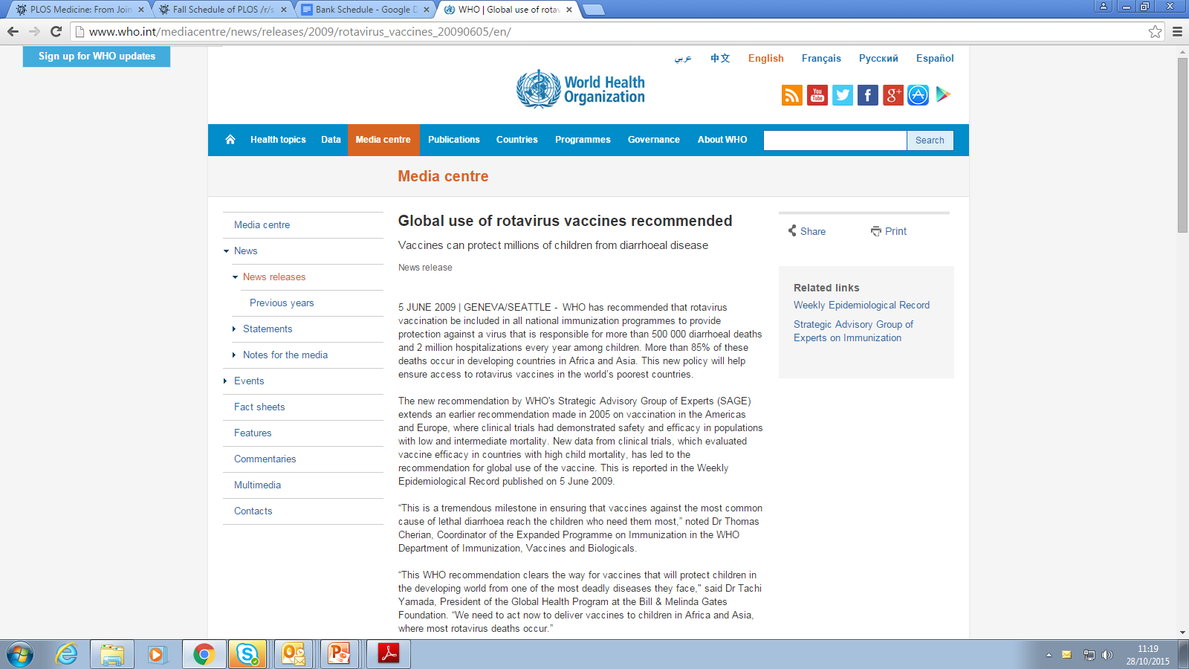
WHO recommends more holistic approach…
WHO Recommends holistic approach o reduce respiratory infections and diarrhoeal diseases - Prevention, Protection and Treatment.
Diseases sensitive behaviours to be targeted to address risk factors.
Right entry points for diseases prevention to be used. Such as vaccination.
Global push for adopting new diarrhoea vaccines such as Rota but is it a ‘Silver bullet’?
Not all vaccines are 100% efficacious!
Healthcare facilities global action plan
Nutrition-sensitive WASH
2030 Cholera Roadmap
WASH and NTDs
Guideline on AMR
Guideline for enteric diseases

Slide 19
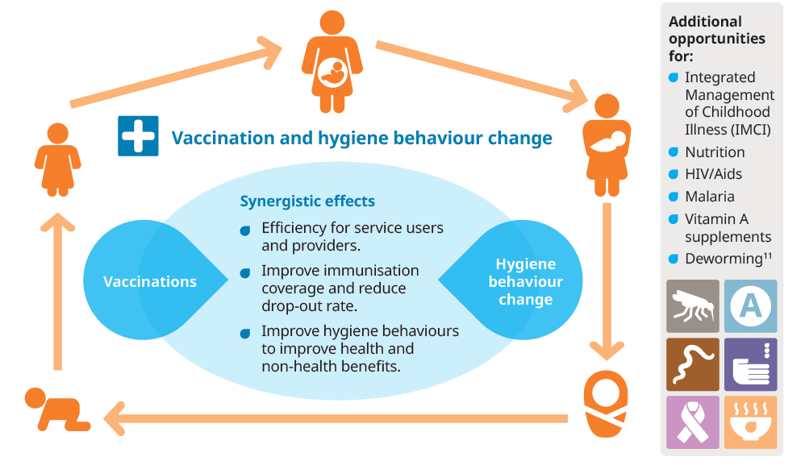
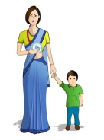
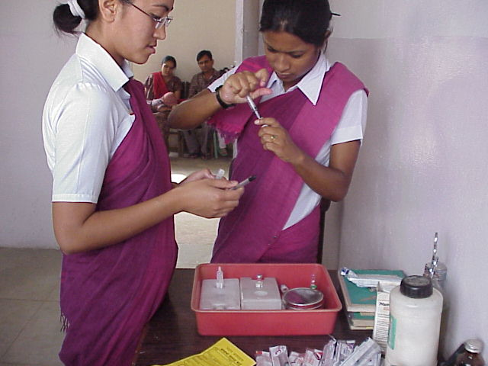
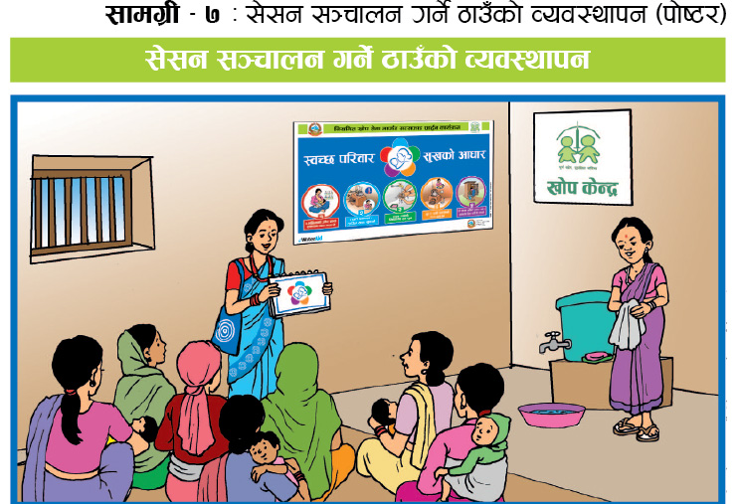
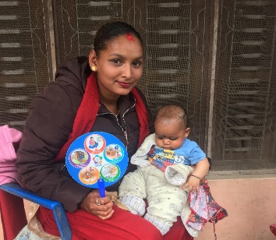
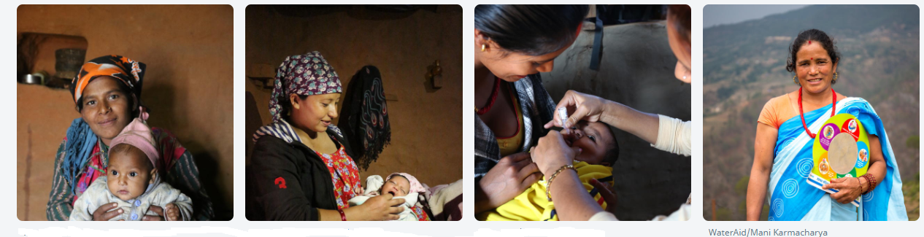
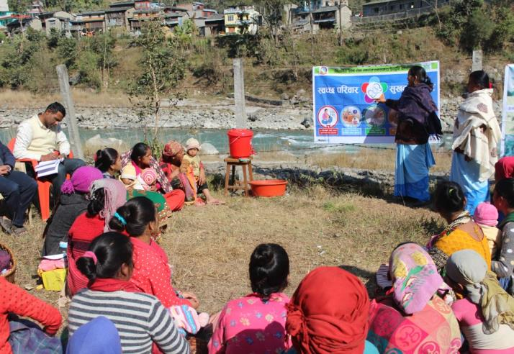
Why hygiene integration into immunization?
For synergistic effects and mutual benefits:
To improve immunization coverage, reduce drop-out and vaccine wastage and improve capacity of health workers.
Improve behaviours and contribute to improve health and non-health benefits
To transform public health programme and strengthen health system.
When to integrate hygiene into routine immunization?
Routine Immunization
Routine Immunization: 5 to 7 times
Hygiene session (30-45min) each time they visit vaccination clinic
BCG
DPT+OPV+Hib1
DPT+OPV+Hib2
DPT+OPV+Hib3
Mother/guardian with children
DPT+OPV+Hib3
MMR+PCV3
JE

Slide 20

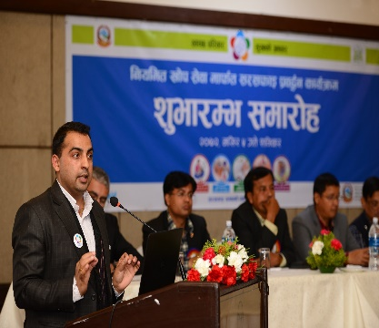
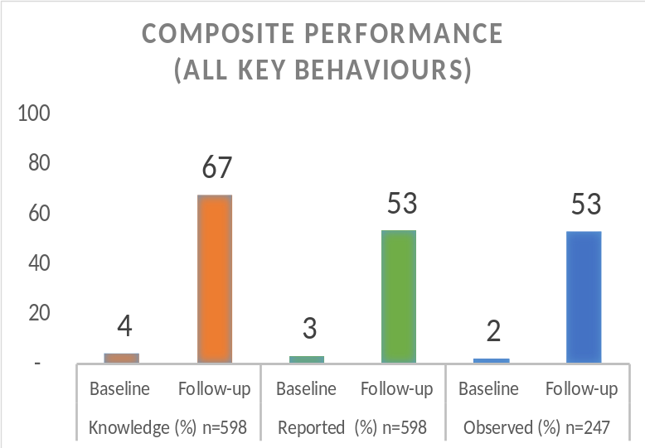
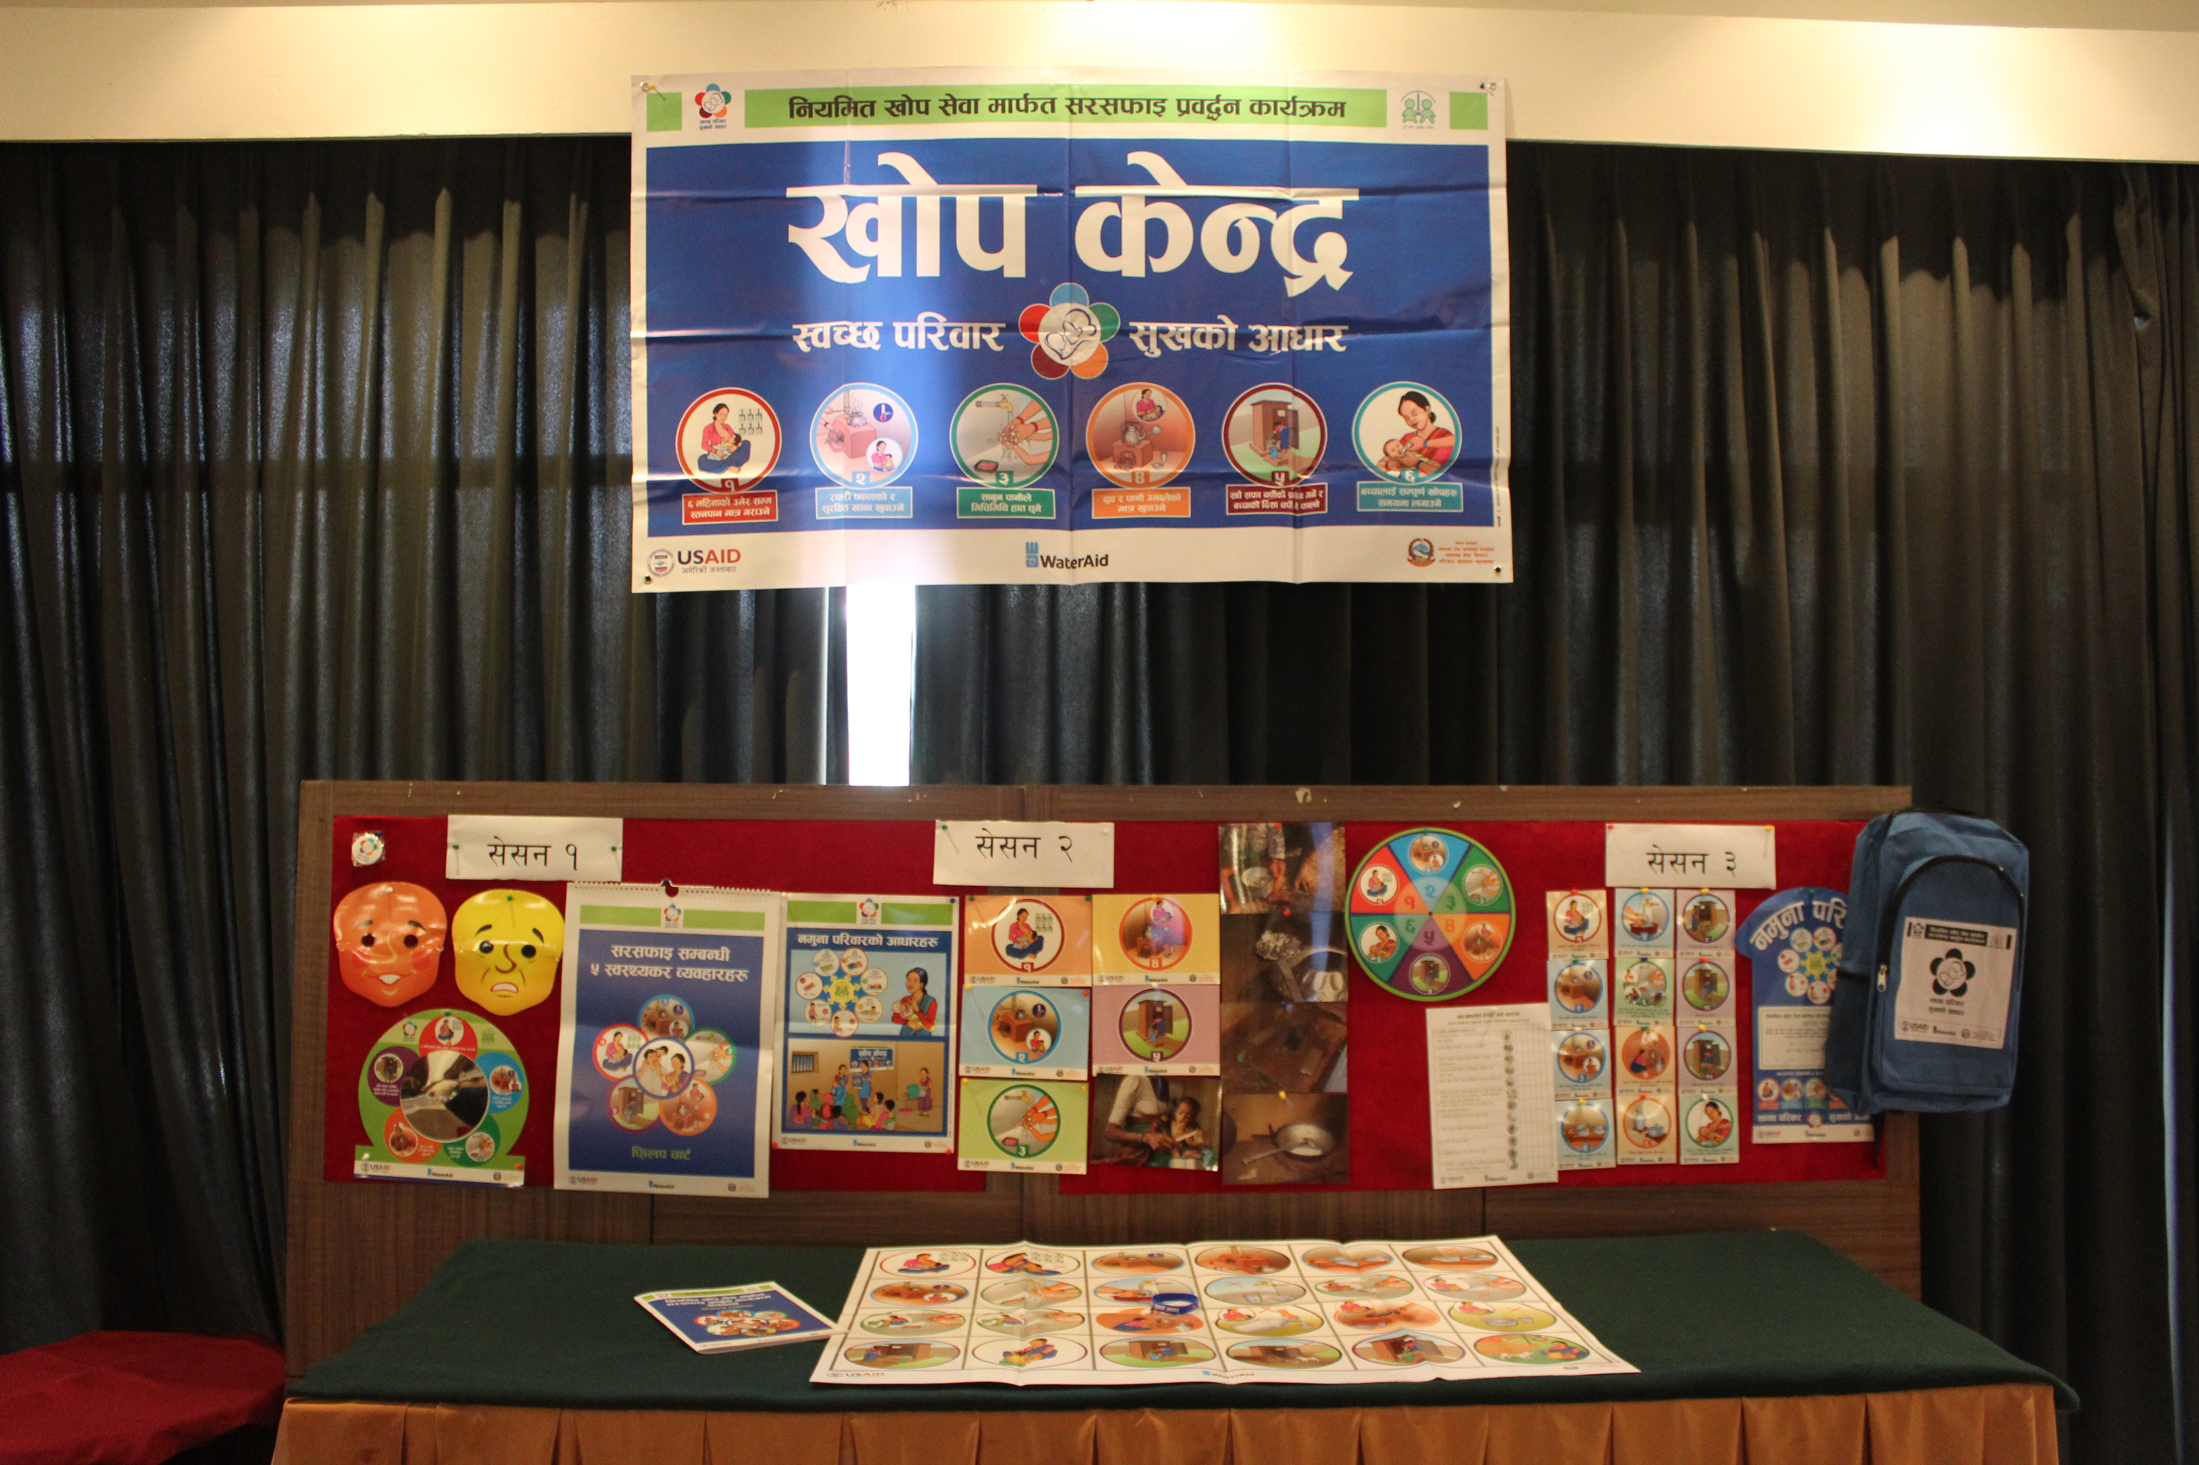
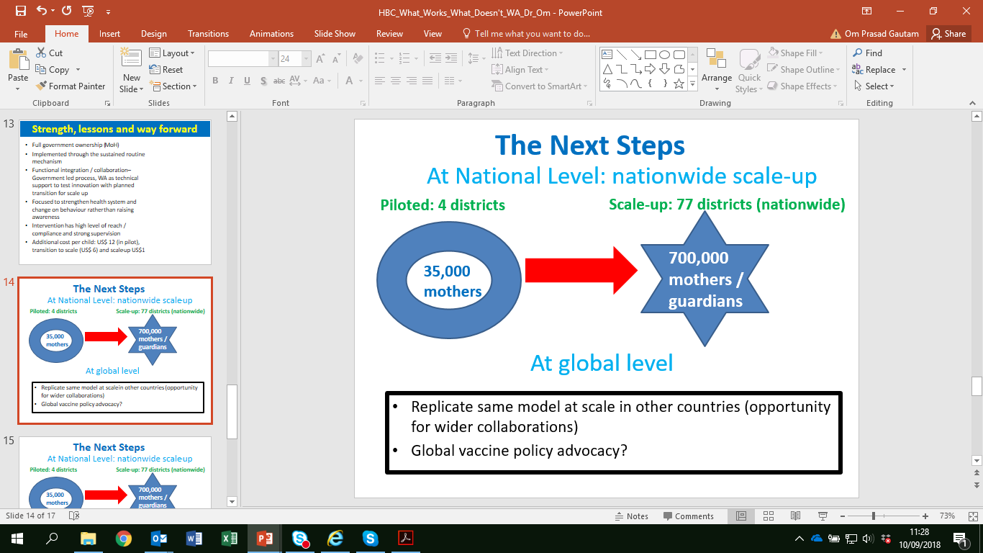
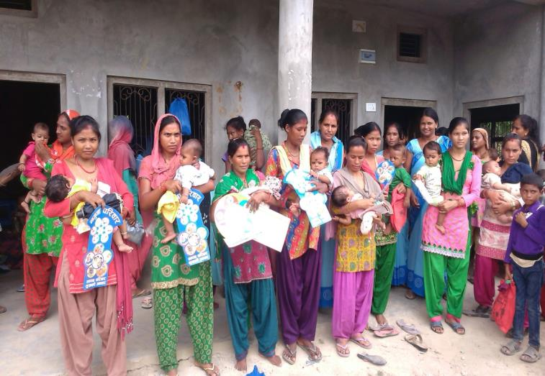
How to integrate with immunization at scale?
Gov of Nepal, Ministry of Health in Partnership with WaterAid piloted (2015) and now scaled-up at national scale ‘hygiene integration into routine immunization programme’ since 2020.
Behaviour Centred Design approach
A
B
C
D
E
Assess – Scoping Study, 2013
Build – Formative research to identify determinants and prioritized diseases sensitive key behaviours 2014.
Create – designed attractive and engaging package for integration and sustainability ‘clean family, happy family campaign’, 2015
Deliver – Piloted in 4 districts through Gov routine system targeting 35,000 guardians, 2015/2016
Evaluate effectiveness – achieved sustained results and demonstrated mutual benefits, 2017
Deliver – Gov continue delivered programme in 4 districts for 4 years. Policy decision to scale-up in 2018, national scale delivery since 2020 reaching >550,000 guardians each year.
D

Slide 21
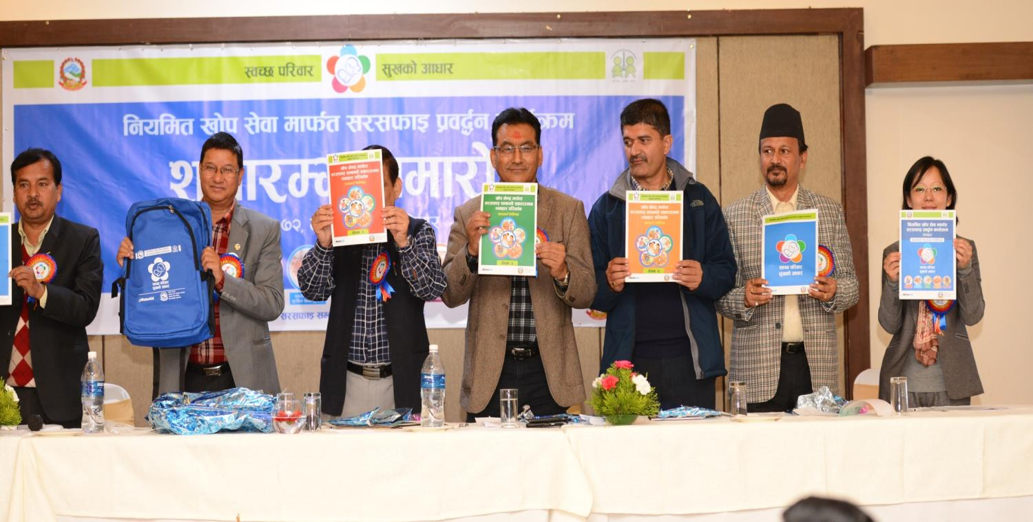
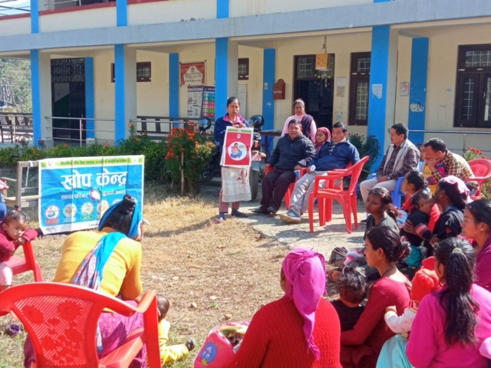
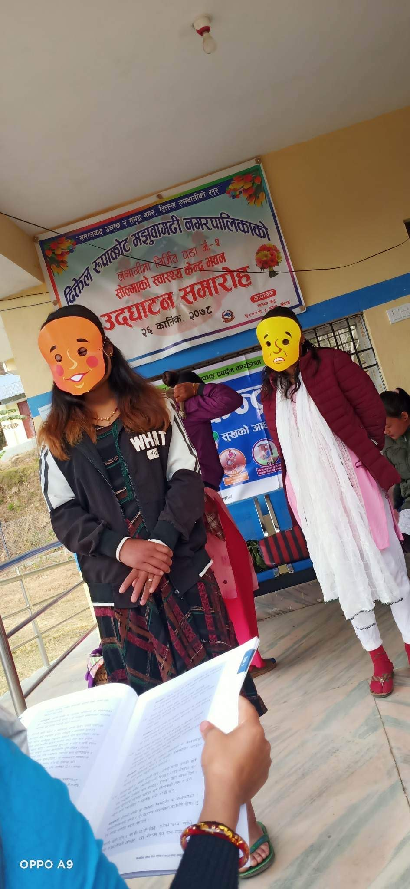
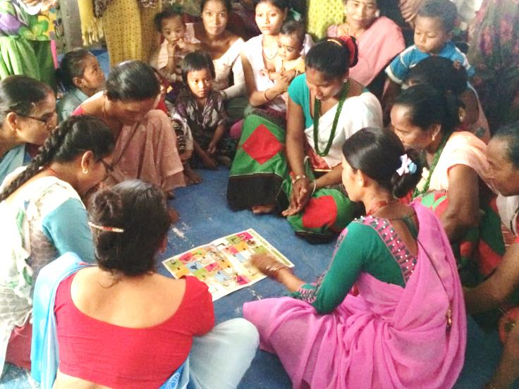
Strength and lessons from
hygiene integration
Lessons:
Integration is feasible and national scale integration is possible.
Immunisation: unique opportunity for hygiene integration
Hygiene integration strengthen health system: improves behaviour, immunization coverage, reduce drop-out, vaccine wastage and improves capacity of health workers
Additional cost per child: US$ 8 (in pilot), transition to scale (US$4) and scale-up US$1.75
Donor funding for enteric vaccines such as rotavirus, cholera and typhoid should use as opportunity and routine immunization shouldn’t be missed opportunity.
Strength for success and sustainability at scale:
Full government ownership (MoH) and right technical support (WA) to test innovation with
planned transition for scale up.
Implemented through the sustained routine mechanism
Focused to strengthen health system and change on behaviour
Used behaviour centred design approaches and novel intervention (attractive package).
Intervention has high level of reach / compliance and strong supervision
Support from multiple partners: Gov-leadership, WaterAid-technical, USAID-funding (lately) and UN Orgs.

Slide 22
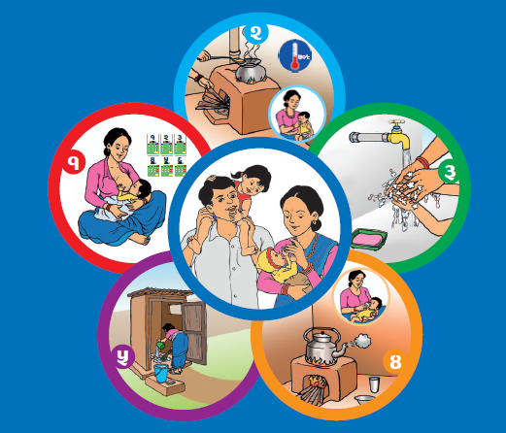
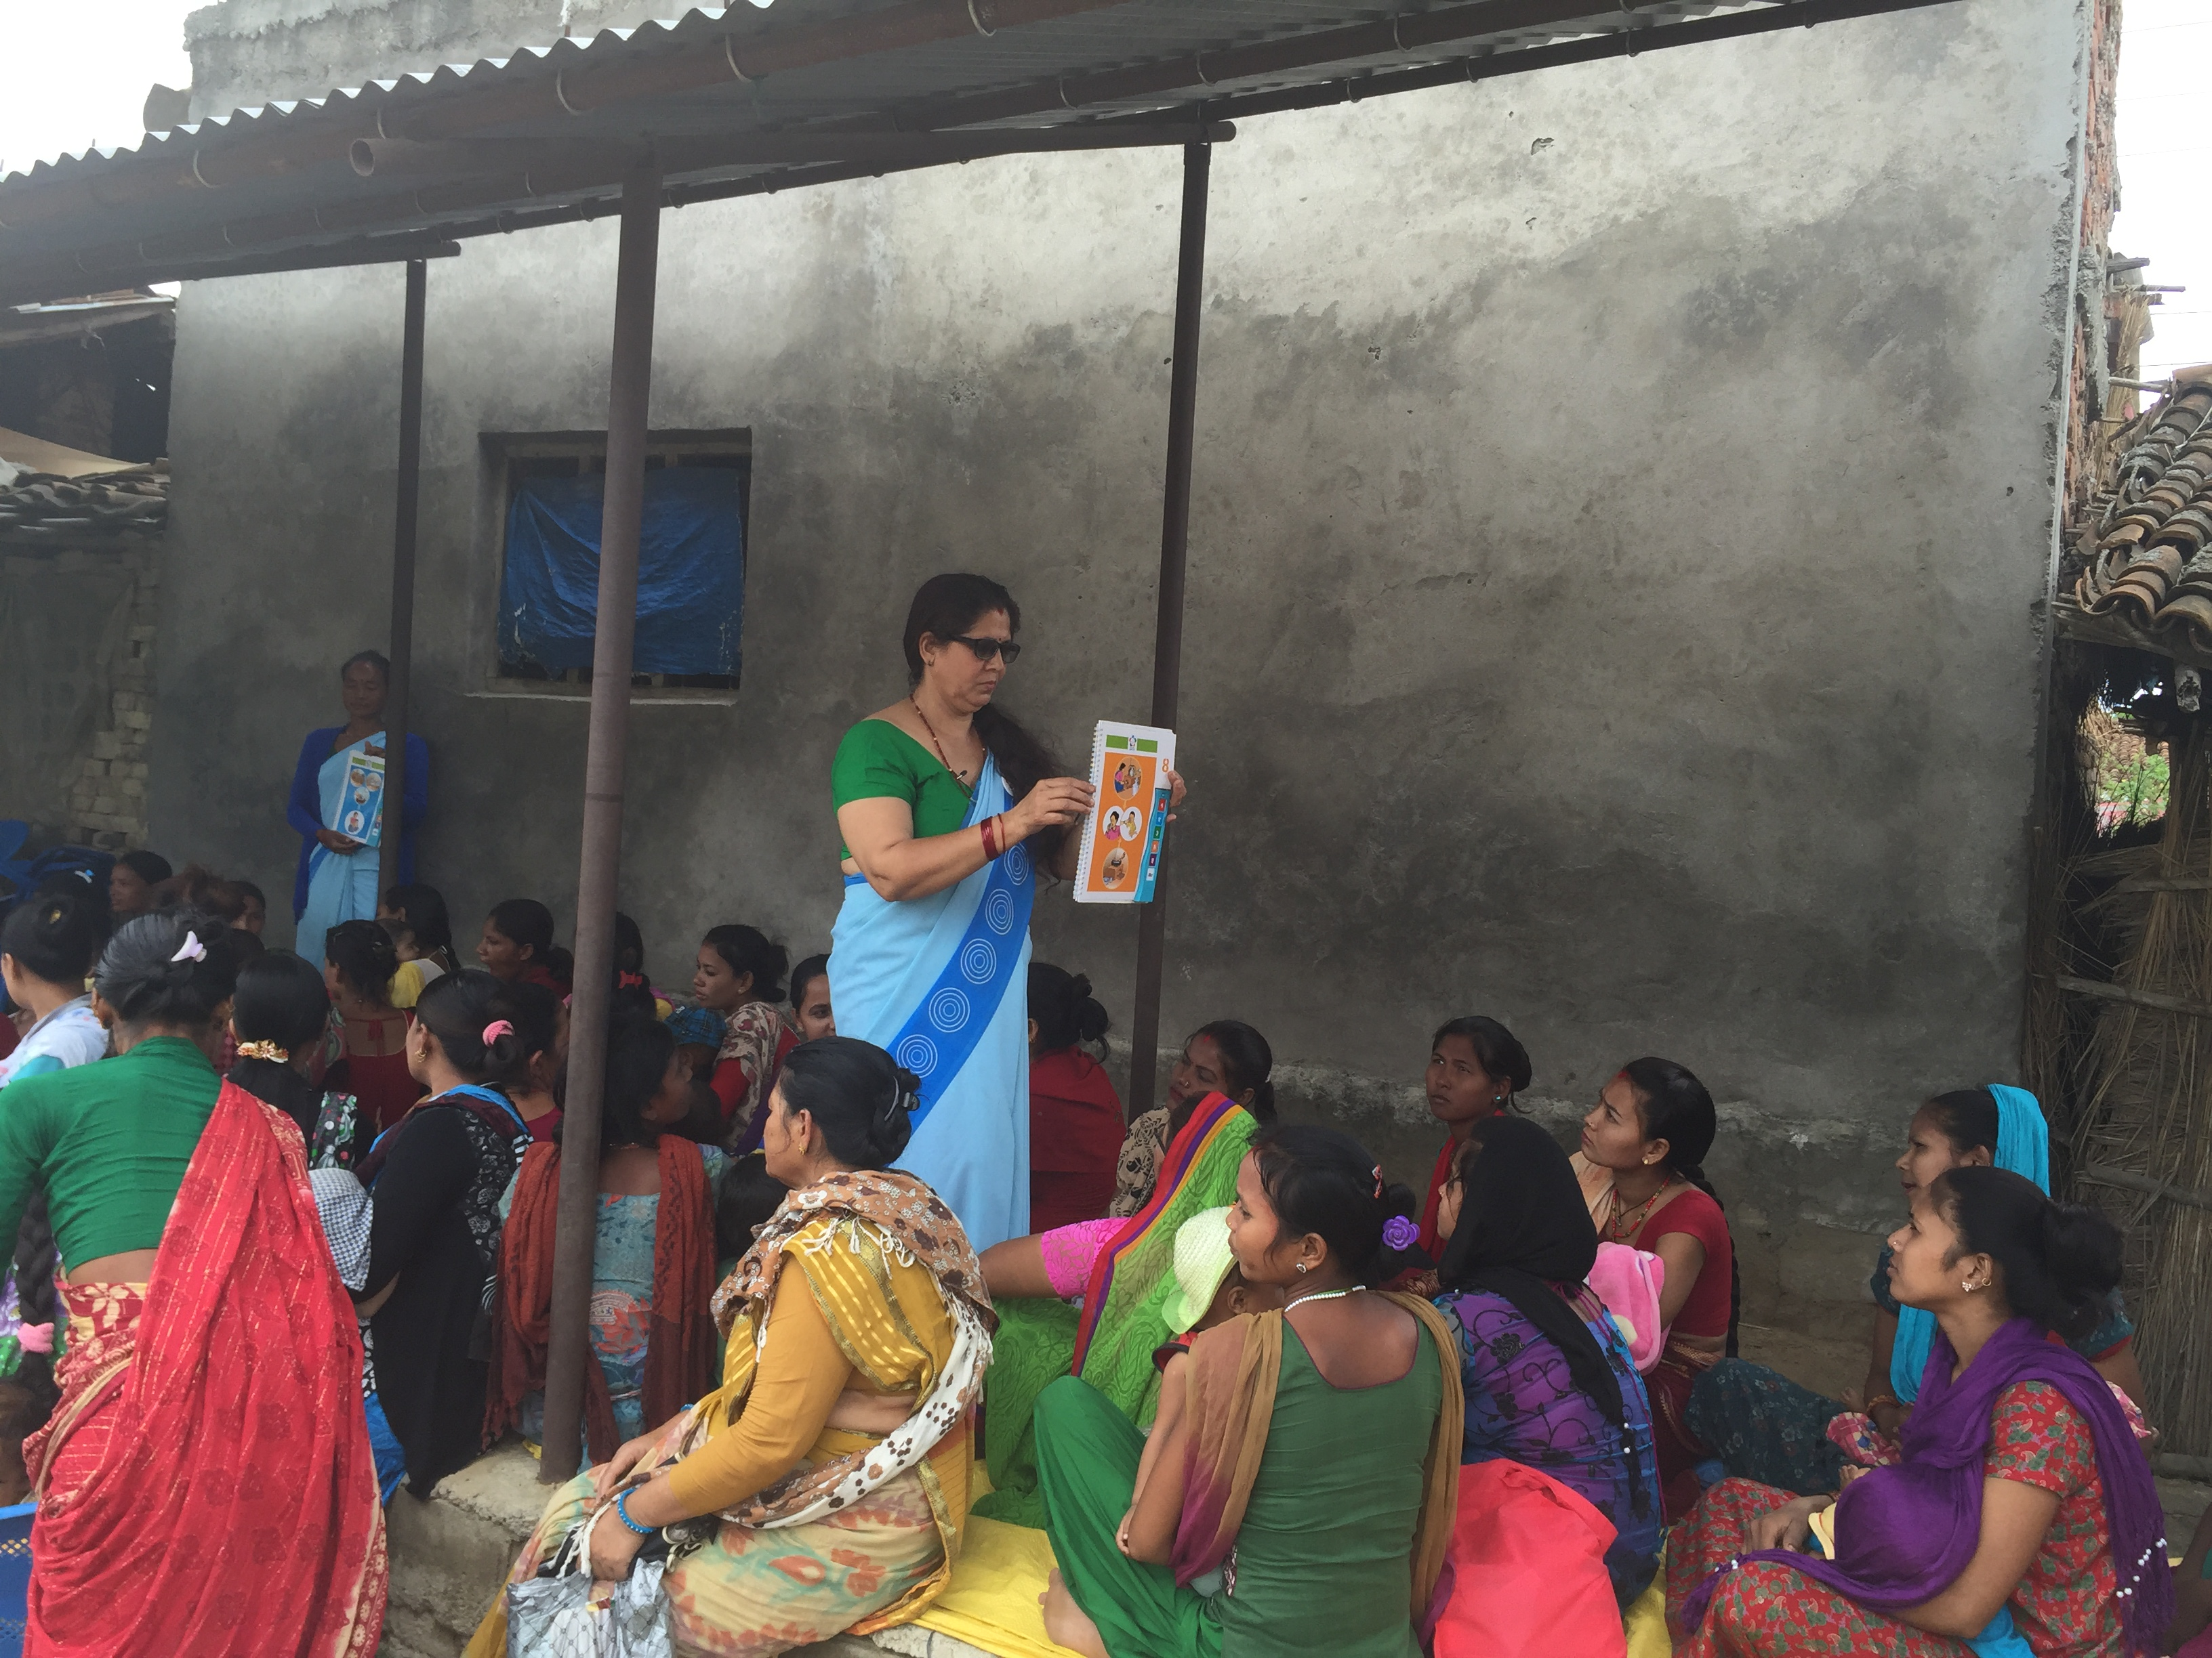
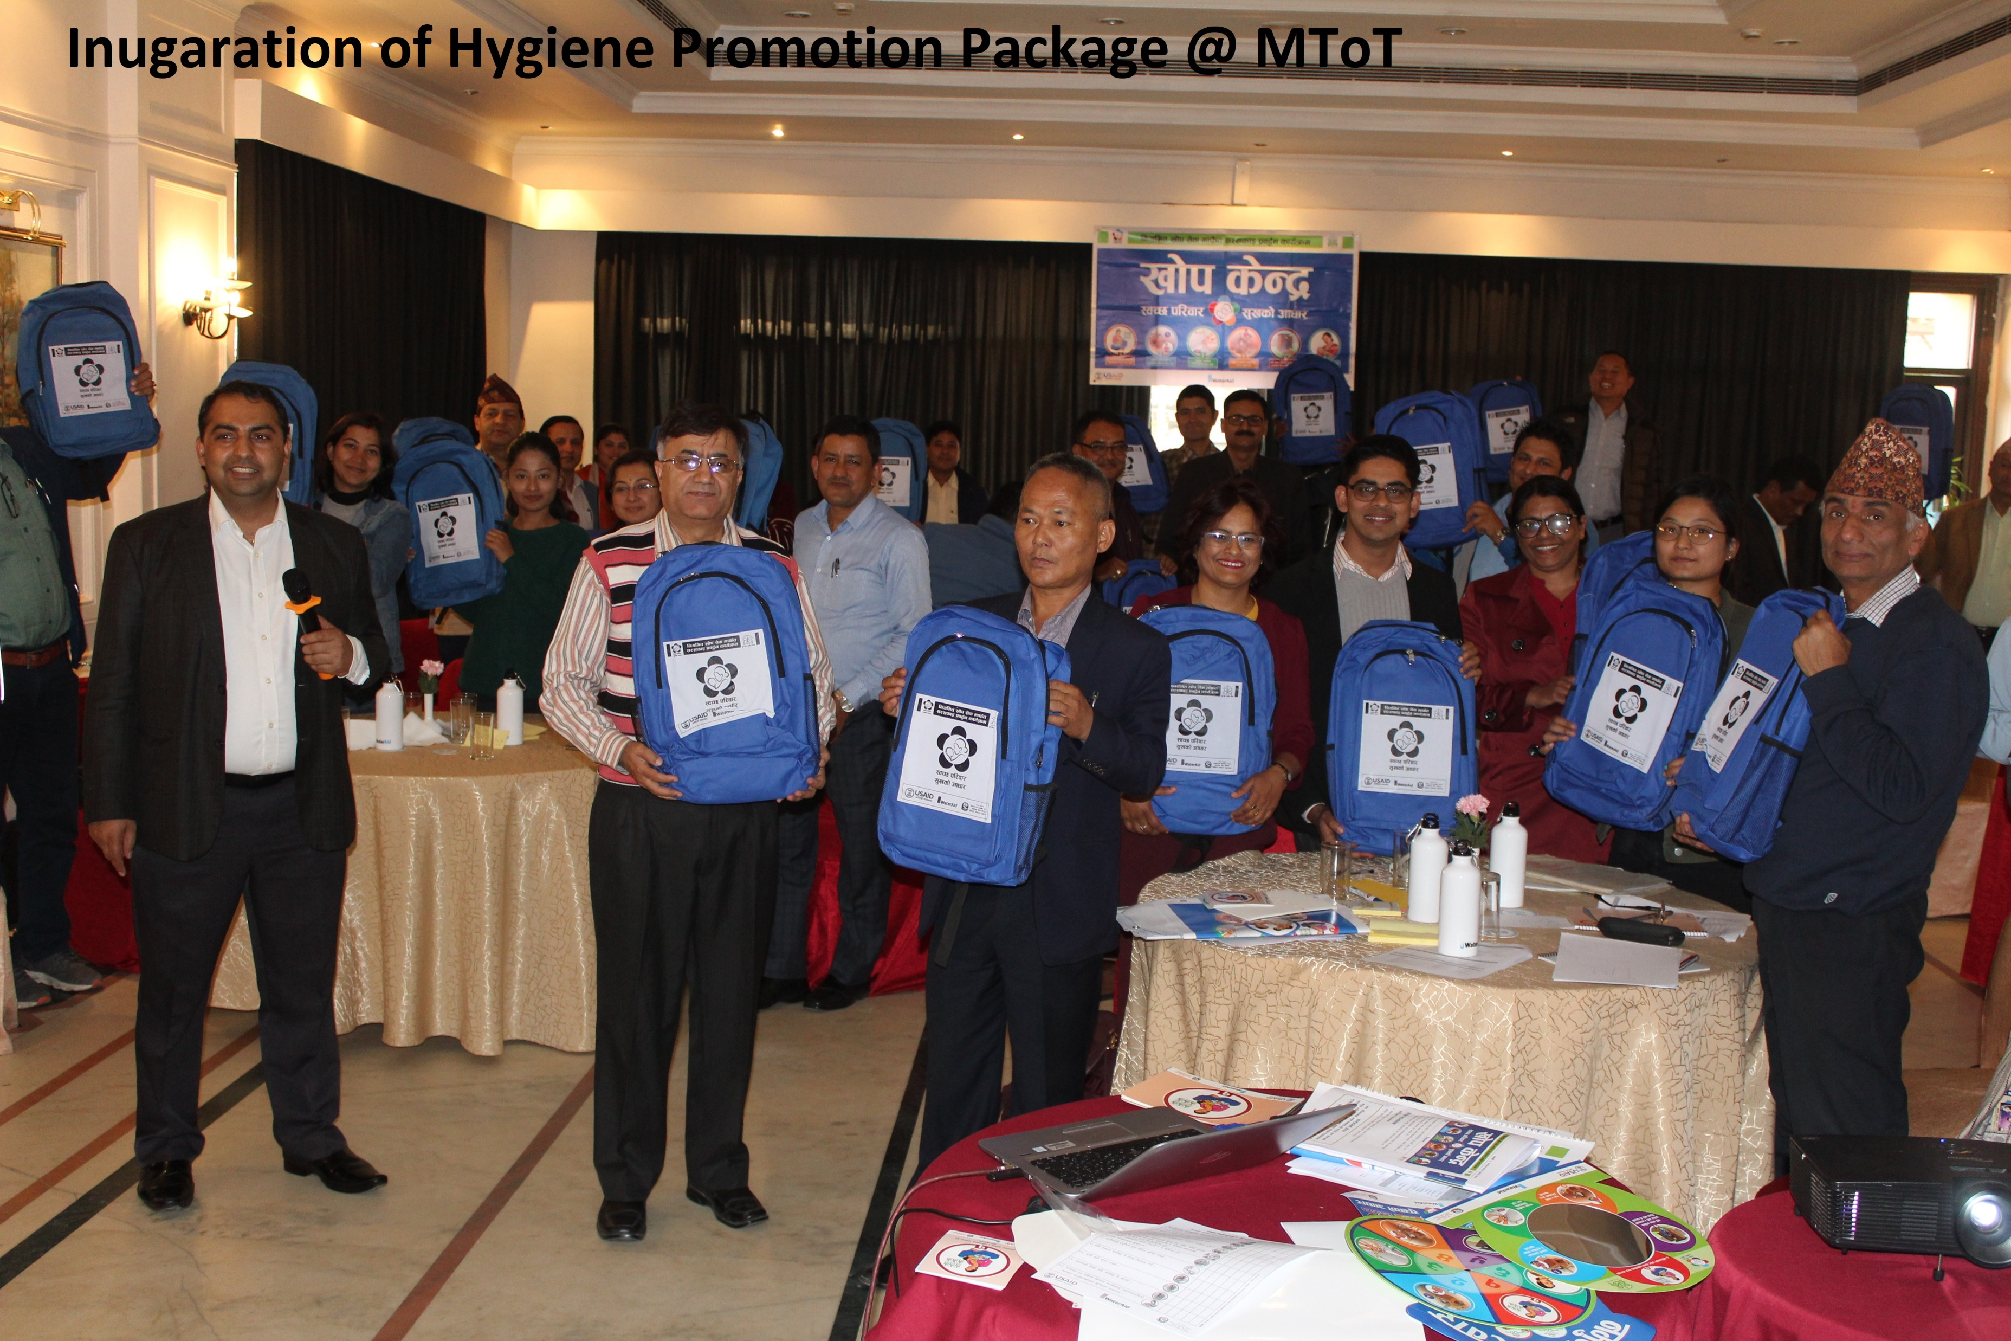
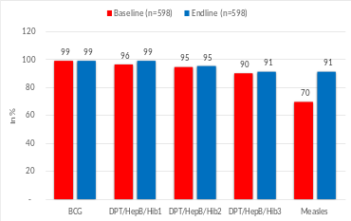
Five key learnings from diseases sensitive integrated HBC programmes
Science and diseases sensitive HBC campaign
Integrated programme must demonstrate mutual benefits and strengthen system.
Higher reach and exposure using routine delivery mechanism
Focus on inclusivity and sustainability
Coordination, and Government leadership
Target disease sensitive behaviours, application of science based proven approach (such as BCD) to inform programmes. FR and creative process is must, emotional (using motives), attractive and context specific intervention design.
Feasibility of integration should be proven and integrated programme must demonstrate mutual benefits. It should also transform health system (vice versa) such as building capacity, deepening coordination, leveraging financing and monitoring.
Higher reach with repeated frequency is must. The delivery modality should be using the existing health programme delivery modality through the same health workers / volunteers. Fedality has to be maintaied. Cost effective.
Be intentional to use E&I framework since start. The package has to be in the local languages. Integration leads for greater sustainability. The promotion should focus on behaviour change rather than knowledge improvement.
Gov leadership is vital for large scale integrated HBC programme / campaigns. Cross-sectoral coordination is vital. Government should make policy decisions for scale integration. Technical support from relevant WASH partner is must.
Notes:
Summarise 4 key lessons. Use icons/ infographics to display these where possible and keep text to a minimum

Slide 23
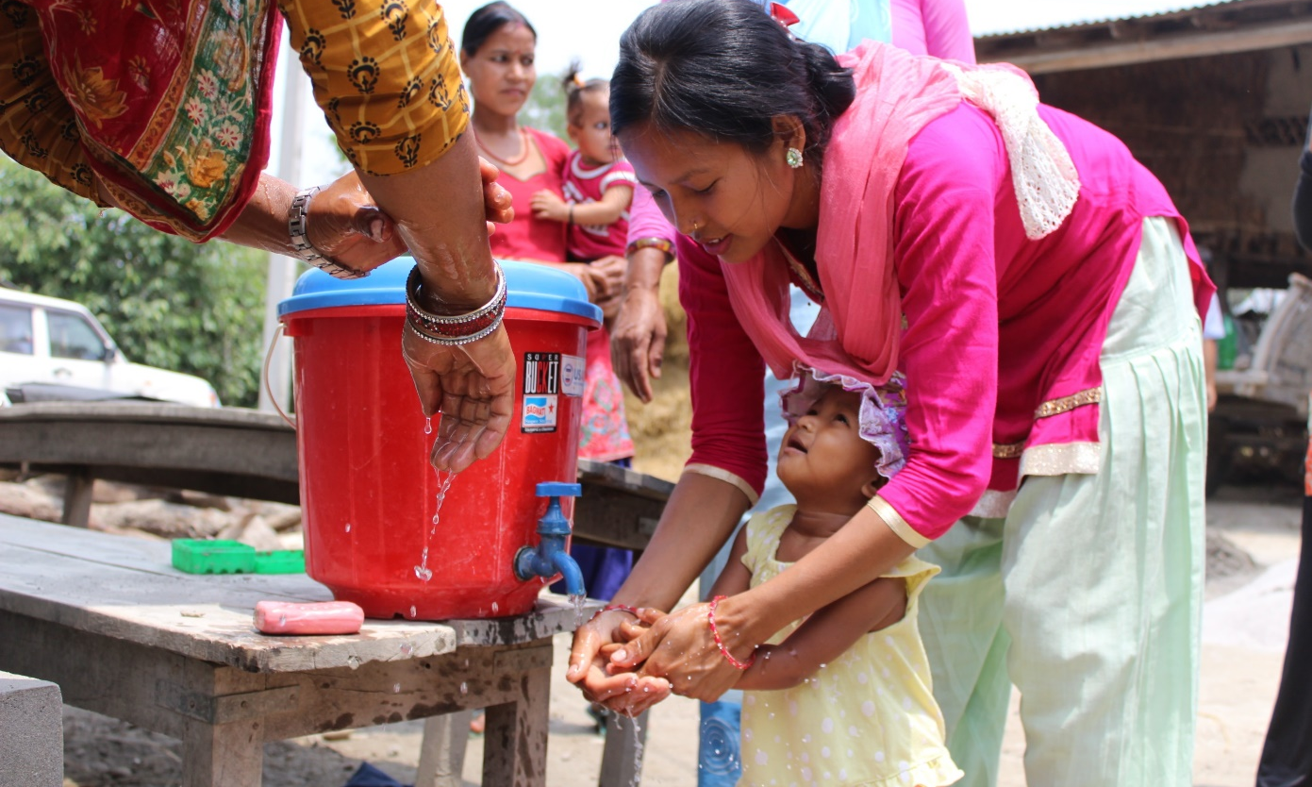

Thank you!

Slide 24

Creating and sustaining collaboration between WASH and disease control programmes
Tools and resources for progress

Slide 25
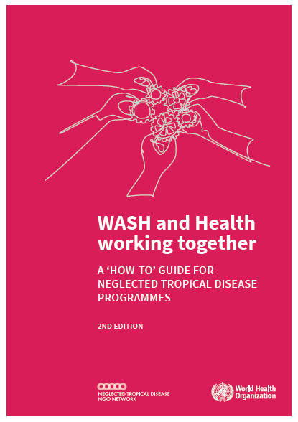
Purpose
Step-by-step guidance to NTD programme managers and partners on how to engage and work collaboratively with the WASH community to improve delivery of WASH services to underserved populations affected by NTDs.
What’s new?
Streamlined, colour-coded and format
Distinction between core and supplementary tools
Updated content, including new section on data for decision making

Slide 26
Content overview
I. What can this toolkit help you achieve?
II. Context
  Interventions for NTD control, elimination, eradication and care
  NTD-related behaviours
  Understanding behaviour to develop behaviour change interventions
III. Steps to success
STEP 1. Setting the programme vision
STEP 2. Building partnership
STEP 3. Analysing the situation
STEP 4. Planning and programme design
STEP 5. Implementing and monitoring

Slide 27
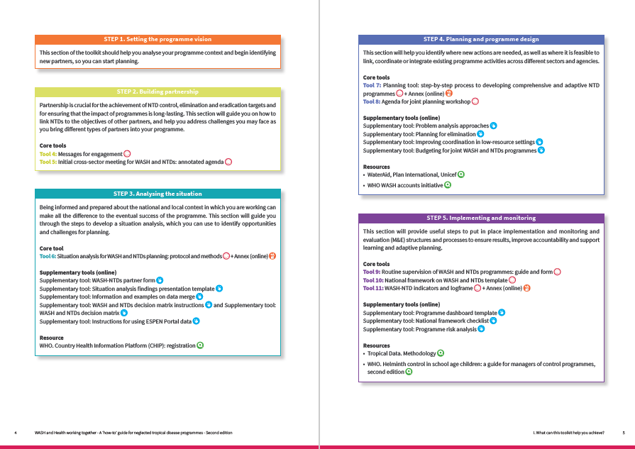
Supported by
> 20 tools and resources based on programme experiences

Slide 28
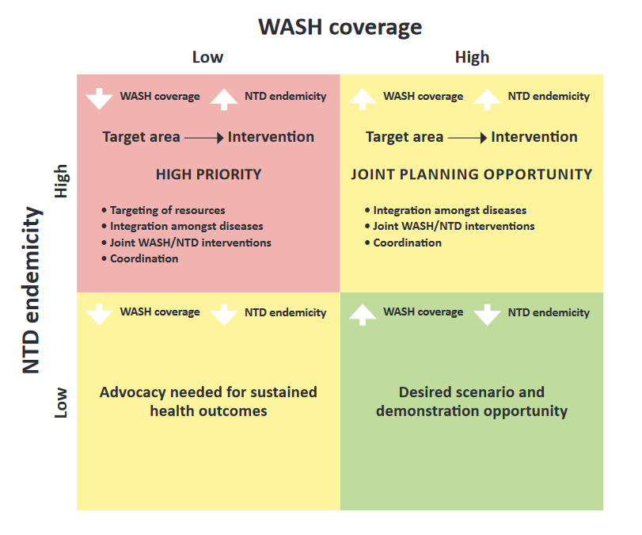
Identifying high priority areas to inform targeting of WASH efforts
STEP 3. Analysing the situation
Data considerations:
WASH and NTD data available in separate central databases.
District level data available, but they are not held in one or two central locations.
WASH data not available at district level / administrative unit that is relevant for NTD programmes.
Notes:
Identifying high priority areas – those with high NTD endemicity and low WASH access - as represented in red in this simple 2x2 matrix can be used to inform WASH efforts
However, WASH and NTD data may be not be readily available to do that…

Slide 29
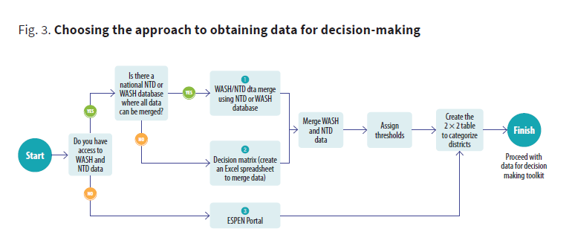
Toolkit includes new tools to support the use of WASH and disease data for decision making
Three main options based on data availability

Slide 30
Three main approaches based on data availability:
Data merge
using an existing WASH or NTD platform or database to add additional information (for instance, adding WASH data to an NTD database or vice versa), for use on a regular basis.
Decision matrix
for one-off data collection and analysis, pulling together data from multiple sources onto an Excel based tool.
ESPEN NTD Portal
Modelled WASH data from surveys alongside NTD endemicity data
The data can be filtered down to district level and interactive maps can be built to help with prioritization and decision making for WASH services in NTD endemic areas.

Slide 31
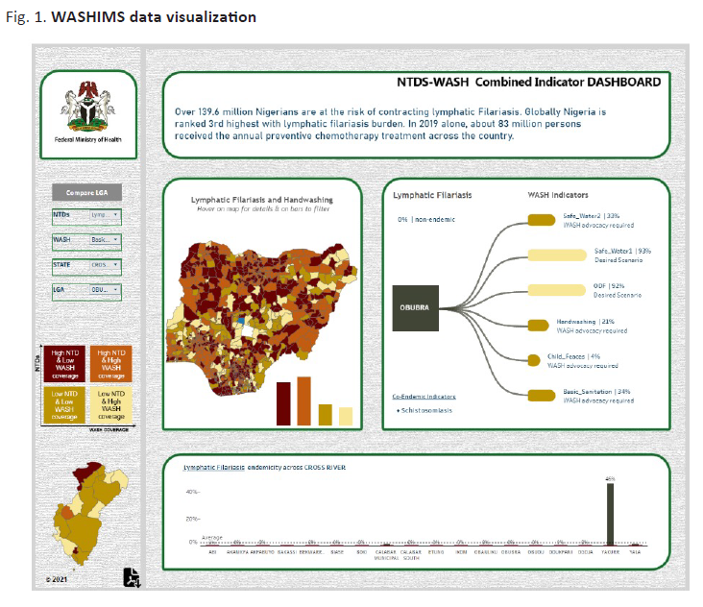
Option 1. Data merge
Example from Nigeria
Data brought together from the NTD snapshot and from the WASHNORM report
NTDs-WASH Combined Indicator DASHBOARD

Slide 32

Option 2. Decision matrix
Collate information on NTD endemicity alongside information on access to WASH services, at implementation unit (IU) level.
The Excel-based matrix displays NTD and WASH data in a summarized form to help identify high risk/need districts and prioritize allocation of resources.
Data can be exported from Excel to create maps with different WASH component and NTD prevalence layers.

Slide 33

Option 3. WHO ESPEN portal WASH and NTD
The portal is a platform which illustrates, through maps, site and district-level NTD data by disease and country in sub-Saharan Africa.
ESPEN WASH files provide STH and SCH endemicity for the most current year of data, along with the high/low status of access to improved water and access to improved sanitation.

Slide 34
Summary and wrap up

Slide 35


















All Systems Connect 2023 is made possible thanks to the generous support of our partners including the World Health Organization and :

