Slide 1



Slide 2
The role of repayable finance: financing different segments in the WASH and water security landscape
A session highlighting how different streams of repayable finance can be used to de-risk loans and address the finance gap for each of the market segments.

Slide 3
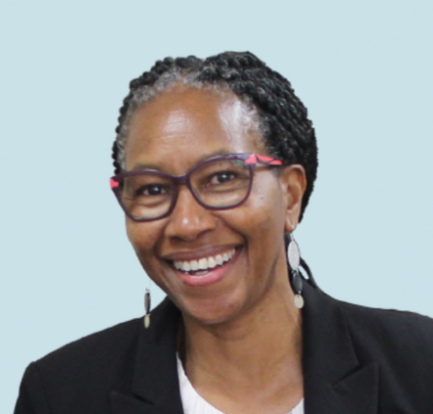
Moderator
Wambui Gichuri
Chair, IRCWASH Supervisory Board;
Previously:
Acting Vice-President for Agriculture, Human and Social Development at AfDB
World Bank Water Practice Manager for Latin America and The Caribbean, and Africa.

Slide 4
Session Overview
General allocution from the moderator
Framing presentation from the Africa Water Investment Programme (AIP)
Presentation of the panellists
Panel Discussion
Q/A: questions from the audience
Closing remarks and take-aways: concrete next steps for which stakeholders and participants can be accountable for.

Slide 5
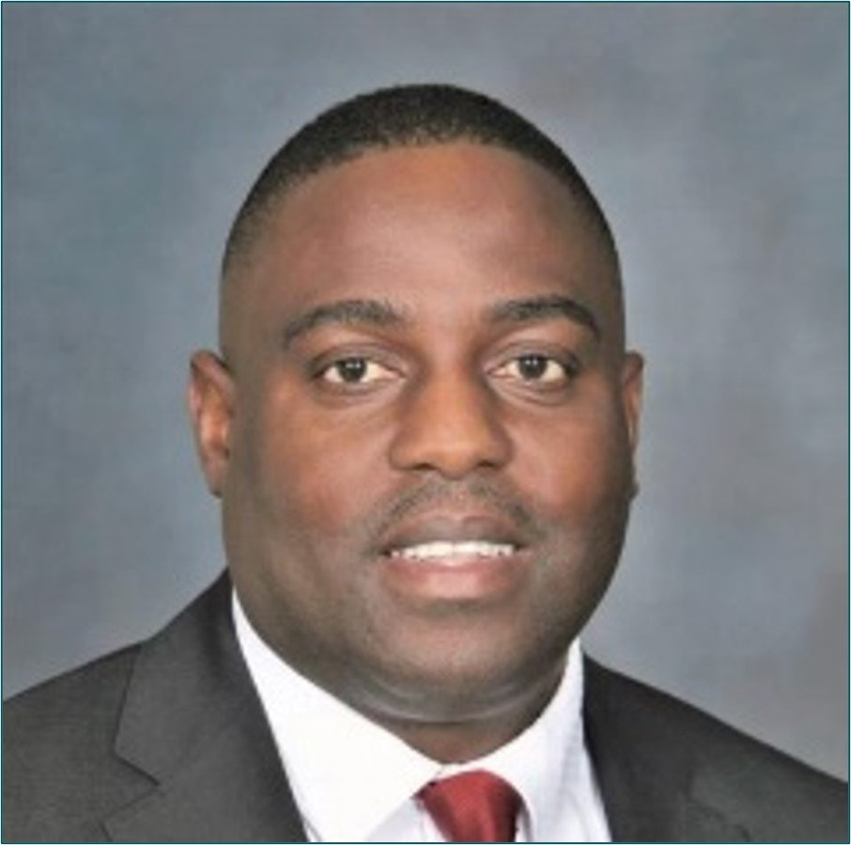
FRAMING PRESENTATION:
Africa Investment Plan High Level Report
(and takeways from the UN Water 2023 Conference)
Mr Alex Simalabwi
Executive Secretary
Global Water Partnership Southern Africa
Notes:
Presentation slides from Tom

Slide 6
International High Level Panel Report on Water Investments for Africa
Africa’s Riding Investment Tide

Slide 7
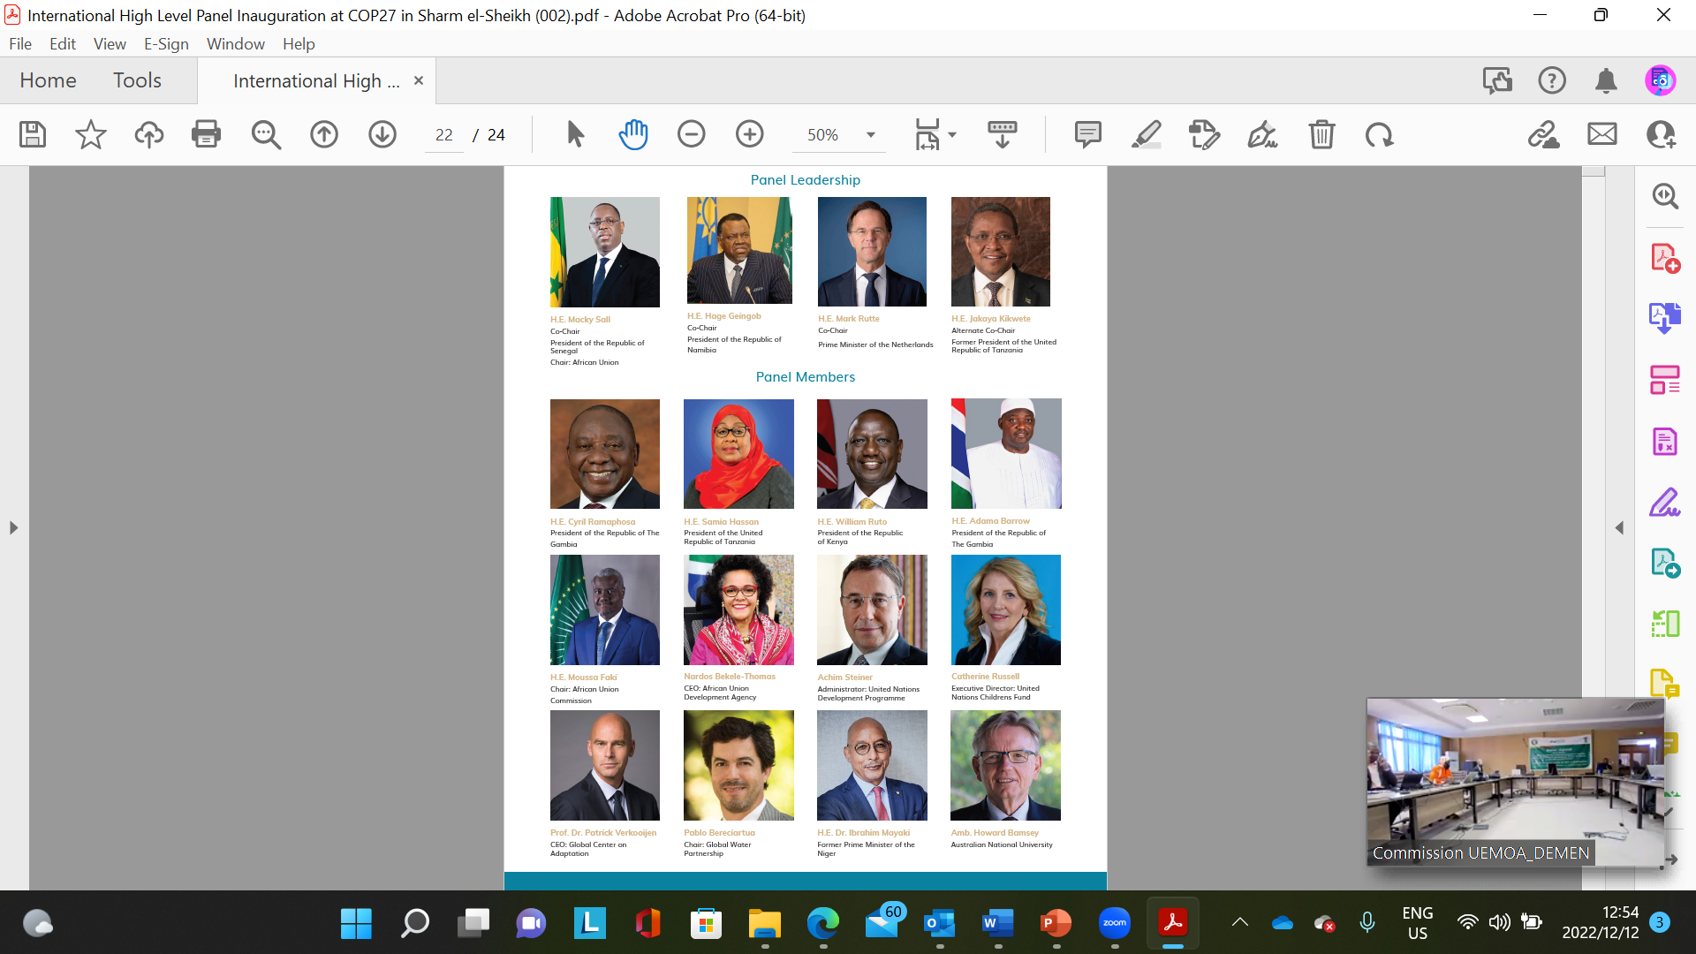
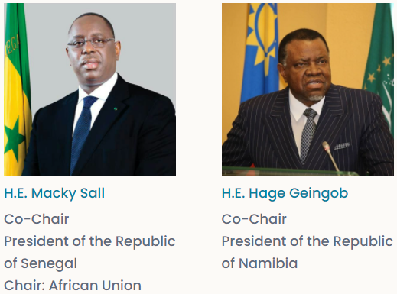
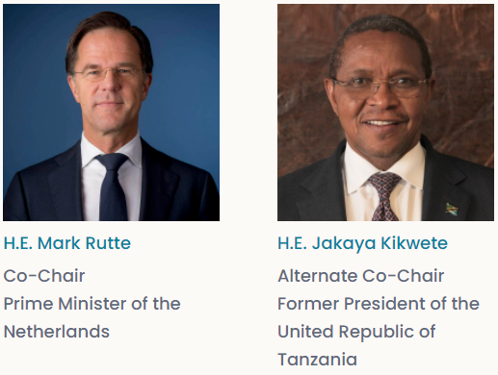
AIP International High-Level Panel on Water Investments for Africa
Panel Leadership

Slide 8
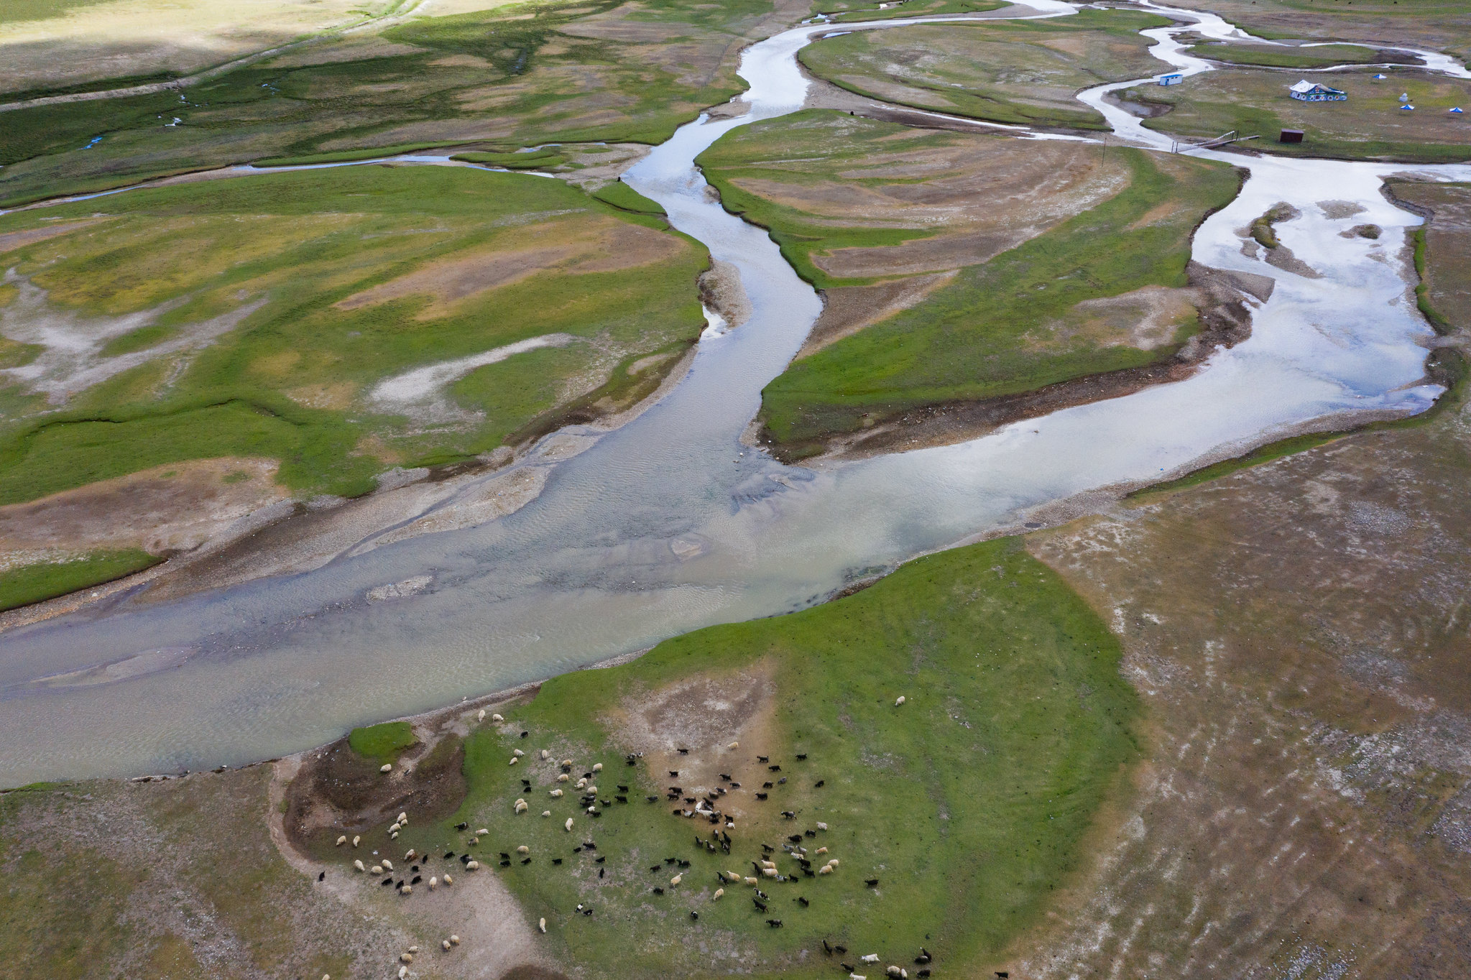
With conservative assumptions, over US$30 billion per year can be mobilised through three actionable pathways

Slide 9
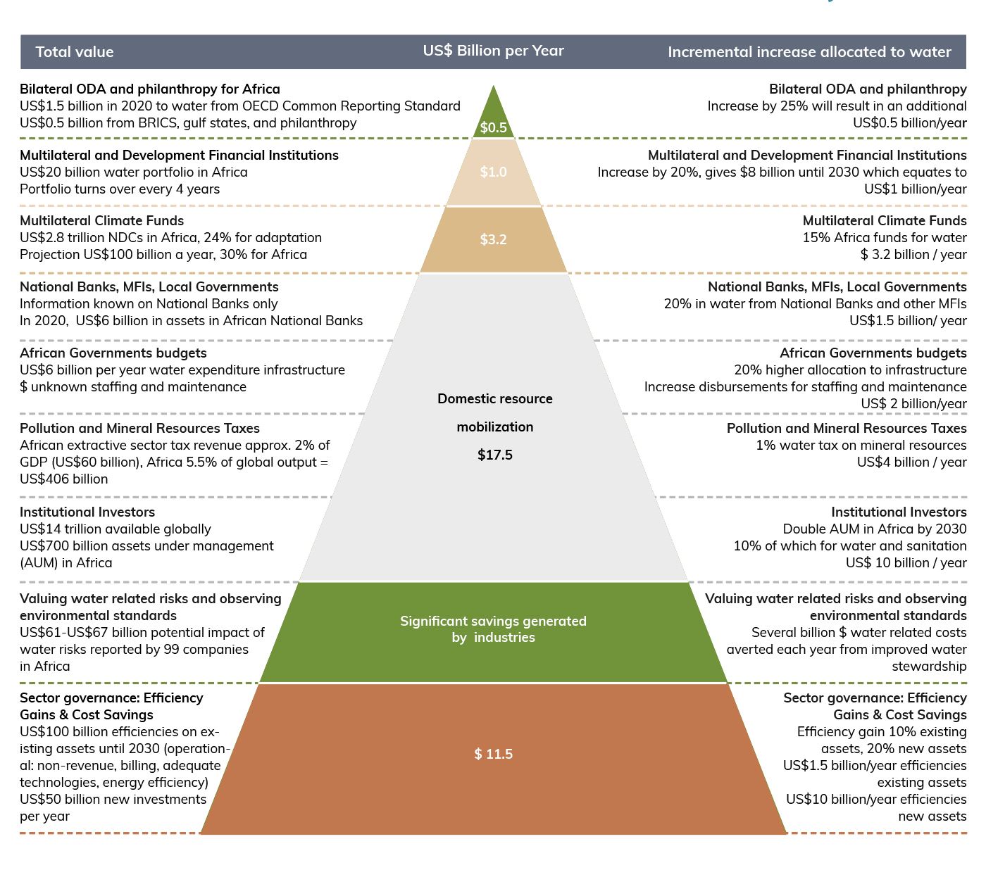
Pyramid of water investment transformation

Slide 10
  A 5 point plan for African governments and financial institutions
High-level cross-sector leadership and commitment
Track progress, enhance mutual accountability
Innovative finance and matchmaking
Strengthen regulation and efficiency
Use ODA to de-risk investment

Slide 11
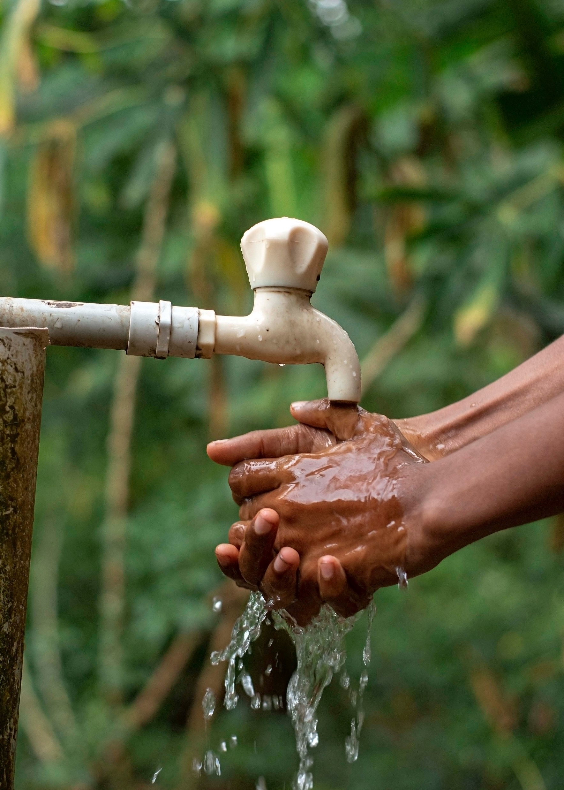
3 pathways to mobilise at least US$30 billion/year
by 2030
1. Achieve more impactful water spending and financial leveraging
2. Mobilise domestic resources
3. Secure global and continental investment and finance

Slide 12
The cost of inaction is too high - nearly US$200 billion/year
African countries lose up to US$200 billion/year due to insufficient investment, coupled with the impacts of climate change and inefficiencies.
By 2030, the continent will need to produce at least 50% more food and at least ten times more water for energy production to enable growth and development.
By 2050, 6 out 10 people in Africa will live in urban areas and 70% of them will be children and youth.
Africa’s population is forecast to grow to 1.6 billion by 2050.

Slide 13
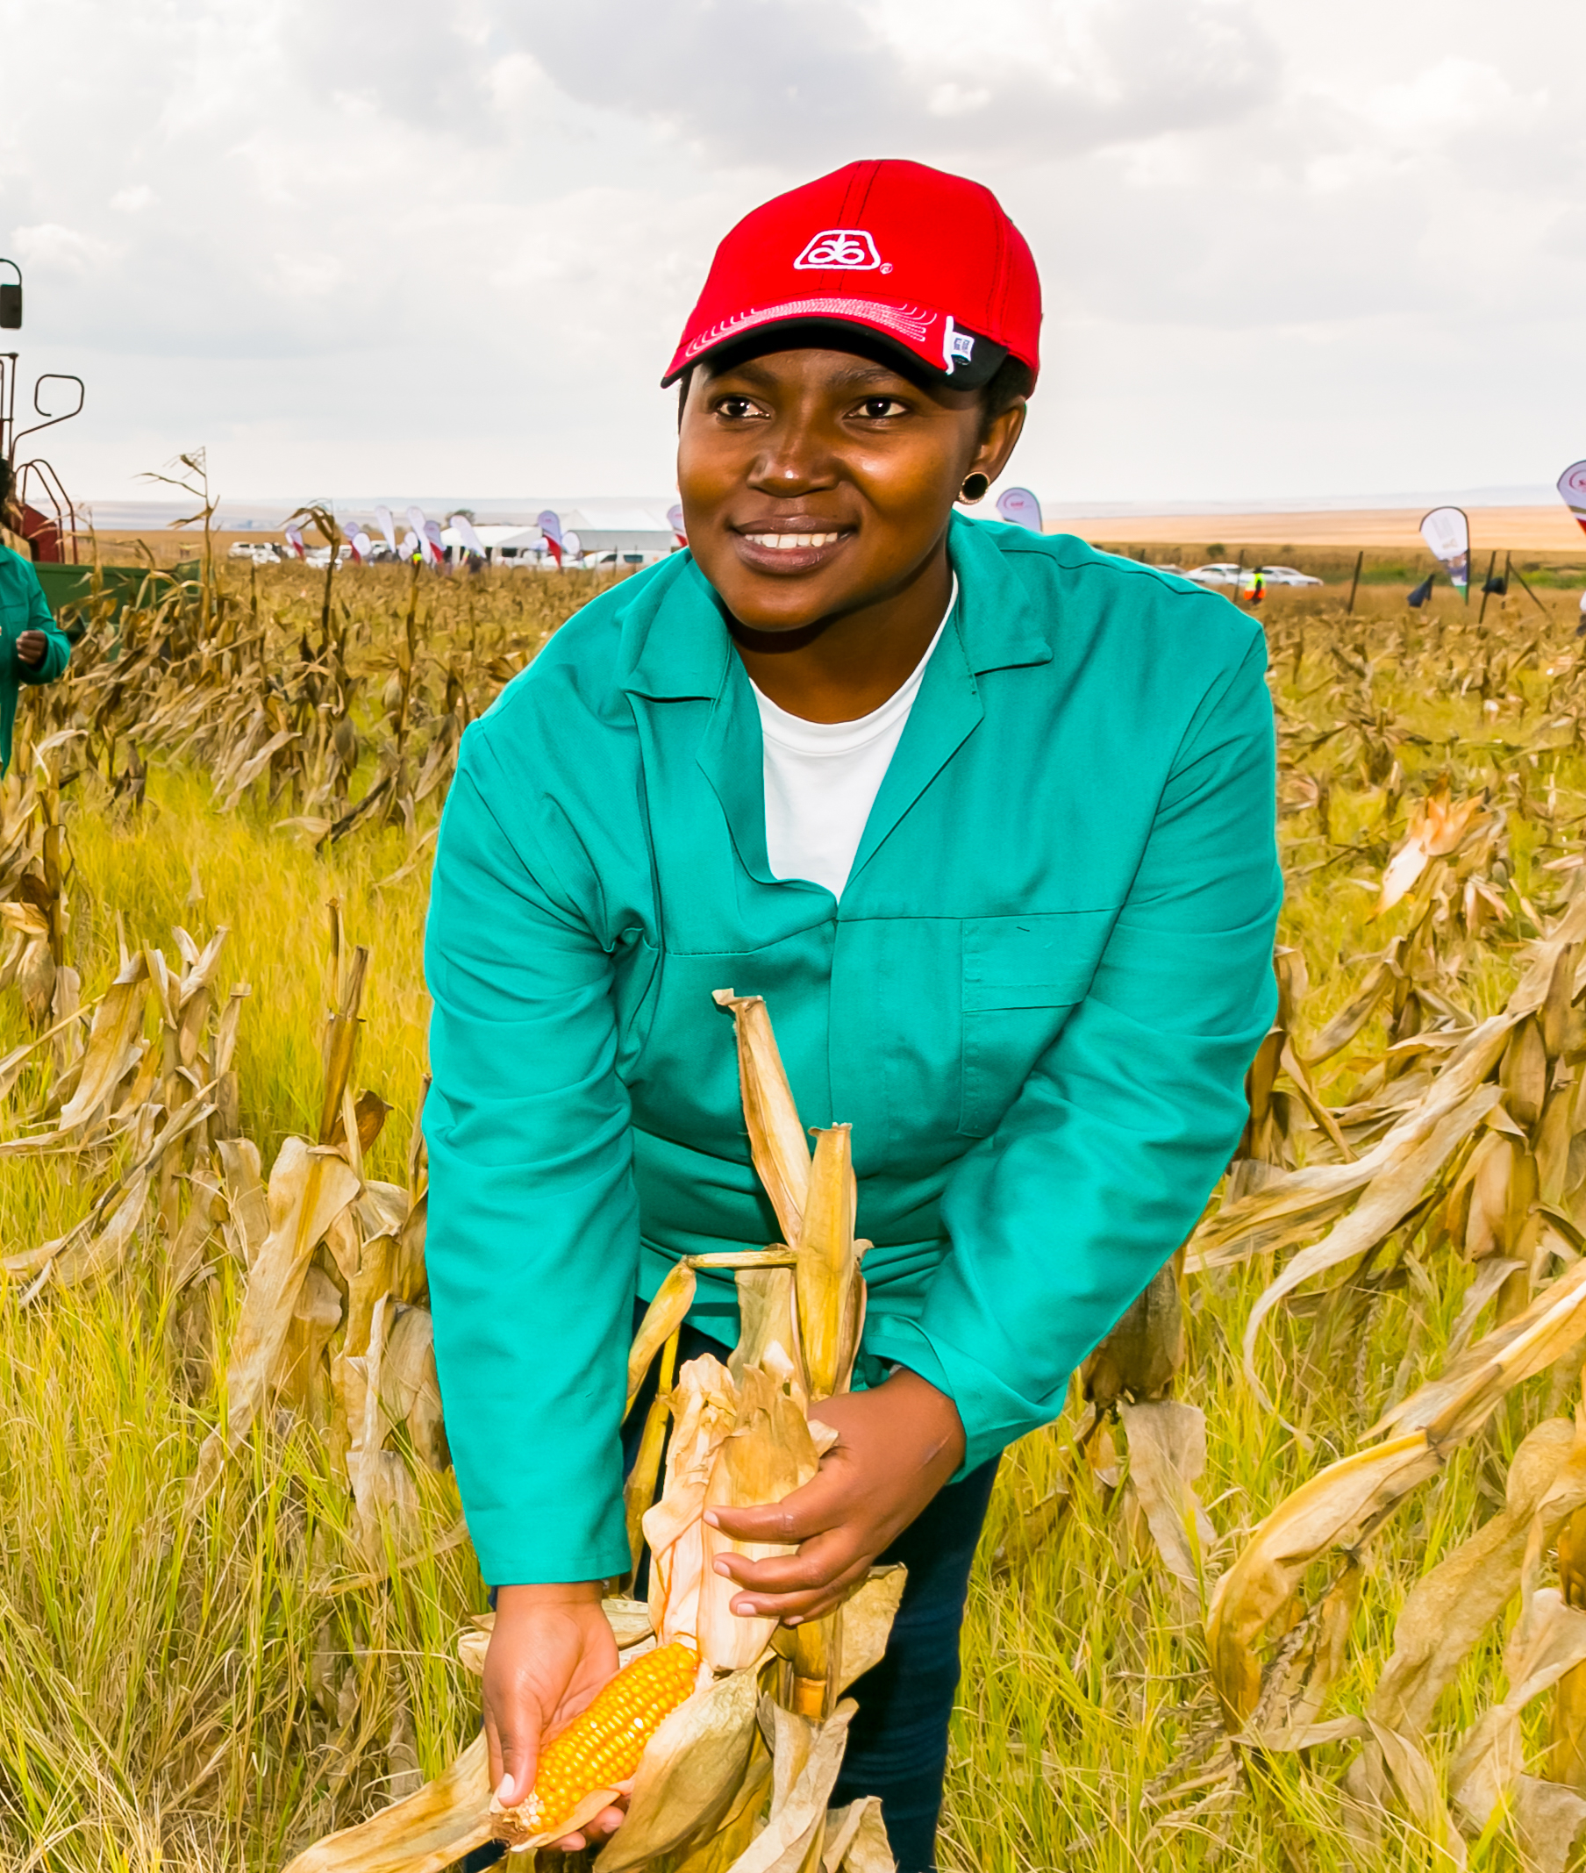
We need a paradigm
change in water investments partnerships
.

Slide 14
The change we need
Approximately US$50 billion annually, or US$40 per African per year is required, to achieve water security and sustainable sanitation in Africa by 2030.
Currently, US$10-US$19 billion is invested each year.
At least an additional US$30 billion/year needs to be invested by 2030.

Slide 15
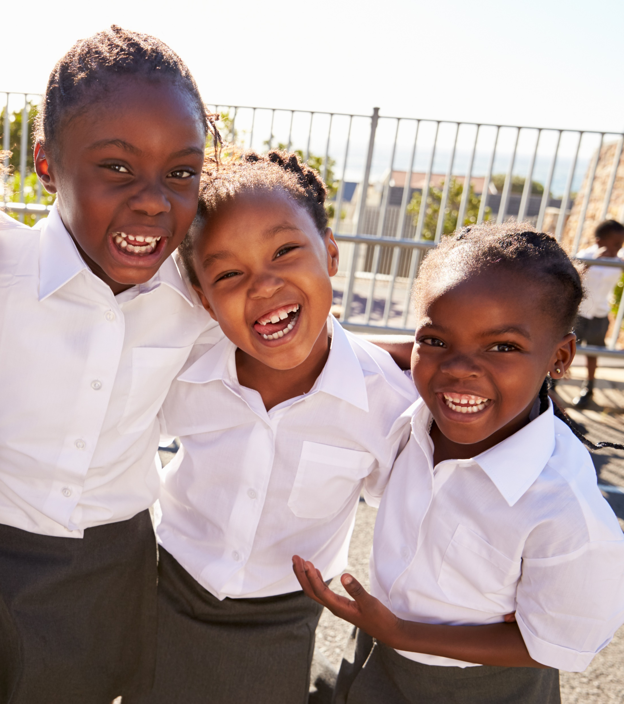
Every US$1 invested in climate-resilient water and sanitation returns at least US$7

Slide 16
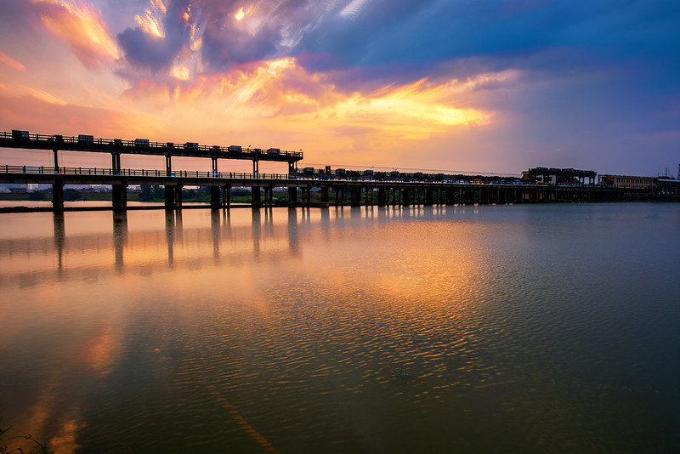
THE HIGH-LEVEL PANEL INVITES AFRICAN HEADS OF STATE AND GLOBAL LEADERS TO JOIN EFFORTS To at least DOUBLE CURRENT WATER INVESTMENTS AND IMPLEMENT NATIONAL WATER INVESTMENT PROGRAMMES BY 2030

Slide 17
High Level Panel supports the African Union to close the water investment gap through the Continental Africa Water Investment Programme (AIP)

Slide 18
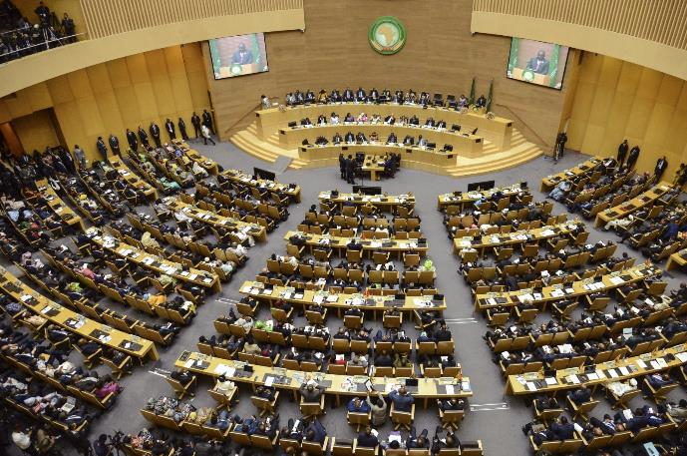
AIP was adopted by AU Heads of States in February 2021
2019: Endorsed by the Governance Council of the African Ministers’ Council on Water in February 2019 – to transform Africa’s water investment outlook through increased partnerships and implementation the AIP.
2018: Joint UN/World Bank High-Level Panel on Water called for the launch of an Africa Water Investment Programme in its final report.
February 2021
The AIP was adopted during the 34th Ordinary Session of the Assembly of AU Heads of State and Government in Addis Ababa, Ethiopia, as part of the Programme for Infrastructure Development in Africa (PIDA) Priority Action Plan.

Slide 19
HOW AIP WILL CLOSE THE WATER INVESTMENT GAP
Establish a High level Panel at Heads of States level, strengthen political commitment and leadership
Develop and implement the AIP-PIDA Water Investment Scorecard to enhance mutual accountability, transparency and efficiency of water finance and investments
Establish an International Blended investment Facility to leverage public- private partnership finance
Develop regional, transboundary and national water investment programmes to close the water investment gap
Promote gender equality and empowerment of women and girls in water investments

Slide 20
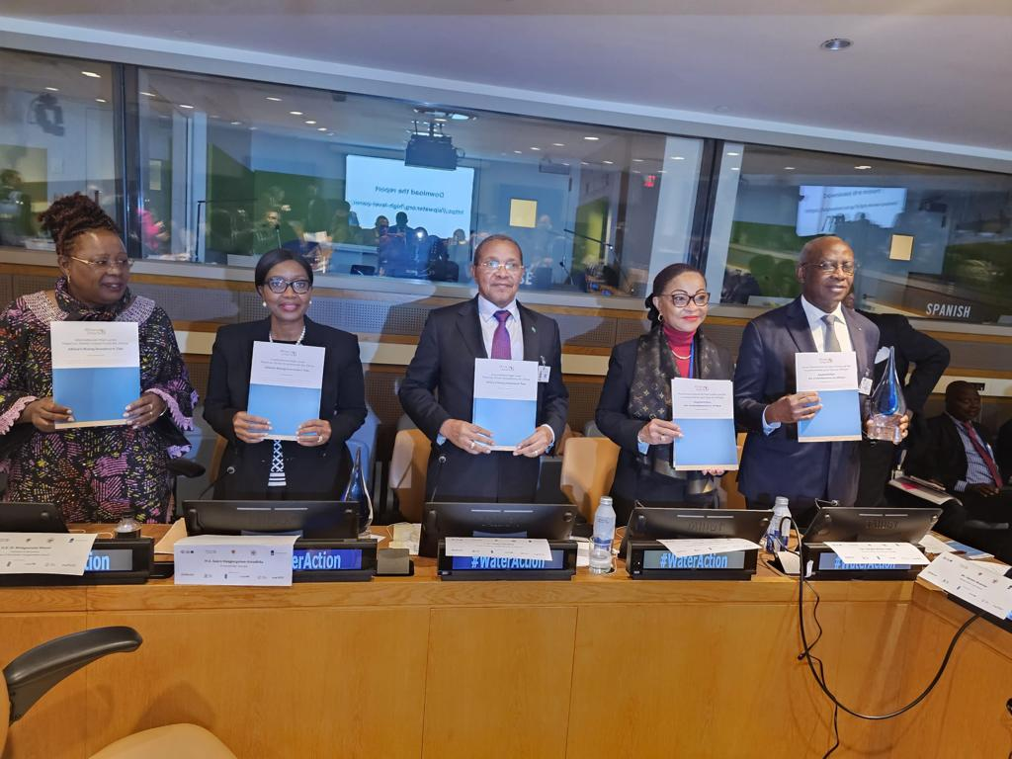
High Level Panel Report launched at UN Water 2023 Conference

Slide 21
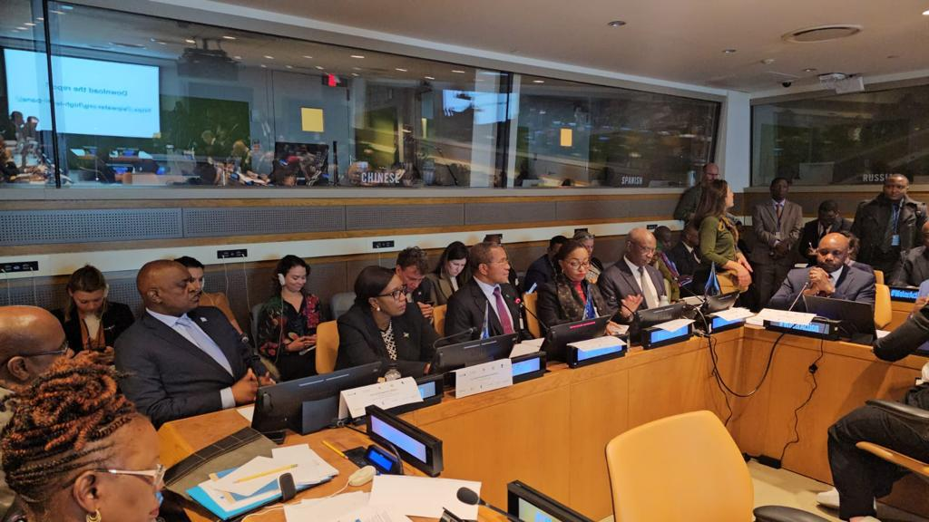
Launch of the High Level Panel Report at UN 2023

Slide 22

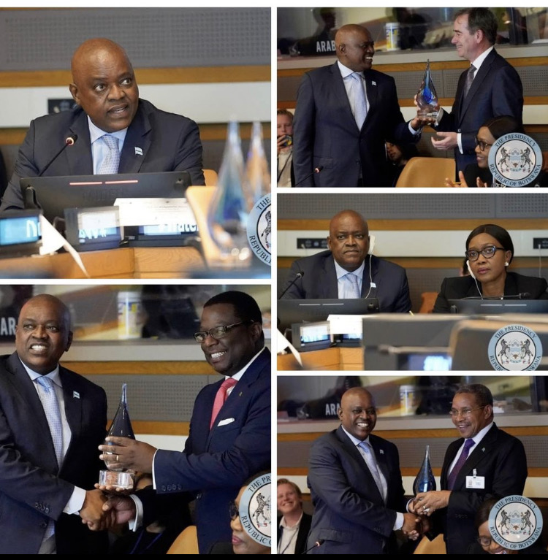

Slide 23
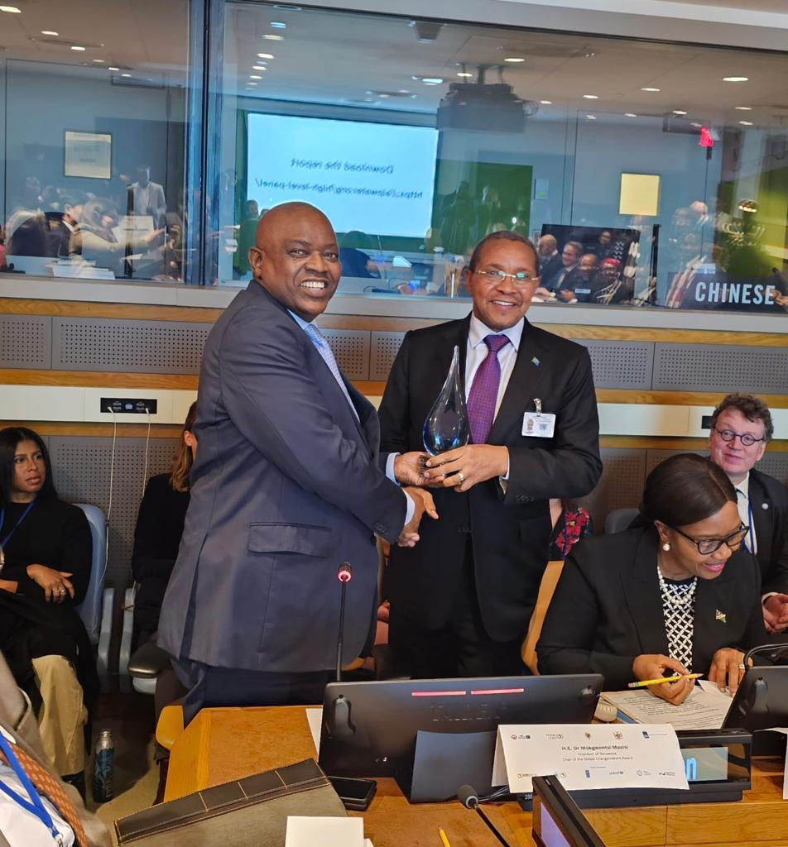

Slide 24
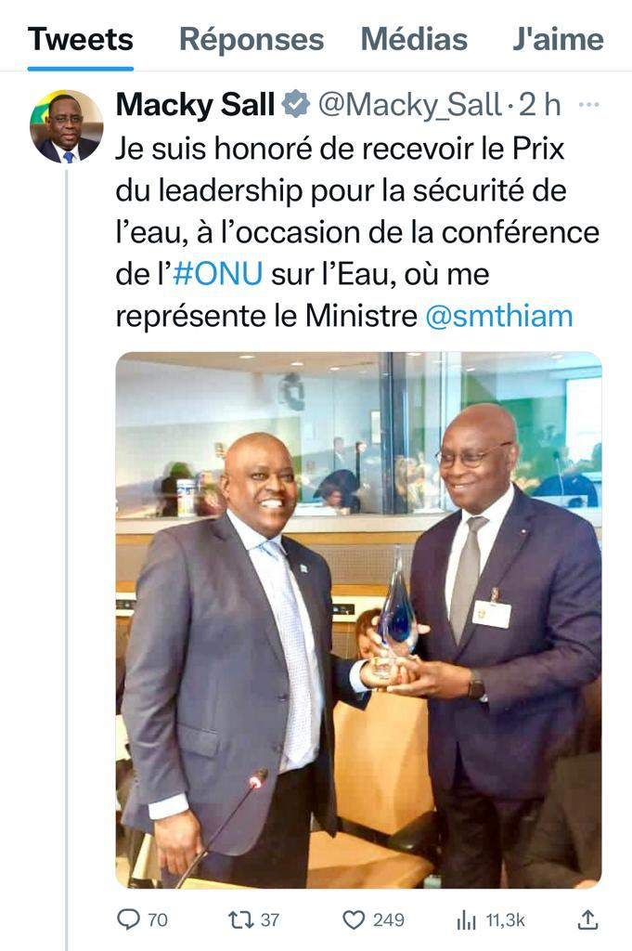
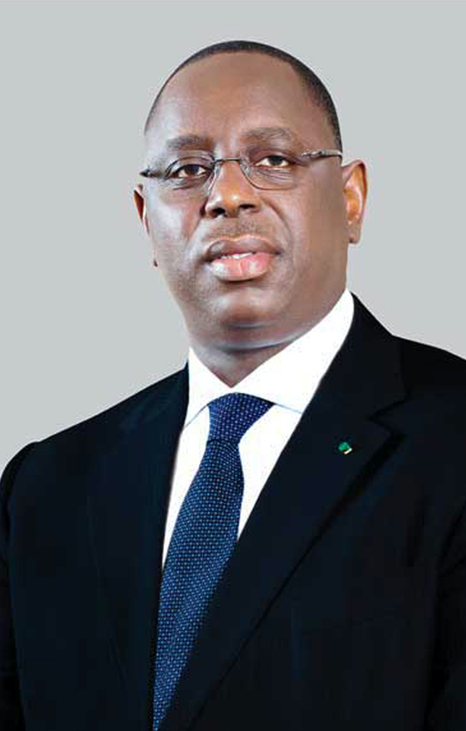
H.E Marky Sall, President of Senegal welcome Global Award

Slide 25
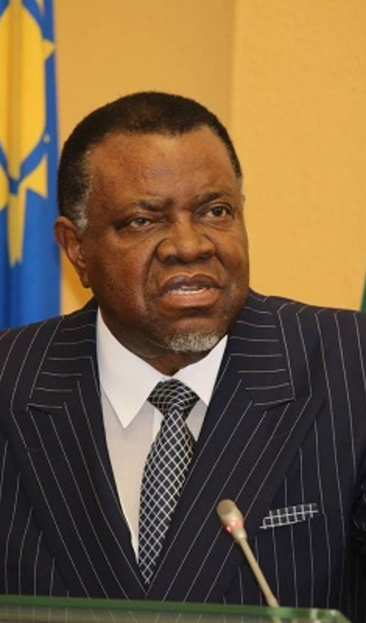
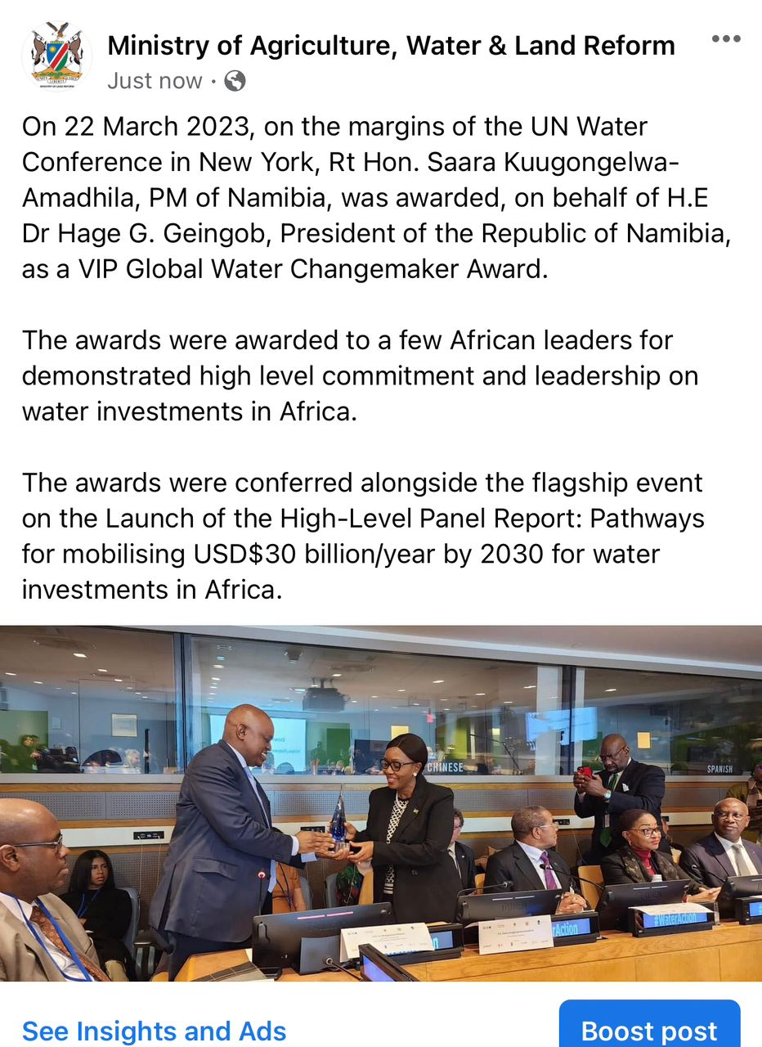
H.E Hage Geingob, President of the Republic of Namibia welcome Global Award

Slide 26
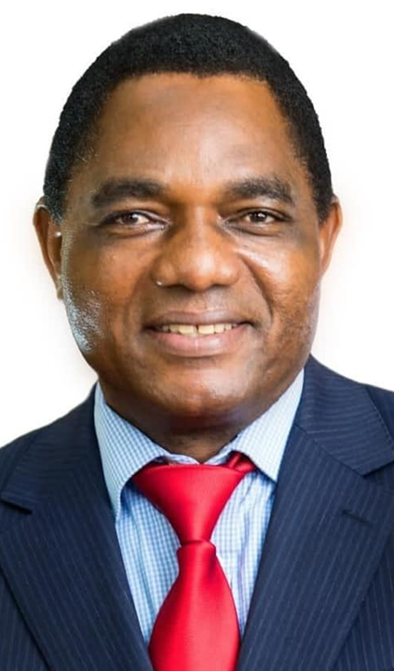
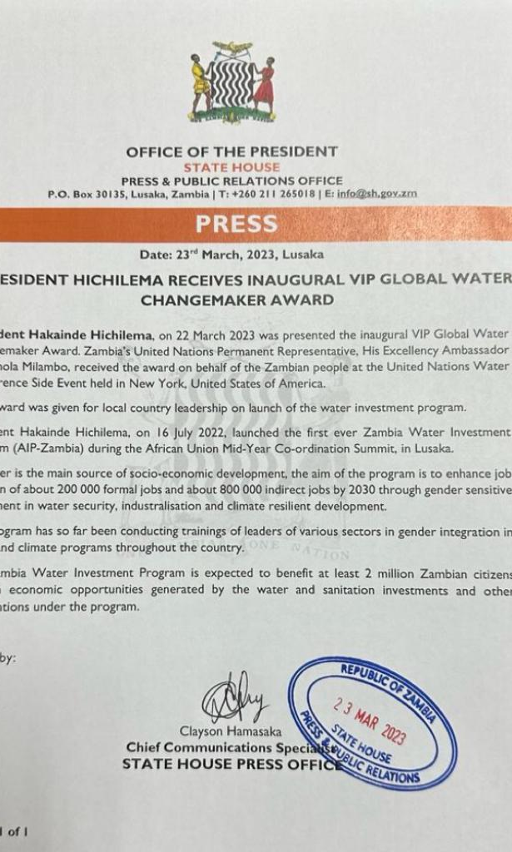
H.E H.E. Hakainde Hichilema
President of the Republic of Zambia welcome Global Award

Slide 27
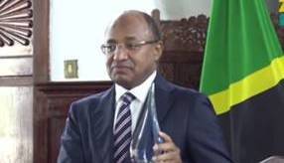
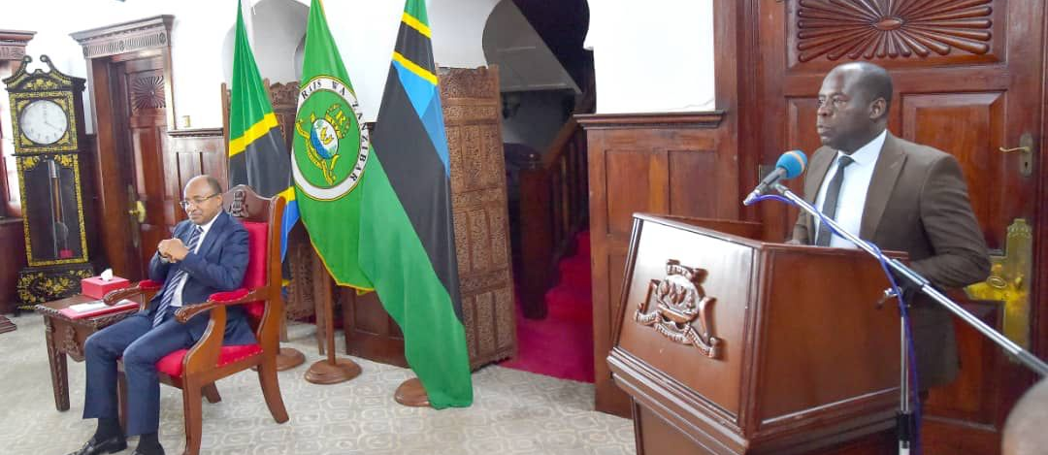
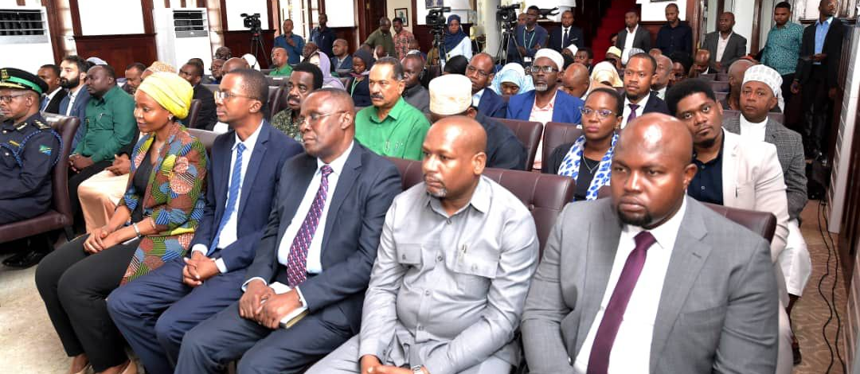
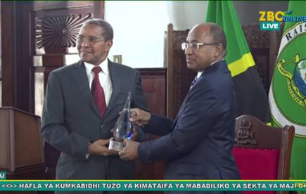

Slide 28
Panel Discussion
Examining how different streams of repayable finance can be used to de-risk loans and address the finance gap for each of the market segments.

Slide 29
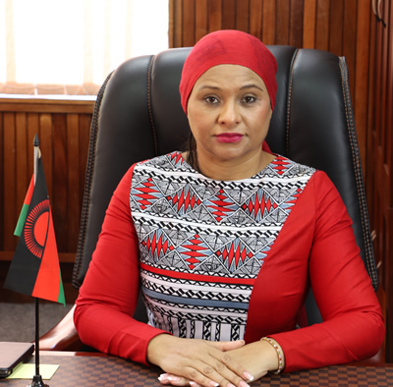
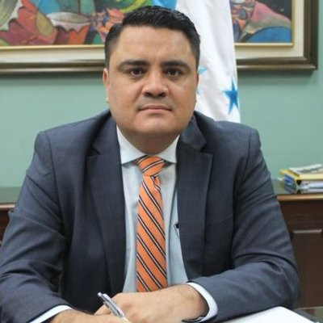
PERSPECTIVES FROM THE DEMAND SIDE
H.E. Mrs. Abida Mia
Minister of Water and Sanitation
Malawi
H.E. Mr. Roberto Carlos Ramirez Alvarenga
Vice Minister of Finance in charge of Credit and Public Investment Honduras

Slide 30
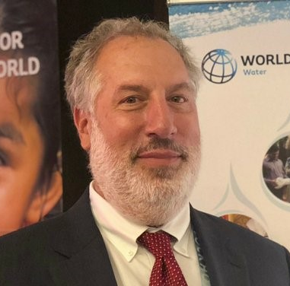
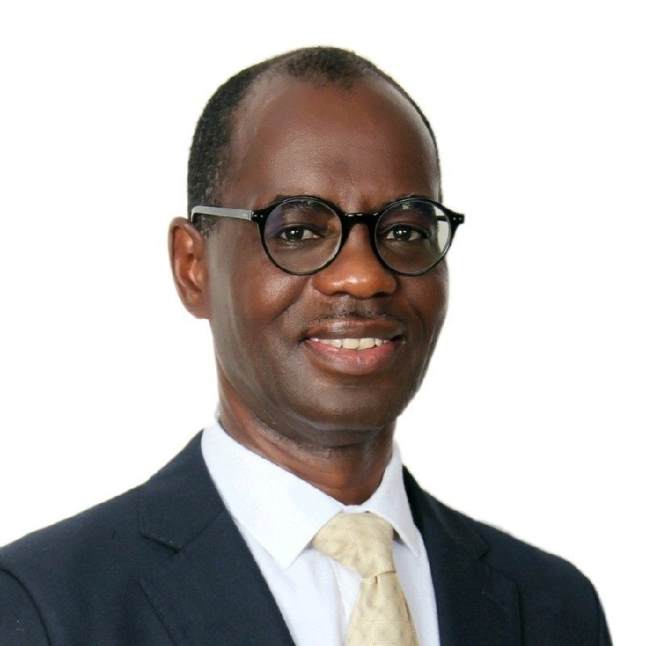
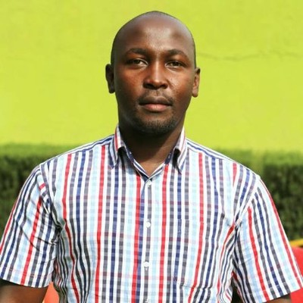
PERSPECTIVES FROM THE SUPPLY SIDE
Peter Karanja
WASH Manager
World Vision Kenya (on behalf of Vision Fund)
Joel Kolker
Global Lead Water and Finance
World Bank Group
Osward Chanda
Director of the Water and Sanitation Development Department
African Development Bank

Slide 31
Moderator
Wambui Gichuri
Chair, IRCWASH Supervisory Board;
Previously:
Acting Vice-President for Agriculture, Human and Social Development at AfDB
World Bank Water Practice Manager for Latin America and The Caribbean, and Africa.

Slide 32
Highlights of the discussion and concrete next steps
Wambui GICHURI

