Slide 1



Slide 2
Blended finance for sanitation
The role of finance intermediaries

Slide 3
Agenda
Conceptual introduction: the landscape for financing sanitation, its different segments
Cases:
  Sanitation financing for improved household sanitation (Malawi, Rwanda)
  Repayable finance services at household, private service provider (Bangladesh)
  Pro-poor commercial sanitation financing (India) including video
  Linking supply and demand of finance for sanitation (Kenya & Senegal)
Panel debate interactions with the audience
Conclusions and take away messages

Slide 4
Demand for sanitation finance (guestimates SDG 6.2) US$ million / year | Available finance different segments US$ million / year | Sanitation challenge – role intermediaries US$ million / year
Households 20,000 | Microfinance 200,000 | Generating / aggregating demand Loan product development Capacity development MFIs Handholding MFIs RBF Policy environment
Enterprises 15,000 | MSME financing 3,700,000 | Technical expertise MSMEs Business development Handholding MSMEs Capacity development financial sector Design guarantees & other financial instruments Enabling environment
Utilities 5-15,000 | Pension funds 56,000,000 | Building business cases meeting R/R profile Project financing (DFIs) Enabling environment
 |  | Public financing SDG 6 20,000

Slide 5
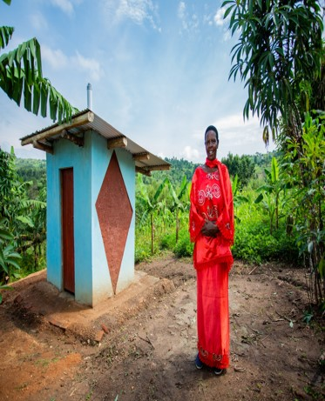
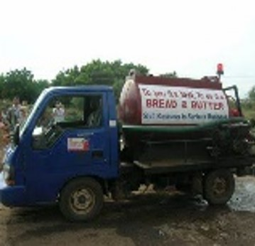
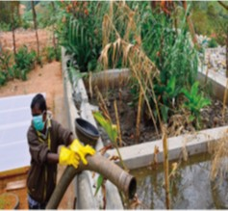
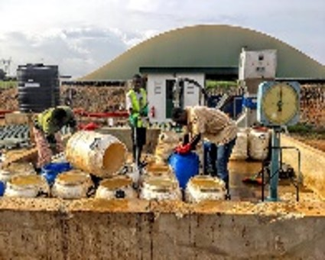
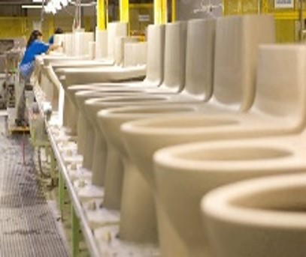

Scaling : < $10 M
 |  |  | US$ 100 |  | US$ 100 | US$ 1,000 | US$ 1,000 |  |  | US$ 10,000 | US$ 10,000 |  |  |  |  | US$ 100,000 |  |  |  |  | US$ 1,000,000 | US$ 1,000,000 |  |  |  | US$ 10,000,000 | US$ 10,000,000
Financing instruments deployed
 | Informal sector |  |  |  | Microfinance |  |  | Guarantees | Guarantees |  |  |  |  |  | Public investment |  |  |  | development finance | Development finance |  |  |  | regular commercial | Commercial impact finance
 | lending |  |  |  | RBF |  |  | grants | grants |  |  |  |  |  | grants |  |  |  | guarantees | guarantees |  |  |  | development finance | development finance
 |  |  |  |  |  |  |  | revolving funds | Revolving funds |  |  |  |  |  | dedicated funds |  |  |  | Public investment | Public investment
 |  |  |  |  |  |  |  |  |  |  |  |  |  |  |  |  |  |  | dedicated funds | dedicated funds
 |  |  |  |  |  |  |  |  |  |  |  |  |  |  |  |  |  |  | Climate finance? | Climate finance?
 |  |  |  |  |  |  |  |  |  |  |  |  |  |  |  |  |  |  | grants | grants
Technical assistance
 | Construction |  |  |  | Construction |  |  | business skills | Business skills |  |  |  |  |  | Business skills (capacity dev.) |  |  |  | business skills (handholding) | Business skills (handholding) |  |  |  | enabling environment | EE (legal etc)
 | Supply side development |  |  |  | Demand aggregation |  |  | enabling environment | Enabling environment |  |  |  |  |  | Enabling environment |  |  |  | enabling environment | Enabling environment
 | development |  |  |  | Business skills

Slide 6
Scaling : < $10 M
 |  |  | US$ 100 |  | US$ 100 | US$ 1,000 | US$ 1,000 |  |  | US$ 10,000 | US$ 10,000 |  |  |  |  | US$ 100,000 |  |  |  |  | US$ 1,000,000 | US$ 1,000,000 |  |  |  | US$ 10,000,000 | US$ 10,000,000
 |  |  |  |  |  |  |  | Guarantees |  |  |  |  |  |  |  |  |  |  | development finance |  |  |  |  | regular commercial
 |  |  |  |  |  |  |  | grants |  |  |  |  |  |  |  |  |  |  | guarantees |  |  |  |  | development finance
 |  |  |  |  |  |  |  | revolving funds |  |  |  |  |  |  |  |  |  |  | Public investment
 |  |  |  |  |  |  |  |  |  |  |  |  |  |  |  |  |  |  | dedicated funds
 |  |  |  |  |  |  |  |  |  |  |  |  |  |  |  |  |  |  | Climate finance?
 |  |  |  |  |  |  |  |  |  |  |  |  |  |  |  |  |  |  | grants
 |  |  |  |  |  |  |  | business skills |  |  |  |  |  |  |  |  |  |  | business skills (handholding) |  |  |  |  | enabling environment
 |  |  |  |  |  |  |  | enabling environment |  |  |  |  |  |  |  |  |  |  | enabling environment
 | development
Micro finance in its various forms
“SME” financing with guarantees
incubation funds (grants/loans); blended finance; competitions
“SME” financing with guarantees
Project finance (DFIs); blended finance; new funds (TAS,YSB, waterequity, DGGF)
commercial
impact
finance,
development finance

Slide 7

Scaling commercial funding : $10 M < $100M < $ 1B, How?
US $ 1 – 10 million
US $ 100 million
US $ 1 billion
Most of us are here
How to get here?
And here?

Slide 8
“What “size of fish” are you in currently ($1-10M, $100m, $250M)?
Is it working well?
How do you become the “next fish”, what is holding you back?
How and by whom does the intermediary get paid?
Money often costs too much – Ralph Waldo Emerson

Slide 9
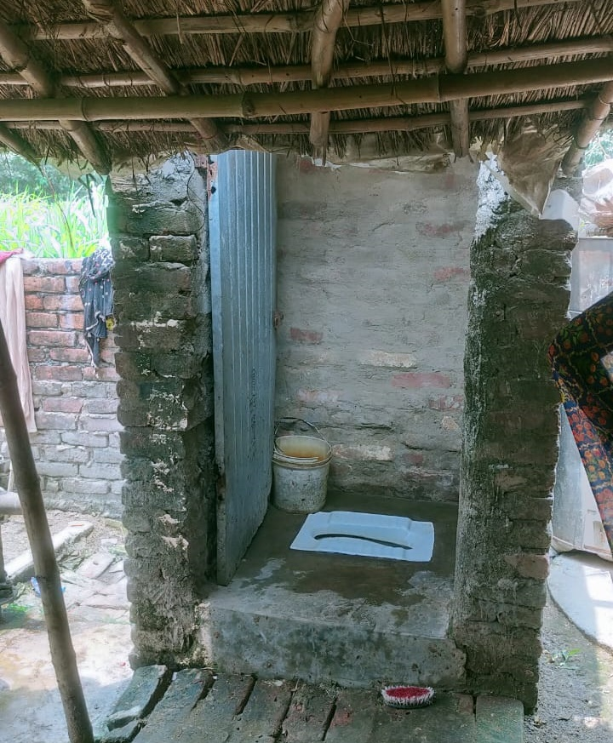
Proof of concept of the ‘sanitation impact bond
US$ 3 million loan ACTIAM to Cashpor (proof of concept)
Finish Society provided TA to Cashpor
TA package: demand generation, mason training, monitoring support, handholding
Results: (1) loan conversion 100%; (2) Utilisation 97%
36,843 safely managed HH sanitation
Testing contracts (RBF), financing routes
Independent
Evaluation
M-CRIL Limited – Incorporating EDA Rural Systems
Inclusive microeconomics

Slide 10


















All Systems Connect 2023 is made possible thanks to the generous support of our partners including the World Health Organization and :

