Slide 1



Slide 2

Sanitation financing for increased access to improved household sanitation
A case of Malawi and Rwanda

Slide 3
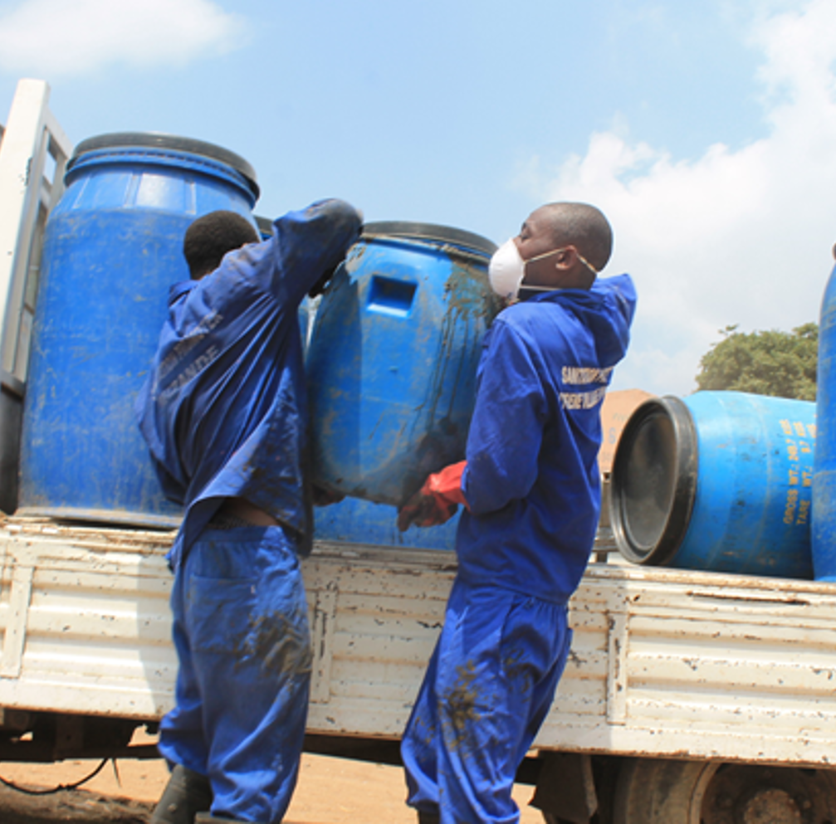
Background Context
Rwanda
Community mobilisation to
self-construction of latrines
Capacity building of local sanitation entrepreneurs
Village Savings and Loans Associations (VSLAs) – Rural
Sanitation loans through
Saving and Credits Cooperatives (SACCOs)
Malawi
Sanitation Revolving Fund – Peri-urban
Community Led Total Sanitation (CLTS) - Rural
Borehole banking model – Rural
Capacity building for sanitation entrepreneurs

Slide 4
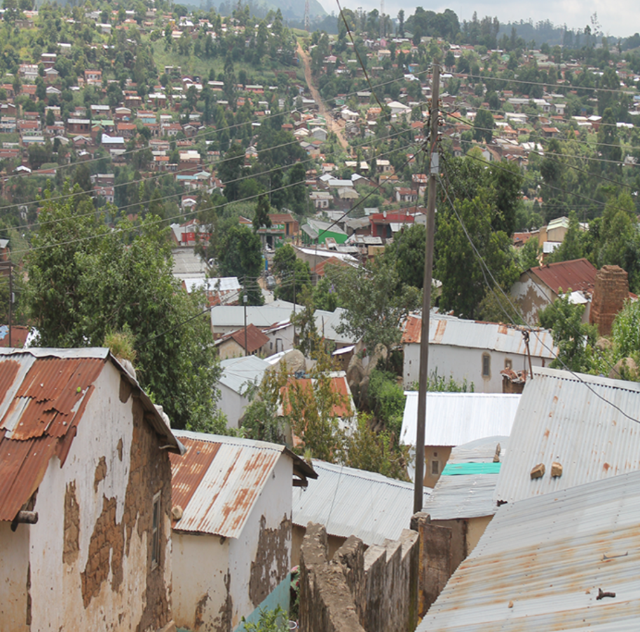
Background Context (Con’d)
Affordability and quality of latrines coupled with lack of funding for low-income earners, remain the main challenges.
Lending in sanitation services/products are perceived as a high-risk product by mainstream commercial banks and Financial Management institutions (FMIs).
Very high interest rates on loans offered by mainstream commercial banks.
Low awareness amongst commercial
banks on opportunities found in sanitation service delivery.

Slide 5
Approach to Sanitation Financing
How has Water for People addressed local financing challenges to enable households access quality sanitation products and services?
Malawi – The Sanitation Revolving Fund
Entered formal partnership with Mudi and FINCOOP SACCOs
A win-win partnership
    SACCOs interest is on having more members while Water for People's interest is on increased access and coverage of quality household sanitation
Initial "Seed" funds provided to SACCOs by Water for People and UNICEF
SACCOs utilize the "seed" to procure sanitation materials from hardware shops
SACCOs sign MoUs with reputable hardware shops
SACCOs work with trained masons in provision of sanitation services to loans clients
at 3% which is lower than commercial banks(6%)

Slide 6
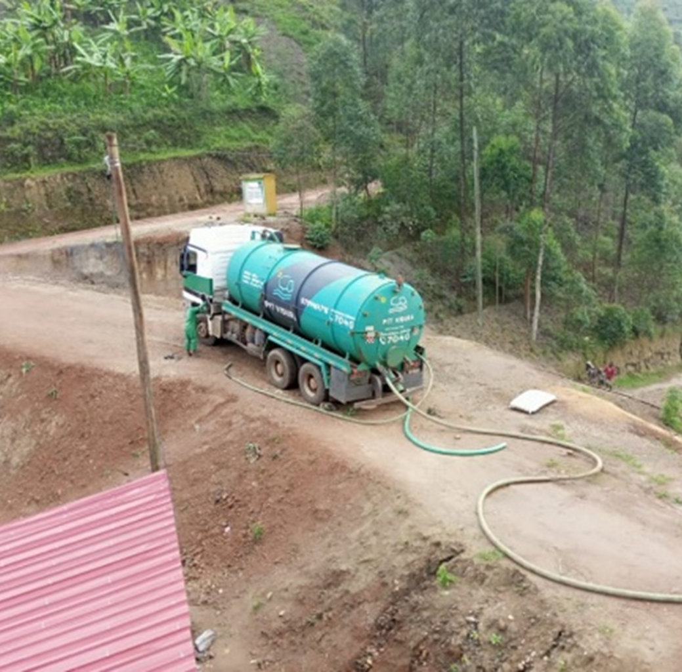
Approach to Sanitation Financing
Rwanda –The Loan guarantee Fund
Access to finance for local entrepreneurs
VSLAs: a micro credit model where 25-30 members meet in a self-managed group to save and borrow money for home improvement
SACCOs – social responsibility: To provide sanitation loans at negotiated interest rates (9% to 17% per year) to VSLAs.
Access to finance for local entrepreneurs
Agreement between SACCOs and local masons and sanitation-business entrepreneurs – Loan interest rates below 15%
Water For People to provide the guarantee fund
(up to 60%)

Slide 7
Water for people as an intermediary
Role of Water for People
Cushioning the risk that comes with sanitation loans through
          Providing ‘Seed’ to SACCOs for the sanitation revolving fund
          Providing loans guarantee to support sanitation entrepreneurs by covering most of the collateral
Providing technical support on sanitation to SACCOs
Monitoring the performance of the loans for sustainability
Sustainability of sanitation financing, what next?
The ultimate goal to attain sustainability: Make the sanitation loan market attractive enough for financing institutions to venture into, even at the proposed low interest rates, through;
    Cushioning the sanitation loans risk for Increased uptake of sanitation loans by both households and businesses leading to profitability of the initiative
    Increased loan recovery rate

Slide 8
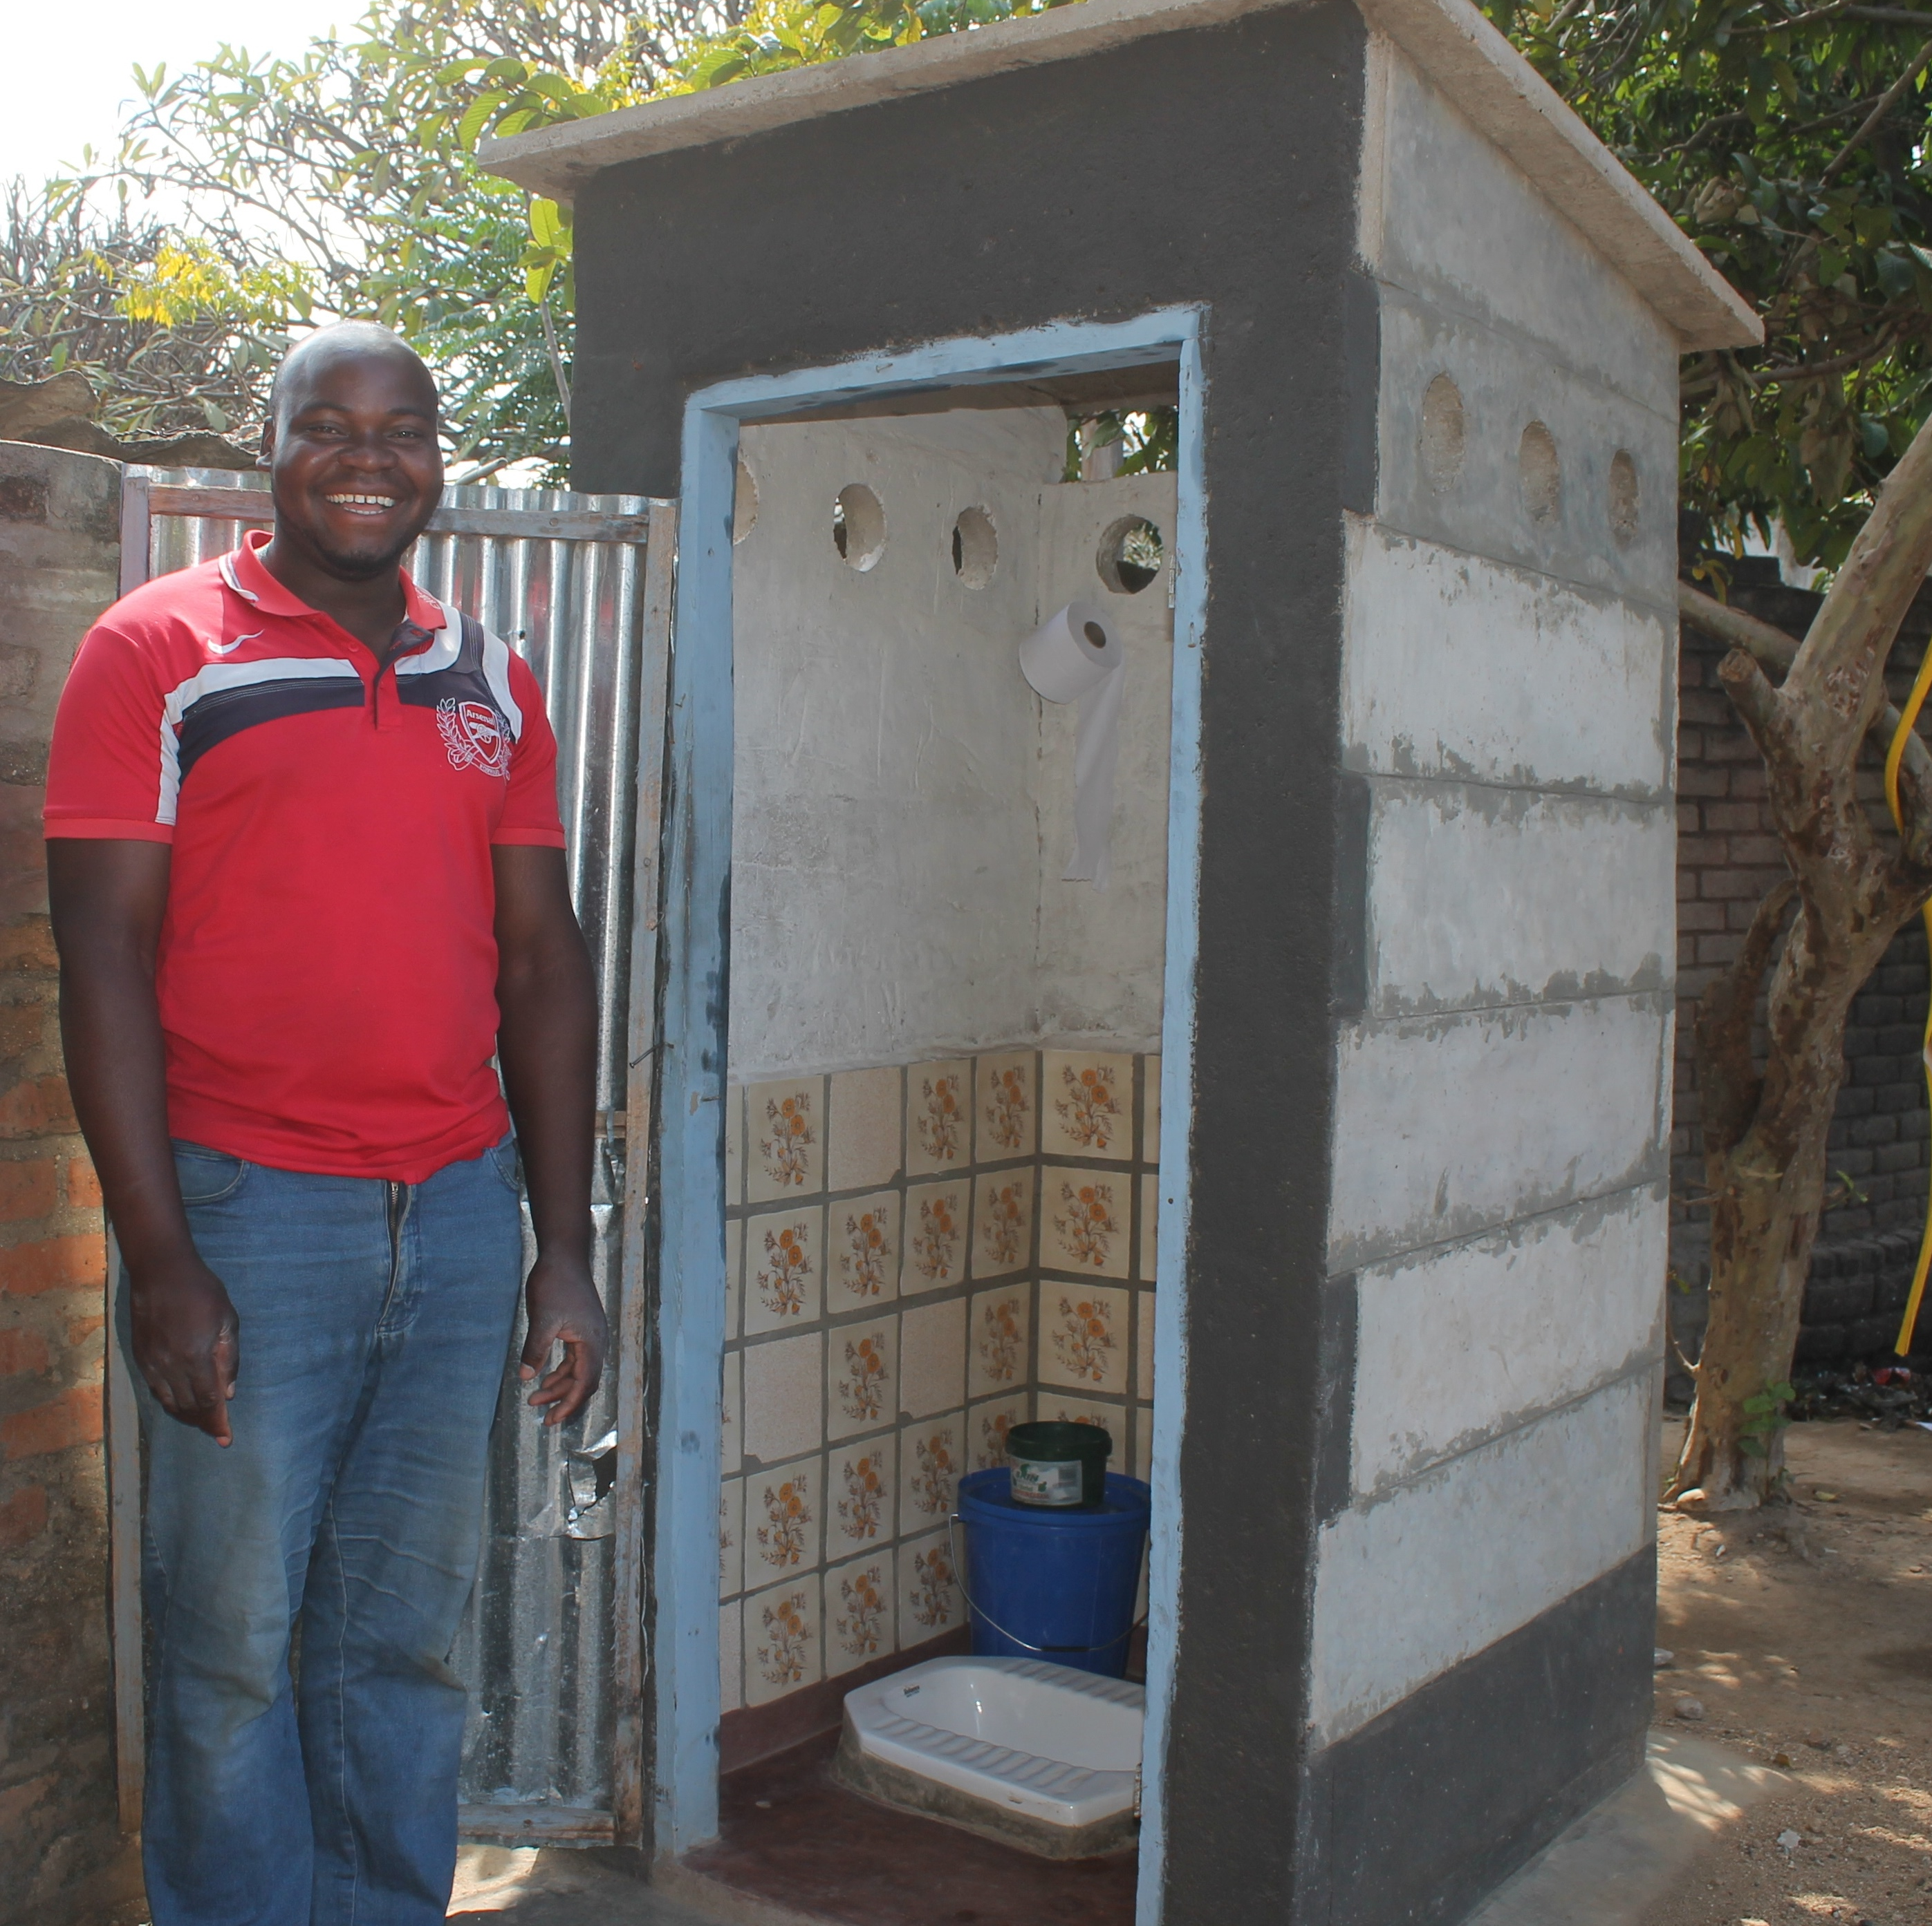
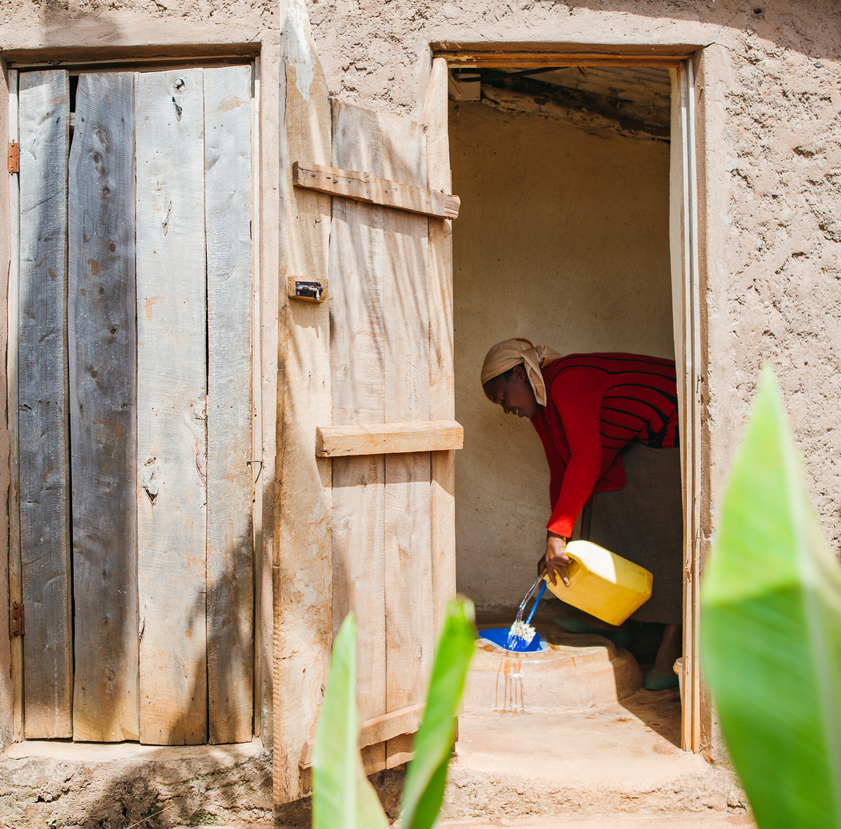
Successes: Malawi & Rwanda
From 2019 – More than 937 HHs have constructed/upgraded their latrines through sanitation loans ( 767 in Rwanda & 170 In Malawi).
78 SACCOs enrolled in the program
19 sanitation entrepreneurs were supported to have access to finance through the initiative
More than 700 upgraded through VSLAs in Rwanda
Impact: Some SACCOs are introducing "Home Improvement Loans" as new products

Slide 9
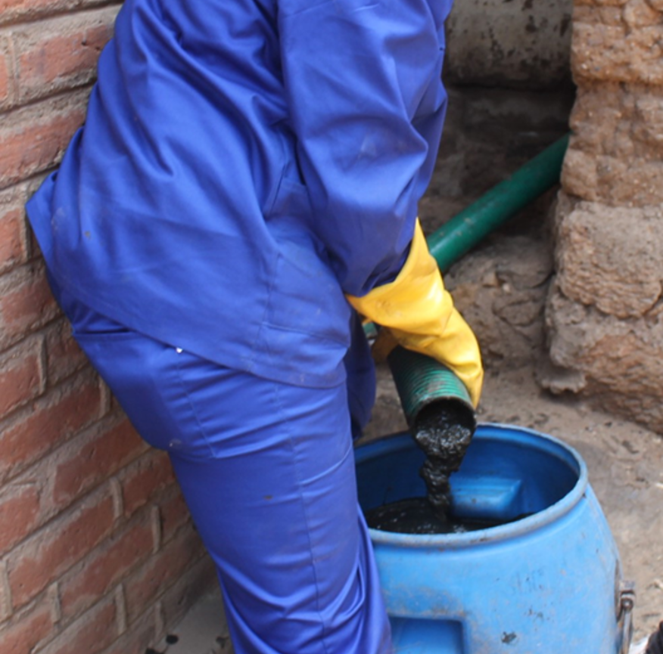
Challenges: Malawi & Rwanda
MFIs not yet committed to use their
own funds
Limited funds
Market distortion influenced by other institutions which do not use Market
based sanitation

Slide 10
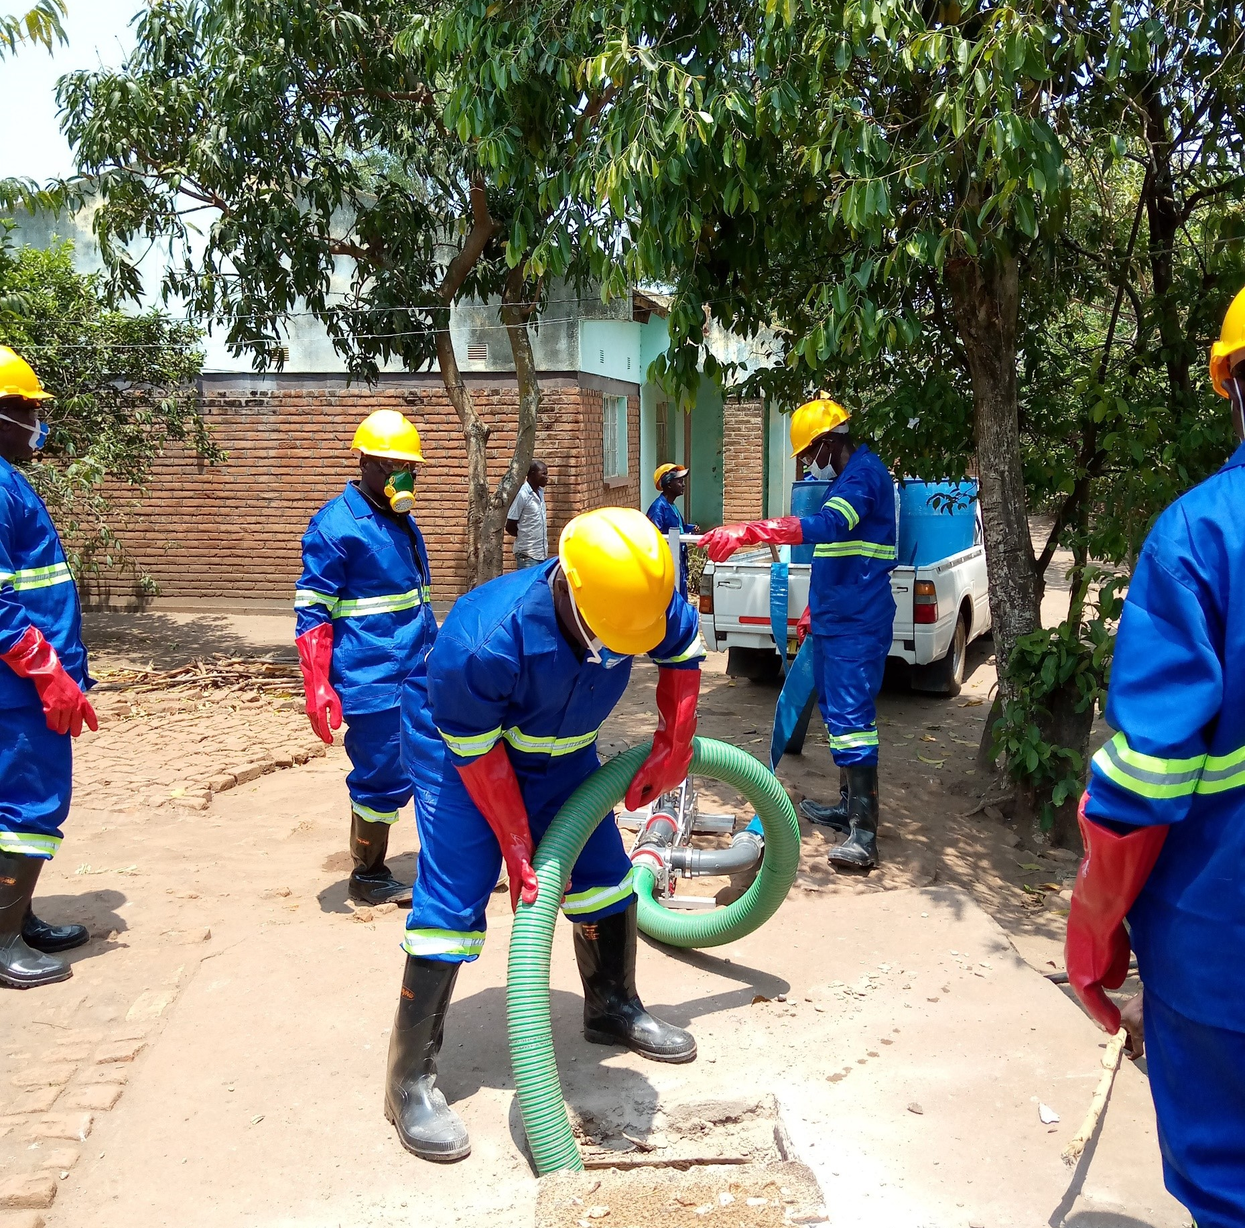
Lessons learnt
Malawi & Rwanda
SACCOs' willingness to participate in this model creates an opportunity for demonstrating to the financial sector business opportunities available in sanitation service provision.
Need for behavioral change as sanitation is not considered as a priority worth to get a loan for – leading to slightly low loan uptake in Malawi
Rural households still reluctant to work with institutions and prefer VSLAs-Rwanda

Slide 11
The next steps
  Scale out the initiative nationwide
  Bring on board more financing institutions to introduce sanitation loans
  as a product
  Lobby for increased funding and independence of the Sanitation financing product by financial institutions

Slide 12
Resources and more info slide
< Space for logos >

Slide 13


















All Systems Connect 2023 is made possible thanks to the generous support of our partners including the World Health Organization and :

