Slide 1



Slide 2
Decentralised public finance and expenditure tracking for WASH:
The role of CSOs in WASH budget and policy advocacy

Slide 3
About the Case Study/Project
Objectives:
Building the capacities of CSOs and communities in budget tracking, analysing allocations of WASH financing from the national and sub-national levels, along with expenditure at the local level WASH.
Facilitating a dialogue with service providers and communities to examine the evidence generated from the analysis to improve WASH service delivery
Coordinated and supported between 2018 and 2020 by:
IRC project-”Capacity Building Support for Civil Society Organisations to Leverage Water and Sanitation Programmes in Bihar and Odisha”
WaterAid India project- “Scaling-up Capacity Building Support for Civil Society Organisations to Leverage Water and Sanitation
Programmes in Bihar and Odisha: Budget Tracking and Using the Life Cycle Cost Approach in Rural WATSAN”

Slide 4
Methodology
Preparatory work such as formative research, capacity building manual for CSOs, life-cycle cost analysis (LCCA) framework for budget analysis.
Capacity building: workshops carried out in the districts.
WASH budget analysis at national, state district and Gram Panchayat *(GP) level.
Outputs, dialogues and dissemination at national, state district and village level.
Workshops on findings at the GPs.

Slide 5
Impact of the
Intervention
gram panchayat budgets, ganjam district
%age watsan expenditure on total expenditure
Increased capacity among CSOs in
budget tracking.
Elected leaders better able to respond to the communities and engage with officials at district level.
In Odisha, requirement to include O&M costs was discussed with State’s Planning and Convergence Department.
Village communities set up registers to list O&M needs and suggestions.
Awareness on importance of O&M costs increased. Households started contributing 30–60% of recurring costs of community-level WASH services.
Source: Primary data collected by CSO partners,
Gram Utthan from line departments, Ganjam district, October 2019

Slide 6
“While it has taken time for us to understand the requirements for using finance commission funds, the devolution of resources has helped our communities.
Going ahead we will make better use of this.”
Hemendra Pandit, GP representative , Bhagwanpur Kamla, Samastipur, Bihar

Slide 7
Limitations and Challenges
Poor data availability and quality:
Lack of data availability. outdated or incomplete data at district and sub-district levels
No clear information on fund utilisation in programme implementation plans
Reluctance from authorities to share and lack of capacity
District level authorities reluctant to share data
Despite training, CSOs capacity not equipped enough data collection and assessment
Gender aspects:
Gender was neither a parameter of the project nor explicitly mentioned in LCCA
GPs with active women self-help groups saw greater participation in the initiative
Timeframes and COVID:
Larger advocacy agenda could not be fully pursued due to COVID-19 lockdown

Slide 8
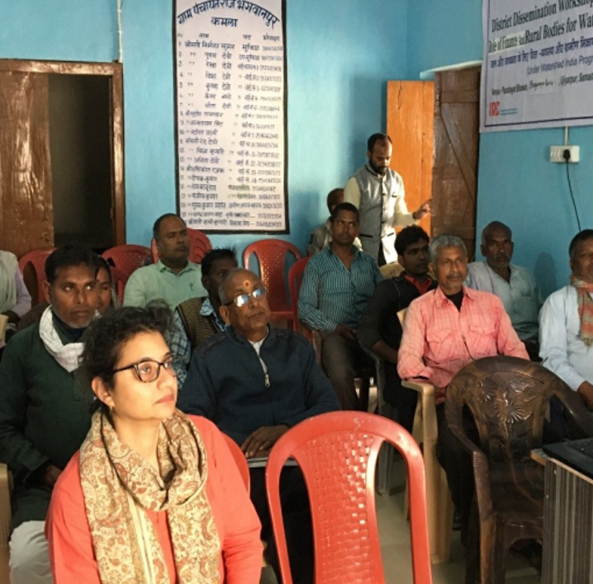
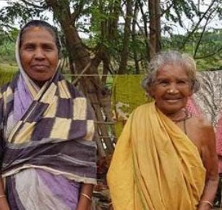
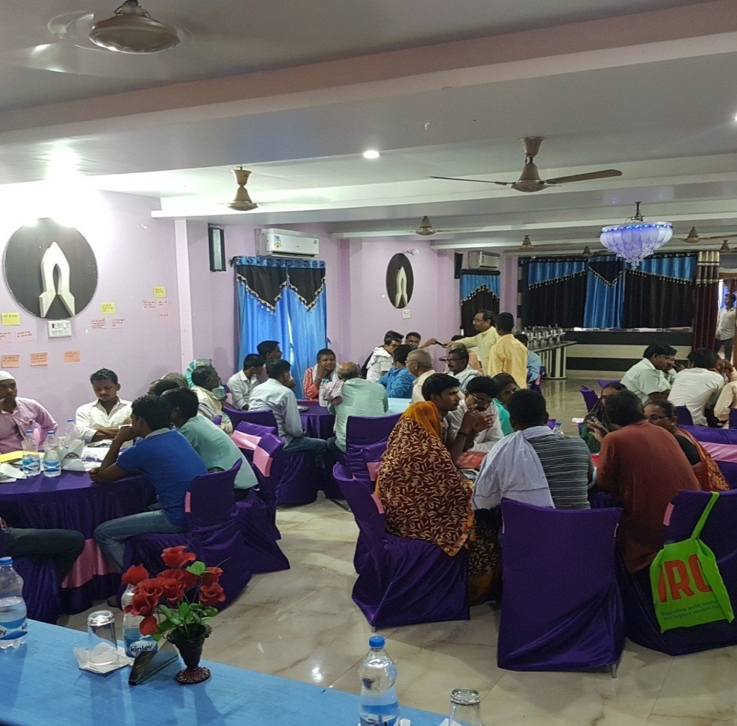
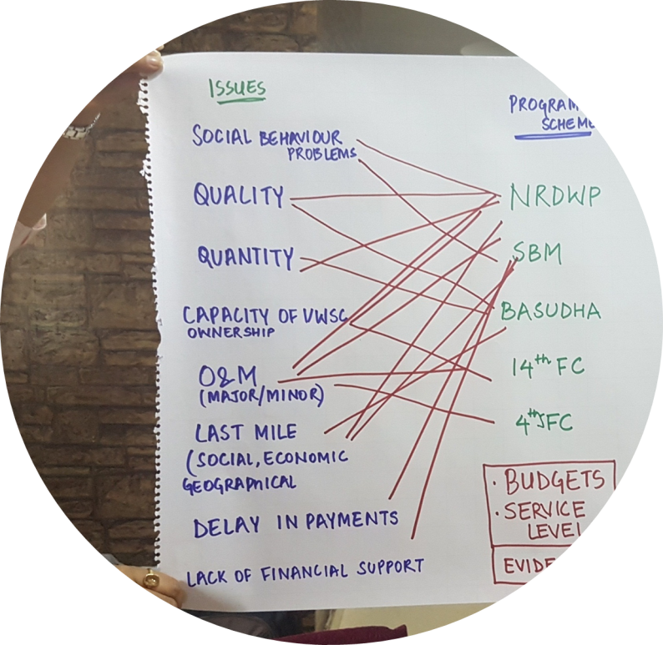
Lessons and learnings:
Life-cycle cost analysis: helped understand requirements for WASH budget and highlighted the importance of O&M costs.
Sustainability of budget advocacy : enabled by intensive capacity building and extensive efforts to engage communities.
Participation of communities, CSOs and elected leaders was key.
Role of local governments: Limited understanding of NGOs/CSOs on officials/offices for WASH. Local
officials and elected leaders
engagement is critical.
Reflections:
Buy-in from the State government officials is critical
Regular training and capacity building in WASH budget tracking of government officials and elected leaders by a State accredited institute.

Slide 9

Resources and more info
Contact:
Centre for Budget and Governance Accountability (CBGA)
B-7 Extn./110A (Ground Floor), Harsukh Marg,
Safdarjung Enclave, New Delhi-110029, India
Tel: +91 11 49 200 415 / 400 / 401, 4050 4846 (telefax)
Follow us on: www.cbgaindia.org |Facebook |Twitter|
Email: trisha14@gmail.com
https://www.cbgaindia.org/wp-content/uploads/2020/08/Policy-Brief-Role-of-PRIs-in-WASH.pdf
https://www.cbgaindia.org/wp-content/uploads/2020/08/Tracking-Budgets-for-Rural-WASH-Odisha.pdf
https://www.cbgaindia.org/wp-content/uploads/2020/08/Budgets-for-WASH-in-Social-Sector-Institutions-Nuapada.pdf
https://www.cbgaindia.org/blog/training-wash-governance-lessons-field/
https://washmatters.wateraid.org/publications/water-sanitation-and-hygiene-budget-advocacy-lessons-from-south-asia

Slide 10

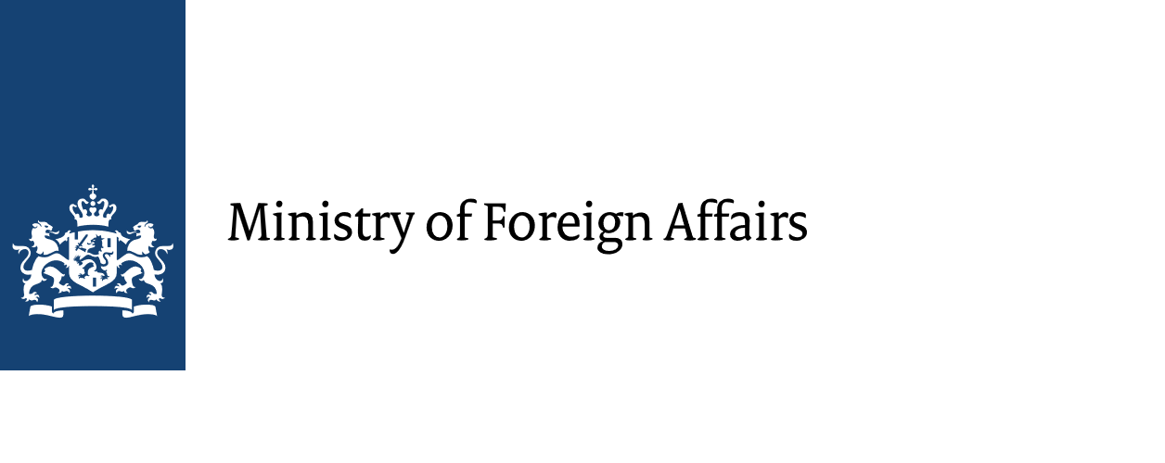




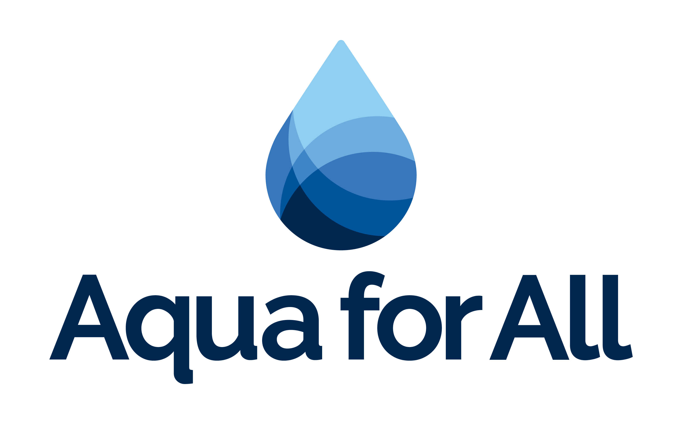




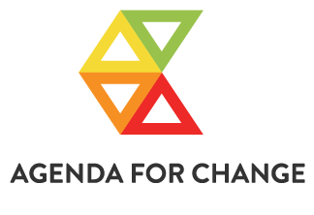






All Systems Connect 2023 is made possible thanks to the generous support of our partners including the World Health Organization and :

