Slide 1


Slide 2

Mobilizing public finance for WASH at sub-national level of Bangladesh
Experience of WASH SDG Programme.

Slide 3
Welcome to presentation of Simavi
WASH SDG Programme Bangladesh

Slide 4
Public finance flow at sub national (District) and local level (Union Parishad and Municipality)
DPHE, LGED, DOE,
WASA
Revenue Budget from Central Govt to Local Government Institution
Development Budget from Central Govt. to Local Government .
Local Government own income
Govt. WASH service provider at District level
Govt. WASH service provider at Sub-district level
Salaries and Administrative cost
Service Delivery and project preparation
Govt. WASH service provider at Union level
(Tax, charges, fee, land tax etc).
Implementation of Project & Service delivery

Slide 5
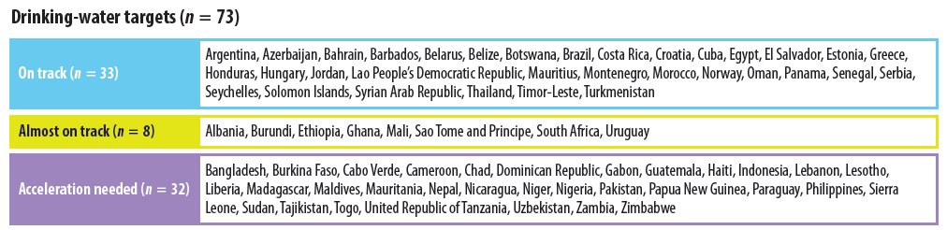
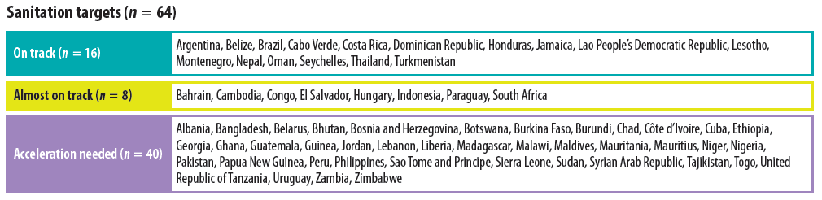
SDG-6: Bangladesh is within the group “Acceleration needed”
“Acceleration needed” category
GLAAS 2021/2022 Report

Slide 6
Public WASH Budget Allocation (in Million USD)- Bangladesh
WASH Budget has increased over 3 times since the MDG era. ​
To meet the SDG 6 target additional financing need
Expenditure tracking is also important​
Capacity enhancement for mobilizing funds in a timely manner.​
17 Billion USD (2016 current price)

Slide 7
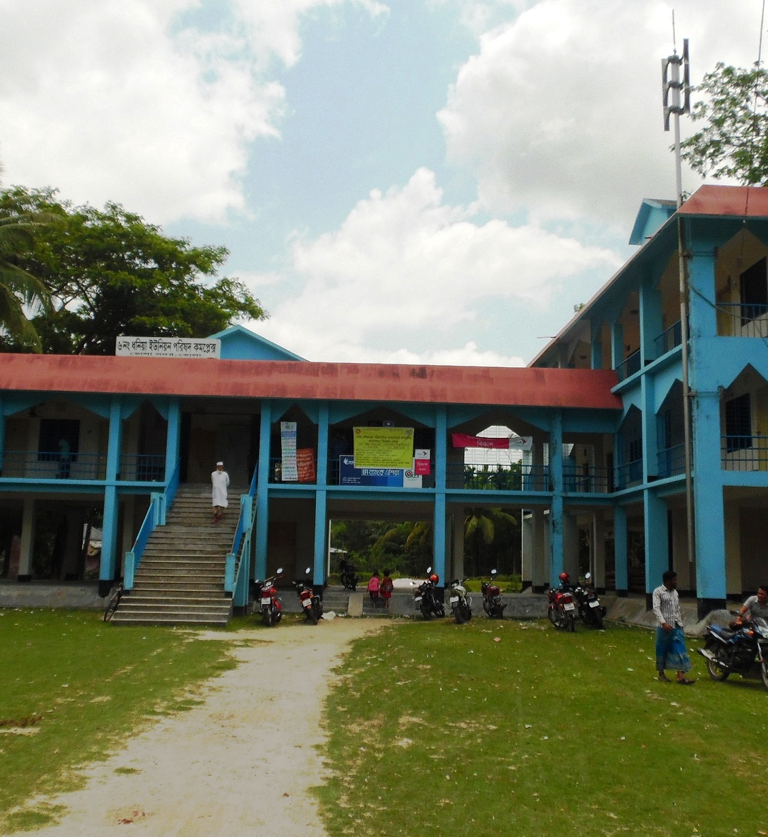
Local Level Public Financing(Million USD)
Data source: World Bank Public Financing report 2019
1USD=55 BDT in 2001, 1USD=75 BDT in 2012,

Slide 8
Why Mobilizing public finance for WASH?
Increase of WASH Allocation at Local government Institutions (LGIs)
To track equitable WASH budget
Accountability of Local government Institutions and increase efficiency of budget spending.
Help to realize the human rights to water and sanitation
Who benefits from it?
Women, poor and excluded people are benefited

Slide 9
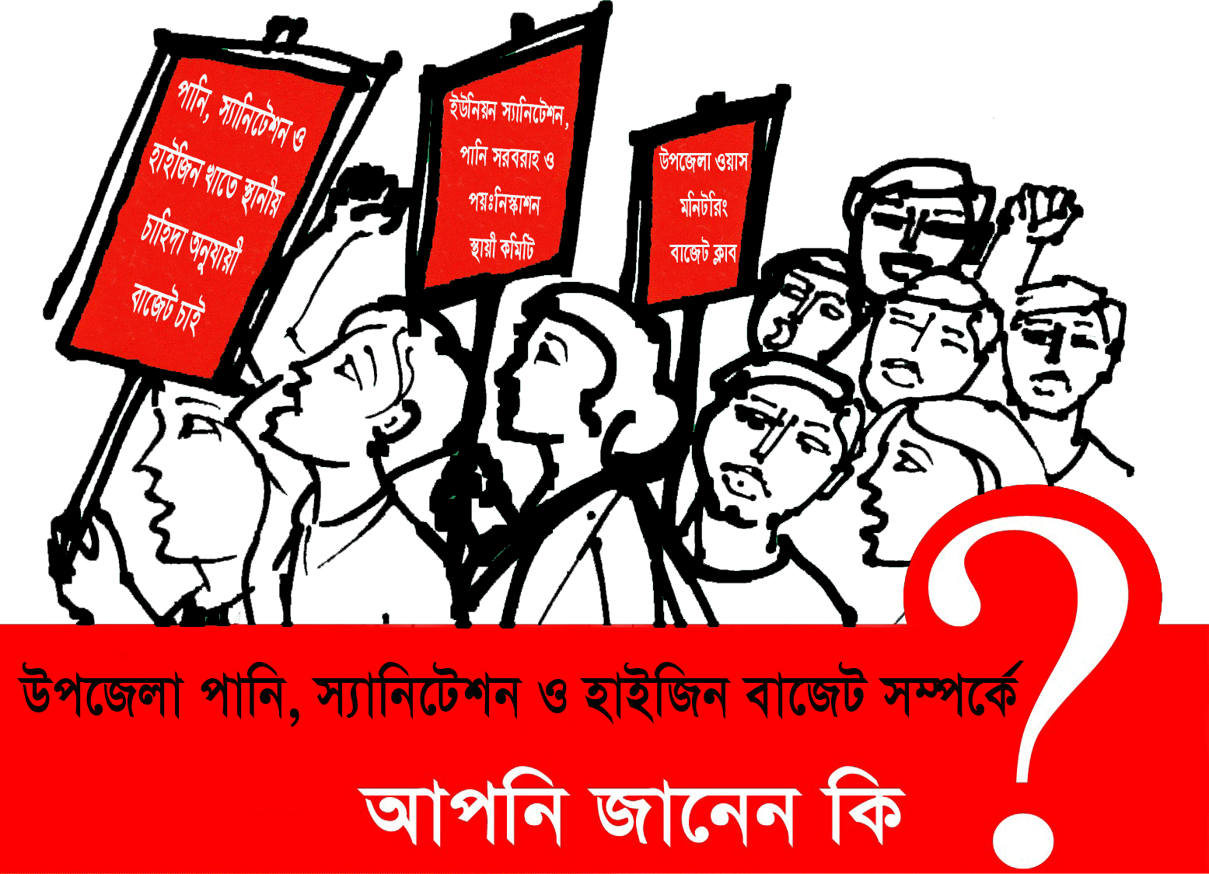
Budget Tracking
Campaigns and Social Mobilization
WASH Service Monitoring
Lobby and Advocacy
WASH Budget Tracking

Slide 10
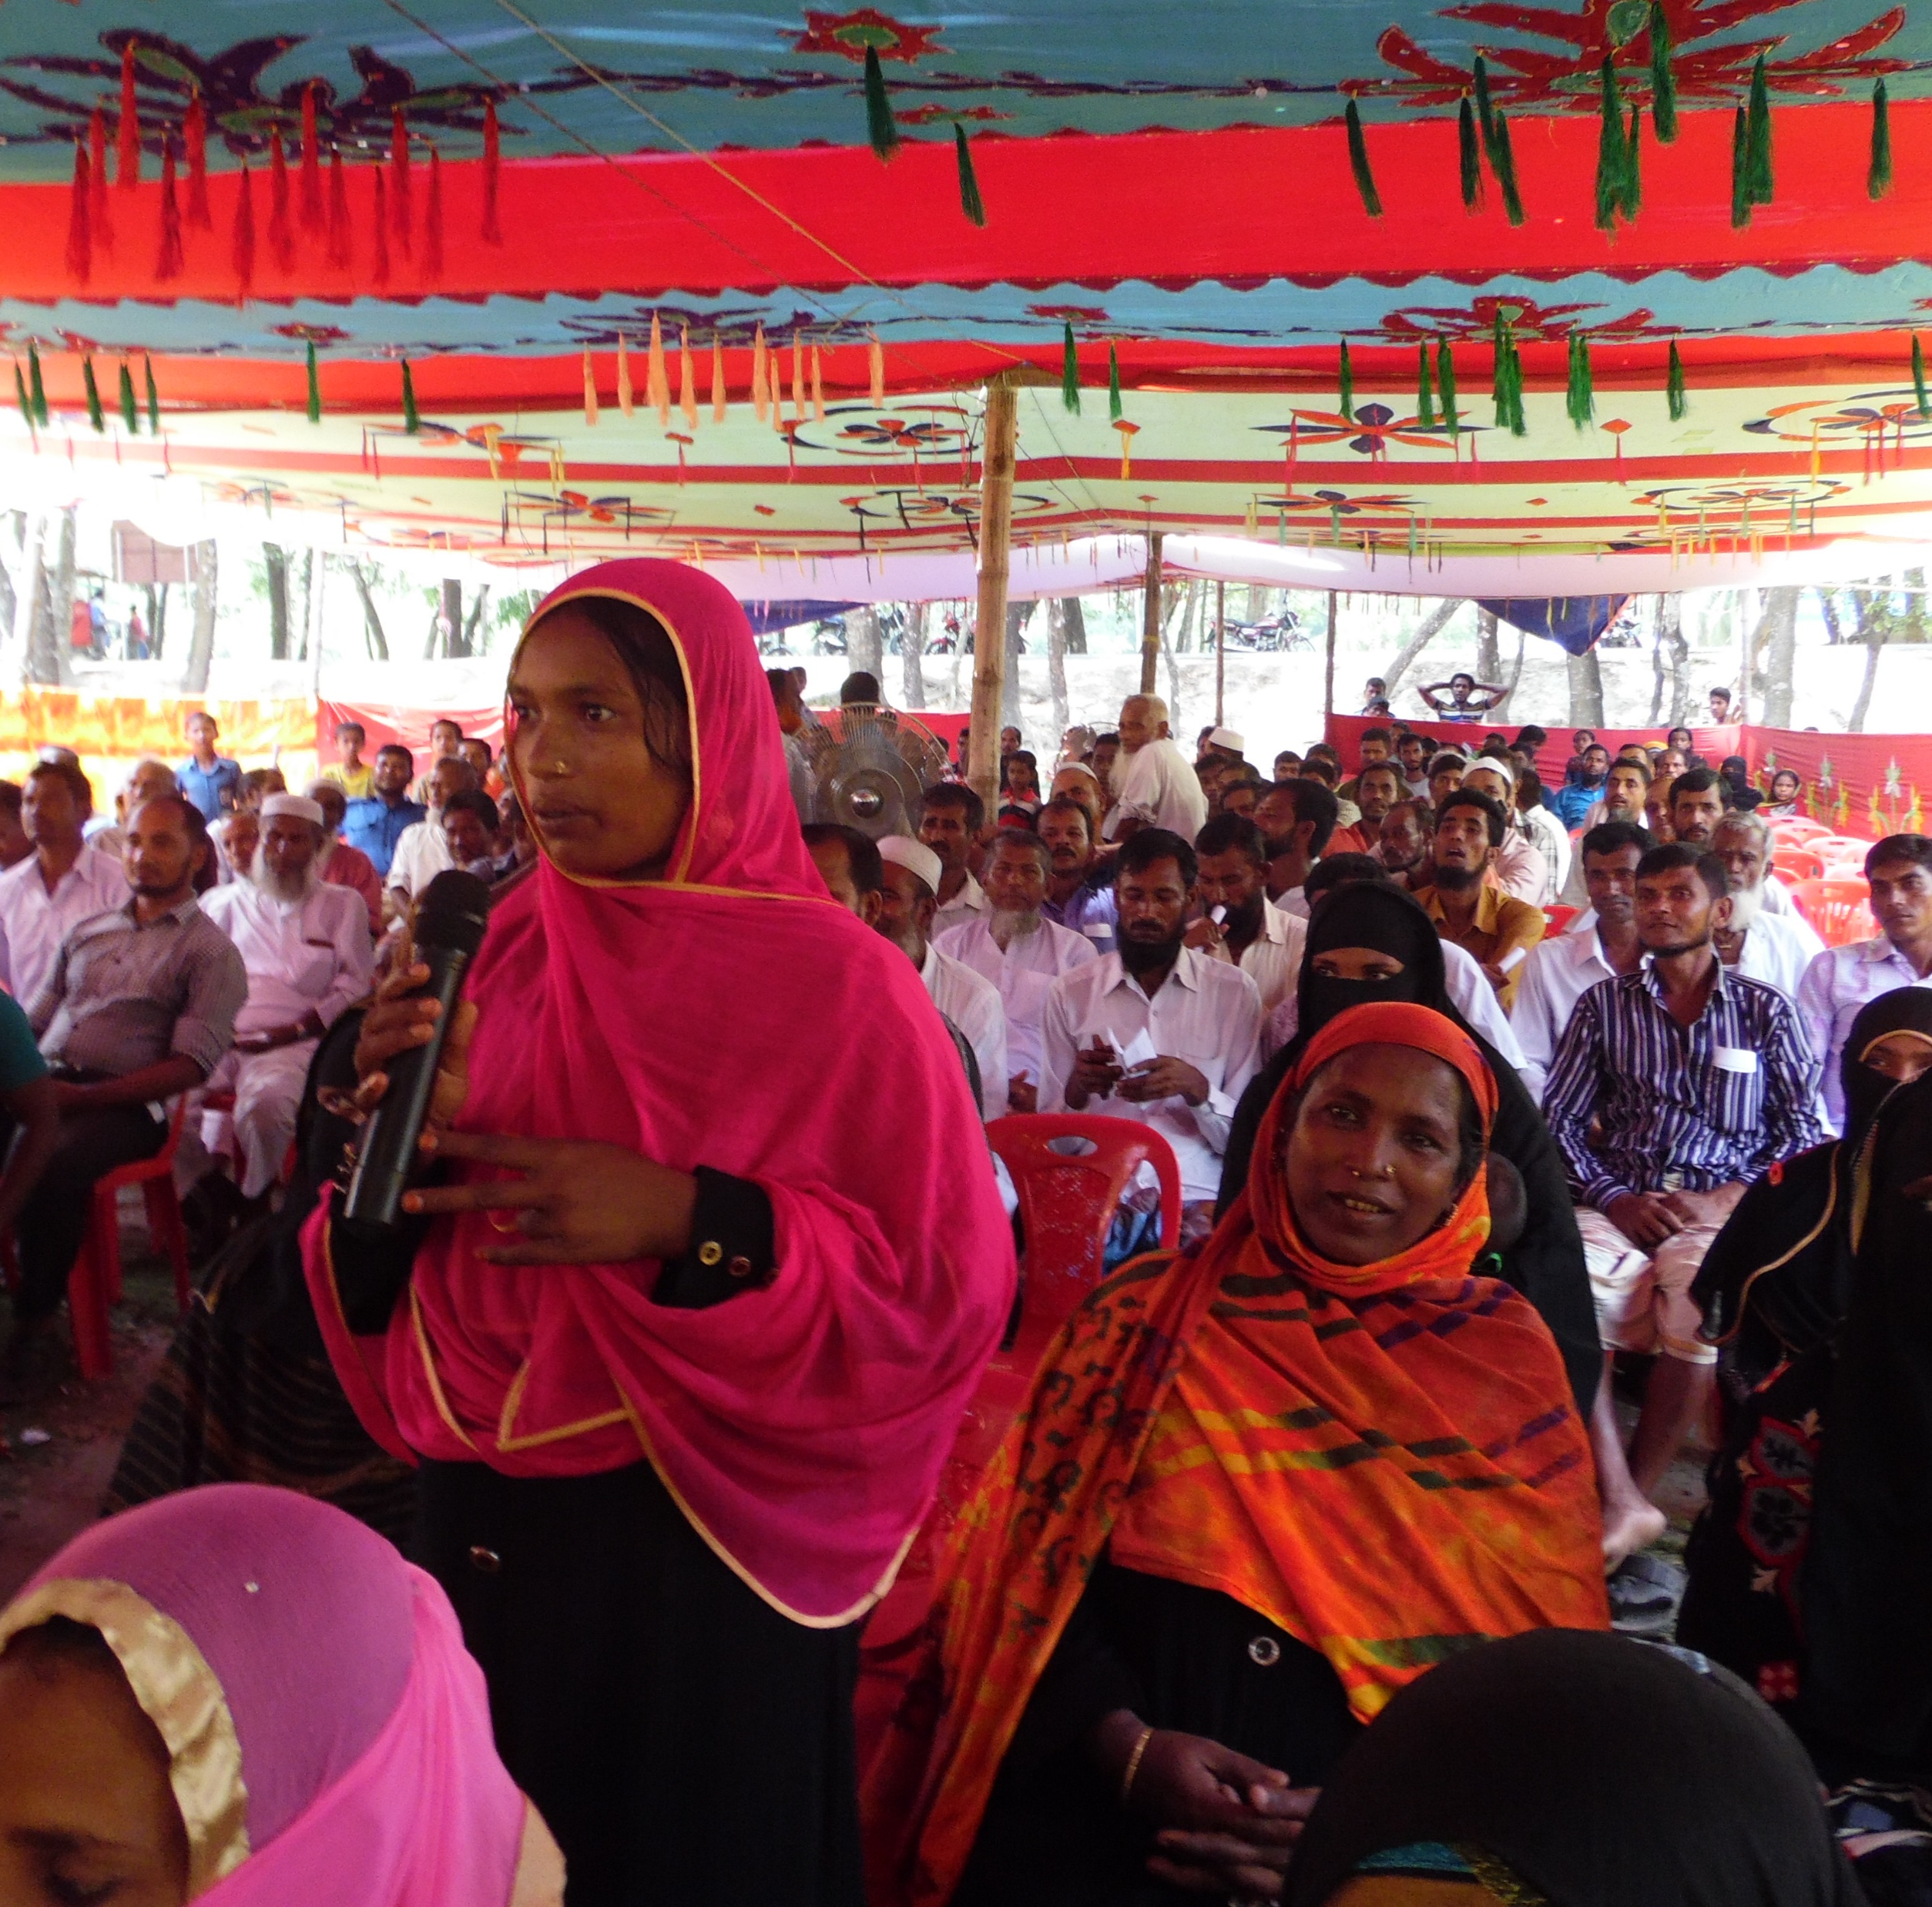
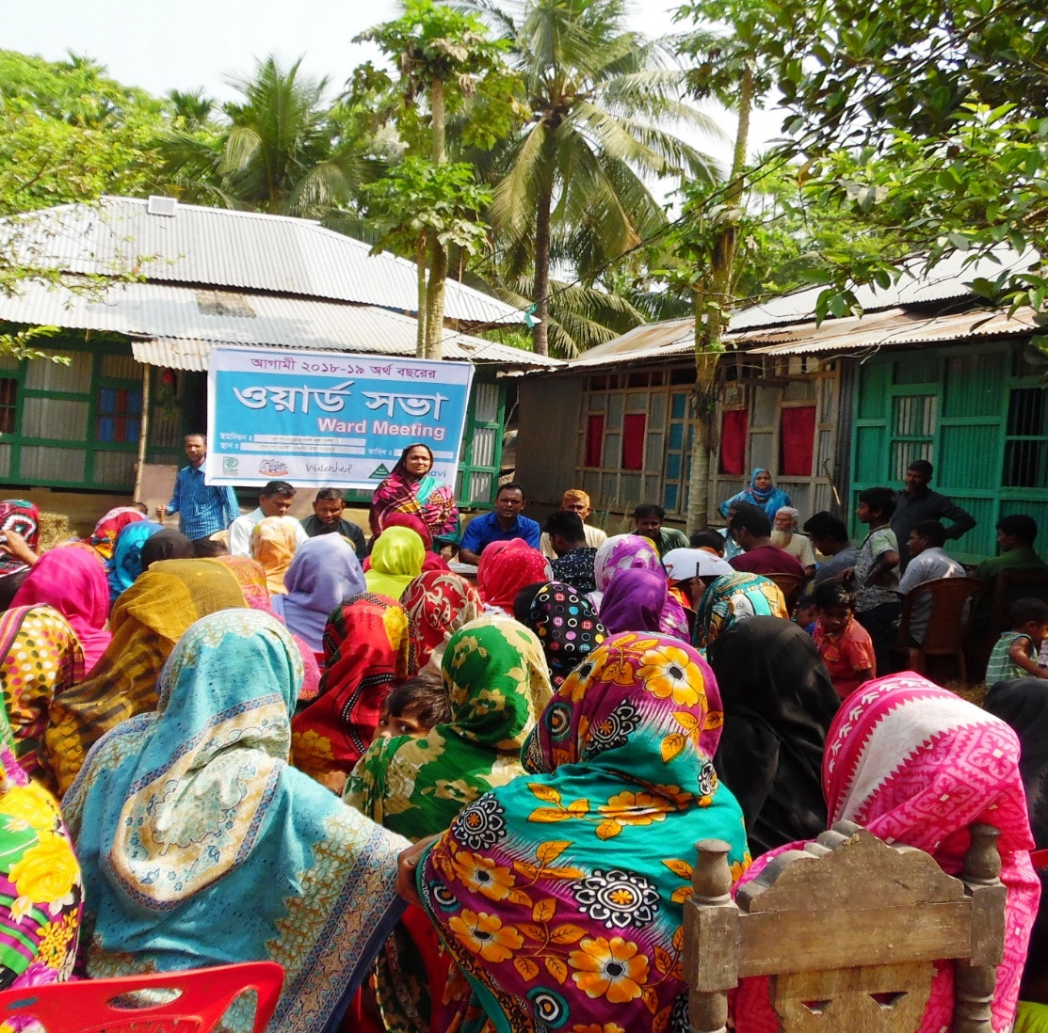
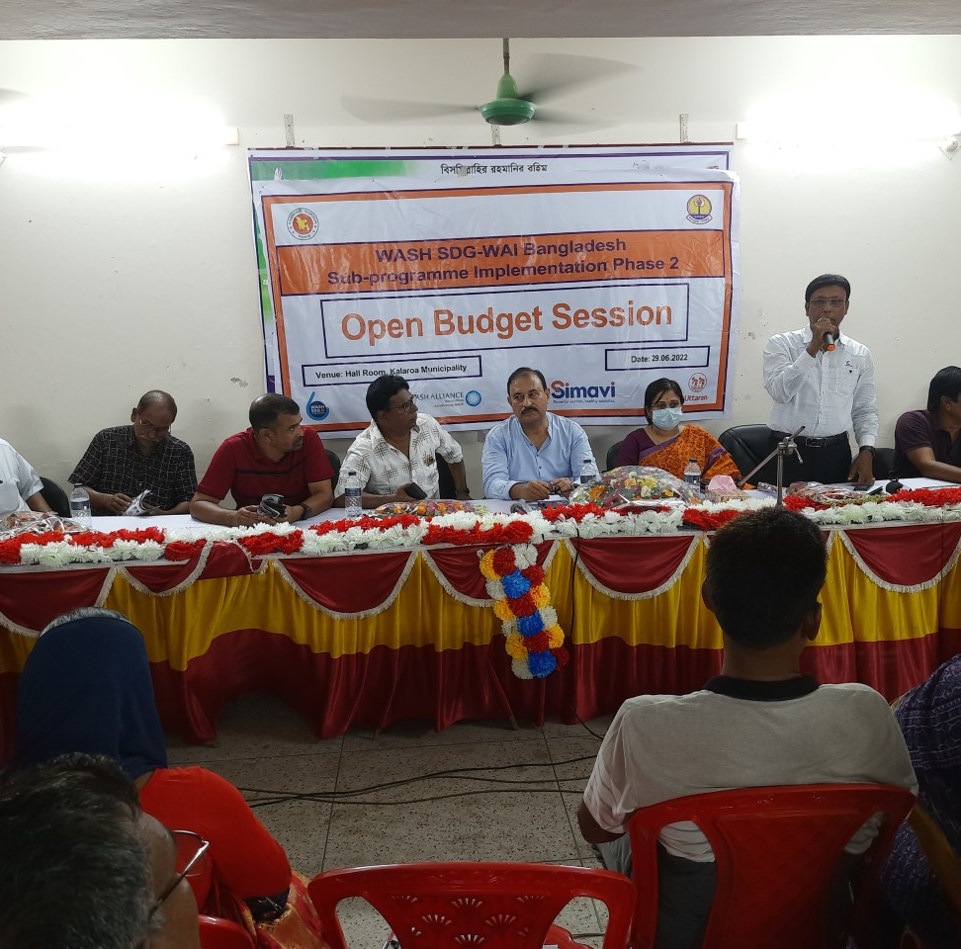
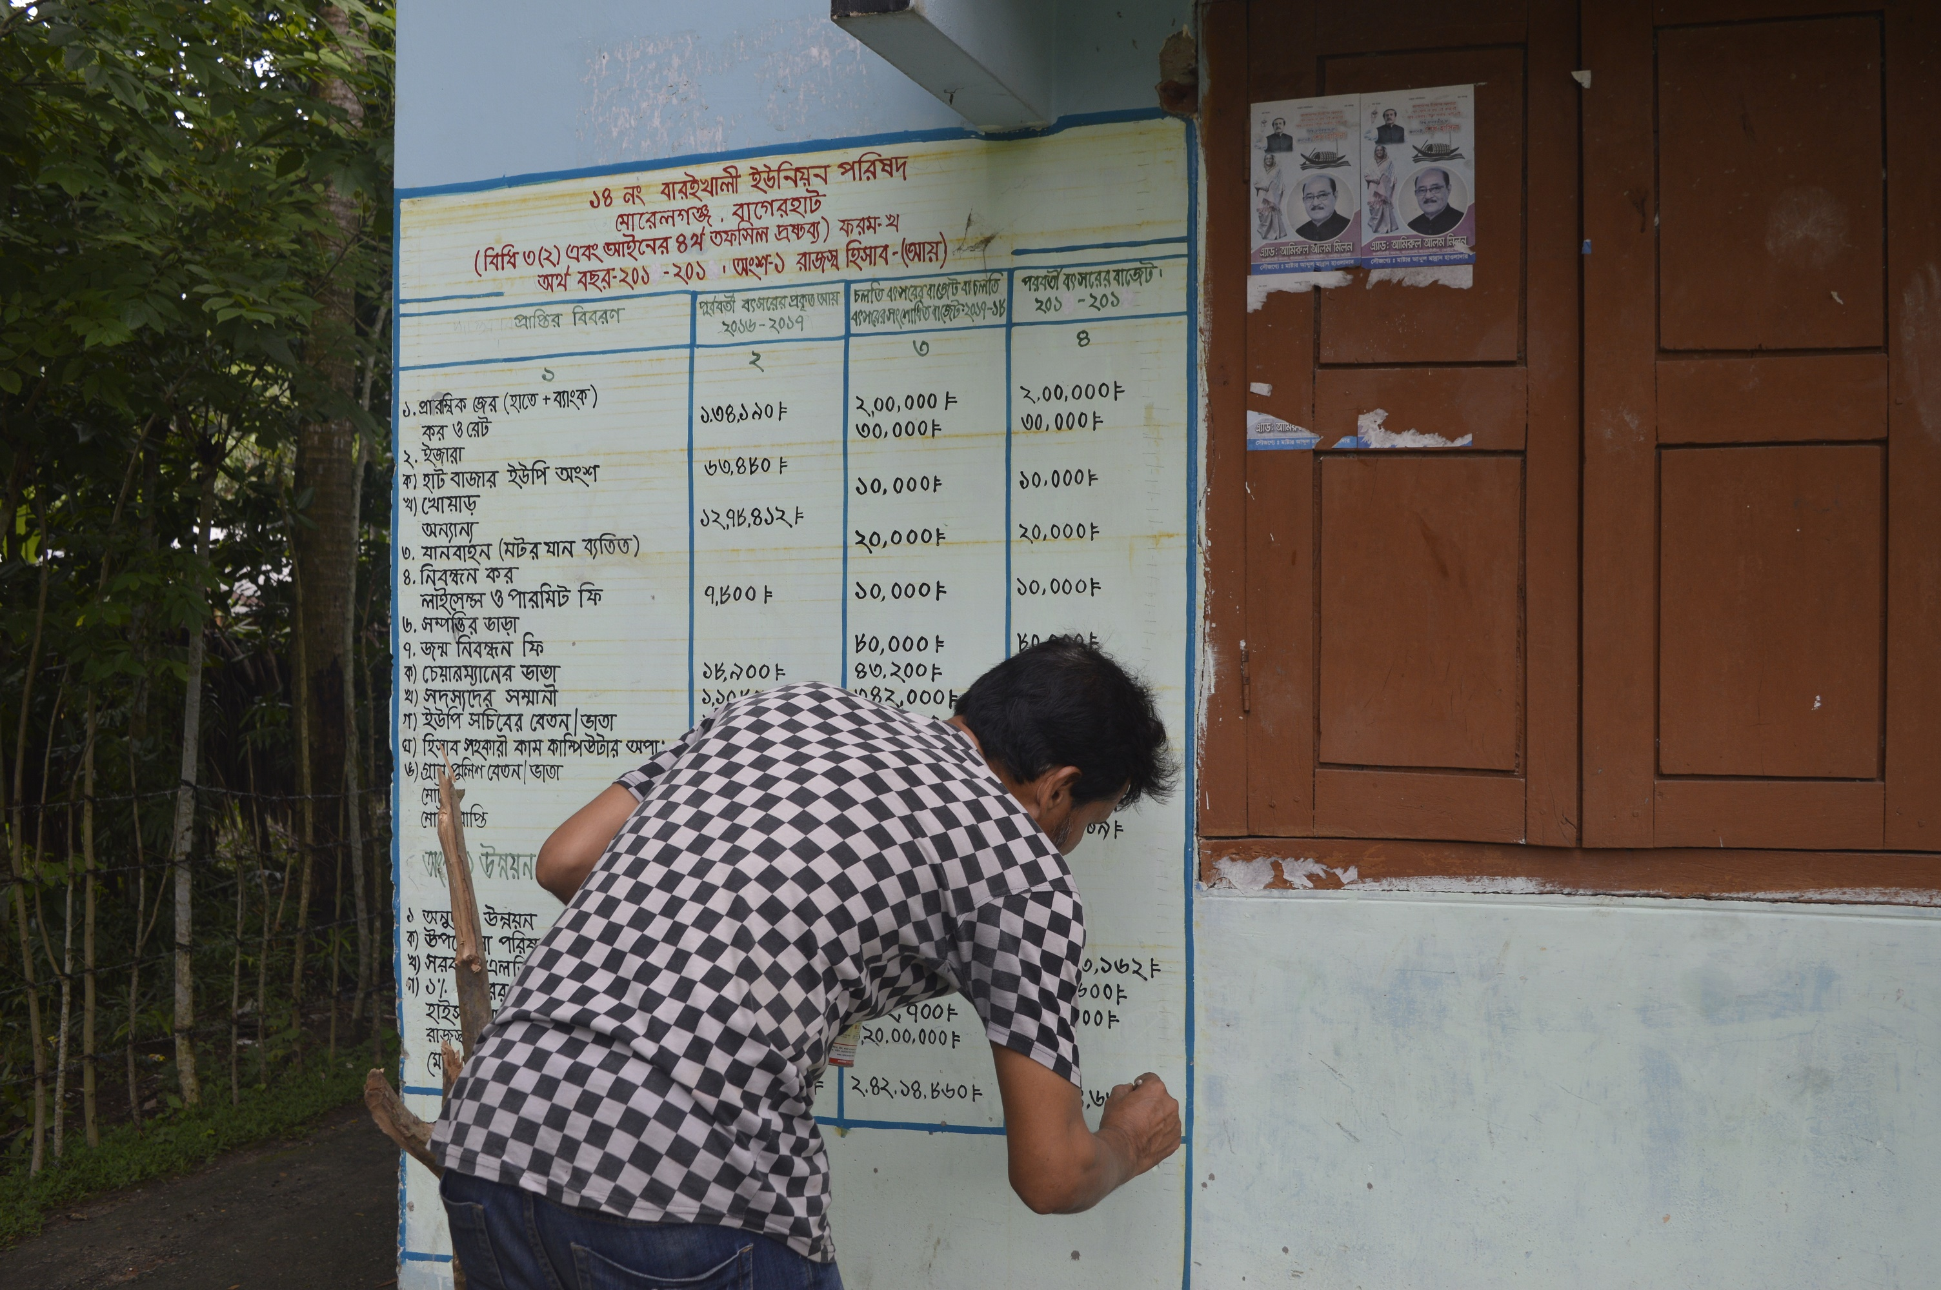
Open budget process at Local government
Open budget declaration: Public meeting. For review and endorsement
Ward Meeting for WASH demand assessment.
Budget drafting meeting at LGIs
LGI budget at open place for transparency

Slide 11
Inclusive and Gender Responsive WASH Budget Monitoring Tool
Budget head | Proposed (Million Tk.) | Approved (Million Tk.) | Received (Million Tk.) | Expenditure (Million Tk.) | Reasons for Deviation | Segregated WASH budget
 |  |  |  |  |  | Women/ girls | Elderly | Persons with disabilities | Excluded groups
Health care and water
Health service and water supply
Advertisement & dissemination
Repair & maintenance
Tube well and latrine installation | 2 | 2 | 2 | 1.5 | Rain &Flood | 0.4 | 0.2 | 0.2 | 0.1
Village Water Supply Project.
National Sanitation Project (3rd Phase) | 6.5 | 6.5 | 6.5 | 6 | Late fund received | 1.0 | 0.5 | 0.5 | 0.3
Char Development and Settlement Project-4 (DPHE)
Public toilet construction at Bus stand | 0.5 | 0.5 | 0.5 | 0.6 | Price hike | - | - | - | -
Notes:
Why are there row with budget lines but then no information to the left?

Slide 12
Results of Open Budget and Budget Monitoring Tools
Open budget WASH budget monitoring tools
Accountability
Transparency
People participation and trust
Tax collection increase
Sustain WASH budget increase
Equitable WASH Service

Slide 13
Result: Public WASH Budget increased at Municipality (USD)

Slide 14
Result: Public WASH Budget increased at Union Parishad (In USD)

Slide 15
“Open budget process and inclusive gender-responsive budget monitoring tools are very effective to ensure people’s participation and trust on the institutions.
Within 4 years tax collection in my union parishad has increased around 3 times”.
Abdul Kuddus Alo Akand-Chairman, Barguna Sadar Union Parishad.

Slide 16




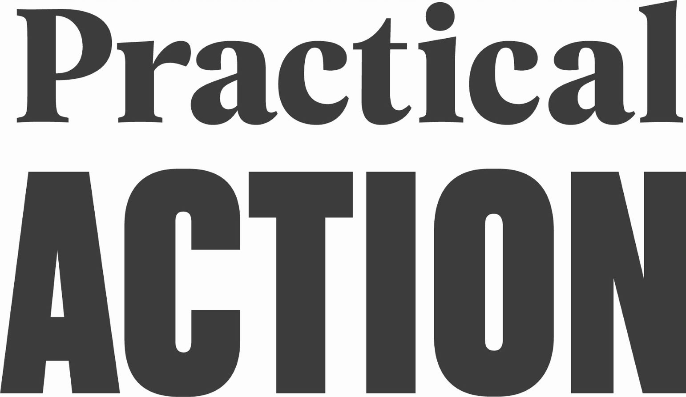

Acknowledgement to the Local Partners
Notes:
WASH alliance logo?

Slide 17

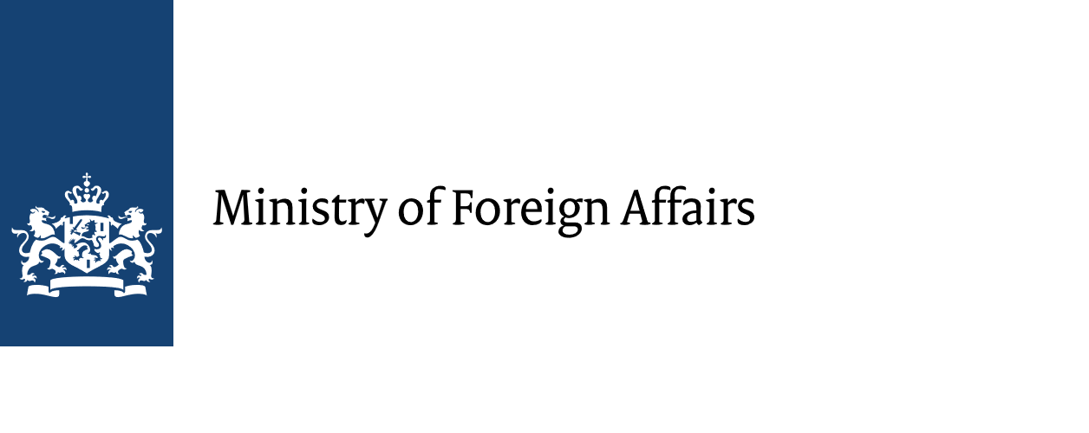




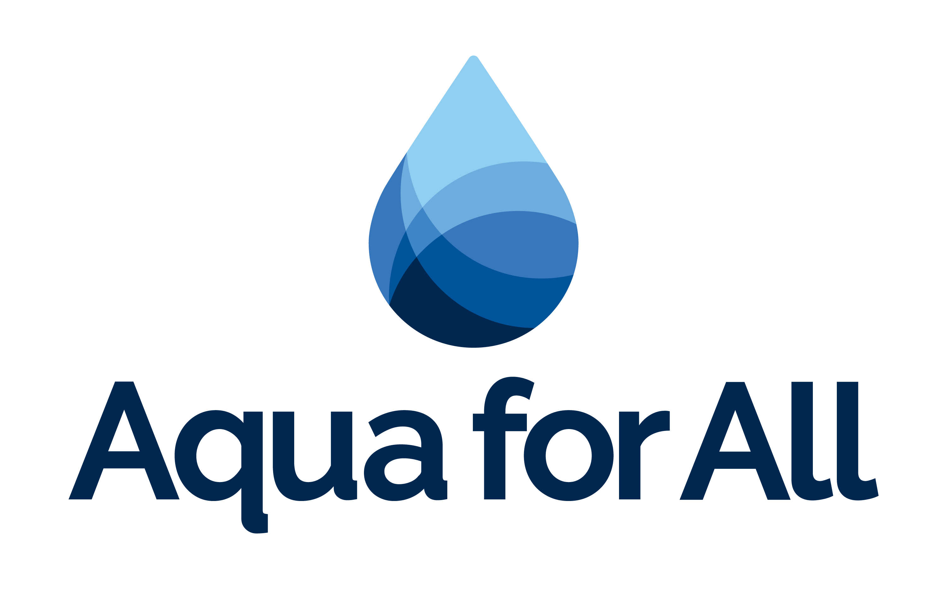











All Systems Connect 2023 is made possible thanks to the generous support of our partners including the World Health Organization and :

