Slide 1



Slide 2
A Tale of Two Cities
Government Co-funding for WASH
in Schools, Ethiopia

Slide 3
About Splash
Using the city as the unit of scale, we work with diverse partners to improve the delivery of WASH services to schools while creating systemic change in how WASH is managed, maintained, and financed by governments.
Key aspects of our approach include:
Local partners
Local products
Leveraged local funding
Designed for replication by NGOs and governments
Clear exit strategy

Slide 4

In 2019, we launched a bold new project, WASH in Schools for Everyone.
In Ethiopia, we aim to reach all public schools in two cities – Bahir Dar and Addis Ababa – with water, sanitation, hygiene, and menstrual health support, serving 700,000 kids by 2023.

Slide 5
The Cities
Addis Ababa
Capital of Ethiopia
5.4M population
4-5% annual population growth rate
500+ government schools
600,000+ students
Bahir Dar
Capital of Amhara State
~500,000 population
4-5% annual population growth rate
56 government schools
90,000 students
Notes:
Talk about why we work in Addis Ababa: the capital city, center of government, total population, water shortages

Slide 6
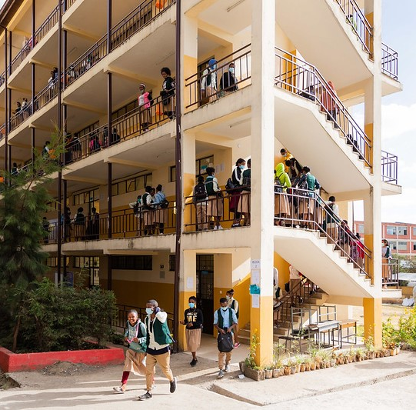
Addis Ababa:
The financing landscape
Commitments
  $8M committed in Addis Ababa for school sanitation
    Secured in 2018 ahead of the project start date in
    Ethiopian Birr terms
  $2.8M extension agreement secured
    Secured in 2022 along with a two-year project extension to enable more funding for sanitation construction
  $1.5M leveraged from World Bank
    The Water and Sewerage Authority constructed additional sanitation facilities using Splash designs with World Bank funding.
Notes:
In 2018, the Addis Ababa municipal government committed funding for construction of new sanitation facilities at schools, using Splash designs and standards.
Project sponsors include the bureaus of education, construction, finance, and
Funding flows directly to contractors, not Splash
$4M spent to date
In 2022, Addis Ababa approved a 2-year extension and allocated additional funding in hopes of reaching citywide coverage of improved sanitation facilities.
Due to substantial devaluation of the Ethiopian birr, along with inflation, the original commitment was not enough to meet our collective goals.

Slide 7
Addis Ababa: challenges & solutions
Challenges
Devaluation of the Ethiopian Birr (ETB) against the
US dollar led to lower investment in $ terms
High sanitation costs limited coverage
Government wanted WASH coverage to be distributed equitably across sub-cities, changing agreed upon plans
Delays in government budget approvals
Government-funded sanitation construction not concurrent with project implementation
Asked for $8M of CapEx, not OpEx
Solutions
Additional government funding committed
Reduced sanitation costs from $14K to $2K per
stall over time
Flexible implementation plans; aligning with government priorities
Playing a proactive role between the bureaus of finance and education
Strong government relationship & partnership visibility
Still negotiating over OpEx funding

Slide 8
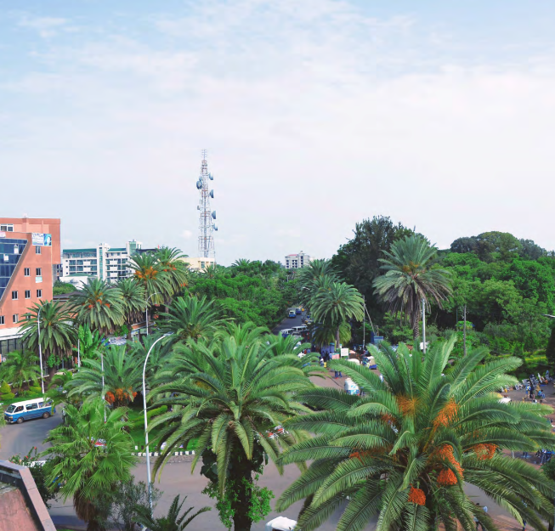
Bahir Dar:
The Financing Landscape
Commitments
  $3.1M committed by the Bahir Dar Municipal Administration and the Amhara State Government
    $2.1M for CapEx to improve school sanitation facilities
    $1M for OpEx to fund operations and maintenance over 10 years
  The education department is working with schools, communities, and NGOs like CARE Ethiopia to mobilize funding for the construction of
  toilets in schools.

Slide 9
Bahir Dar: challenges & solutions
Challenges
Ongoing inflation and currency devaluation
Spill-over regional conflict has impacted budget priorities
Several peri-urban school sites have no access to water; potentially raising costs
Solutions
Major inflation assumptions factored into project budget
Splash is raising additional philanthropic funding to supplement government shortfalls
Splash is working with local utilities to extend water access to schools, at
their cost

Slide 10
Secrets to success
  Align with existing government mandates and plans; be agile to accommodate requests
  Conduct an in-depth citywide survey in close consultation with government to clearly identify gaps in WASH coverage, as well as legislation, coordination,
  and capacity
  Show proof of concept, including cost effectiveness and rapid implementation time, to convince government to invest
  Bring significant matching funds to the table
  Seek funding from existing budget line items, e.g. sanitation and water storage
  Build a broad coalition of stakeholders; engage them frequently through mechanisms such as technical and steering committees
Notes:
The finance agency needs to come on board early
Both bureau heads and technical staff are essential
Develop relationships with all levels of government, from the Mayor to the sub-cities and woredas
Develop working groups, such as technical and steering committees
Hold frequent site visits to monitor progress

Slide 11
Lessons learned
  Mobilizing public funds is complex and requires playing a proactive coordination role to expedite budget approvals and project execution
  Commitments (even in MOUs and Project Agreements) do not equal annual budget allocations
  Plan for inflation and exchange rate risks
  Consider both CapEx and OpEx funding at the outset
  Manage expectations, for your organization and your donors
    Have a “Plan B” if government can’t meet commitments
    Ensure donors understand the need for flexibility and adaptability
  Think beyond service delivery – capacity building, advocacy, and coordination mechanisms are key for systems strengthening

Slide 12
What’s next?
Splash has had 30-35% co-investment committed by local governments, an amount that is exceptional in the WASH sector.
We aim to package our insights and learnings around government funding into a detailed case study and rigorously researched stakeholder engagement framework that will be validated with government and implementation partners.
Ultimately, we hope to share this knowledge with the sector and document learnings as we expand our work in Ethiopia as well as to Kenya, Bangladesh, and beyond.
Notes:
OR we could talk about the work we are going to do with HIlton Foundation to better understand gov't funding

Slide 13

Thank You!
Thank you!
Contact:
yodit.mekuria@splash.org
www.splash.org

Slide 14

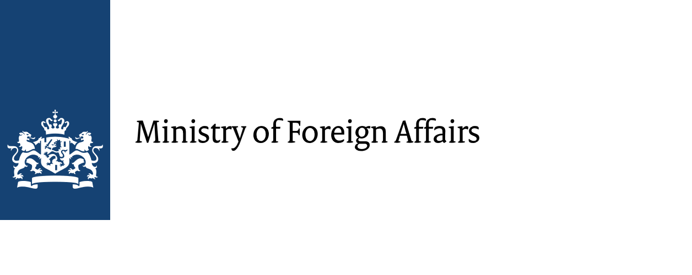


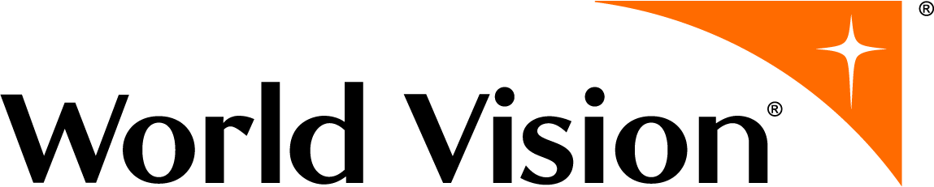

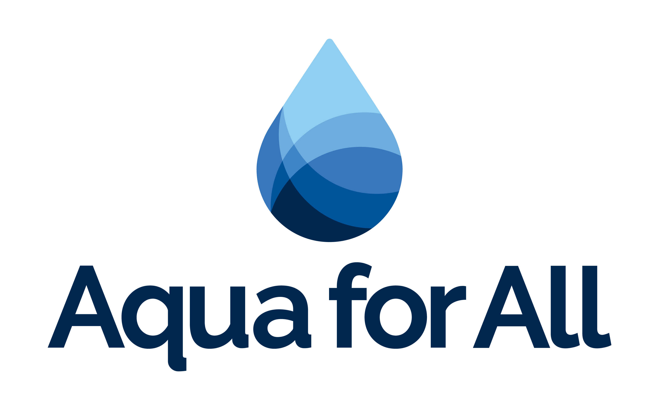




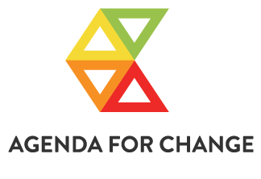
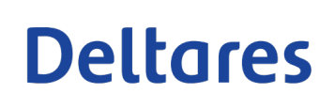



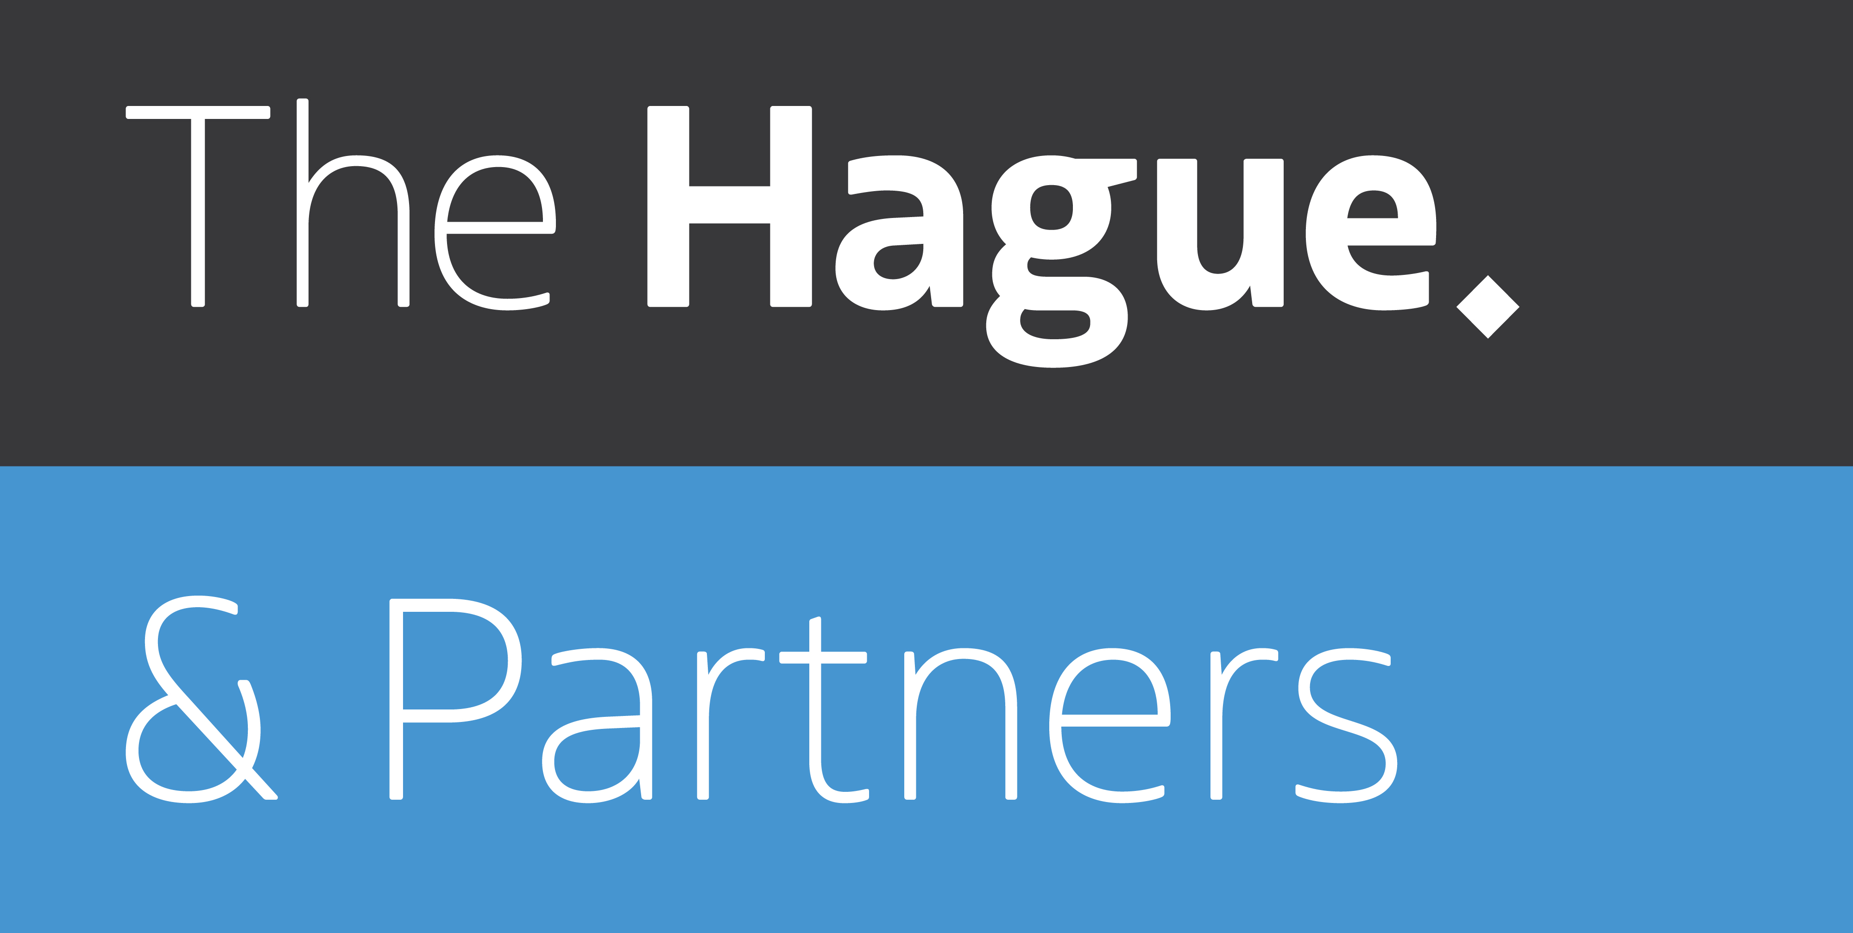

All Systems Connect 2023 is made possible thanks to the generous support of our partners including the World Health Organization and :

