Slide 1



Slide 2
Financing complexity:
Public-Private Partnerships for implementing ambitious WASH programs in Rwanda
Case of Gicumbi WASH Program

Slide 3
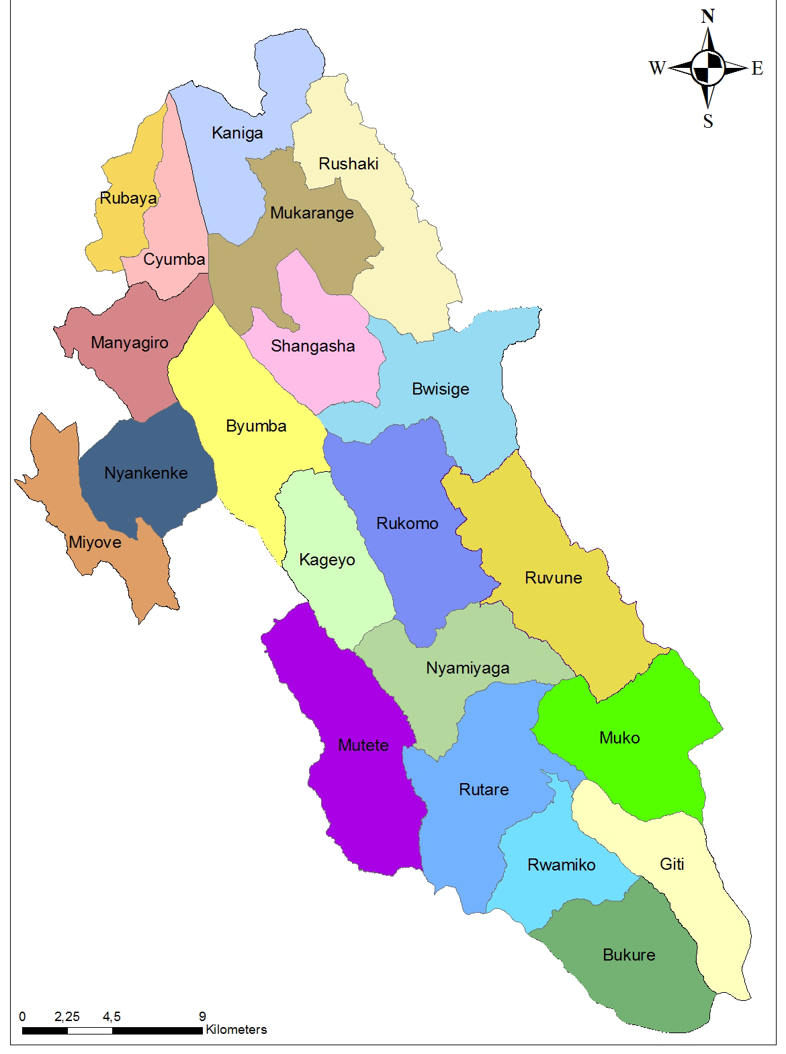
Gicumbi district context
  Access to Safe Drinking Water: 45%
  Access to improved toilets: 47.4%
  Population in 2016: 424,112
  Annual budget: 200-400 thousand USD for minor rehabilitations and extensions
  Budget earmarked from Central Government
  No Water Office in the district
  No engineering designs and no investment plan
  No official private operator for maintenance
  WASH Partner:
    World Vision with a small WASH component in only 3 sectors

Slide 4
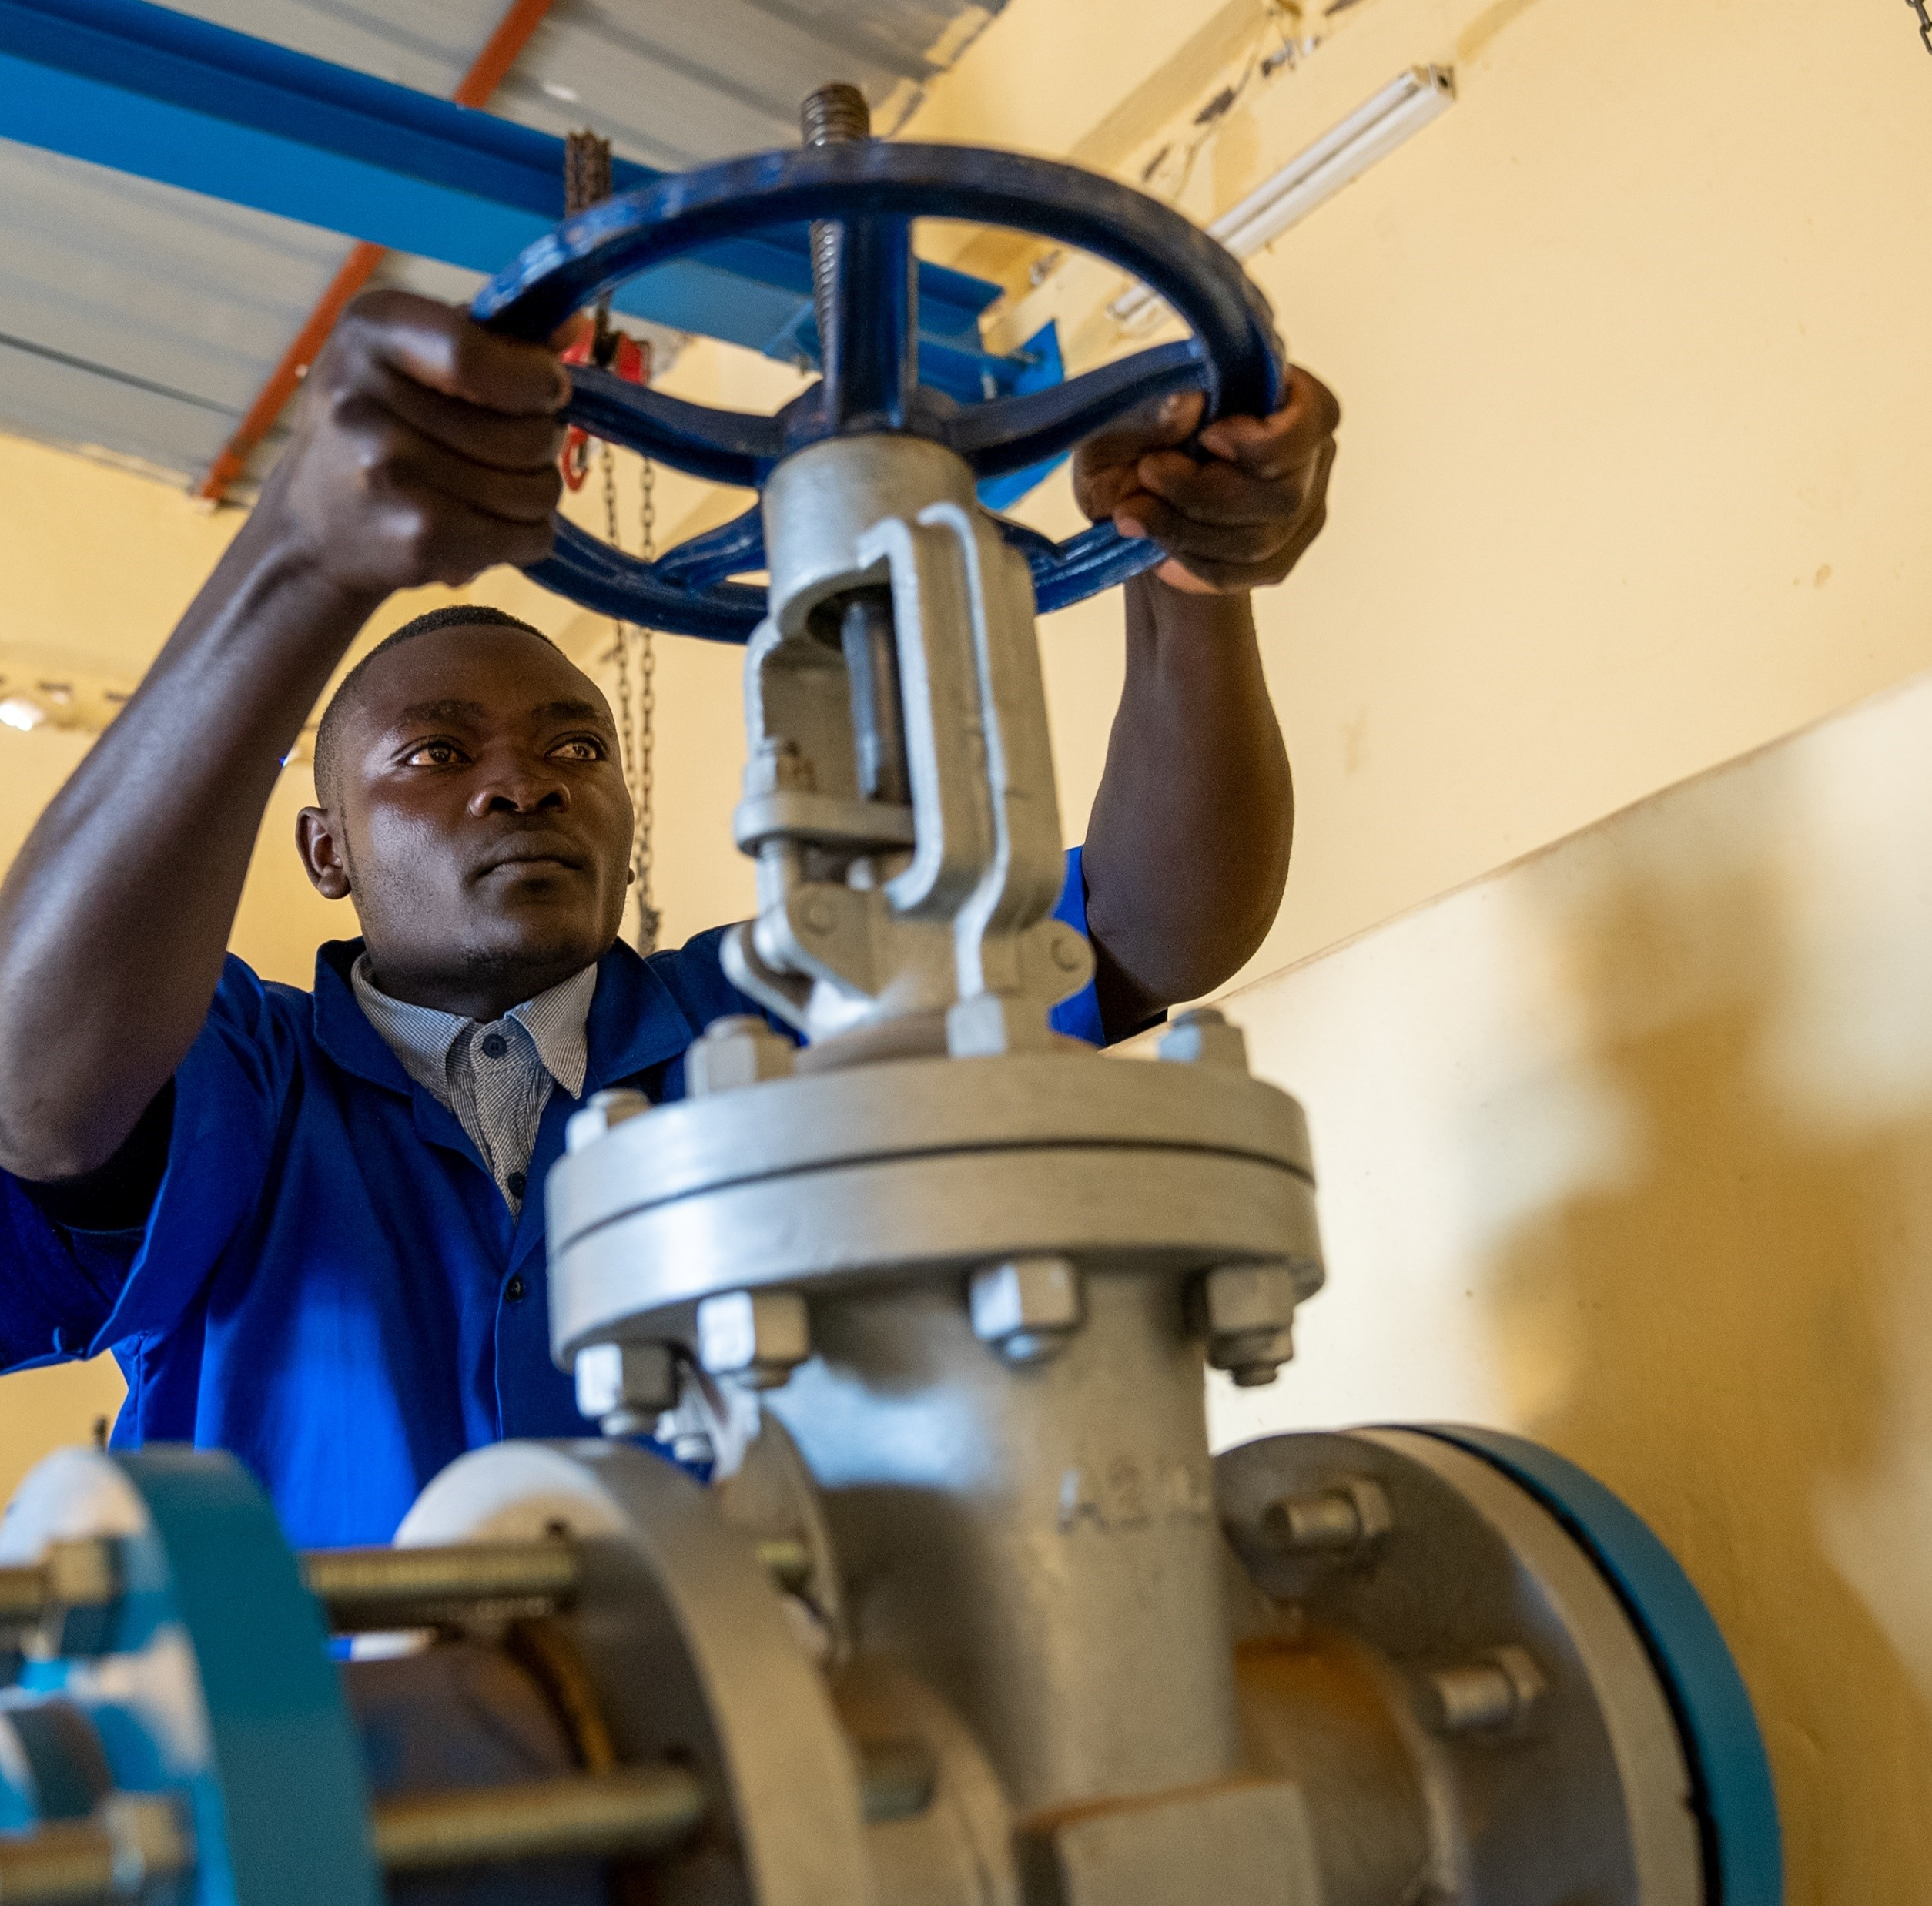
Institutional arrangements
Signatories of the 2016 MoU are:
  Ministry of Infrastructure (MININFRA)
  District
  Water For People
  WASAC (Water and Sanitation Corporation)
Responsibilities of the District:
  Owner of the Program
  Owner of ALL infrastructure
  Procurement of all contracts
  Contract signature and management
  Hiring of Private Operators for O&M
  Land compensation for infrastructure
  development
  Plan for future CAPMANEX

Slide 5
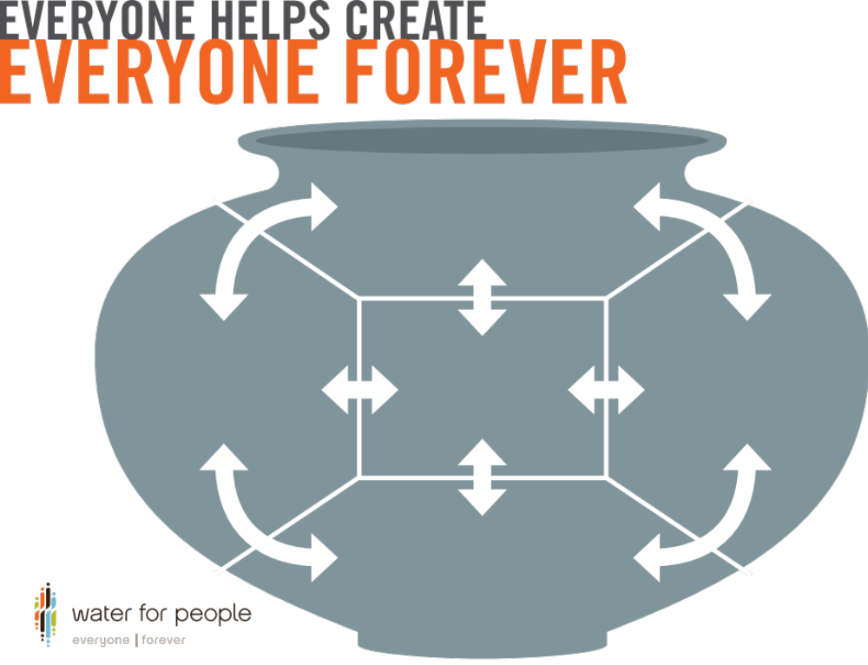
^{GOVERNMENT}
^{Oversees regulation}
^{Provides financing}
^{Coordinates multiple agencies}
(Finance, Water, Agriculture, Health, Education, etc.)
^{PRIVATE SECTOR}
Offers incentives for ongoing services
Develops market-based solutions
^{Provides skill/technical}
^{capacity where needed}
^{COMMUNITY}
^{Reaches Everyone}
Basic operations and maintenance
^{Financial management}
^{Tariff implementation}
^{CIVIL SOCIETY}
^{Leads accountability}
Provides skill/technical capacity where needed
^{FINANCIAL INSTITUTIONS}
^{Provides financing options}
Provides insurance coverage options
Institutes long-term investment mechanisms for system replacement/extension

Slide 6
Mobilizing public finance: Gicumbi trend

Slide 7

Costs and source of funding
Cost Breakdown:
  Infrastructure development (CAPEX)
  Staffing for District and WASAC
  Operation and Maintenance (OpEx)
  Capital Maintenance Expenditure (CAPMANEX)

Slide 8
Costs and source of funding
Current Source of Funding:
  Direct transfers from Central Government (National treasury)
  Own revenues (District tax transfers)
  External transfers through Ministry of Local Government (LODA)

Slide 9
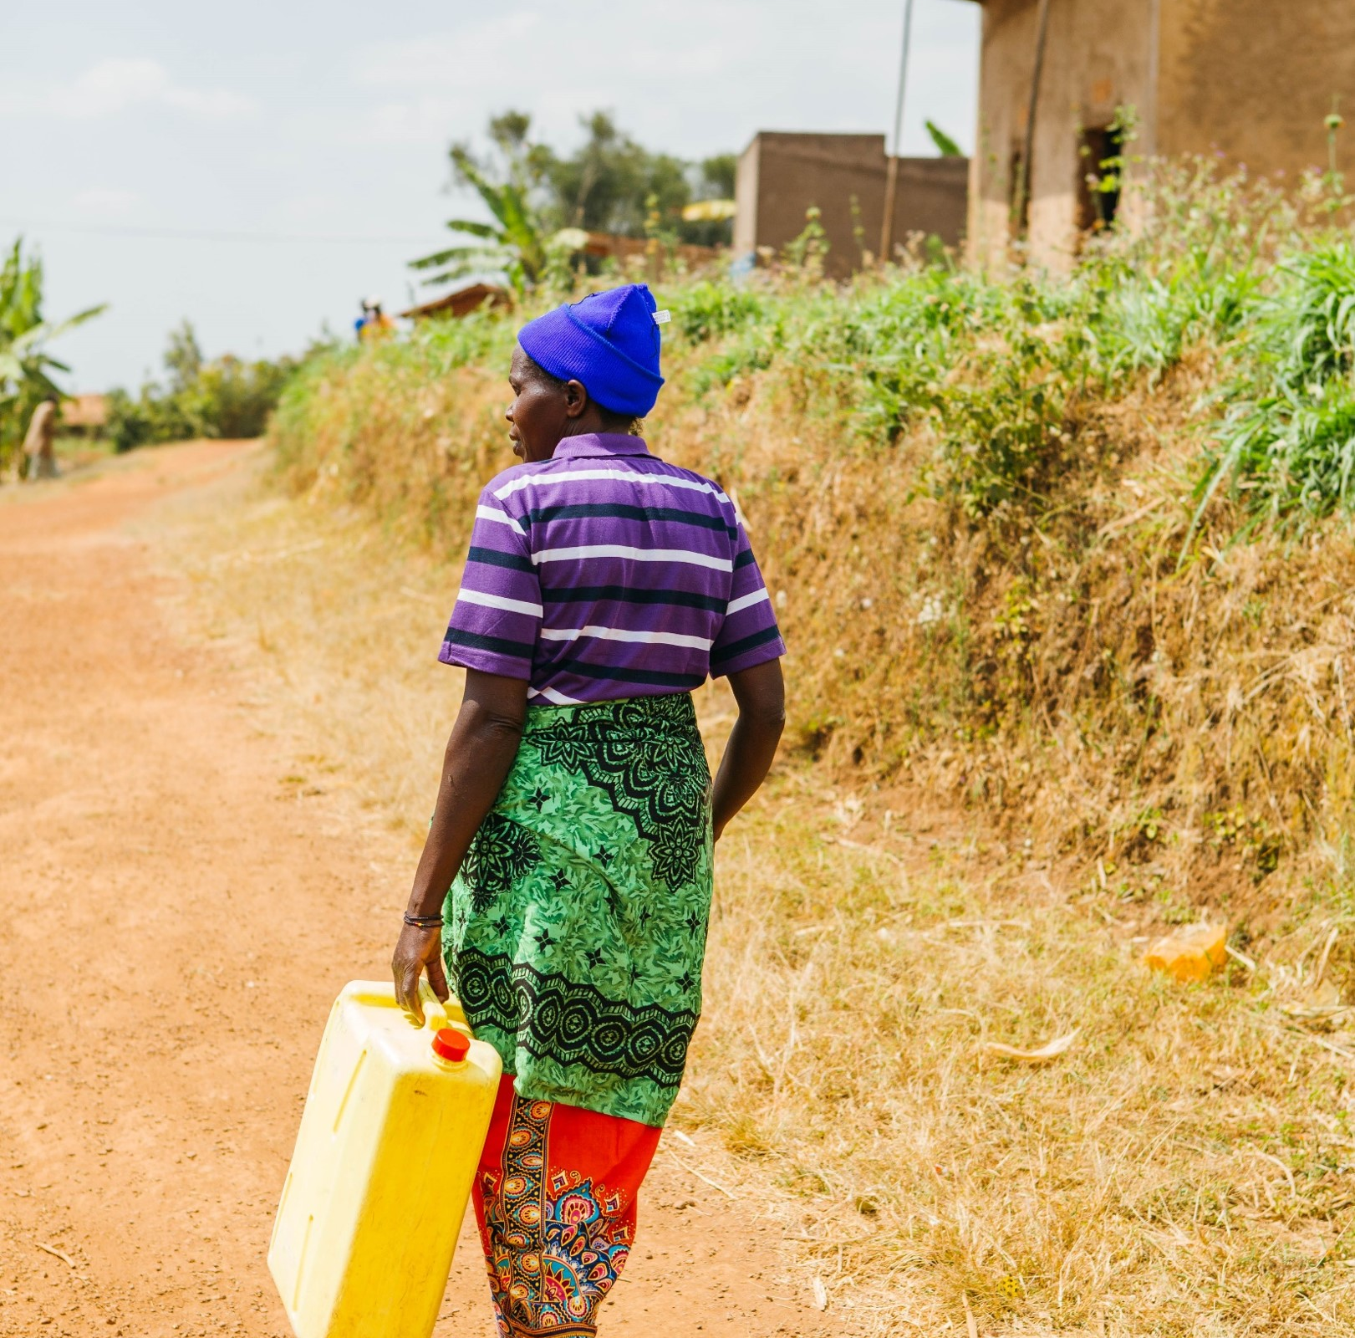
Role of water for people in Gicumbi
Strong political will
Strong community engagement
Strong institutional arrangement
Co-Financing and co-paying as you implement
Strong systems (procurement, contract management, technical skills,…)
Strong collaboration between program stakeholders
Joint planning, implementation and monitoring
A clear plan of post-implementation

Slide 10
Water service coverage is increasing

Slide 11
Next challenges for mobilizing public finance

Slide 12
Next challenges for mobilizing public finance (cont’d)
Reduction of Transfers from Donors and Bridging the financial gap
Future Funding plans:
  Maximize Tariff collection through use of online billing in rural areas
  Active involvement of Private Sector for OpEx and CapManEx through robust monitoring of performance and revenue collection

Slide 13

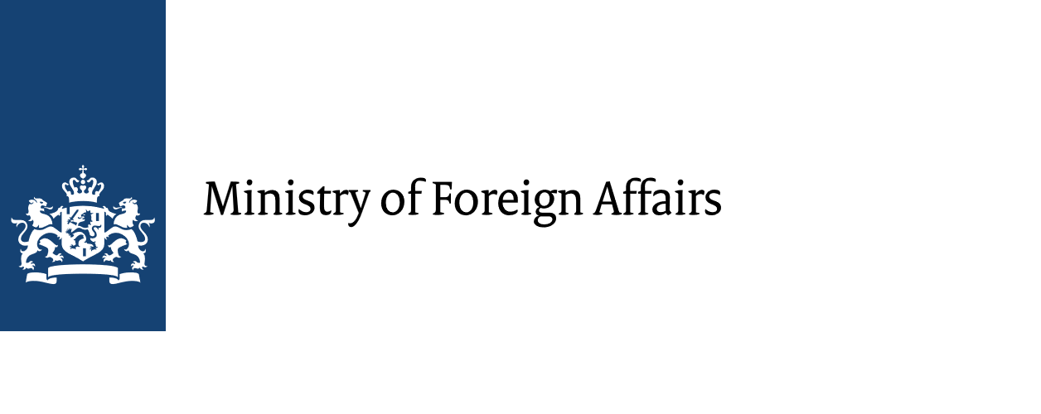




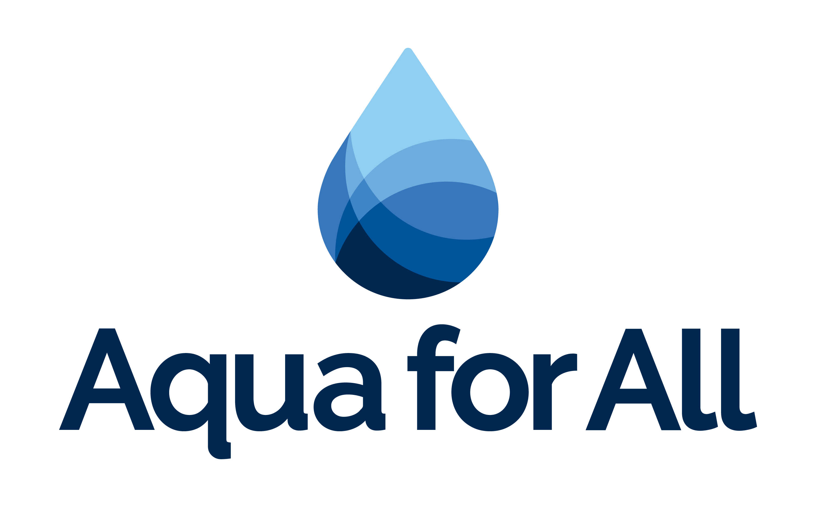




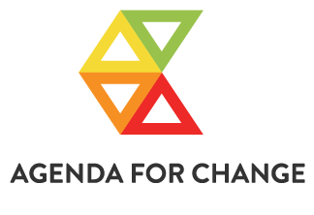






All Systems Connect 2023 is made possible thanks to the generous support of our partners including the World Health Organization and :

