Slide 1
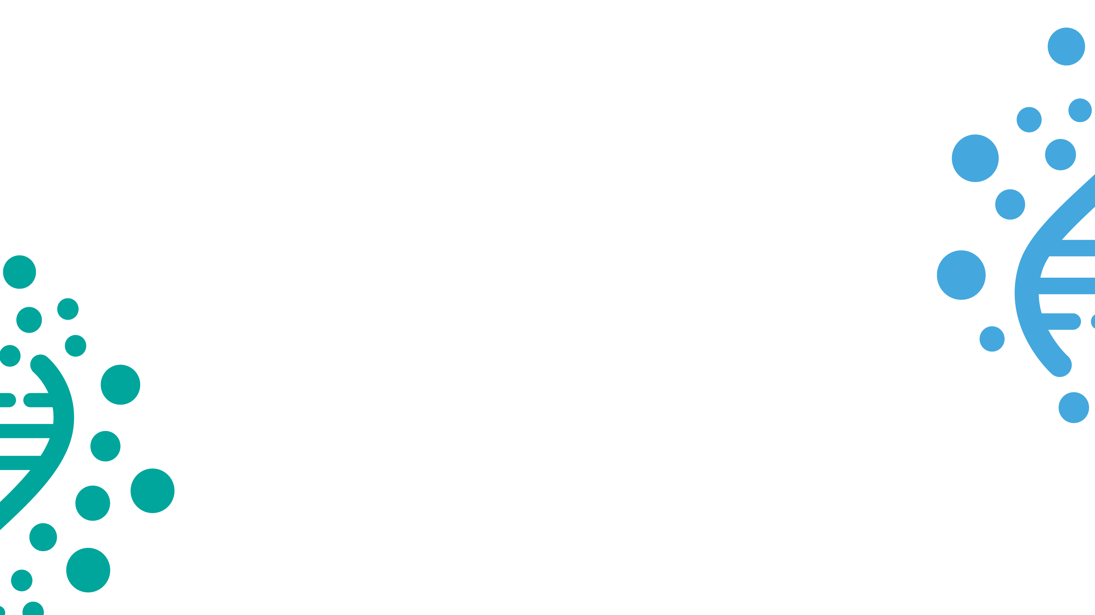
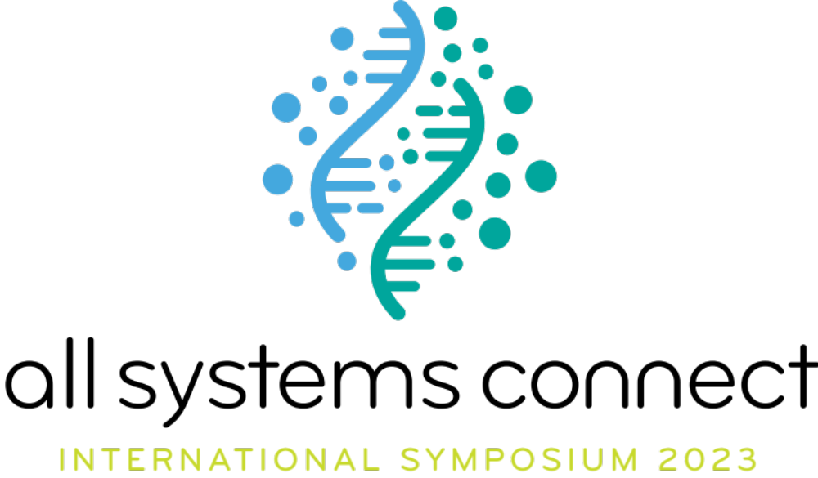

Slide 2
Claim your water rights
By Freshwater Action Network Mexico

Slide 3
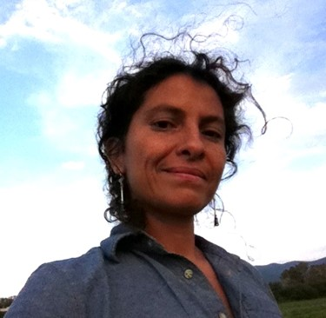
M.Sc.Nathalie Seguin Tovar
Studied Physic’s engineer with speciality on thermodynamics at the
Iberoamericana University in Mexico and a Master degree on
Water Management with a focus on governance at the University of
Montpellier in France.
She has been the coordinator for the Freshwater Action Network Mexico since 2006, a civil society advocacy network implementing and influencing water and sanitation policy and practices from the local to the national, regional and global level. In 2013 created in collaboration with other organizations the water national movement Agua para todos that developed in a participatory process a new water law that regulate the HRWS, the same year co-founded the Mexican alliance against fracking. In 2022 she has launched Redes del Agua Latinoamerica, a wider platform to coordinate latin american advocacy to influence global decision making with a Latin-American perspective. Redes del Agua works to improve water governance at national and global level, and ensure sustainable and equitable water management in latinoamerican countries by coordinating and strengthening civil society
advocacy capacities.

Slide 4
M.Sc.Nathalie Seguin Tovar
She has implemented capacity building programs on Human Right
to Water and Sanitation, the Agenda 2030, the right to access updated
and accesible information, transparency and accountability in the water sector, the inclusion of water on Climate change adaptation agenda and health impacts of pollution of industrial processes and extractives industries such as fracking.
Former member of the Board of FAN global, and actual representative of Latin-American NGO in the Steering committee of Sanitation and water for all (SWA), the Butterfly effect coalition and the End Water Poverty campaign platform.

Slide 5
Two of the strategies used in the Claim your water right’s campaign were:
  1. Evidence based advocacy: Mexico reported high figures of water access coverage for years, but those figures were linked to the infrastructure but didn’t guaranty if water was running through the pipes or if the quality was safe. Water quality is a mayor problem in Mexico. So our strategy was to demonstrate with information obtained through the access to information and transparency law, that water in schools was pollute.
  After a massive work of systematization of the pdf’s info, we presented the data in a friendly digital interface (to make it accesible) called Water in schools www.aguaenescuelas.mx where you can consult the water quality of more than 16000 schools in the country. The launch of this webpage was done along with a series of webinars where we invited different authorities to discuss the results. And we also had meetings with education and water authorities to expose the problematic we found.
  The downside: we could not keep updating the data, because the program that collected this info
  was terminated.
  The positive aspect was that Water quality became an agenda item for the National agenda.

Slide 6
Two of the strategies used in the Claim your water right’s campaign were:
  2. Strengthen capacities of communities on the HRWS:
  A right that you don’t know what it means it is a dead right. It is important to share information at local level on the implications and what the HRWS means at local level. It is only when you share information with communities and help them through participatory processes, to realize that they are right holders, that women (as they are responsible to provide water for the household) start to empower themselves and mobilize in a more articulated manner to demand their right.
  The downside: it is a long process that need to be developed with all rural and
  periurban communities.
  The positive: Once the women understand they are right holders, there is an empowerment process that is started and help the development of local strategies to mobilize for the implementation or improvement of infrastructureture to
  access safe and enough water.

Slide 7

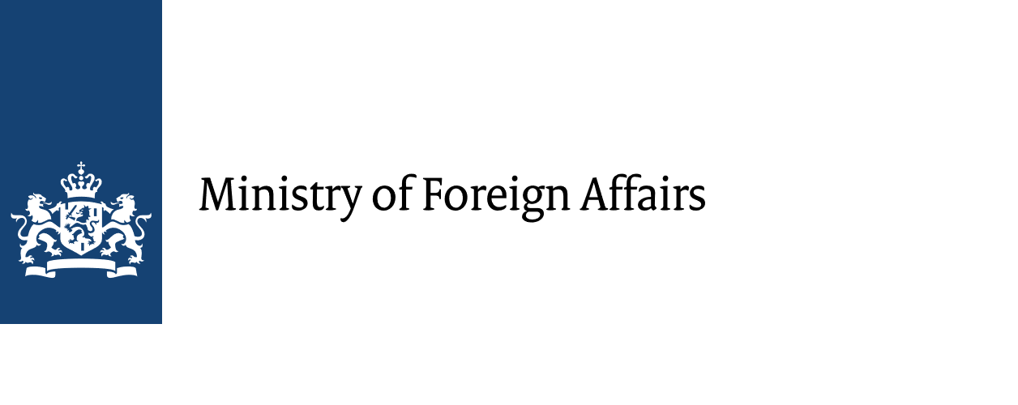




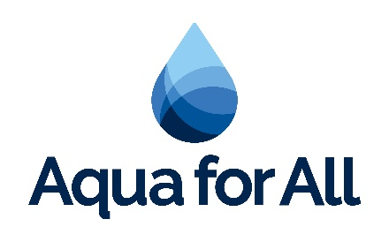
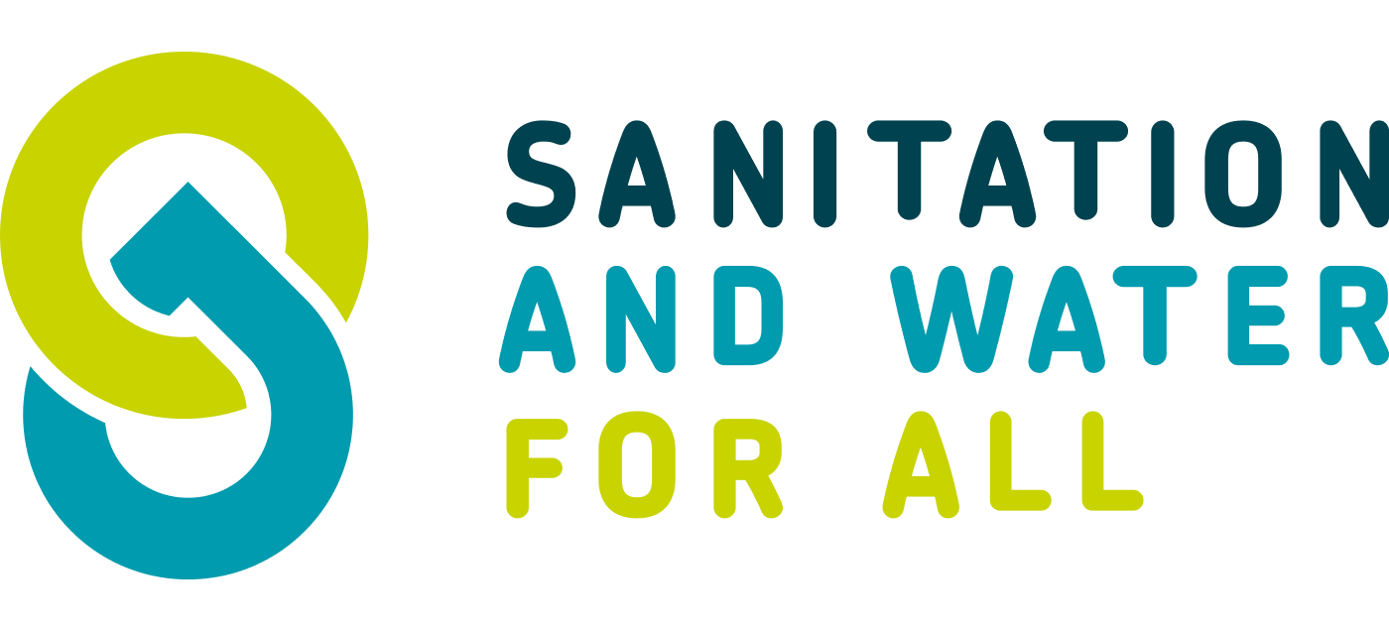


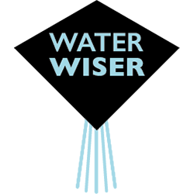
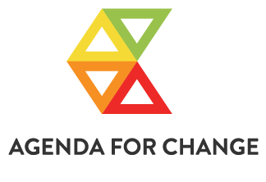

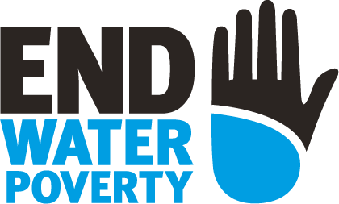


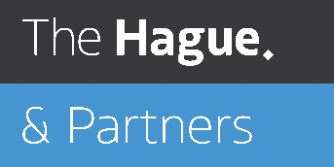

All Systems Connect 2023 is made possible thanks to the generous support of our partners including the World Health Organization and :

