Slide 1



Slide 2
Using the media to promote the rights to water & sanitation in Tanzania
Subtitle of presentation

Slide 3
About MeCE
Media for Community Empowerment (MeCE) is a NGO, legally registered in 2019.
Our goal is facilitating, promoting, inspiring and empowering the communities through media (i.e. community radio, social media and alternative media)
We are facilitating marginalized communities “women and men” to identify societal challenges and amplify their voices, broadcasting their views, enabling to ask for their government responses and transform their lives

Slide 4
“Sauti Yangu” – community radio that’s changing lives
Our focus: Water and Sanitation, we believe that it’s a basic need/right that offers solutions to various social problems such as health, poverty, education, and even bringing peace to the community and family level.
Our Strategy: Radio program using community radio
“Sauti Yangu” is a Swahili word that means 'My Voice' in English
It’s a 30-minute unique, powerful and interactive show that engages community members in rural areas to identify the prevailing water crises in their localities, share their experiences and challenges in accessing clean and safe water
It amplifies their voices and pressures the government to resolve the water crises in rural areas.
Our programs have reached more than 11 million people across Tanzania

Slide 5
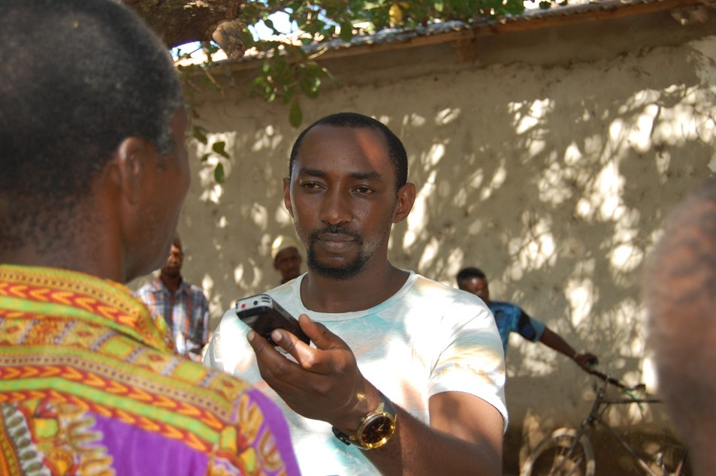

Slide 6
Using community radio to promote water & sanitation rights
In 2020, MeCE joined forces with End Water Poverty (EWP), a global civil society coalition, campaigning to end the water and sanitation crisis, through their #ClaimYourWaterRights campaign
During the #ClaimYourWaterRights campaign, MeCE produced more than 50 radio programs
Programs were aimed at enabling citizens to realize their rights to water by claim their right to clean and safe water across Tanzania

Slide 7
Success stories: Media advocacy leads to authorities drilling wells & committing funding to improvement of infrastructure
“Sauti Yangu” has reached millions of people and led directly to several local authorities drilling wells and boreholes, as well as committing funds to improving services
For example, just one month after MeCE’s radio show on Mtegani FM, the local Mkuranga government successfully drilled a well in response to residents airing complaints about the village’s decade-long water crisis
For example, Three days after MeCE’s broadcast from Kikwawila village in Ifakara, the local government drilled a borehole after residents raised concerns about their lack of water with their village chairperson

Slide 8
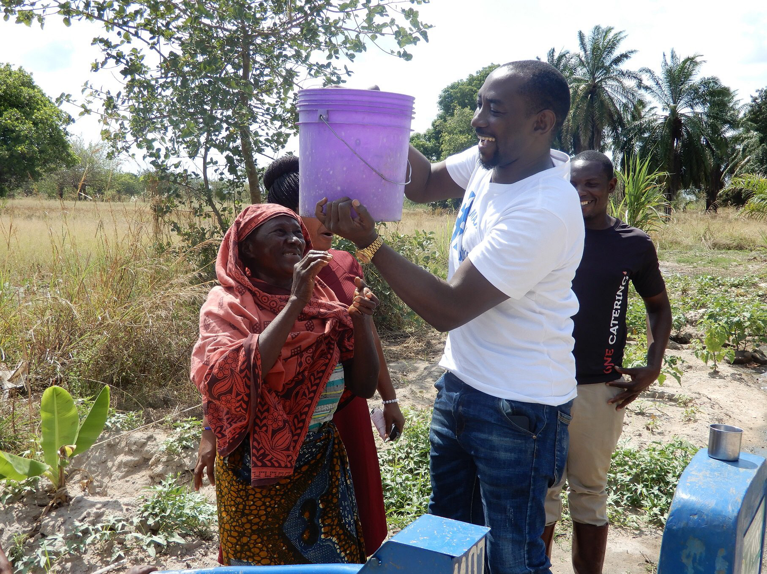


Slide 9
Using community radio to promote water & sanitation rights
In 2021, MeCE conducted capacity building training to staff at Tanzania League of the Blind (TLB) in Morogoro
  The training was how to produce interactive content that enables people to express themselves and demand their rights to water.
Recently, in 2023, MeCE has virtually engaged in the training Human Rights to Water and Sanitation Journalist in Zimbabwe in collaboration with Matebele Land Institute.

Slide 10
The power of the media
Media is a powerful tool if well utilized (identify issues, sharing results and reaching out the intended audiences - both community and mainstream)
Elevating the community's voice can reach policymakers and solve water crisis and change people's lives.
Local communities are potential in addressing water crisis if empowered, engaged
and informed
Unheard voices are dead voice, they are far from available opportunities and supports that aims at addressing water challenges
Since water challenge is not over yet, our journey has just begun! Our aim is to reach all over Tanzania. Every region, every district, every ward and every village.
The voice of everyone from everywhere must be heard. Equal Water Voice to All.

Slide 11

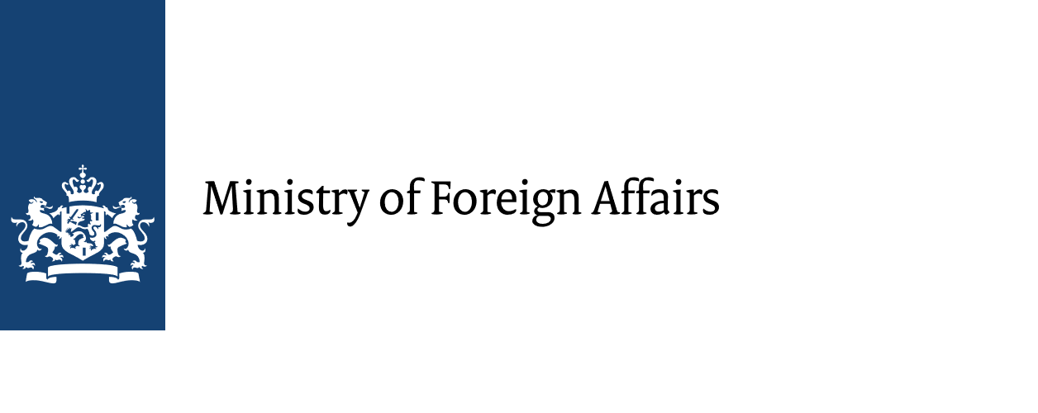




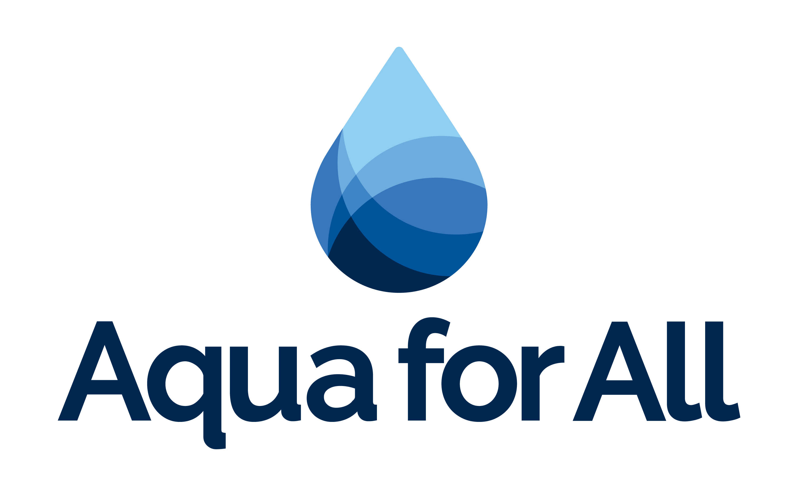
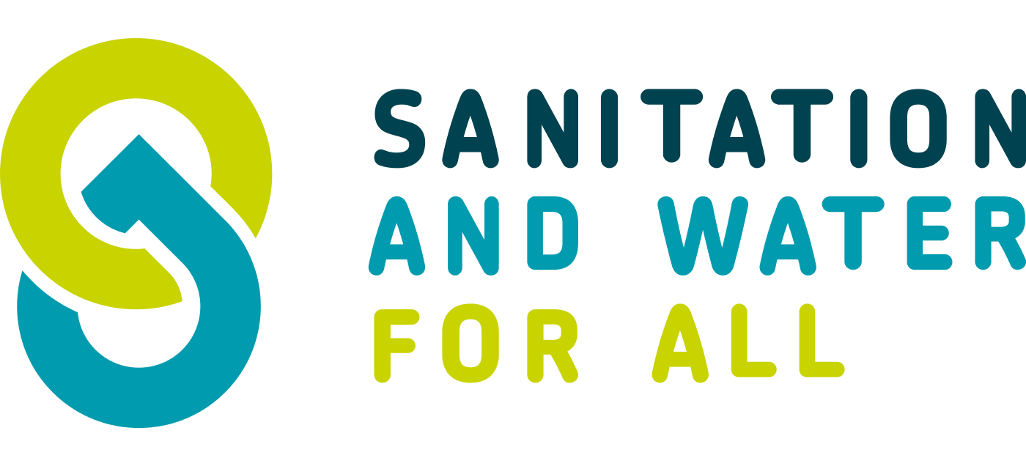



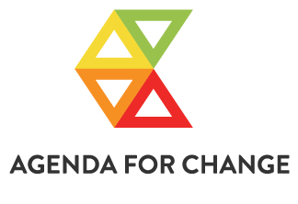

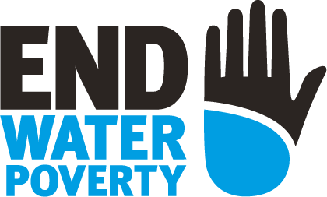

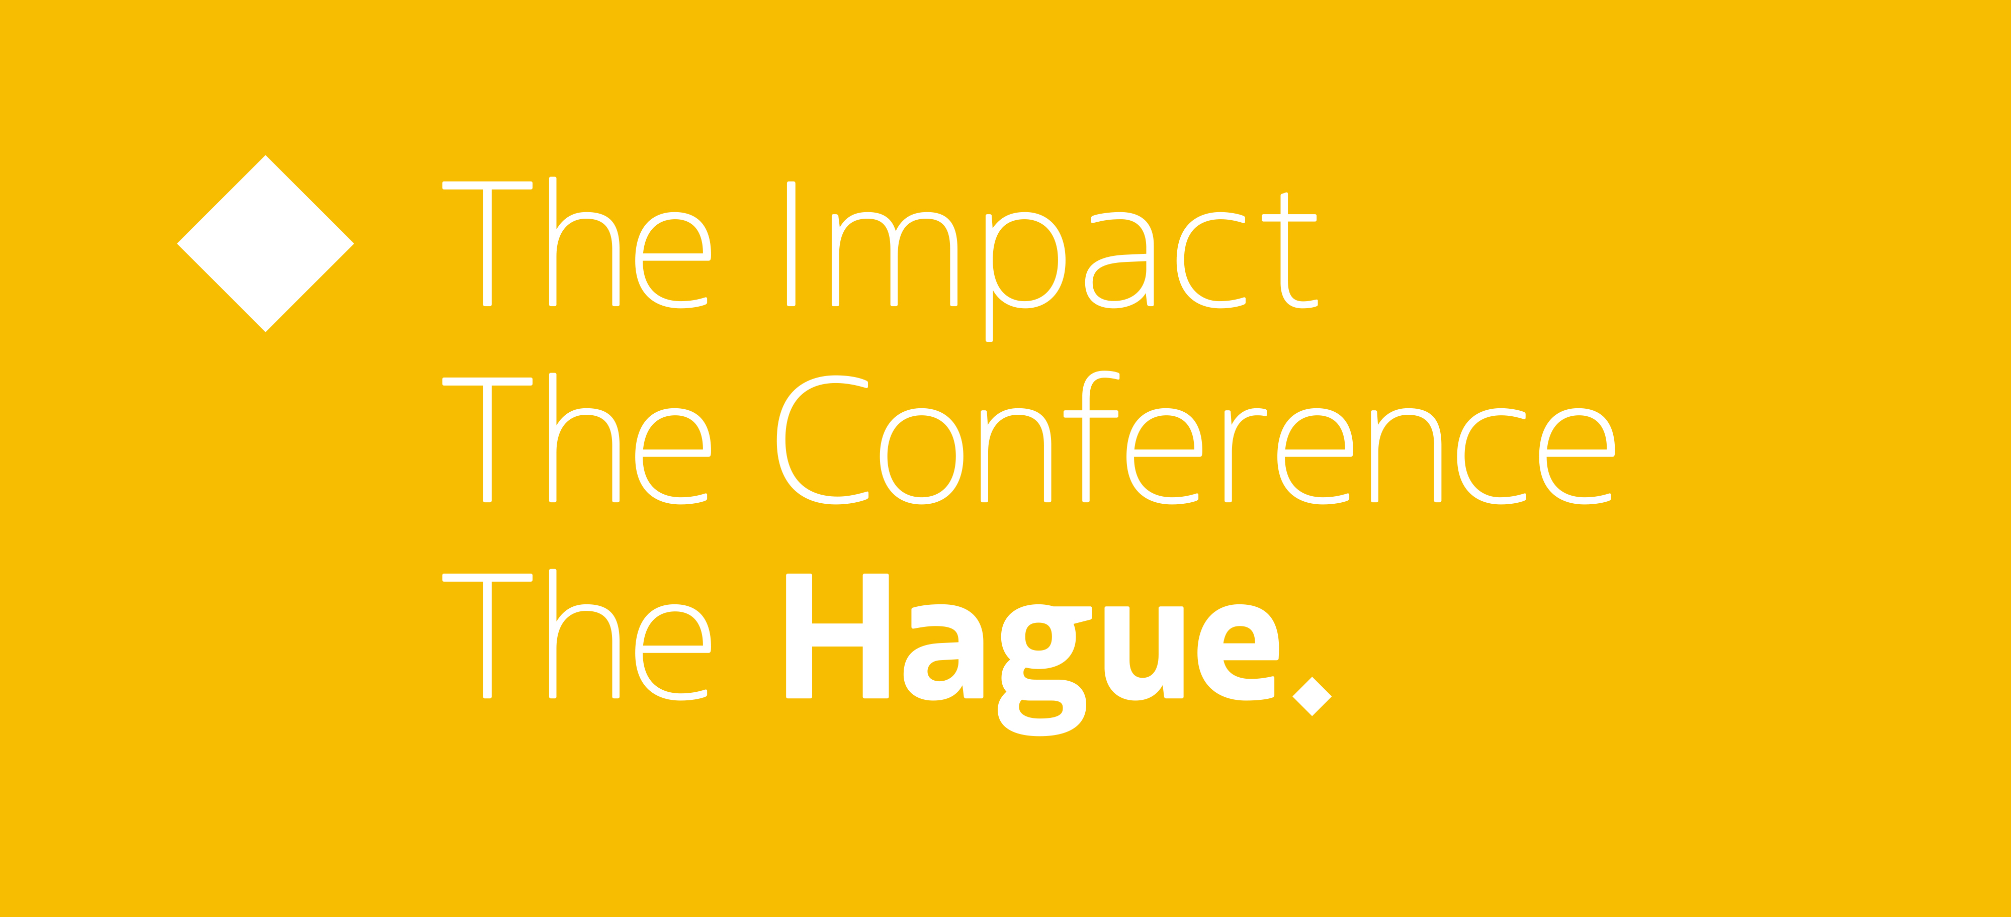
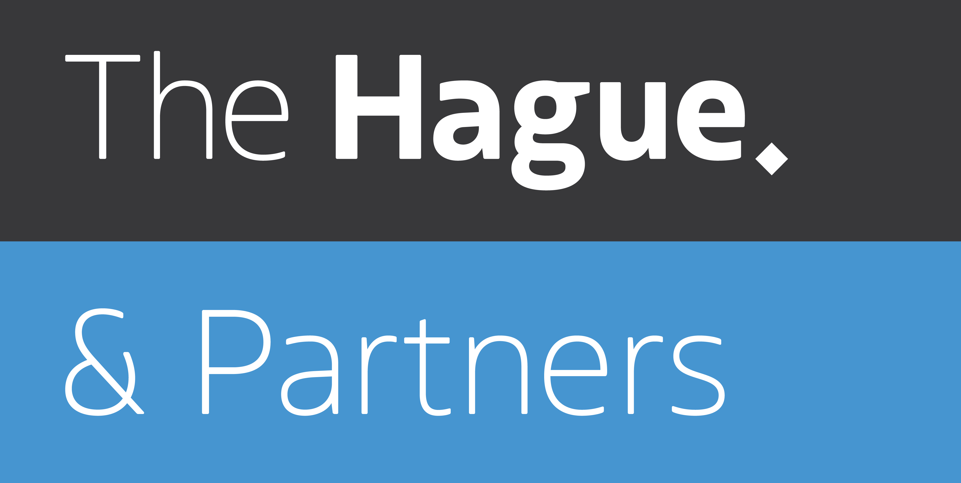

All Systems Connect 2023 is made possible thanks to the generous support of our partners including the World Health Organization and :

