Slide 1



Slide 2
Advancing progress towards universal WASH services in Africa
A high-level session highlighting systems challenges and solutions in Africa

Slide 3
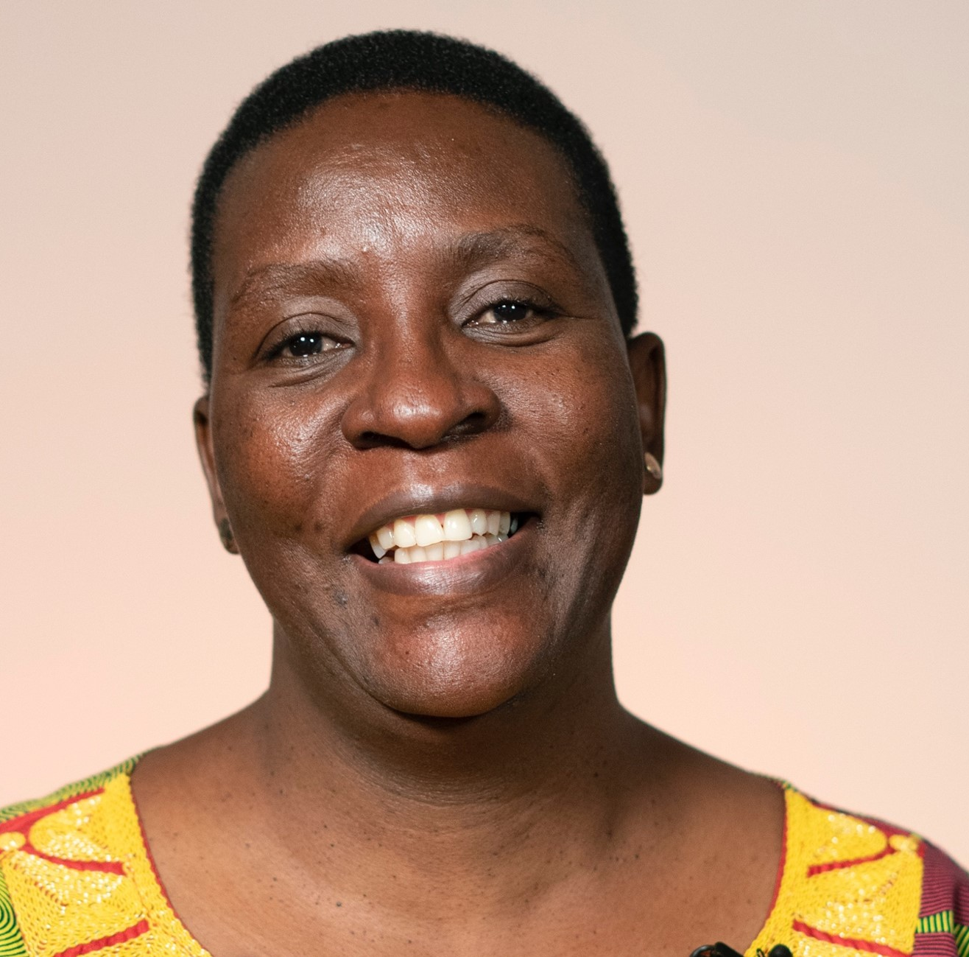
Introduction
Jane Nabunnya Mulumba
IRC Uganda Country Director
Session moderator

Slide 4
Contents slide
Overview of the session
Regional and country level progress: Background and scene setting
Regional and country level progress: national level examples
National level panel discussion
Regional level panel
Highlights of the discussion and concrete next steps for which regional leadership can be accountable and their agreement to support the process

Slide 5
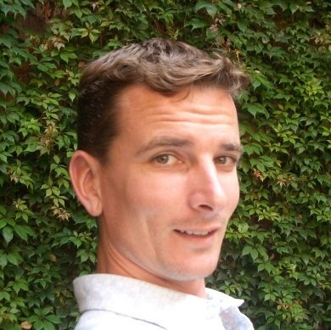
Name of the presenter
Tom Slaymaker,
WHO/UNICEF Joint Monitoring Programme for Water Supply, Sanitation and HygieneUNICEF
Notes:
Presentation slides from Tom

Slide 6
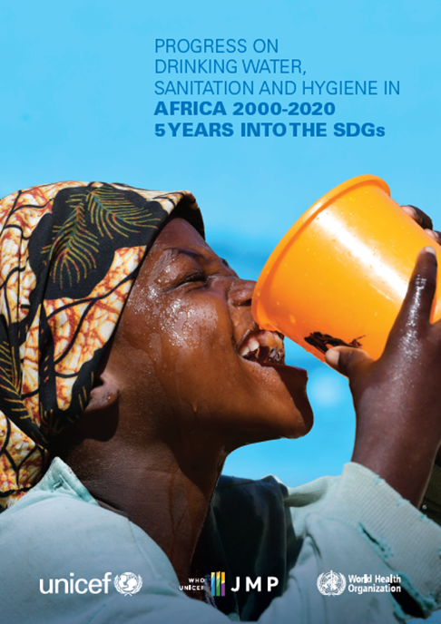
Tom Slaymaker, WHO/UNICEF Joint Monitoring Programme
Progress on drinking water, sanitation and hygiene in Africa 2000-2020:
five years into the SDGs
Advancing progress towards universal WASH services in Africa
tslaymaker@unicef.org
washdata.org

Slide 7
SDG service ladders for WASH in households
Drinking Water |  | Sanitation |  | Hygiene
Safely managed: Drinking water from an improved source that is accessible on premises, available when needed and free from faecal and priority chemical contamination |  | Safely managed: Use of improved facilities that are not shared with other households and where excreta are safely disposed of in situ or removed and treated offsite
Basic service: Drinking water from an improved source, provided collection time is not more than 30 minutes for a round trip, including queuing |  | Basic service: Use of improved facilities that are not shared with other households |  | Basic service: Availability of handwashing facility with soap and water at home
Limited service: Drinking water from an improved source, for which collection time exceeds 30 minutes for a round trip, including queuing |  | Limited service: Use of improved facilities that are shared with other households |  | Limited service: Availability of handwashing facility lacking soap and/or water at home
Unimproved: Drinking water from an unprotected dug well or unprotected spring |  | Unimproved: Use of pit latrines without a slab or platform, hanging latrines or bucket latrines |  | No facility: No handwashing facility at home
Surface water: Drinking water directly from a river, dam, lake, pond, stream, canal or irrigation canal |  | Open defecation: Disposal of human faeces in fields, forests, bushes, open bodies of water, beaches or other open places, or with solid waste
Improved
Notes:
The JMP uses ‘service ladders’ to benchmark and compare progress across countries, and these have been updated and expanded for SDG monitoring.
This slide shows the service ladders for WASH in households but we have also developed similar service ladders for WASH in schools and for WASH in health care facilities
The drinking water ladder defines five service levels, ranging from surface water to safely managed drinking water services, which is the global indicator for SDG target 6.1. The ladder builds on the improved/unimproved source type classification used for Millennium Development Goal (MDG) monitoring and introduces additional criteria related to the level of service provided. For SDG monitoring, households using improved sources are divided into three categories. If a round trip to collect water, including queuing, exceeds 30 minutes, it counts as a ‘limited service’, and if it takes no more than 30 minutes, it counts as a ‘basic service’. But to meet the SDG standard for ‘safely managed services’, improved sources must be accessible on premises, available when needed, and free from contamination.
The sanitation ladder ranges from open defecation at the bottom to safely managed sanitation at the top. Households using improved sanitation facilities that are shared with other households count as limited service and if they are not shared then they count as a basic sanitation service. But additional criteria are applied to meet the SDG standard for ‘safely managed services’, excreta must either be safely disposd of in-situ, or removed and treated offsite
The hygiene ladder was added for SDG monitoring and only has 3 rungs. Basic hygiene service means households have a handwashing facility with soap and water available at home. If facility is available but either soap or water are missing it counts as limited service and at the bottom of the ladder we have no handwashing facility at all.
Since households with safely managed drinking water and sanitation services also meet the requirements for basic services, the two levels can also be grouped together as ‘at least basic service’, which is then combined with basic hygiene for monitoring SDG target 1.4 ‘universal access to basic services.

Slide 8
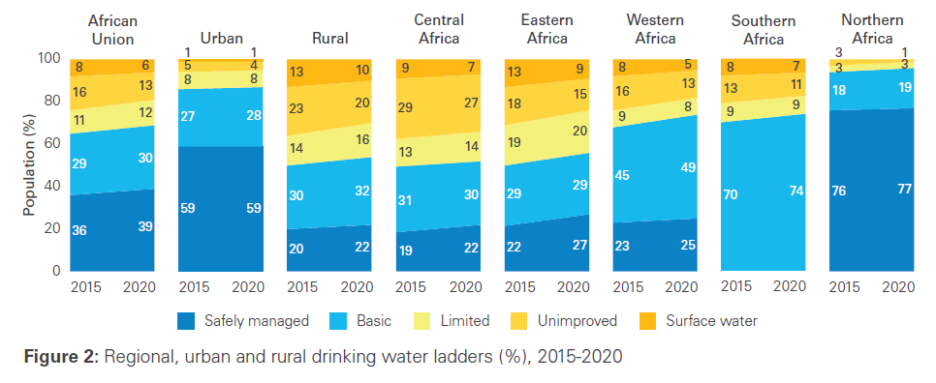
3 out of 5 people in Africa lacked safely managed drinking water services in 2020
Notes:
The ladders show trends between 2015 and 2020 for the African Union as a whole (on the left hand side), for urban and rural, and for each of the AU sub-regions
Between 2015 and 2020 coverage of safely managed services has increased from 36% to 39%. This means that 3 out of 5 people still lacked safely managed drinking water in 2020. Coverage is significantly higher in urban areas (59%) than in rural (22%)
Estimates for safely managed services are available for 4 out of 5 sub regions and coverage ranges from 22% in Central Africa to 77% in Northern Africa
In Africa, 411 million people still lacked even a basic drinking water services in 2020 (8 out of 10 lived in rural)

Slide 9
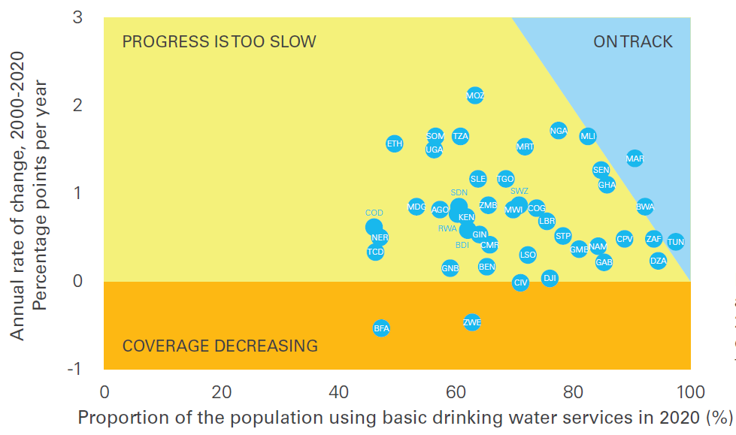
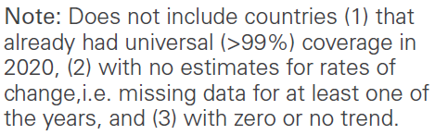
Only 3 out of 46 countries with <99% coverage are on track to achieve universal access to at least basic drinking water by 2030
Notes:
This chart combines coverage in 2020 (x axis) and rate of change 2000-2020 (y axis) to assess whether countries are on track to achieve universal access to basic drinking water (>99%) by 2030
It shows that only 3 out of the 46 countries, which had not already achieved universal access by 2020, are currently on track to achieve universal access to basic drinking water (blue)
The majority are progressing too slowly (yellow)
And in some countries coverage of basic drinking water services is actually decreasing (orange)

Slide 10
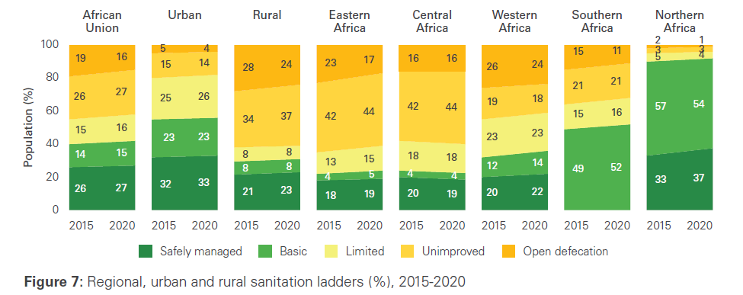
Nearly 3 out of 4 people in Africa lacked safely managed sanitation services in 2020
Notes:
The ladders show trends in sanitation services between 2015 and 2020
Between 2015 and 2020 coverage of safely managed services has increased from 26% to 27%. This means that nearly 3 out of 4 people still lacked safely managed sanitation in 2020. Coverage is slightly higher in urban areas (33%) than in rural (23%)
Estimates for safely managed services are available for 4 out of 5 sub regions and coverage ranges from 19% in Eastern Africa to 37% in Northern Africa
In Africa, 779 million people still lacked even a basic sanitation service in 2020 (including 208 million who still practised open defecation). 9 out of 10 open defecators lived in rural

Slide 11
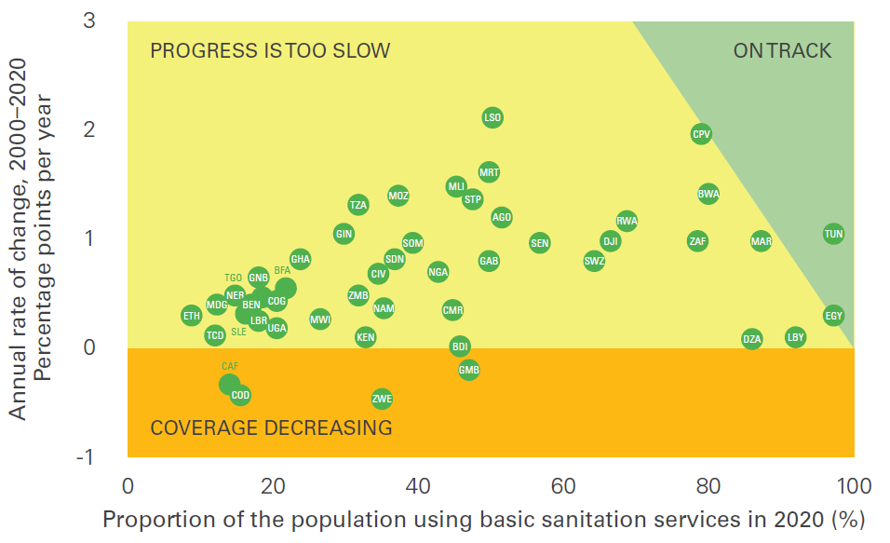
Only 2 out of 48 countries with <99% coverage are on track to achieve universal access to at least basic sanitation by 2030
Notes:
This is the same chart assessing whether countries are on track to achieve universal access to basic sanitation (>99%) by 2030
It shows that only 2 out of the 46 countries, which had not already achieved universal access by 2020, are currently on track to achieve universal access to basic drinking water (green)
In many countries coverage remains low and the majority are progressing too slowly (yellow)
And in several countries coverage of basic sanitation services is actually decreasing (orange)

Slide 12
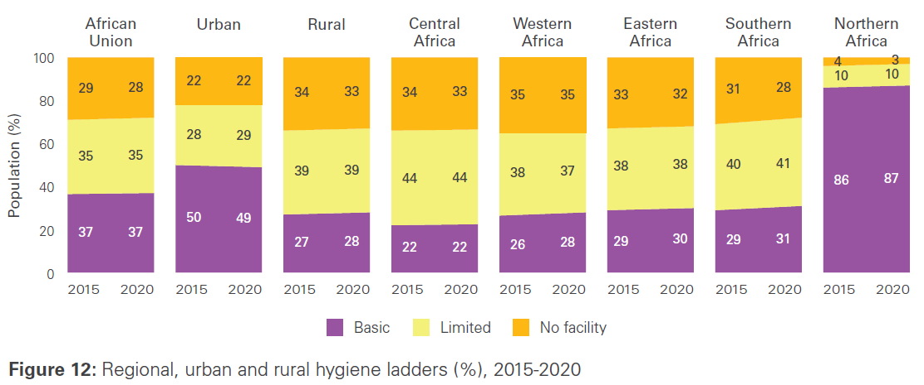
3 out of 5 people in Africa lacked basic hygiene services in 2020
Notes:
The ladders show trends in hygiene services between 2015 and 2020 for the AU and its sub-regions
Between 2015 and 2020 coverage of basic services has remained unchanged at 37%. This means that 3 out of 5 people still lacked basic hygiene services in 2020. Coverage is much higher in urban areas (49%) than in rural (28%)
Estimates for basic hygiene services are available for all AU sub regions and coverage ranges from 22% in Central Africa to 87% in Northern Africa
In Africa, 839 million people still lacked even a basic sanitation service in 2020. Two thirds lived in rural areas

Slide 13
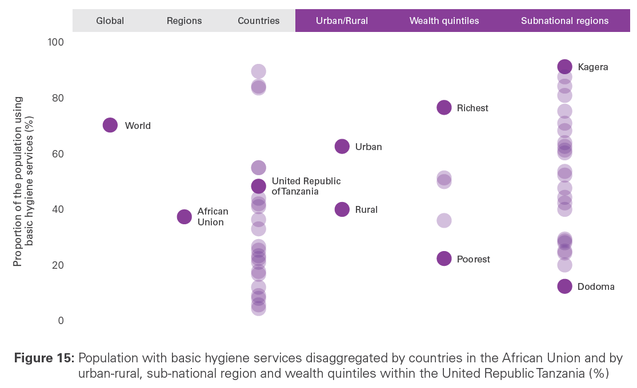
In Africa there are large disparities in access to basic hygiene services between and within countries
Notes:
The 2030 Agenda has a strong commitment to ‘leave no one behind’ and an explicit focus on reducing inequalities between and within countries
The JMP inequalities database has been expanded and we now have estimates disaggregated by wealth quintile and sub-national region for >100 countries
This chart shows that in Tanzania 48% of the population have basic hygiene services, but there is an 23% pt gap between urban and rural areas, and 54% pts separated the richest and poorest quintiles. In Kagera region, 92% had basic hygiene services while in Dodoma region only 13% did.

Slide 14
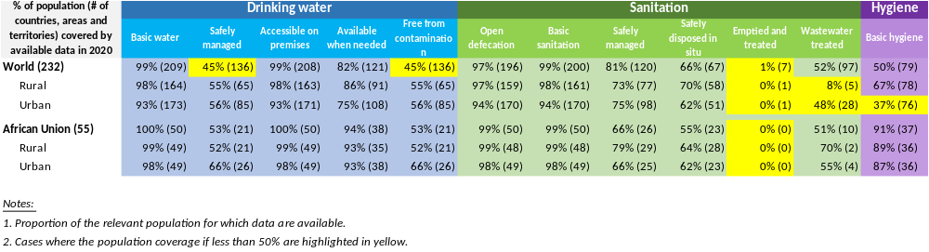
Data availability is improving but many countries in Africa still lacked estimates for SDG indicators in 2020
Notes:
21/55 African countries with estimates for safely managed drinking water
26/55 for safely managed sanitation, and
37/55 for basic hygiene in 2020

Slide 15
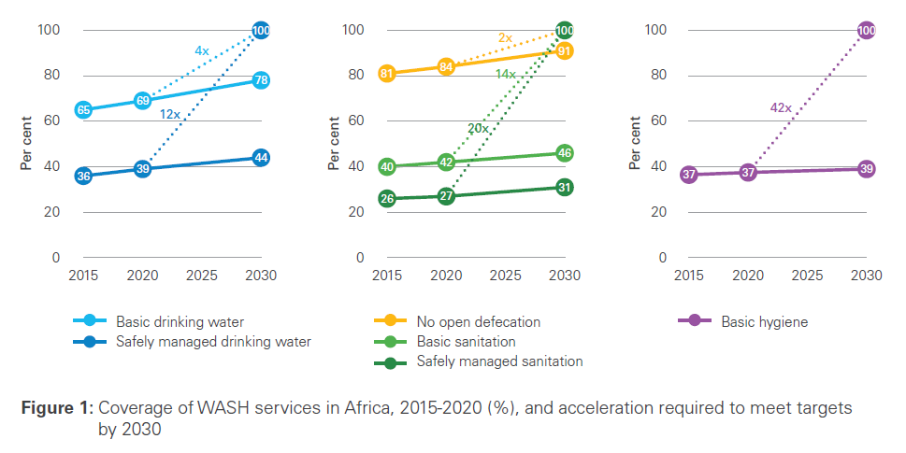
Achieving SDG WASH targets in Africa will require a dramatic acceleration in current rates of progress
Notes:
For the first time the 2021 report assessed rates of progress between 2000 and 2020 and extrapolated these to illustrate current trajectories and acceleration required to achieve 2030 targets
This chart shows that Africa needs to dramatically accelerate current rates of progress in order to achieve the 2030 targets
Eliminating open defecation by 2030 (no open defecation shown in orange) will require a doubling of current rates of progress
Achieving universal coverage of even basic drinking water (shown in light blue) will require a 4x increase and basic sanitation services (shown in light green) will require a 14x increase in current rates of progress
Achieving and SDG ambition of universal coverage of safely managed water, safely managed sanitation and basic hygiene will be even more challenging.
We will need a 12x increase for safely managed drinking water (dark blue), a 20x increase for safely managed sanitation (dark green) and a 42x increase for basic hygiene (purple)

Slide 16
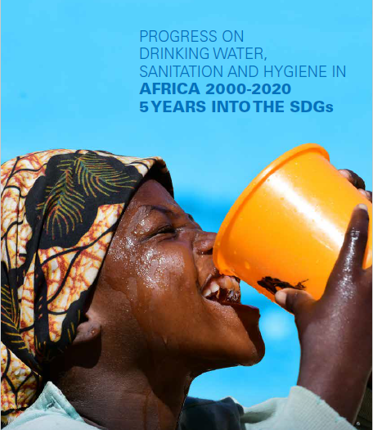
Achieving the 2030 SDG targets in Africa will require
12x increase in current rate of progress on safely managed drinking water
20x increase in current rate of progress on safely managed sanitation
42x increase in current rate of progress on basic hygiene services
Between 2000 and 2020
Africa’s population increased from 800 million to 1.3 billion
500 million people gained access to at least basic water services
290 million people gained access to at least basic sanitation services
But in 2020
411 million lacked basic water services
779 million lacked basic sanitation services (incl. 208 million open defecators)
839 million still lacked basic hygiene services
Only 7 out of 42 countries on track to eliminate open defecation by 2030
Significant inequalities between and within countries
3 out of 4 in rural areas lack safely managed water and sanitation
Large gaps between richest and poorest and sub-national regions
Data availability is improving but large gaps remain
21 African countries with estimates for safely managed drinking water, 26 for safely managed sanitation and 37 for basic hygiene in 2020
Thank you!
info@washdata.org
Notes:
So here is a summary of key findings from the JMP snapshot of progress on WASH in Africa
Over the first 5 years of there has been a steady improvement in the availability of national data on SDG indicators but large gaps remain
I look forward to discussing how we can work together to address these data gaps and to continue to strengthen WASH monitoring at national, regional and global levels

Slide 17
Regional and country level progress: national level examples

Slide 18
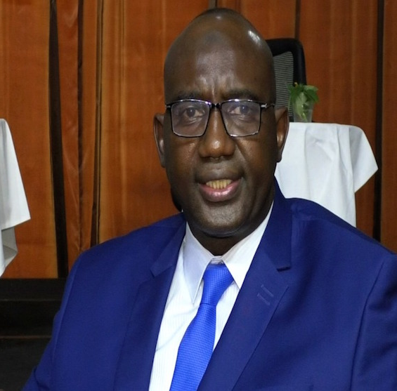
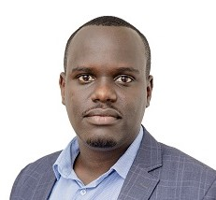
Mr. Bocoum Djoouro
National Director of Hydraulics/ National Focal Point for SWA in Mali
Mr. Vincent de Paul Mugwaneza,
Director of Rural Water and Sanitation Services, Water and Sanitation Corporation-WASAC, Rwanda

Slide 19
Panel 1
National level panel discussion

Slide 20
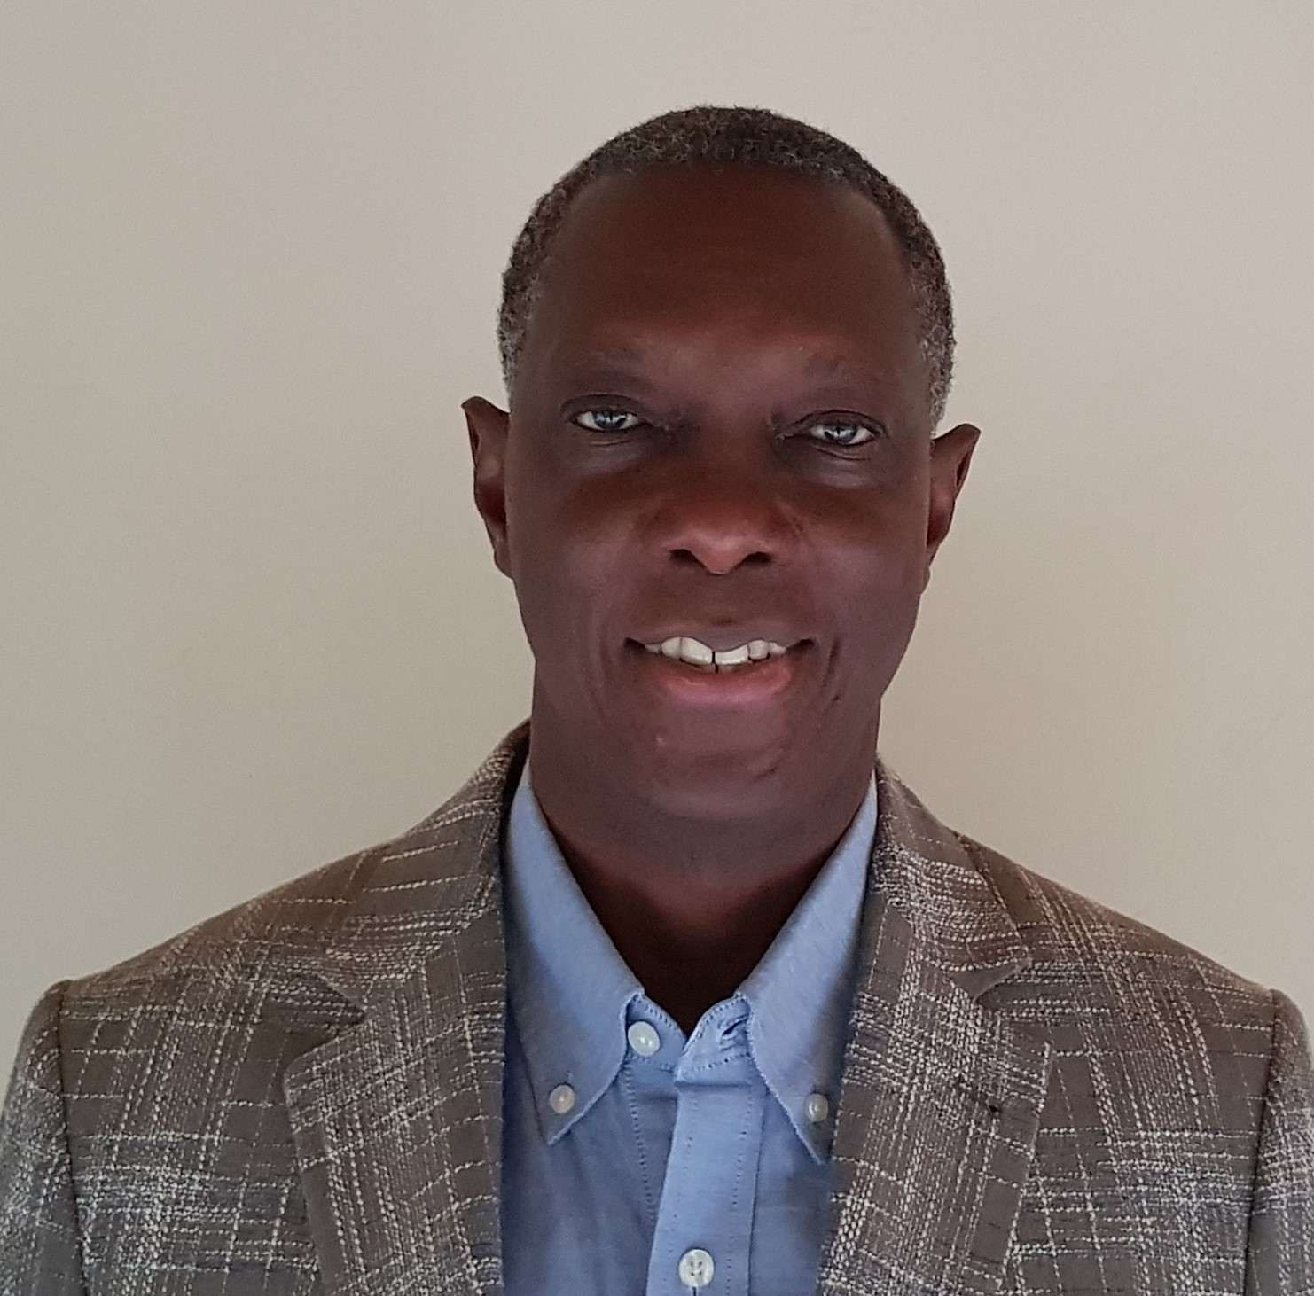
Moderator
Arnold Cole
Senior WASH and Climate Specialist
ESARO, UNICEF

Slide 21
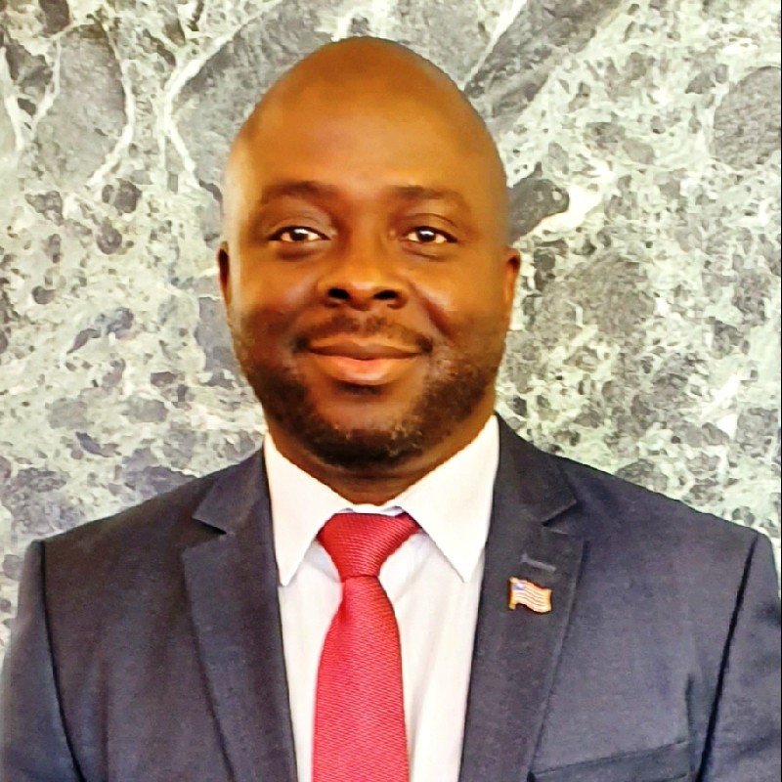
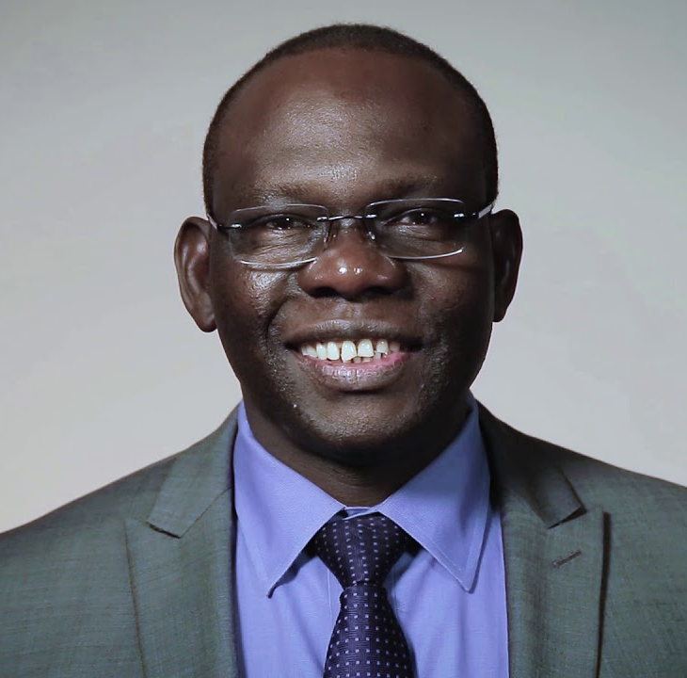
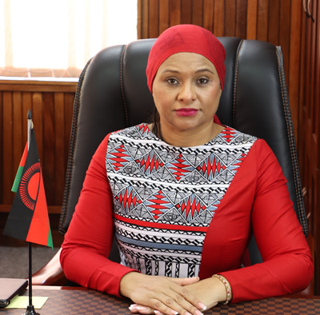
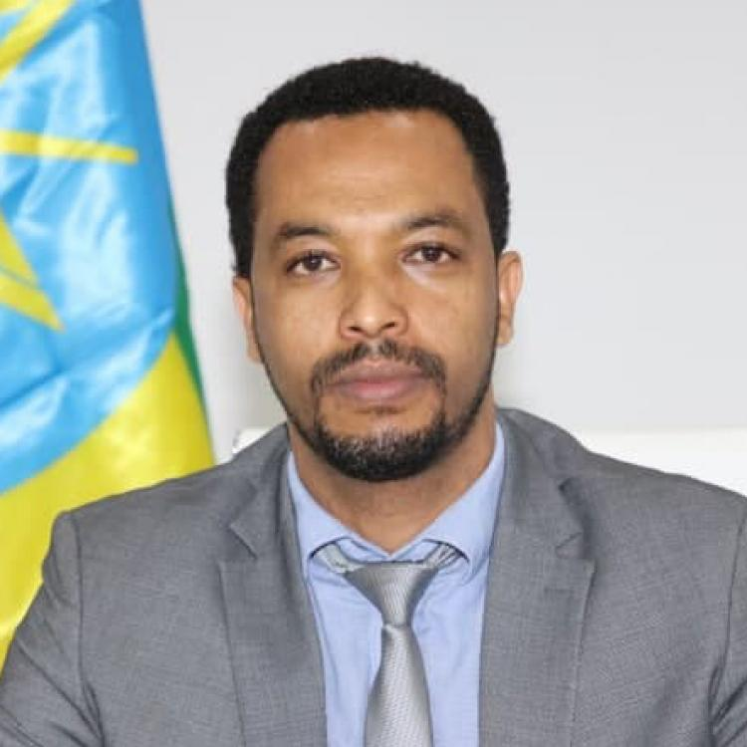
Bobby Whitfield
Chairman and CEO, National Water, Sanitation and Hygiene Commission, Liberia
Eng. Joseph Oriono Eyatu.
Director, Directorate of Water Development, Ministry of Water and Environment (MWE), Uganda
Abida Mia Sadik
Minister of Water and Sanitation, Malawi
Dereje Duguma Gemeda
State Minister, Ministry of Health, Ethiopia

Slide 22
Panel 2
Regional level panel

Slide 23
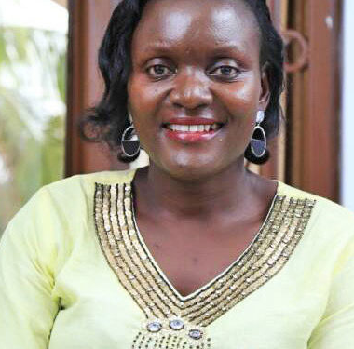
Moderator
Cate Nimanya
Water For People

Slide 24
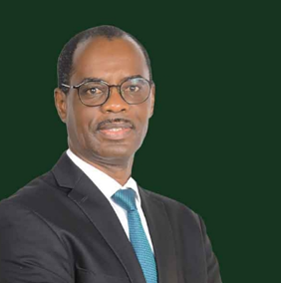
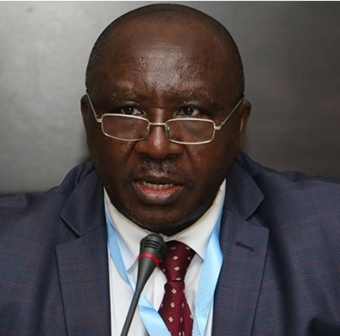
Dr Siméon Kenfack
Director of Programs, AFWASA
Mr Osward Chanda
Chief of Water department, African Development Bank
Notes:
AFWASA to highlight safely management water and sanitation services integrated into future planning and events
AfDB to briefly highlight plans to support current commitments and agreements on the finance side especially in the sanitation sub-sector (ex: AUSIF RFPs recently launched through the AWF)

Slide 25
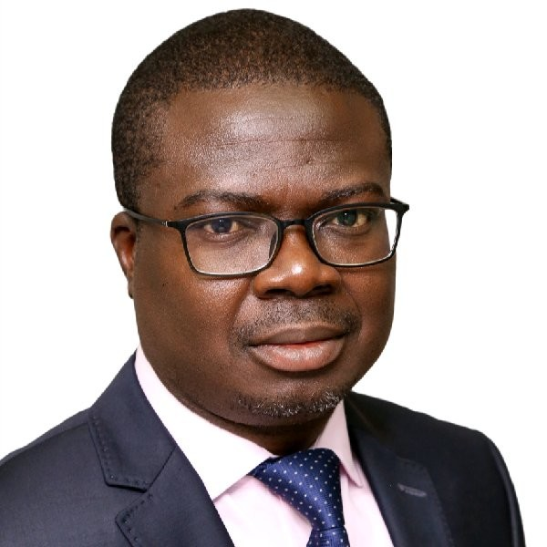
Highlights of the discussion and concrete next steps
Juste, Hermann NANSI
Director Africa Hub, IRC

