Slide 1



Slide 2
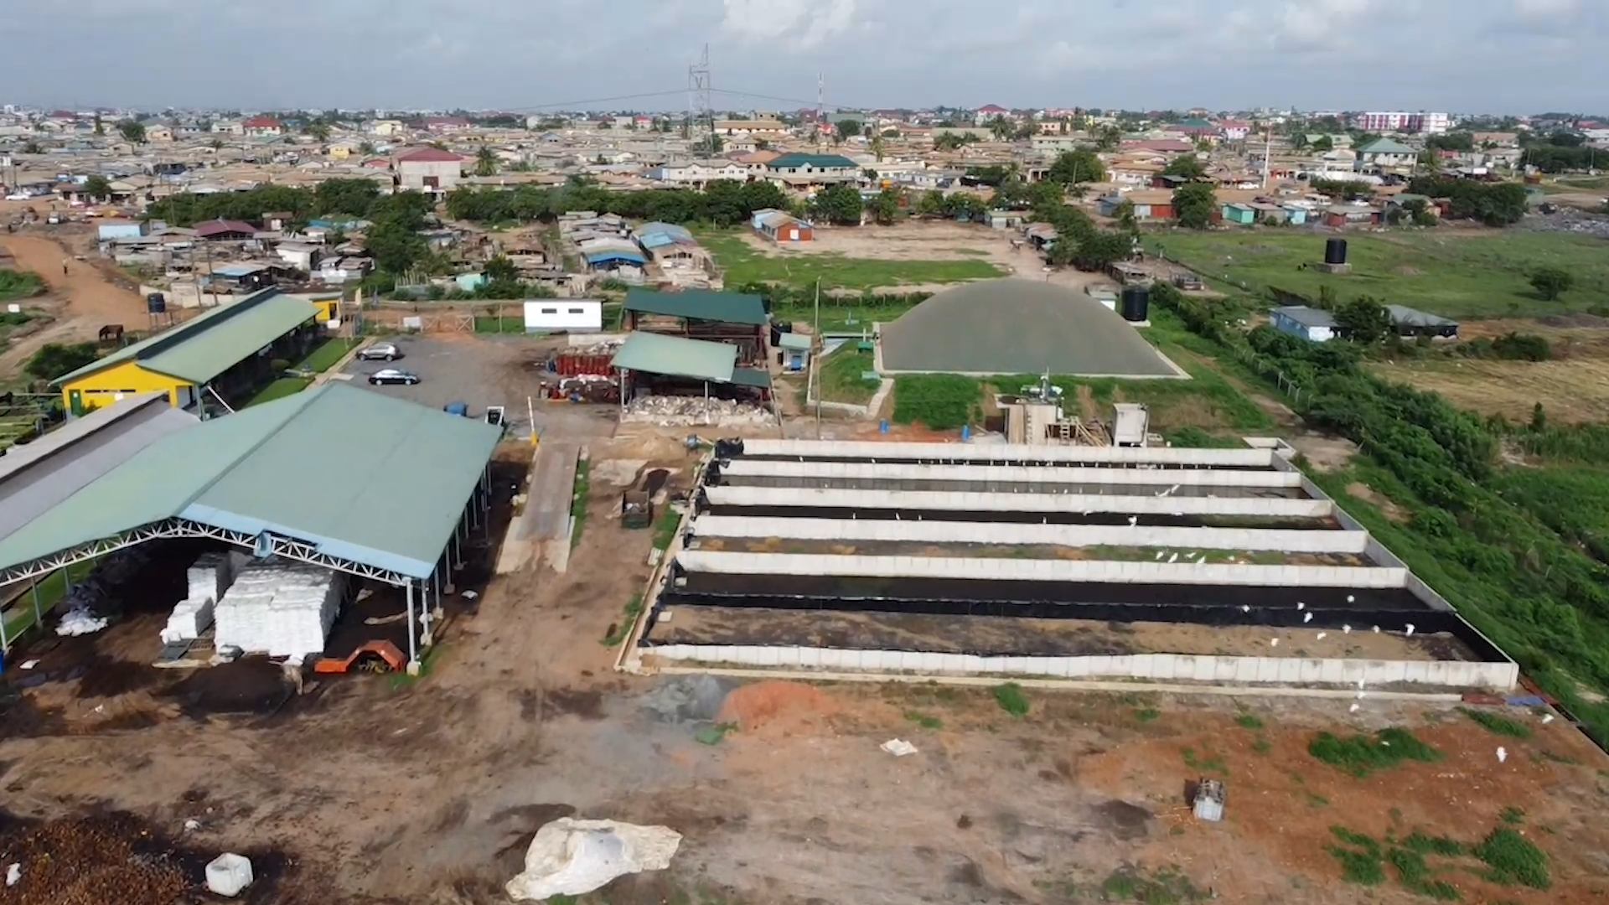

Slide 3
The Safisana Solution in Ghana - Turning Waste into Value - YouTube

Slide 4

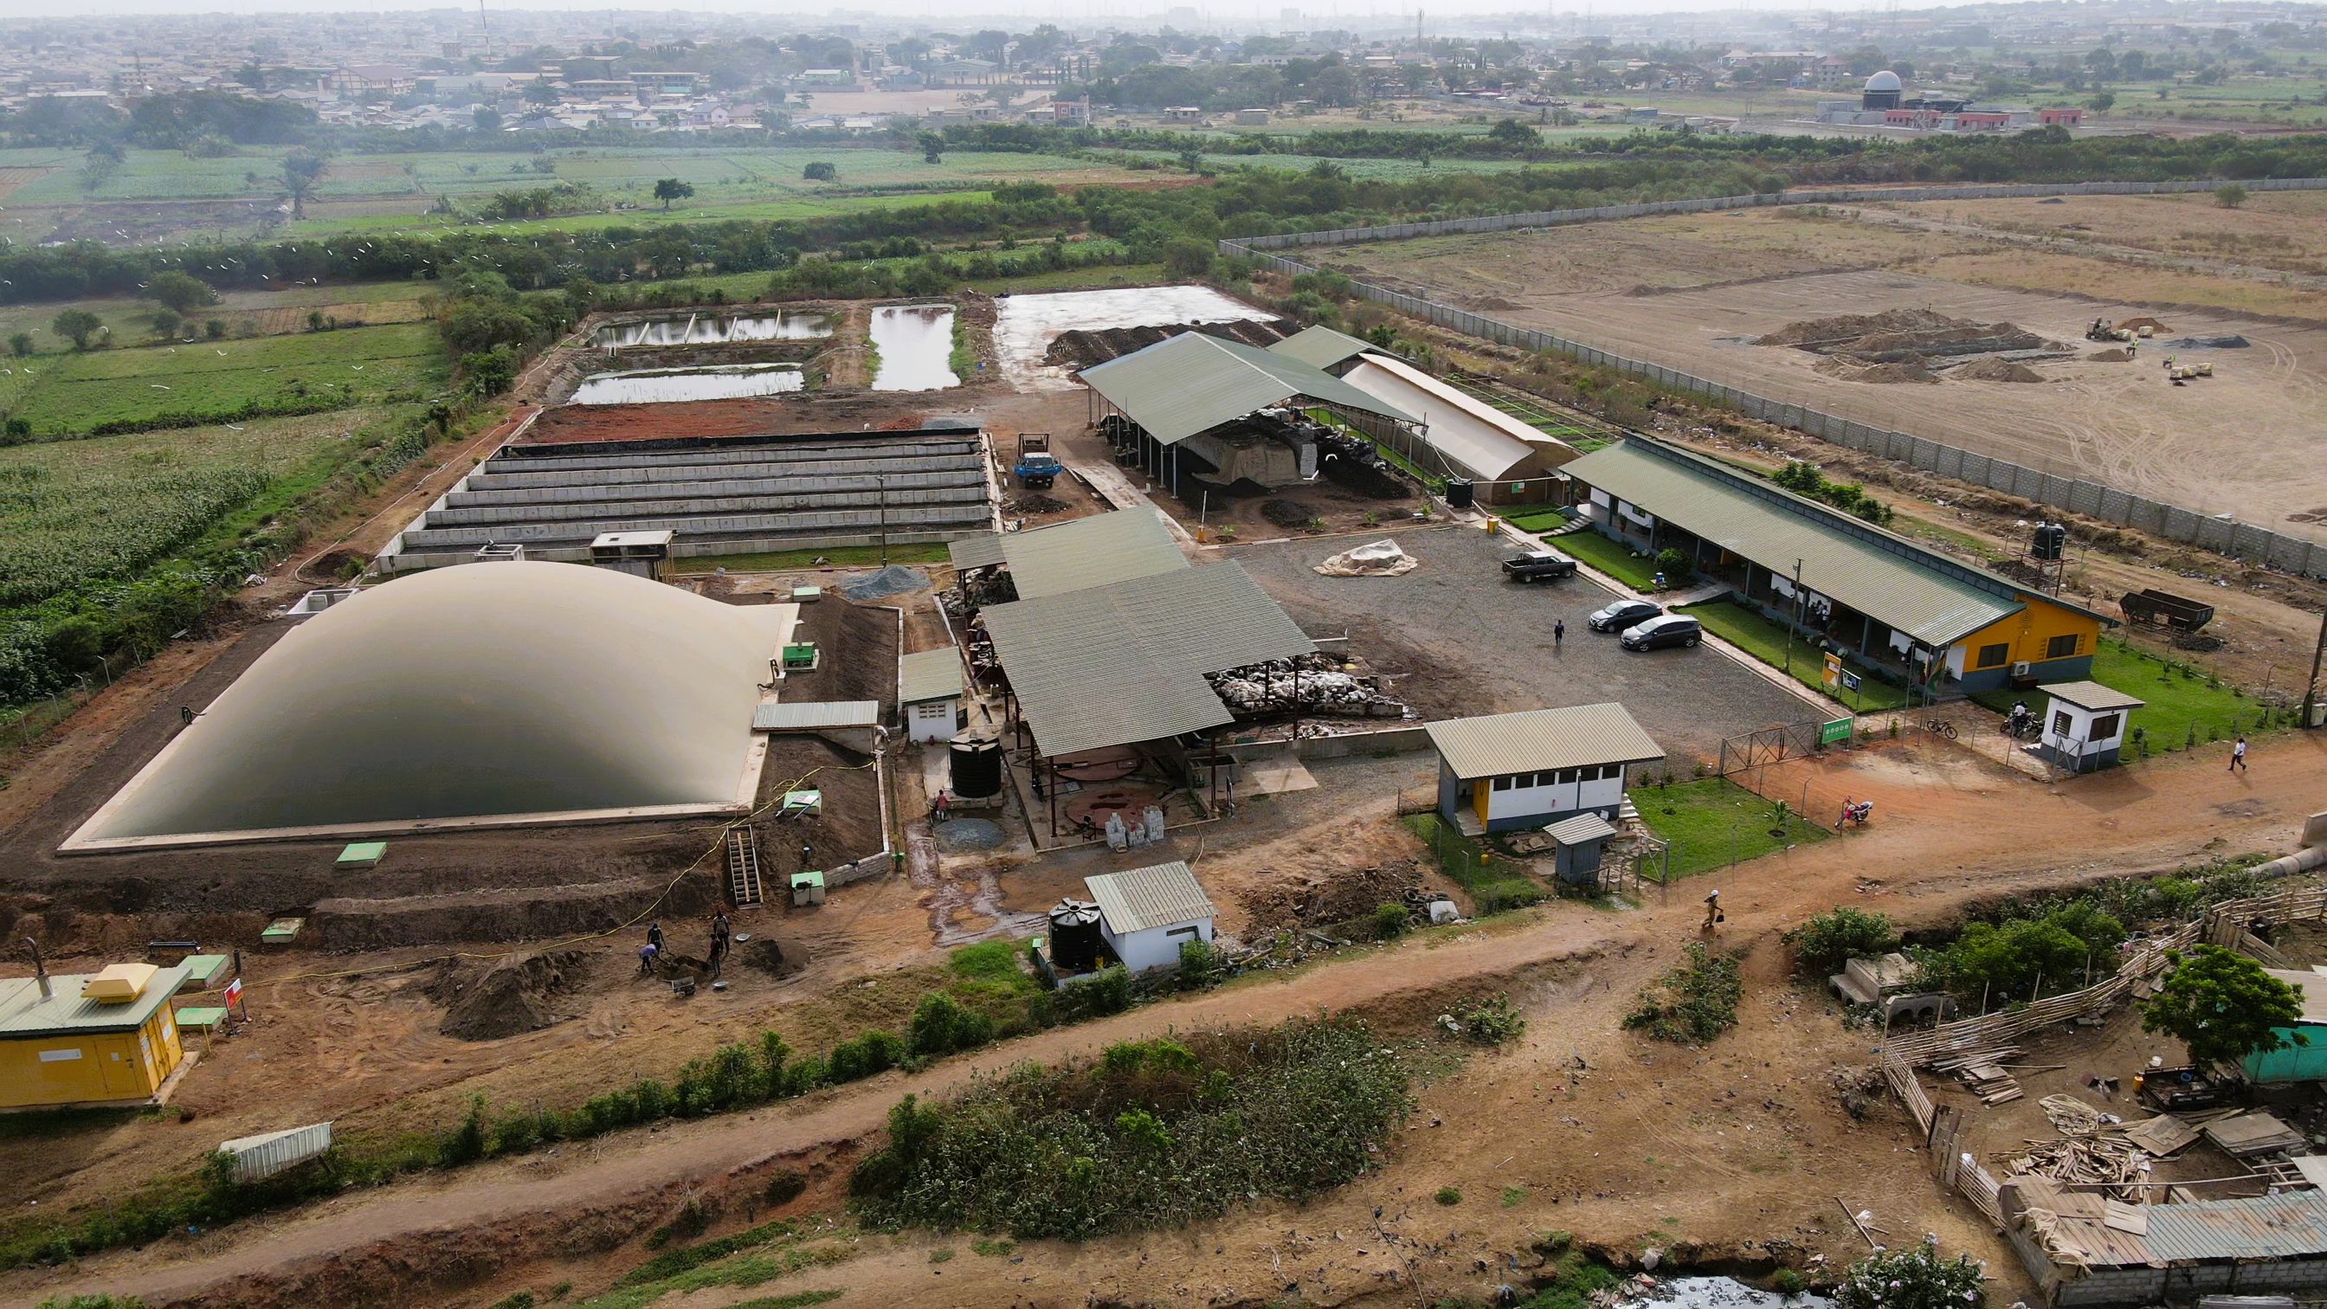
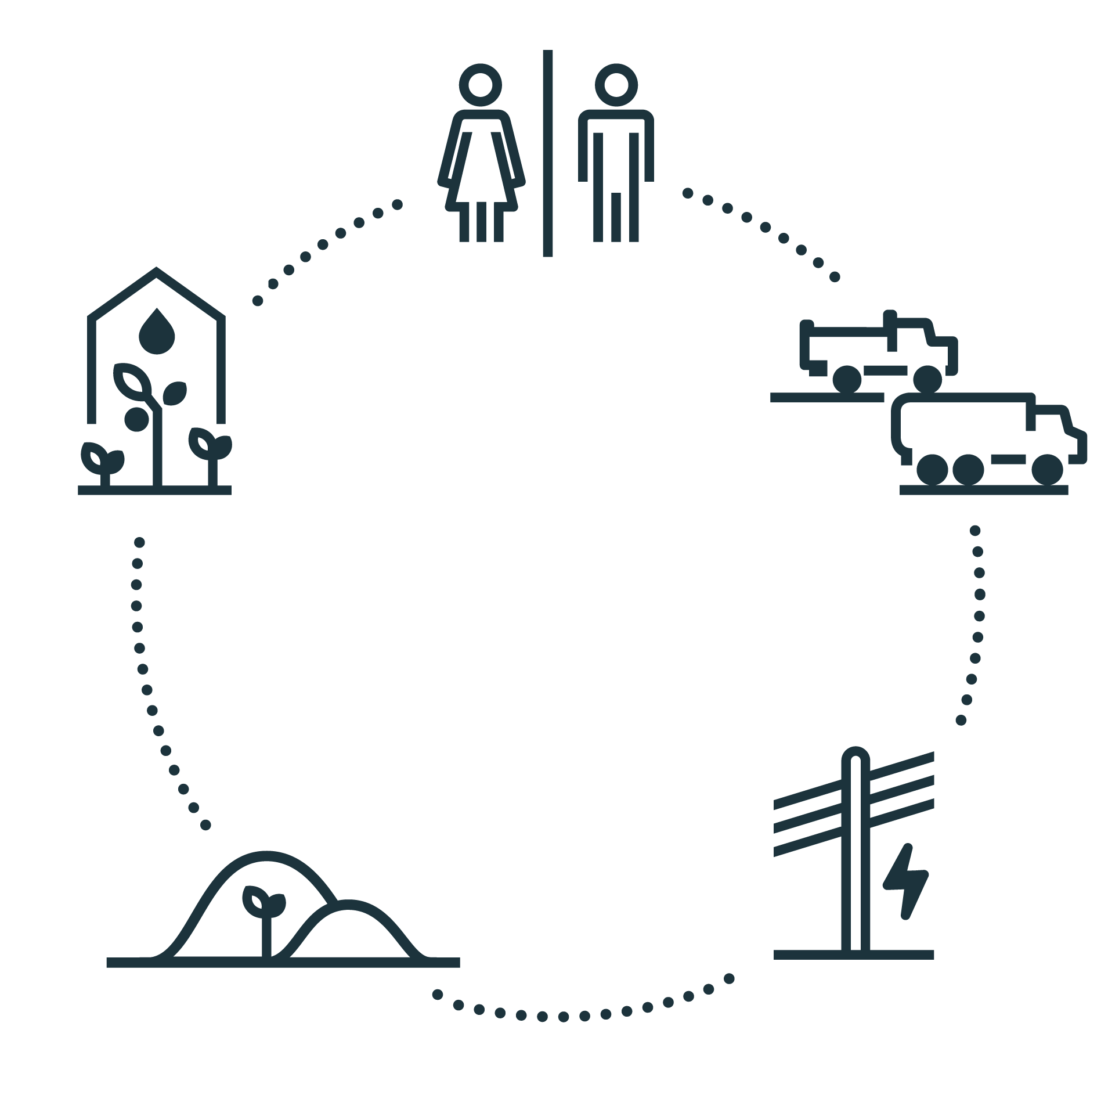
A solution that connects all systems…
Notes:
So, this video gives a good insight into what we already do in Ashaiman.
It is our mission to bring solutions that improve people’s health and help save the environment.
My name is Michiel Bakkum, and I am responsible for Business Development at Safisana.
And today I want to show you what we need to scale beyond Ashaiman.
And how you could help.
The treatment plant you see up here is a solution that connects all systems…

Slide 5
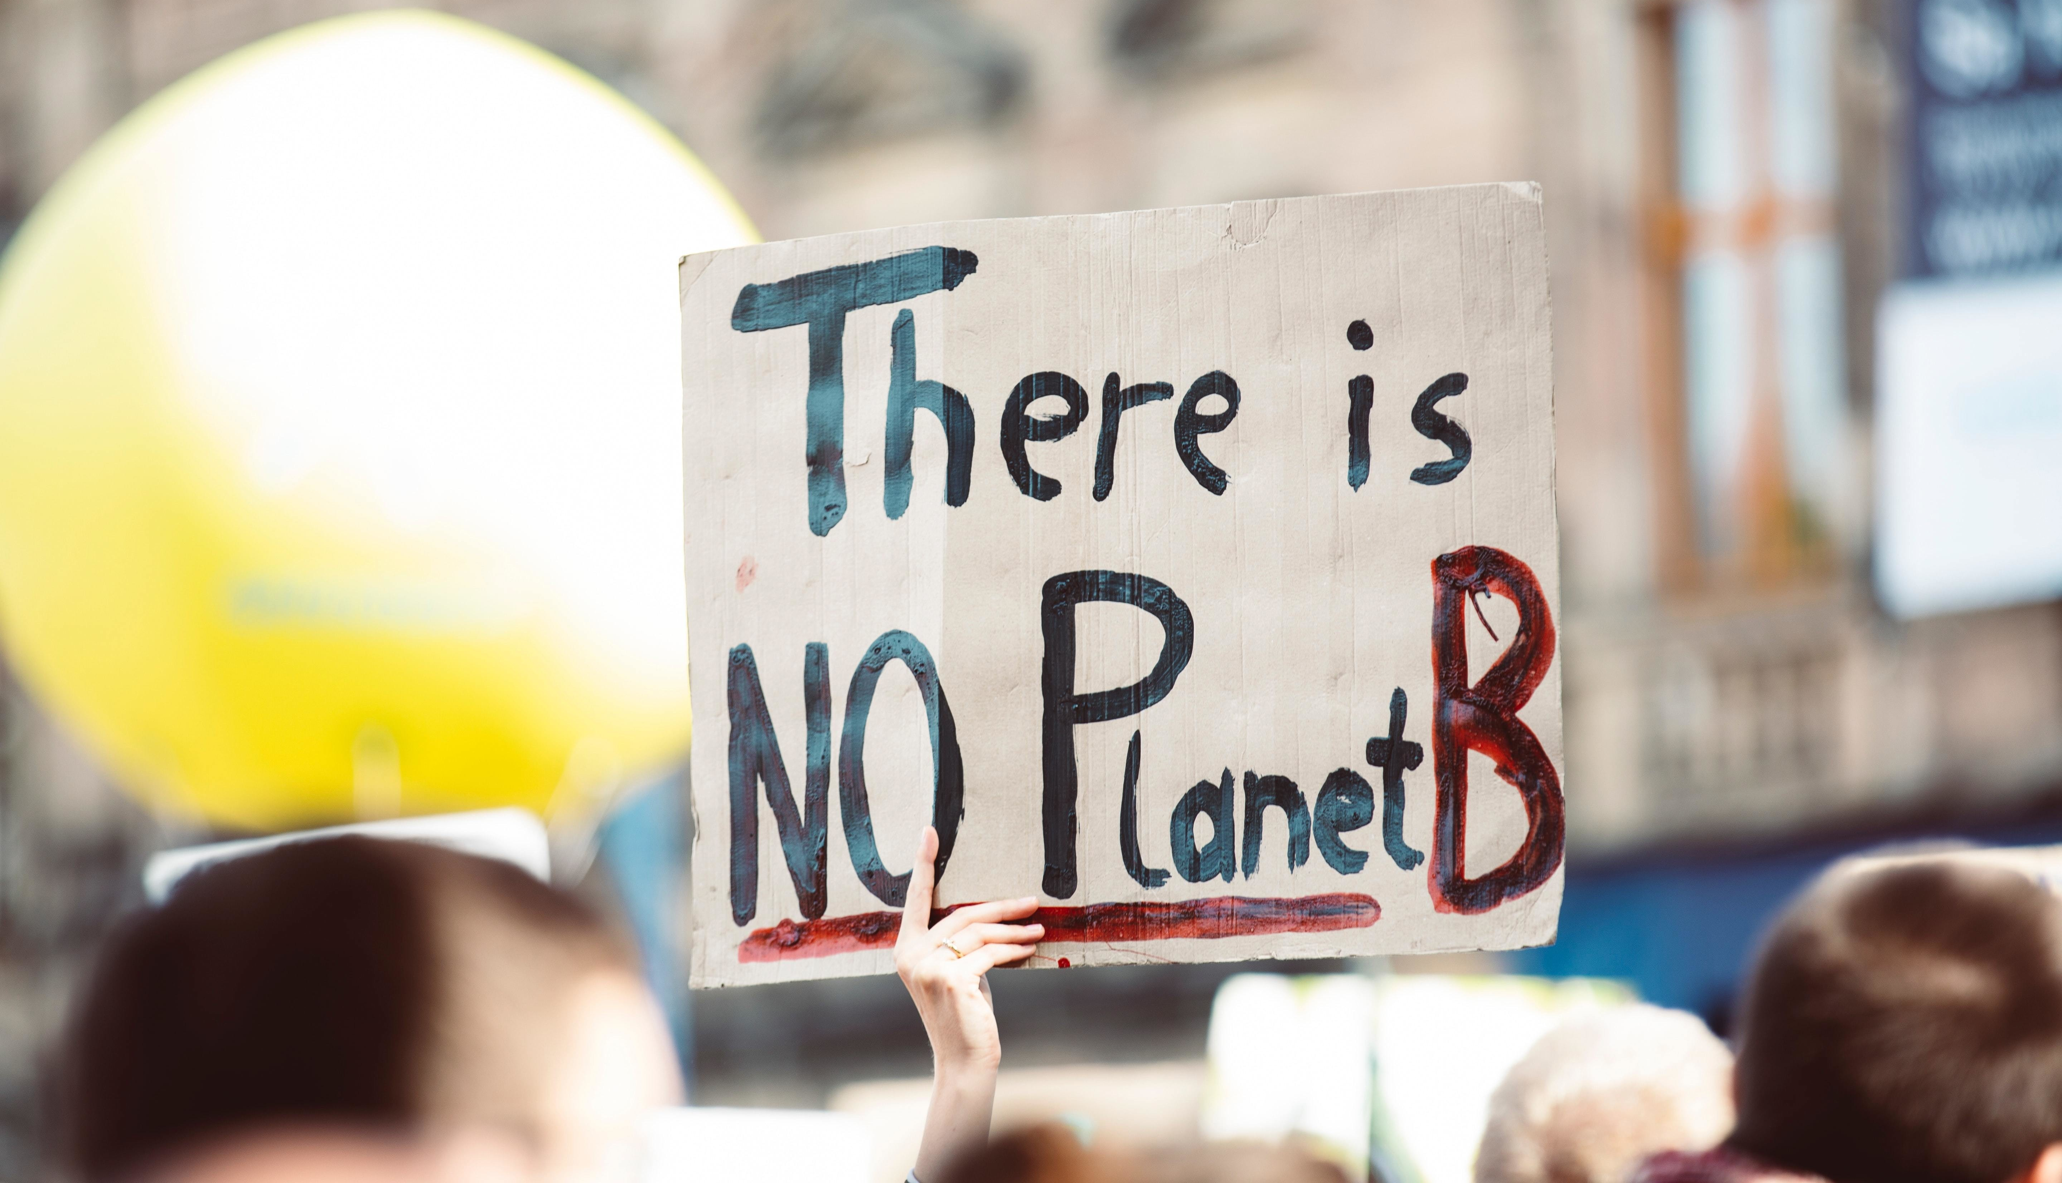
… combatting multiple crises!
Notes:
To combat many of the crises the world is facing today.
We see that the current systems fail to deliver appropriate and proportional solutions.

Slide 6
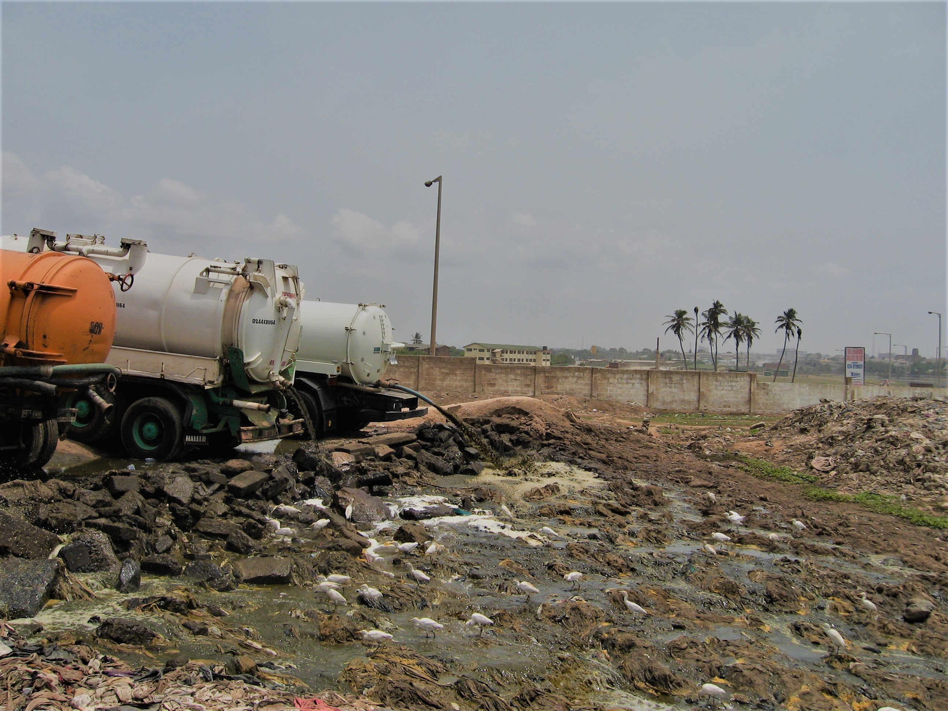
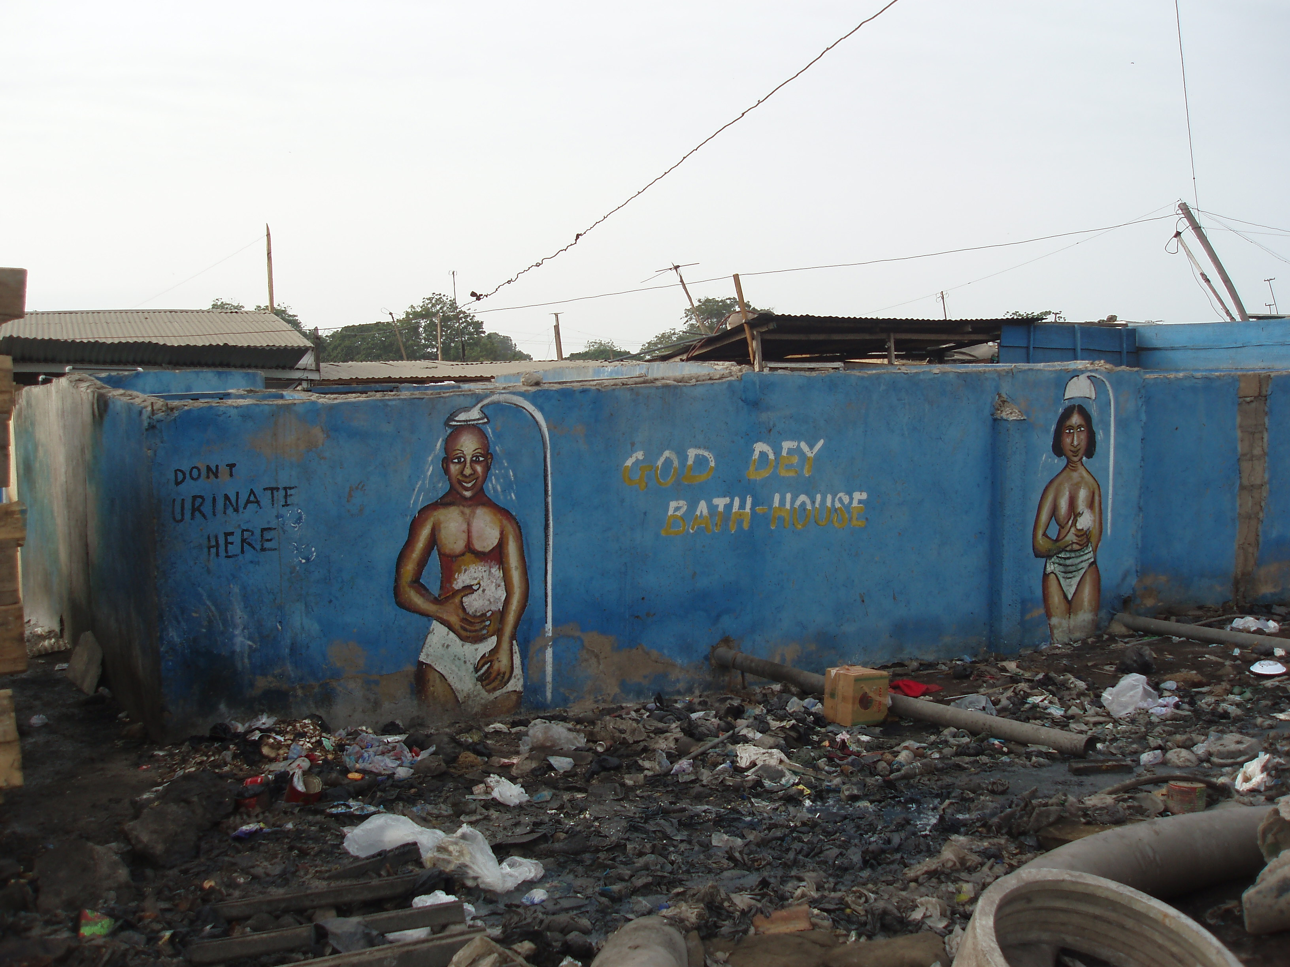

Poor health and lack of hygiene
Globally, 80% of wastewater flows back into the ecosystem without being treated or reused
Over 800 K people die from poor sanitation and hygiene, yearly
Notes:
Especially where it comes to sanitation.
A lack of proper waste management leads to many diseases, such as cholera, dysentery and typhoid.
Around 1.8 billion people use a source of drinking water that is contaminated with faeces,

Slide 7
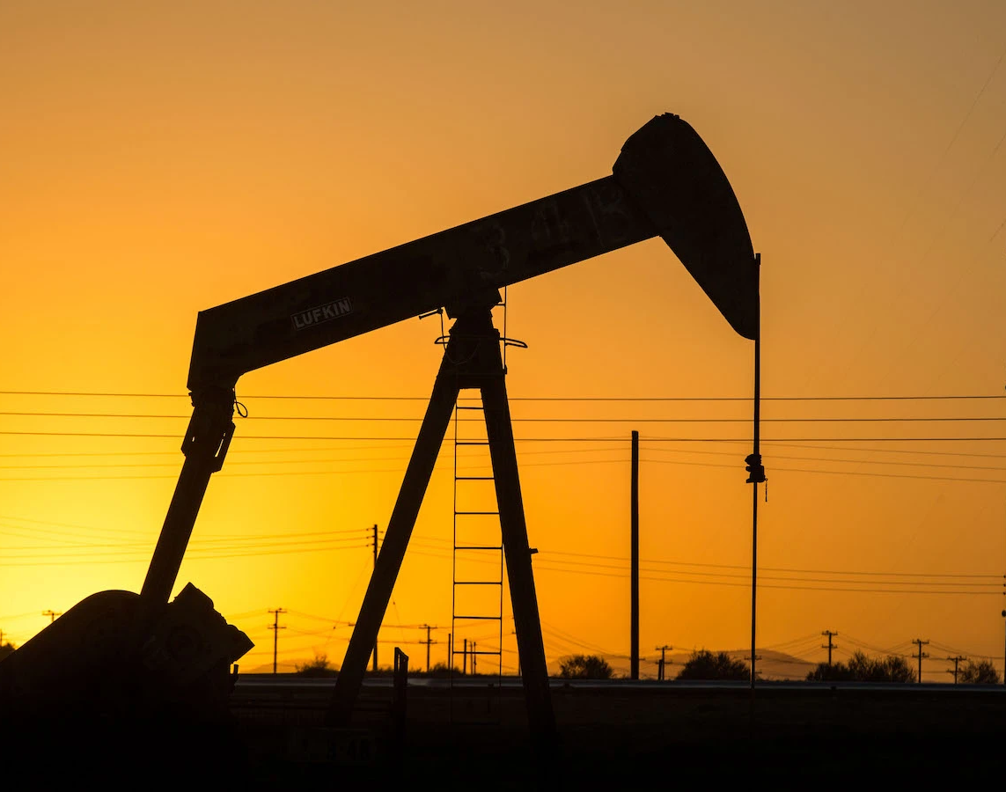
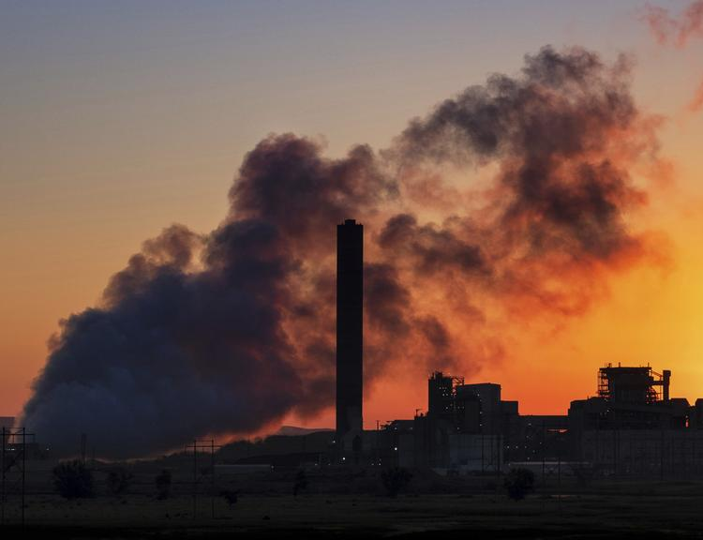

Climate change and
Energy transition
Greenhouse gas emissions need to be limited by 2030 with 45 %
to get on track to 1.5°C global warming
Notes:
We see the climate is changing.
Predominantly caused by greenhouse gas emissions from burning fossil fuels and dumping waste into landfills.
And although the energy transition is happening,
Most of us still rely on fossil fuels as our primary energy source.

Slide 8


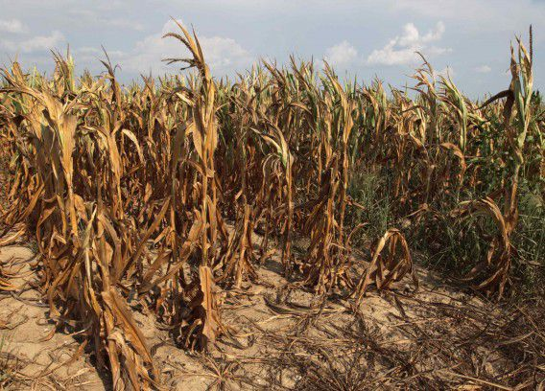
Struggle for food security
Global reserves of phosphate will
be depleted in 50–100 years
By 2050 nearly 10 billion people will live on Earth
Notes:
And then of course the Food crisis.
Think of the exponential growth of the world’s population with many more mouths to feed.
Think of soil depletion and nutrient scarcity (like phosphorus).
Think of fertilizer shortage and the wrong use of chemicals and pesticides.
All these crises seem to be interconnected.
And so, to fight them we believe it’s necessary to adopt solutions that are also interconnected and circular in nature.
So, how does our model respond to these challenges then?

Slide 9
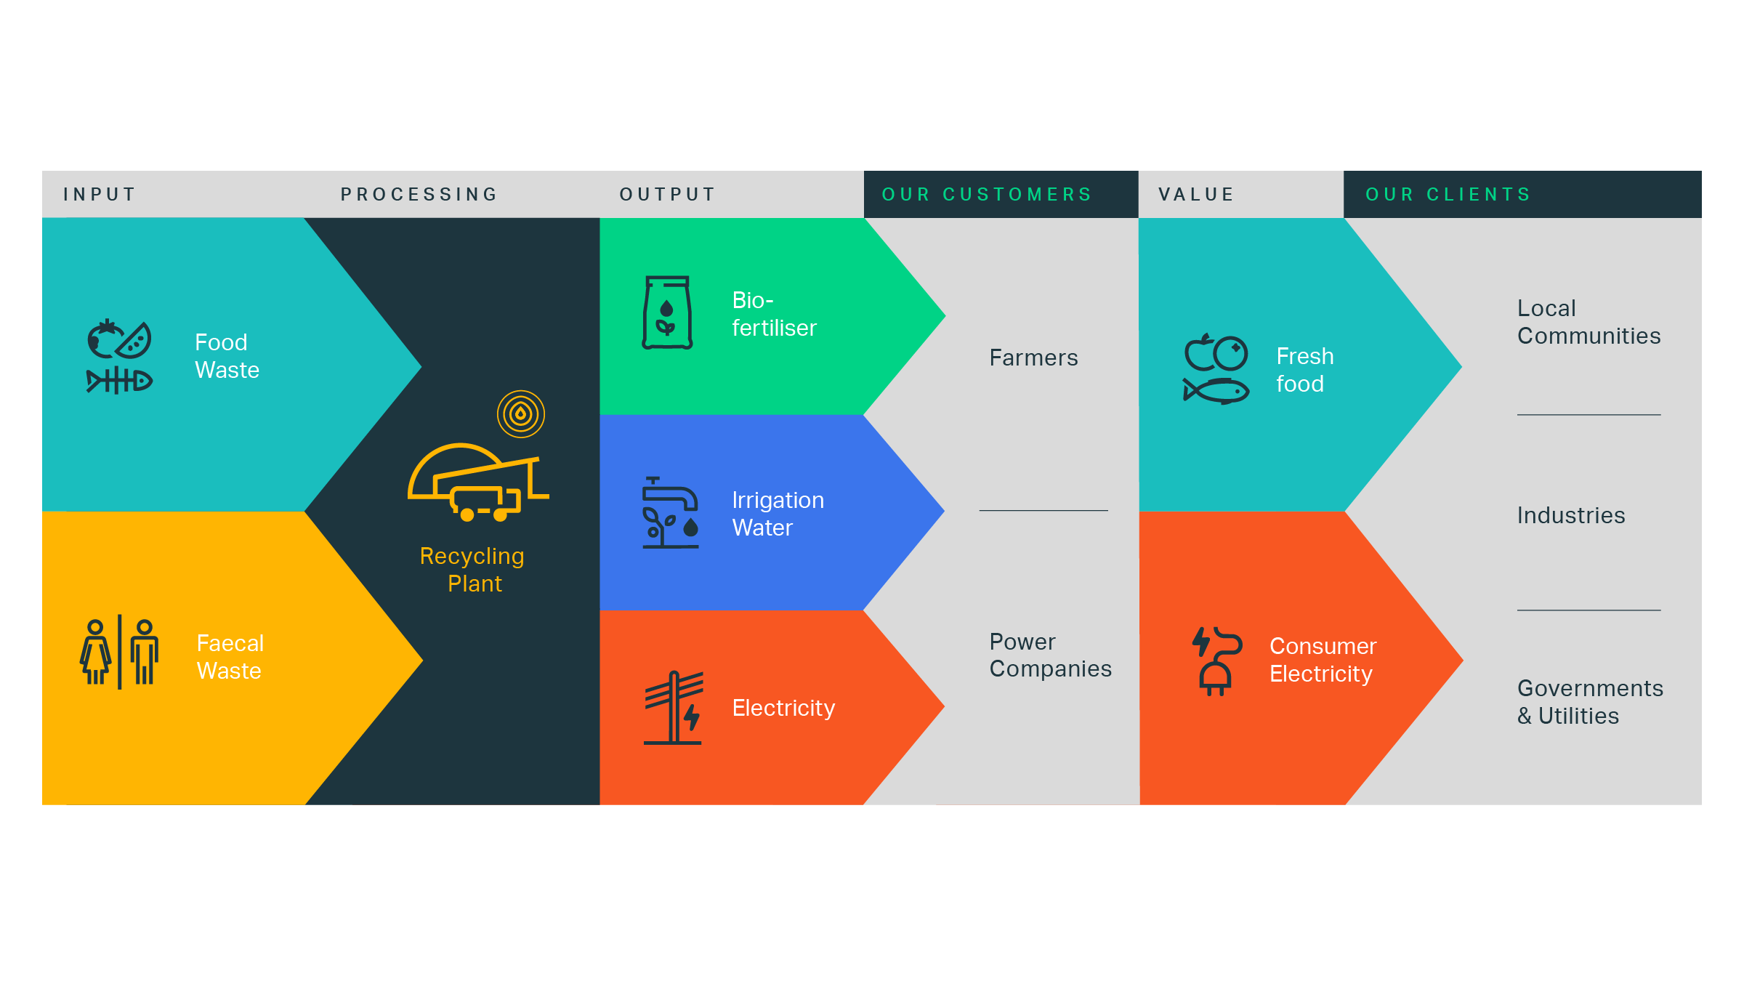
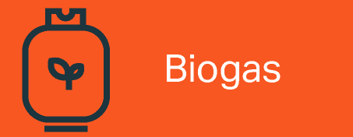
A circular and sustainable business model
Notes:
Well, we have built such a circular model.
In the video we showed you how we use waste to create our valuable products
These products go to our customers and clients
Who in turn produce waste that we can reuse.
We serve industries and consumers with our products
We serve governments with our treatment services
We serve communities with our social impact
So we basically offer a private solution for a public problem!

Slide 10

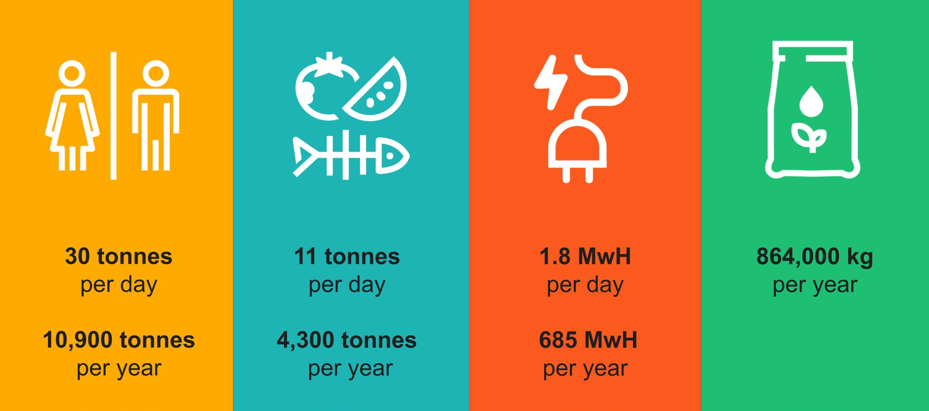
Our scale
Notes:
In this slide you see the scale of what we do in Ashaiman.
In yellow the faecal matter and in blue the organic waste.
And from the treatment of this waste, we generate 2 outputs
Electricity and organic fertilizer.
And so how does that relate to the impact that we are aiming for?
Our faecal waste treatment serves 31.000 people per year, by improving their personal hygiene and well-being
Organic waste treatment around 35.000 people, through cleaner living and working conditions
Our green electricity covers a 100% of the energy need of 2.300 people per year.
Our organic fertilizer benefits almost 12.000 farmers per year, by increasing the yields of their crops.
And these are just the direct benefits!

Slide 11
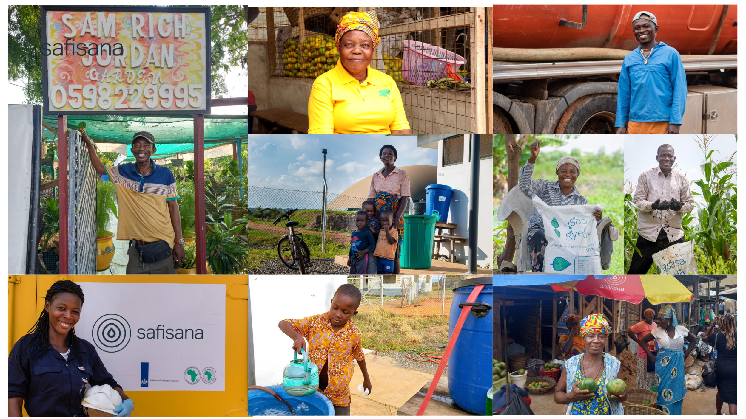
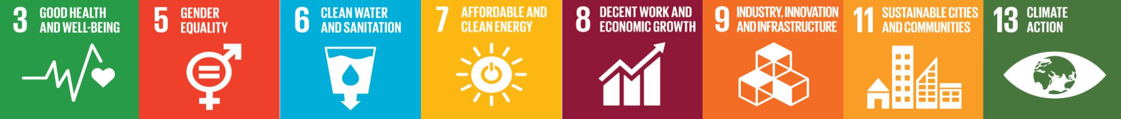
Our Impact
80,000 primary beneficiaries yearly
Notes:
This all adds up to some 80,000 primary beneficiaries per year.
Which equals more than a quarter of the population of Ashaiman.
On the top right you see one of the vacuum truck drivers we work with.
And below him one of the farmers that use our organic fertilizer.
We improve livelihoods and cleaner working conditions for example for the market queens here.
We provide employment.
On the bottom right you see my colleague Gloria who has worked with us for more than 10 years.

Slide 12
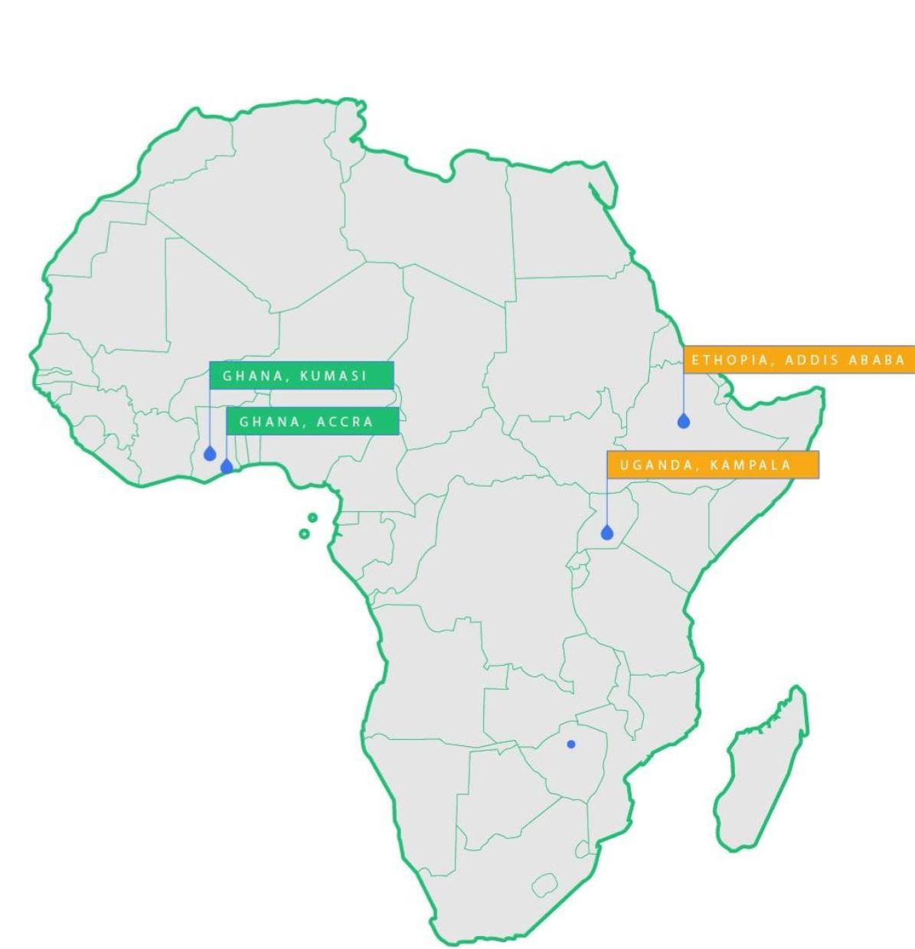
Our focus
2025: 2 to 3 new plants
Ghana, Ethiopia and Uganda
At least 3 plants per country
Beyond 2025:
3 > 5 > 10 > 25 plants per year
Notes:
We have been operating in Ghana for 10 years now.
And we recently started a second location in Kumasi.
And we are doing new projects in Ethiopia and Uganda.
We aim for at least 3 treatment locations per country.
We plan to make our model an open source licensing model that is replicable.
That makes exponential growth possible

Slide 13
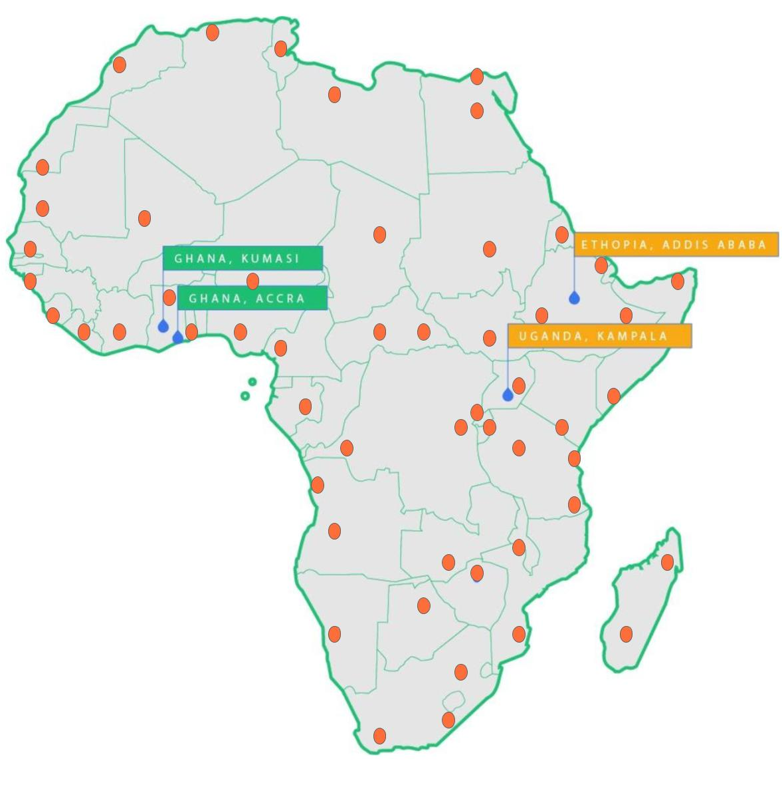
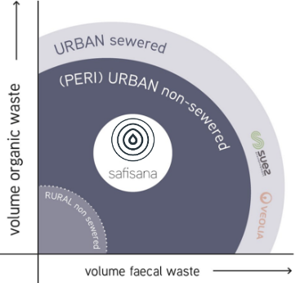
Our goal: 1.000 plants
Notes:
Our Big Hairy Audacious Goal is to see 1.000 plants created, and not just Africa.
Creating 1.000 plants will provide treatment capacity of ~100.000 tons of faecal sludge, every day!
Mind you, that is ~5% of the faecal sludge that is produced worldwide.
So, in order to make our solution proportional to the problem
we need to scale – and we need to scale fast.

Slide 14
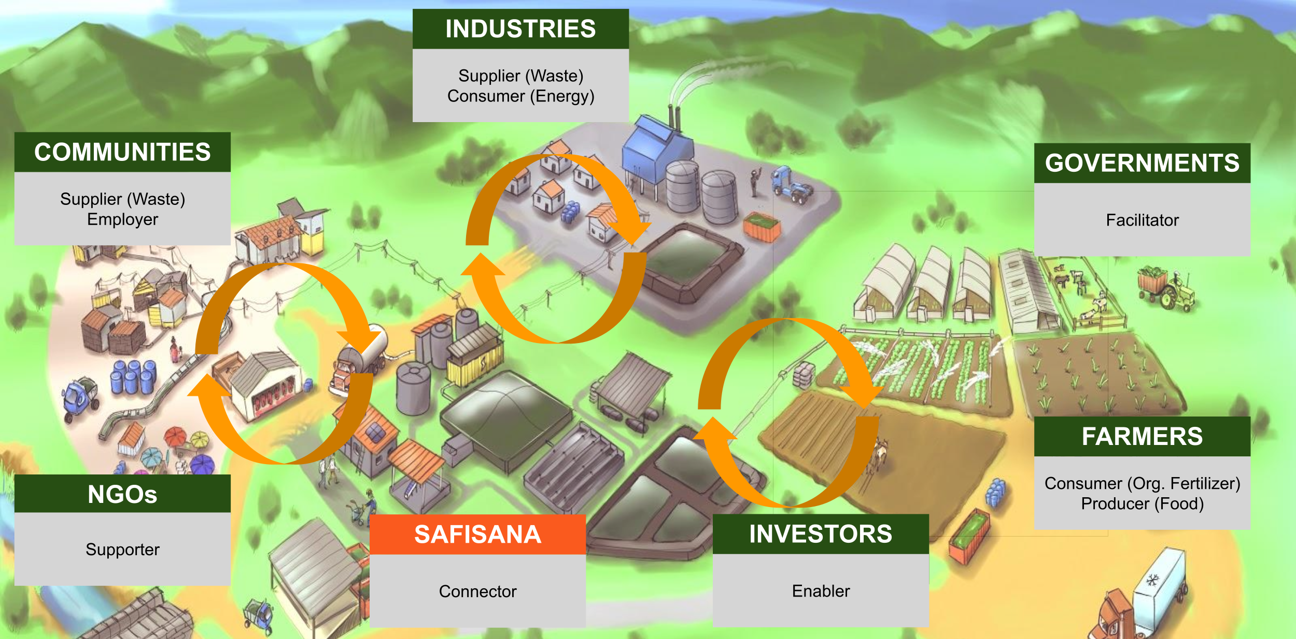
Connecting all systems and stakeholders!
Notes:
But we can not do it alone!
We need to connect with all kinds of players to make it work.
Governments to facilitate an enabling environment for us to operate in
(like the Ashaiman Municipal Assembly and Ghana ministry of WASH, who provided us with space).
Industries and businesses to co-create our models that supply us with their waste and that consume our products.
Investors for access to finance, that will help us to scale to other countries.
And we connect with the communities – this is where we make our impact.
Let me share in a bit more detail what we are already doing with the key players…
And what some of the challenges are that we face.

Slide 15
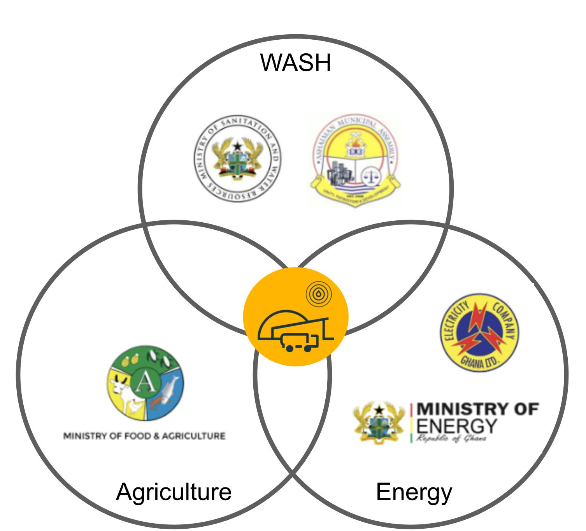

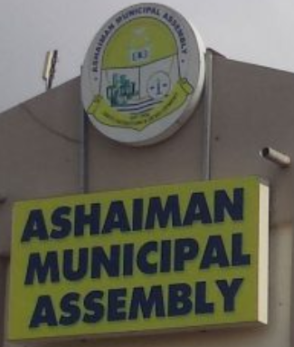




Working with the Public Sector
Notes:
We work with many parts of the public sector, like the ministries, the municipal assemblies, and various agencies and authorities.
Ministries/Assembly - provided land
EC/ECG – feeding electricity to the grid
EPA – processes stay within regulations
FDA – designated us as intaker for food that has gone bad.
All very valuable and essential for running our business.
But in a new location this all starts over again.
We see an inconsistent supply of waste from the markets.
This makes it challenging for us to ensure the quantity and quality of our outputs.
The markets are managed by the muncipality and we would really be helped if we could formalize an agreement where we become one of the key waste intakers.
In Ashaiman we are provided with space, but we are not very sure for how long.
Uncertainty around the this will negatively affect decisions from our funders and our B2B clients.
Having clear and suitable conditions enables us to present strong business cases, that hopefully get the green light for additional investments.
More challenges:
Like the influence of politics that affect decisions around the continuity of our work in Ashaiman.
It’s hard to navigate through all the different layers of public office > every new treatment plant will be done with new stakeholders that need convincing.
Governments are not able or willing to pay us for our sanitation services or public health improvements
Chemical fertilizers are currently subsidized.

Slide 16
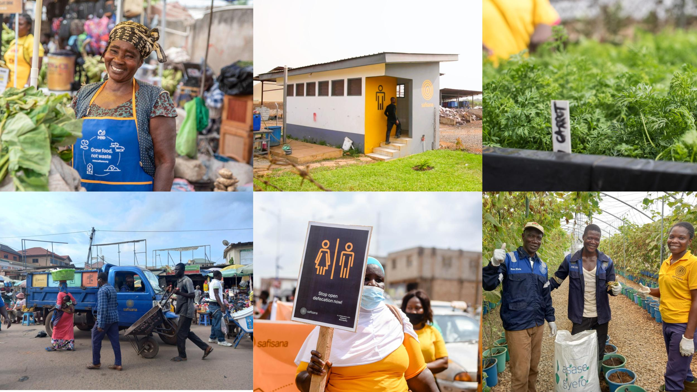
Working with communities and farmers
Notes:
In the video we explained how we work with communities and farmers.
But also here we still see challenges:
There is still little awareness of the effects of poor waste and sanitation practices
Segratation of waste is not done on a large scale
Open defecation still takes place (and people still contract related diseases)
Most people still rely on a linear sanitation system. In other words, the waste goes to waste. It’s great to see so many initiatives to build public toilets and services, but most of the collected waste is still dumped illegally, in the sea or in wetlands.

Slide 17
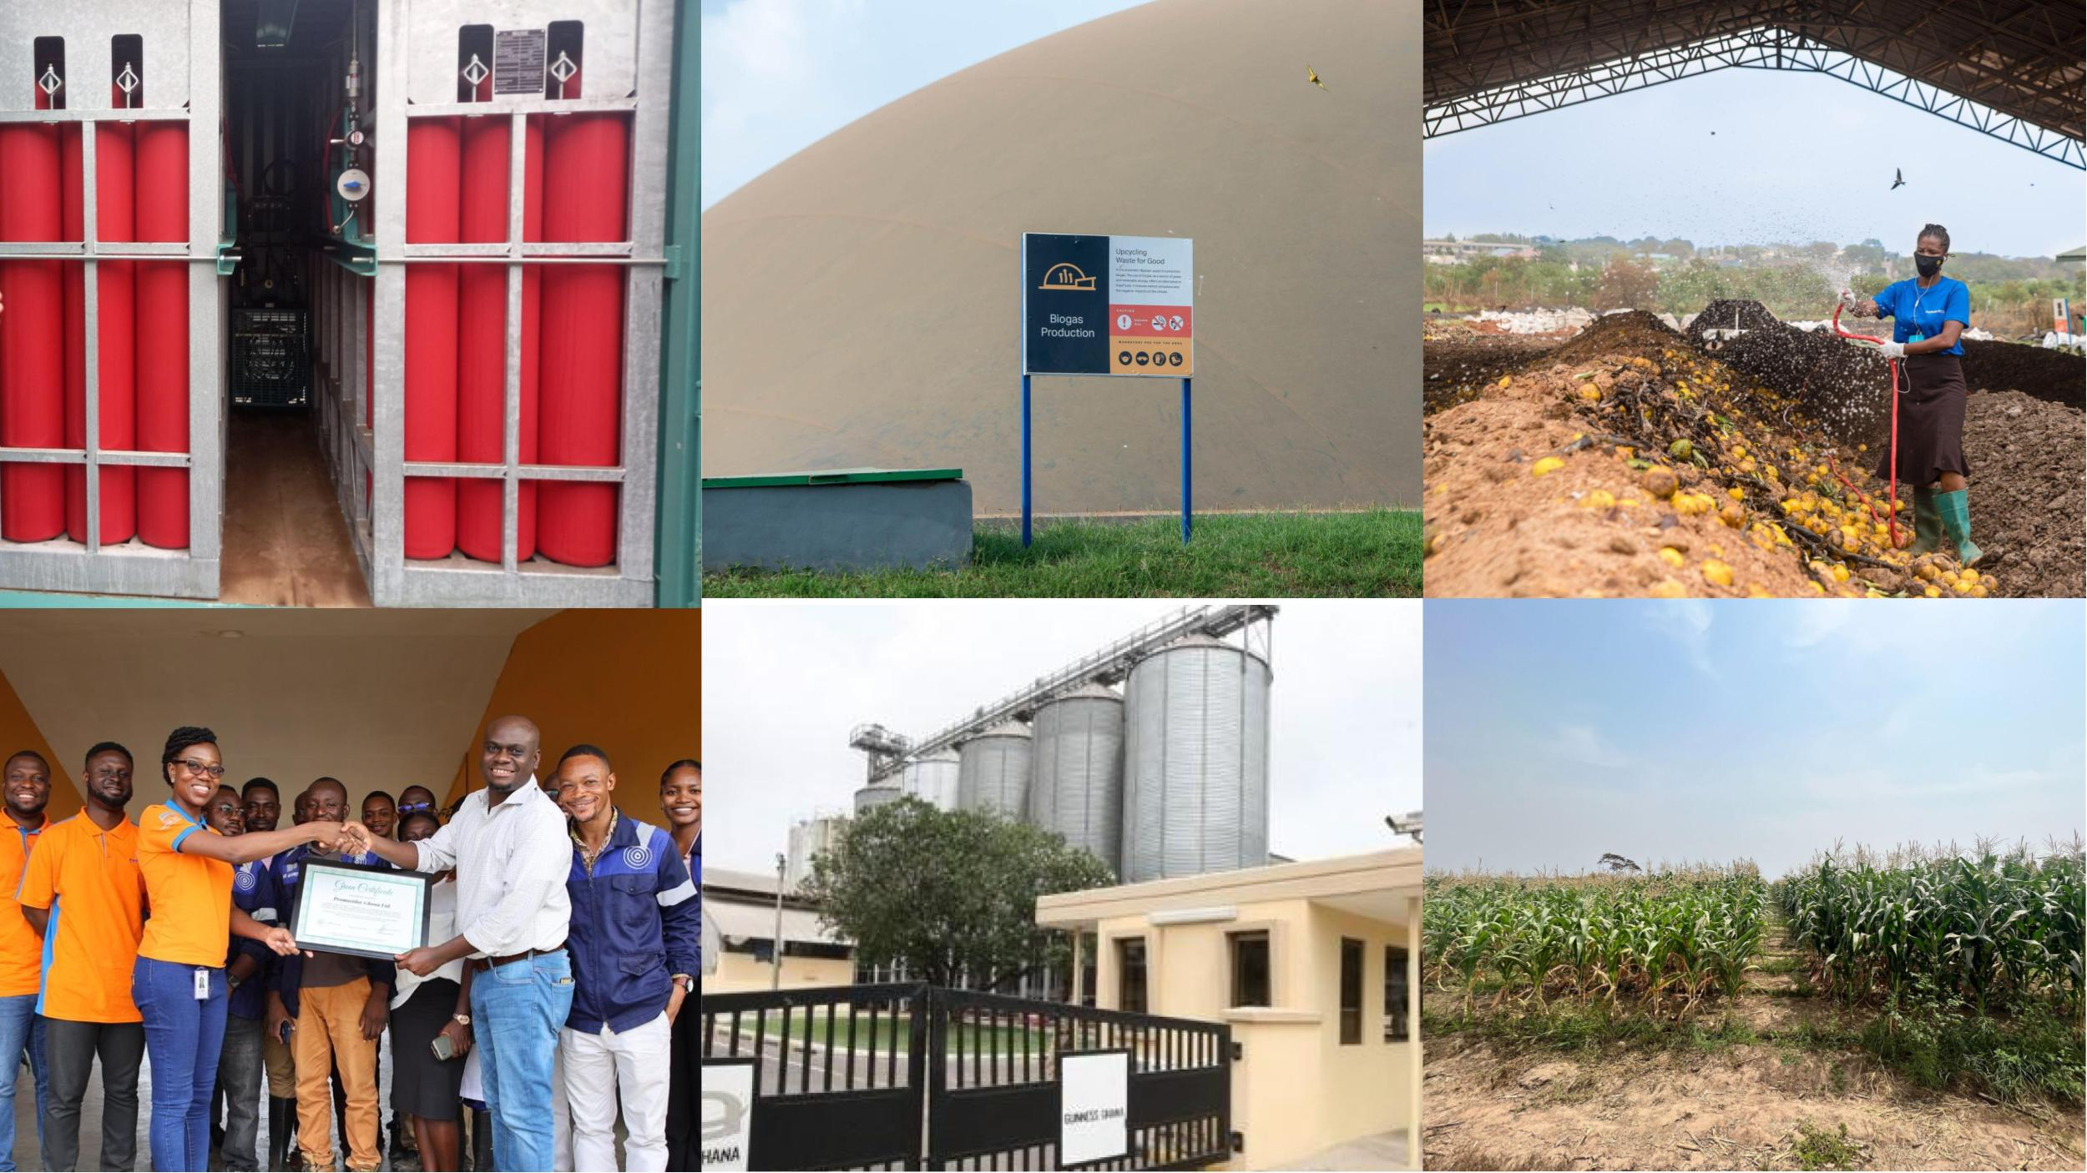
Working with businesses and industries
Notes:
And what about the businesses and industries?
For example, we are working on a compressed biogas case as an addition to our Ashaiman operations.
We produce around 2.000 m3 biogas per day.
Part of that is transformed into electricity and fed back to the national grid.
The remaining part we intend to sell as compressed biofuel that we can transported to the client location.
We see a technical challenge for businesses in adapting our biogas.
We have been looking into mixing our biogas with fossil fuel that is currently being used.
That is difficult and can only be done in small volumes or switch to 100%.
Businesses will not take the risk of becoming fully dependent on our biogas right away.
And so they want to test on a small scale.
And that causes a problem for us, as we can’t justify investing into the expensive equipment.
We see an economic challenge.
While the business (HQ) is profiling itself with strong ESG ambitions, on plant level the business still requires to be profitable first and foremost and has a cost saving mindset.
What we need is the opportunity to co-create a tailormade solution that takes into account the short-term priorities and the long-term goals.
We believe that once we have overcome these challenges, we should be able to replicate to other plants of the business a lot faster.
It is something we are doing with one of the big global breweries right now.
It is one of the reasons we believe that focusing on B2B will enable us to scale faster.
Another reason is our strong financial model.

Slide 18
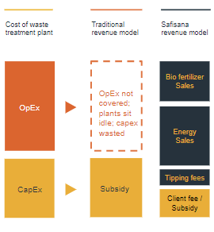
A financially sustainable, revenue- generating business model
Notes:
Typically the costs for a treatment plant are made up out of Capital Expenditures and Operating Expenses.
The CAPEX is the initial investment, needed to buy the equipment and assets.
The OPEX covers wages and costs for transport, energy and maintenance etc.

Slide 19
A financially sustainable, revenue- generating business model
Notes:
In the traditional model, the CAPEX is granted through a subsidy.
And once the plant is built, the leading authority or agency would operate it.
It happens too often that this authority or agency has no budget allocated to operate the plant.
Which can result in a plant sitting idle and doesn’t offer the intended solution.

Slide 20
A financially sustainable, revenue- generating business model
Notes:
And so we created a different business model.
The income from sales of our products covers the OPEX AND brings a Return on Investment.
Therefore, less investment is needed, to achieve the same results.
This makes our model interesting for blended financing (mix of subsidies, grants and loans).
Which in turn makes it more interesting for our funders and B2B clients
And this ties back of course to that Big Hairy Audacious Goal of ours, the 1.000 plants.

Slide 21

Conditions to Scale
  Finance
Notes:
And that brings us to the last part of this presentation: what conditions do we need to scale?
From a finance perspective:
We need about 5 MM USD per plant.
However, there seems to be an investment gap between 2-20 MM USD.
We ask for ways to help us overcome this investment gap
Which might be done by bundling projects.
Or in finding more creative ways to finance solutions (e.g. $ 15,- per tonnes waste treated)

Slide 22
Conditions to Scale
  Governments
  Finance
Notes:
From Government perspective
We need an enabling environment where government can facilitate access to land and waste resources.
It would help to see stronger environmental policies on waste, recycling, carbon emission and (renewable) energy
And stronger enforcement of environmental regulations
And also, to encourage the production and use of renewable energy and organic fertilizer, through for example subsidizing.
Advocate behavior change through social marketing around the reuse of faecal matter and benefits of using organic fertilizer vs. non-organic.
Most of all, to find ways to reward the sanitation service we provide or the public health that we improve.

Slide 23
Conditions to Scale
  Industries
  Governments
  Finance
Notes:
From industries perspective
Make ESG goals concrete and allocate more budget for implementing solutions
Acknowledge the value of carbon reduction when replacing fossil fuel
Plan ahead for the energy transition. It is happening and it is unavoidable.
And so, what can you ask from us?
Well that we provide tailormade solutions that deliver valuable products and services
That we can connect you to all other players and their systems.
And that we are here to start these kinds of conversations.
So, I want to leave you with these thoughts:
What can you do to help us reach our full potential?
As we make the problems of others our business => we encourage you to do the same.
What if you could take on one of the obstacles I’ve shared with you today?
We all have the same goal: to improve the lives and living conditions of many.
But we cannot do it alone, we need you – and we need your systems.
That leaves me with just one question…

Slide 24
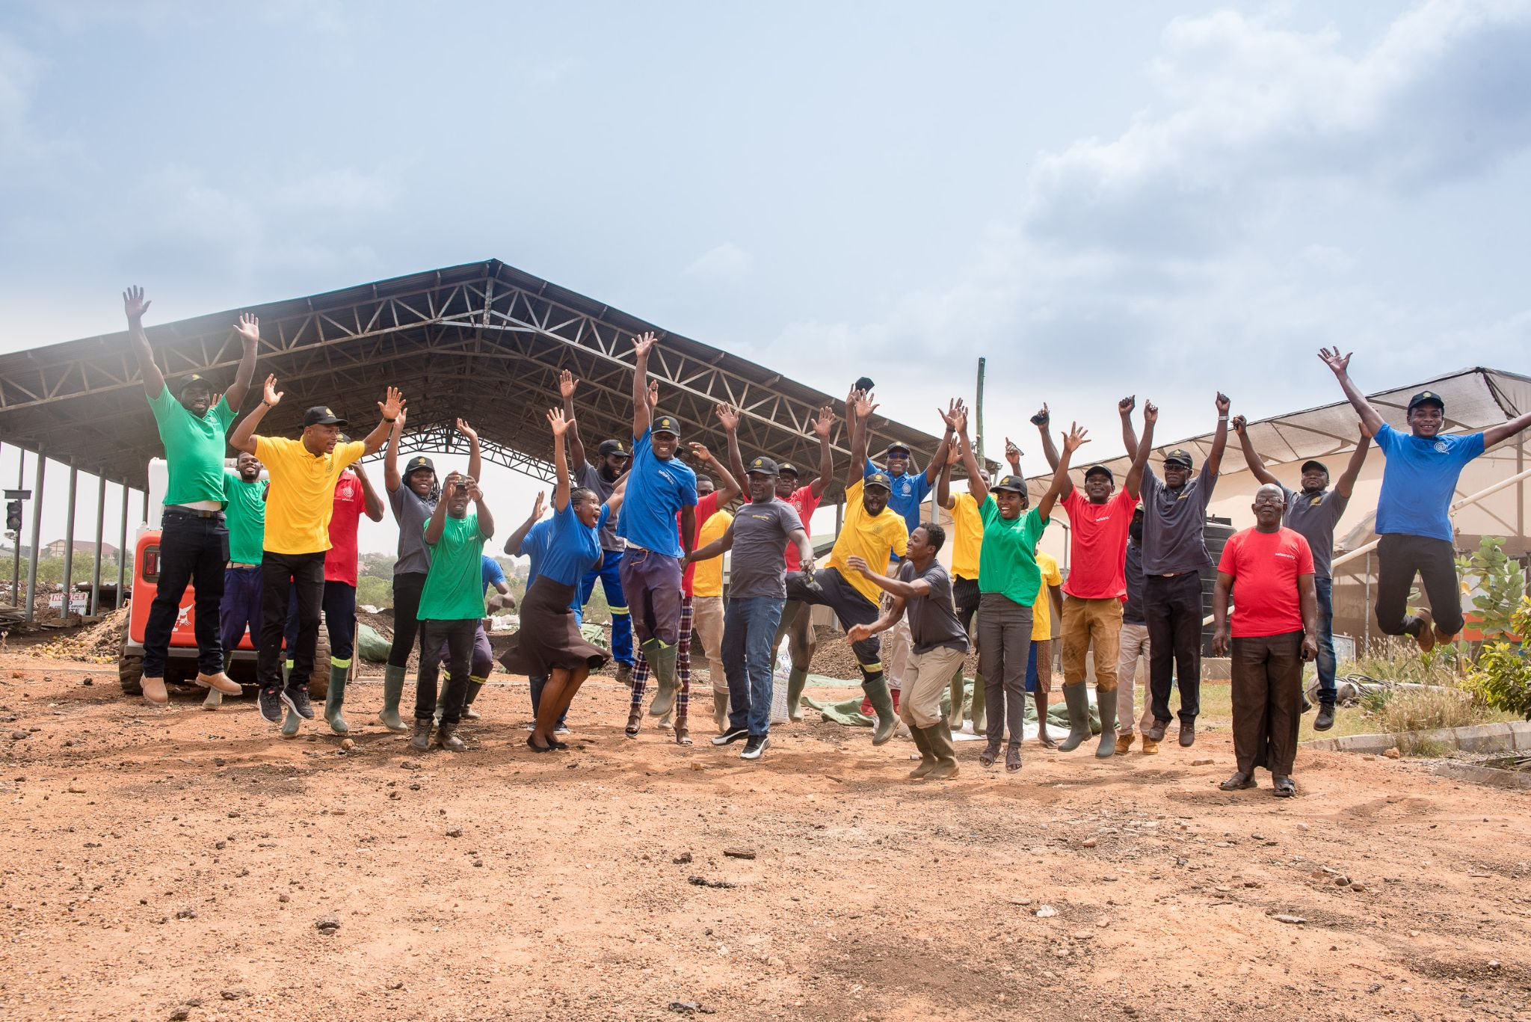



Who wants to join our mission?
Contact us:
Safisana Holding
+31 (0)294 773857
info@safisana.org
Visit us:
www.safisana.org
Follow us:

