Slide 1
Integrity, some experiences and ideas of Dutch Water Authorities
Herman Havekes, DWA
15th of April 2016,
The Hague

Slide 2
Corruption and Fraud in the water sector
The water sector is very vulnerable for integrity problems:
There is a lot of money going on
Public and private parties meet
“In most countries water crises are not due to resource scarcity but primarily to governance failures. TAP is inevitable to reach good water governance and to prevent corruption” (Delft Statement on Water Integrity, 2013). So good water governance is very important

Slide 3
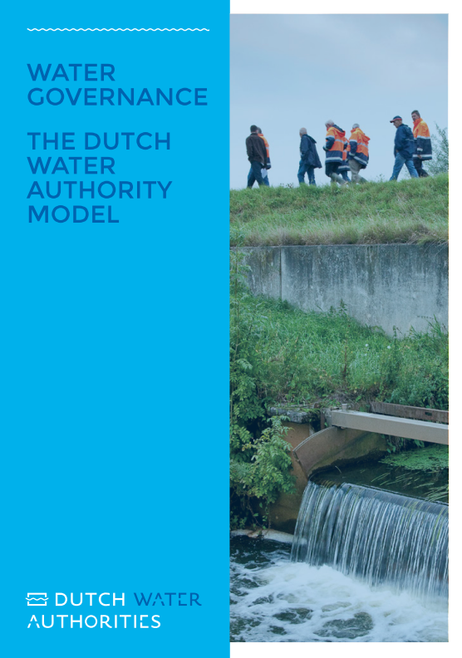
Public organization of Dutch water management (1)
National Government:
national water policy and management of the main water system and flood barriers
Provinces (12):
regional water policy
Municipalities (390):
sewage management
urban rainwater and groundwater
Drinking Water Companies (10)
private companies but public ownership

Slide 4
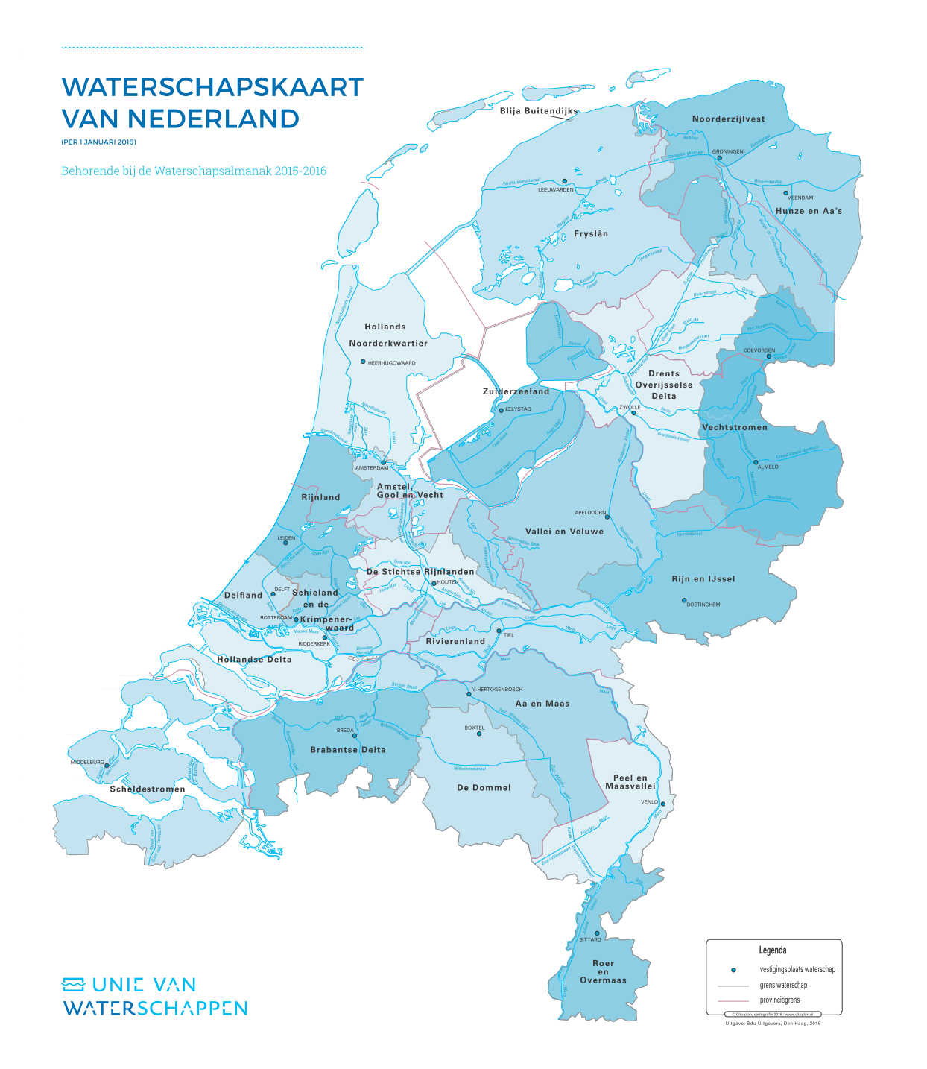
Public organization of Dutch water management (2): RWAs
Government body:
Own legal power
Own tax system
Own assembly and executive board
Own elections
Only water management tasks
Water management tasks:
Flood protection for 16 million people
Surface water quantity (irrigation and drainage)‏
Surface water quality
Urban wastewater treatment
Groundwater management
Muskrat and coypu control
10.300 employees

Slide 5
Costs of Dutch Water Management
The total yearly costs of water management in the world are huge and almost unbelievable (see the Global Outlook). In the Netherlands the costs for all the different water task are almost 7 billion euro per year. For the RWAs this is 2.7 billion euro, besides the yearly exploitation costs they invest 1.3 billion euro per year in strengthening dikes, building new pumping stations and waste water treatment plants and so on.
The “market”, private companies, do that job and earn a lot of money: public and private parties meet

Slide 6

Some Dutch incidents
The Netherlands may be high on the list of Transparency International, but we do have our problems
Reclamation of the Haarlemmermeer (1848-1852)
Environmental scandals in the seventies and eighties (illegal dumping of waste materials in surface water)
Building fraud scandal (2001) in which more than 450 private companies were involved
Prosecution of a provincial governor for corruption in 2015 who was sent to prison for three years

Slide 7
preventing fraud and corruption (1)
Legal provisions are inevitable (General Administrative Law Act, Criminal Code, Civil Servants Act)
A recent new provision is the change of the RWA Act (2016), that makes the chair of the RWA (and the provincial Commissioner of the King en the mayors) responsible for the integrity of their organisations, so there is a point of contact
Yearly judgement of the financial report by an independent external accountant
Sound procurement and tender rules

Slide 8
Preventing fraud and corruption (2)
So-called Act BIBOB which should prevent that public authorities do business with companies with a bad reputation or criminal record
A sound position for whistle-blowers (the building fraud scandal of 2001 was denounced by a whistle-blower who lost his position, house …
On an international level the OECD prepares an update of the Recommendation on Public Integrity, with the central plea for a comprehensive integrity system and a lot of concrete tools
It goes without saying that compliance and enforcement of these legal provisions is extremely important

Slide 9
Preventing Fraud and corruption (3)
Soft law: Codes of Conduct. A joint guideline of the Ministry for Home Affairs and the umbrella organisations of provinces, municipalities and RWAs was renewed in 2013. This guidelines gives clear advice for all politicians how to handle in certain situations (accepting gifts, compensation of expenses, the use of confidential information, accepting other functions and so on)
Integrity Toolkit
Benchmarks. The regular benchmarks in the water sector provide a lot of useful information, which can be a reason for further investigation

Slide 10
Some conclusions
The Dutch Water Sector is aware of integrity risks and has taken a number of measures to prevent fraud and corruption
Good water governance is therefor a prerequisite
The recommendations of the Global Outlook can strengthen these measures.
Nevertheless it’s wise to realize that fraud and corruption can never be banned totally, so we will have our (little) problems in the future

Slide 11
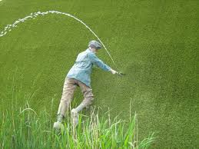
Further information
Thanks for your attention!
See for further information:
Water Governance. The Dutch Water Authority Model , www.uvw.nl
OECD (2014), Water Governance in the Netherlands: Fit for the Future?, OECD Studies on Water, OECD Publishing, www.oecd.org
Building blocks for good water governance, second edition, Water Governance Centre, The Hague 2016, www.watergovernancecentre.nl/publications
www.dutchwaterauthorities.com + info@dutchwaterauthorities.com

