Slide 1
Towards systemic change in sustainable sanitation and the role of CLTS
UNICEF WASH Seminar
October 7th 2015

Slide 2
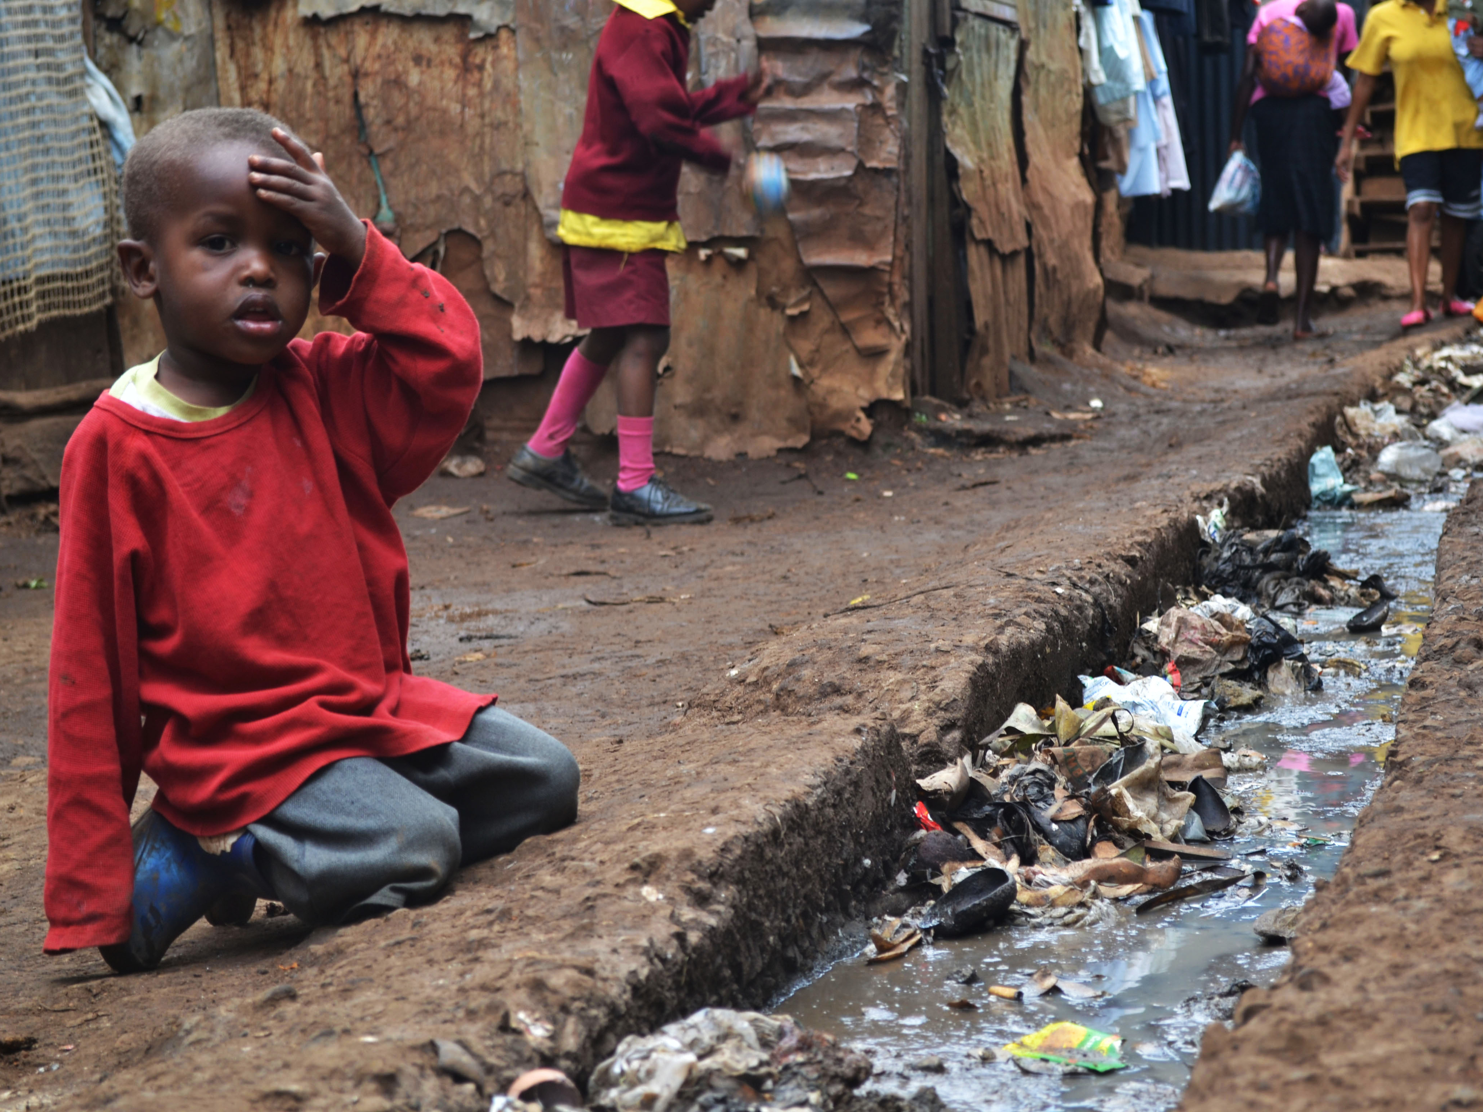
Introduction | current situation
The real situation is often very different from the perceived situation
Some examples based on recent programmes & field trips

Slide 3
CLTS builds on participatory approaches such as PRA (Participatory Rural Appraisal). The following six factors are cited by CLTS promoters as key characteristics of the approach:
1. The community is seen as the key driver for safe sanitation efforts;
2. The community is the unit of assessment for monitoring open defecation;
3. Facilitators enable communities to do their own analysis and planning;
4. Low-cost local latrine designs are encouraged;
5. No hardware-related subsidy, but triggering collective analysis and commitment to change;
6. Households maintain and improve their toilet facility themselves so that separation from faeces is maintained.
For further information on CLTS see: http://www.communityledtotalsanitation.org/

Slide 4
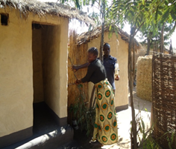
Trrrtet
Pan-Africa Programme: Empowering self-help sanitation of rural and peri-urban communities and schools in Africa (PLAN, IDS & IRC)

Slide 5
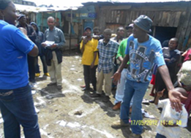
Pan-Africa programme in eight African countries
The Community-Led Total Sanitation (CLTS) approach has been used to mobilise not only citizens but also governments to improve sanitation conditions. It is becoming popular with governments because it is a relatively simple approach and it produces quick results.
There is now experience with adapting the CLTS approach to urban contexts, schools and post-emergency situations: dubbed Urban-Led Total Community Sanitation (ULCTS). This approach has been piloted in a number of countries such as Kenya (Mathare 10), Ethiopia (Arba Minch and Hawasa), Malawi (Mzuzu). Uganda (Tororo) and Zambia (Lusaka).

Slide 6
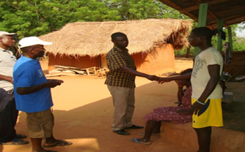
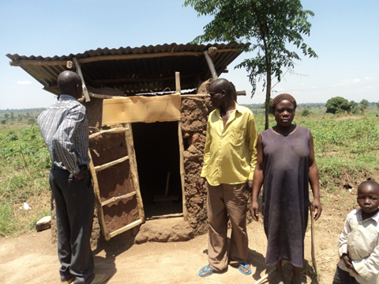
Example from the Pan-Africa programme in eight African countries…
These adaptations relate to a greater need for better sanitation services that include faecal sludge management (FSM) and solid waste management.
Inevitably this entails a greater role for the private sector. Other issues include the lack of tenure, the need for better quality toilets, and a greater potential for access to loans.

Slide 7
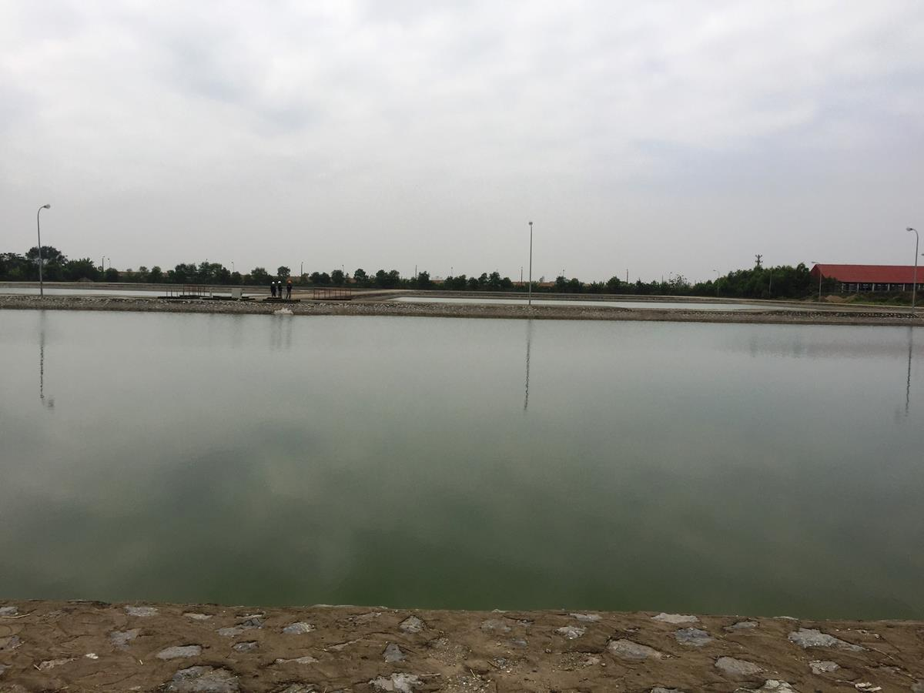

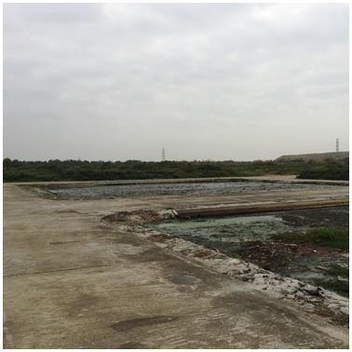
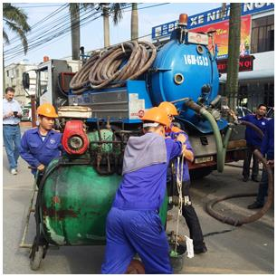
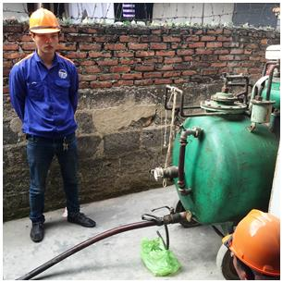
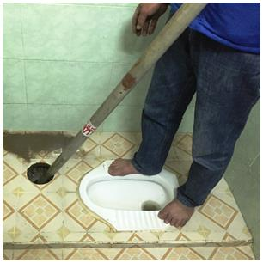
Other case studies
Hai Phong City in Vietnam

Slide 8
Example of a visit to Hai Phong city in Vietnam
96% of households in Hai Phong reportedly have some sort of onsite septic or holding tank
However, some 70% of Hai Phong’s wastewater is collected in a sewer system and then discharged untreated in a river
Of the faecal sludge contained onsite only a portion is collected and transferred to a World Bank financed faecal sludge treatment plant
Conclusions
May be only some 20% is collected and treated
The system works but is seriously inadequate

Slide 9
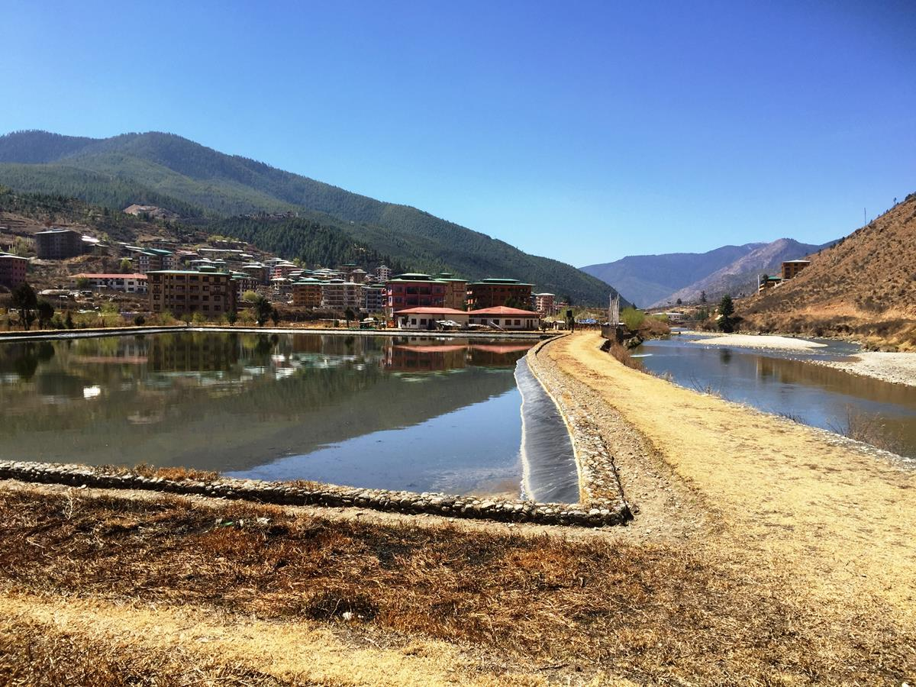
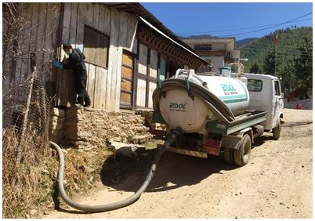
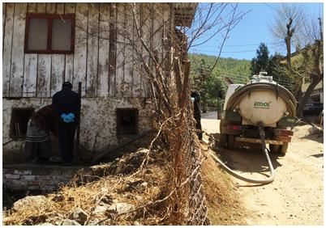
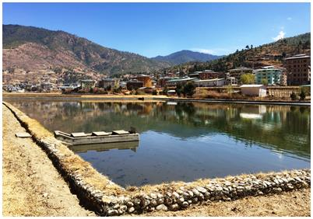
Thimphu City in Bhutan

Slide 10
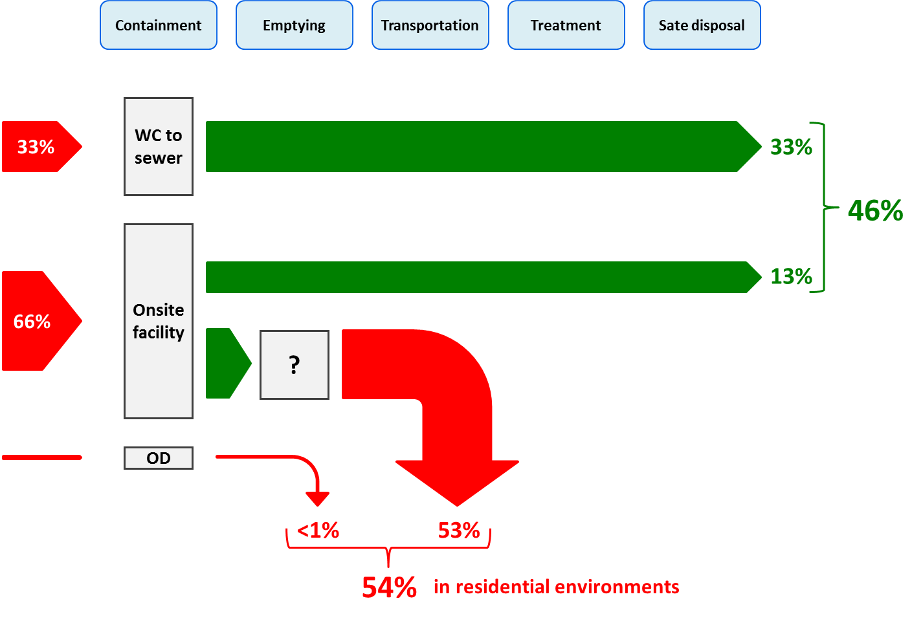
Example of a visit to Thimphu in Bhutan
Crude shit flow diagram of Thimphu municipality

Slide 11
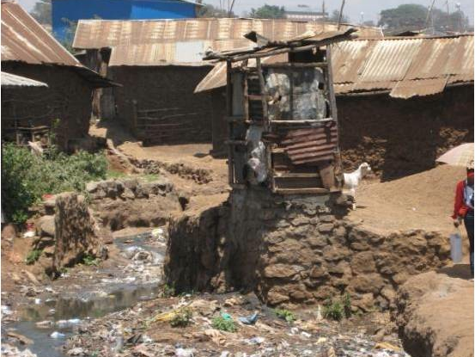
Introduction
Lots of talking about “whole system change” and “whole system approach” whether this be in the urban or rural context…but…
  What is it all about?
  What are the elements or components that make up the “whole system”?

Slide 12
Core concepts
Systemic change
“change that encompasses all parts of a system, taking into account the interrelationships and interdependencies among those parts”
versus
Piecemeal change
“changing one or several parts of a system”

Slide 13
Core concepts
Systemic change means that we need to
Improve (sanitation) conditions in an entire geographic or administrative area (e.g. municipality, administratively designed rural area/boundaries)
Address all the relevant (weak) parts by considering the whole range of issues
Involve and work with all the stakeholders
Be consciously systematic
Notes:
Urban systems can be highly complex, surprisingly similar across countries, and very resistant to change. Where once they were the solution to a problem—“inefficiency”—some observers now see them as the problem: antiquated bureaucratic and technical structures that make it difficult to focus on the paradigmatic change.

Slide 14
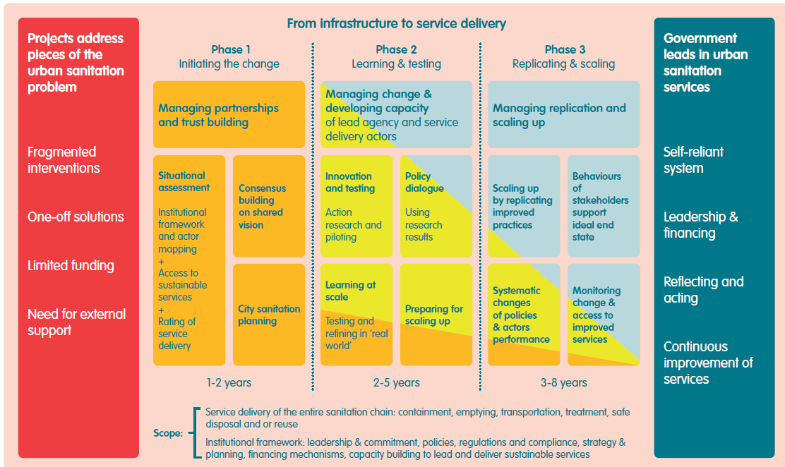
Change process
Towards systemic change in urban sanitation (2014)
…providing clarity on the change process

Slide 15
How to get started
First things first!
Following IRC’s process of change logic, any urban or rural sanitation development programme will have to start with
Phase 1: Initiating the change

Slide 16
How to get started
This crucial first phase will include four interconnected elements:
Managing partnerships and building trust;
Carrying out a comprehensive situational assessment;
Consensus building around a shared vision; and
Developing a comprehensive city-level or rural-level sanitation strategy and plan

Slide 17
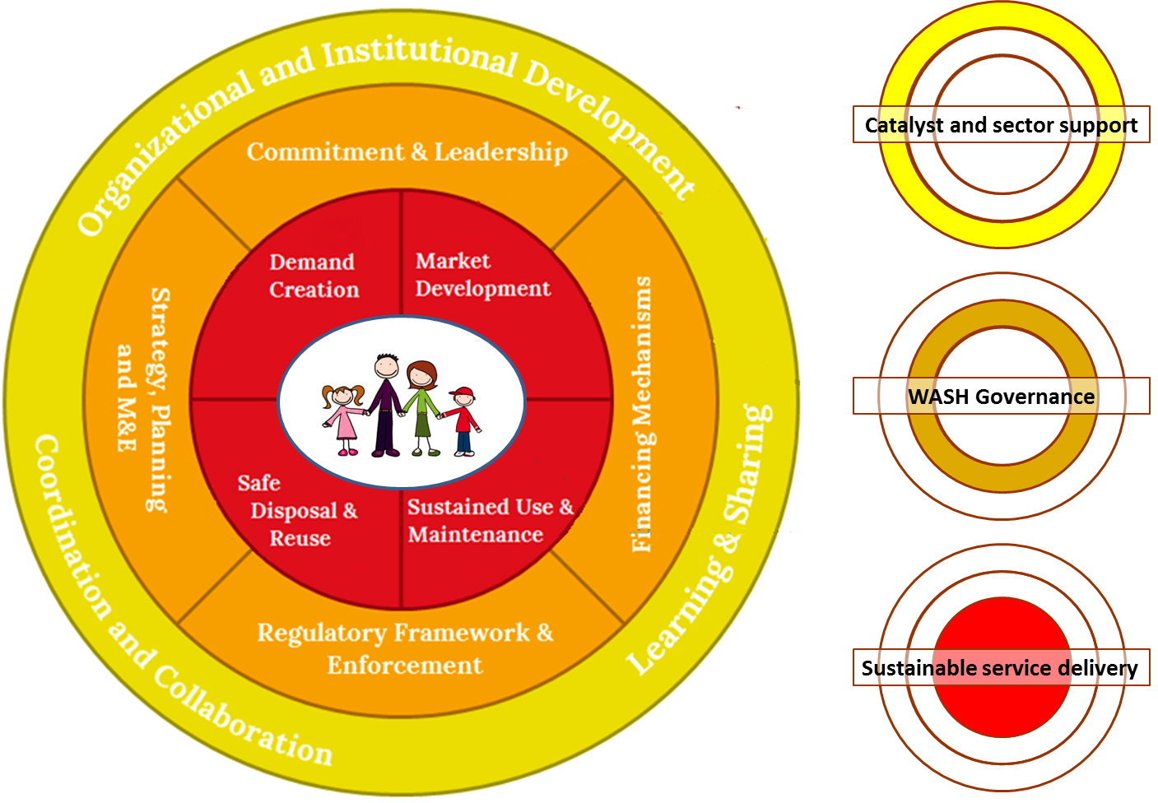
Whole system
Focus on “everything”; all important elements

Slide 18
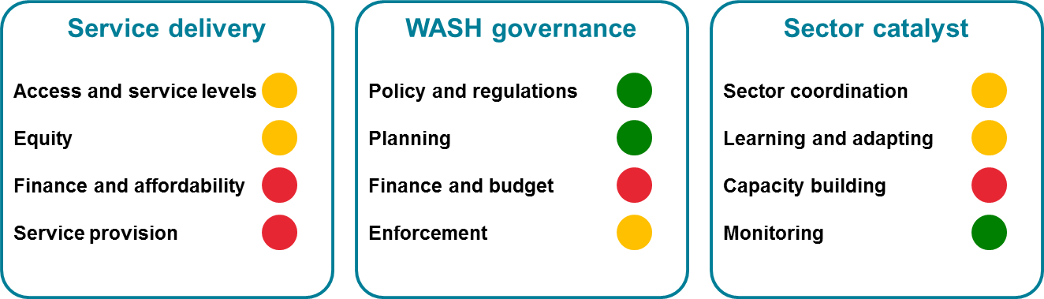
How to get started
Rapid assessment tool with the underlying principle:
What you assess is what you address!
Example of a possible urban sanitation scorecard

Slide 19
