Slide 1
One WaSH M&E system development
National WASH Multi-Stakeholder Forum 7
Hilton Hotel, December 16-17, 2015
John Butterworth (IRC Ethiopia)

Slide 2
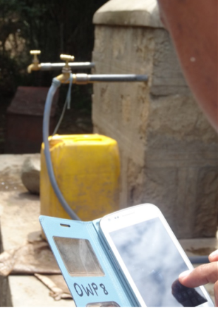
Objective/ content
Objective: To share progress and status on DFID support to OWNP M&E (by Coffey/IRC)
Content:
  Introduction
  Key diagnostic findings
  Enhanced M&E framework
  Integrated reporting
  WaSH M&E MIS
  NWI2
  Operational plan and funding

Slide 3
Introduction
Our objective: OWNP M&E that lasts
Supporting government (NWCO and OWNP IPs)
Scope of ToR: People, processes and systems
  Task 1: strengthening M&E systems across WaSH sectors
  Task 2: impact evaluation (Coffey)
  Task 3: promoting dissemination and use of WaSH data
Inception phase: Mar-Sep 2015
Implementation: Dec 2015-Feb 2019

Slide 4
Key diagnostic findings (1)
OWNP is a challenging programme to report
Existing processes sectoral and fragmented
Existing IT-systems in use, except in water
NWI was a major advance and results used
New WaSH M&E MIS software is functional but not operational, and does not meet requirements as they have evolved

Slide 5

Key diagnostic findings (2)
Introduction of ICT at early stage
Quality assurance has not received much attention
Strong demand for data but use is neglected
Substantial capacity constraints
Development partners have made major financial commitments

Slide 6
Enhanced M&E Framework
Proposals for updated KPIs (14)
Disaggregation a critical issue for addressing equity, gender and VfM issues
KPIs link well to SDGs but gaps remain (potential for collaboration with global efforts)
80 supplementary indicators and other indicators possible
Includes indicators related to environment, social, resettlement and fiduciary risks

Slide 7
Integrated reporting
Critical requirement of NWCO
Approach agreed is to strengthen and utilise sector systems as far as possible (HMIS, EMIS, IBEX etc)
Requires commitment to share data in line with MoU
ICT-enabled WaSH MIS will support water supply reporting, and integrated reporting

Slide 8
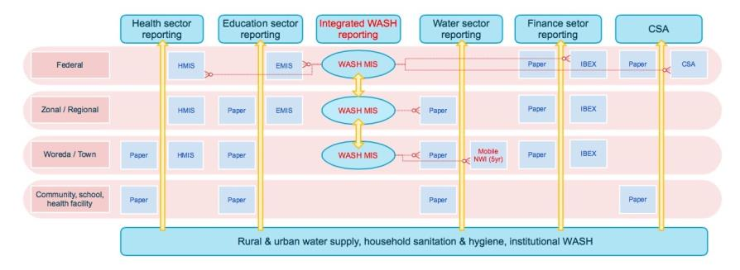
Integrated reporting

Slide 9
WaSH M&E MIS
System has been in development since 2008
Twin-track approach
Further improvements to make use of the PUT-system (focus on data storage, reporting and analysis)
Alternative (commercially available off the shelf) software with mobile data collection and other capabilities
Support to procurement, testing and roll-out

Slide 10
National WaSH Inventory 2
Priority for 2016
New inventory, not updating
More focus on making data available including WaSH Atlas
Mobile-based data collection (as in Somali)
Build and retain capabilities so NWI2 can be updated
NWI3 may not be required or could look radically different

Slide 11
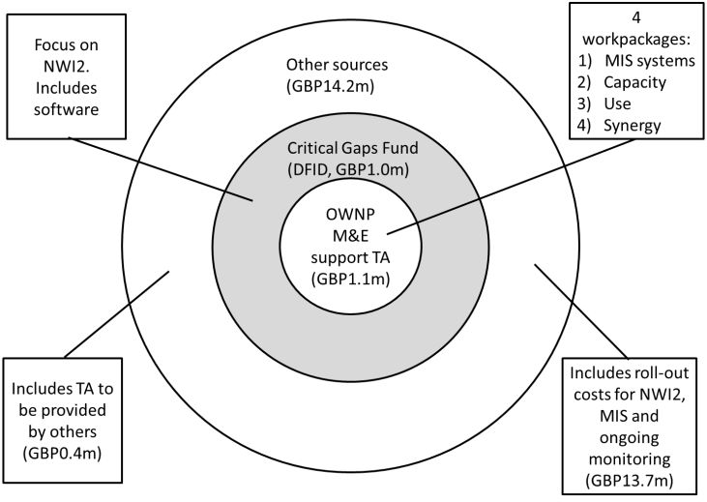
Operational plan funding
100 mths

Slide 12
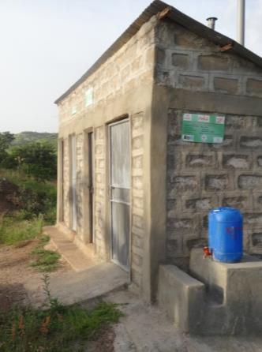
Undertaking proposals
OWNP website (with data rich capabilities)
OWNP annual report
NWI2
WaSH MIS IT systems operational
  Water sector monitoring
  Integrated reporting

Slide 13
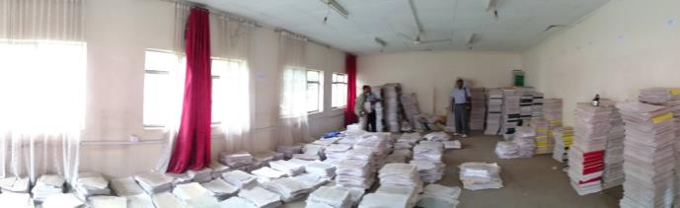
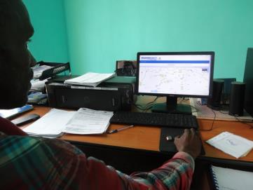
Thank You!

