Slide 1
Welcome
Back

Slide 2



Slide 3
Challenge Ikenna!

Slide 4
Countdown clock
5 mins animation
VIDEO

Slide 5
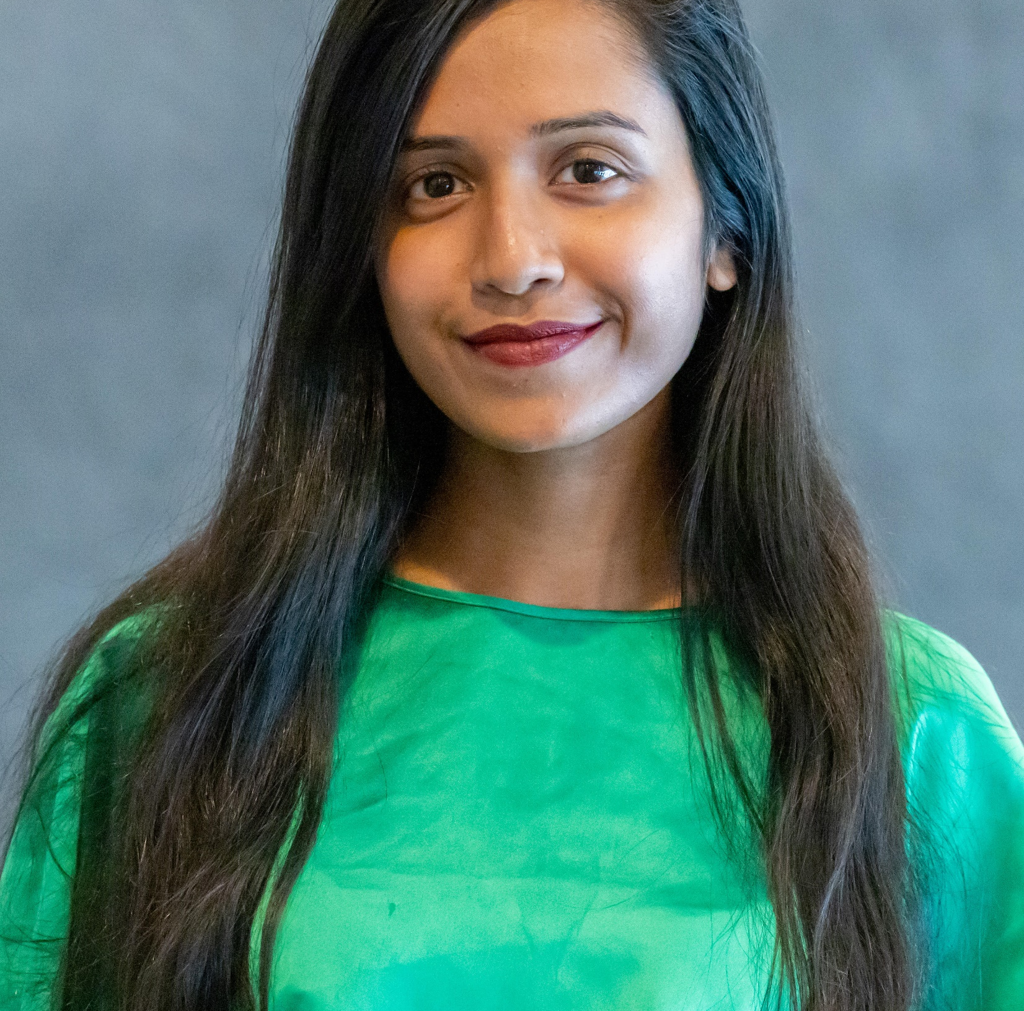
Shomy Hasan Chowdhury
Co-founder, Awareness 360

Slide 6
Toilet talk animation

Slide 7


Slide 8
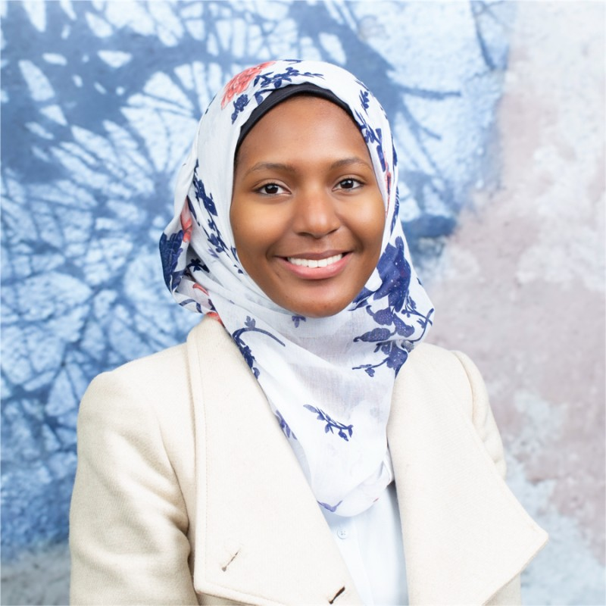
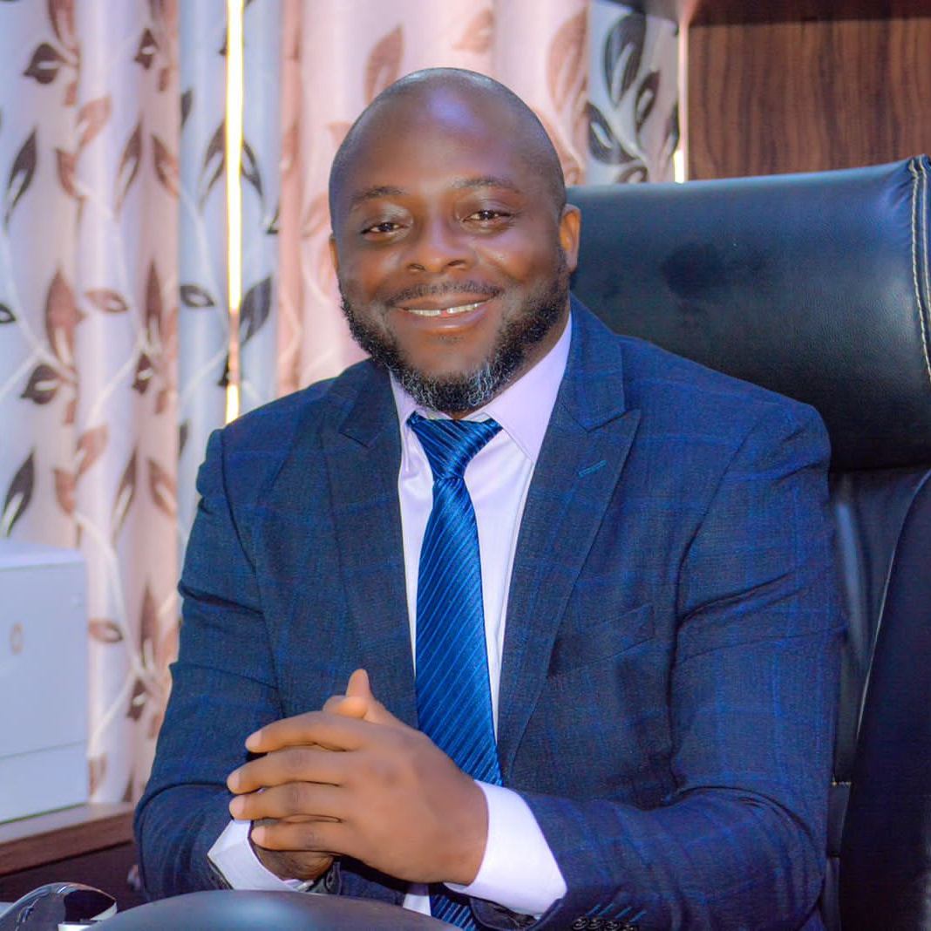


Toilet Talks Speakers
Live
Hadi Toure
Water Engineer and
Co-founder of Afr'eau
Ambassador Bobby Whitfield
Chairman & Chief Executive Officer, National Water, Sanitation and Hygiene Commission, Liberia
Shomy Hasan Chowdhury
Awareness 360
Co-Founder
Dr Amaka Godfrey
WaterAid UK’s Global Director for Policy and Research

Slide 9
Flush it animation

Slide 11
Follow us to dinner

