Slide 1
Welcome
Back

Slide 2



Slide 3


Slide 5

Maame Akua Ohenewaa Gyima
Child Sanitation Diplomat, Ghana

Slide 7
Video live clock counting down 2 mins

Slide 9
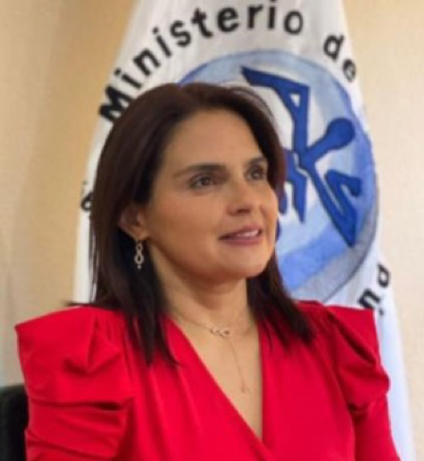
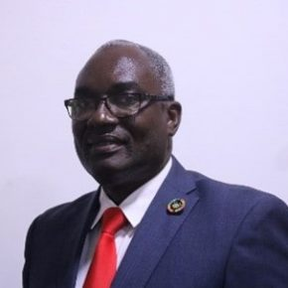
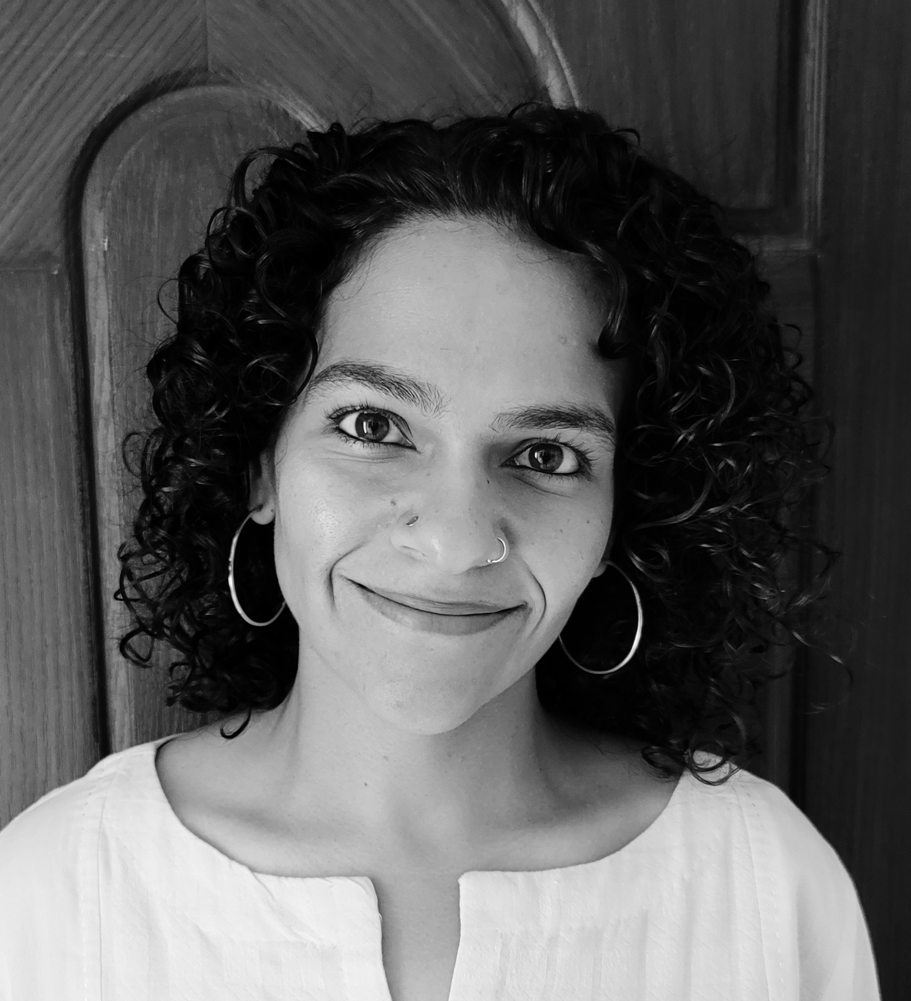
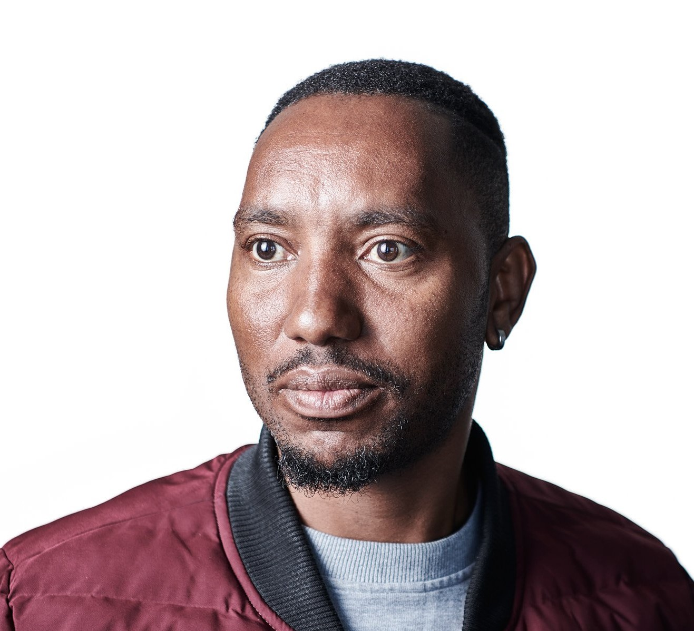
Hon. Leslie
Samayoa Jerez
Vice Minister, Ministry of Health and Social Assistance, Government of Guatemala
Dr Kodjo Esseim Mensah-Abrampa
Director General, National Development Planning
Commission, Ghana
Neha Mankani
Global Health Practitioner and midwife
Pakistan
Siyabonga Mahlangu
Inner City Human Rights

Slide 10
Let’s get comfortable

Slide 11
Video/Gif – forest/valley/fire (sofa session) TBC for setup - Bryony

Slide 13
See you tomorrow!

Slide 15


















All Systems Connect 2023 is made possible thanks to the generous support of our partners including the World Health Organization and :

