Slide 1
Self supply: Integrating WASH & Food security
Sector Learning & Sharing Forum on WASH & Food Security
25 June 2015, Elily International Hotel, Addis Ababa

Slide 2
Introduction
Definition: Household initiative to take the lead (largely or wholly) in constructing or upgrading own water supply
It is a package of technologies: water source, lifting device, storage, treatment method or conveyance
Water supply sources: It can be any sources
One of the water supply service delivery model; & hence acknowledged in WIF & OWNP

Slide 3
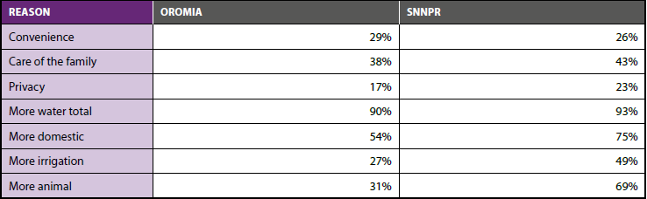

Slide 4
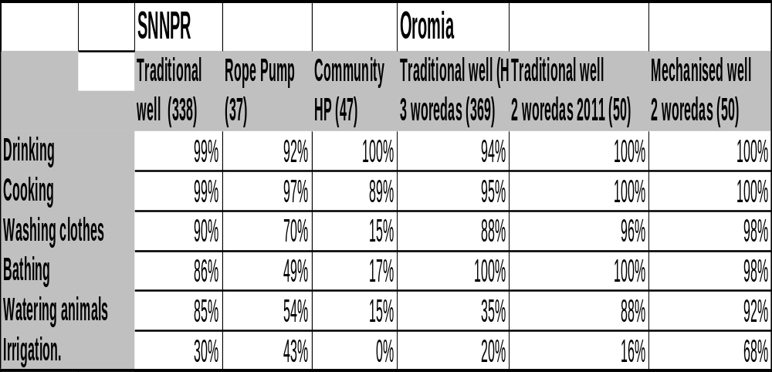
Multiple water Uses

Slide 5
Major studies on self supply
    Benchmarking study: Unicef
    understanding the potential contribution of self supply to UAP
    Potentials & upper ladder Household investment: Unicef
  Upper ladder household investment in 2011 financed by UNICEF, IRC & RiPPLE
  A hidden resource: household-led rural water supply in Ethiopia; published by IRC in 2012
    Towards a regional assessment of self supply potential in SNNPR, Ethiopia, RiPPLE 2012 supported by IRC
    Map based self supply potential assessment

Slide 6
Potential towards WASH: Access & service level
SNNPR: 1% using own well as main drinking water source, a further 1% using neighbours well (NWI Form 5; total 85000 households; BoWR analysis)
Exceptions: 20% in some woredas, 50% in some kebeles (BoWR)
Minimum estimate, limitation of simple questions and one-time surveys
Potential: 29% take drinking water from surface (river, lake, pond) and 31% from unprotected community sources (springs or wells) (Total 2.5 million households)

Slide 7
Potential towards household irrigation
Strategic shift from large and medium scale irrigation project to small scale particularly the household irrigation in order to address the wider parts of the rural community.
Household Irrigation Sector Strategy 2013:
  More than 650,000 households are to be benefited (about 5 million people) from household irrigation
  Double production and incomes, promote food security

Slide 8
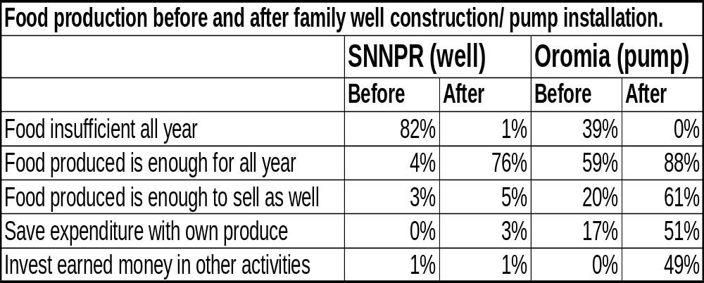
Food security & investment in family wells
  Decreasing food insecurity
  Improving food sufficiency
  Saving expenditure with own produce

Slide 9
Key issues:
  Coordination among key stakeholders and integration
  Fragmented implementation of self supply without considering its holistic approach
  Perception of inferior quality (WQ)
  Incremental improvement or one time high service level

Slide 10
Coordination
Both Agriculture & Water sectors working on household investment: about the same family
  Coordination is a gap
  E.g. in SNNPR in 2006 EC:
    300,000 HDWs & 20,000 RPs in SNNPR by Agriculture
    56,000HDWs & 10,000RPs by Water Bureau

Slide 11
Holistic approach
Assessing potential
Creating demand
Supporting technology choices
Promoting private sector involvement
Supporting access to finance
Strengthening coordination, innovation and learning
Monitoring implementation

Slide 12
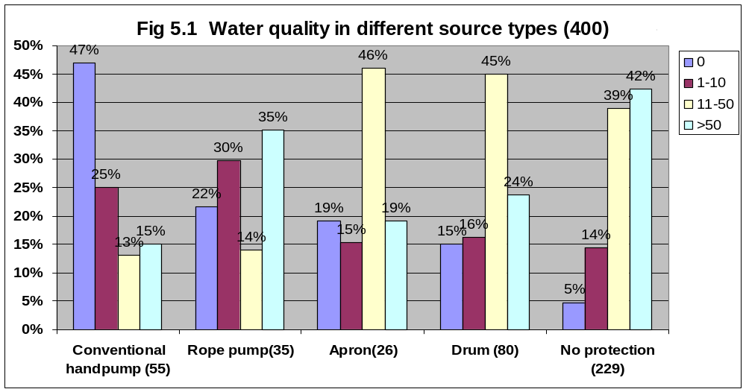
WQ from different water sources in SNNPR (Sutton 2011)

Slide 13
Further reading:
    A Hidden Resource report www.irc.nl/page/74548
    Policy guideline and other docs www.cmpethiopia.org
    All links at www.ircwash.org/selfsupply
    IRC’s Ethiopia WASH blog www.ircwash.org/ethiopia
    RWSN www.rural-water-supply.net/en/self-supply

