Slide 1


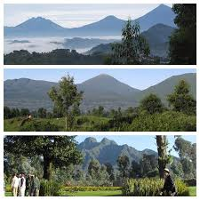
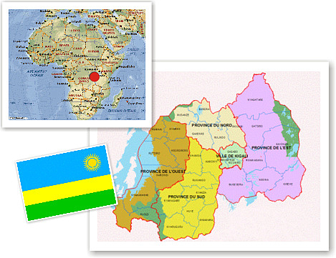
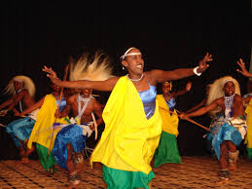
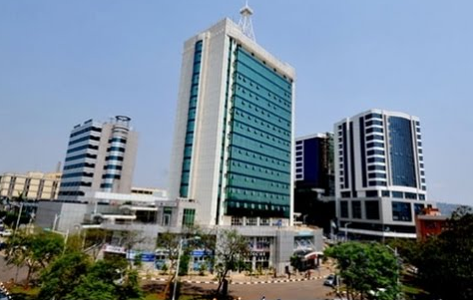


Rwanda Performance Contract mechanism
AFRICASAN Conference, Dakar May 2015

Slide 2
Introduction & Background
Performance contracts “Imihigo” are contracts between the President of Rwanda and government agencies detailing what the respective institution sets itself as targets on a number of governance, justice, economic and social indicators.
The stated objective of Imihigo is to improve the speed and quality of execution of government programs, thus making public agencies more effective.

Slide 3
Introduction & Background
Every year, since 2006, Imihigo performance contracts are evaluated to inform the Government on the relevance of the government’s interventions in changing people’s lives.
Whether the public spending makes difference or value for the money, what policy or program works well, if policy makers are able to judge on the merit or worth of an intervention, among others.
Over time, Imihigo have become institutionalised as a means to keep local leaders accountable to their communities and the Government.

Slide 4
Definition
Imihigo is the plural Kinyarwanda word of ‘’Umuhigo’’, which means to vow to deliver.
Imihigo also includes the concept of ‘’Guhiganwa’’, which means to compete among one another.
Imihigo describes the pre-colonial cultural practice in Rwanda where an individual sets targets or goals to be achieved within a specific period of time.
The person must complete these objectives by following guiding principles and be determined to overcome any possible challenges that arise.

Slide 5
Objectives
To speed up implementation of the local and national development agenda
To ensure stakeholder ownership of the development agenda
To promote accountability and transparency
To promote result-oriented performance
To promote innovation and competitiveness
To engage stakeholders (citizens, civil society, donors, private sector, etc) in policy formulation and evaluation
To promote zeal and determination to achieve set goals
To emphasize the culture of regular performance evaluation

Slide 6
Methodology
Imihigo is the result of a participatory process of identifying and implementing priorities from the grassroots to the national level.
In the process of identifying priorities, each level demonstrates its contribution to achievement of development goals. For more on the methodology visit:
Imihigo _ Rwandapedia.htm
The assessment of Imihigo is done by a team comprised by members from the President’s Office, Prime Minister’s Office, Ministry of Local Government, and Ministry of Finance and Economic Planning.

Slide 7
Impact of Imihigo
Over the EDPRS 1 period, the average real GDP growth rate was 8.2 % and poverty was reduced from 56.7 % to 44.9 % between 2006 and 2011.
Access to improved sanitation increased from 52% in 2000/01 to 75% in 2010/11.
Access to education and health services have become universal with 96% of school-aged children now enrolled in primary school, and 90% coverage of health insurance

Slide 8
Impact of Imihigo
Indicators | Achievements
Kilometers of water pipe lines installed | 2,978.37
Number of family toilette constructed | 9,625
Number of piped schemes constructed | 27
Number of public toilette (ECOSAN) constructed | 129
Number of pumps installed | 15
Number of reservoirs constructed | 162
Number of water points constructed | 645

Slide 9
Impact of Imihigo
Indicators | Achievements 2012/2013
Number of new latrines constructed | 2,478
Number of new nursery classrooms constructed | 42
Number of new primary classrooms constructed | 985
Number of new secondary classrooms constructed (12YBE) | 196
Number of new vocational training center (s) constructed | 3
Number of teachers / administrative blocks constructed | 197

Slide 10
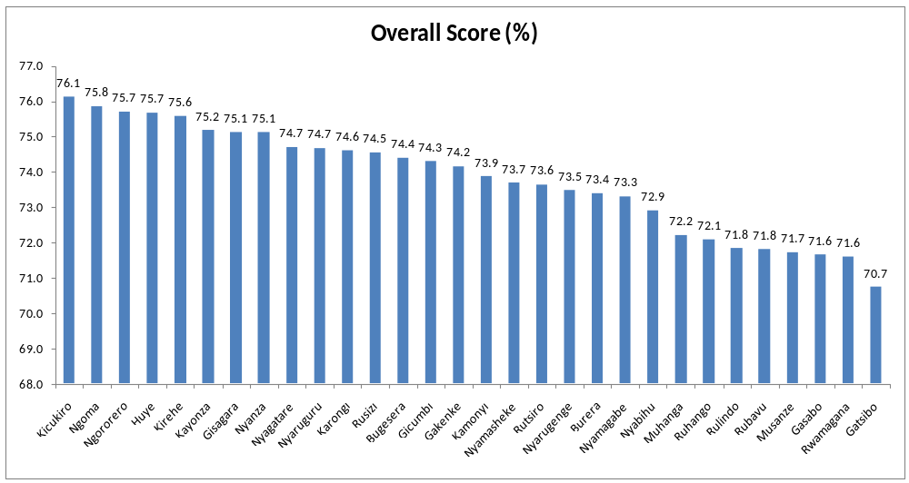

Slide 11
Lessons learnt
The tradition of Imihigo has improved development planning in the broad sense.
Improvements in priority setting and coordination with the relevant administrative levels and entities
The central and local government have enhanced extent of consultation which ensures a sense of common purpose.
Shared responsibilities
Ownership of local challenges by citizens

Slide 12
Recommendations
To other Countries we simply recommend the implementation of Imihigo (performance contract mechanism)
Study tour to Rwanda to see in more details, how Imihigo is implemented in the Country

Slide 13
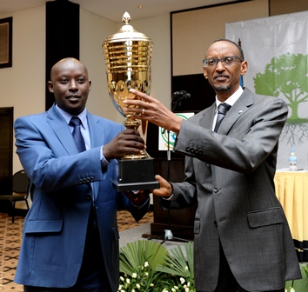
Mayor of Kicukiro District being awarded by H.E Paul Kagame during last year Imihigo evaluation

Slide 14
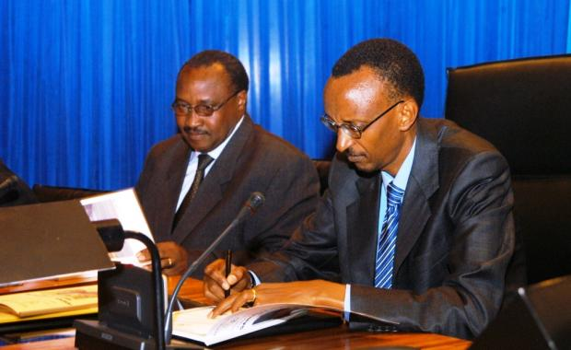
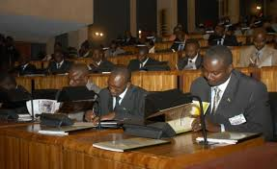
Signing of the first Imihigo between H.E Paul Kagame and Mayors of Districts in 2006

Slide 15
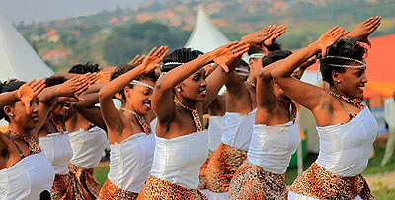
Thank you
Murakoze

