Slide 1





SO WHAT'S FOR LUNCH
PRESENTATION ON THE SANITATION CHALLENGE FOR GHANA
Vida Duti
8th November, 2016

Slide 2
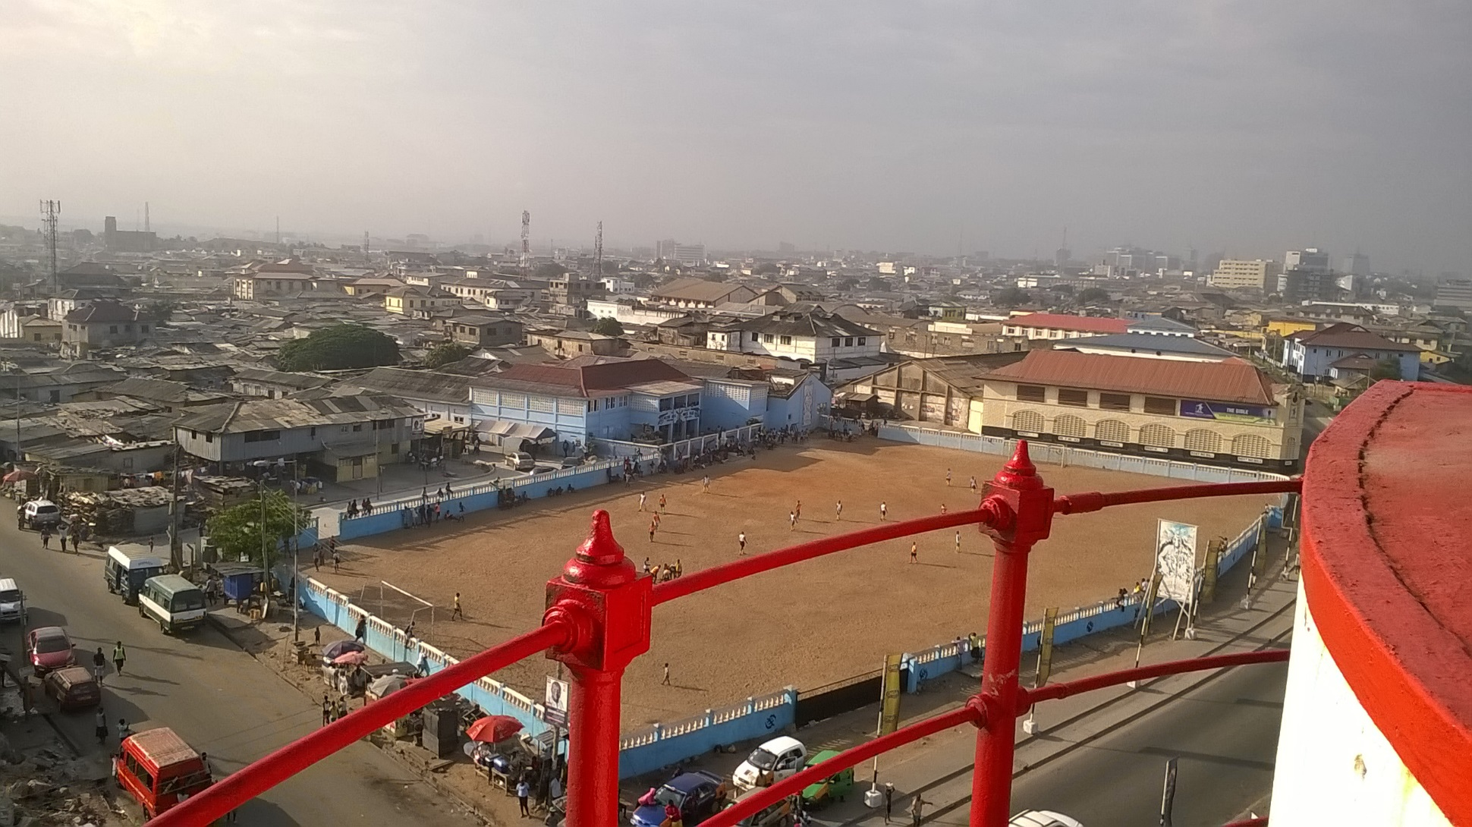
REWARDING EXCELLENCE IN URBAN LIQUID WASTE MANAGEMENT

Slide 3
THE SANITATION CHALLENGE FOR GHANA
An innovation programme to motivate MMDAs to team up with their citizens, innovators and solvers to design and then implement their own liquid waste management strategies
Aims to bring about transformational change to poor households in urban centres, through the use of a set of inducement prize competitions.
(http://www.sanitationchallenge4ghana.org).
Targeted at MMDAs that have at least one population centre of over 15,000 people.
Part of a large action research programme called Ideas to Impact, which aims to test the applicability and effectiveness of innovation prizes for addressing critical development challenges in climate change adaptation, energy access, and water and sanitation for the world’s poorest people or low-income households.
Ideas to Impact is managed by a consortium led by IMC Worldwide and runs over five years in these three sectors with a total prize purse of GBP 7.5 million and is currently running in Ghana, Kenya and Nepal.
The prize purse of the Sanitation Challenge for Ghana is GBP 1.43 million.

Slide 4
THE CHALLENGE –THE GAME CHANGER
Motivate MMDAs to:
Take leadership and make urban sanitation a political priority for Chief Executives
Use innovative approaches to transform and improve sanitation service delivery;
Prioritise the use of existing public funding to support sanitation services
Mobilise external donor funding for urban sanitation to equitably target and benefit the poor;
Enable private sector financing, particularly for household sanitation and sanitation businesses;
Partner with civil society, academia, NGOs, and innovators to harmonize sanitation programme approaches
Actively engage with urban neighbourhoods and households in solving sanitation challenges.
A KEY SUCCESS FACTOR FOR THE PRIZE WILL BE FUNDING BEING MADE AVAILABLE BY MMDAS OR FROM OTHER SOURCES FOR IMPLEMENTING CITY-WIDE LIQUID WASTE MANAGEMENT STRATEGIES AND SUSTAINING SANITATION SERVICE DELIVERY PROGRAMMES.

Slide 5
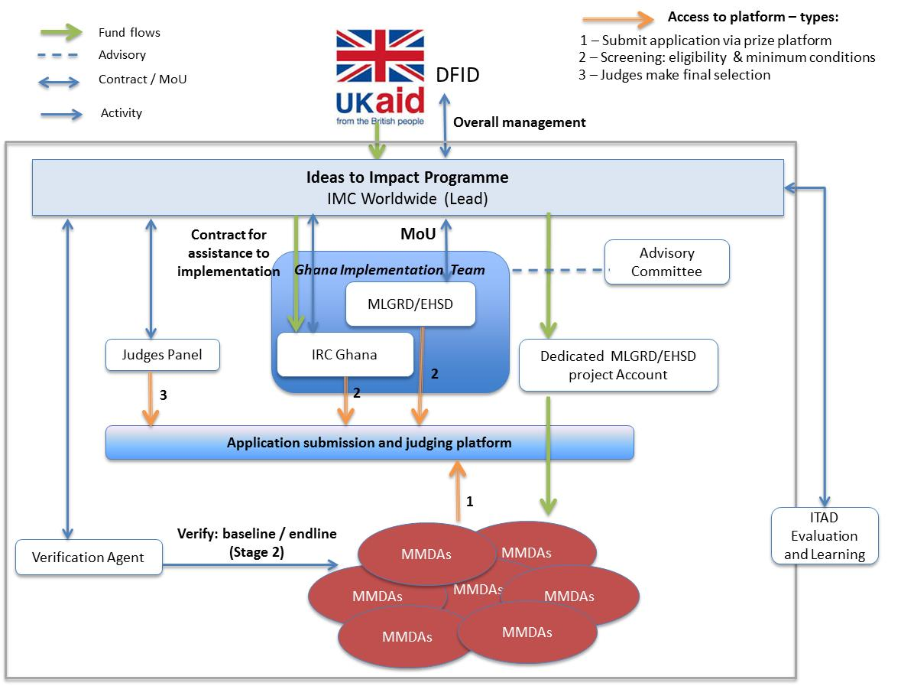
ORGANISATIONAL STRUCTURE FOR THE SANITATION CHALLENGE FOR GHANA

Slide 6
OVERVIEW OF CHALENGE- STAGE 1
Ideas ( September 2015-june, 2016)
Development of liquid waste management strategy by MMDAS
  139 eligible MMDAS with town population of 15.000 +
  Set-up and managed helpdesk
  Outreach to create media buzz
  Workshops for MMDAS to register intention to participate
  Inclusive partnership with the private sector and other non-state actors
  127 registered
  48 submitted liquid waste management strategies
  21 selected to participate in stage 2 and received honorary awards
3 out of 21 received cash prizes totaling GBP 75,000.00
Jasikan district assembly =30,000 GBP
Atiwa district assembly = 25,000 GBP
Nanumba north district assembly =20,000

Slide 7
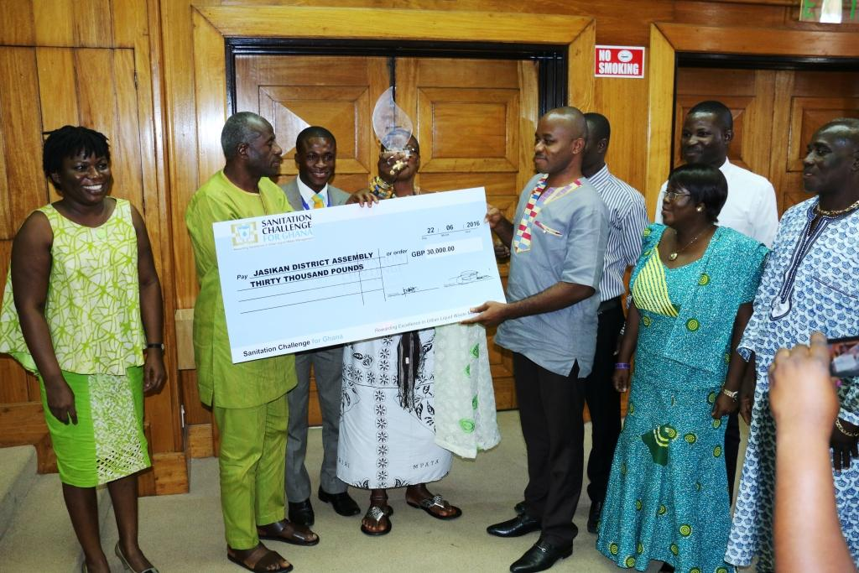
AWARDS FOR STAGE 1

Slide 8
OVERVIEW OF CHALLENGE – STAGE 2
Results ( July 2016- December 2018)
implementation of liquid waste strategies designed under stage 1 by MMDAs
  21 prequalified MMDAs from stage 1 responded to commitments to participate 2 (plans, financial, self sponsorship to event, data collection and reporting, focus on the poor)
  17 selected to participate in stage 2
  Independent assessment by baseline and end line verification agent
  Learning and practice workshops
  Media partnerships and outreach
  Independent judging by local and international judges
  Final Award ceremony in December, 2018

Slide 9
Proposed judging criteria for Stage 2
Criteria | Overall weight
Consistence of results (compared to results report) | Pass/Fail
Innovation | 10%
Involvement of private sector and non-state actors | 10%
Sustainability and links with strategic sector development plans | 15%
Scaling – up¹ | 15%
Relevance of technical interventions | 20%
Focus on the poor | 20%
Community participation | 10%
Overall | 100%
¹Including how the services will reach the whole city and how the MMDAs are planning to use their own resources

Slide 10
PROPOSED SPECIAL CATEGORY AWARDS
Final Prize Awards and Distribution | Amount GBP
1st Prize -Metro & Municipal Assembly | 400,000
 | -
 | -
1st Prize –Districts | 285,000
 | -
 | -
3. Special Category –Recognition Awards (@30,000) | Amount GBP
Best Business and service delivery model | -
Setting standards through influencing partnerships in sanitation | -
Local innovation | -
Awareness creation | -
Networks and partnerships | -
MLGRD-Policy influencing for sustainability | Plaque
Grand Total | 1,285,000

