Slide 1
Sanitation Marketing Progress in the case of
Tigray Region

Slide 2
Presentation Outline
    Regional Overview
    Business Model
    Major Achievements
    Major Changes (Outcome results)
    Major Opportunities
    Major Constraints
    Next Steps

Slide 3

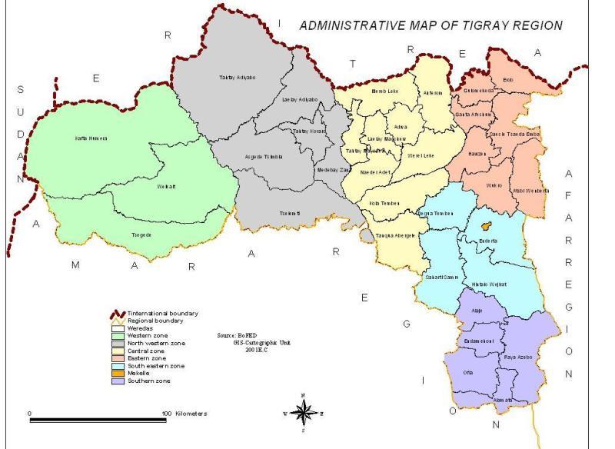
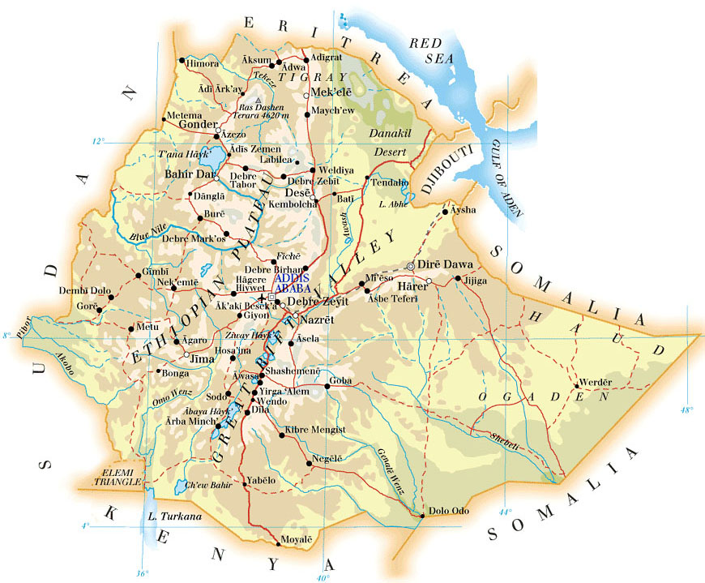
Back ground of Tigrai
Situated in the Northern part of Ethiopia
Divided into:- 7 Zones, & 34 Rural Woredas, & 18 towns and one City Mekelle
Kebele: 720
Population : 5,247,005

Slide 4
Introduction
National level
Government of Ethiopia show progress in the areas of sanitation
marketing and business development
National Sanitation Marketing Guideline Endorsed
Regional Level
Training manuals and Guidelines of sanitation Marketing by Local language were prepared
MOU Signed among the 4 sectors
Duties and Responsibilities of the sectors clearly stated
Consensus reached among the sectors that health Bureau would take
the leading role
Adwa and Axum Poly Technical Colleges were selected to train the
established associations

Slide 5
Regional Progress on San. Marketing

Slide 6
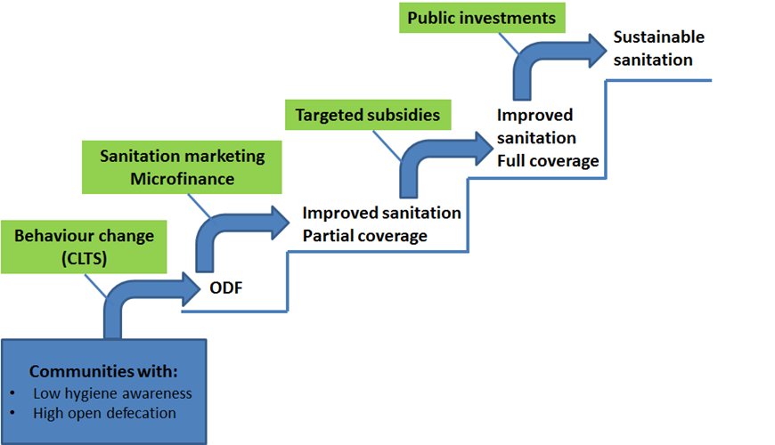
Sequencing of public interventions to increase access to sanitation facilities
Source: Sophie Trémolet, Pathfinder, Sanitation Markets, December 2012

Slide 7
Strategies Sanitation Marketing
Product
Slab : San plat & other related technologies,
Hand washing facility,
Ventilated plastic Vent pipe
Sanitation related services
Promotion (demand creation)
Printed materials like posters, leaflets
Audio visual materials like Mobile Van school mini media & Radios
Near health centers & health posts
Larger, denser rural communities
Early adopters’ with self- financed HH’s
Place
Main outlets of the products are:-
San Mark shop (fixed)
Personal selling of artisans (mobile)
Health Centres
Health posts
FTC
Pricing
Ability to pay by the communities
profit to the private sector
Alternative business options are studied at the beginning

Slide 8
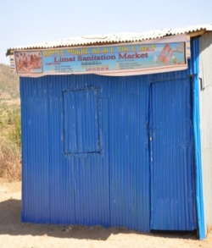
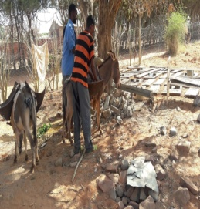
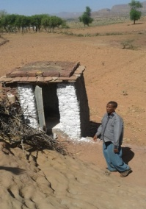
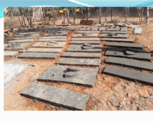
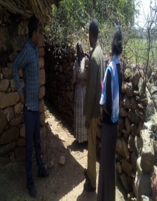
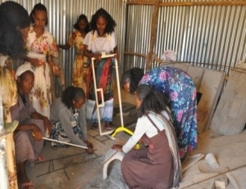
Business Model (TRHB)
Order
San Mark shop
Manufacturing
Promotion
Delivery
Installation
Order
Production Site

Slide 9
Promotion (demand creation)
    WDGs, HEWs, health staffs
    Religious leaders
    Women Development Army (WDA)
    Opinion leders and Community members
    About
  The need and importance of Improved sanitation
  Sanitation Marketing

Slide 10
Encouraging local initiatives
WDGs collect money from their members by traditional and volunteer way of collecting called “Ekub” for slab purchase
From the accumulated money one member of the group will purchase slab. This will continue on monthly basis for other members.
In some woredas the WDG themselves establish an association and engaged in slab production

Slide 11
SBCC Interventions
Training manuals and Guidelines of sanitation Marketing by Local language were prepared
Culturally appropriate and target specific IEC/BCC Materials were developed and disseminated to community on Improved sanitation
  Posters
  Brochures
  Bill boards
  Banners
  Booklets
  Spot, program through local radios and television

Slide 12
Closely work with sectors
MOU was signed among four key sectors on how to introduce sanitation Marketing
  TVETs
  Small and Micro Enterprise (SME)
  Health
  Micro Finance Institution
  Closely work with sectors on
    Selecting and establishing potential enterprises
    Arrange technical as well as financial training
    Facilitating loan access for the established enterprises
    Follow up

Slide 13
Capacity building
86 members of the enterprises from 6 woredas were trained in Axum & Adwa TVET
Sanitation marketing practical training was provided to 260 woreda Environmental Health experts in two rounds
240 PHCU directors experience sharing on sanitation marketing.
75 Slab moulds distributed to all rural woreda of the region
Different Enabling Environmental activities were conducted

Slide 14
Public Private Partnership (PPP)
local residents prefer to purchase latrine parts from private vendors because they are closer to people’s homes (Adiha, Zana & Megab kebeles)
Private companies can access capital (from loans or reserves)
Private sector organisations often specialise in a small number of services and goods
Private enterprise is motivated by profit and has greater freedom to use its money effectively

Slide 15
Major Changes (Outcome results)
Woreda health offices capacitated to make sanitation products accessible to the community using a variety of options
25% 0f the rural woredas already started production & distribution slabs to their beneficiaries
21,680 households (95,392 people) have access to and use self
financed improved latrine in the region.

Slide 16
Major Achievements on HEH ,2009 EC ,TRHB
Activities | Achievement in %
Improved latrine | 43
Latrine utilization | 54.5
Hand washing practice | 25.5
WTHP | 45
ODF (primary) | 62.8

Slide 17
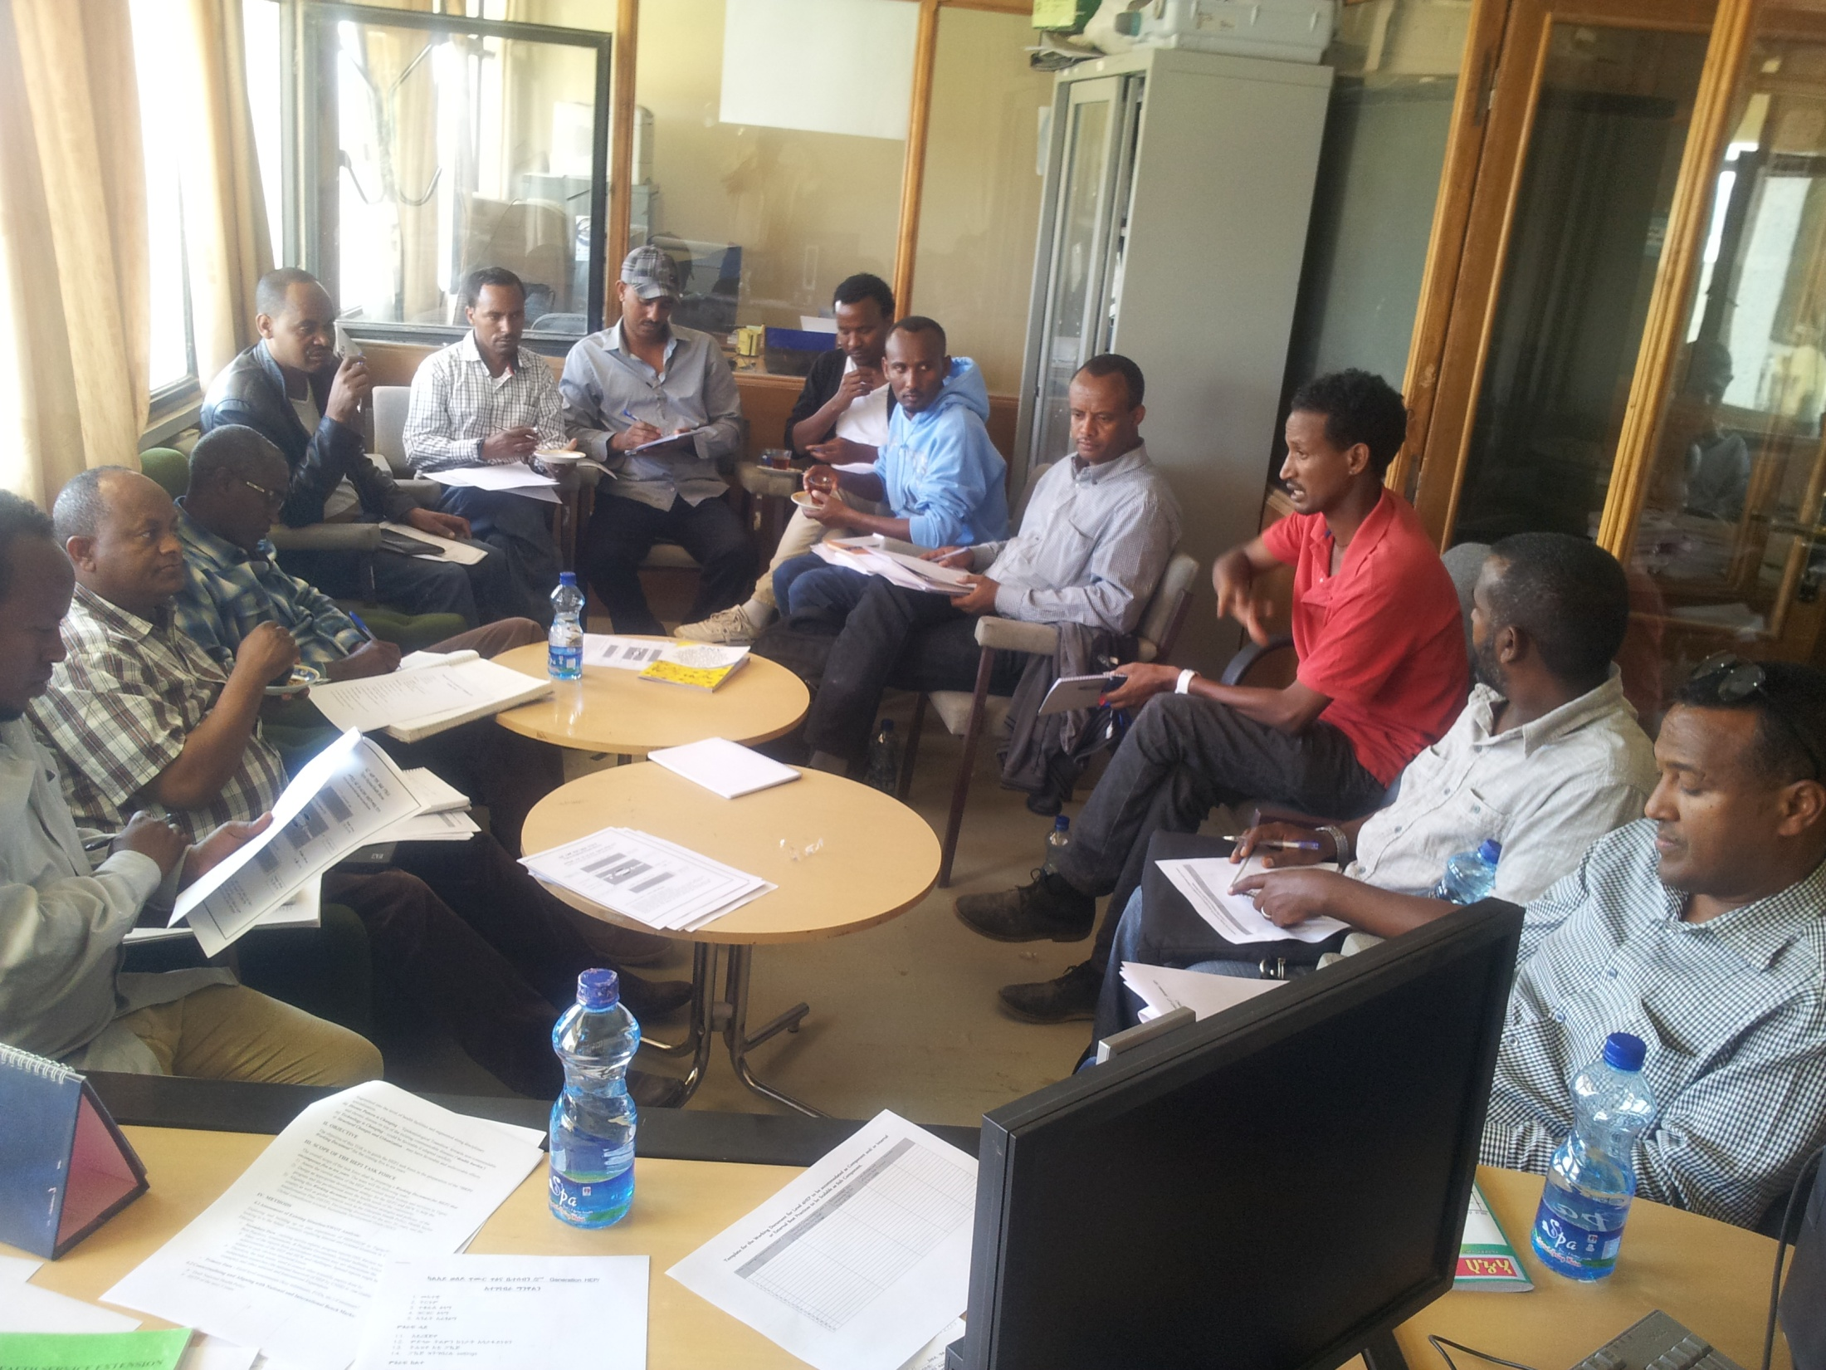
WaSH TWG, TRHB

Slide 18


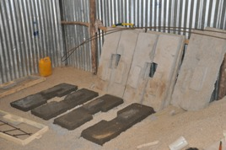
Sanitation Marketing in Medebay Zana

Slide 19
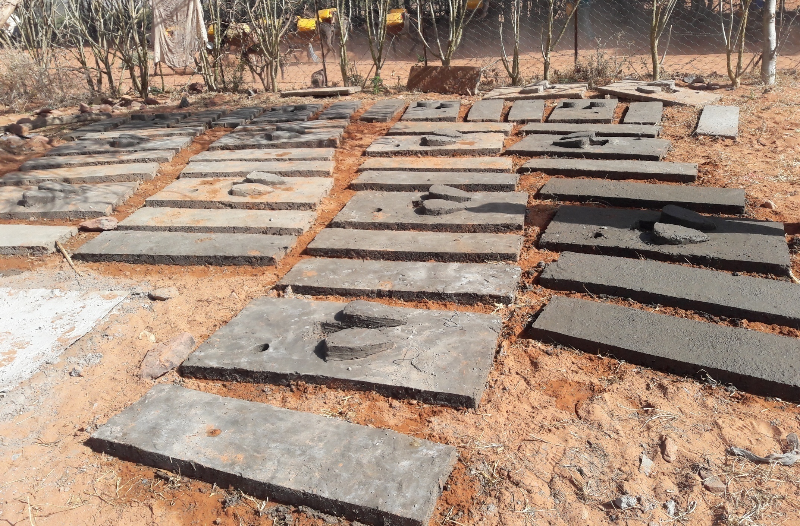

Slide 20
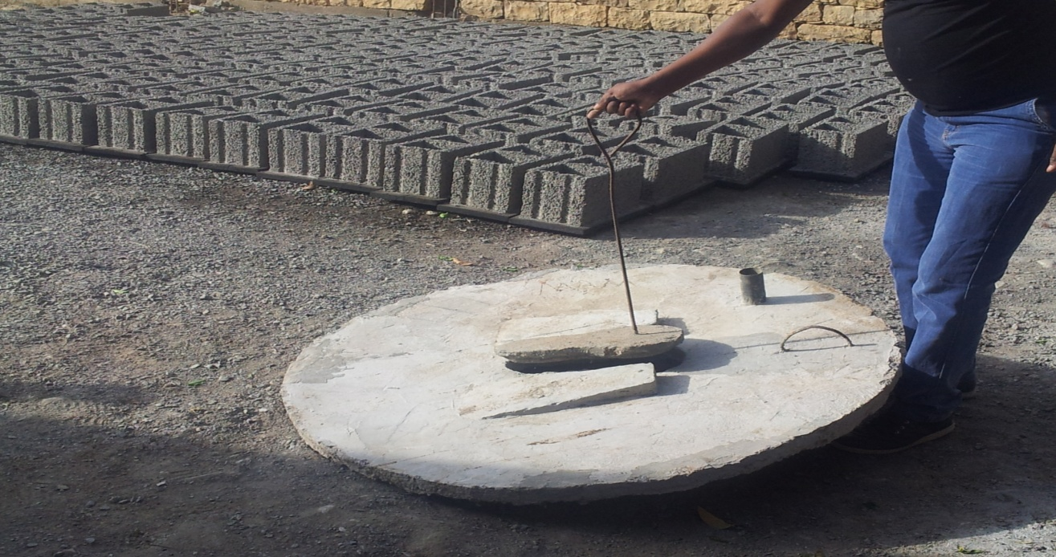

Slide 21

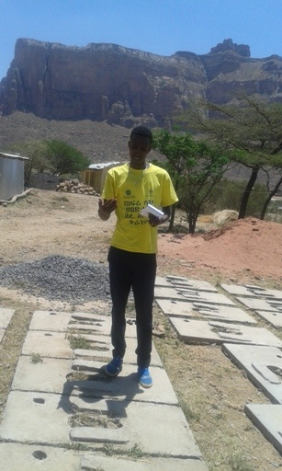
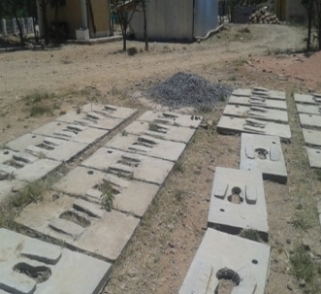
  Megab Tabiya

Slide 22
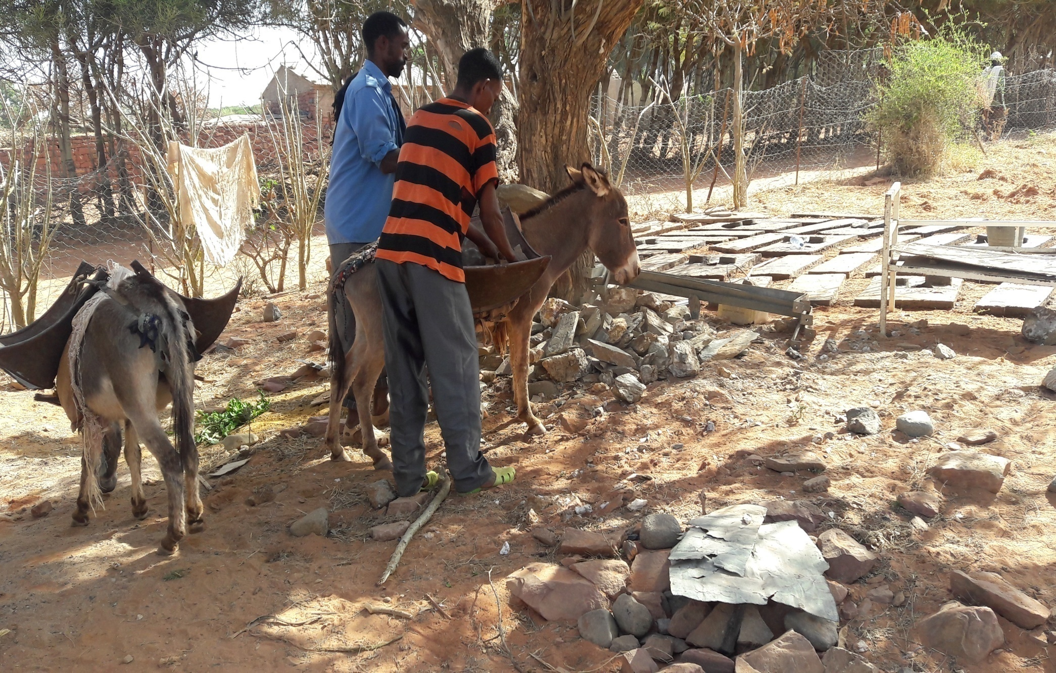
Adi’ha kebele

Slide 23
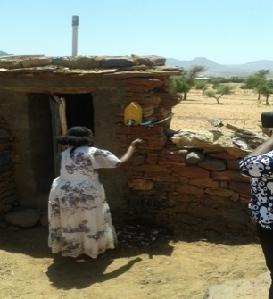

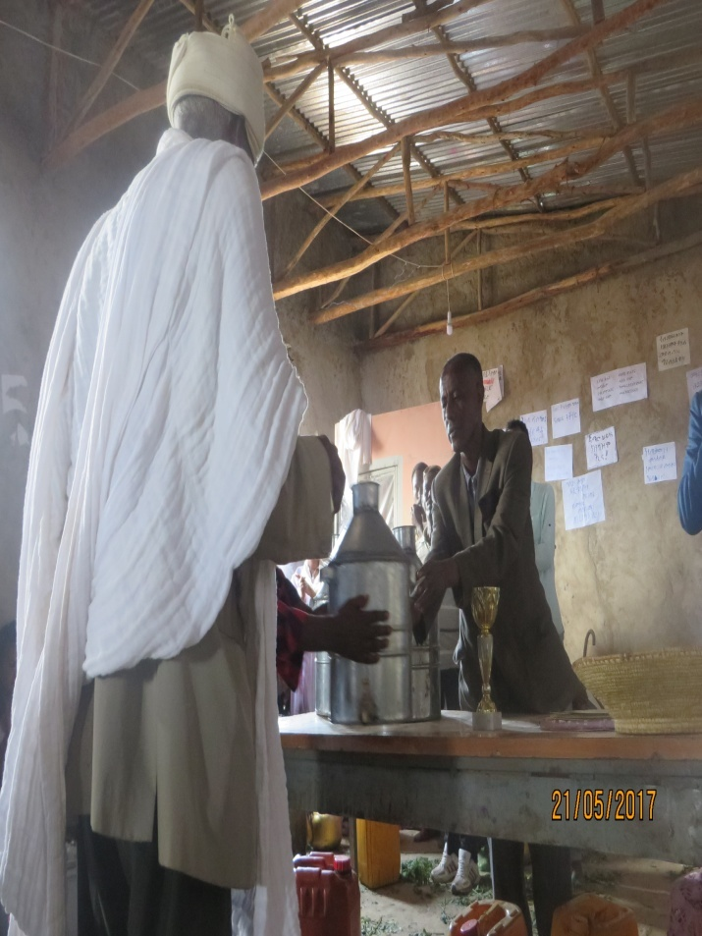
Best practice
  Woreda Kolla Tembem
  Woreda T/koraro

Slide 24
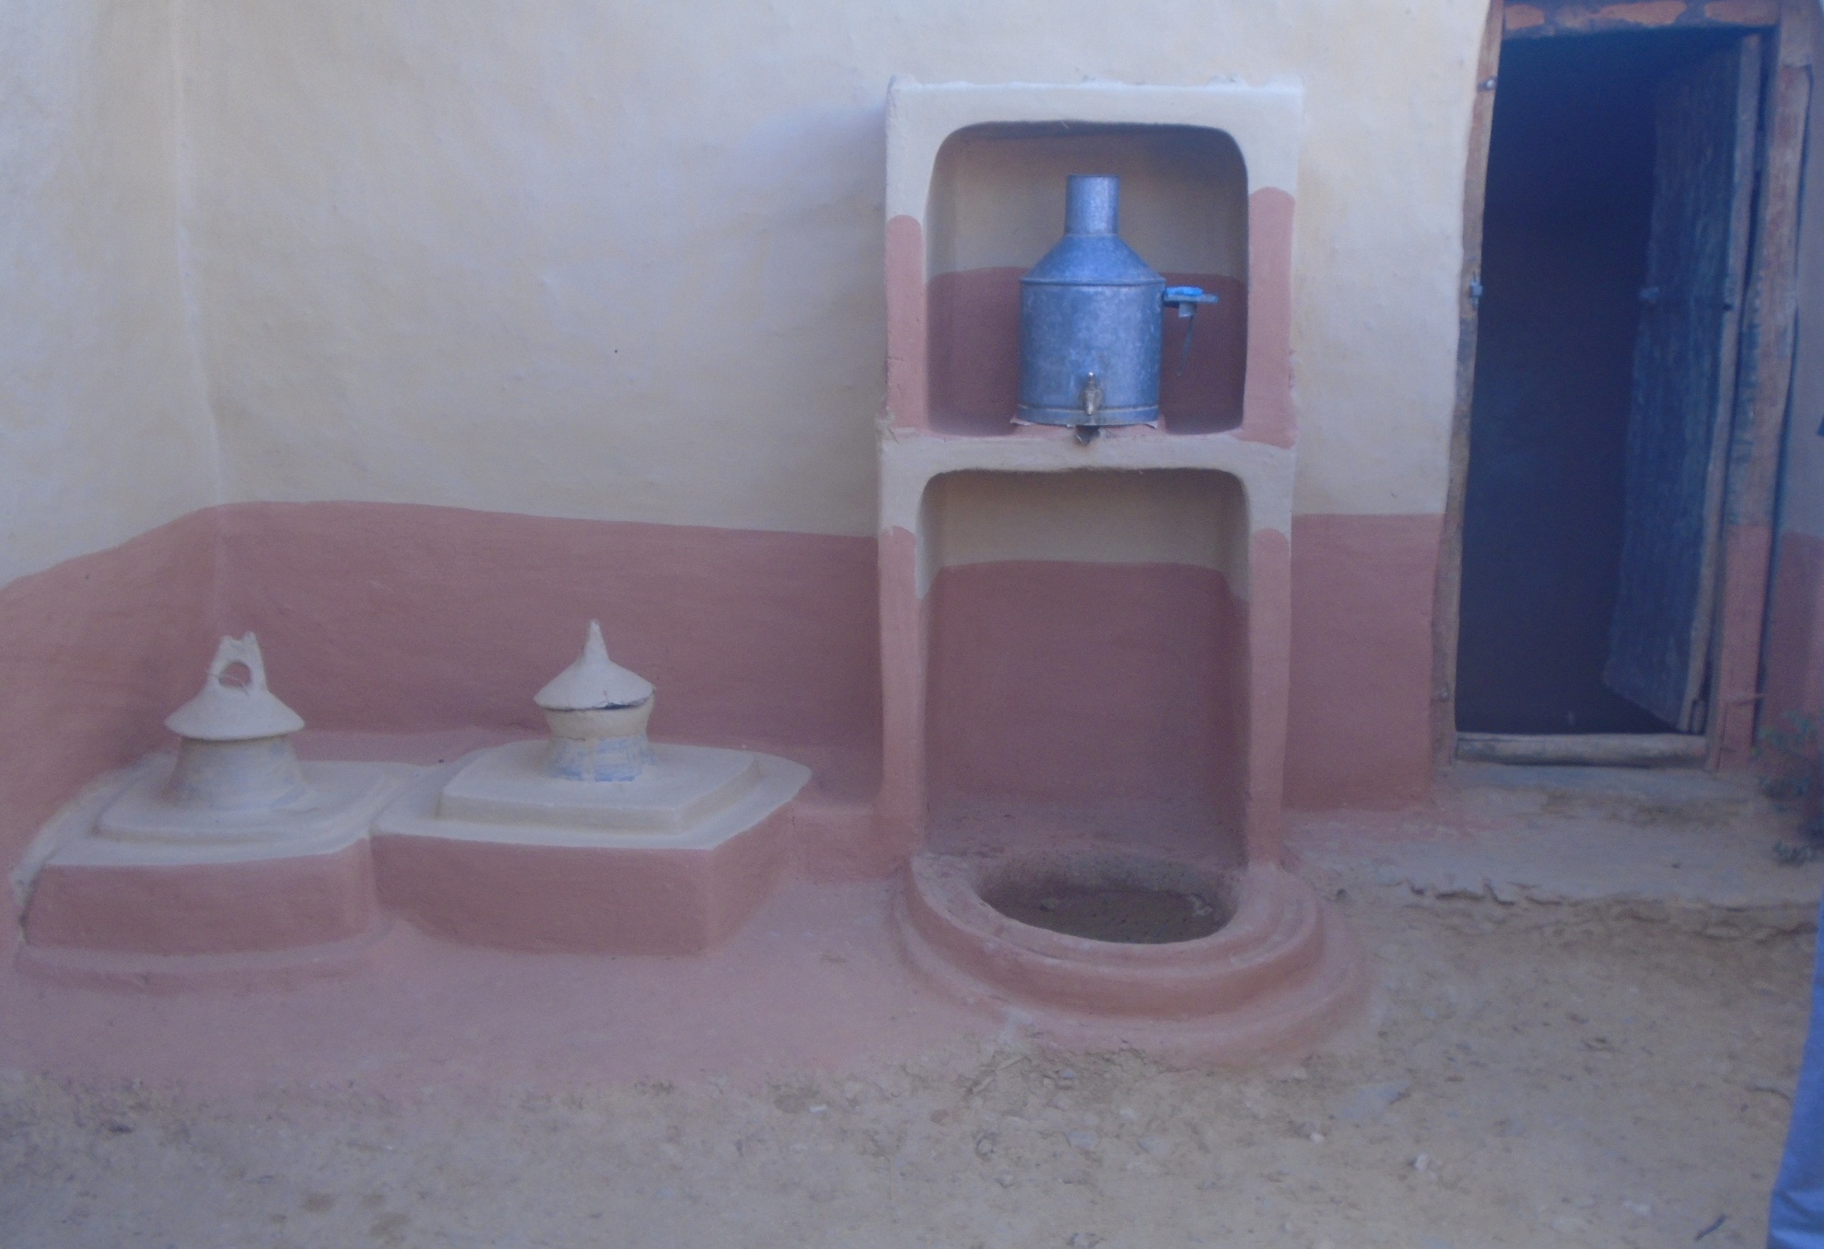
Improved technologies

Slide 25
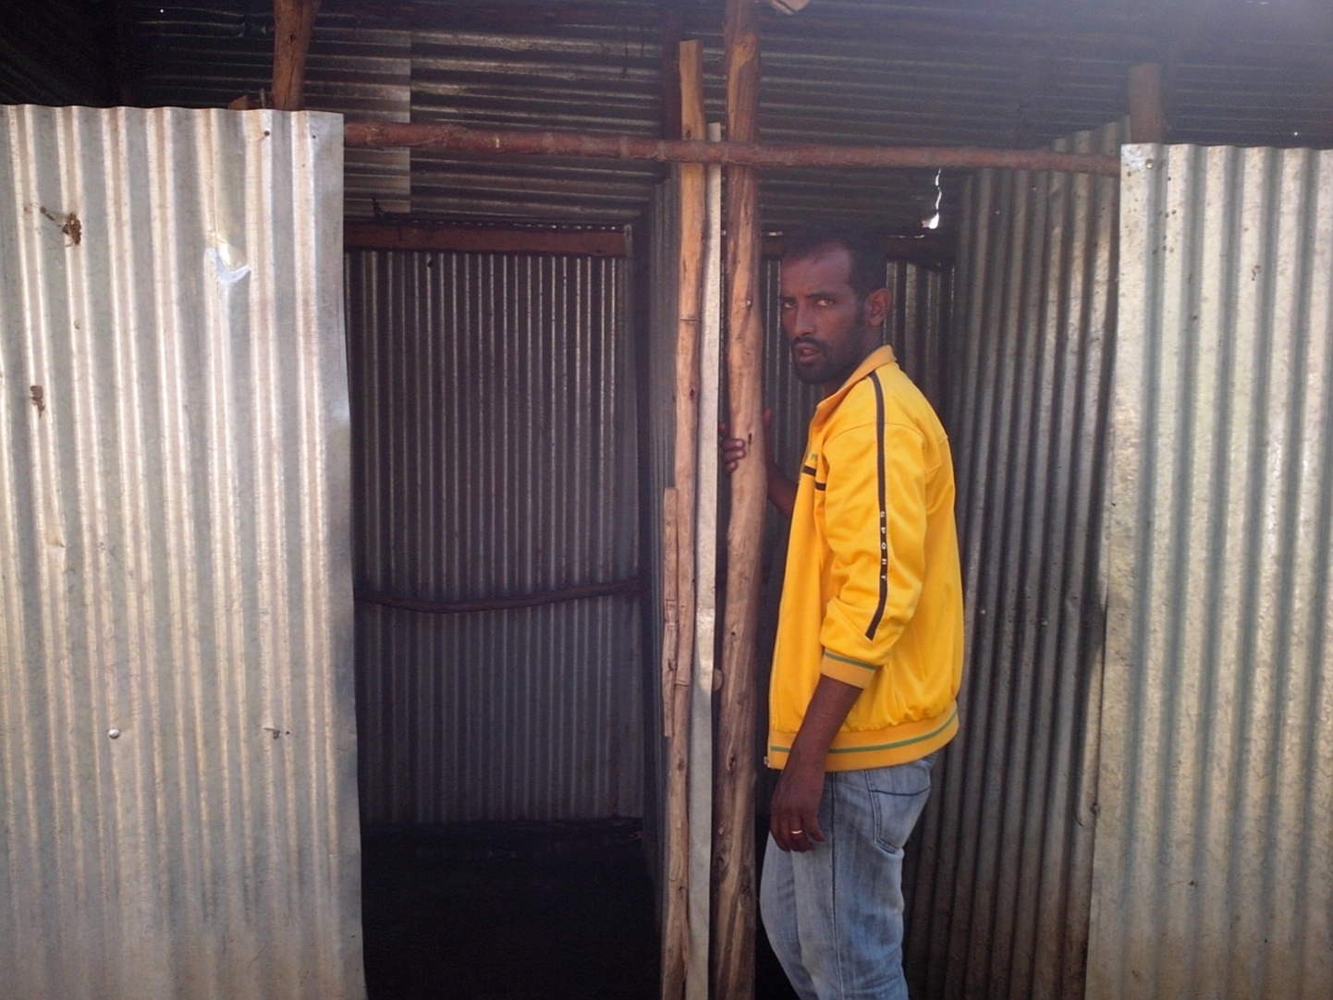
Community Latrine facilities at centers

Slide 26
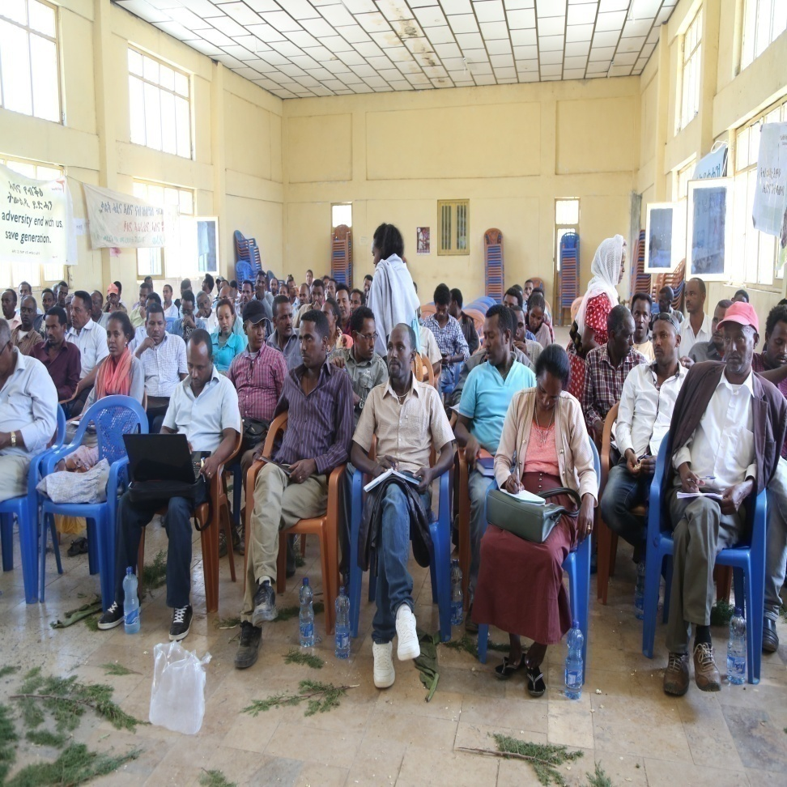
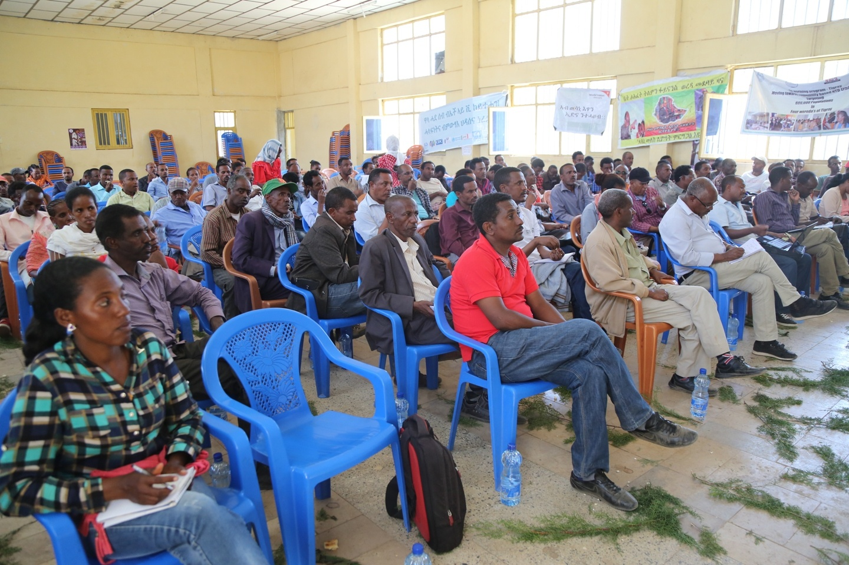
Experience sharing and training of sanitation marketing 2009

Slide 27
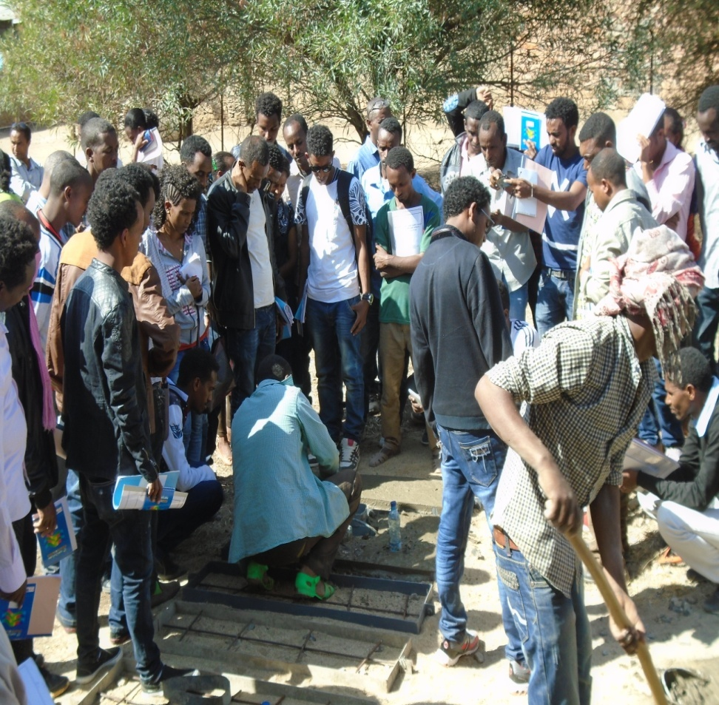
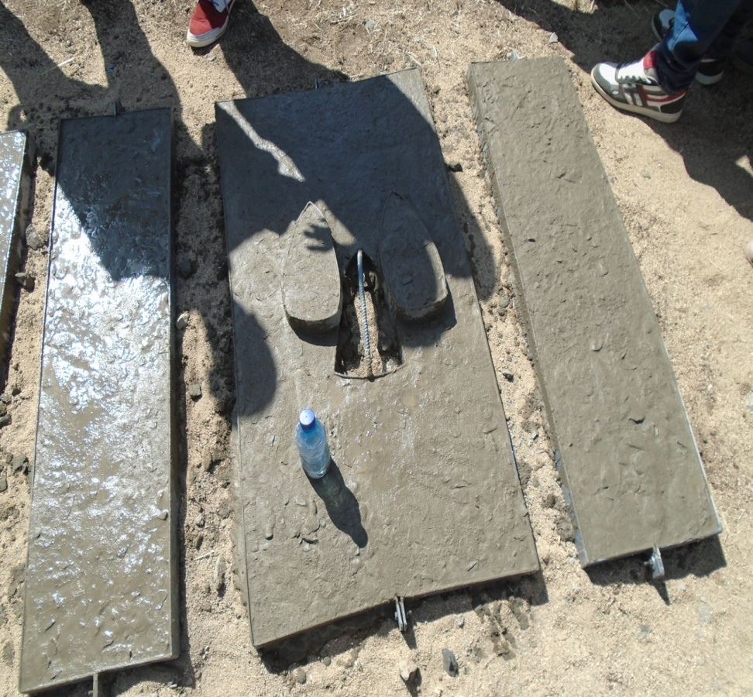
Photos during practical training slab productions

Slide 28
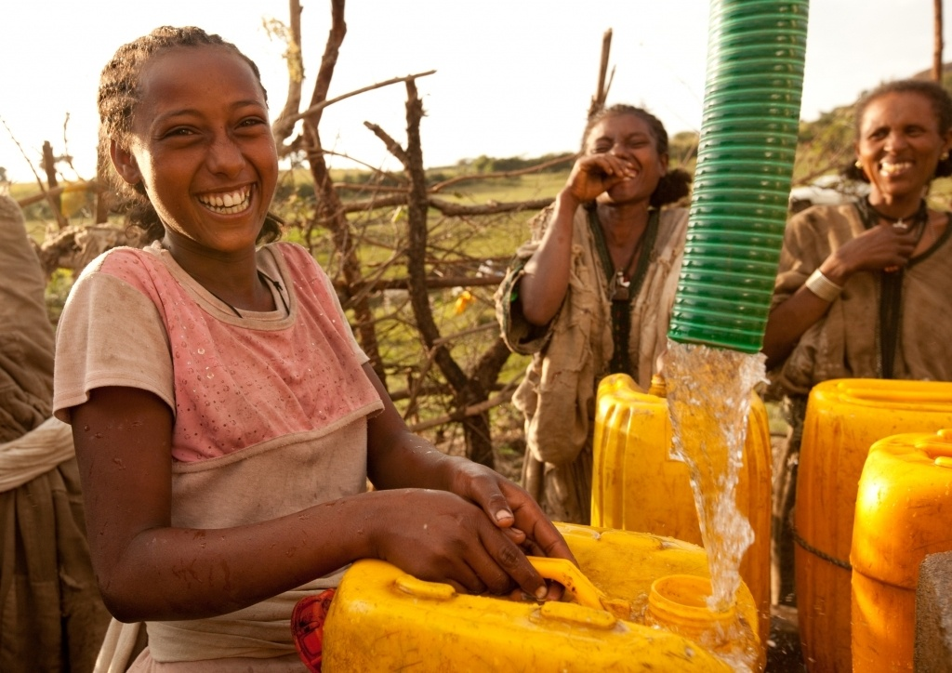
Access to water supply

Slide 29
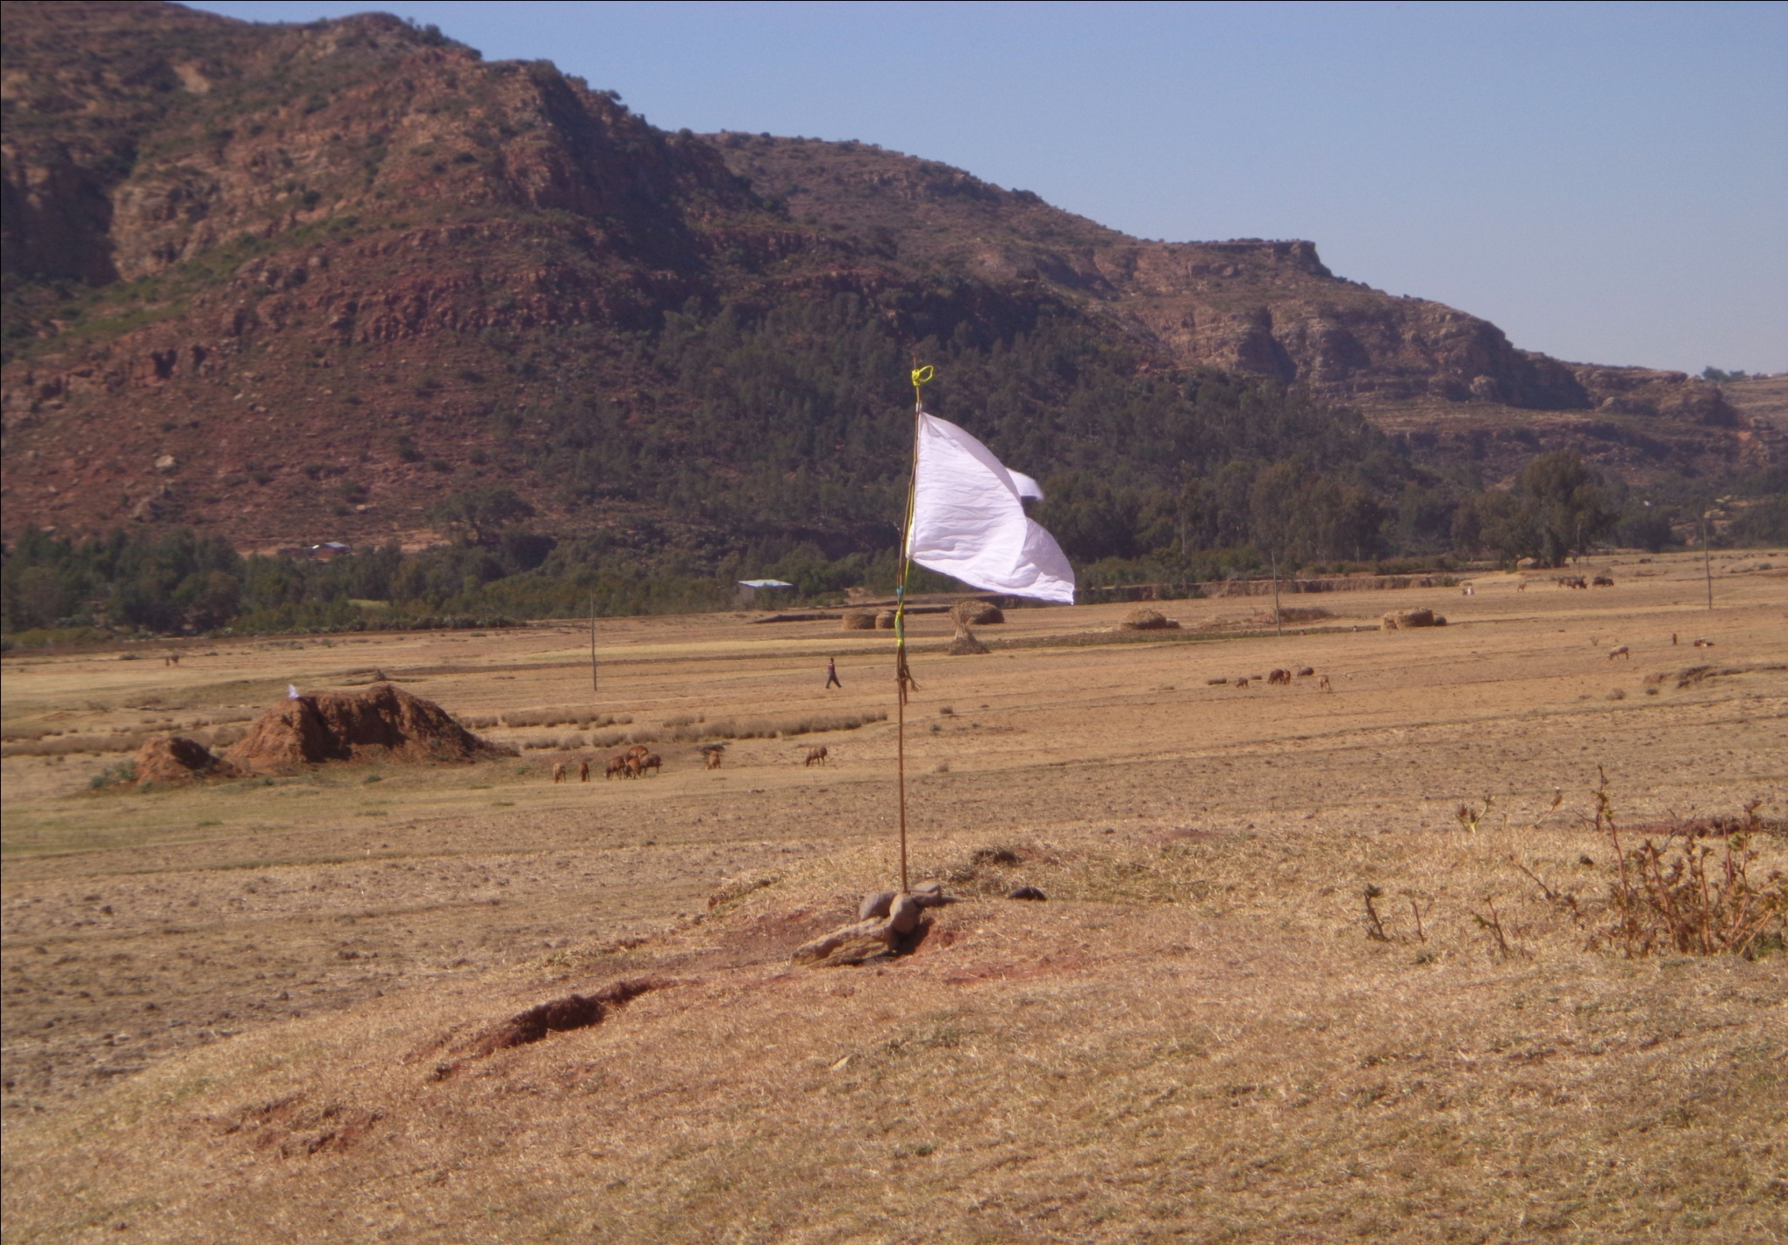
ODF Declared community

Slide 30
Major Opportunities
Focus of the health sector ladership for improved sanitation at all level;
Currently, Sanitation Marketing is acknowledged as an option of job opportunity for youths;
Government policy to support micro and small scale enterprises;
Presence of Regional Hygiene and Sanitation Technical Working Group;
Presence of organized communities (Women Development Group)
Continuous support of development partners

Slide 31
Major Constraints
Sanitation marketing is at infant stage to attract organized youths or micro and small enterprises as business
Only slab production and sales will not sustain the life of the enterprises
No frequent meeting as scheduled among the sectors due to other competing activities
Financial start up support – In kind and cash for early adopters of business models;

Slide 32
Next steps
Increase political , technical and resource commitment to address key challenges
Skill gap identification
Designing viable approaches for start up support
Capacity building
Organize experience sharing and review meeting to facilitate learning among regions and
Facilitating to loan access

Slide 33
‘Thank you for your attention’

