Slide 1


Slide 2
Smart and Targeted Sanitation Subsidies for
Poor Households
W2.3 Policy and finance addressing inclusion
in market systems

Slide 3
Contents
Introduction on Sanitation Subsidies
Sanitation subsidies in Cambodia
Sanitation subsidies in Ethiopia
  National sanitation subsidy protocol
  Findings of pilot study

Slide 4
Introduction on Sanitation Subsidies

Slide 5
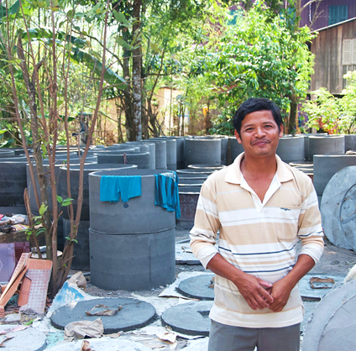
Why sanitation subsidies?
Demand-driven approaches like CLTS have had some positive results but face challenges with sustainability
Market-based approaches work on demand, supply, and enabling environment, to sustainably increase access to sanitation
…but market-based sanitation (MBS) is not inherently inclusive
…and loans are not necessarily adapted to the needs of those that are unable to pay
Notes:
Demand-driven approaches like CLTS have had some positive results in eliminating of open defecation but face challenges with sustainability of behaviour change
Market-based approaches work on demand, supply, and enabling environment, to sustainably increase access to sanitation
…but MBS is not inherently inclusive. Equity considerations are important to ensure we are not leaving the poorest and most vulnerable behind
Loans help address liquidity gaps but are not adapted to the needs of those that are unable to pay

Slide 6
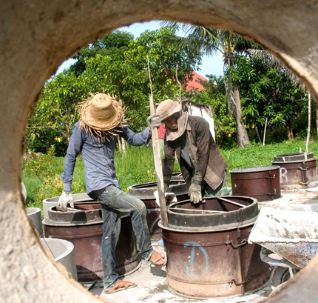
The controversy with subsidies
Subsidy = when a customer pays less for a product or service than the service provider’s cost
Most WASH subsidies are:
  Expensive - $320 billion/year
  Poorly targeted – more than half go to the wealthiest 20% and only 6% to the poorest 20%
  Nontransparent – opportunities for rent-seeking
  Distortionary – threaten sustainability
Notes:
Andres, Luis A., Michael Thibert, Camilo Lombana Cordoba, Alexander V. Danilenko, George Joseph, and Christian Borja-Vega. 2019. “Doing More with Less: Smarter Subsidies for Water Supply and Sanitation.” World Bank, Washington, DC.
https://openknowledge.worldbank.org/entities/publication/4e3b7a20-e719-5632-ad78-5762aef66cae
Expensive: The cost of subsidies associated with the operations, maintenance, and major repair and replacement of existing WSS infrastructure in much of the world (excluding, notably, China and India) is an estimated $289–$353 billion per year, or 0.46–0.56 percent of these countries’ combined gross domestic product (GDP). This figure rises, shockingly, up to 1.59–1.95 percent if only low- and middle-income economies are considered,

Slide 7
Sanitation Subsidies in Cambodia

Slide 8
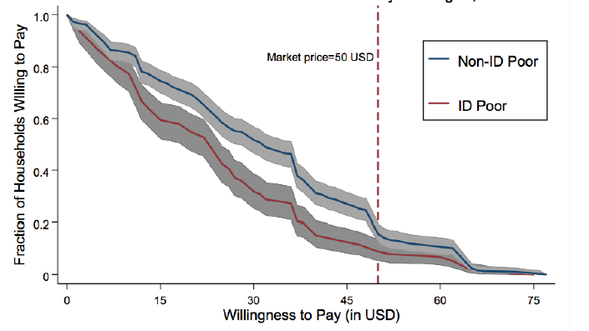
Setting the stage
By 2015, iDE Cambodia had facilitated the sale of 200,000 toilets
Toilet coverage doubled across intervention provinces between 2009 to 2015 (23 percent to 56 percent)
Despite success, iDE recognized that market actors were not incentivized to reach the poorest
Notes:
In November 2015, with the support of Australian Aid, iDE launched a Targeted Subsidy Pilot and randomized controlled trial in three districts in Kandal province. Through this pilot, iDE hoped to learn more about the potential market impact of targeted subsidies and develop a strategy to more effectively serve the rural poor at scale. In collaboration with Amplify Markets and Causal Design, the program trialed an innovative mechanism for selling toilets with subsidized price discounts, which was compared against selling with micro-credit and full cash payment options.
Government-identified IDPoor households were targeted through regular sales events and in the treatment group were able to purchase latrines at a discounted price with the option of microcredit to support. 3 In the control group, IDpoor households were only offered the ability to pay the full price in cash or with the support of microcredit.

Slide 9
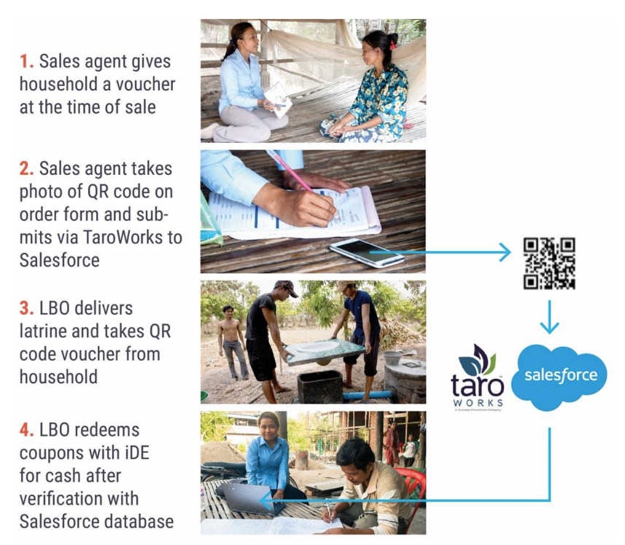
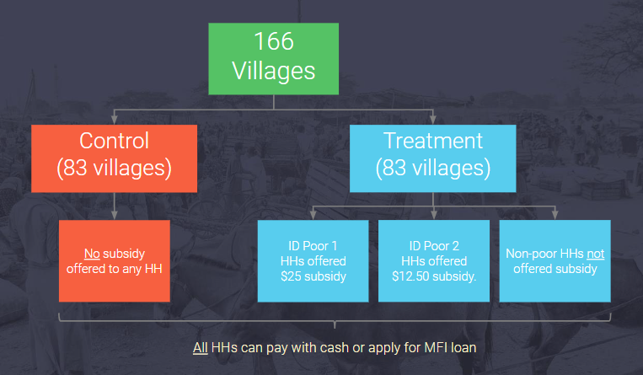

Research design and intervention
Do targeted, partial subsidies increase latrine sales to poor households?
Do targeted, partial subsidies affect latrine sales to non-poor households?
Are targeted subsidies or sanitation financing options—or a combination of the two—the most cost-effective means of increasing latrine sales to poor households?
Notes:
Product prices:
Easy latrine +Soft shelter
Non-poor $57 $90
IDPoor 2 $37 $50
IDPoor1 $32 $45

Slide 10
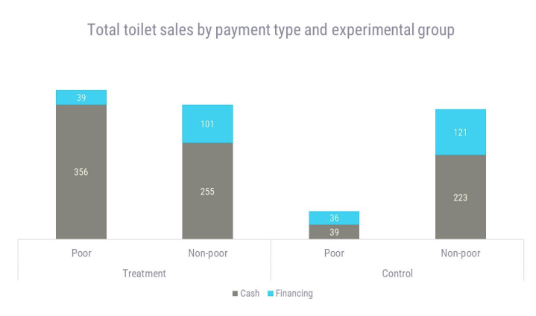
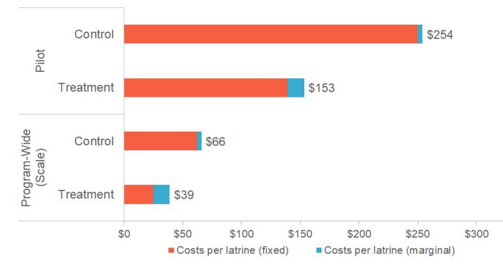
Results
Sanitation
Take-Up & Market Distortion
Cost Effectiveness

Slide 11
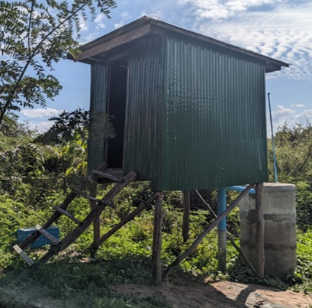
2022 research: adapting subsidies for climate-vulnerable households
What is a practical means for identifying climate vulnerability at a household level? → vulnerability assessment tool developed​
How can this approach be used to deliver targeted sanitation subsidies to the most climate vulnerable?​ How effective are these climate-targeted sanitation subsidies at increasing sanitation coverage while not damaging
local markets?​
  → 38% of treatment households purchased a toilet, compared to 8% of eligible households in control communities
  (nearly 5x more likely)​
  → No evidence of market distortion​
​
​
​
LOOKING AHEAD​
Compliant with the Rio Markers, in 2023 iDE is scaling up delivery of climate-resilient sanitation subsidies with climate finance from the Government of Australia through the Water for Women Fund.​
​
​
​
Notes:
IMPLICATIONS​
effective mechanisms to direct adaptation financing to the most vulnerable households exist​
proven additionality based on our analysis of the counterfactual​

Slide 12
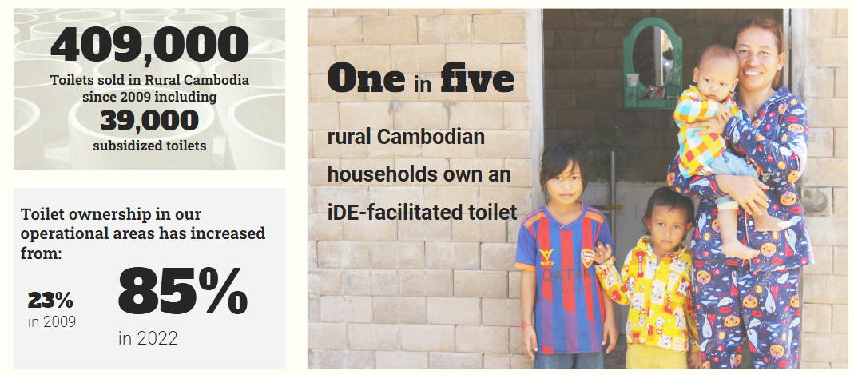
Where we are today

Slide 13
Sanitation subsidies in Ethiopia

Slide 14
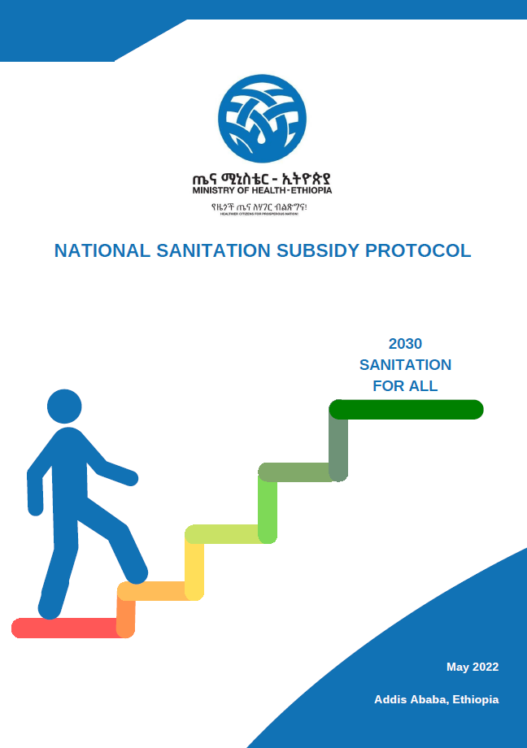
Subsidies must be:
SMART to ensure that they do not distort or hamper MBS and CLTSH approaches but rather contribute to overall expansion of sanitation markets
TARGETED so that the subsidies address the most vulnerable population groups, who are not able to construct improved sanitation facilities on their own

Slide 15
Guiding principles
  Subsidies must be well-targeted
  (e.g., targeting households exempted from paying the community-based
  health insurance)
  Subsidies should be designed to reach a minimum acceptable level of sanitation services (e.g., targeting only latrine sub-structures and flooring solutions)
  Subsidies should only cover a proportion of the overall cost
  (e.g., direct subsidies paid to a household must not cover more than 80% of the
  total cost)
  Subsidies should only be introduced in places with a well-established supply chain
  (e.g., coverage of improved sanitation at least 50% and open defecation less than 10%)
  The guiding principles must apply to everyone

Slide 16
Findings of pilot study
Full payment
(25 to 45 USD)
  Results from 320 households in six kebeles in two woredas in Sidama region by T/WASH in 2022

Slide 17
Findings of pilot study
Medium subsidy
(ca. 9 USD)
Full payment
(25 to 45 USD)
  Results from 320 households in six kebeles in two woredas in Sidama region by T/WASH in 2022

Slide 18
Findings of pilot study
High subsidy
(ca. 2 USD)
Medium subsidy
(ca. 9 USD)
Full payment
(25 to 45 USD)
  Results from 320 households in six kebeles in two woredas in Sidama region by T/WASH in 2022

Slide 19
Additional subsidy research in Ethiopia
  Prime example of collaboration between implementing organizations and government
  Lessons from iDE Cambodia → Ethiopia Sanitation Multistakeholder Platform → National Subsidy Protocol → T/WASH research and lessons → Updated National Subsidy Protocol → iDE research with USAID WASHPaLS #2→ Further inform policy
  Additional research questions in partnership with USAID WASHPaLS #2:
  Market distortion
  Targeting
  Effect of baseline coverage levels
  Timeline: design phase and formative research ongoing in 2023
  by iDE, T/WASH and Ministry of Health; subsidy rollout by 2024

Slide 20


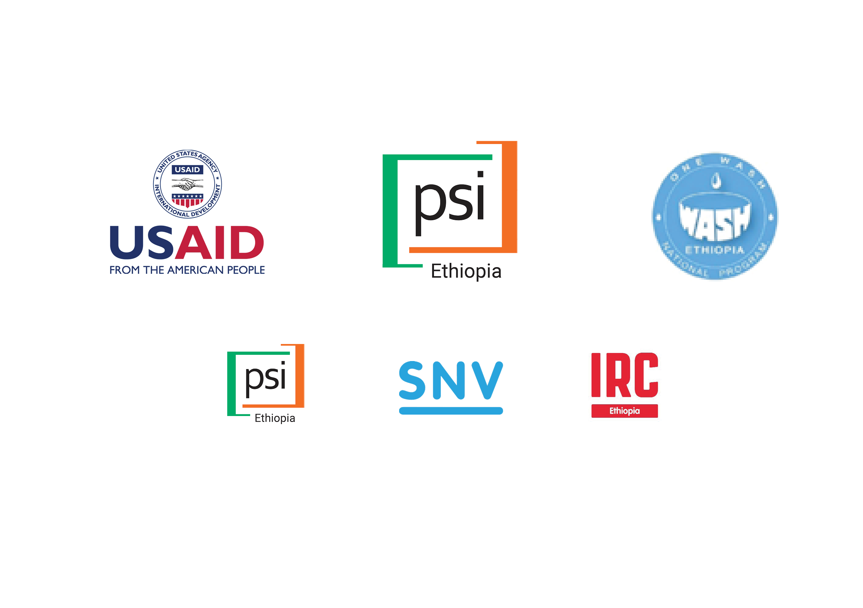




Thanks a lot!
Sarah Custer-Lalanne
iDE
scusterlalanne@ideglobal.org
Lars Osterwalder
USAID Transform WASH / IRC Ethiopia
osterwalder@ircwash.org

