Slide 1
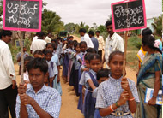
Examining children’s “participation” in sanitation (CLTS and SLTS) programmes
Deepa Joshi, Water Resources Management, October 7, 2015

Slide 2
Sanitation Dialogues?
Assessment, dialogue, shared vision? Research, Policy and Practice – huge gaps!
Testing and learning? Targets to be met, blue-prints: numbers vs. process
School Led Total Sanitation
Student interest in WASH!

Slide 3
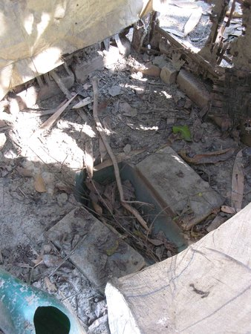
Participation: CLTS
Supply does not match demand! not appropriate
Culture of dependency
Demand-led approaches
PARTICIPATION
NEO-LIBERALISM
‘More money is clearly needed
but little is available’ (Evans, 2005)

Slide 4
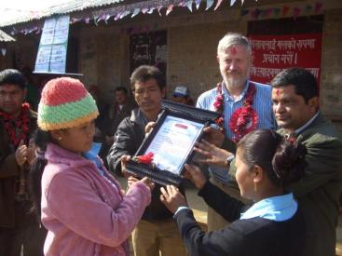
Participation in development
Infinitely malleable – can be framed in any way possible
Meaningful participation (empowerment) TO passing the baton of commitments, roles and time-bound responsibilities.

Slide 5
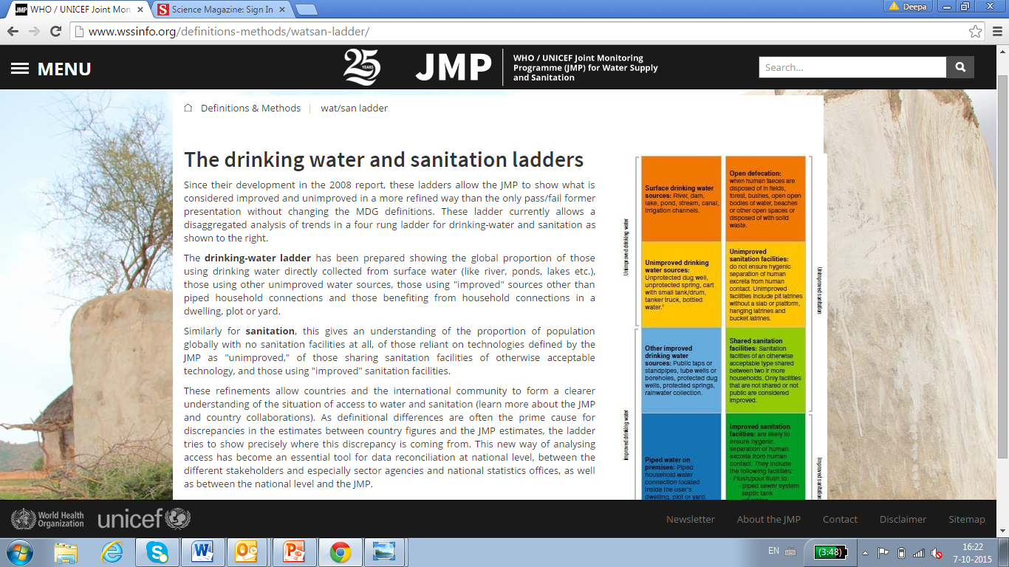
Participation in CLTS
Walk of shame/ shameful walk
Faeces quantification
Faeces, pathogens and disease: drinking water competition
Pledge to make the community ‘Open Defecation Free’

Slide 6
Participation and CLTS
Poor communities progressing on their own on the sanitation ladder? Fair? Feasible? Sustainable services?
Blaming, shaming, indignities.
Children’s roles in CLTS
Bangladesh: “Bicchu bahini” army of scorpions: shaming/ reporting on openly defecating adults: highly effective and empowering!
Indonesia: songs about eating shit

Slide 7
Children’s roles in CLTS/ SLTS
Are children participating – setting the agenda for their involvement/ engagement?
Is their engagement or “participation” in their best interests?
Articles 12 and 13: UN Convention on the Rights of the Child (CRC): children’s rights to participate in decisions/ issues relevant to their lives – sanitation!
Just, equitable societies – give children the space to voice opinions/ influence decisions

Slide 8
CRC lessons learnt:
Agenda for children’s participation set by adults; driven by development goals and interests, rather than the interests of children.
Enabling environment? Are adults aware and mindful?
Children’s rights and responsibilities of the adults to children.
Sanitation change agents: enabling environments?

Slide 9
SLTS and Children’s Participation
2000, Nepal: Children as sanitation change agents
School sanitation: from supply to demand-led
Same principles of blaming/ shaming
UNICEF!

Slide 10

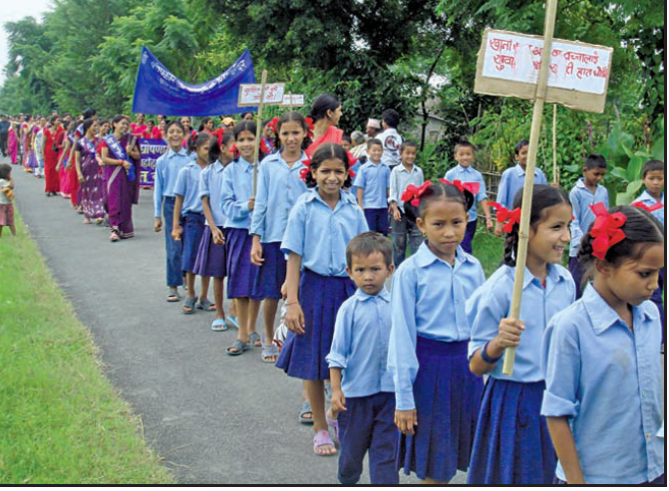
Viral! School-Led Total Sanitation (SLTS)

Slide 11
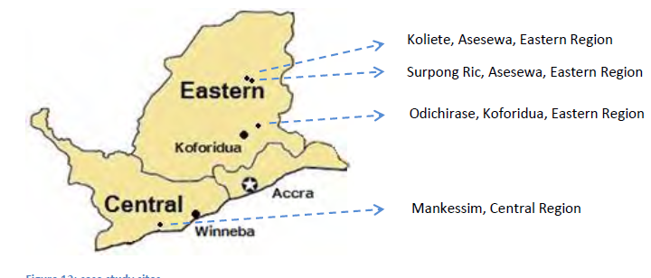
Review of SLTS initiatives in Ghana
MSc research: Vincent van den Ouden
Ghana: 4 rural schools
Different SLTS model
Secondary data: Fernandez (2008) – Kenya, Tanzania, Ethiopia.

Slide 12
Enabling environment?
Pour flush toilets in 2 schools (donor-supplied); community built pit-latrine + none
Toilet maintenance: children – empowering?
Handwashing equipment (donor-supplied)

Slide 13
Participation and CLTS

Slide 14
To participate or not? Fear of the adults
School health clubs
Glass of water competitions – negative?
Punishment for open-defecation!
The authority of teachers

Slide 15
The practice of SLTS
Aware – yes! But often unable to practice in the school.
In the community: fines for OD persons (10 Ghanaian cedis (GHC).
Not reporting, not blaming and shaming (violence against children – 2009)
Ghana’s culture: ‘children should know their place’

Slide 16
To sum:
SLTS
need for training adults
agenda for participation, for the programme to be set by children
being aware will not change ‘infrastructure and services’: schools, poorest households
Development for children OR children for development?
https://www.youtube.com/watch?v=xbqA6o8_WC0

