Slide 1


Slide 2
Faecal Sludge Management Concept and Practices
Faecal Sludge Management Improvement in small towns, as Contribution to the Achievement of Safely Managed Sanitation Services in Rwanda

Slide 3
Contents slide
What is the sanitation progress in Rwanda?
Intervention approach in Sanitation/FS Value Chain
Lesson learnt, challenges
Way forward

Slide 4
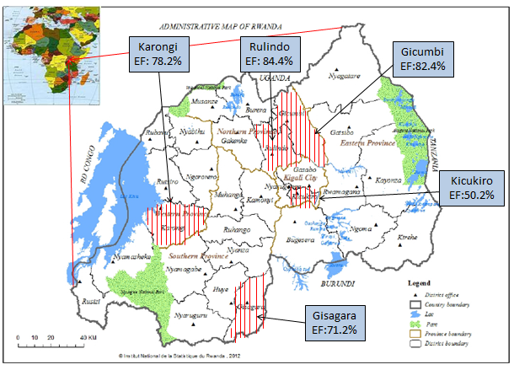
What is the sanitation progress in Rwanda ?
Basic administrative data of Rwanda | Basic data of Rwanda
Surface area | : 26,338sqm
Location | : East Africa Country
Administrative subdivision | : 4 Provinces, and City of Kigali : 30 Districts : 416 sectors : 2,148 cells
Population | : 13,246,394
Density | : 500 pop /Sqm
Urban pop | : 27.1%
Rural pop | :72.9%
National access to basic sanitation
Total | :72.1%
Urban | :56.4%
Rural | : 78.5%

Slide 5
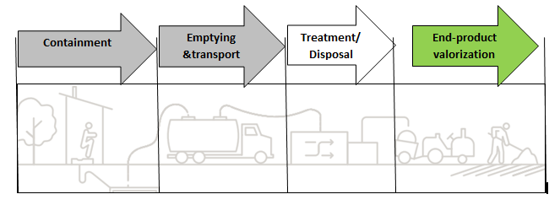
Intervention approach in sanitation/FS value chain
WFP in Rwanda began in 2008,
with an overall objective to help all communities, schools and health Facilities gain access to
sustainable water, sanitation and hygiene services
Water For People supports Sanitation as Business and promotes innovations
Sanitation/FS Value Chain
WFP supports Rwanda:
to achieve basic sanitation services by 2024 (NST1)
to achieve safely managed sanitation services by 2030 (SDG#6 targets)
Since 2016, WFP in collaboration with other partners has supported and influenced the domestication process of SDG#6 indicators under NISR

Slide 6
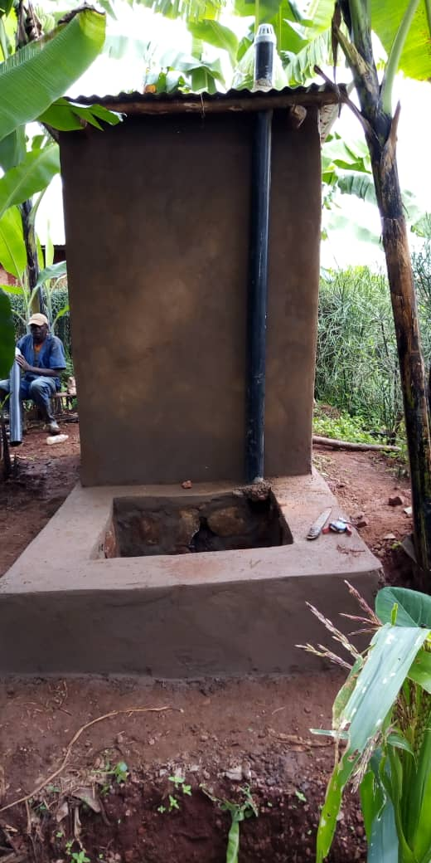
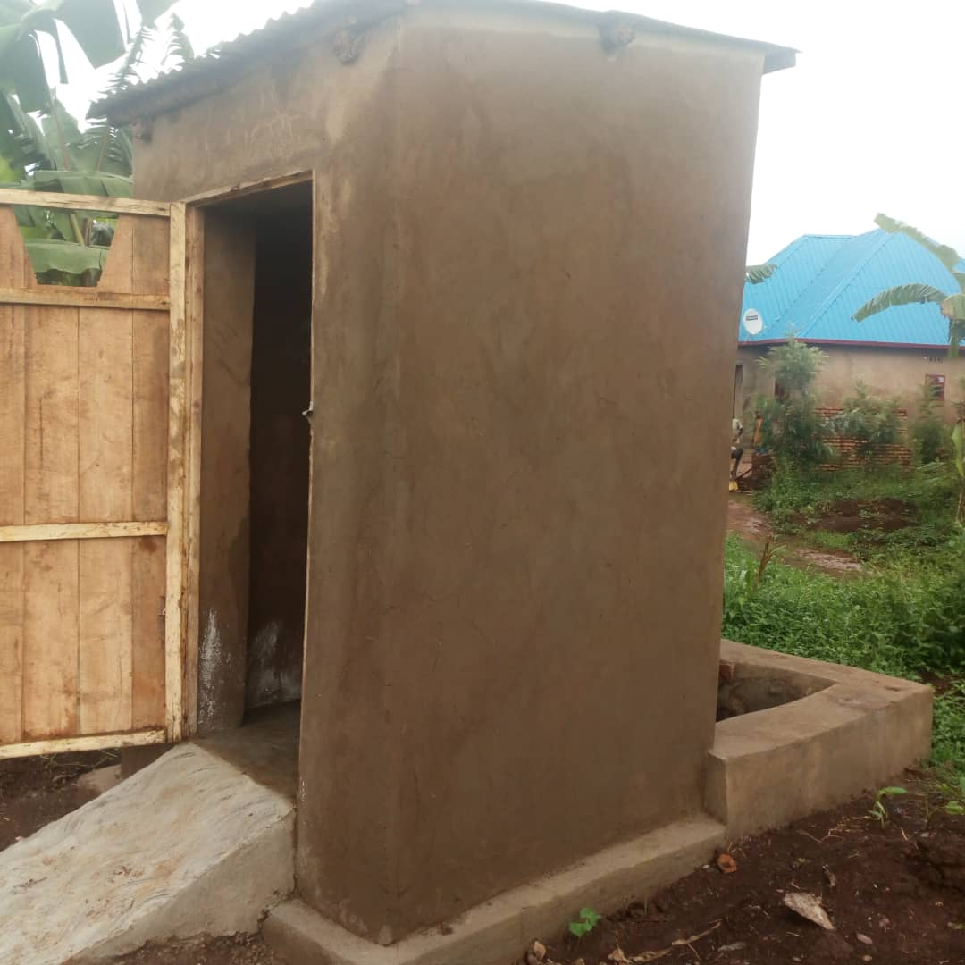
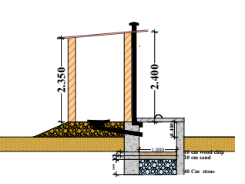
New innovations for the faecal sludge containment
In 2018, WFP has promoted the new HH latrine technology called Tiger Toilet that uses tiger worms to digest and treat fecal matters onsite
As demonstration, around 96 Tiger toilets were constructed in 8 Districts
^{CIVIL SOCIETY}
^{Leads accountability}
Provides skill/technical capacity where needed
Tiger toilet design

Slide 7
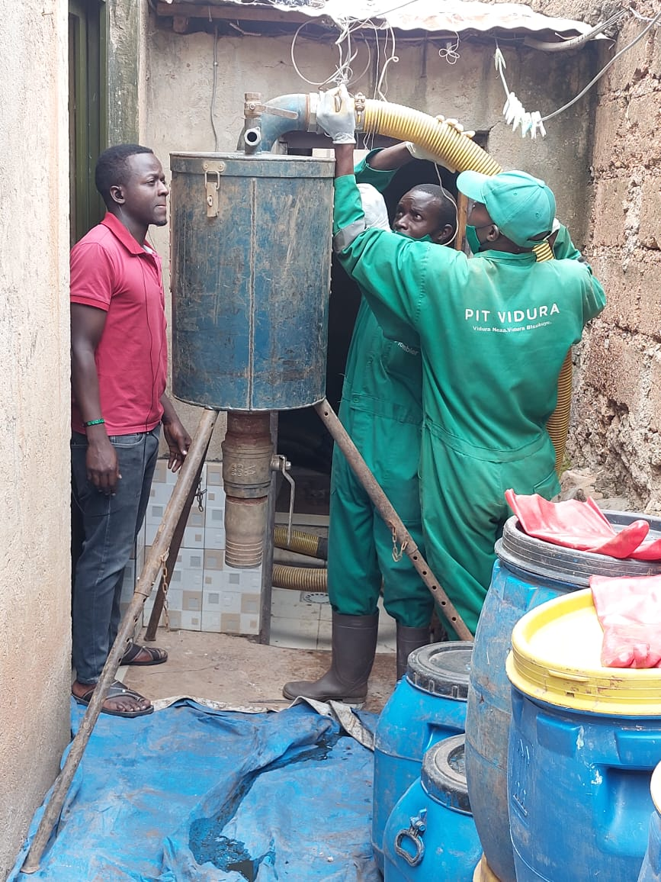
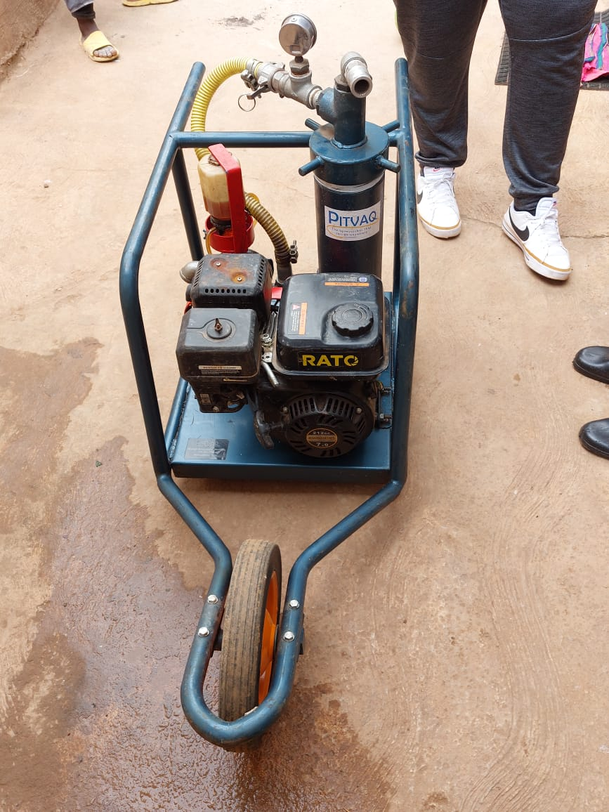
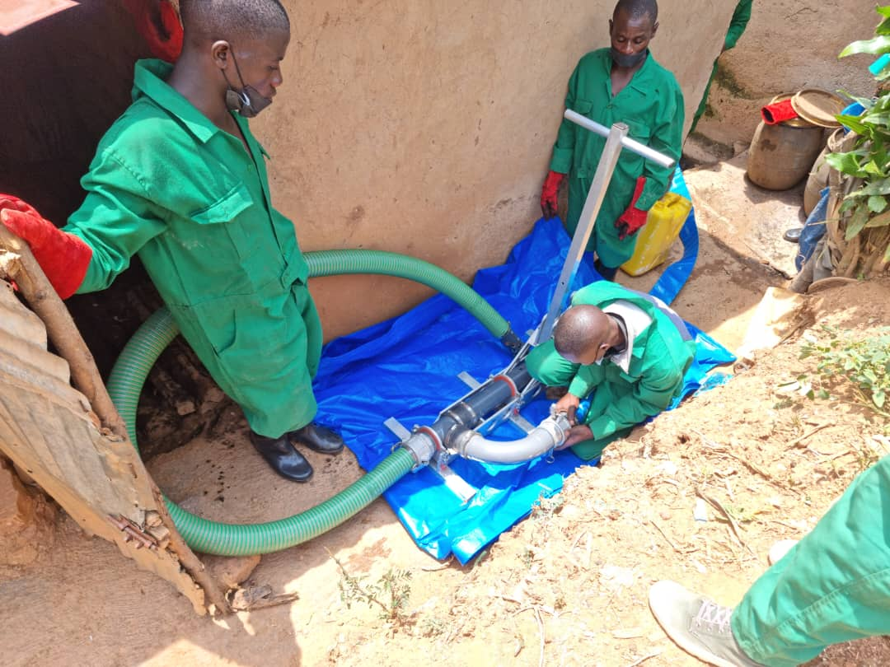
New initiatives in the pit emptying and FS transportation
Water for People supports pit emptiers grouped into their association ASSERWA for the business promotion
^{CIVIL SOCIETY}
^{Leads accountability}
Provides skill/technical capacity where needed
^{CIVIL SOCIETY}
^{Leads accountability}
Provides skill/technical capacity where needed
Training on the E-Vac utilization
E-Vac machine
Training on the utilization of Gulper 4

Slide 8
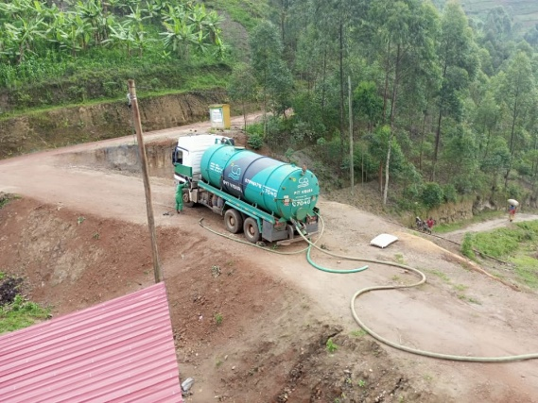
Professional equipment and materials utilization
WFP has supported and facilitated pit emptiers to meet financial institutions to request for loans for their Businesses to procure pit emptying and transportation equipment and materials
^{CIVIL SOCIETY}
^{Leads accountability}
Provides skill/technical capacity where needed
^{CIVIL SOCIETY}
^{Leads accountability}
Provides skill/technical capacity where needed
^{CIVIL SOCIETY}
^{Leads accountability}
Provides skill/technical capacity where needed
Vacuum Truck used by Private Operator Pit Vidura Ltd

Slide 9
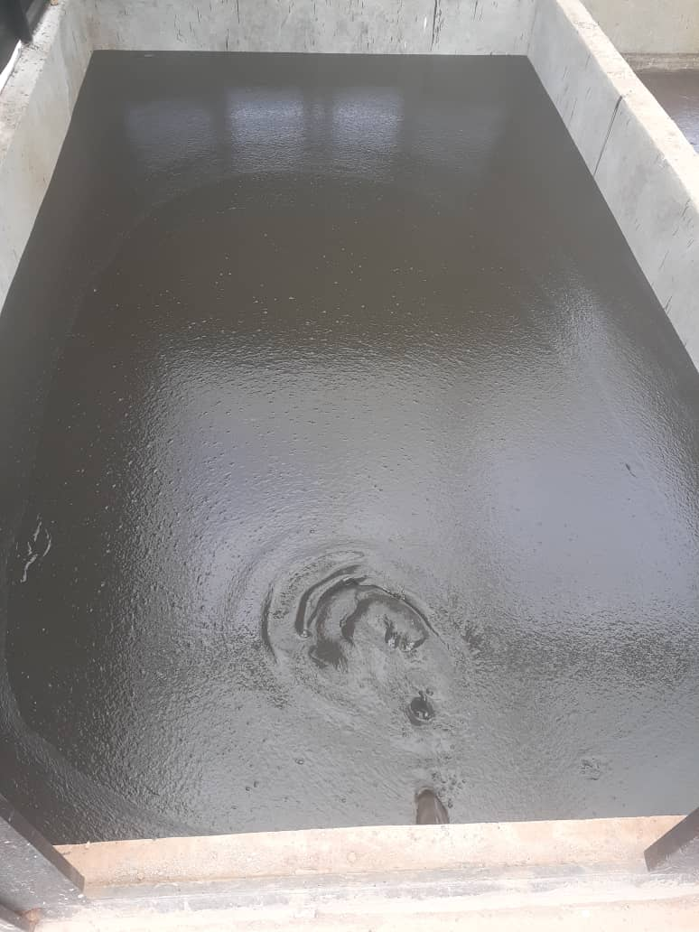
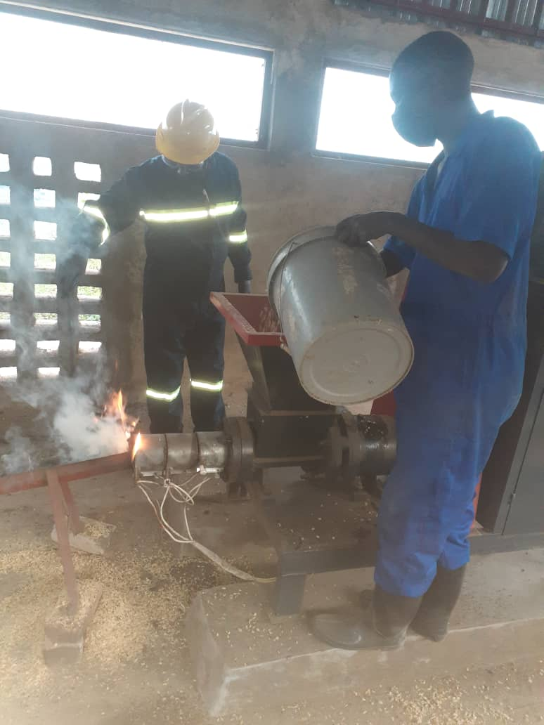
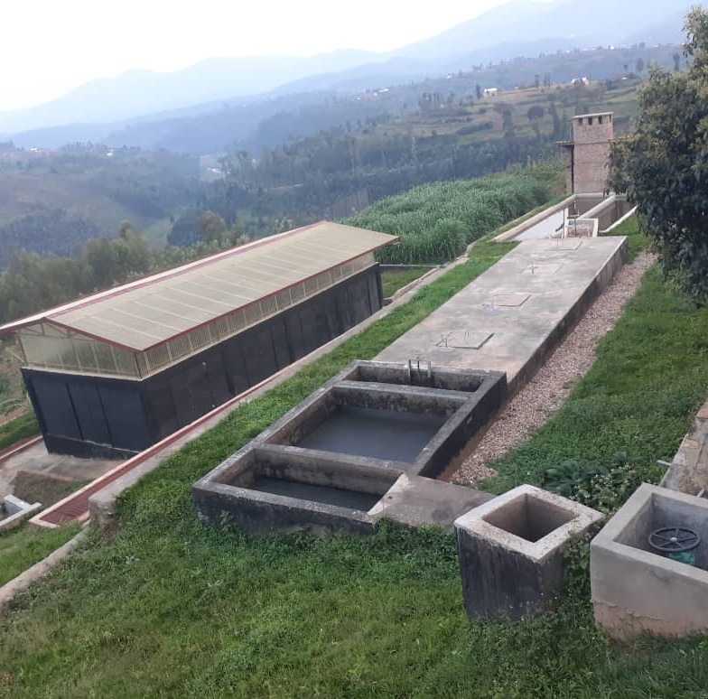
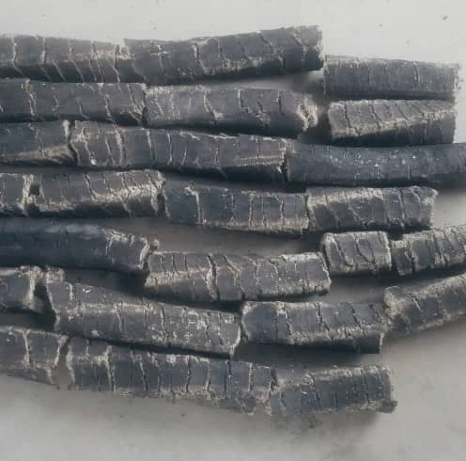
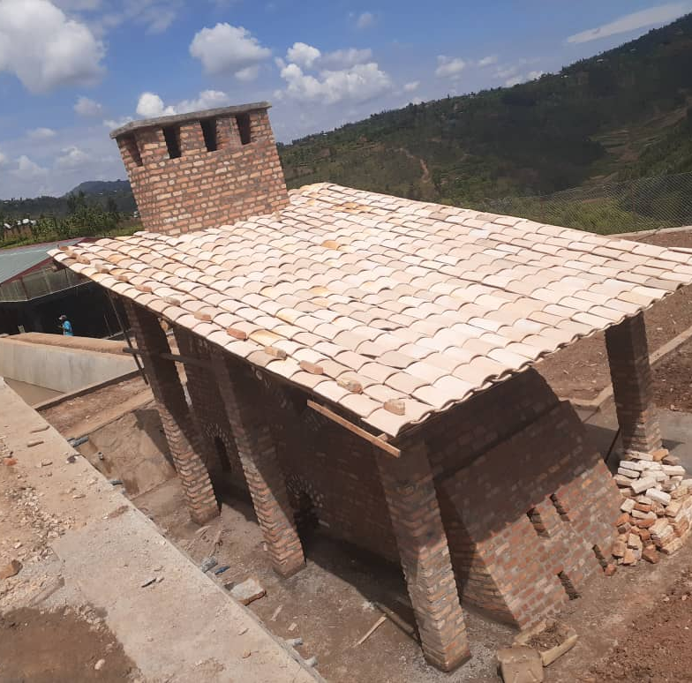
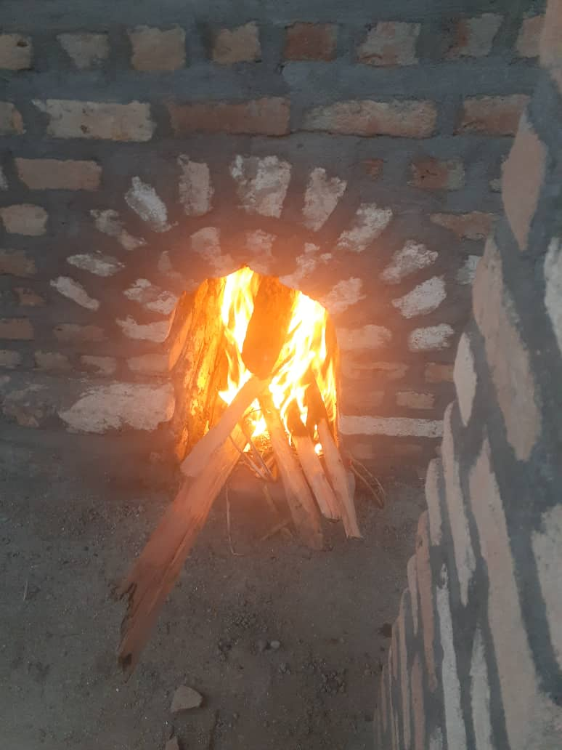
New innovations in FS Treatment/Disposal/end-products valorization
NYAMAGABE DEFAST
Constructed in 2021 with a capacity: 10KLD
Artificial wetland
Aeration pond
FS dewatering at 95%
Cooking briquettes making
Drying bed
Anaerobic stabilization
Reactor
Settling tank
Rice husk-based cooking briquettes
FS carbonization in the Kiln

Slide 10
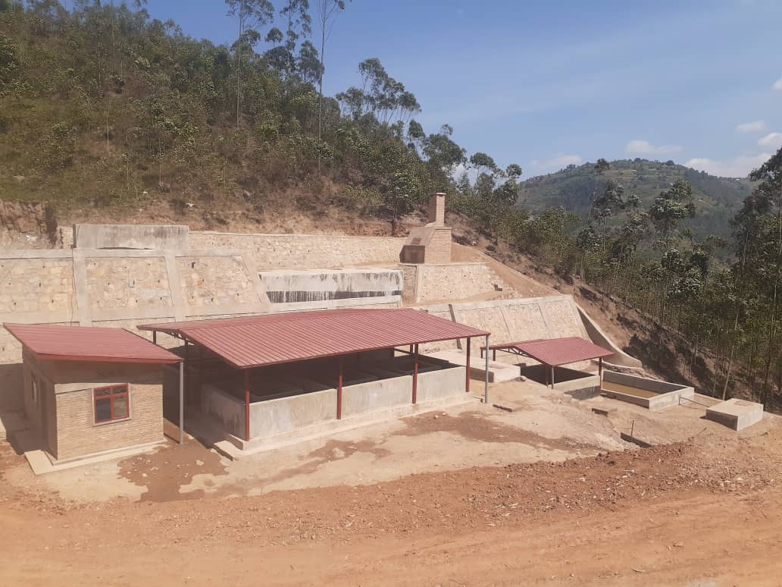

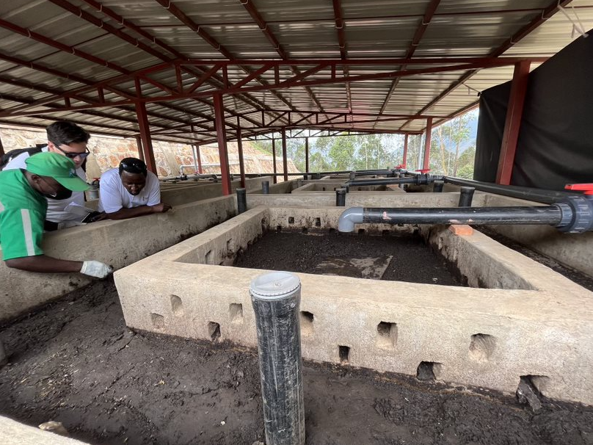
New innovations in FS Treatment/Disposal/
end-products valorization
RULINDO VERMIFILTRATION PLANT
Constructed in 2022 with Capacity:10KLD
Settling tank
Anaerobic digestor
Tiger worms digest and decrease the Volume of
faecal matters
Bio-compost is produced for soil amendment
Storage tank
TBF1
TBF2
Zero energy
FS flows by gravity
Planted gravel
No smell
No flies
Treated water

Slide 11
Lessons learnt, challenges
Lesson learnt: pit emptying service is increasing and attracting the
private sector and financial institutions are coming in for investment. But there are some challenges:
^{CIVIL SOCIETY}
^{Leads accountability}
Provides skill/technical capacity where needed
^{CIVIL SOCIETY}
^{Leads accountability}
Provides skill/technical capacity where needed
Key challenges | Action to be taken
Facilities are still underused because of the limitations of emptying services, | Collaboration with Districts and WASAC to mobilize the potential users,
Insufficient capacity of PO for Operation and Maintenance, | Capacity Building to PO staff,
Limitation of professionalism of the PO | Define a clear Service providers profile,
Lack of the tariff for emptying, transportation services and dumping fee, | RURA, to establish tariff for emptying , transportation services,
Sanitation initiatives are not yet taken as business for bankable project by Financial Institutions. | Put in place a funding mechanism to support sanitation initiatives through financial institutions.

Slide 12
Way forward
According to the Water For People Destination 30 (Global Strategy), WFP is committed to provide technical assistance in the promotion of Sanitation initiatives/innovations under Sanitation Marketing/Business approach.
Water For People is partnering with imperial college in London to do research efficiency of faecal sludge management plants and Tiger Toilets in Rwanda.
Initiating partnership with University of Rwanda to do research on faecal sludge management and valorisation of end products.
Water For People will partner with MININFRA/WASAC and other WASH stakeholders to scale up successful technologies/innovations in other towns/cities in need.

