Slide 1


Slide 2
Quality Assurance & Quality Control
Measures to improve accuracy and precision
in faecal sludge management

Slide 3
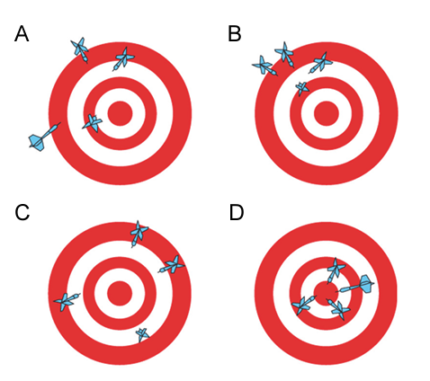
What is the difference?
Precision = repeated measurements return the same value
Accuracy = measurements are equal or close to the ‘true’ value

Slide 4
What is the difference?
Quality Assurance
  Focus on preventing errors
  All activities that contribute to efficient and effective functioning of a laboratory or programme
  “Total process whereby overall quality of laboratory results can be guaranteed”
Quality Control
  Focus on detecting errors
  The part of Quality Assurance that deals with verifying accuracy and precision
  of analyses

Slide 5
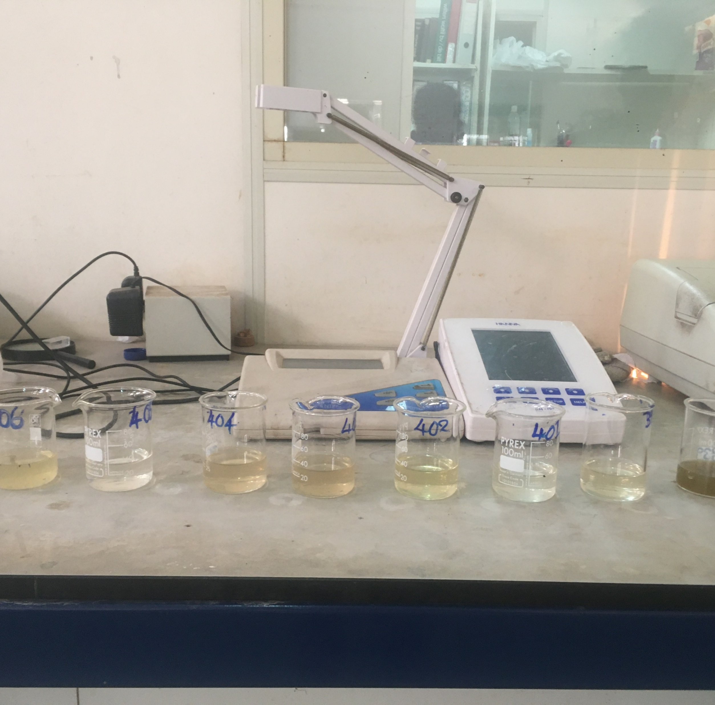
Where in your own work could you improve QA/QC?

Slide 6


More information
Chapter 8:
Laboratory procedures and methods for characterisation of faecal sludge

