Slide 1



Slide 2
Markets and behaviour change
How to get customers to pay for your product or service: lessons learned from market-based approaches to sanitation and providing safe water

Slide 3
Agenda
Introduction - Tyler Roy, WRP
Warm-up
One-minute pitches - IDE, Safisana, Max Tapwater, SFF and SWN
Case Studies
Audience joins a break-out group - presentation with Q&A
Audience joins a second break-out group - presentation with Q&A
Audience feedback and concluding remarks

Slide 4


Slide 5
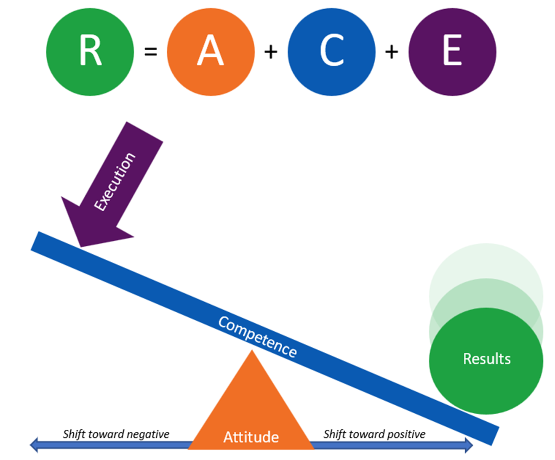
Results Framework

Slide 6
One-minute pitches

Slide 7
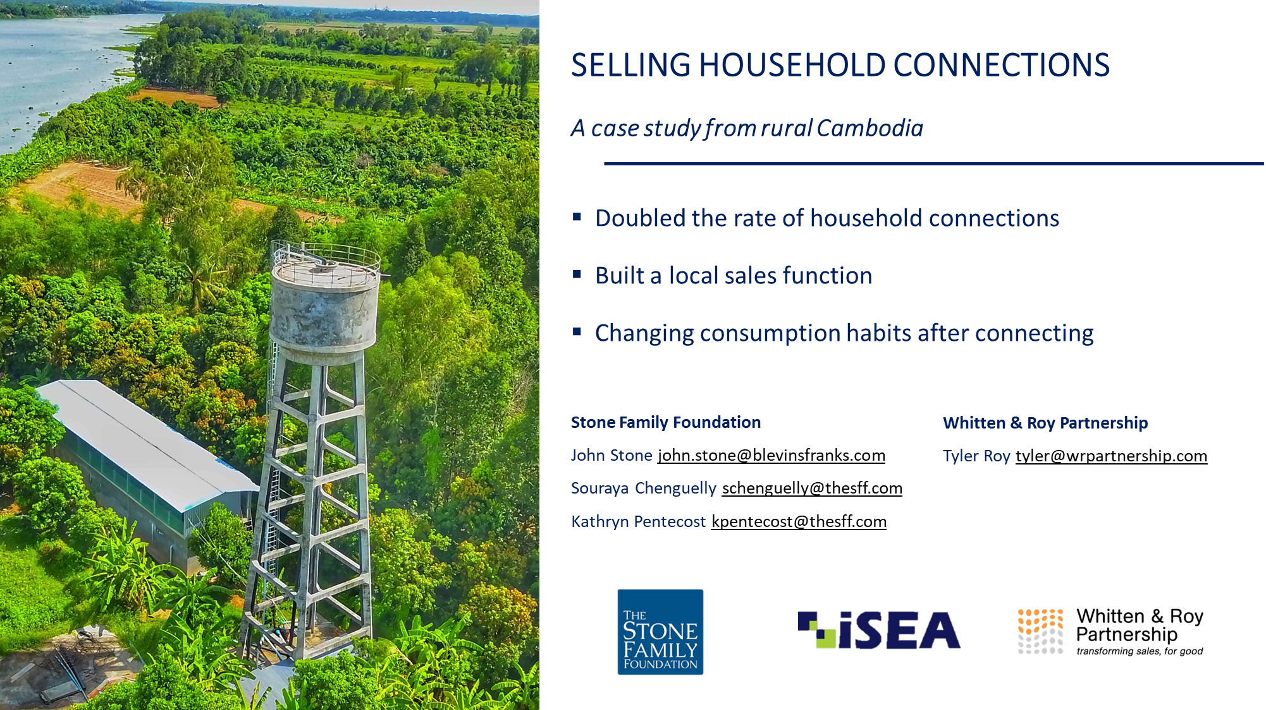
iSEA Cambodia

Slide 8
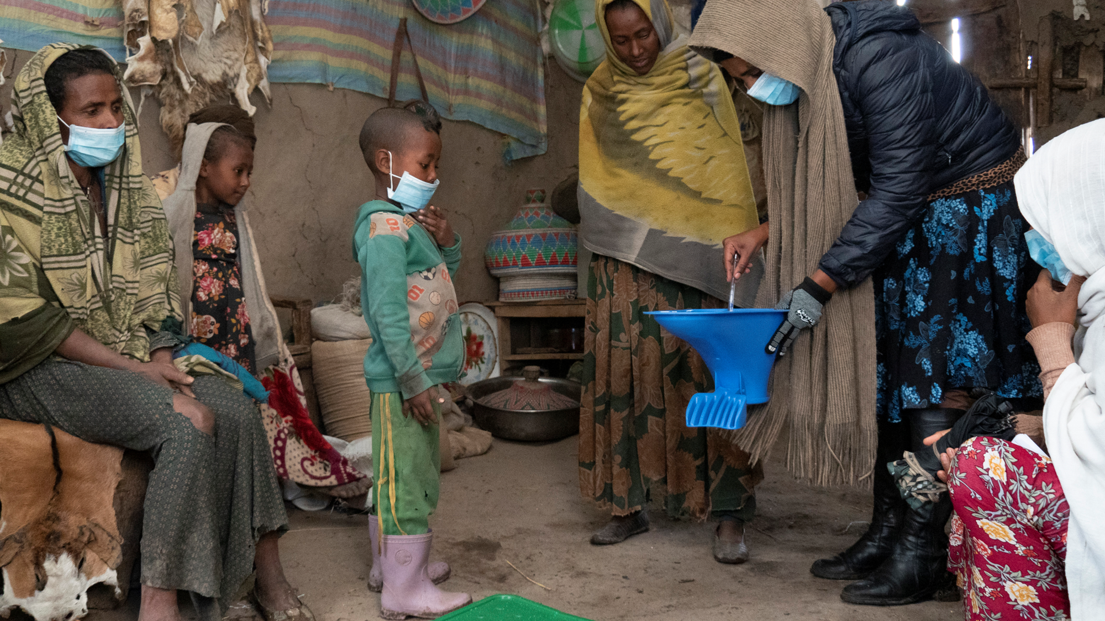
iDE Ethiopia

Slide 9
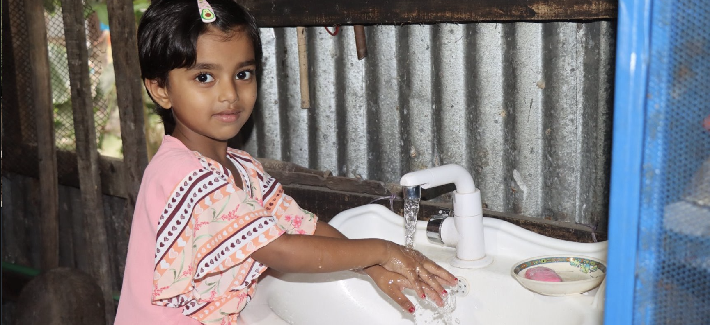

Max TapWater, Bangladesh
Joke Le Poole

Slide 10
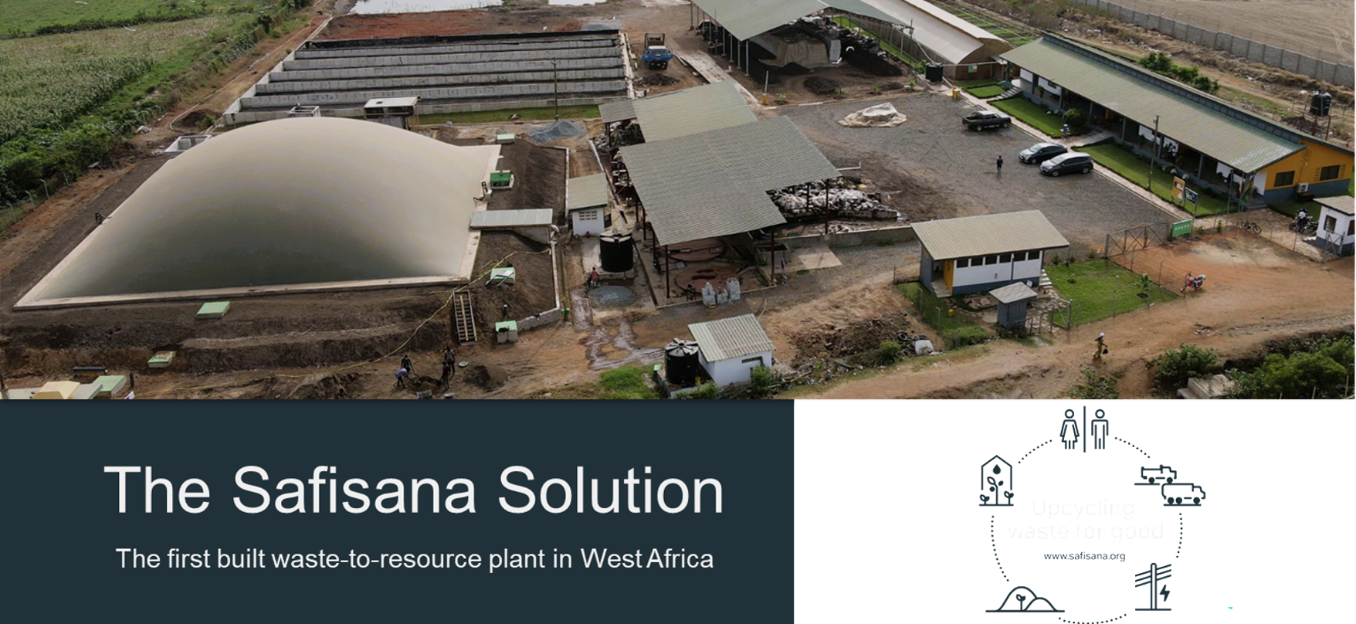
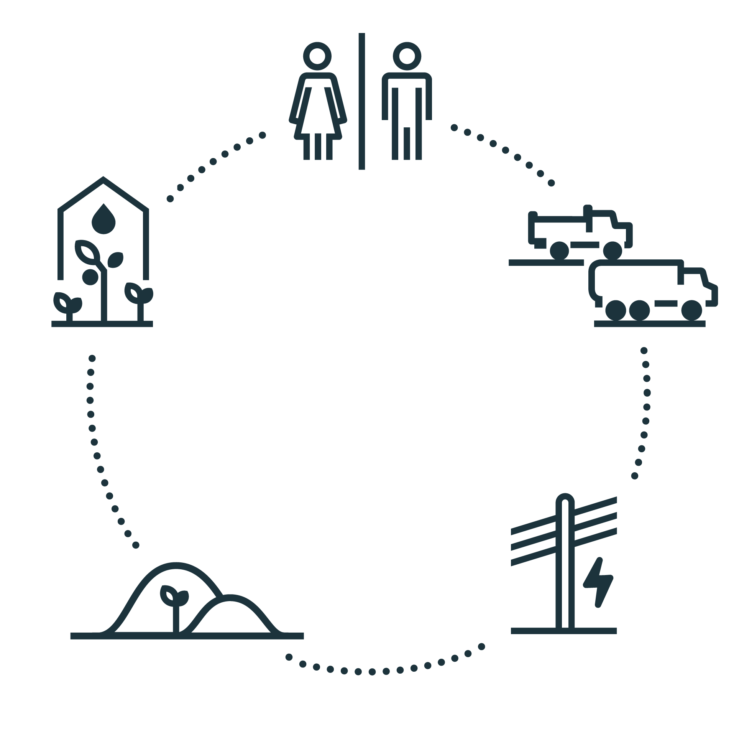
Safisana, Ghana
Marlene Nelisse

Slide 11
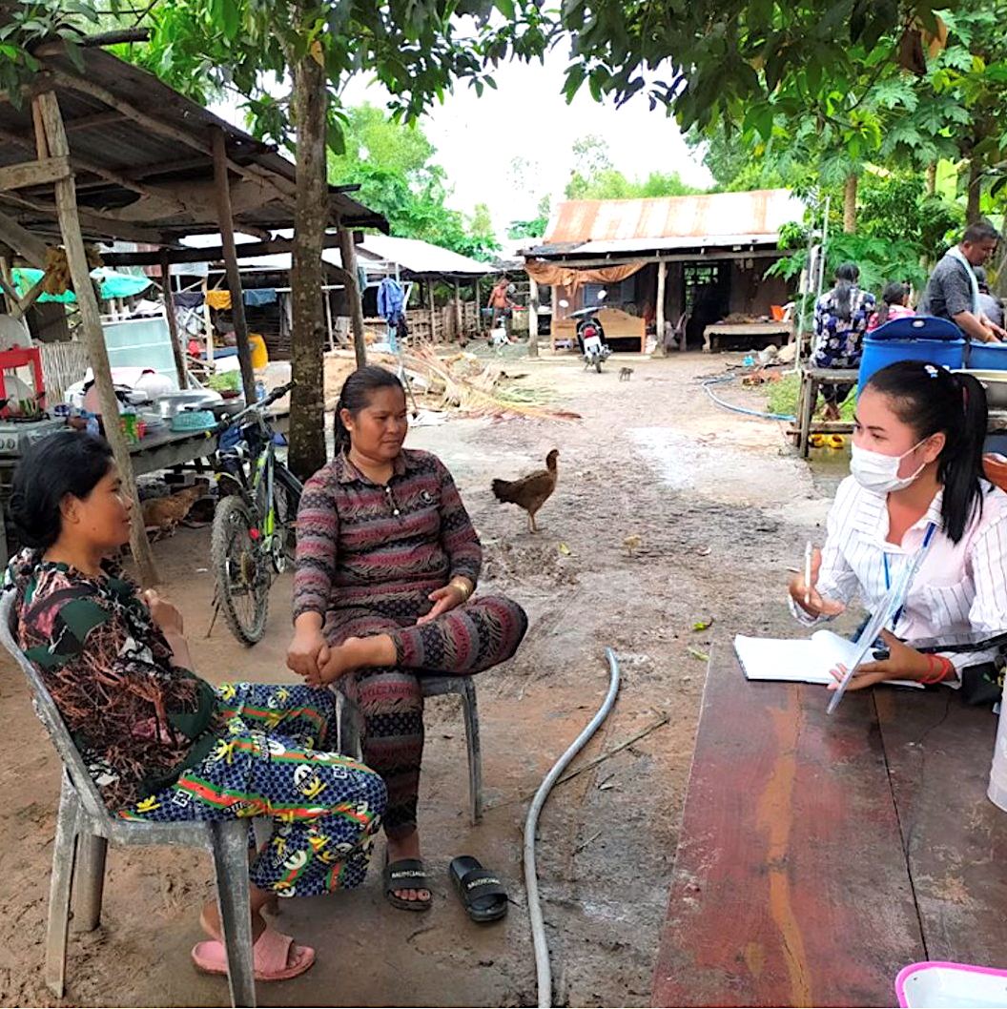
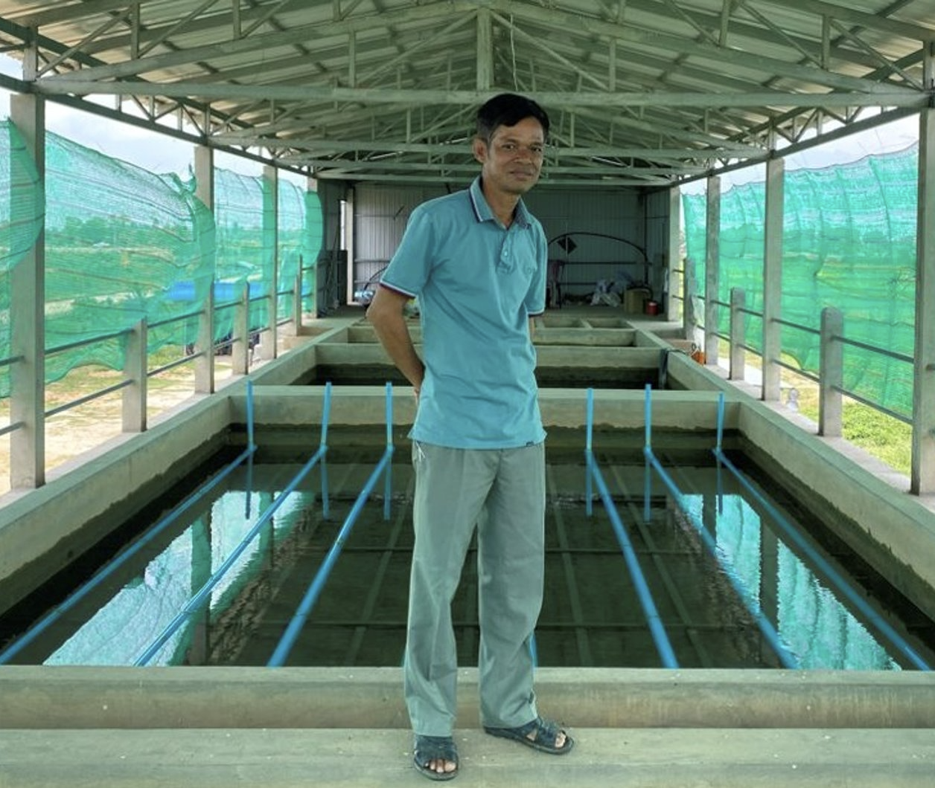
The Stone Family Foundation and iSEA, Cambodia
Kathryn Pentecost

Slide 12
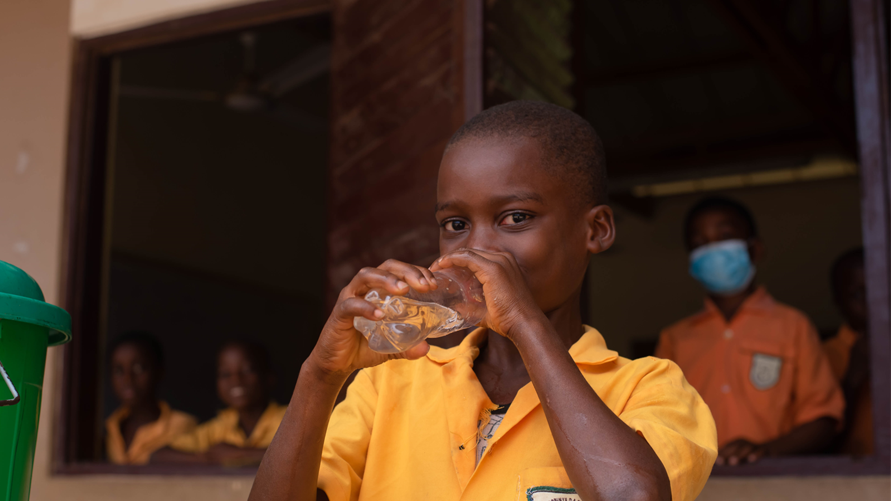
Safe Water Network

Slide 13
Breakout Groups - pick two for 20 minutes
Group 1: iDE, Ethiopia - Sarah Custer Lalanne
Group 2: Max Tapwater, Bangladesh - Joke Le Poole
Group 3: Safisana, Ghana - Marleen Nelisse
Group 4: The Stone Family Foundation, Cambodia - Kat Pentecost
Group 5: Safe Water Network, Ghana - Lauren Cuscuna

Slide 14
Resources and more info
iDE Ethiopia
https://www.ideglobal.org/country/Ethiopia
Max Foundation
https://maxtapwater.com/
Safisana
https://safisana.org/
Stone Family Foundation
https://www.thesff.com/
iSEA Cambodia
http://iseacambodia.com/
Safe Water Network
https://safewaternetwork.org/knowledge-hub/what-the-customer-thinks/
WRP Social Impact
https://www.wrpsocialimpact.com/

Slide 15


