Slide 1


Slide 2



Pilot to Scale: Designing and implementing integrated behavior change programs to scale
Through public and private sector approaches based on behavioral science

Slide 3
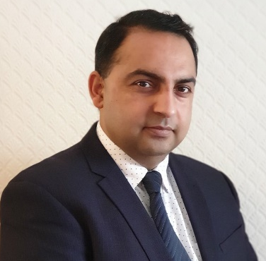



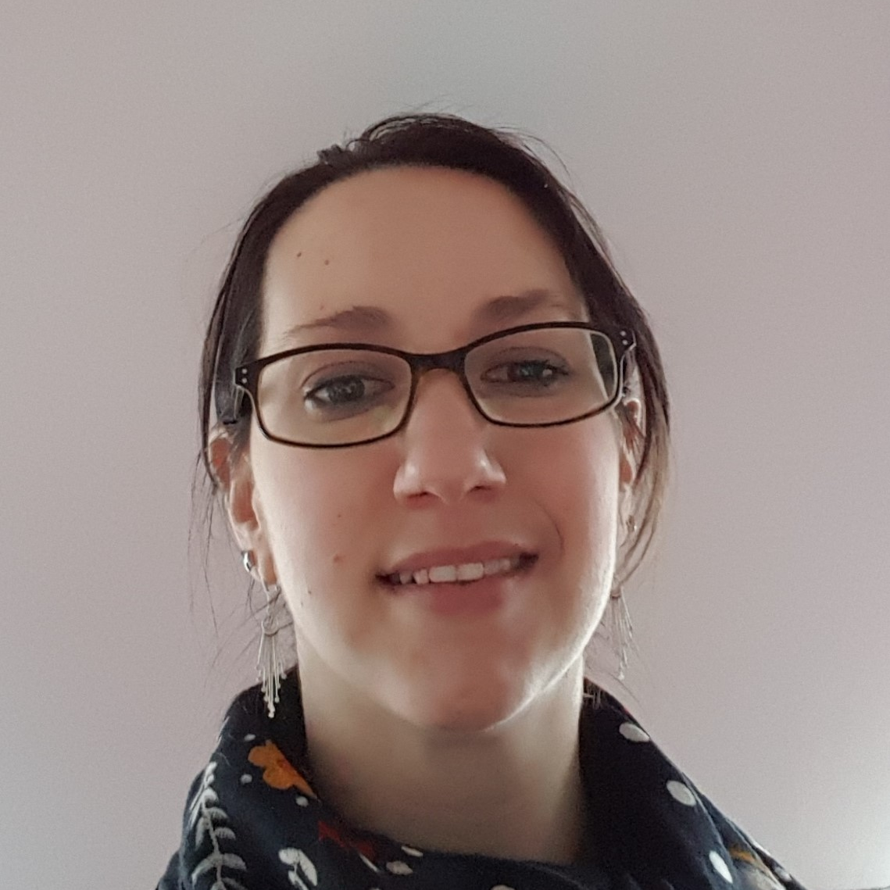
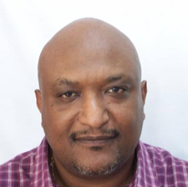
Presenters
Moderator
Dr. Om Prasad Gautam
WaterAid UK
Ms. Sidney Shea
World Vision U.S.
Ms. Cynthia Fosuah
World Vision Ghana
Dr. Ben Tidwell
World Vision U.S.
Ms. Esther Shaylor
UNICEF
Mr. Robel Wamisho
World Vision Ghana
Notes:
Leave up while people enter the room.
Om will introduce Ben: Ben Tidwell is a Senior Technical Advisor for World Vision US who focuses on sanitation and hygiene, behavior change, and implementation research.

Slide 4
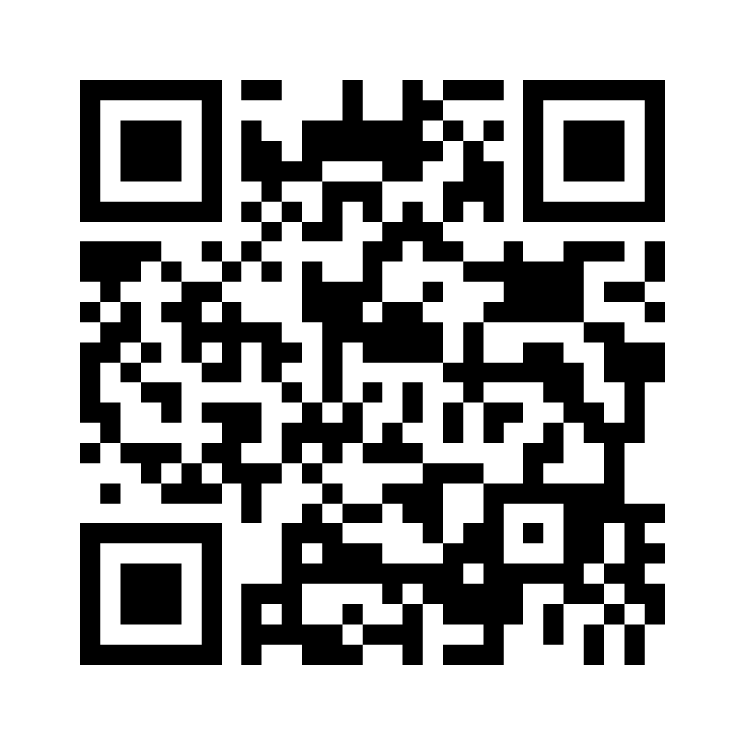
Mentimeter
Code: 1260 6246
Notes:
Note that this Mentimeter will be available throughout the session and people can upload questions as they have them, and direct them towards specific people or all speakers

Slide 5
Sidney Shea, World Vision U.S.
In her role as a WASH Fellow, Sidney supports the global WASH portfolio through a variety of programming lenses, including gender equality and social inclusion, market-based sanitation and hygiene, and behavior change capacity building. She has most recently been supporting the development, roll-out, and assessment of World Vision’s WASH behavior-change toolkit.
Notes:
I believe you will want to replicate this training to your colleagues and else where: Our roles as facilitators is to help in modeling Learner-centered education uses interactive strategies to engage the students and develop their abilities. This educational approach helps students develop skills such as decision making and problem solving, team work, and presentation skills that are relevant to the current labor needs.

Slide 6
World Vision’s RapidBCD Toolkit
Essential tools for effective, contextualized behavior change at scale

Slide 7
Background
Lots of behavior change research
Hard to apply
Time consuming and costly
Burdensome on field staff
Unclear how to adapt across contexts
Need for behavior change tools that can apply to a wide set of behaviors, can be contextualized, and are scalable
Notes:
Add in some detail about purpose (formative research, implementation design, etc.)

Slide 8


World Vision’s RapidBCD Toolkit
Behavior Change Implementation Guidance
RapidBCD (behavior centered design) tool
Four behavior specific guides
  Breakdown of behavior
  Interventions mapped to RapidBCD tool
Formative research flowchart
RapidBCD Toolkit
Behavior Change Implementation Guidance
RapidBCD (behavior centered design) tool
Four behavior specific guides
Formative research flowchart

Slide 9
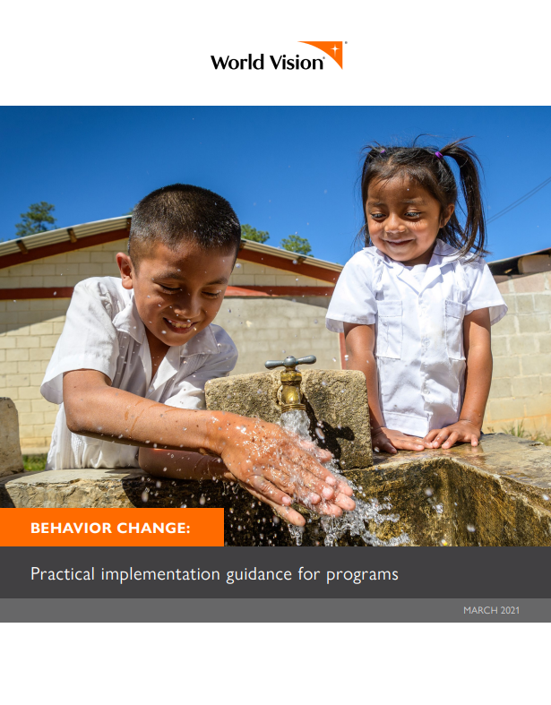
Handwashing with soap and running/ flowing water at critical times
Safe construction and proper/hygienic use
of toilets
Safe disposal of infant/child feces in a toilet (linked with toilet use)
Separation of children from soil and animal feces
Households that treat, handle, and store their drinking water with appropriate methods
Safe use and disposal (or cleaning if reusable) of menstrual hygiene materials
Food hygiene (including eating utensils and
eating area)
Paying for water use

Slide 10
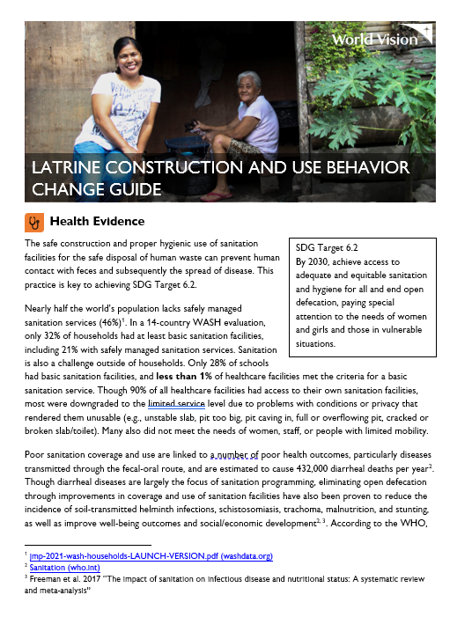
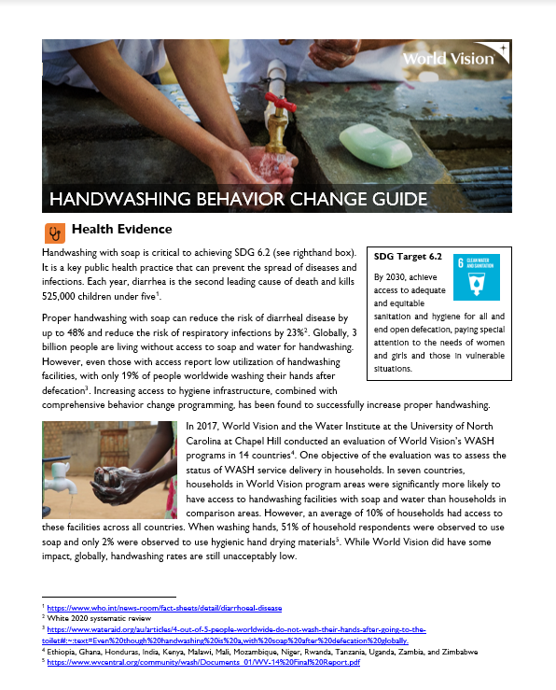
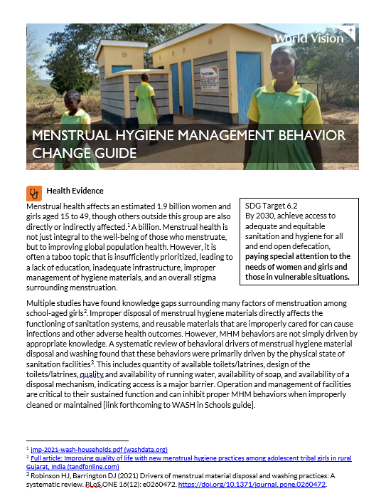
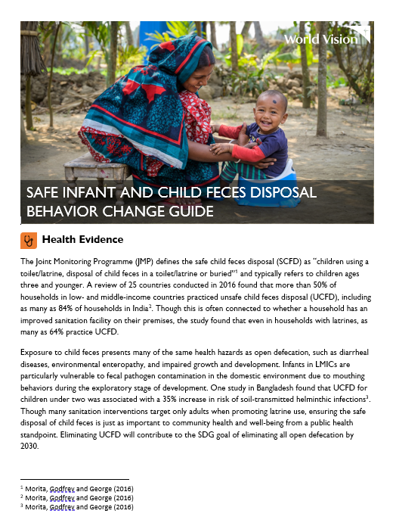

Slide 11
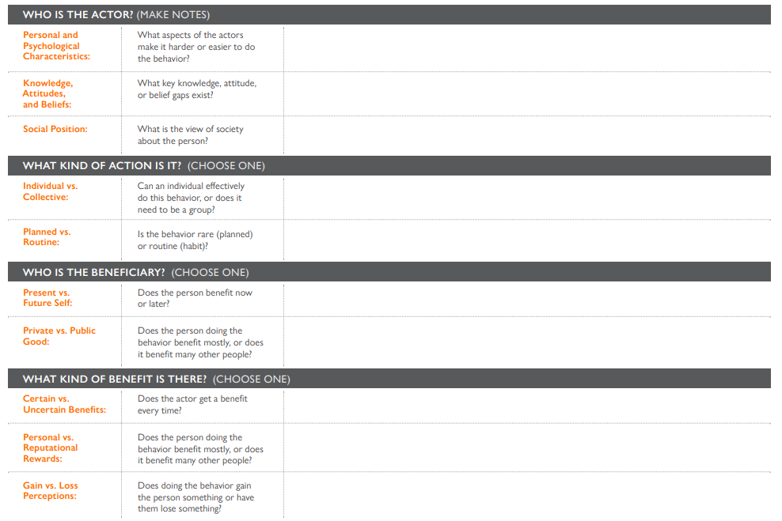

Slide 12
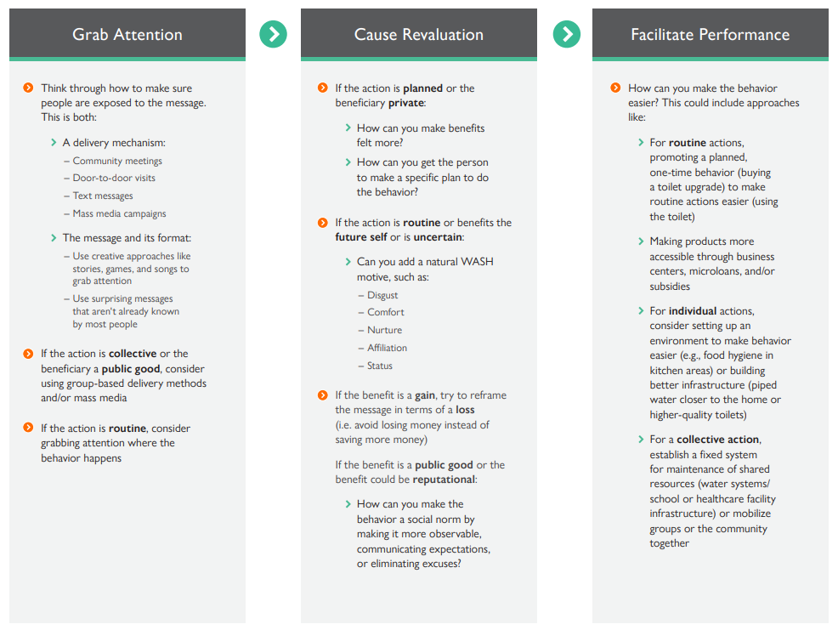

Slide 13
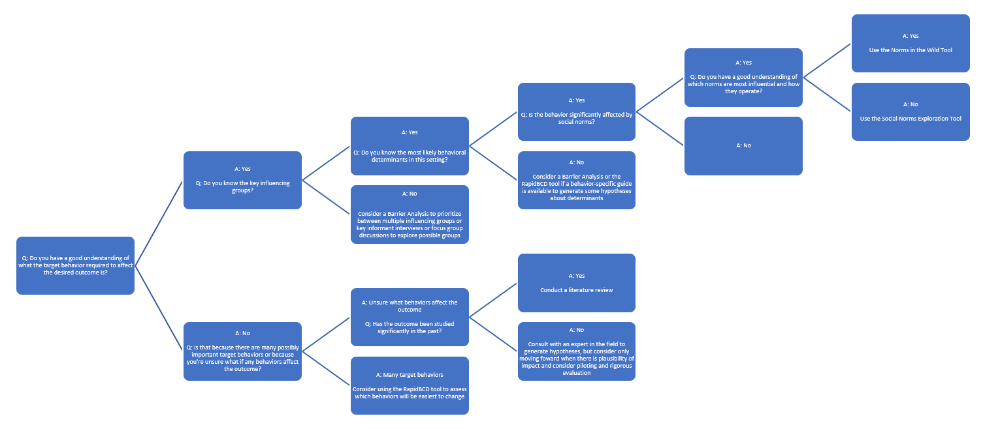
Do you have a good understanding of the target behavior?

Slide 14
Methods
Piloted these tools in an interactive 2-hour workshop format
Targeted national office/field office staff
Walked through practical examples
Analyzed 11 completed RapidBCD tools
Conducted qualitative interviews to understand benefits and challenges of workshops/toolkit

Slide 15
Summary of findings
What went well
Different behaviors were well understood/adapted
Tailored to context
Teams had creative ideas, especially for “grab attention”
2-hour workshops were manageable
Worked well with variety of staff background/experience
What needed improvement
More specificity in behaviors (time and location)
More specificity in target population (e.g., no “households”)
Alignment of interventions and target population
Clarity in what kind of formative research to choose

Slide 16
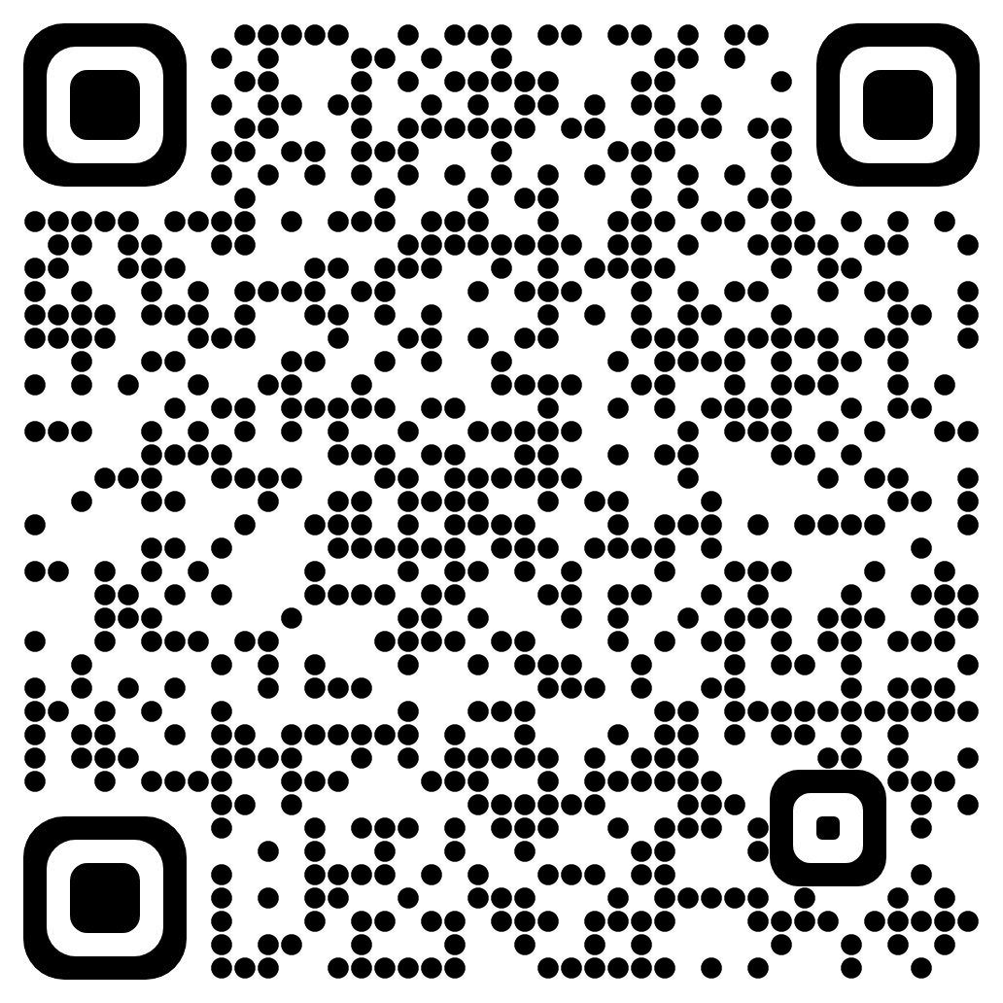
Conclusions/Next Steps
Continue follow-up with offices implementing behavior change, refine existing guides
Expand to more countries
Finish evidence summaries for last four behaviors
Make the evidence summaries public and translate
Finalize formative research tool
Behaviour Change Practical
Implementation Guide

Slide 17
Cynthia Fosuah, World Vision Ghana
Cynthia heads the WASH software and Behavior Change Unit in World Vision Ghana, West Africa, where she led the Nurturing Care Group pilot in 2020. She is an expert in community mobilization, behaviour change, and intervention development. She has 10 years of experience in WASH program design with backgrounds in Environmental Security, Public Health, and Global Health.
Notes:
I believe you will want to replicate this training to your colleagues and else where: Our roles as facilitators is to help in modeling Learner-centered education uses interactive strategies to engage the students and develop their abilities. This educational approach helps students develop skills such as decision making and problem solving, team work, and presentation skills that are relevant to the current labor needs.

Slide 18
Nurturing Care Groups; a vehicle for delivering transformative WASH behaviours at scale

Slide 19
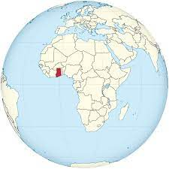
Behaviour change outlook in Ghana
CLTS is an institutional model for rural sanitation programming
in Ghana
Behaviour change maintenance is still a challenge
17.7% of Ghanaians still practice open defecation (GSS 2021 ) largely due to poor sanitation infrastructure quality and entrenched social norms

Slide 20
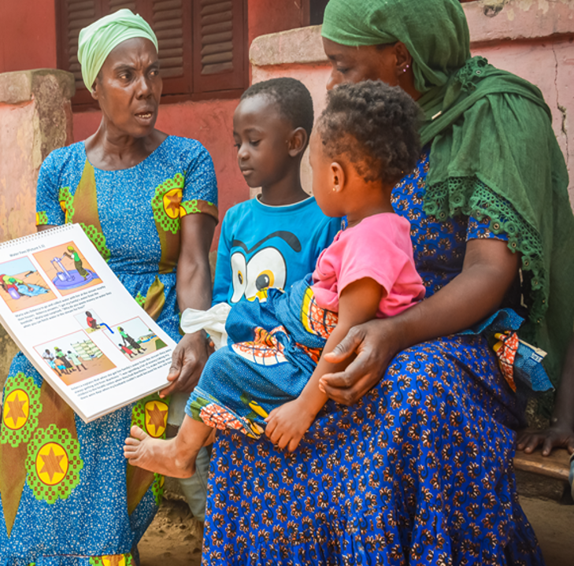
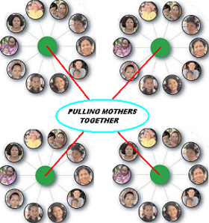

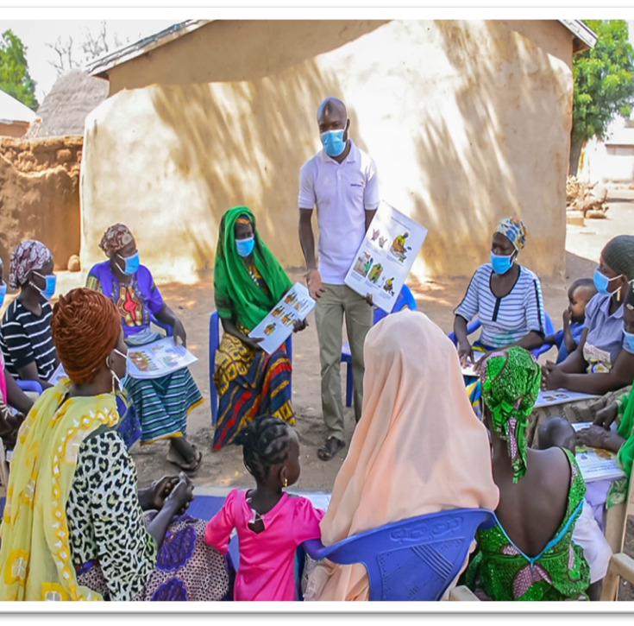
The Nurturing Care group Model
Use interpersonal and group communication with a structured teaching aid
Use a multisectoral approach driven by a team of volunteers
Build on behavioural science theory
Have massive coverage and are
cost effective

Slide 21
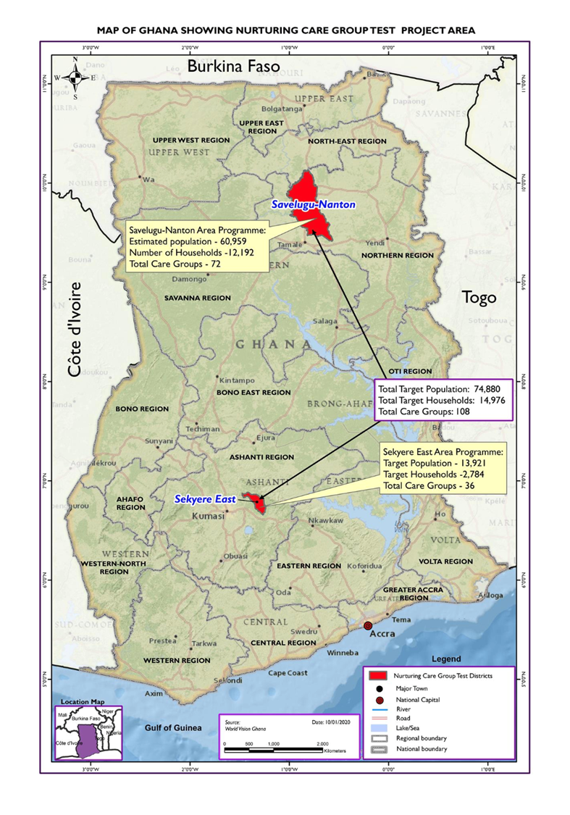
Methods
2 study sites
Savelugu
Sekyere East
Intervention vs. Control study
Study participants: Mothers/Caregivers of children U5
Cluster Sampling
Sample size
Intervention: 324
Control: 430
Linear regression & Difference in Differences
Descriptive statistics
Notes:
1 minute 30 seconds
Thank you Cynthia. I will share more on the methods and results of the study. Per the study design,
Study locations were Savelugu and Sekyere East districts. These districts were purposely selected and intended to generate context-specific learnings due to the diversity in cultural norms in these 2 areas. NCG was implemented in some parts of the districts, that is WVG programme areas. The remaining areas within the same districts were treated as the control area
Controlled Before and After Trial method was used to limit bias in assessing program impact
Cluster sampling was used to select 324 respondents in the intervention area and 430 respondents in control areas. This design was adopted to minimize contamination confounding and other potential biases.
Objective measures, observations, and standardized indices were used to maximize objectivity
Also simple difference in differences used to assess large-scale changes over the duration of the program

Slide 22
Results: water quality, basic sanitation services and hygiene
9 % change
1.7 % change
2% change
24 % change
15.5 % change
Notes:
1 minutes
Due to the consistent engagement of households on selected WASH behaviours over the project period, the following improvements in WASH were observed;
Efforts under the project in reinforcing water quality protocols at the point of use saw an increase in households with no detectable microbial contamination (Ecoli) by 24 % (67.9% to 92% ) in the intervention area whiles a marginal increase of 2% (71% to 72.8%) was experienced in the control area.
An increase in access to basic sanitation by 15.5% was recorded within the intervention area compared to 9% net change in the control area

Slide 23
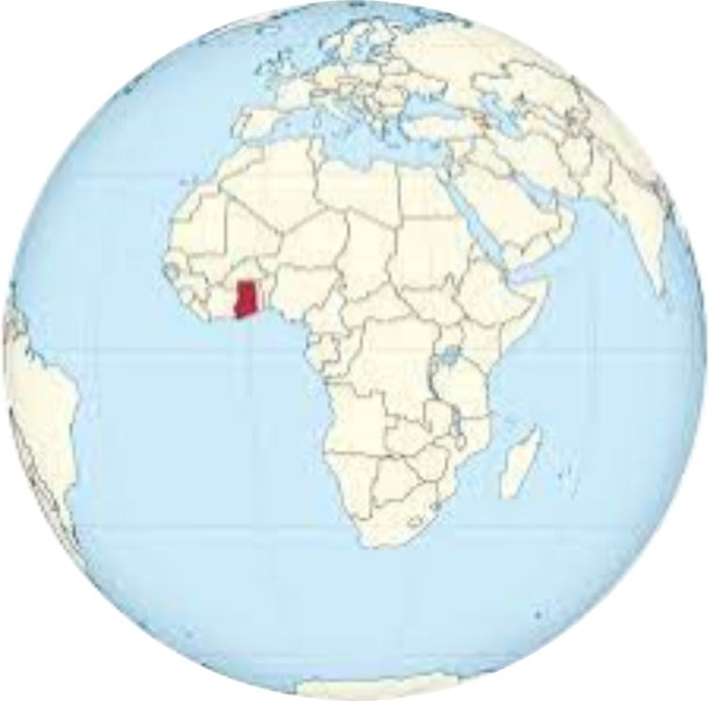
Delivering @ scale
Pathways
Institutional capacity face-to-face and online
Modifying staffing structure to upscale
Integrating data into community health surveillance system
Linking volunteers to the health system in
the community
Engaging the national levels structures for national uptake
Scale-up includes 365 groups (3,650 participants) in 73 communities across 8 districts
New Entry
Kadjebi
Fantiakwa
Zabzugu
Krachi West
Agortime
East Gonja
Afram Plains
West Gonja
Wa West
Notes:
Highlight some numbers

Slide 24
Conclusion
NCG has the ability to improve HH water quality by 24%, access to basic sanitation by 15% and basic handwashing by over 50% within a year!
All this for a cost per beneficiary of $2-$4 while other approaches average at a CPB of at least $9
This makes NCG the model a good tool for WASH behaviour change and can also be used in other sectors (e.g., CP, health, etc.)
It is absolutely essential for WASH implementers to adopt the model as a vehicle for behaviour change and sustained access to safe WASH services. This is critical for efforts towards attaining the SDG6

Slide 25
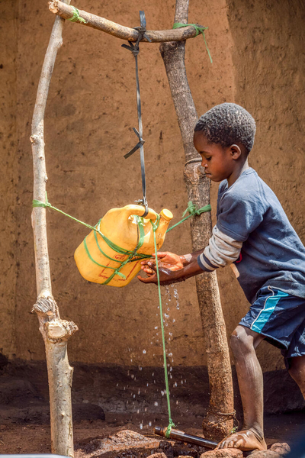
NCG Resources
Access NCG programming guidance and tools by visiting:
The Health & Nutrition project models page in WVCentral, or
This link: https://www.wvcentral.org/community/health/Pages/Care-Groups-and-Nurturing-Care-Groups.aspx

Slide 26
Dr Om Prasad Gautam, PhD, MPA, MA
Public Health Expert and Behaviour Change Scientist
Senior WASH Manager – Hygiene, WaterAid UK
Dr Om Prasad Gautam is a Public Health Expert and Behaviour Change Scientist. He works at WaterAid UK as a ‘Senior WASH Manager – Hygiene’. He leads WaterAid’s global work on Hygiene Behaviour Change and supports countries across Asia and Africa. He holds a PhD from LSHTM-UK, MPH from JPGSPH-Bangladesh and MA from TU. Dr Om is passionate about the role that sustainable behaviour change programme play through WASH and health programme in human development.

Slide 27
Journey from Pilot to National Scale
Hygiene integration into national scale core public health (Routine Immunization) programmes

Slide 28
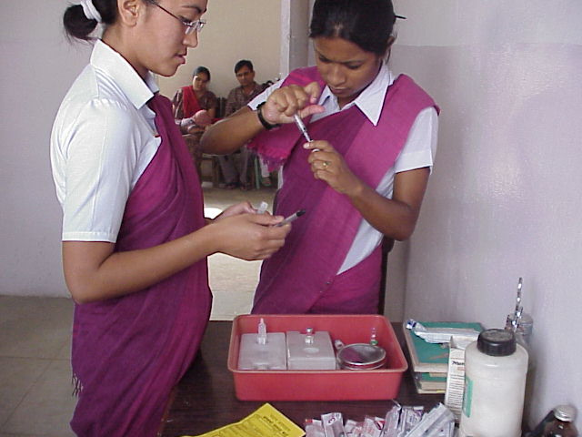
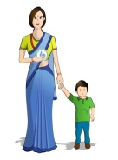
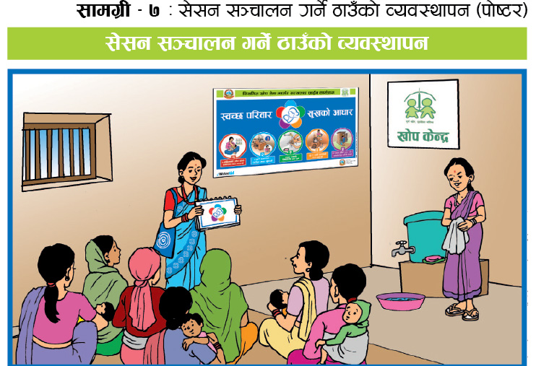
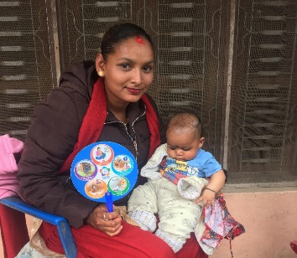
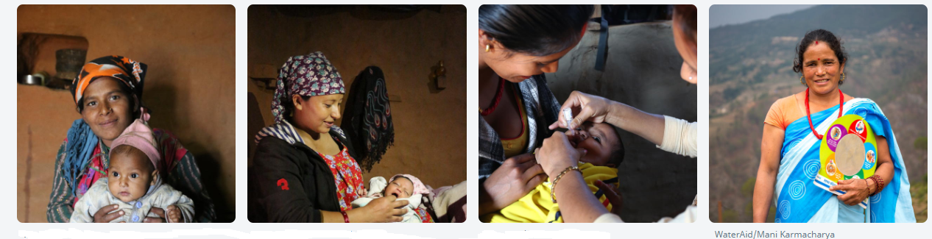
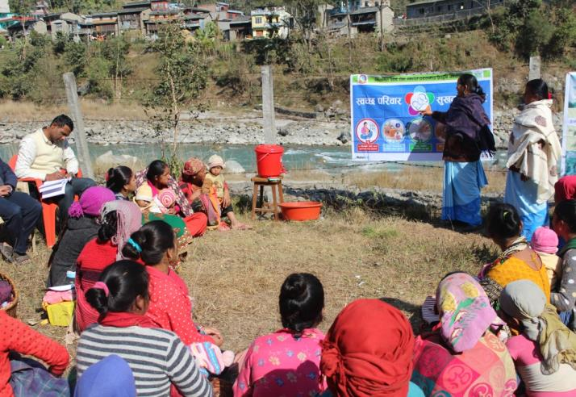
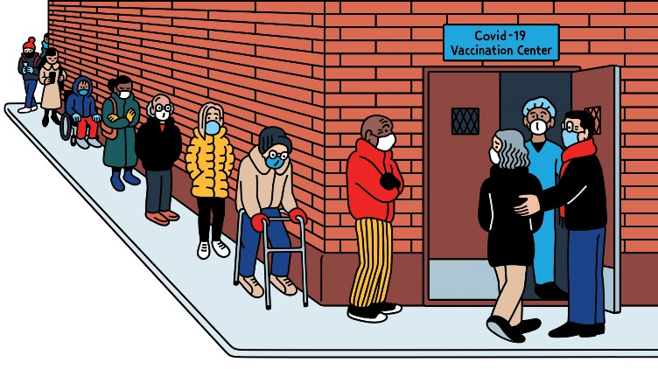
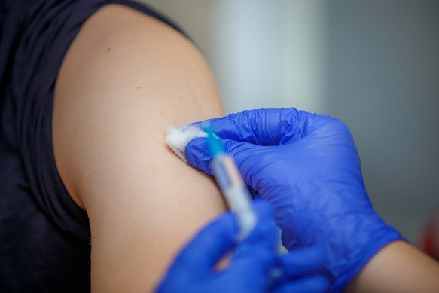
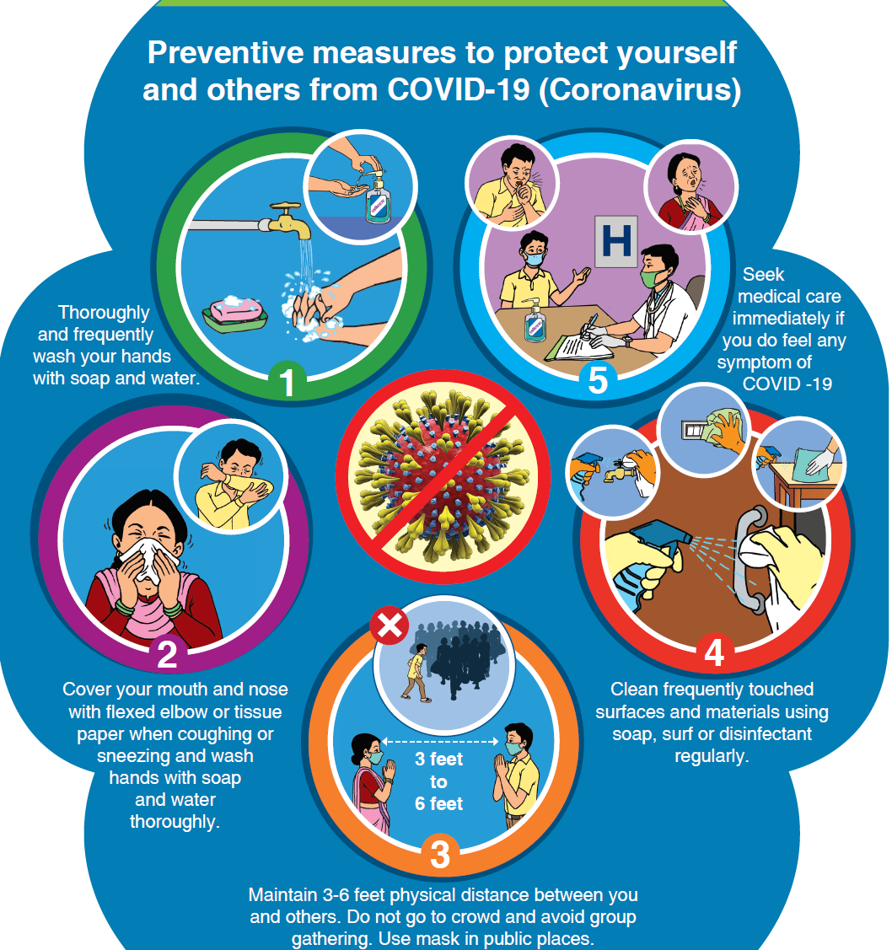
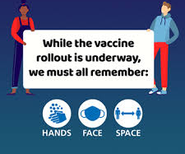
What do we mean by hygiene integration? In this context
Routine Immunization: 5 to 7 times
Hygiene session (30-45min) each time they visit vaccination clinic
Routine Immunization
BCG
DPT+OPV+Hib1
DPT+OPV+Hib2
DPT+OPV+Hib3
Mother/guardian with children
DPT+OPV+Hib3
MMR+PCV3
JE
Mass Immunization
COVID19 Vaccination: 2 times +
Hygiene exposure before-during vaccination
Dose 1
Dose 2

Slide 29
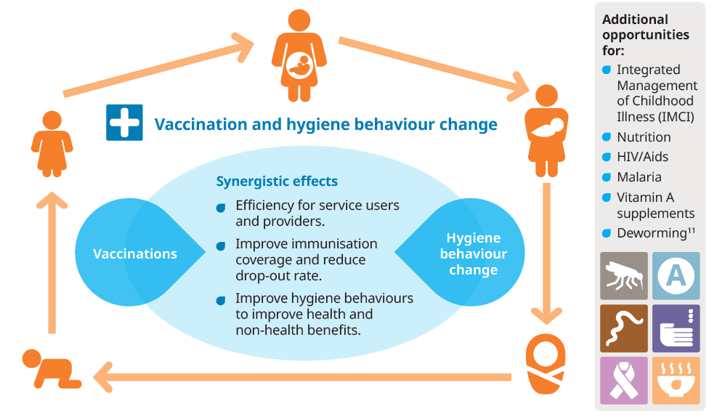
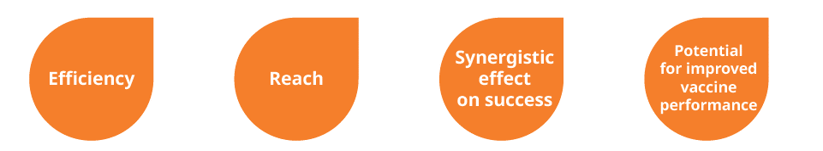
Why hygiene integration into routine and supplementary campaigns
Hygiene integration through immunization
Local: context specific implementation
National: cross-ministerial planning and resourcing
Global: joint advocacy for integrated programming

Slide 30
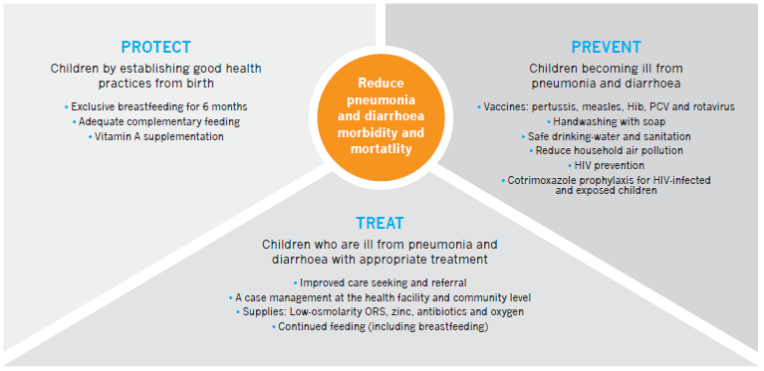
Why hygiene integration into routine and supplementary campaigns
Hygiene integration rationale
Global push for adopting new vaccine such as Rotavirus
Vaccine might seen as silver bullet for disease prevention
Vaccine efficacy (not all vaccines
are 100% efficacious)
Preventive hygiene behaviours are essential before, during and after vaccination to prevent and
respond diseases
WHO recommends more holistic approach to prevent diarrhoea
Few countries recommends: “Vaccine introduction for enteric vaccines (RV, typhoid, cholera) should be one component of an integral child health programme to decrease morbidity and mortality from diarrhoeal disease, including safe water, hygiene, sanitation, nutrition and IMCI”.

Slide 31
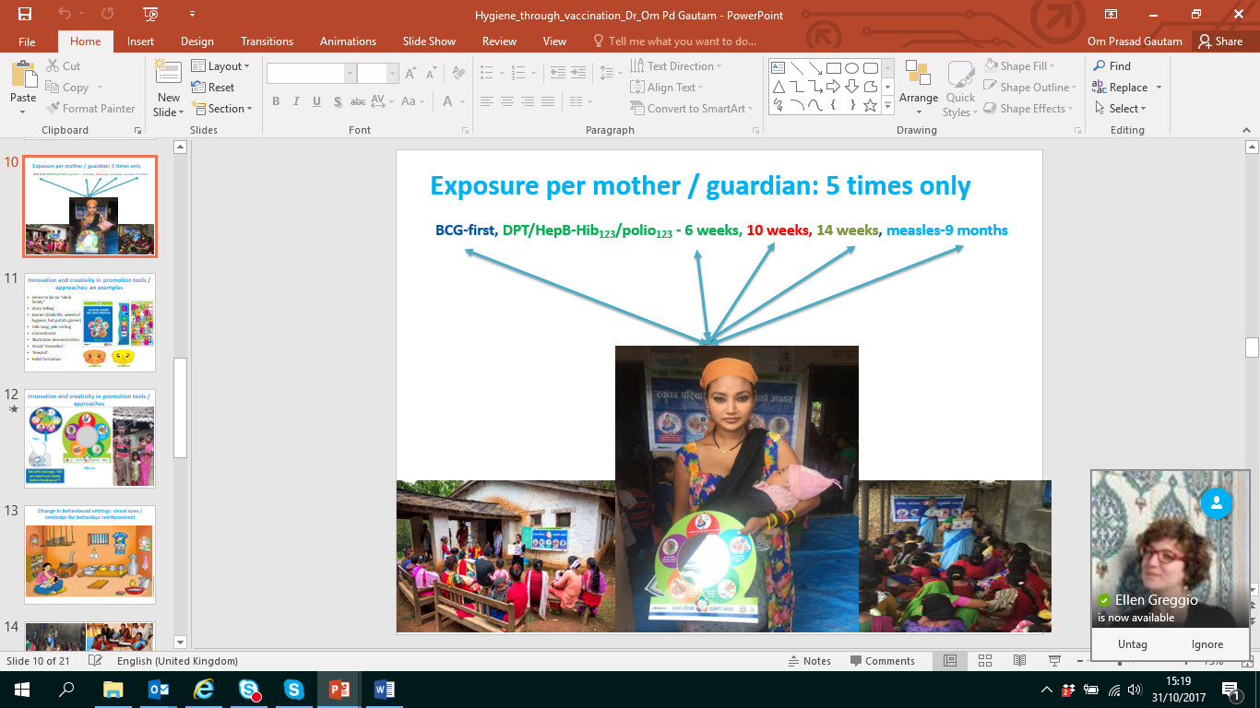
Hygiene integration through immunization: Pilot to Scale
Key questions to answer?
Is effective in changing behaviours?
Benefits to immunisation programme?
Is cost effective and feasible for scale-up?
Enhances the capacity of Health Workers?
Is nationwide integration feasible in reality?

Slide 32
A successful case study from Nepal
(2013 – 2023)
Aim: with the view to nationwide scale-up, the promotion of good hygiene practices through the routine immunization (vaccination) programme in four districts of Nepal as pilot. Successful pilot leding to nationwide integration (77 districts).
Approach: Behaviour Centred Design (BCD) Approach – 5 steps ABCDE process
Time: 2013-2023 (10 years of story)
Targets: 4 districts (pilot) and nationwide (scale-up – 77 districts).
=
BCD
=
A
B
C
D
E

Slide 33
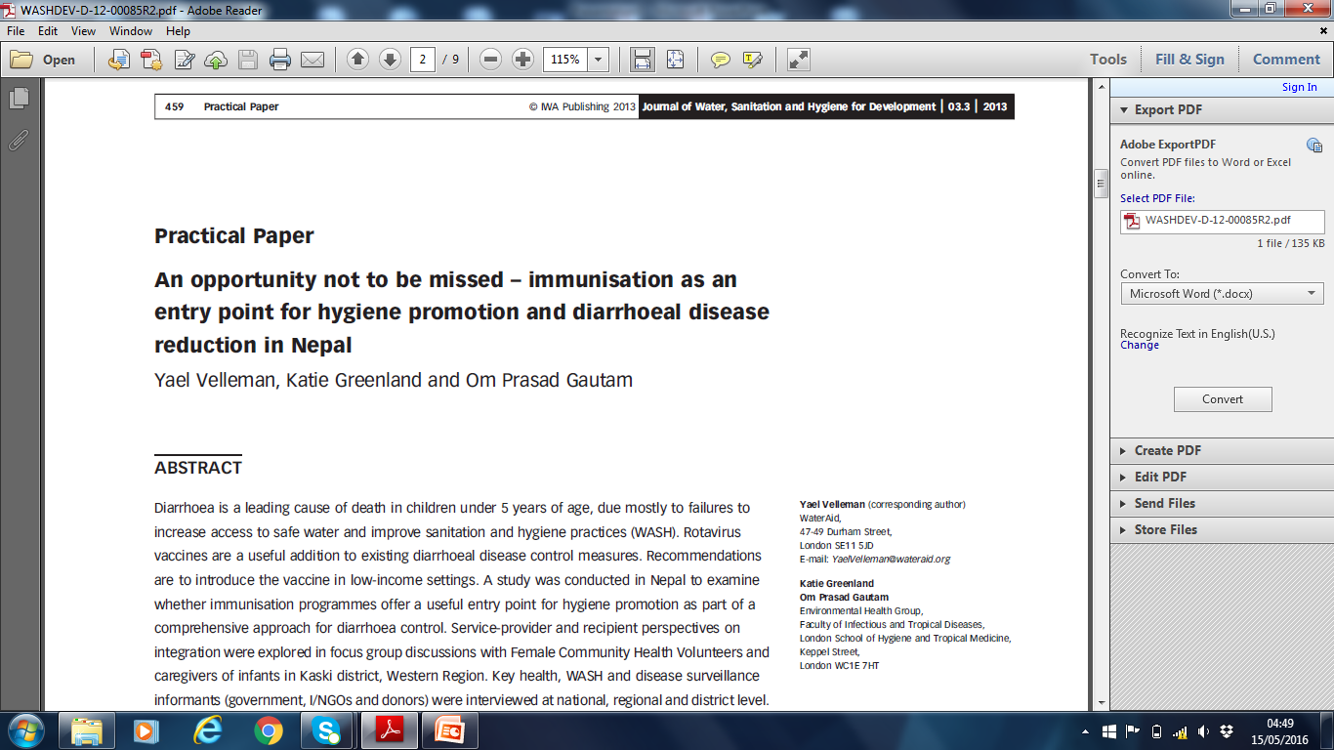
Pathways for hygiene integration into immunization – pilot to scale
A
2012/2013 Scoping Study
Results: Sufficient interest for piloting and developing an appropriate hygiene promotion intervention
  Pilot project conceptualised
  MoU signed between Ministry of Health (MoH) and WaterAid
  Project management structure: MoH lead with WaterAid

Slide 34

Pathways for hygiene integration into immunization – pilot to scale
B
2014 Formative Research
Assessed behavioural determinants, key motives, barriers and behavioural settings
Assessed routine immunization practices
Prioritised hygiene behaviours:
  Exclusive breastfeeding
  Food Hygiene
  Handwashing with soap
  HHs Water and milk treatment
  Hygienic use of toilet; child faeces disposal
  Vaccine uptake (routine immunization)

Slide 35

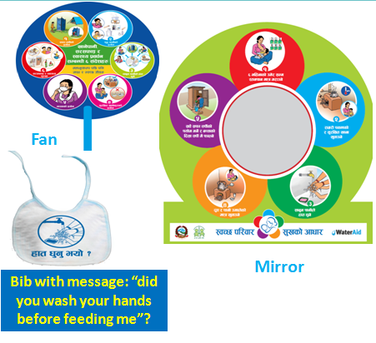
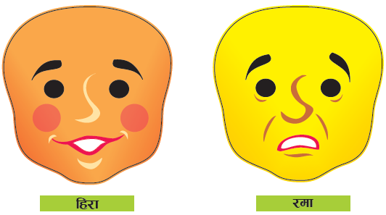
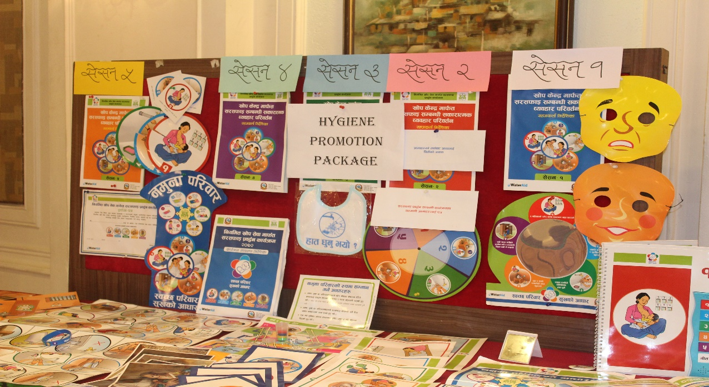
Pathways for hygiene integration into immunization – pilot to scale
Creative process to design Innovative and creative HBC package – 2015/2016
Creative process to design package
Campaign desire: to be an “ideal family” with a theme “clean family, happy family”.
Used emotional drivers (Disgust, Nurture, Affiliation & Status) and change settings
HBC Components: Innovative activities and tools: Games (Child life, wheel of hygiene, hot potato games), Story-telling, Folk song, pile sorting, Commitment, Illustration demonstration, Visual ‘reminders – nudge’, public ‘reward’ etc.
Delivery model: Implemented through Gov’s routine immunization system
Implementation Period - Pilot: One year targeting 35,000 mothers / guardians from 4 pilot districts.
Total exposure: 5 to 7 times within a year
C

Slide 36
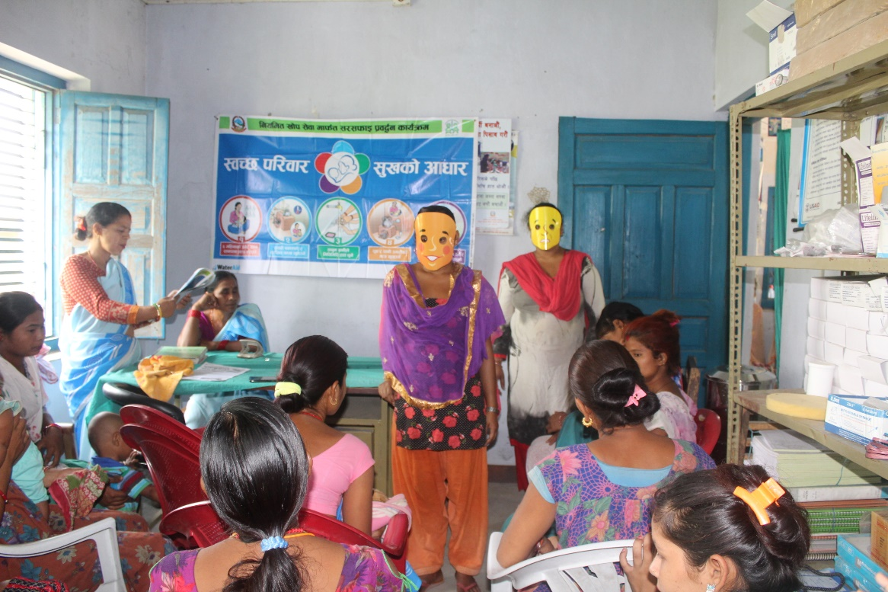
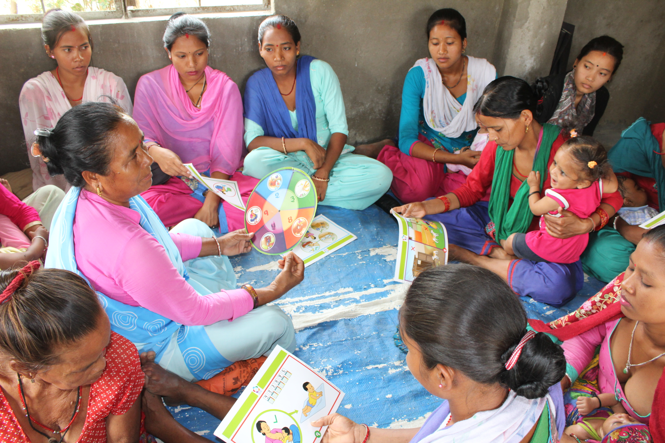
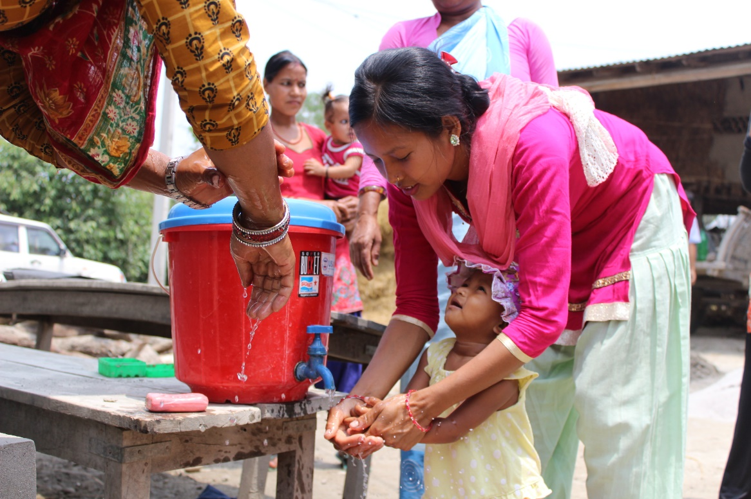
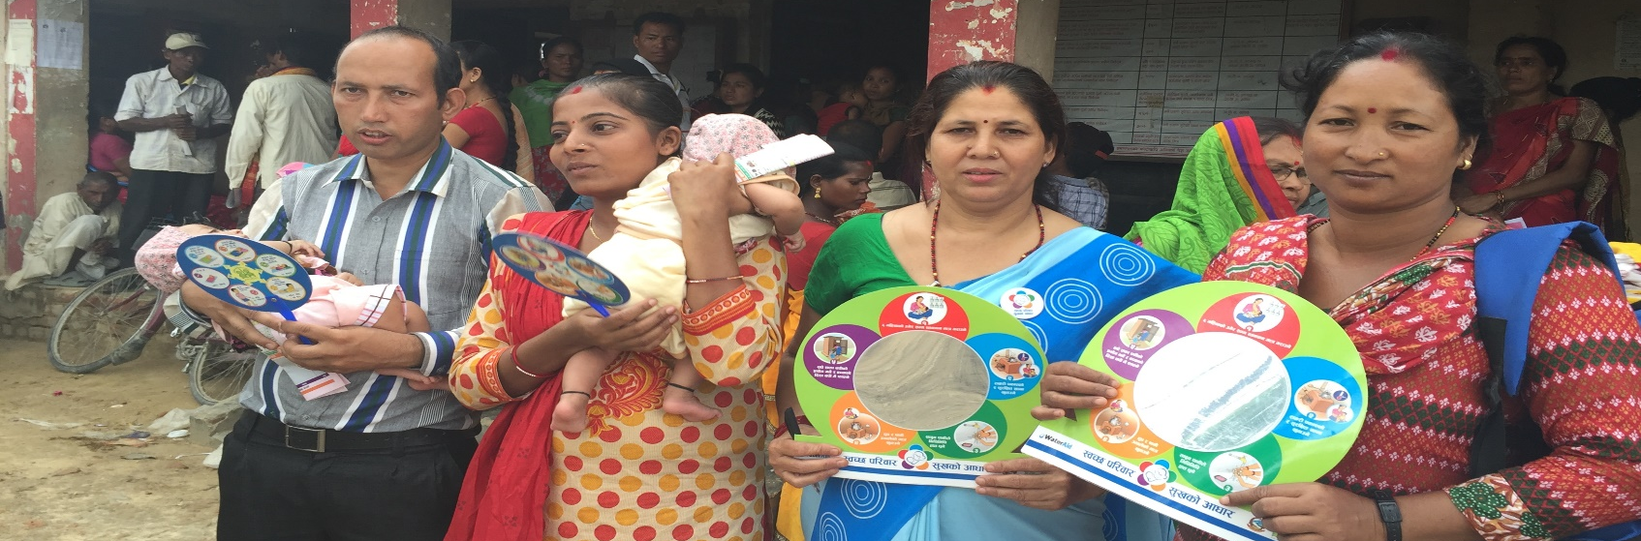
Hygiene integration into routine immunization – 5 to 7 exposure
D
30 to 45min session before vaccination

Slide 37
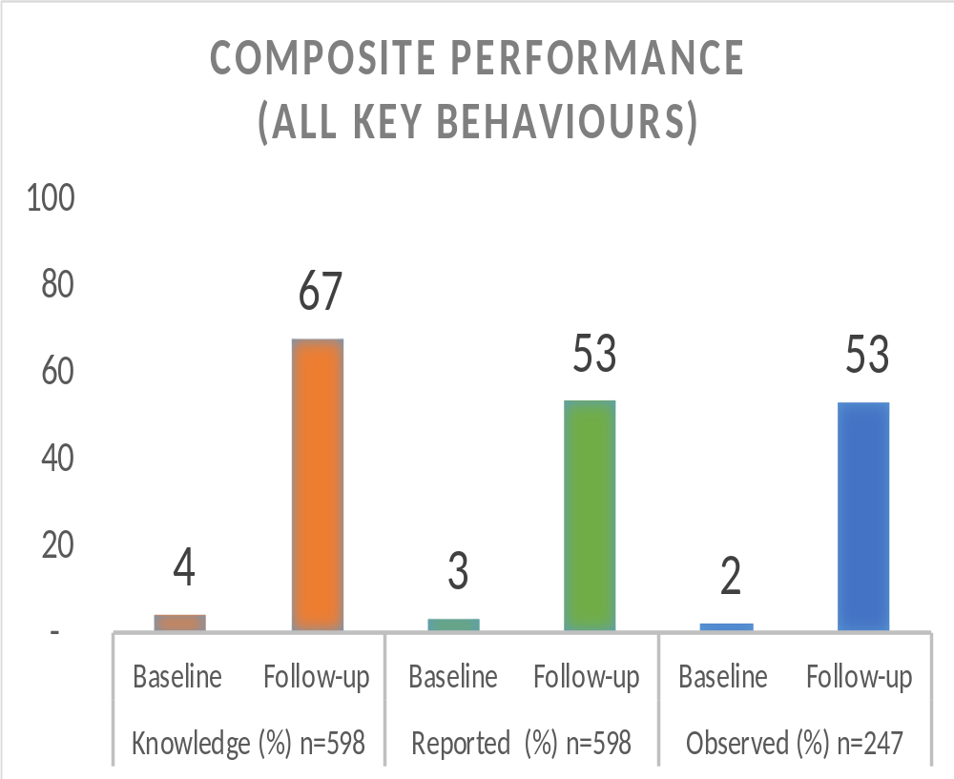
Is effective in changing behaviours and improving immunization?
E
All key hygiene behaviours improved – (primary outcomes)
Source: WaterAid/Gov - Baseline and Endline. Note: randomly selected mothers’ key hygiene behaviours were observed

Slide 38
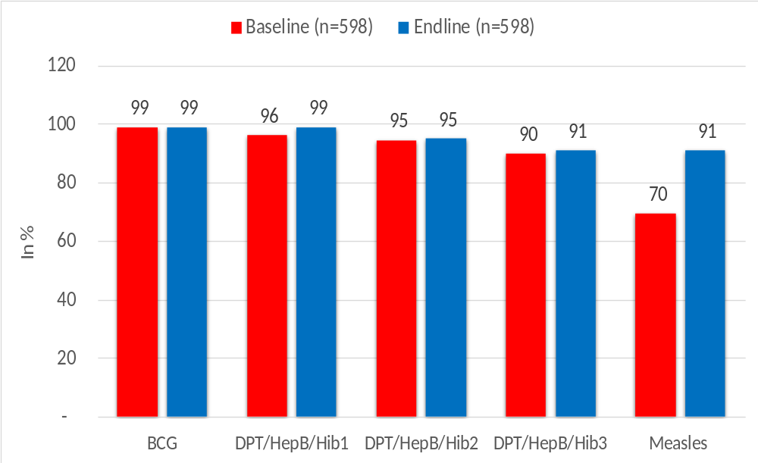
Is effective in changing behaviours and improving immunization?
E
Immunisation coverage increased and drop-out reduced (secondary outcomes)
Source: WaterAid/Gov - Baseline and Endline. Note: randomly selected mothers’ key hygiene behaviours were observed

Slide 39
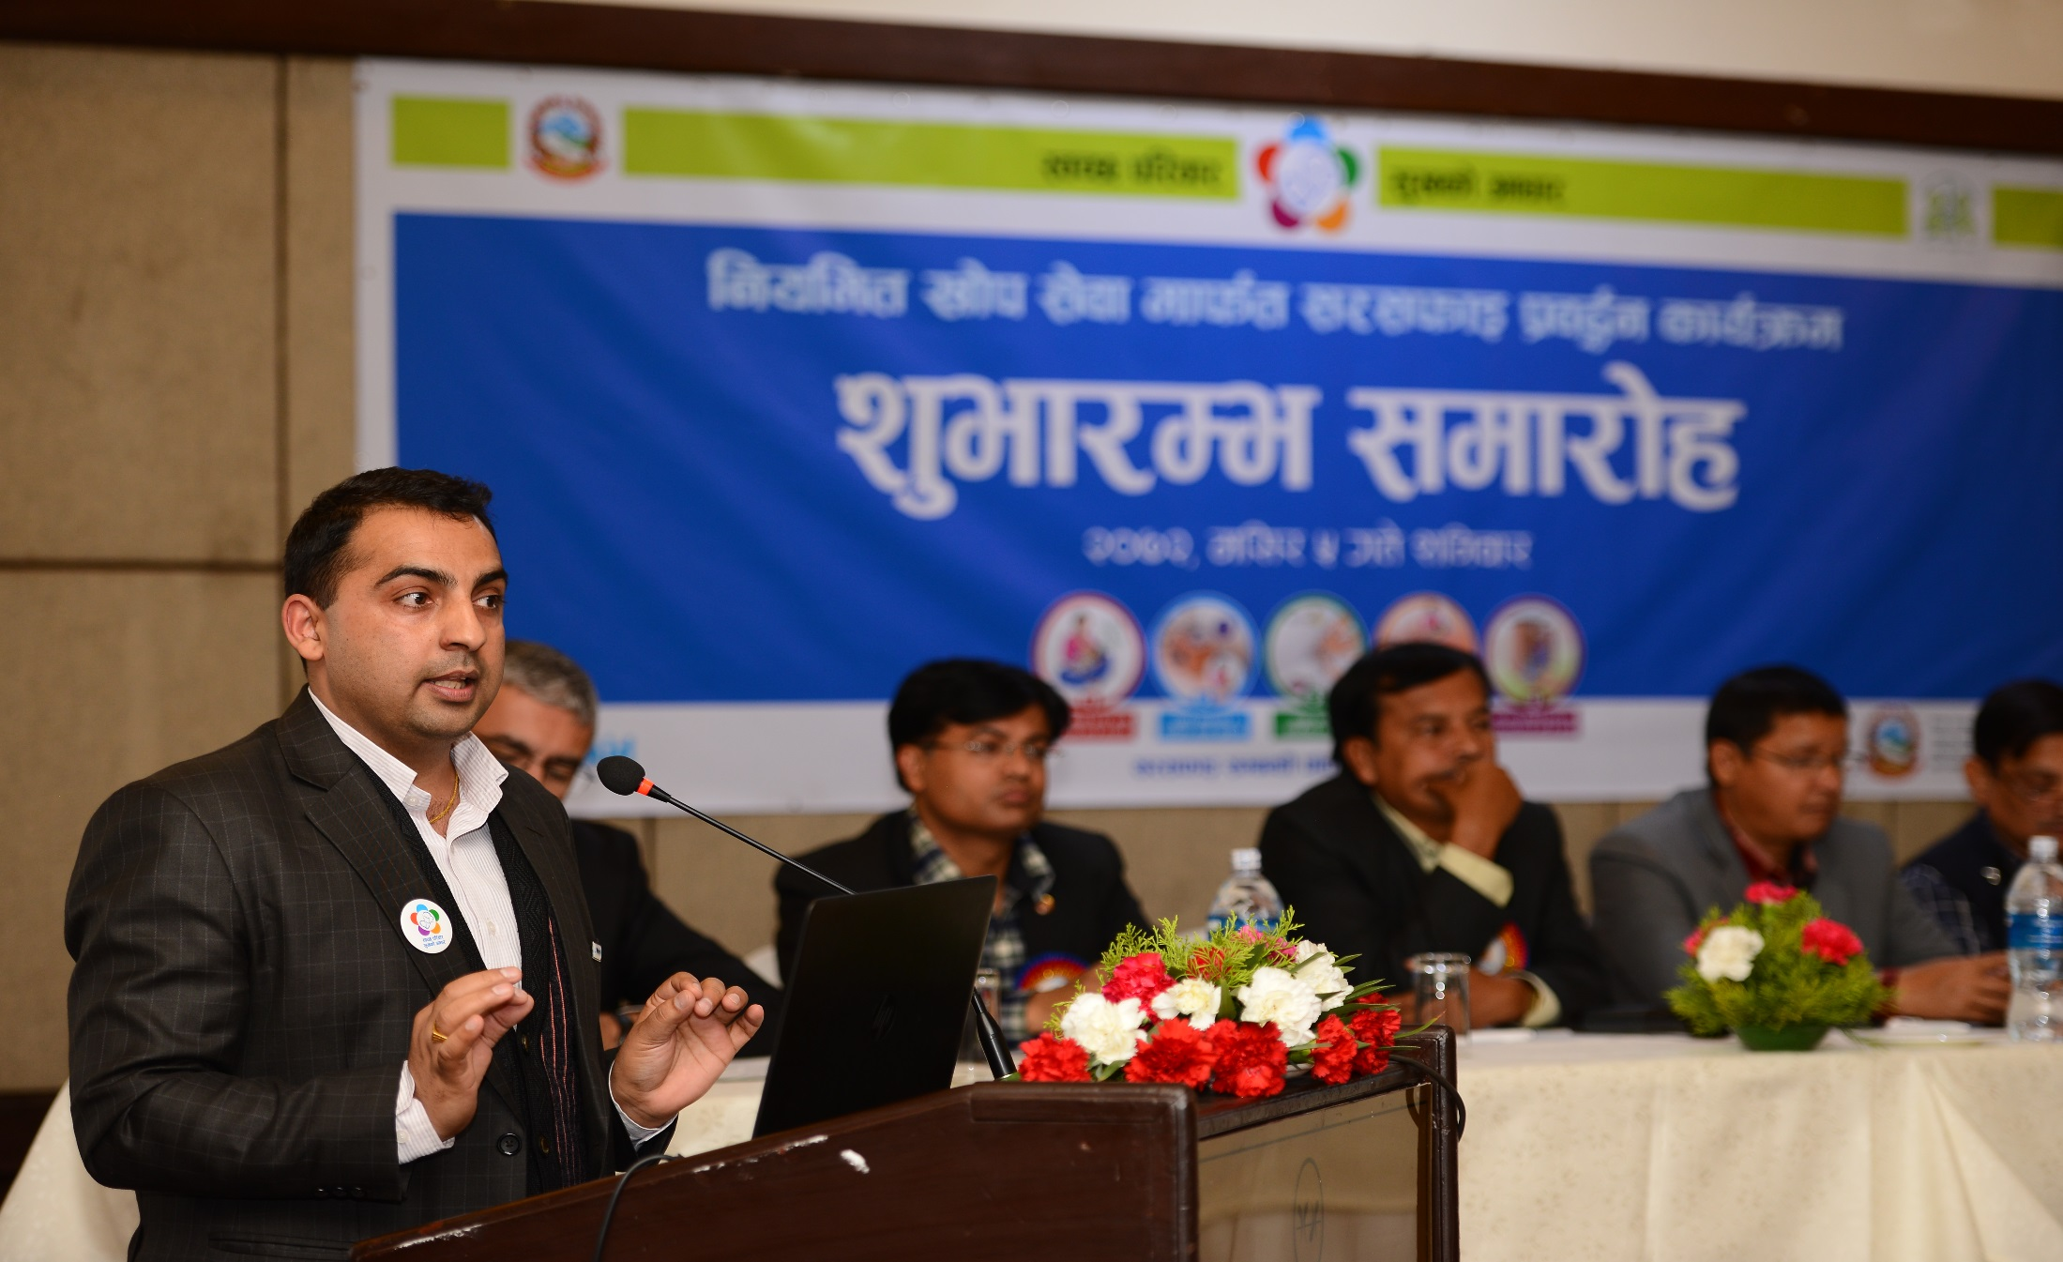
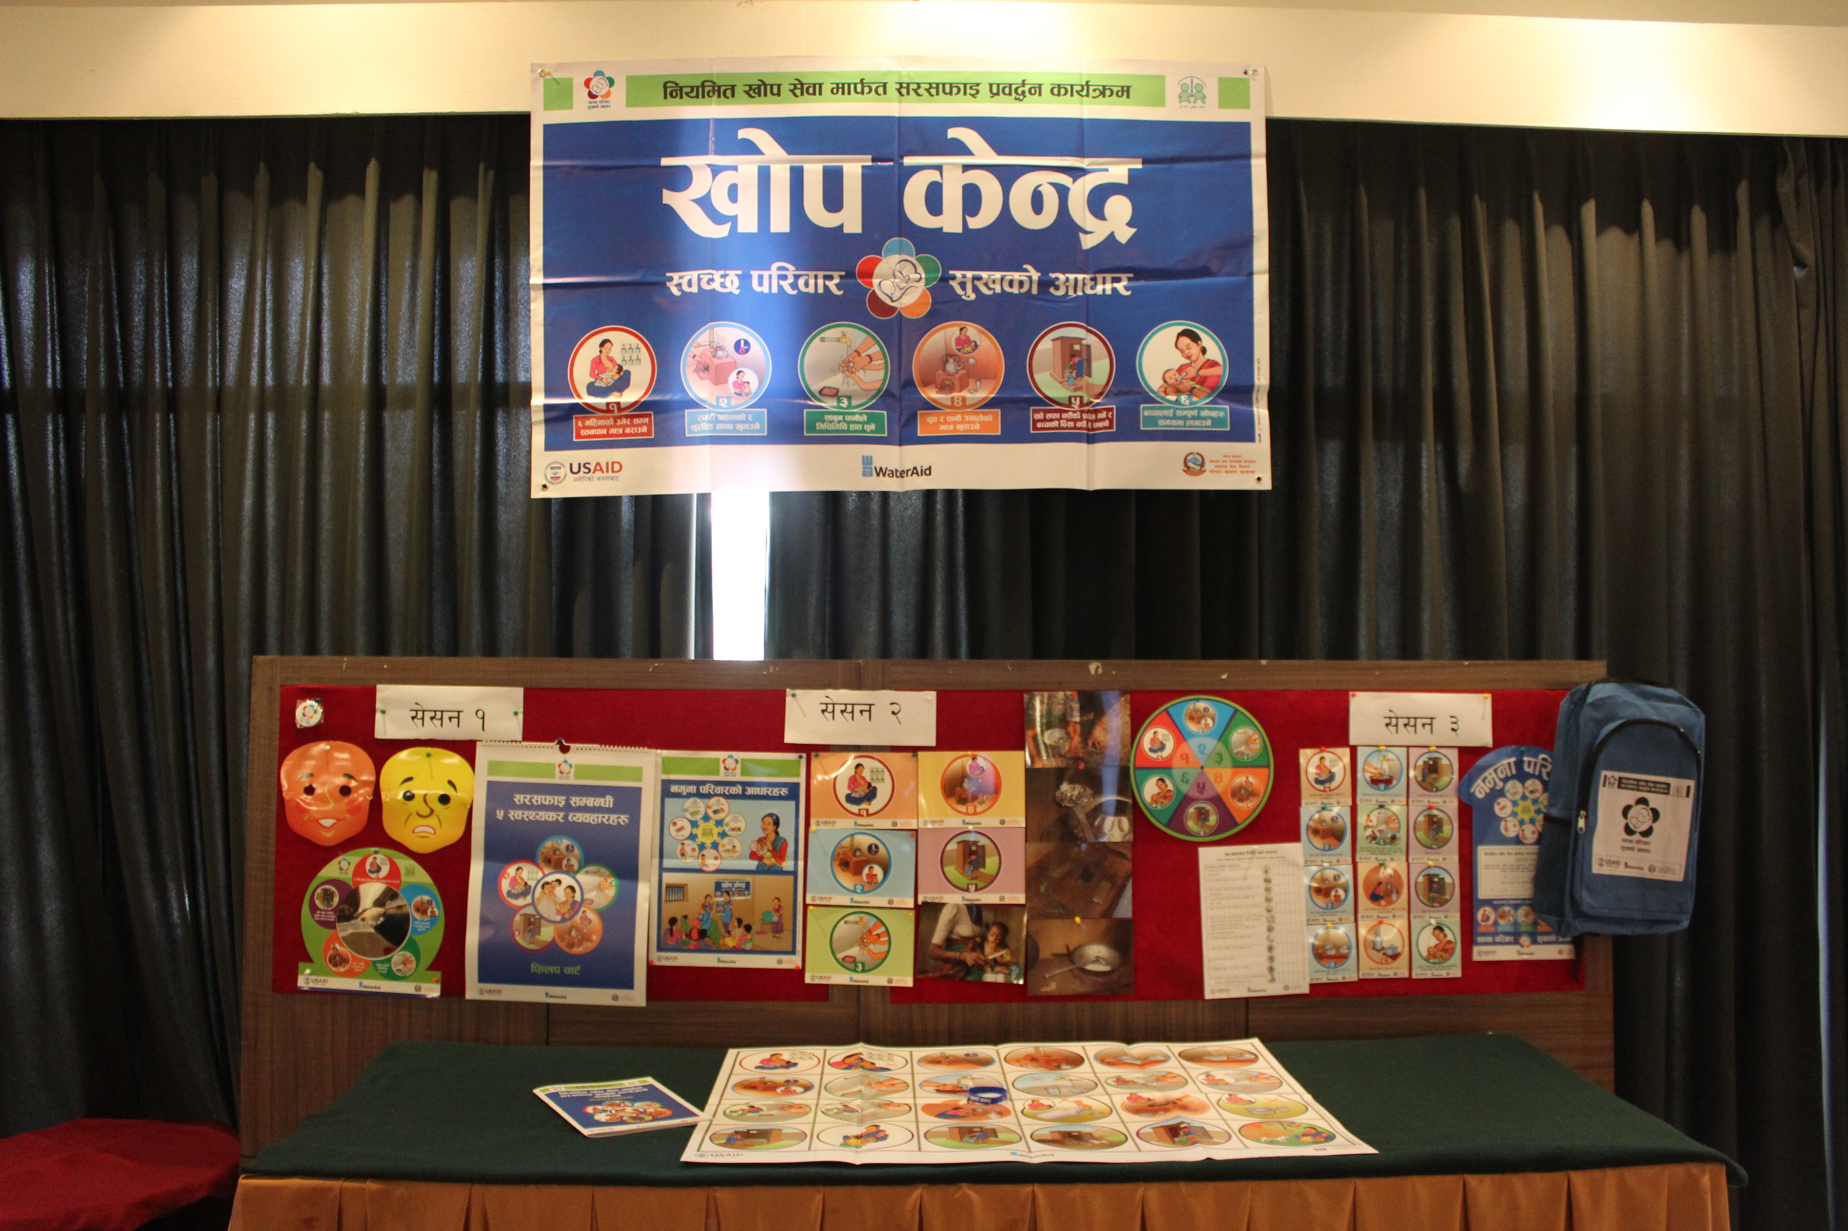

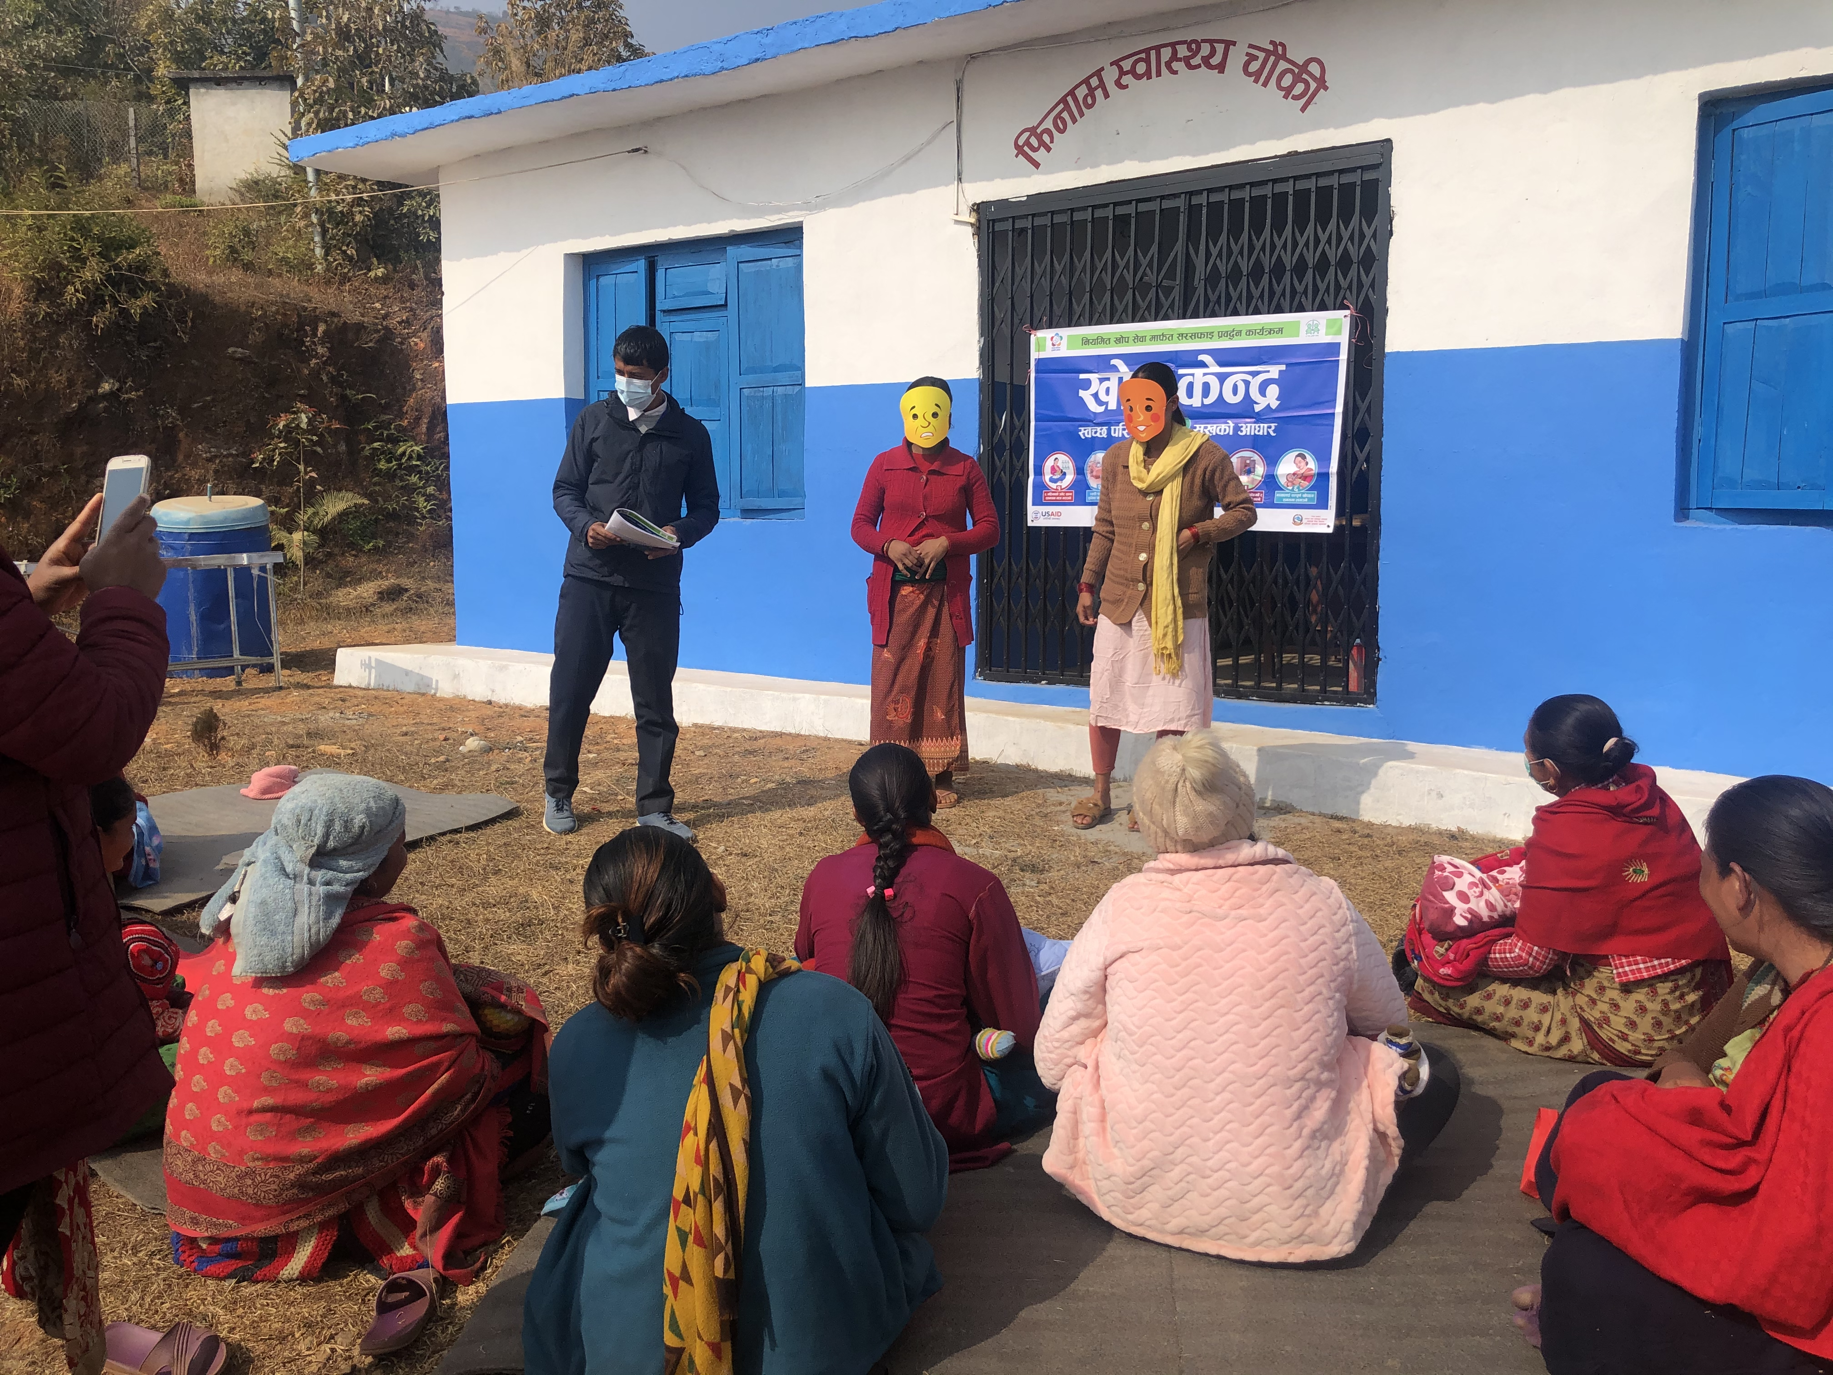
Is Integration cost effective and enhance the capacity of promotors?
E
Capacity:
FCHV’s self confidence in facilitating all the sessions (mean): 84%
Self confidence among health workers: 95%

Slide 40
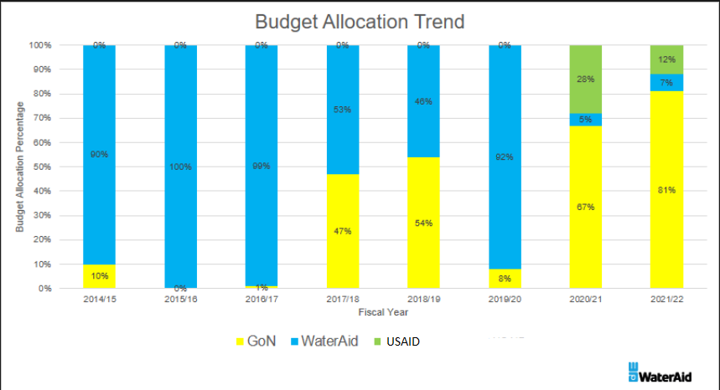
Is Integration cost effective and enhance the capacity of promotors?
E
Cost associated for the integrated programme:
US$ 44 for routine immunization (excluding system cost)
~US$ 8 for hygiene integration (pilot phase)
~US$ 4 for hygiene integration (transition phase)
~US$ 1.75 for nationwide integration phase

Slide 41
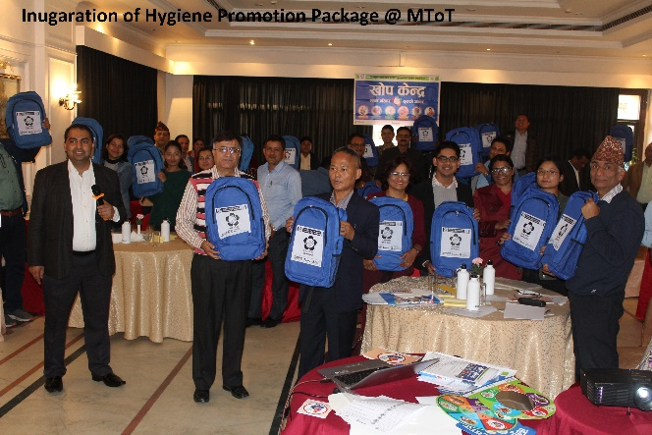
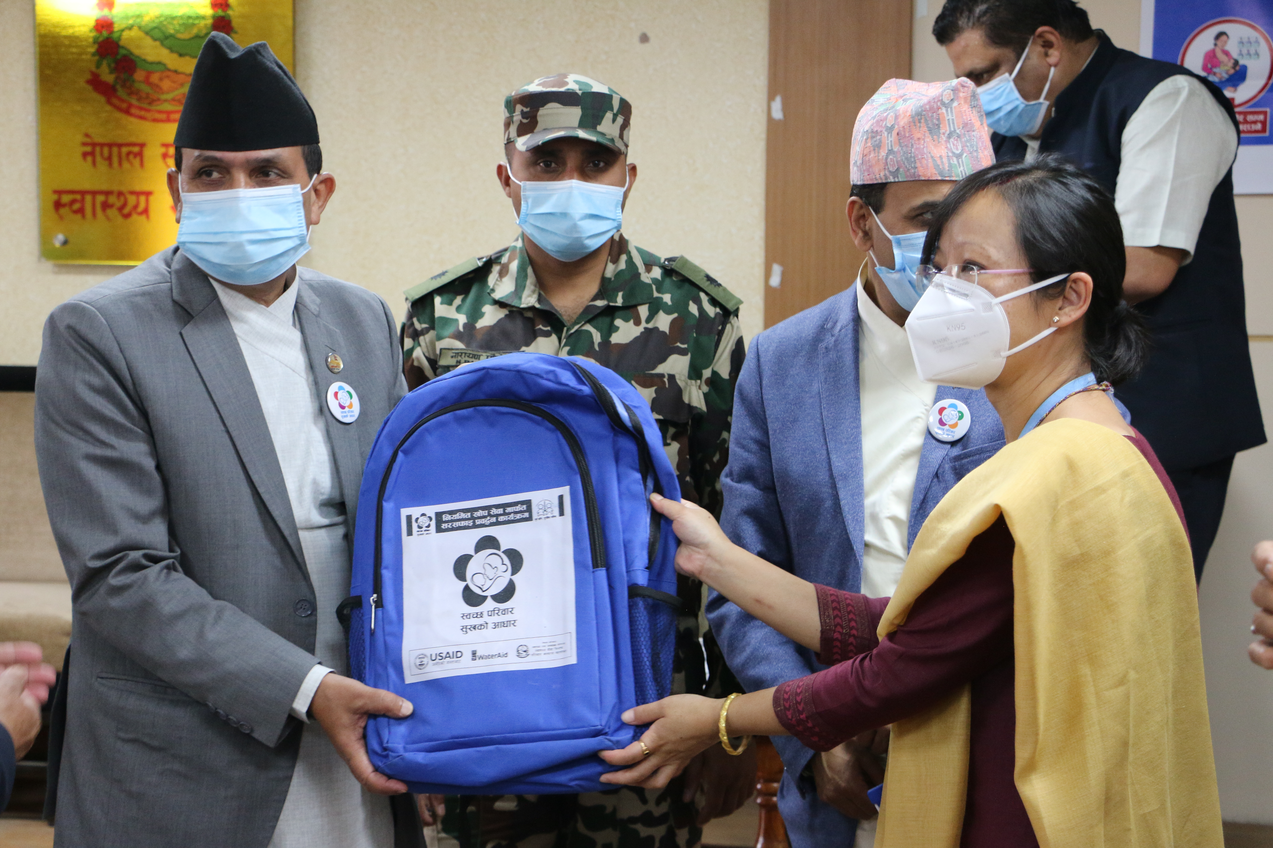
Government policy decision to retain the programme in four districts and scale-up nationwide 2018
Pilot: 4 districts,
35,0000
mothers + learnings
Retention: 4 districts, 35,000 mothers each year since 2017 to 2019. National launching June 2020
Nationwide: 650,000 mothers / guardians
3 years (2017-2019)
Official decision was made on Dec 2018
2 years
(2015-2017)
National Launch
(June 2020)

Slide 42


Strength and lessons from pilot initiative to scale
Lessons:
Immunisation: unique opportunity for
hygiene integration
Hygiene integration strengthen health system: improves behaviour, immunization coverage, reduce drop-out and
vaccine wastage
Additional cost per child: US$ 8 (in pilot), transition to scale (US$4) and scale-up US$1.75
Integration at national scale is possible
and feasible

Slide 43
Strength for success and sustainability at scale:
Full government ownership (MoH). Government led process, WA as technical support to test innovation with planned transition for scale up
Implemented through the sustained routine mechanism
Focused to strengthen health system and change on behaviour using rather than raising awareness
Used behaviour centric approaches and creative process to design and implement novel intervention and build health worker’s capacity to implement at scale.
Intervention has high level of reach / compliance and strong supervision
Emotional and attractive hygiene intervention package
Support from multiple partners: Gov, WaterAid, USAID, and UN Orgs

Slide 44

Donor funding for enteric vaccines such as rotavirus, cholera and typhoid should urge for mandatory hygiene integration and country should use as opportunity

Slide 45






Acknowledgement
For more information visit: https://washmatters.wateraid.org/hygiene-promotion-through-immunisation
Contact:
Dr Om Prasad Gautam, WaterAid
omprasadgautam@wateraid.org

Slide 46
Cutting out the Buzzwords
Working out how we reach more people

Slide 47

Buzz words?
Notes:
Common understanding as a sector on key terms: Scale, Demand, Innovation, Market based (response/sharing/marketing all these kind of terms)
• Reality check of what is possible/feasible in these areas and what role WASH actors should play in this, what information do ‘we’ and the private sector need to make market decisions
• Overview of roles, responsibilities and abilities of different key actors in this area and type of system – Private sector, UN, INGO, NGO, Government, national actors

Slide 48

What is Product Innovation?
The identification, development and scaling of new and innovative products that accelerate results for children and young people
Working with and connecting:
  field partners and programmatic experts to identify the need
  industry to develop products that meet that need
  programming partners and donors to bring new products to scale.
Notes:
UNICEF’s 2.0 innovation strategy defines innovation as "a new or significantly improved solutions that contributes to progress for children and accelerates results for children and young people”

Slide 49




Product Innovation ecosystem
Explore issues
Spark R&D
Validate on the field
Drive scale-up
Clarify needs
UNICEF aims to facilitate access and drive demand for fit for purpose and value for money supplies for children in UNICEF’s result areas.
While UNICEF drives and encourages R&D, this is undertaken by the private sector.
Need
An problem with an existing product or the lack of one has been identified
A thorough process of Exploration is undertaken to research the need and understand the role of UNICEF
Demand
Is there a buyer or user, and if not can a pathway to demand be identified
R&D
UNICEF provides guiding support via industry consultations and field trails among developers in a ‘co-creation’ process.
UNICEF drives R&D through incentives
Scale
UNICEF uses its comparative advantage worldwide during the Scale Phase to ensure it reaches those who need it most.
As the leading agency working globally for the rights of children UNICEF can drive scale through its respected relationships with local governments, NGO and private sector partners.
  Going directly to scale when products exist
Notes:
The Product Innovation Process
There are three stages to product innovation: Need, Research and Development (R&D) and Scale. UNICEF actively engages in the first and last stages (need and scale), whereas the R&D is done by developers, such as businesses and academia, with UNICEF driving the process.
UNICEF only works in product innovation in it’s key strategic areas, focusing on Health, Nutrition, WASH, Education, Child Protection in development and emergency settings.
UNICEF’s strategic areas include:
GOAL AREA 1 Every child survives and thrives (health, nutrition)
GOAL AREA 2 Every child learns (education)
GOAL AREA 3 Every child is protected from violence and exploitation (child protection)
GOAL AREA 4 Every child lives in a safe and clean environment (WASH)
GOAL AREA 5 Every child has an equitable chance in life (cross cutting – equity approach to disability, gender, poverty )

Slide 50



Target Product Profiles
Communicate requirements, without prescribing a specific solution, for a product that is not currently available on the market but fulfils a priority need
Guide industry to develop a product that meets the programmatic needs and is suitable for the context UNICEF and partners operate in
Inform stakeholders about the need for a new/improved solution.
UNICEF

Slide 51

Product Innovation process at UNICEF
The innovation process at UNICEF follows a system of phases and gates through the Need, R&D and Scale stages. Projects live in one of five innovation phases and can pass through a gate to the next phase when they receive approval from UNICEF’s Innovation Review Board.
Notes:
While some Project Innovation Projects (PIP) follow the gradual completion through the stages, this isn’t necessary for all PIPs. For example, if during Exploration UNICEF discovers a quality product already on the market, R&D can be skipped and the PIP can move directly to Validation to conduct field trials to verify if it is fit for programming

Slide 52
Working with different stakeholders to develop products
TPP launched to Industry
Define use case
Product specifications
Use Request for proposal/expression of interest to engage suppliers
TPP specification used in call
Field review of products
Cocreation
Detailed feedback and inputs given to developers on application within intended field use
If needed further field testing carried out to ensure mutually agreed modifications perform as expected
Demand forecast
Technical review of products

Slide 53
Field testing working prototypes
Identified need for field level inputs
Next stage would be tender process
Different readiness levels – developed for different use cases
Products reviewed by Technical advisory group for viability against TPP criteria
Through discussions recognise need for field access and inputs especially on ease of use and practicability
Objectives of field testing
Submissions will need supporting evidence against TPP and regulatory certificate (lab validation)
Those passing technical review will be invited to field test to review ease of use
Best performing kits will be offered LTA
Product understanding - overview of products and technologies in relation to use cases
Field insights - gain insights from the field and relevant partners on the products and for the future
Co-creation - opportunity to give inputs to product design especially around ease of use

Slide 54
UNICEF WASH Procurement and Innovation Resources
UNICEF WASH Tender Calendar: https://www.unicef.org/supply/documents/water-sanitation-and-hygiene-wash-tender-calendar
Register as a supplier on UNGM: https://www.ungm.org/ → Click on “Register”
REOIs for important WASH-related procurement are published on UNGM
Questions: washsupply@unicef.org
New product submissions
https://www.unicef.org/supply/invitation-suppliers-share-your-new-water-and-sanitation-wash-product-unicef
Target Product Profiles (TPP)
https://www.unicef.org/supply/target-product-profiles
UNICEF Product Innovation https://www.unicef.org/innovation/productinnovation
Notes:
UNGM: United Nations Global Marketplace

Slide 55
Questions and Answer

Slide 56
Panel and Group Discussion
https://www.menti.com/alpeu95t4iwr
Notes:
Put this QR code at the beginning as well, and create separate areas for questions per person/questions for the group

Slide 57
Questions for Ben
For Cynthia: What is the outlook of NCG model in Ghana and how are you working towards sustainability and adoption of this approach by stakeholders in the WASH space.
For Om: What were the main motivations for Gov to implement such an innovative programme at national scale?
For Sidney: How has the RapidBCD Toolkit been used to influence formative research and/or program design?
For all:

Slide 58

















All Systems Connect 2023 is made possible thanks to the generous support of our partners including the World Health Organization and :

