Slide 1

Connecting the dots:
How do we achieve universal hand hygiene?
The role of partnerships in system-strengthening efforts

Slide 2
Theme 2 - Markets & behaviour change: how people invest and driving to scale
How NOT to take a systems approach
Reaching more people: leveraging public and private sector approaches with behavioural and implementation science
How can governments and private sector reach shared goals by understanding each other’s constraints and incentives? A review of lessons learned from recent sanitation and hygiene behaviour change initiatives
Context is key: market-based approaches in Ethiopia
How to get customers to pay for your product or services: lessons learned from market-based approaches to sanitation and providing water
Policy & finance addressing inclusion in market systems

Slide 3
Aim
To foster a common understanding of the whole system for hand hygiene, the distribution of roles and responsibilities within that (public, private, civil society), and the function of partnerships in getting hygiene products and services into the homes of consumers.
Objectives
Foster common understanding of hand hygiene system
Identify roles & responsibilities across the system
Unpack role of partnerships in strengthening systems to deliver change
Identify dos and don’ts of partnerships

Slide 4



The hand hygiene system: a framework
Functions, actors, roles & responsibilities

Slide 5
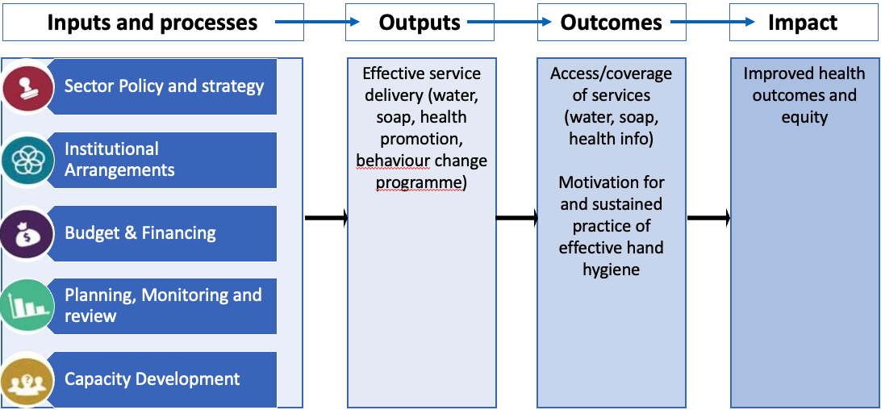
Hand hygiene system results chain

Slide 6
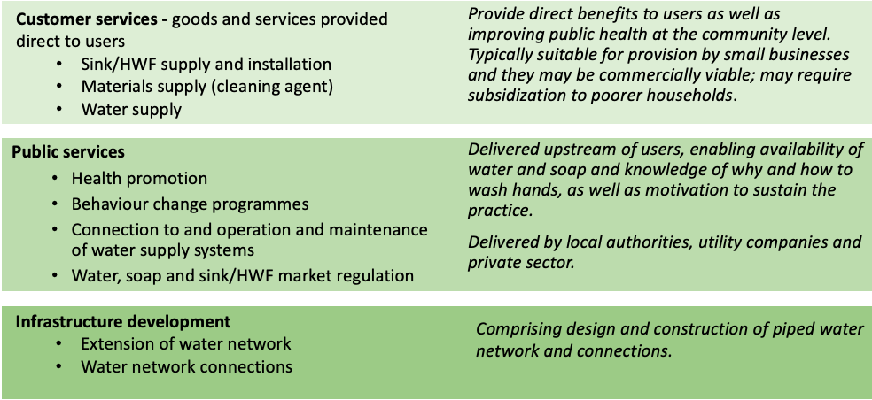
What hand hygiene service delivery?
Service categories

Slide 7
Service delivery – actors involved
Public sector
Private sector
Civil society

Slide 8
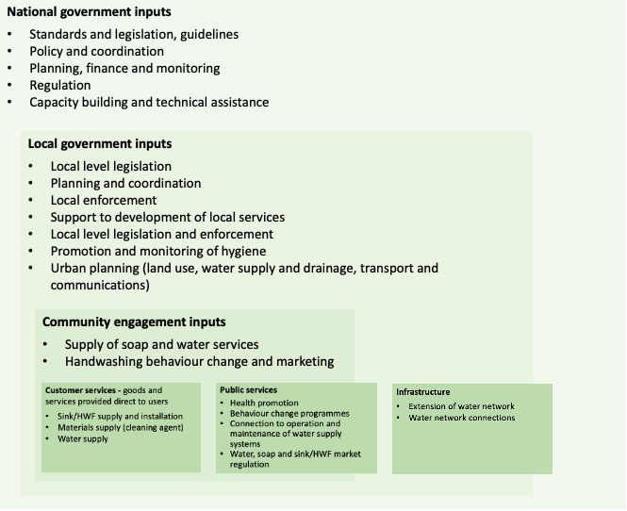
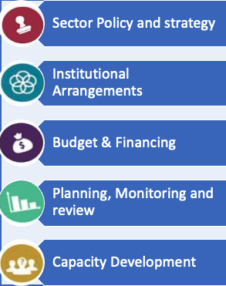
Multi-level inputs
Draft framework for hand hygiene system
WHO Geneva
Under consultation
Outputs
Effective service delivery
Outcomes
Access and motivation
Access/coverage of services (water, soap, health info)
Motivation for and sustained practice of effective hand hygiene
Notes:
Policy and strategy – identification of sector goals and pathways, giving direction to sector investments
Institutional arrangements – identification of institutional roles & responsibilities, inclusive coordination mechanisms, legal & regulatory frameworks
Financing – medium-term expenditure framework matching gov. priorities with available resources, realistic & transparent sector budget, financing data
Planning, monitoring and review – systematic planning, monitoring & eval. of sector performance to ensure effective route to achieving goals, mid- & long-term-review, clearly defined accountability mechanisms, data transparency and public access to info.
Capacity building and technical assistance – plans addressing capacity of institutions to fulfil R&Rs, capacity of individuals to engage, capacity of stakeholders

Slide 9
Panel: Roles & responsibilities
Moderator: Aarin Palomares, Global Handwashing Partnership
Rumat Ashraf, Regional Director, HappyTap
Om Prasad Gautam, Senior WASH Manager for Hygiene, WaterAid UK
Mir Abdus Shahid, Chief Engineer, Dept. of Public Health Engineering, Government of Bangladesh

Slide 10
Panel: Synergising efforts through partnership
Moderator: Robert Dreibelbis, London School of Hygiene and Tropical Medicine
Jenala Chipungu, Centre for Infectious Disease Control, Zambia (CIDRZ)
Belinda Makhafola, Deputy Director, Environmental Health, Ministry of Health, Government of South Africa
Bella Monse, Senior Advisor, Fit For Schools, GIZ
Jan Shepherd, Leader, Marketing & Communications, LIXIL

Slide 11
Plenary discussion
Role of partnerships in system-strengthening
Examples of effective partnerships
Challenges with effective partnerships

Slide 12
Taking stock
What are the key takeaways from Theme 2 to apply in your work?

Slide 13


















All Systems Connect 2023 is made possible thanks to the generous support of our partners including the World Health Organization and :

