Slide 1



Slide 2
WRM data collection, visualization, and management for better water governance
Theme three: Water resource management: finding systemic solutions

Slide 3
Session outline
Lightning presentations:
  Stanley Okettayot Lobi, Water for People
  Jon Shepherd and Freya Scott, Frank Water
  Lauren Cuscuna, Safe Water Network
  Hannah Ritchie, Cranfield University
  Muthi Nhlema, BASEflow
  Emeline Béréziat, Akvo
Audience and presenter discussion
Audience questions
Notes:
Session format
Post-it notes will be given out at the end to say what you learnt / follow up questions / connections you want to make / research gaps / pressing issues that you see in the world of data collection and toolkits

Slide 4
Technical performance of CTD diver as an IWRM tool for mitigating climatic shock and enhancing water supply sustainability
Experience from Mid-western Uganda

Slide 5
Introduction
More than 61% of the Uganda’s water is from GW in Uganda. GW plays a vital role in food production, livelihood improvement, employment, and wealth creation
    Effective GW development and management faces hydrological diversity and complexity, inadequate scientific knowledge on aquifer, pollution, limited knowledge on abstraction and climate change
    CTD diver is one of the techniques to enhance effective GW development and management as it measures depth, temperature and electrical conductivity and stores up to 48,000 measurements
    Water For People constructed over 10 piped water supply systems in Kamwenge district and yet Well performance; safe pumping, recovery, aquifer characteristics, quality and groundwater level was unknown thus threat to sustainability and this necessitated the need for monitoring - CTD diver

Slide 6
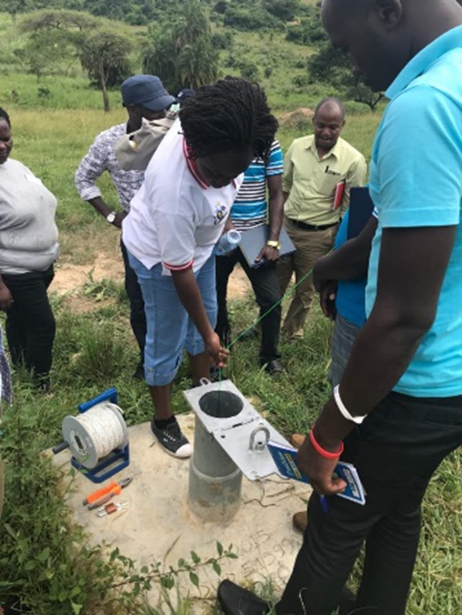
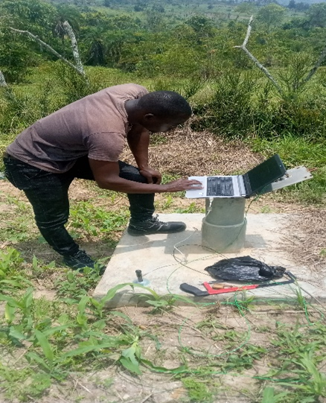
Objectives
1.To understand the well aquifer type
2. To ascertain possibility of groundwater intrusion - quality
3.To validate the significance of wetland restoration to recharge
APPROACH/METHODS
    Assessment of existing technologies
    Training of stakeholders
    Installation of data loggers
    Downloading and analysing of Data
    Data Sharing/Dissemination of data in the region

Slide 7
Results/findings
    Abstraction is within safe yield and recovery is over 85% for motorized and hand pumped wells
    In Biguli, Wells do not tap from same aquifer. No influence of pumping on monitoring wells. In Mubende, effect of pumping has been observed on the monitoring well.
    Fluctuation of water level with season of the year. Wells consist of unconfined aquifer. Drop in water level 0.85m – 0.96m in dry season in monitoring well
    No fluctuation in GW quality. No intrusion

Slide 8
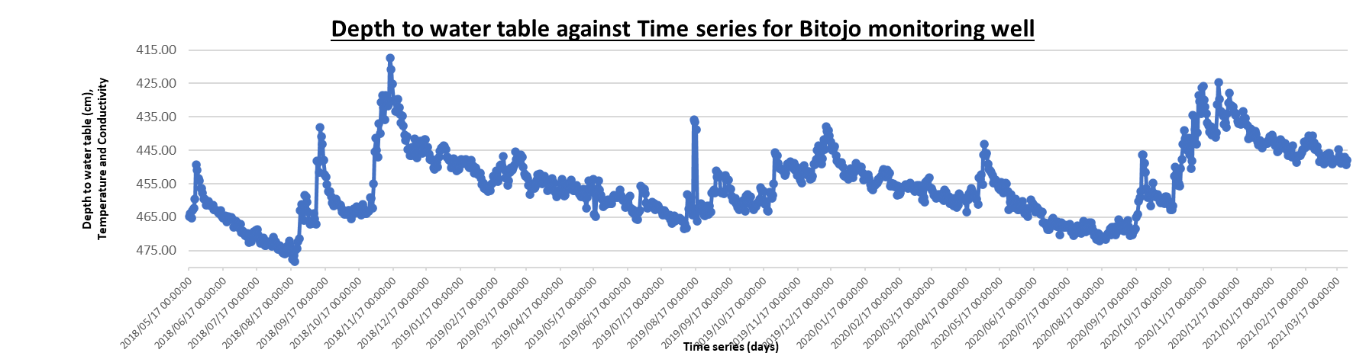
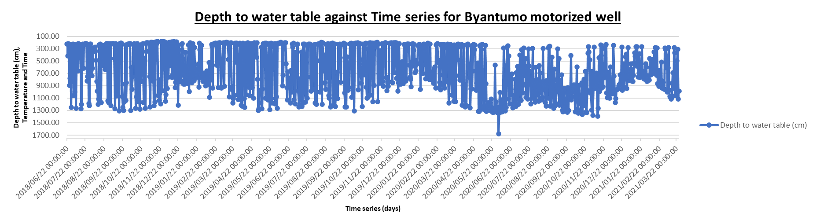
Results/findings cont’d

Slide 9
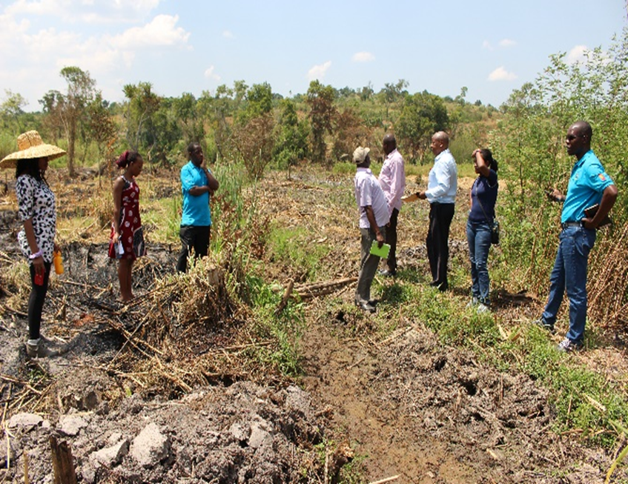
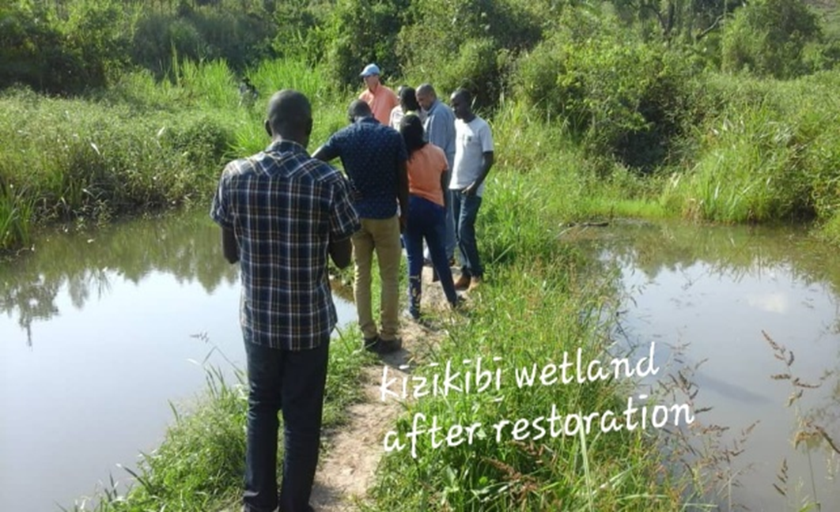
Conclusions and recommendations
There has been insignificant fluctuation in
GW levels in the monitoring wells much as drop by 0.85m – 0.96m has always been experienced in the dry seasons.
Motorized wells have presented good recovery and pumping has always been
done within the safe yield.
RECOMMENDATIONS
Demarcation and restoration of
critical ecosystems

Slide 10
Global WASH Basins
Toolkit in Kenya
A solution for WRM?

Slide 11
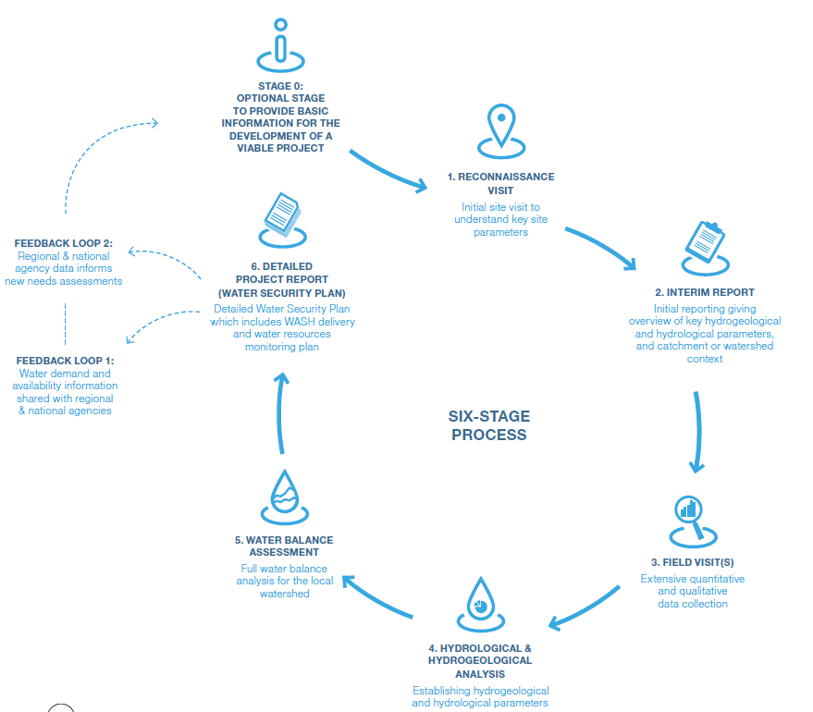
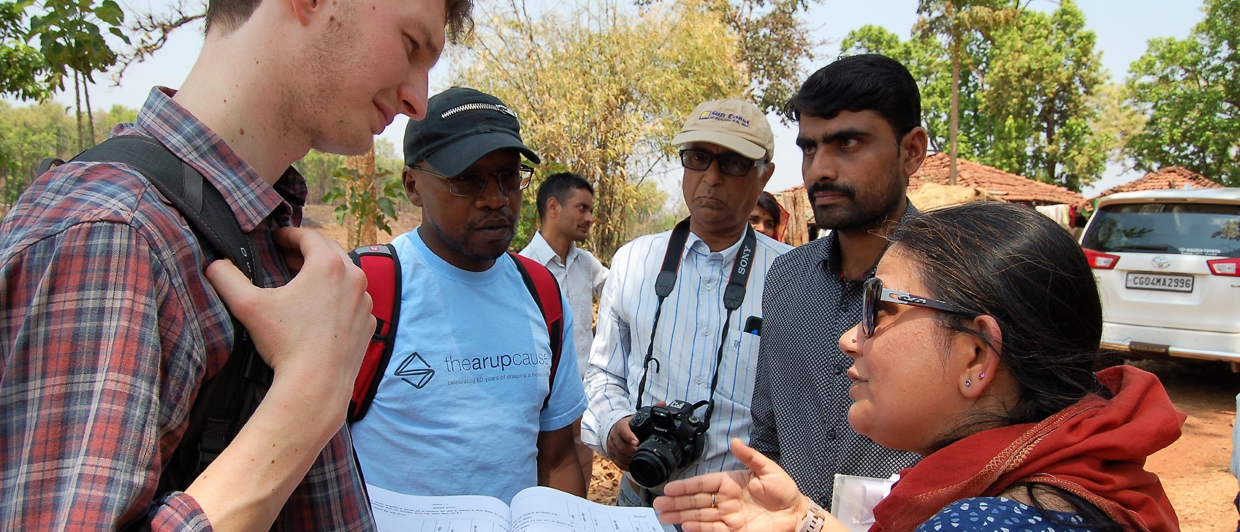



WASH Basins Toolkit a solution for WRM?
Notes:
Slide 2 – how was WASH Basins Global Toolkit created
PSI & Samerth – time taken taking surveys comparison
Tailored to India context
History and benefit
Successful trials in India with NGOs PSI and Samerth
6 Stage process with outcome of WSPs
Updated Toolkit for a Global context…..
Slide 2 – how was WASH Basins Global Toolkit created
PSI & Samerth – time taken taking surveys comparison
Tailored to India context
History and benefit

Slide 12
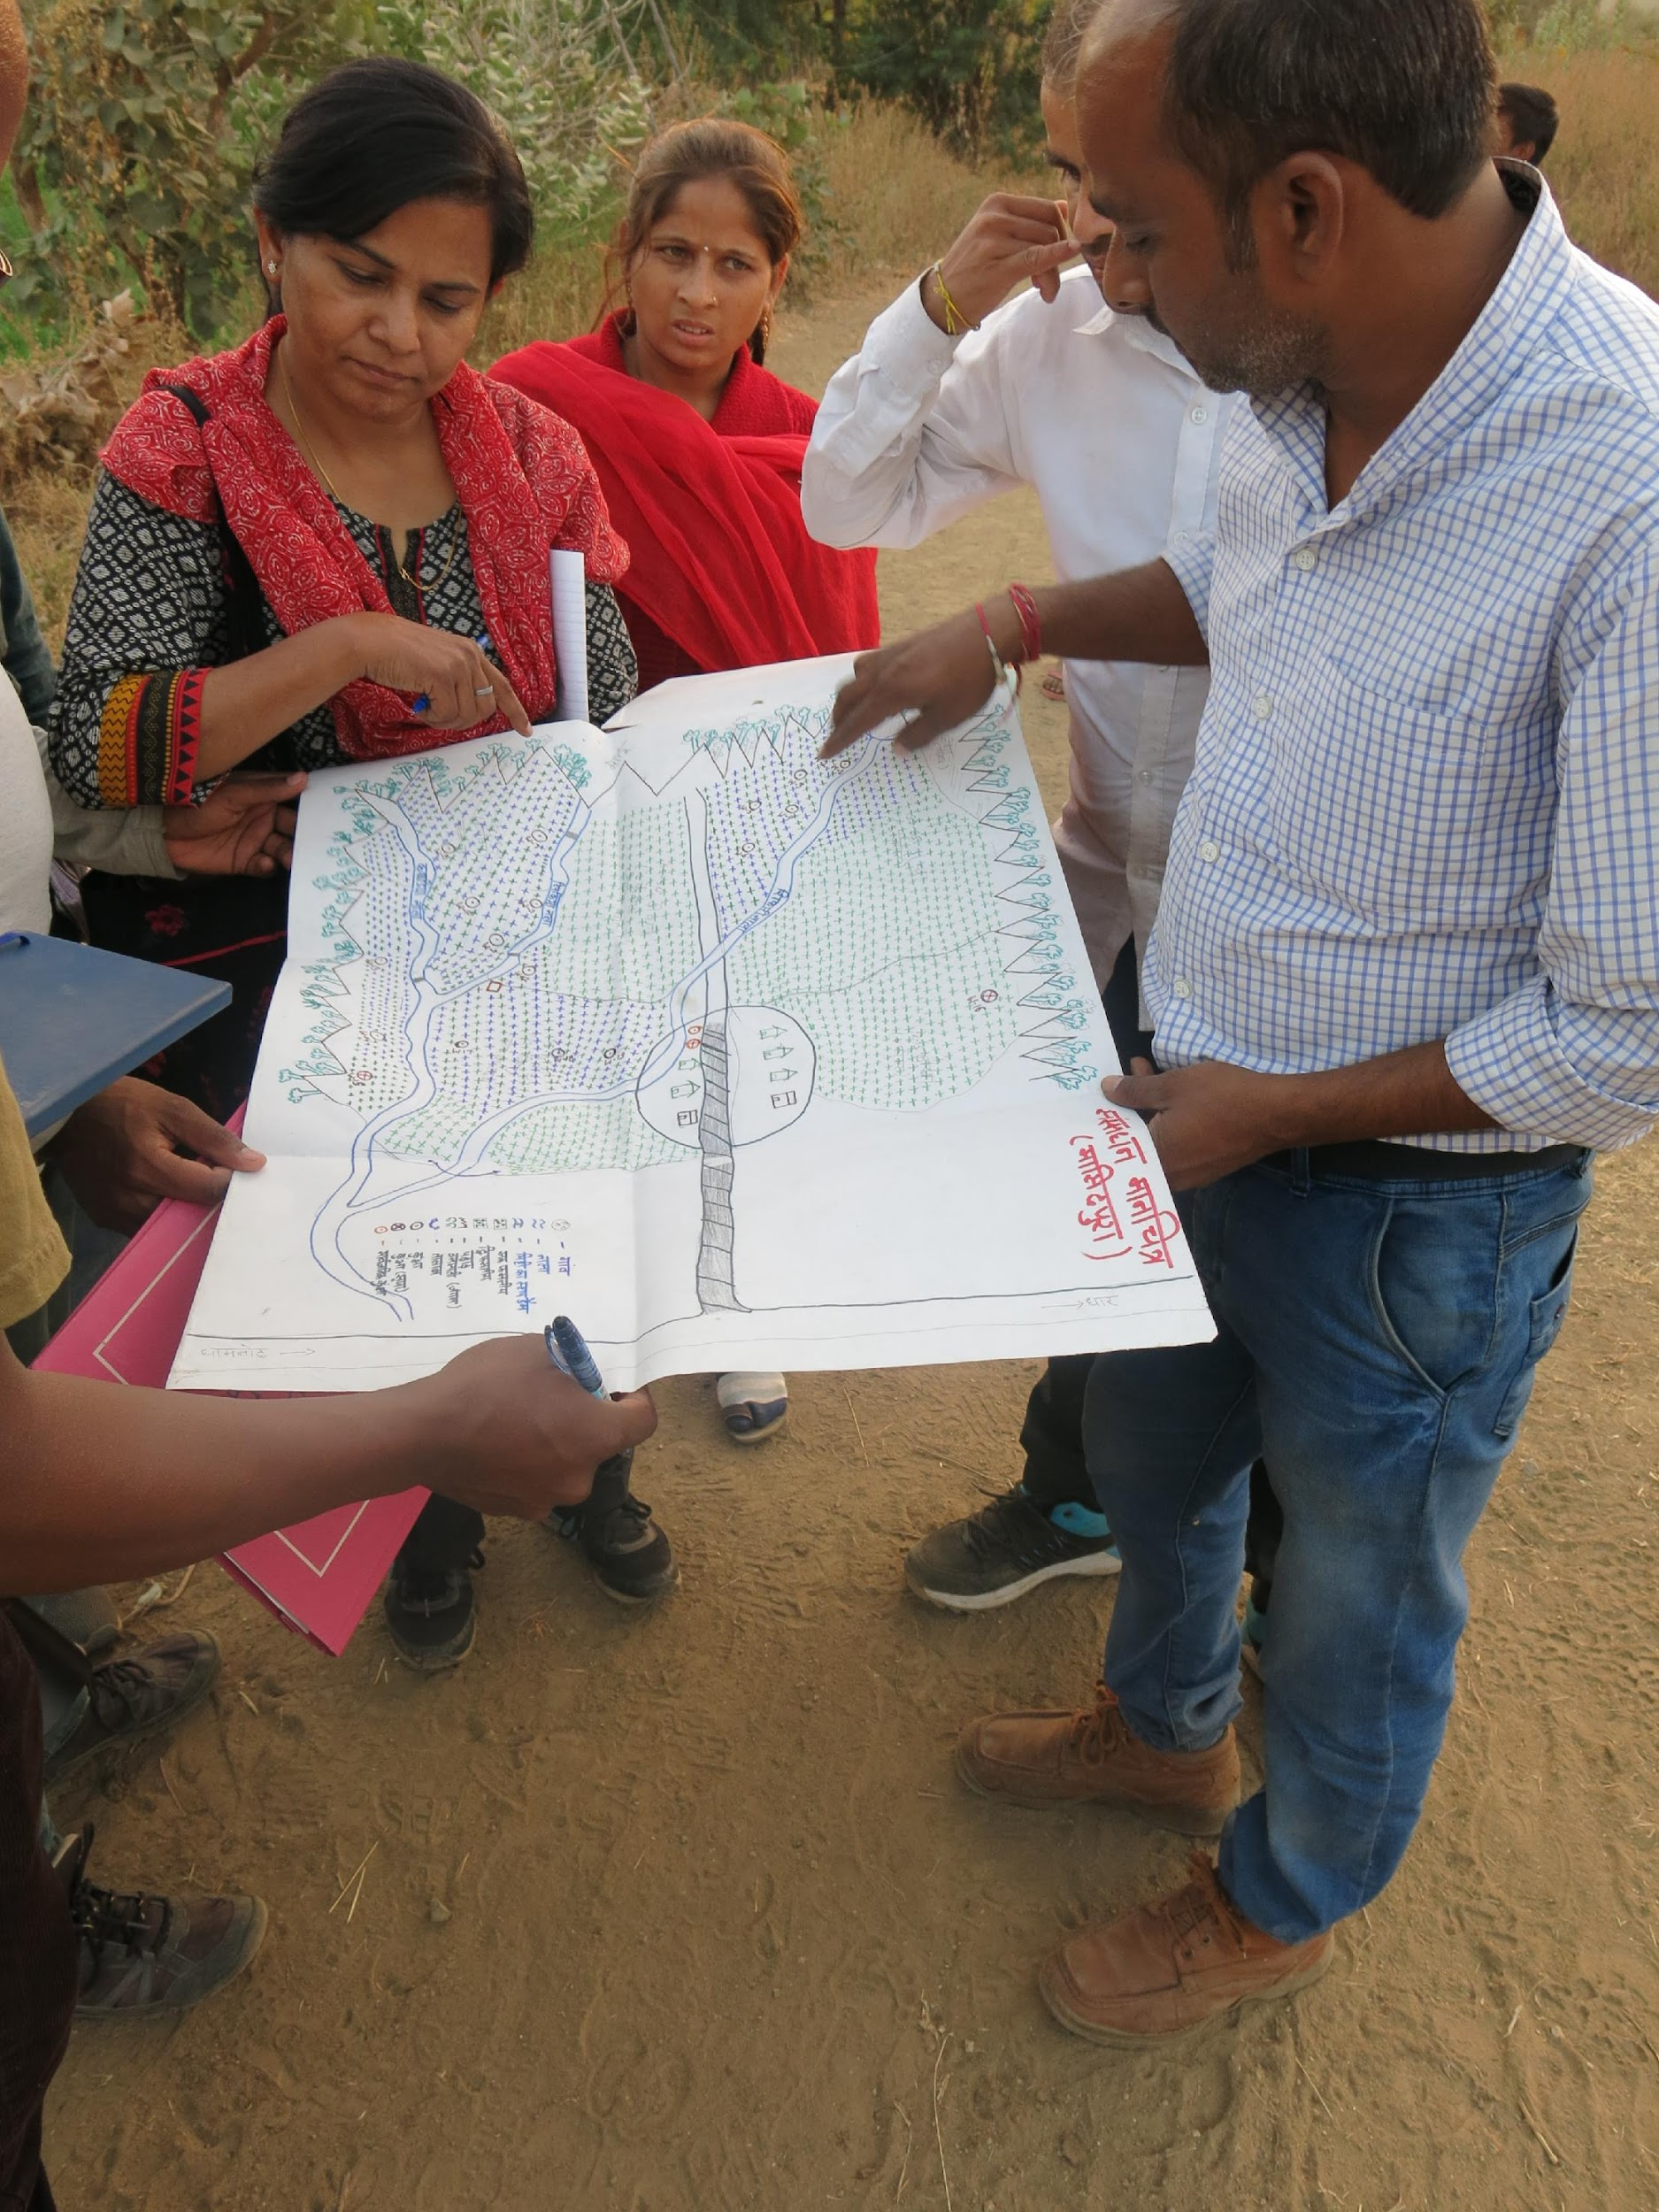
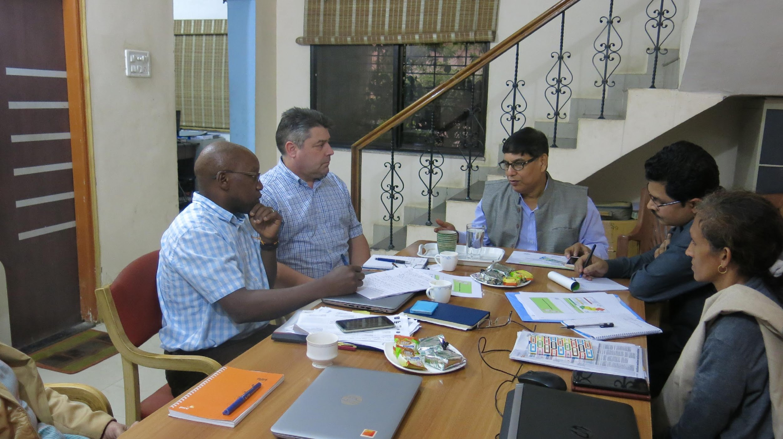

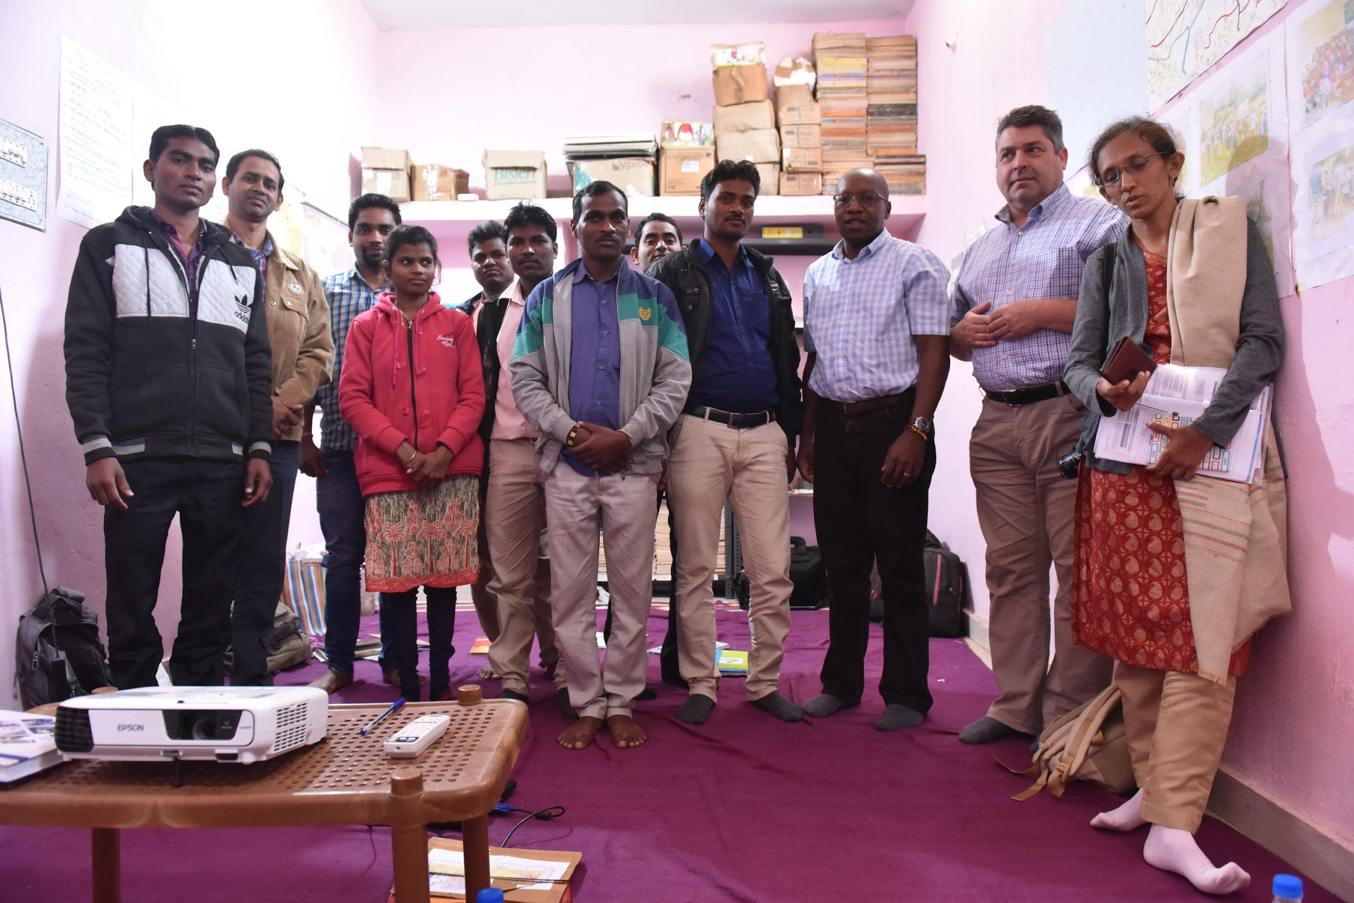

WASH Basins Toolkit history & context
Notes:
Slide 2 – how was WASH Basins Global Toolkit created
PSI & Samerth – time taken taking surveys comparison
Tailored to India context
History and benefit
Successful trials in India with NGOs PSI and Samerth
6 Stage process with outcome of WSPs
Updated Toolkit for a Global context…..
Slide 2 – how was WASH Basins Global Toolkit created
PSI & Samerth – time taken taking surveys comparison
Tailored to India context
History and benefit

Slide 13
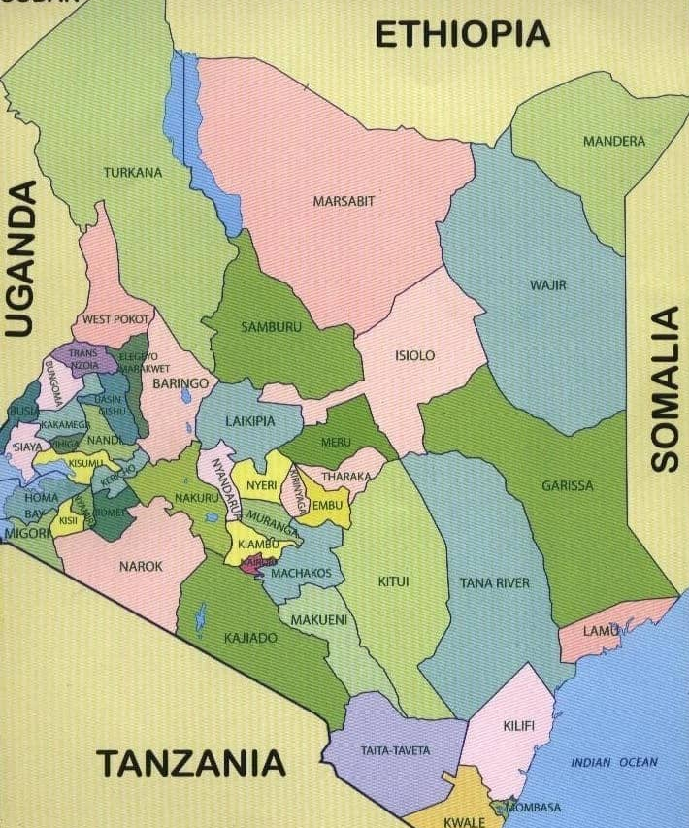
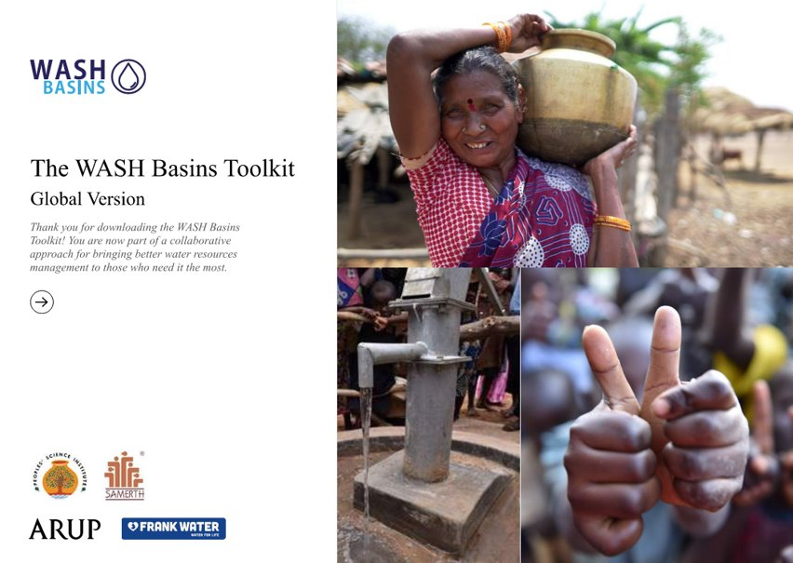
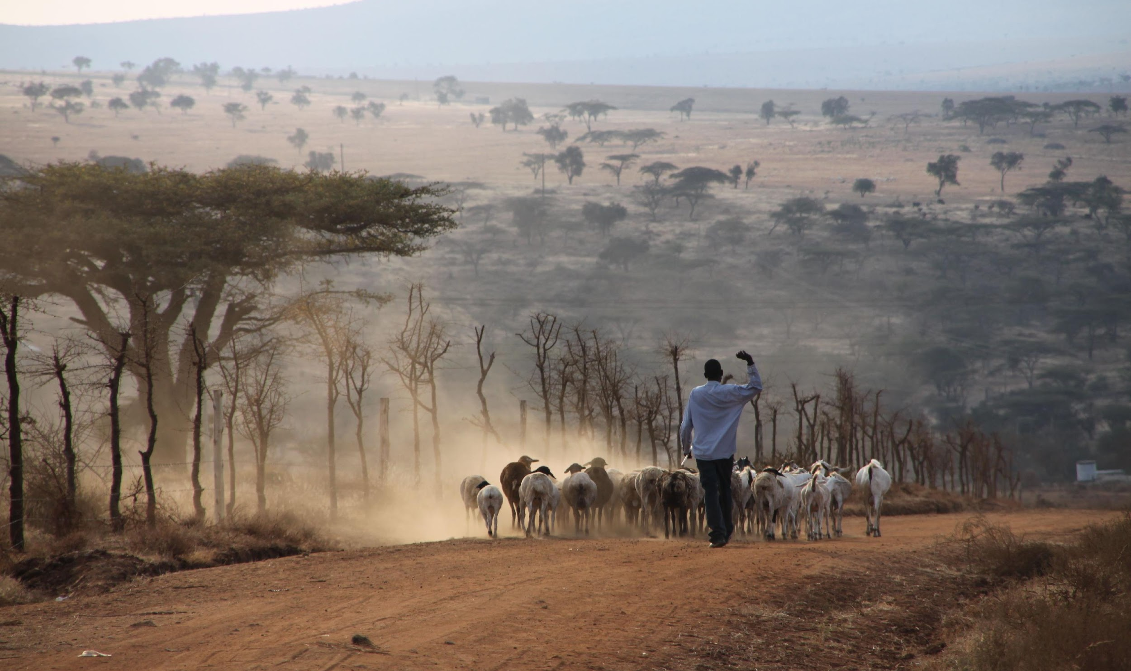
WASH Basins Global Toolkit in Kenya
Partnership with Amref in Kajiado, Kenya
  Local hydrology/hydrogeology
  Consideration of wildlife and livestock
  Water source data – similarity despite context
Notes:
Global Toolkit in Kenya – intro
We have partnered with Amref Health Africa in Kenya to trial the Toolkit in Kajiado County. Field work is to start imminently as we have updated some of the data collection forms to suit the context.
Kajiado – 2/3 bullets points on hydrology
Mainly arid/semi arid. Frequent drought and currently experiencing a severe extended drought
Arid and semi arid with extended droughts
Groundwater is the primary water source
Effect of climate change
Toolkit is directly applicable to the water and health issues in the region
Global Toolkit in Kenya – application there
What have we learnt from working with Amref/in Kenya so far?
Local hydrology in the region must be considered
Animals and livestock - in Kenya – also elephants, nomadic etc.
Global applicability? E.g. India has better borehole data/monitoring, so this was taken into consideration

Slide 14


The Safe Water Resiliency Toolkit: Using GIS Technology to Identify and Mitigate Risk to
Water Infrastructure

Slide 15
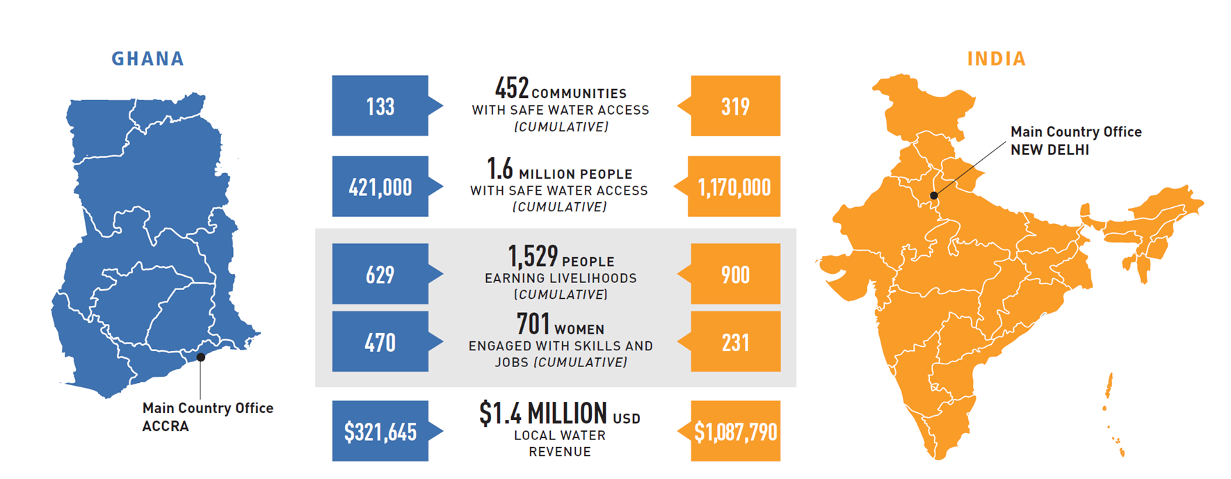
Innovation is a key part of our mission and our success in community water supply
About Safe Water Network
The Safe Water Resiliency Toolkit
Feasibility Tool: Pre-Screen & Assess Optimal Communities
Risk Assessment Tool: Explore Local & Regional Hazards & Risks
EPANET+ Tool: Plan Optimal Infrastructure Design
Mitigation Tool: Creating Infrastructure and Community Resilience
Field Sales Tool: Building Sustainability and Growth

Slide 16
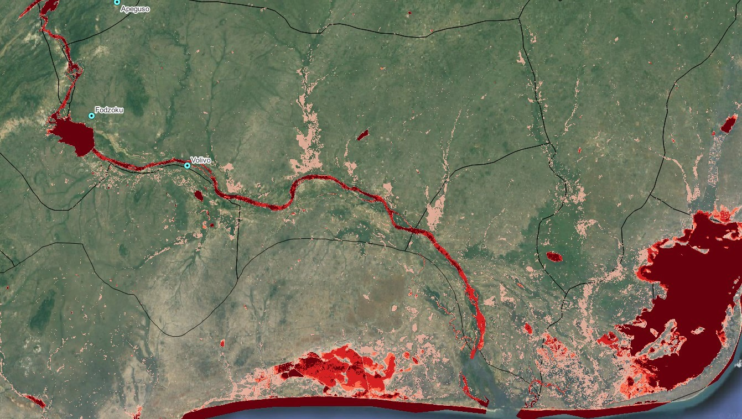
What happens when we don’t plan for climate shocks?
Flooding at water treatment facilities leads to direct and indirect costs
Total Cost of Flood Damage at Station in Volta Region, Ghana
The risk assessment tool identifies areas at-risk for flood and displays data visually to improve site planning and mitigate the impact of environmental hazards.
$615
Lost Revenue
$3,000
Equipment Repair
$3,250
Benefits Lost
Flood Risk Zones in Volta Region, Ghana

Slide 17
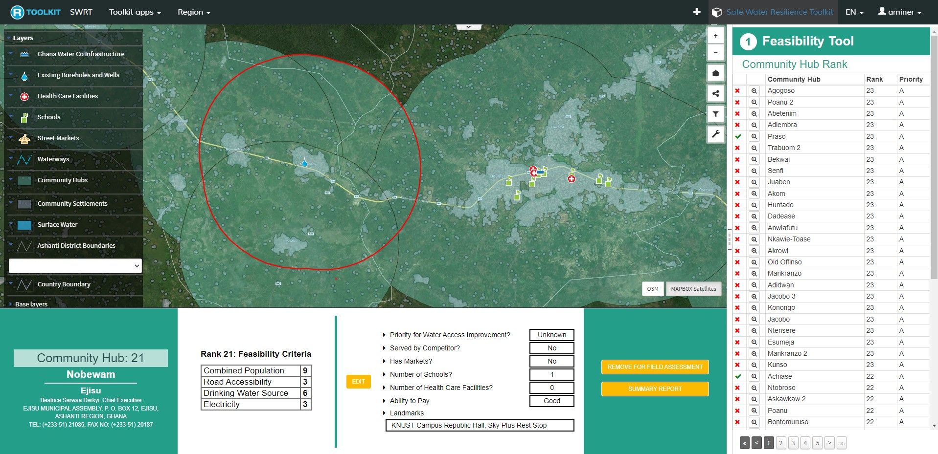
How can site planning technology optimize impact?
Users identify criteria for
site suitability
Feasibility Assessment Tool overlays data across communities
Communities are ranked based
on how much they meet
specified criteria
Streamlines site selection process and provides data visualization
Ensures communities selected are right-fit and benefit most
Planning Data Visualization for Nobewam, Ghana

Slide 18

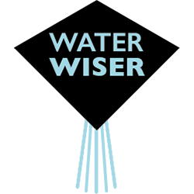


Sand dams: the answer to dryland water in security?

Slide 19
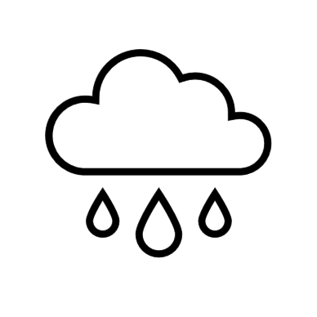
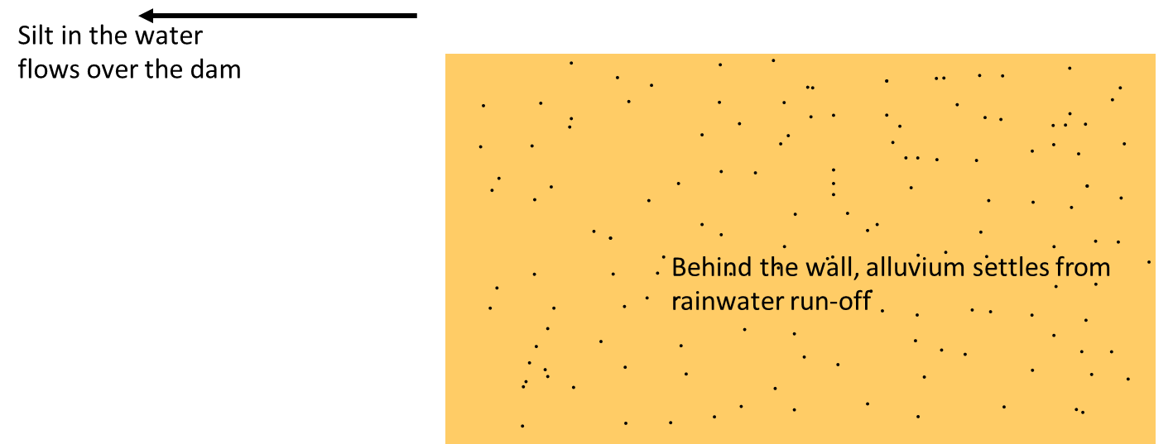
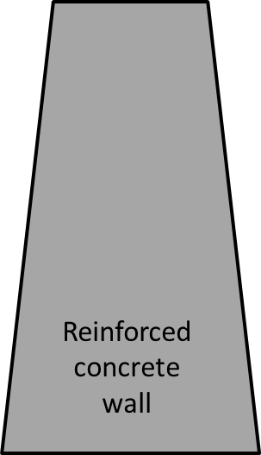
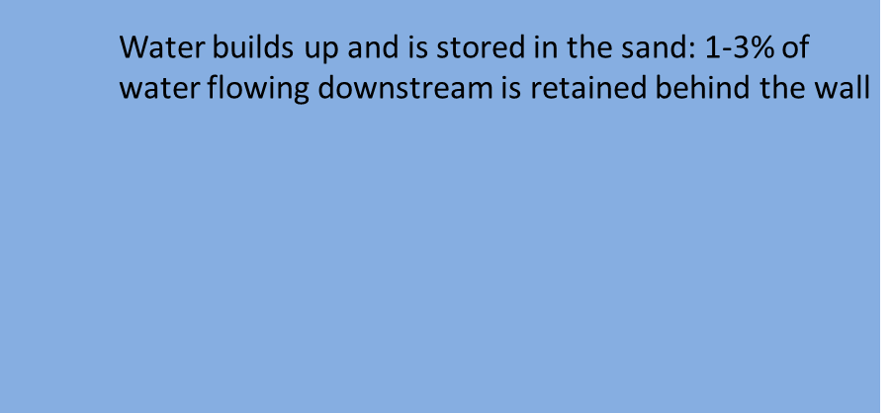


Sand Dams
Notes:
So, what exactly are sand dams?
They’re basically small dams built on seasonal rivers in drylands used to collect and store water for the dry season
We begin with a small river in a dryland
They build a small concrete wall across the stream
Sand builds up behind the dam wall in the rainy season
whilst silt mostly flows over the wall
When it rains water gets stored in the sand

Slide 20
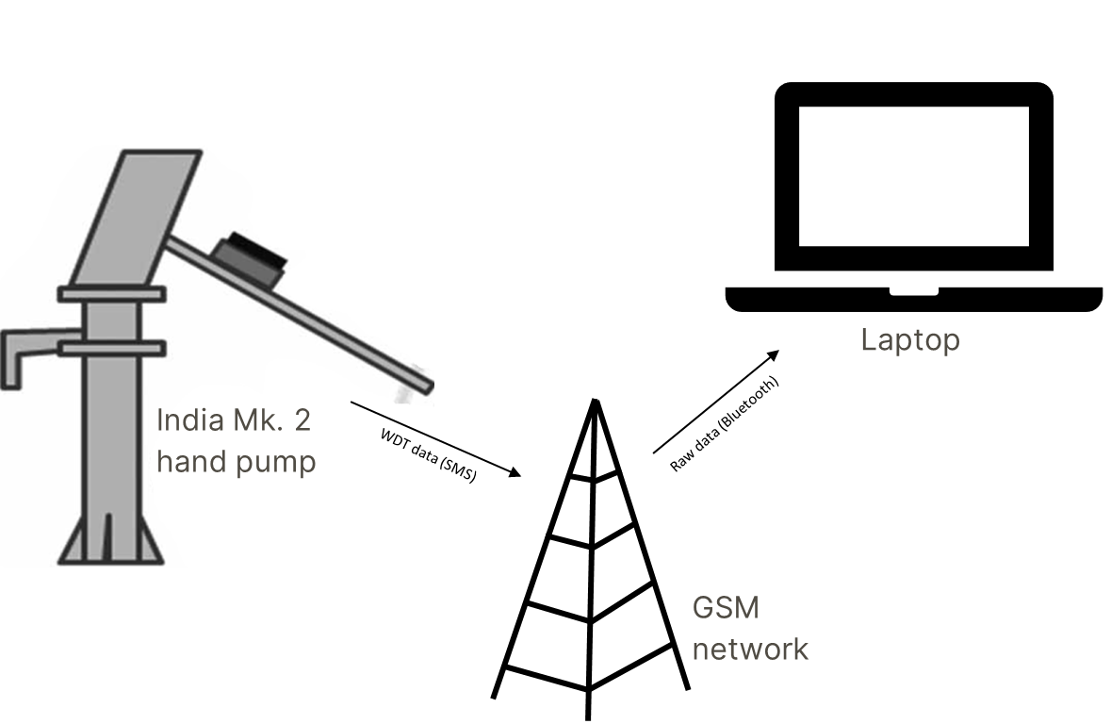
Notes:
I wanted to know how much water was being abstracted from sand dams throughout the year, especially whether they could sustain abstraction by the end of the long dry season when other sources have dried out. I also wanted to know how much abstraction varied spatially between different sites and whether certain characteristics of the different dams impacted abstraction volume
So I used water point data transmitters: basically sensors attached hand pumps at 26 sites to create smart hand pumps
It’s a technology developed by Patrick Thompson at Oxford Uni
Measures the number of times the handle is used in 1 hour and factoring in the force that is exerted converts this into volume of water abstracted
The hourly data is then transmitted as an SMS via the GSM network

Slide 21
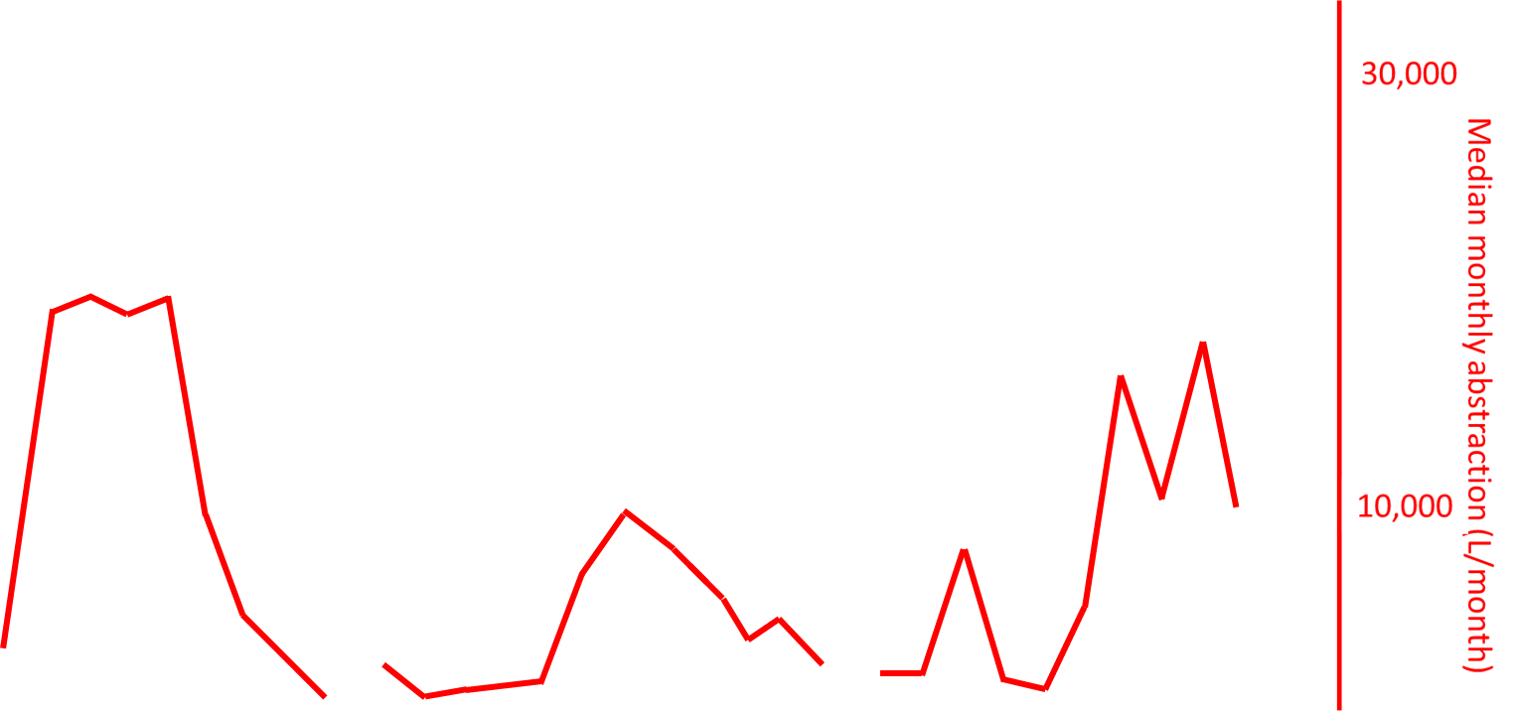
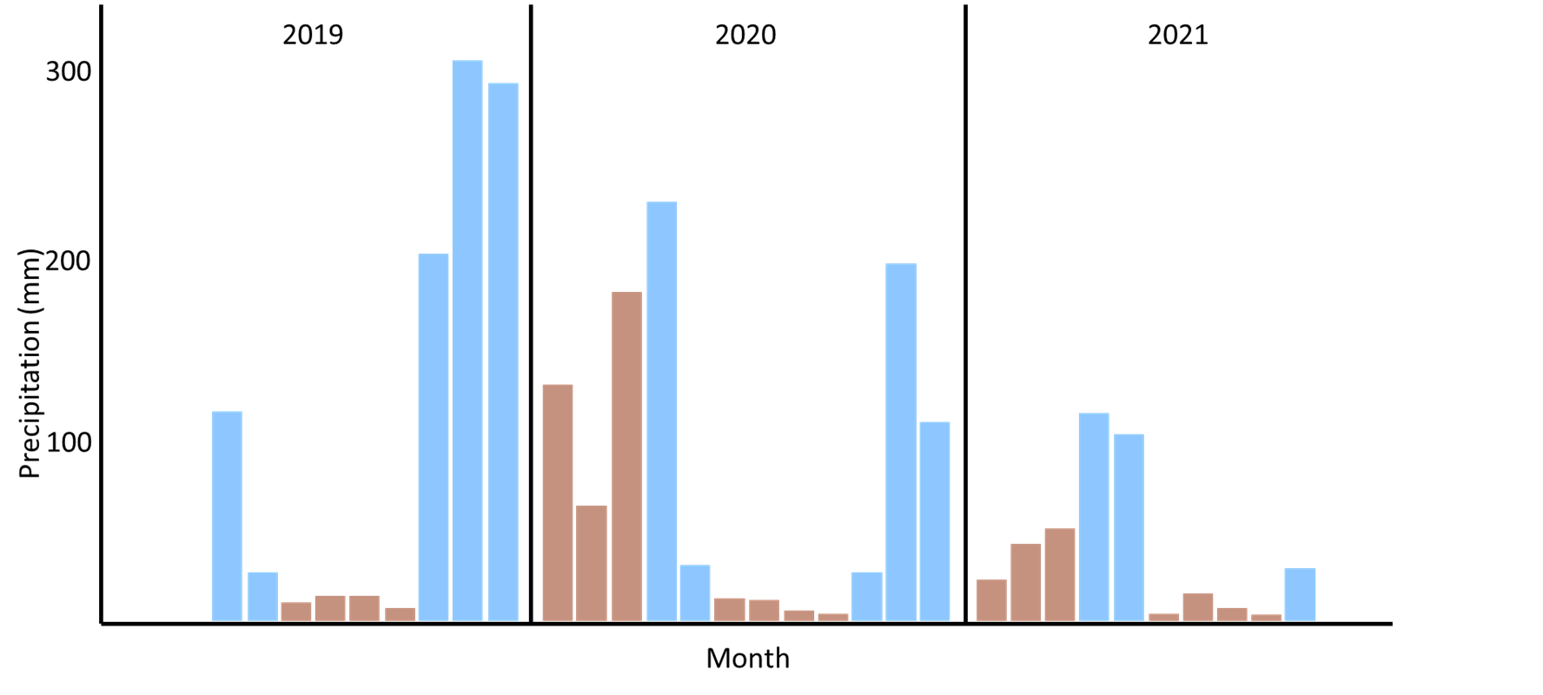
Smart hand pump abstraction
Notes:
Results from SHP research:
This graph show precipitation as bars: blue = perceived rainy season (more) and brown = perceived dry season (less) as per general literature
Then when we add on the abstraction line, we see that the highest abstraction occurs generally when rainfall is lower, highlighting the positive contribution that sand dams can make to year-round water security by providing water in times of greater need
Other results:
- High heterogeneity in abstraction between sites, with median abstraction being over 2,000L at some sites and less than 10 at others
- >50% of sites were meeting drinking water needs of the users by the end of the long dry season, again highlighting their positive contribution to dryland water security
Impacts:
- Aiding decision makers when choosing the most appropriate water management technique
- Improving holistic dryland water management
- Helping in optimising sand dam design
- Aiding sand-dam funding applications

Slide 22
Data Stewards - An Emerging Competency for Catalyzing Utilization of WASH Data for
Decision Making?
A Malawi Case Study

Slide 23
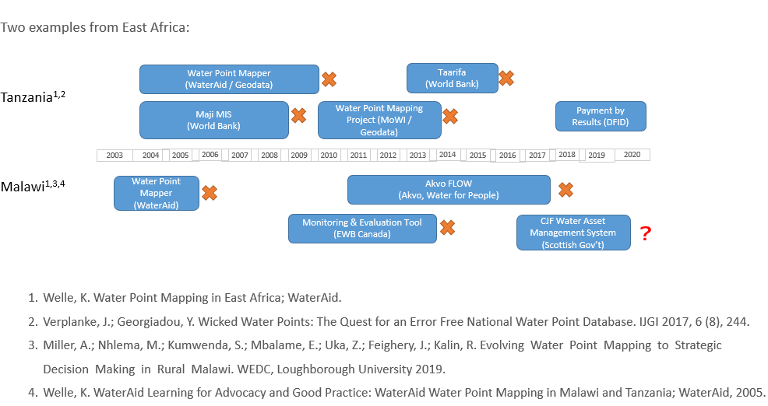
Why is it easier to find failed WASH
MI systems?

Slide 24
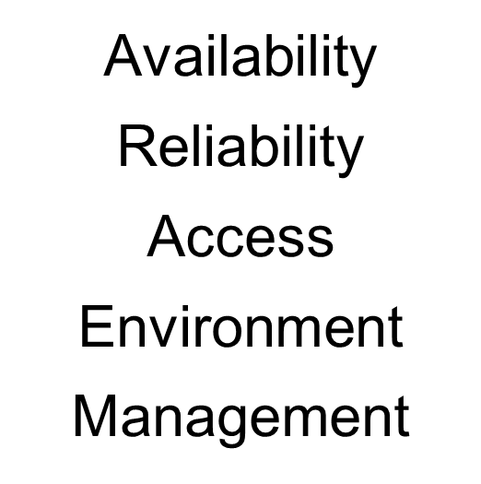
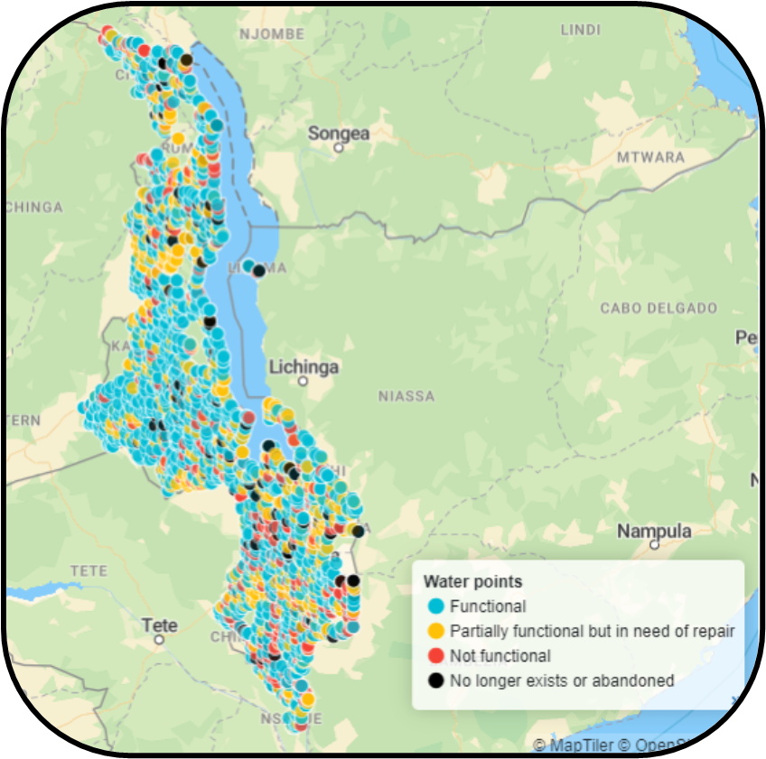
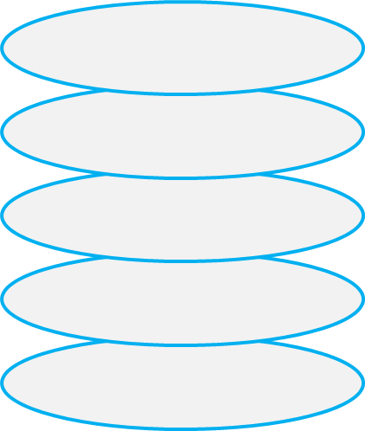
 | Water Points | Pit Latrines
Surveys | 123,774 | 307,273
Data per survey | 67 | 22
Notes:
Slide 2 – how was WASH Basins Global Toolkit created
PSI & Samerth – time taken taking surveys comparison
Tailored to India context
History and benefit
Successful trials in India with NGOs PSI and Samerth
6 Stage process with outcome of WSPs
Updated Toolkit for a Global context…..
Slide 2 – how was WASH Basins Global Toolkit created
PSI & Samerth – time taken taking surveys comparison
Tailored to India context
History and benefit

Slide 25
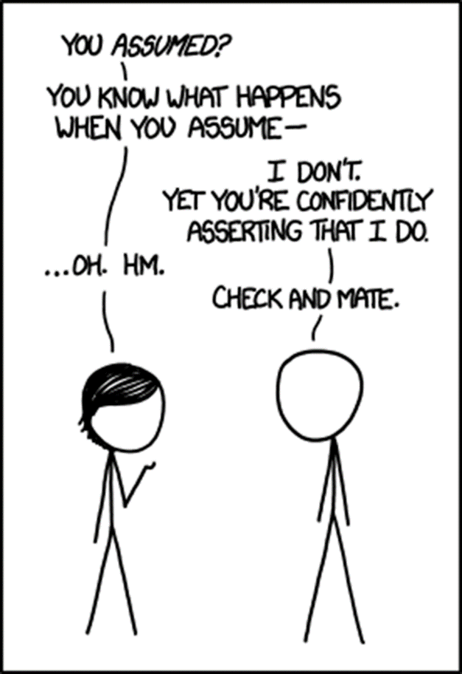
Assumptions
Technology is a game changer (welcome with open arms)!
Build it and they will come!
More data means more impact!
Training is enough!
A conducive data culture is
in place
Functional channels of communication within the government/sector exist

Slide 26
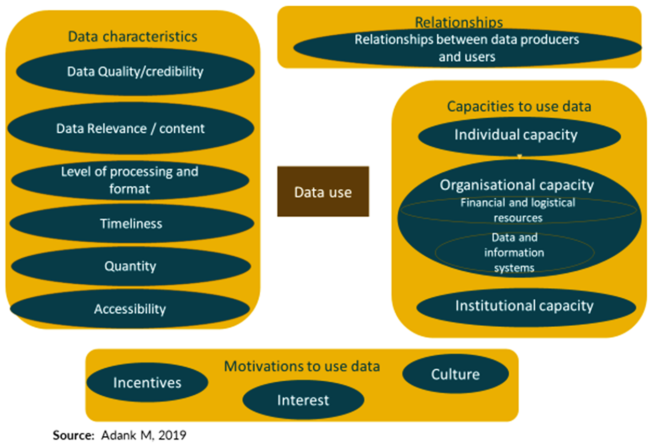
Data use model: systems

Slide 27

Data Stewards: bridging the gap
A new competency is needed in WASH data science/practice: data stewards (Biz world)
Conversant w/ data value chain
Systems builder with political intelligence (pragmatism)
Navigate the political economy (power, gaps & incentives)
Persistent and resilient (systems change)
Impact: Incremental NOT transformational change
Finance: Patient capital
Notes:
Slide 2 – how was WASH Basins Global Toolkit created
PSI & Samerth – time taken taking surveys comparison
Tailored to India context
History and benefit
Successful trials in India with NGOs PSI and Samerth
6 Stage process with outcome of WSPs
Updated Toolkit for a Global context…..
Slide 2 – how was WASH Basins Global Toolkit created
PSI & Samerth – time taken taking surveys comparison
Tailored to India context
History and benefit

Slide 28

Ingredients for increasing impact on water management with data

Slide 29
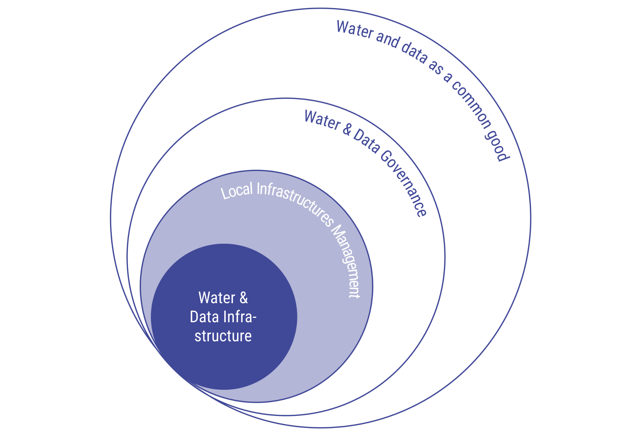

Data for impact
1970s
50 years of water development for improved lives

Slide 30
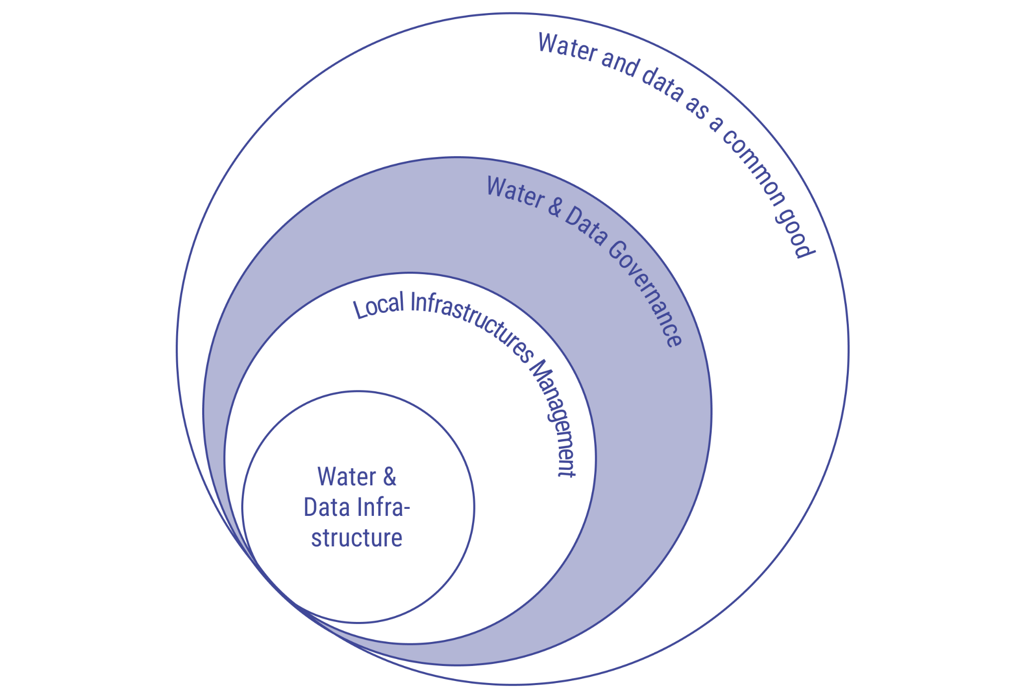
Data for impact
2000s
In the water sector:

Slide 31
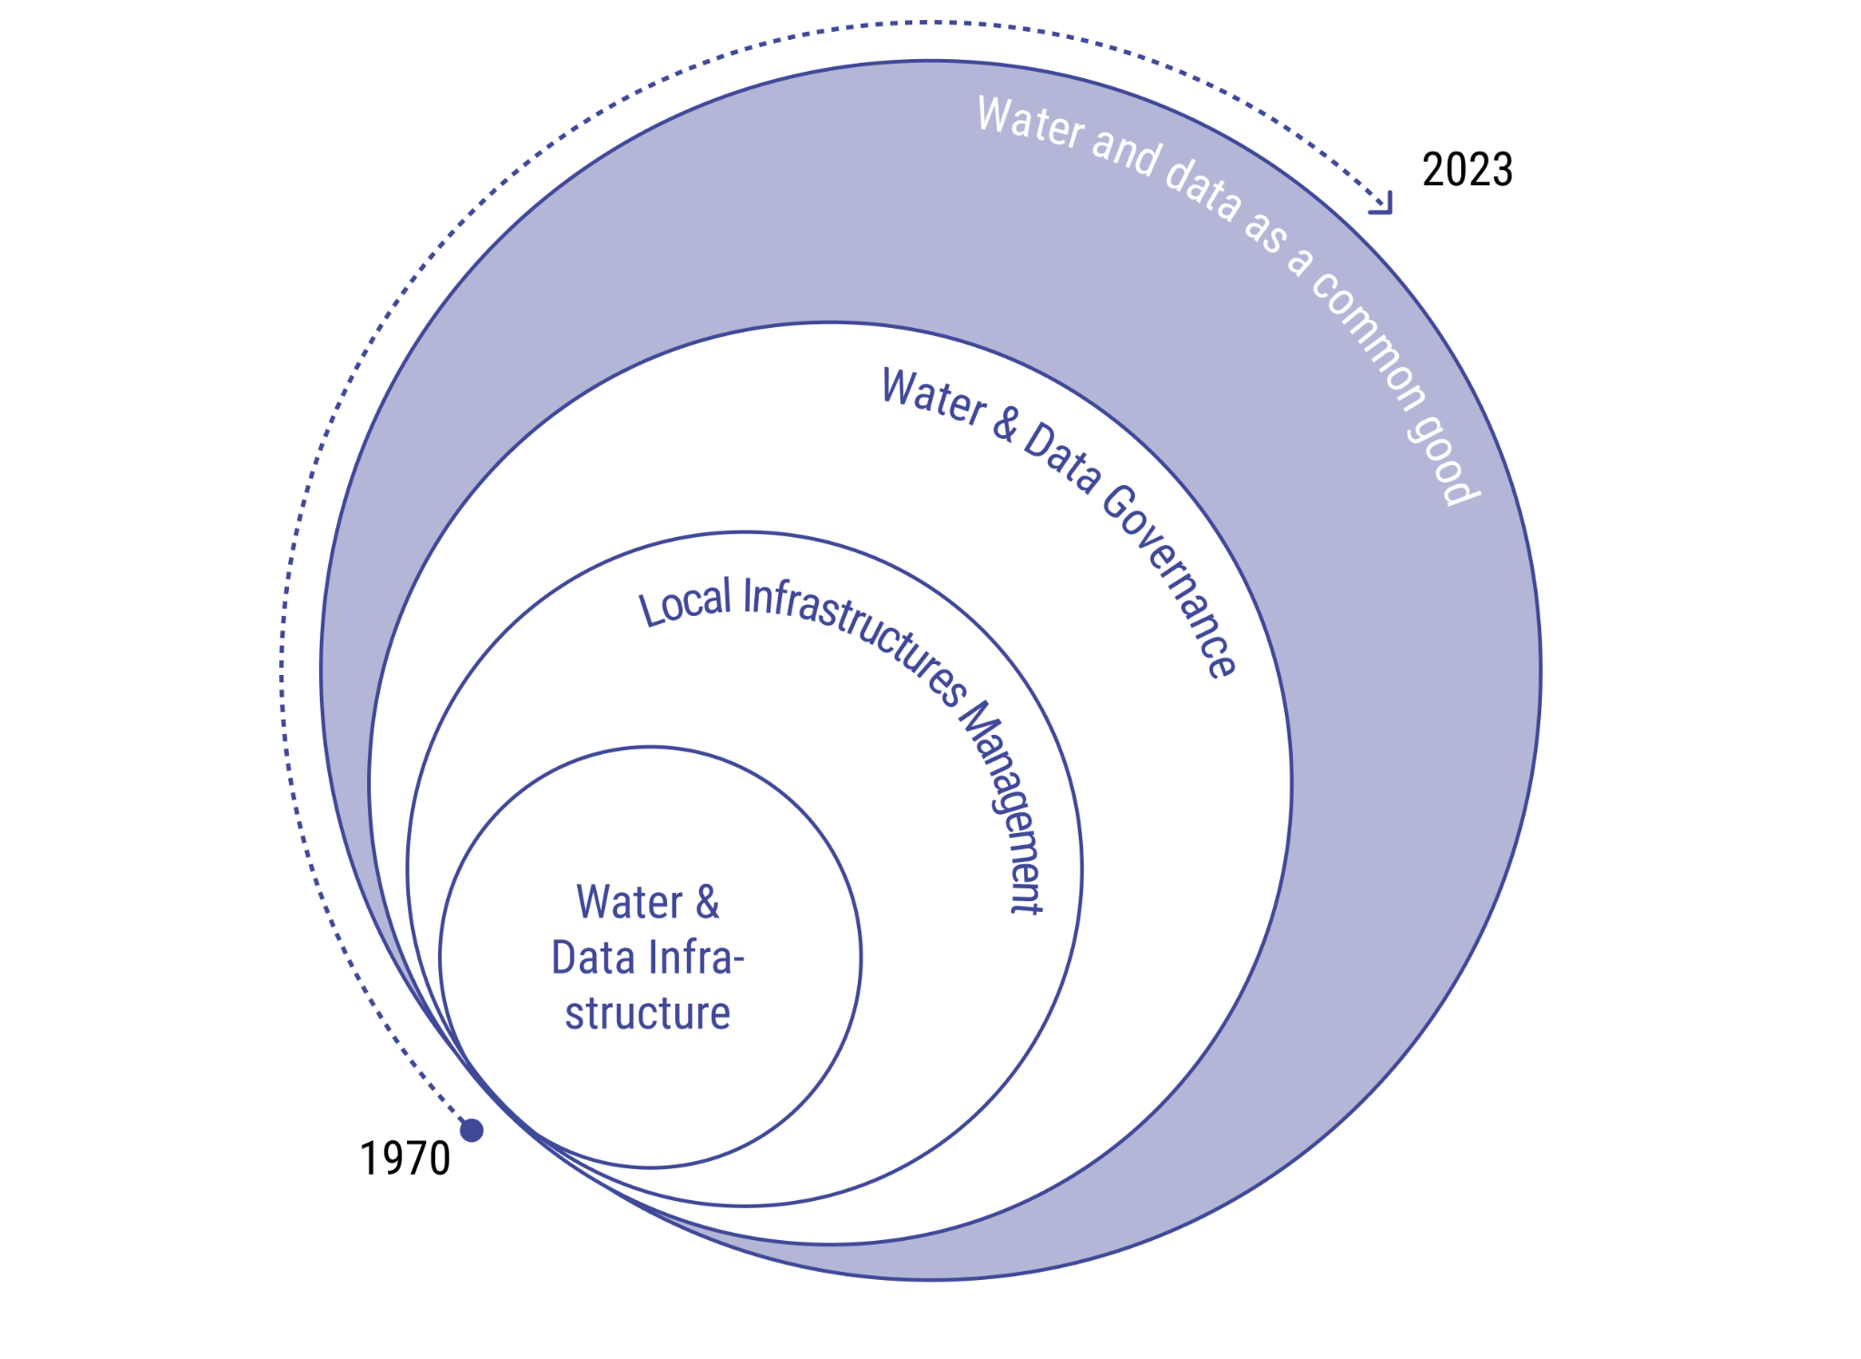
Data for impact
NOW!
In the water sector:

Slide 32
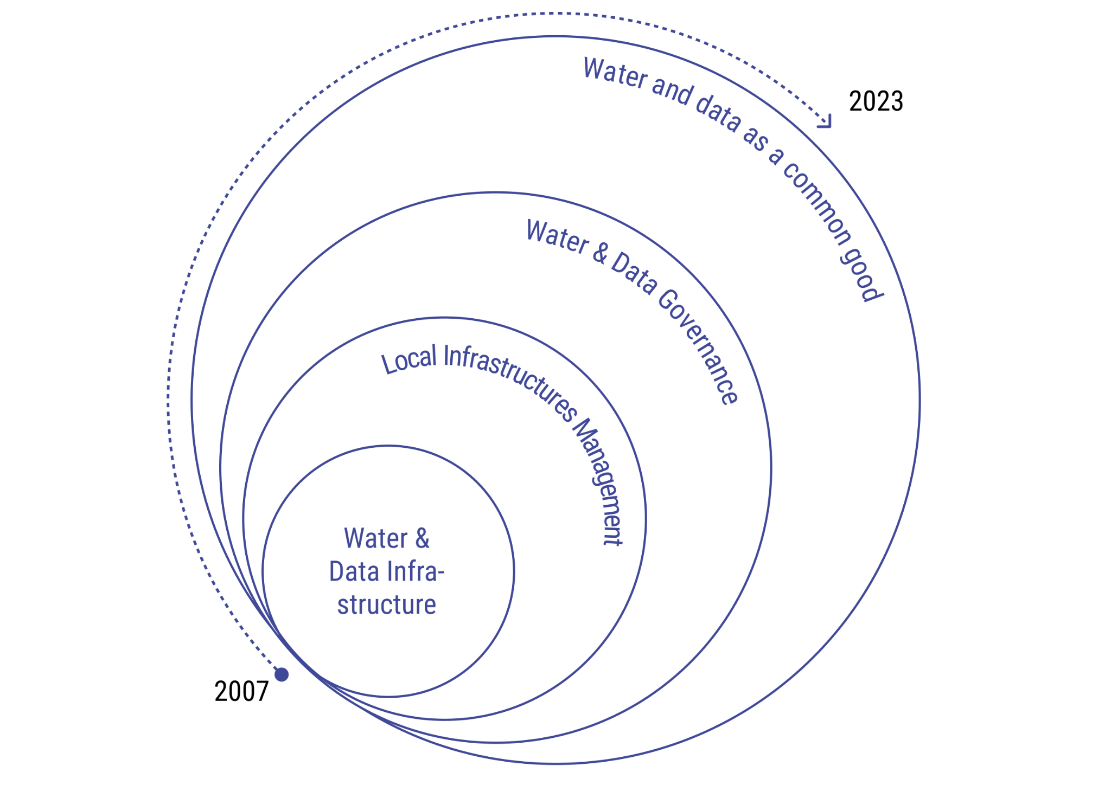
Digital mediation for impact
NOW!
Akvo has 15 years of digital development in the water sector
Co-creation and ecosystem approach
Sector expertise
Local engagement

Slide 33

Data tools
45921705
Notes:
Untitled presentation - Mentimeter

Slide 34
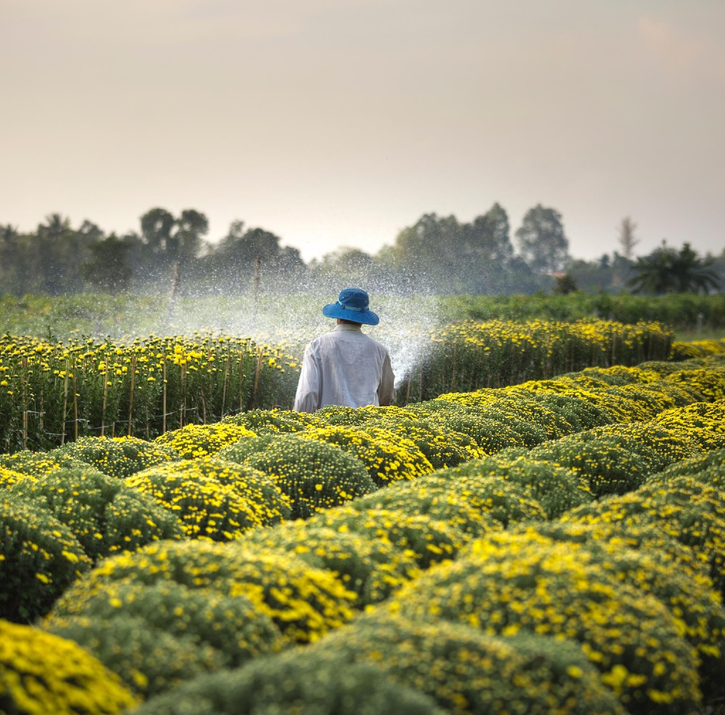

Discussion - sharing data
What potential (system) benefits can you think of coming from sharing water data with both the water and other sectors, like general census, health, housing/infrastructure, agriculture, and using the data from these sectors for water governance?
Can you highlight any challenges or opportunities that you have experienced
with sharing water data with other sectors?
Notes:
Zooming out

Slide 35
Should data always be shared?
45921705
Notes:
Untitled presentation - Mentimeter

Slide 36


Discussion - data use
Do you have inspiring examples of how you are using visualisations of data and methods to make them inclusive and accessible for all (including communities, people in vulnerable situations, the general public)
What are some key learnings (e.g., from case studies) from how data and / or tools are being used and mainstreamed for water governance?
Notes:
Zooming in

Slide 37
Which factors must be used to enable the leap from data visualization to data-driven decision making and action?
45921705
Notes:
Untitled presentation - Mentimeter

Slide 38
Questions

Slide 39




Resources
Water for People
Okettayot, S. L., Achiro, B., & Guma, B. E. (n.d.). Technical performance of CTD diver as an IWRM tool for mitigating climatic shock and enhancing water supply sustainability: Experience from the Mid-western
Uganda region. The 2023 All Systems Connect Symposium.
https://www.vanessen.com
https://diver-office.software.informer.com
Frank Water
https://www.frankwater.com/app/uploads/2022/01/WASH-Basins-Toolkit-Global-.pdf
https://play.google.com/store/apps/details?id=com.ttl.frankwater&hl=en&gl=US&pli=1
Akvo
Water safety platform https://wsp.akvotest.org/
https://worldwatermap.nationalgeographic.org/
https://www.worldbank.org/en/publication/wdr2021
Tools/guidance/document/papers
Safe Water Network
Web GIS Toolkit
Global Mapper
QGIS
Ghana's National Climate Change Adaptation Strategy (NCCAS)
Hannah
Thomson, P., Hope, R., & Foster, T. (2012). GSM-enabled remote monitoring of rural handpumps: A proof-of-concept study. Journal of Hydroinformatics, 14(4), 829–839. https://doi.org/10.2166/hydro.2012.183

Slide 40
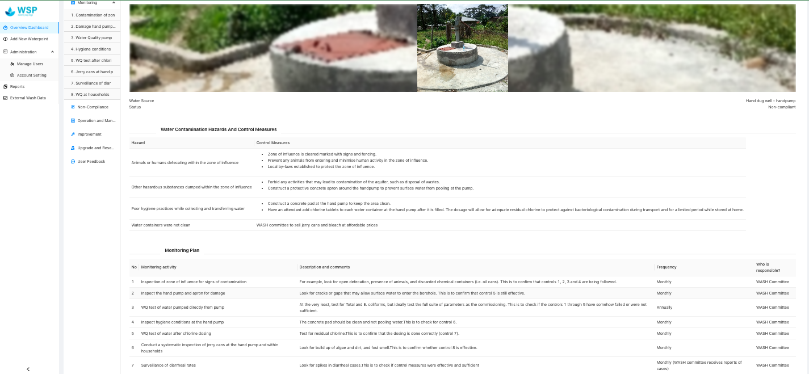
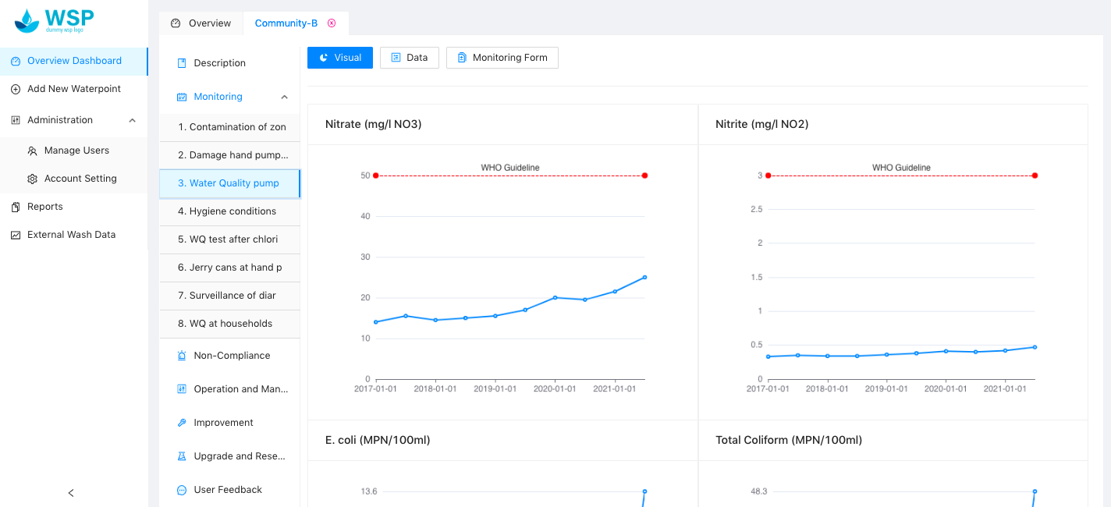
https://wsp.akvotest.org/

Slide 41






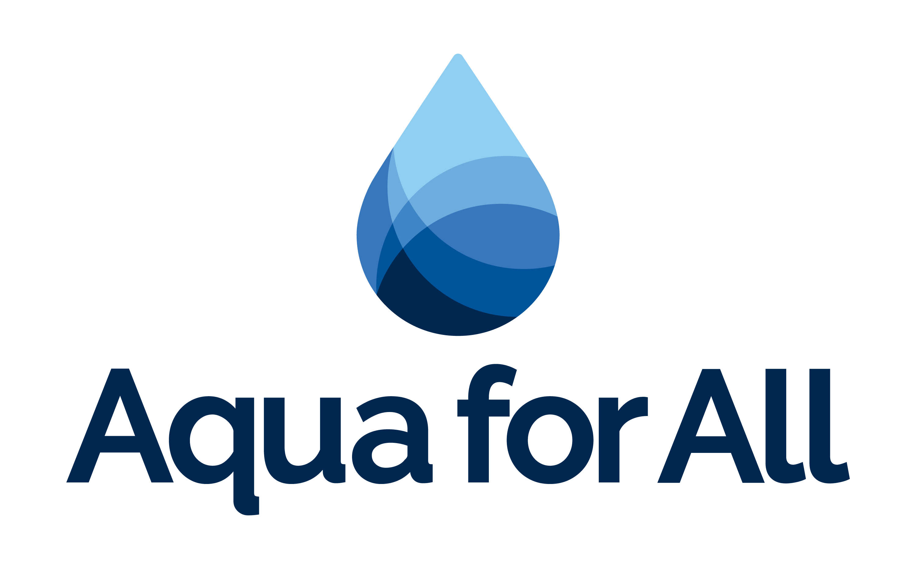



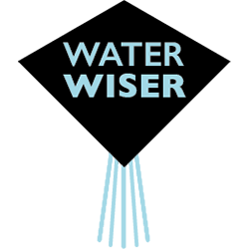







All Systems Connect 2023 is made possible thanks to the generous support of our partners including the World Health Organization and :

