Slide 1
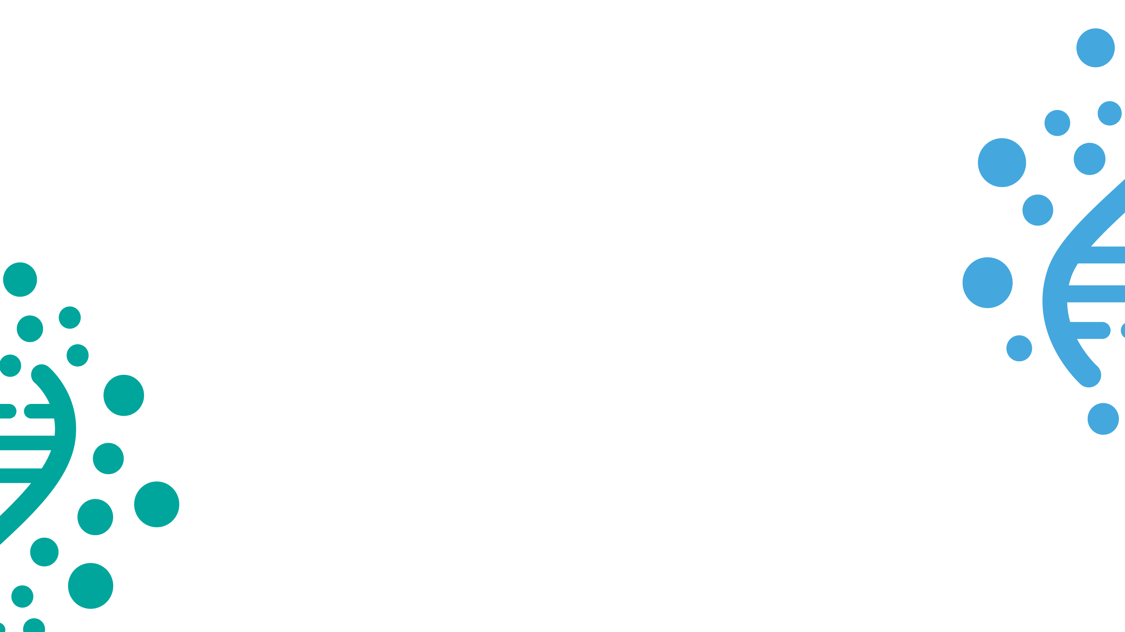
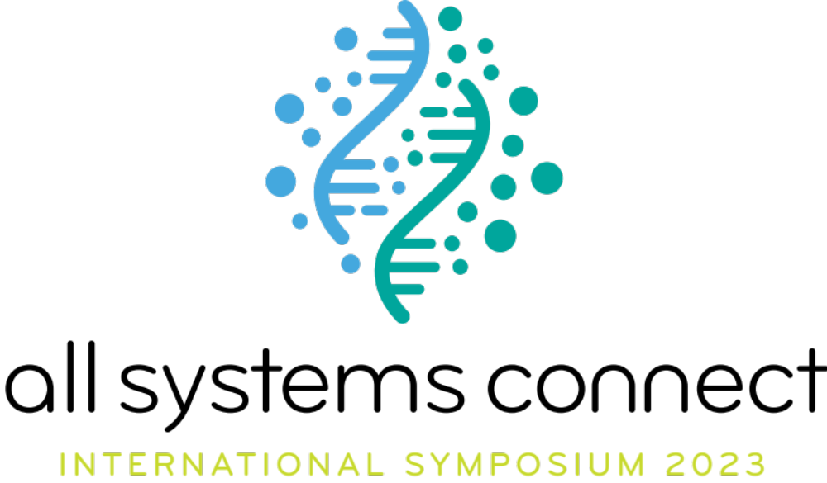

Slide 2

Systems strengthening
The key for a sustainable WASH sector
Subtitle of presentation

Slide 3
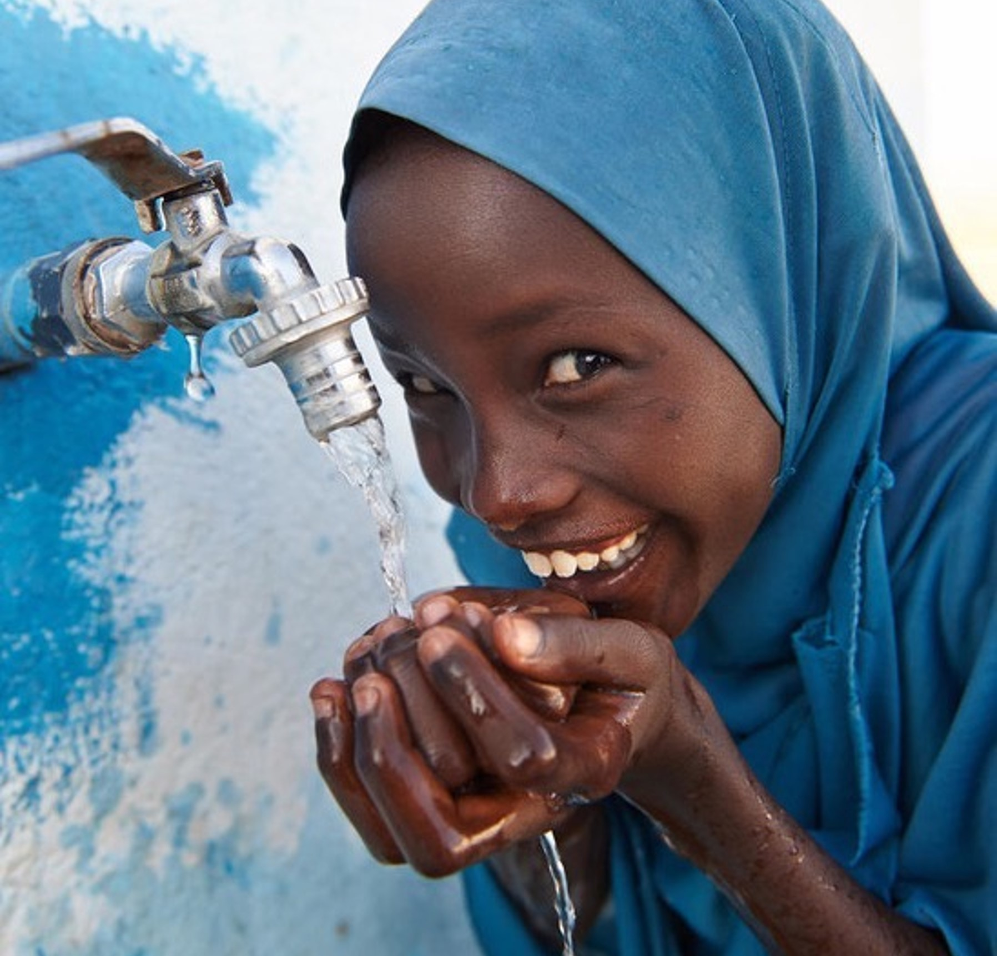
01.
Systems strengthening in the WASH sector an overview
Planning, analysis and collaboration for
better-informed programmes

Slide 4
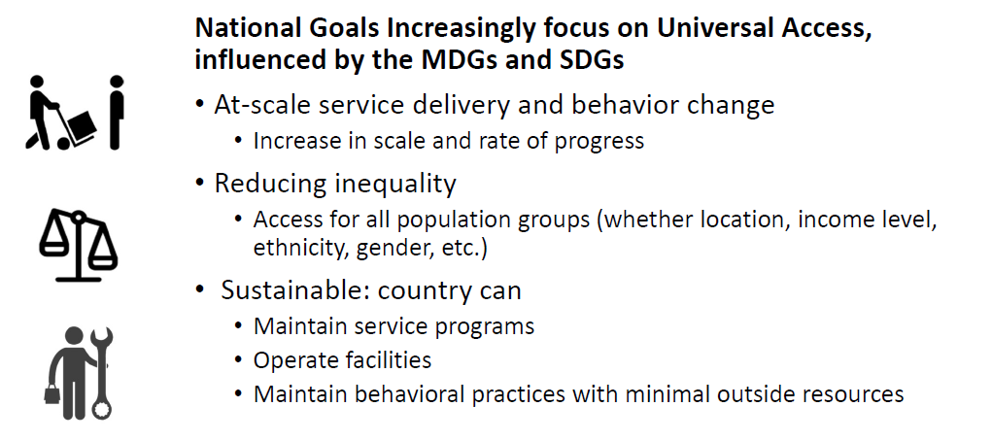
What are WASH sector goals?

Slide 5
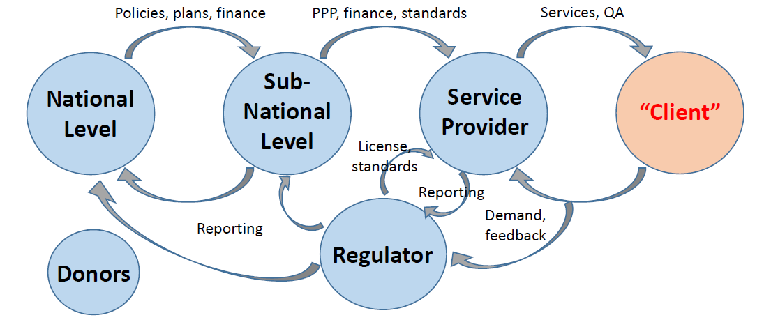
In WASH, outcomes depend on interactions across multiple levels

Slide 6
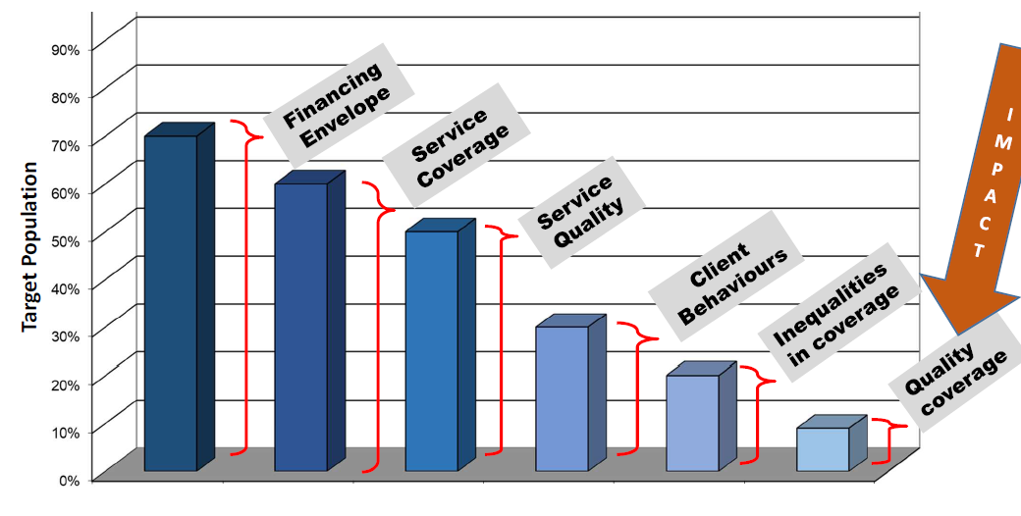
What happens when systems don’t work?

Slide 7
What does it need to achieve strong
WASH systems?
WASH services require strong national policies, financial systems, and monitoring in order to be sustainable, resilient and accountable. But in many countries, institutional structures remain fragile.
Countries that cannot sufficiently fund WASH services for those in need must strive for better coordination between governments, development partners and the general population at all stages of implementation. Adequate human resources and clear roles of government institutions and regulators are also critical.
In many cases, WASH services are planned without timely or accurate data. Budgets are set based on historical patterns rather than the needs of the population.
Government budgets for financing WASH, especially WASH infrastructure, and for expanding services to those in need remain low. Private sector investment is also insufficient, given the lack of legal frameworks, associated risks, and low returns in the water and sanitation business. As a result, one of the greatest barriers to achieving WASH-related targets is the large spending gap.
Without strong governance, neither government stakeholders nor donors and development partners
can be held accountable. What’s more, few WASH programmes are reviewed for their impact using
high-quality evaluations. Please try to use keywords and phrases;

Slide 8

Systems strengthening
in the WASH sector
Many tools are available:
The UNICEF WASH Bottleneck Analysis Tool (WASHBAT)
The WSP / World Bank Country Status Overviews (CSOs)
WASH Joint Sector Reviews (JSRs)
UN-Water Global Analysis and Assessment of Sanitation (UN-Water GLAAS)
The UNICEF Advocacy Toolkit
The Economics of Sanitation Initiative Toolkit (Link2)
The World Health Organization (WHO) Track-Fin
The DFID Value for Money (VFM) Tool
Sustainability Instruments (Clauses, Checks, Compacts)
The UNICEF Monitoring Results for Equity System (MoRES) Framework
WASH Accountability Mapping Tools (Link2)
WASH systems academy (IRC)
© UNICEF/UN0236701/Brow

Slide 9
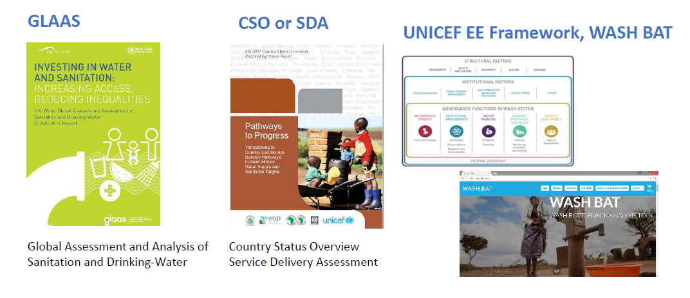
Tools for assessing the enabling environment
Notes:
UNICEF works in the following areas to strengthen WASH systems worldwide:
Data and evidence
The WHO/UNICEF Joint Monitoring Programme for WASH is the leading source of estimates of progress towards targets laid out in the Sustainable Development Goals. Covering over 190 countries and territories, the programme has established mechanisms for collecting and compiling country data. These estimates help enhance sector monitoring, communicate gaps in WASH services, and raise funds.
Collaboration in WASH
As a player in the WASH sector, there are many global, regional and national partnerships to join, which is key to ensure that systems strengthening is part of overall acceleration towards SDG 6. We host Sanitation and Water for All (SWA), a global partnership of governments, donors, civil society organizations and other development stakeholders that coordinates on improved accountability and resource allocation.
UNICEF is also an active participant in UN Water, which coordinates the work of the United Nations in the areas of water and sanitation. We are a founding member of WASH4WORK, and play a leading role in the WASH Working Group and the Grand Menstrual Health and Hygiene Management Collective. UNICEF continues to leverage the private sector for financing, information, social change and system strengthening.
Capacity-building
Training for governments as well as online courses for partners and staff in strengthening WASH systems. Work in countries helps build local governments’ capacities for emergency planning, the collection and use of child services data, and coordination with the private sector and civil society.
Evaluation
With an eye on the Sustainable Development Goals, UNICEF regularly evaluates its work at the country, regional and global levels to improve our programmes and strategies. These evaluations help us understand what is working, what needs to be improved or changed, and what should be scaled up.
Aims of the GLAAS
• Monitors the inputs required to extend and sustain WASH
systems and services to all, especially the unserved and
disadvantaged groups
• Supports country-led processes that bring together
institutions and actors involved in delivering WASH
• Identifies drivers and bottlenecks of progress, highlight
knowledge gaps, and assess strengths and challenges
⇒ Feeds into the Sanitation and Water for All (SWA) meetings
⇒ Works with regional initiatives (AMCOW in Africa)

Slide 10
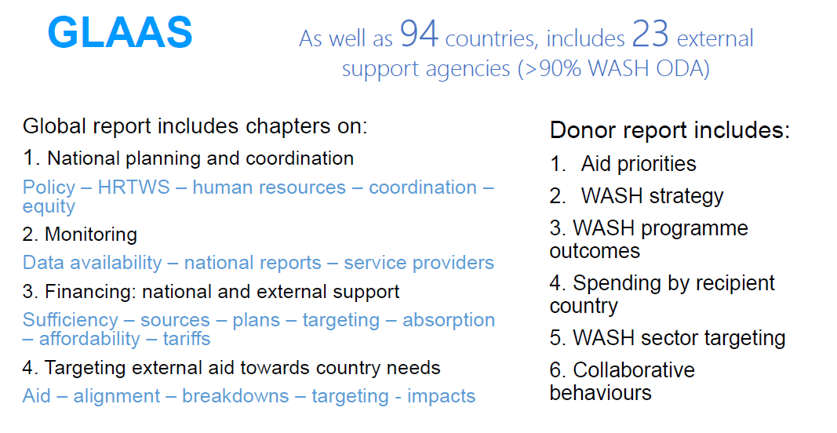

Slide 11
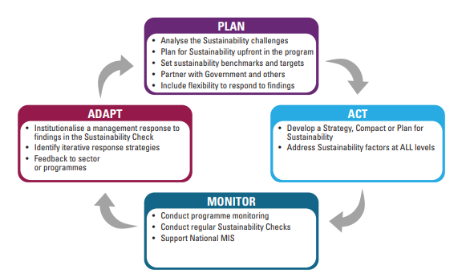
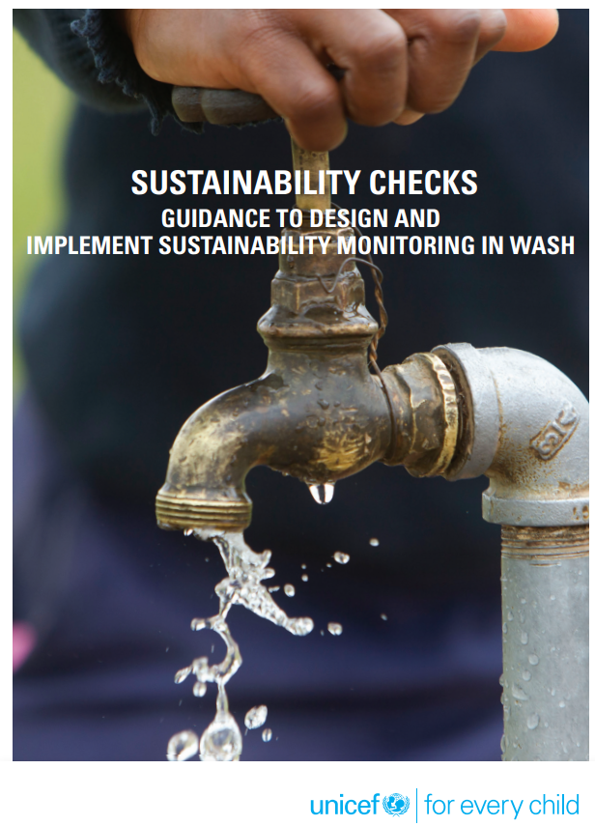
System strengthening in the WASH sector an overview
Sustainability Checks

Slide 12
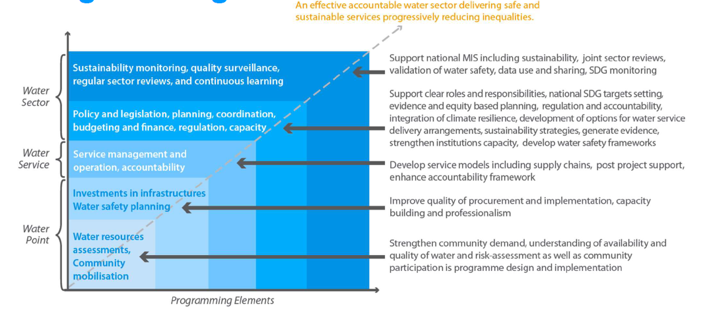
Example: implications for good water programming

Slide 13
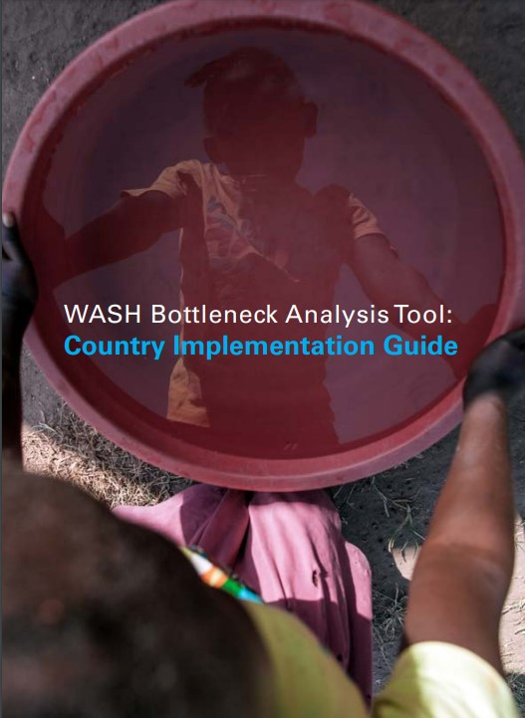
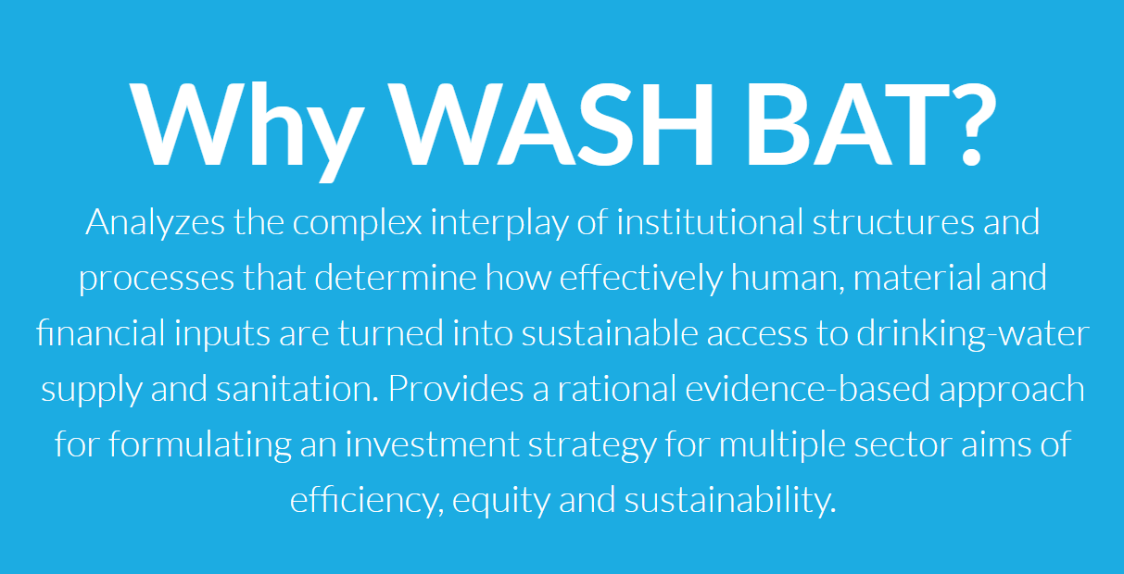
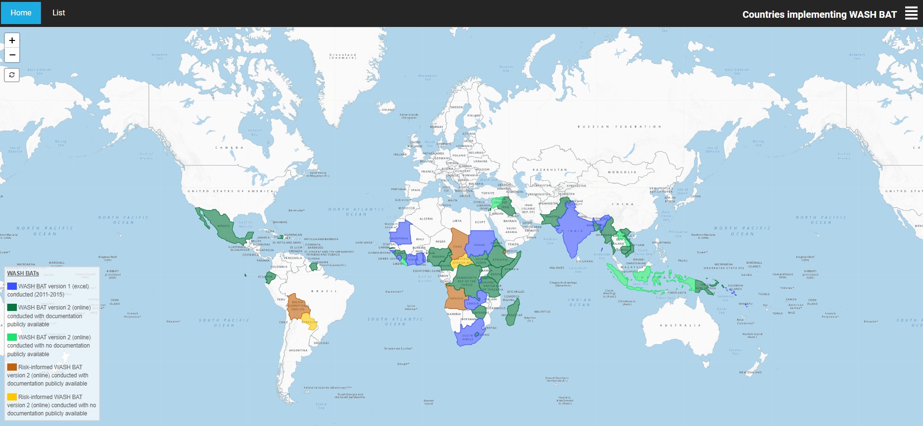
© UNICEF/PHOTO CREDIT
Notes:
In order to support the drinking-water, sanitation and hygiene (WASH) sector to reach the Sustainable Development Goals, an online tool “WASH BAT” or WASH Bottleneck Analysis Tool has been developed. The tool enables the development of costed and prioritized plans to remove the bottlenecks that constrains progress in the WASH sector.
Based on other tools covered in the EE introduction session, the WASH BAT was created to provide a step-by-step methodology to collaboratively identify and propose solutions for the problems afflicting the WASH sector It is a root cause analysis that seeks to answer – what are the key constraints to scaling up and sustaining quality WASH services? How can they be removed and at what cost? What is the priority and sequencing of each? Who is responsible?Primary adopters of the tool: GOVERNMENT with BROAD SECTOR OWNERSHIP Outcome of the tool: 1. Agreed major fundable activities to remove priority bottlenecks that inhibit sector progress 2. Integrated into government systems, gaining political support, with regular M&E

Slide 14
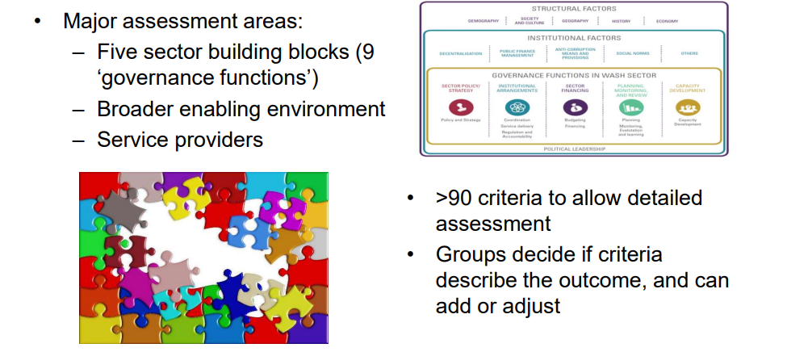
Basis of analysis

Slide 15
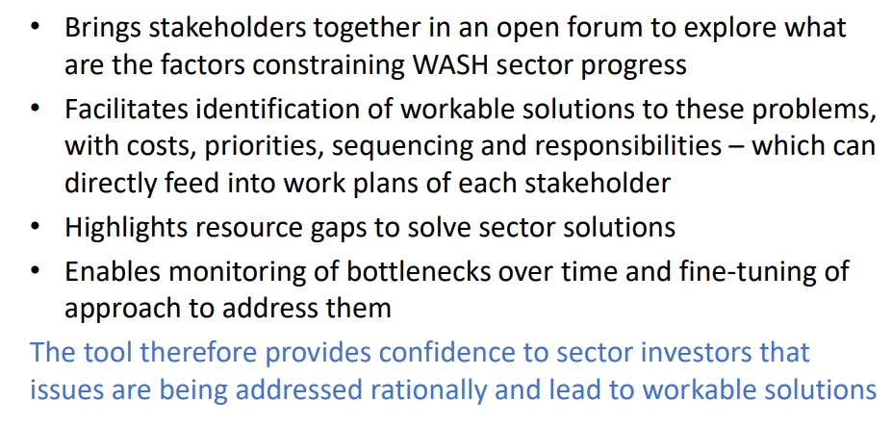
In brief, the WASH BAT:
Notes:
Conclusions •WASH BAT is a powerful tool, if it is connected to policy processes and implementation • Government ownership of process from the start • Workshop outputs need endorsement and follow-up• Can feed into other monitoring initiatives – e.g. JSR• Can be repeated (lighter touch) after 1-2 years

Slide 16
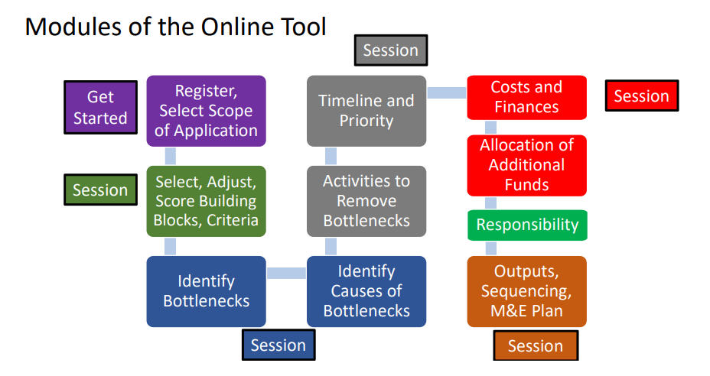
How is bottleneck analysis implemented?

Slide 17
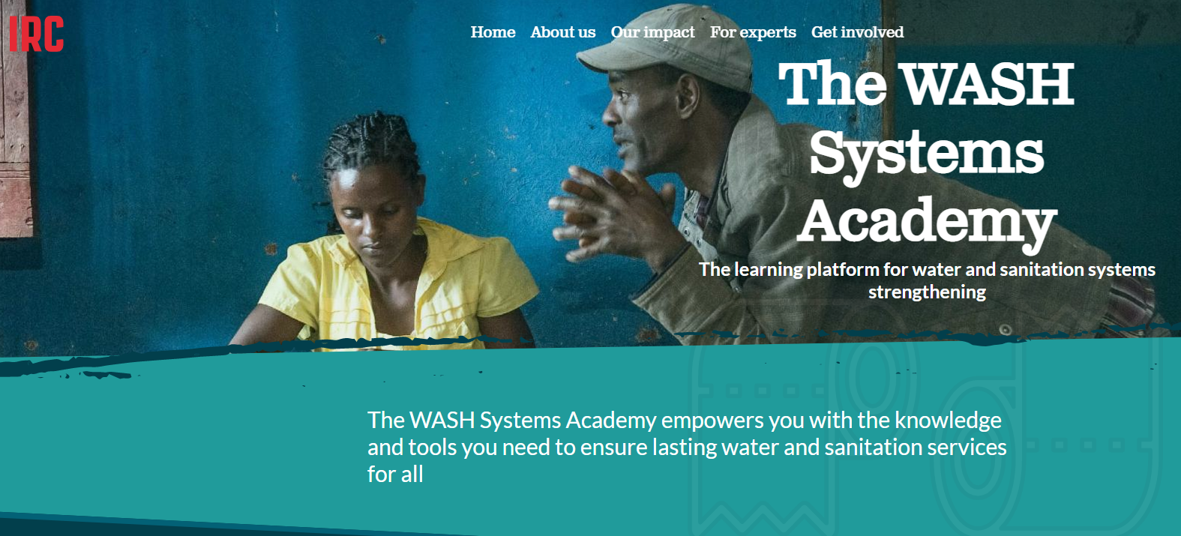
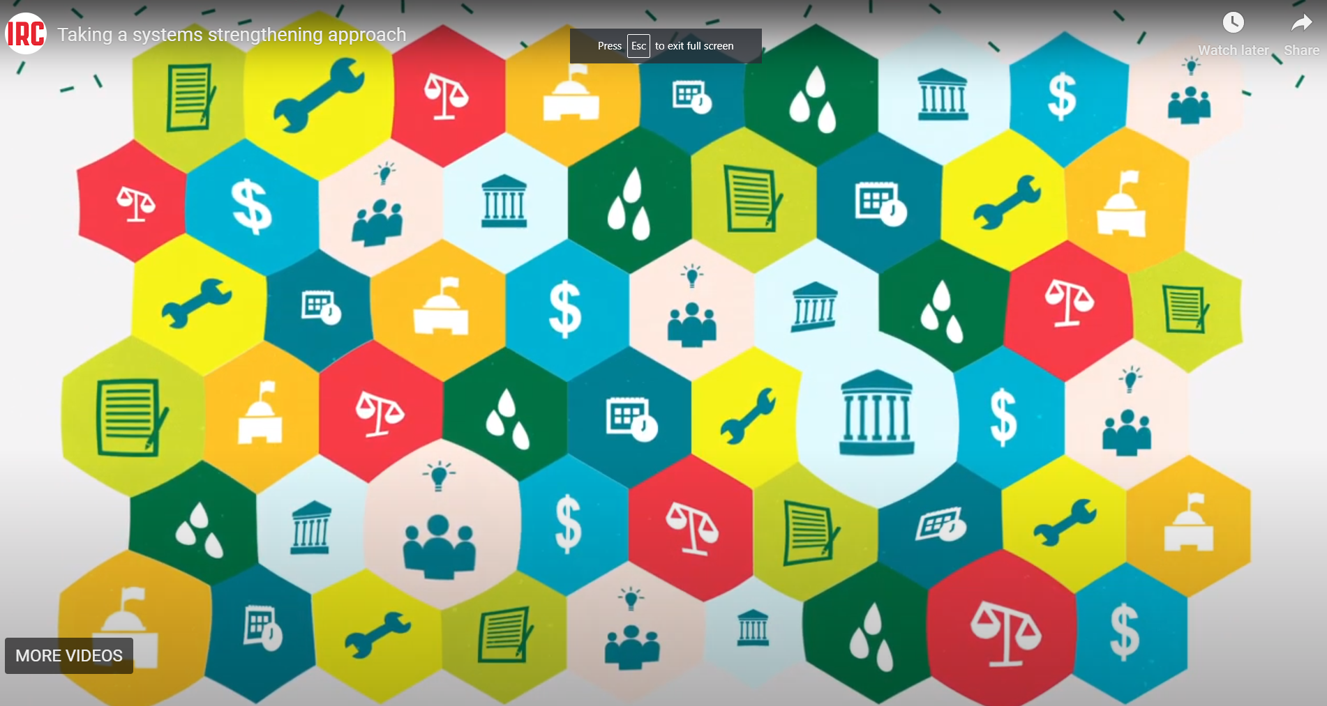

Slide 18

57%
Use this slide as a section
breaker, or to emphasize
on a number that is crucial.
Please avoid exceeding
beyond 1 sentence.
© UNICEF/UN0286458/Sang Mooh

Slide 19

Thank you
© UNICEF/UN0216133

