Slide 1
An Analysis of Strengthening Systems and Enhancing Collective Action to Achieve Universal WASH Coverage
Theme 4: Government, Politics and Systems Change

Slide 2
Session Overview
Overview of “Finish the Job”
Government engagement for sustainability in Rwanda
mWater mapping in Zambia
Working across multiple sectors to achieve universal coverage in Honduras
Partnership with Water for People on implementing a WASH project in Chiradzulu District, Malawi
Q & A

Slide 3
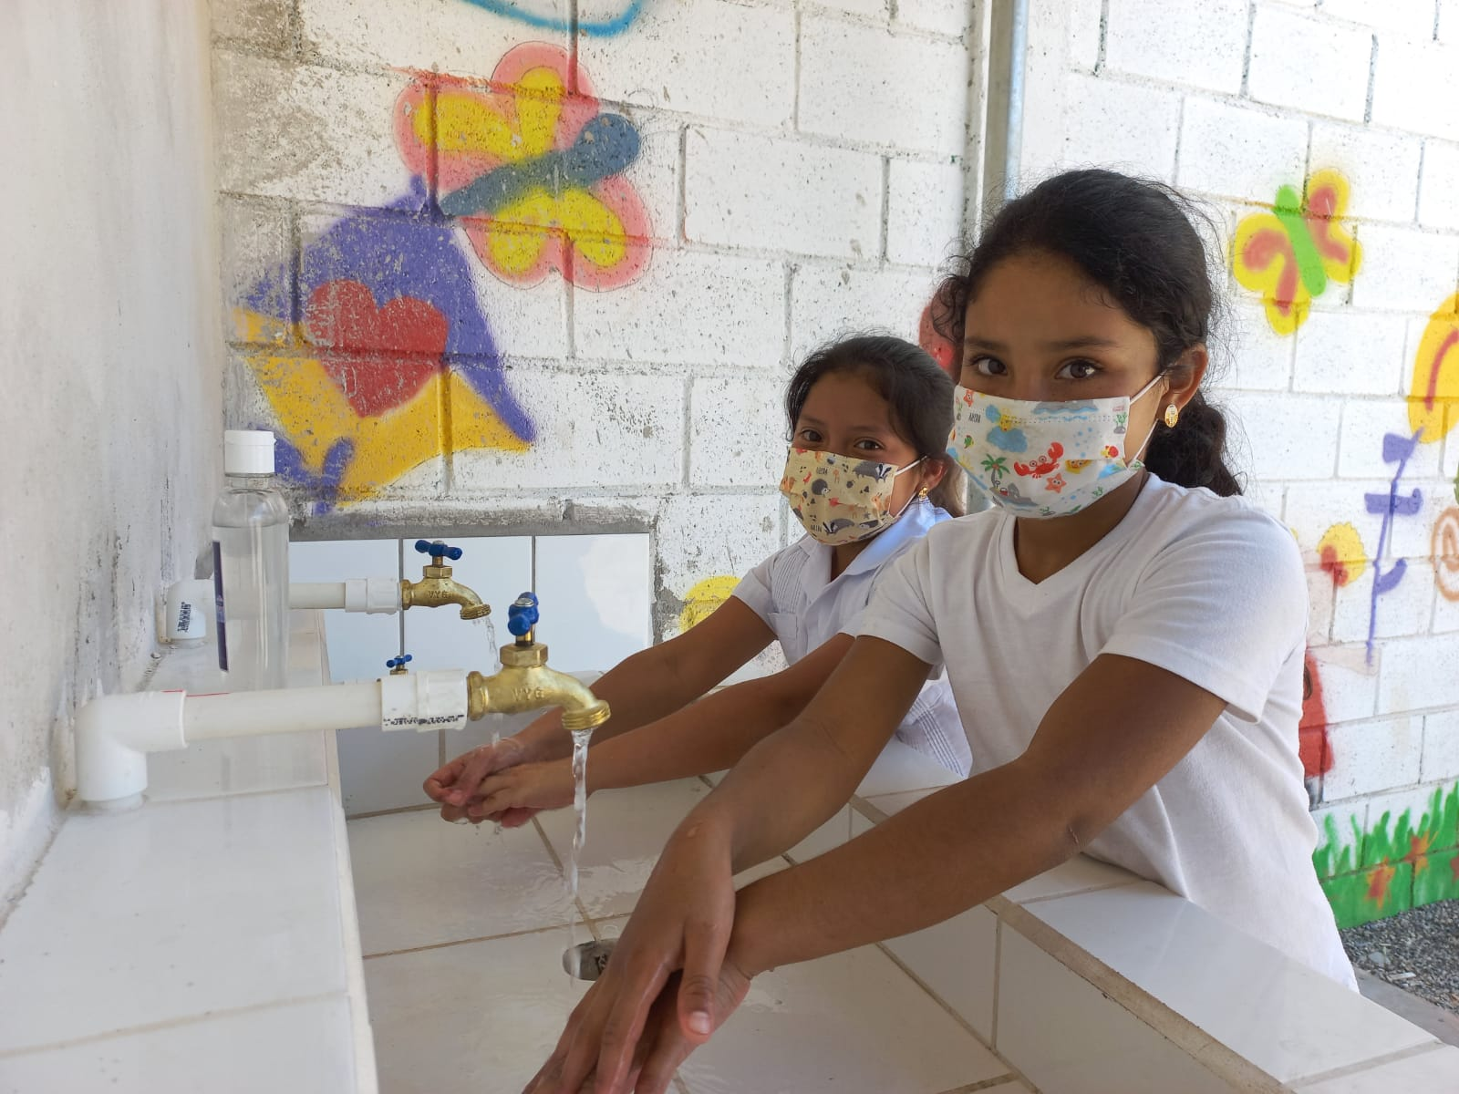
Finish the Job High Level Overview
What is "Finish the Job?"
Definition
Rwanda, Zambia and Honduras
Program Goals and Outcomes
Notes:
*Note definition of finishing the job is 90% coverage – that an endline household survey can show at least 90% of households have water within 30 minute roundtrip with 95% confidence

Slide 4
Government Engagement for Sustainability
Working with the Government and key stakeholders to achieve universal water coverage in Rwanda

Slide 5
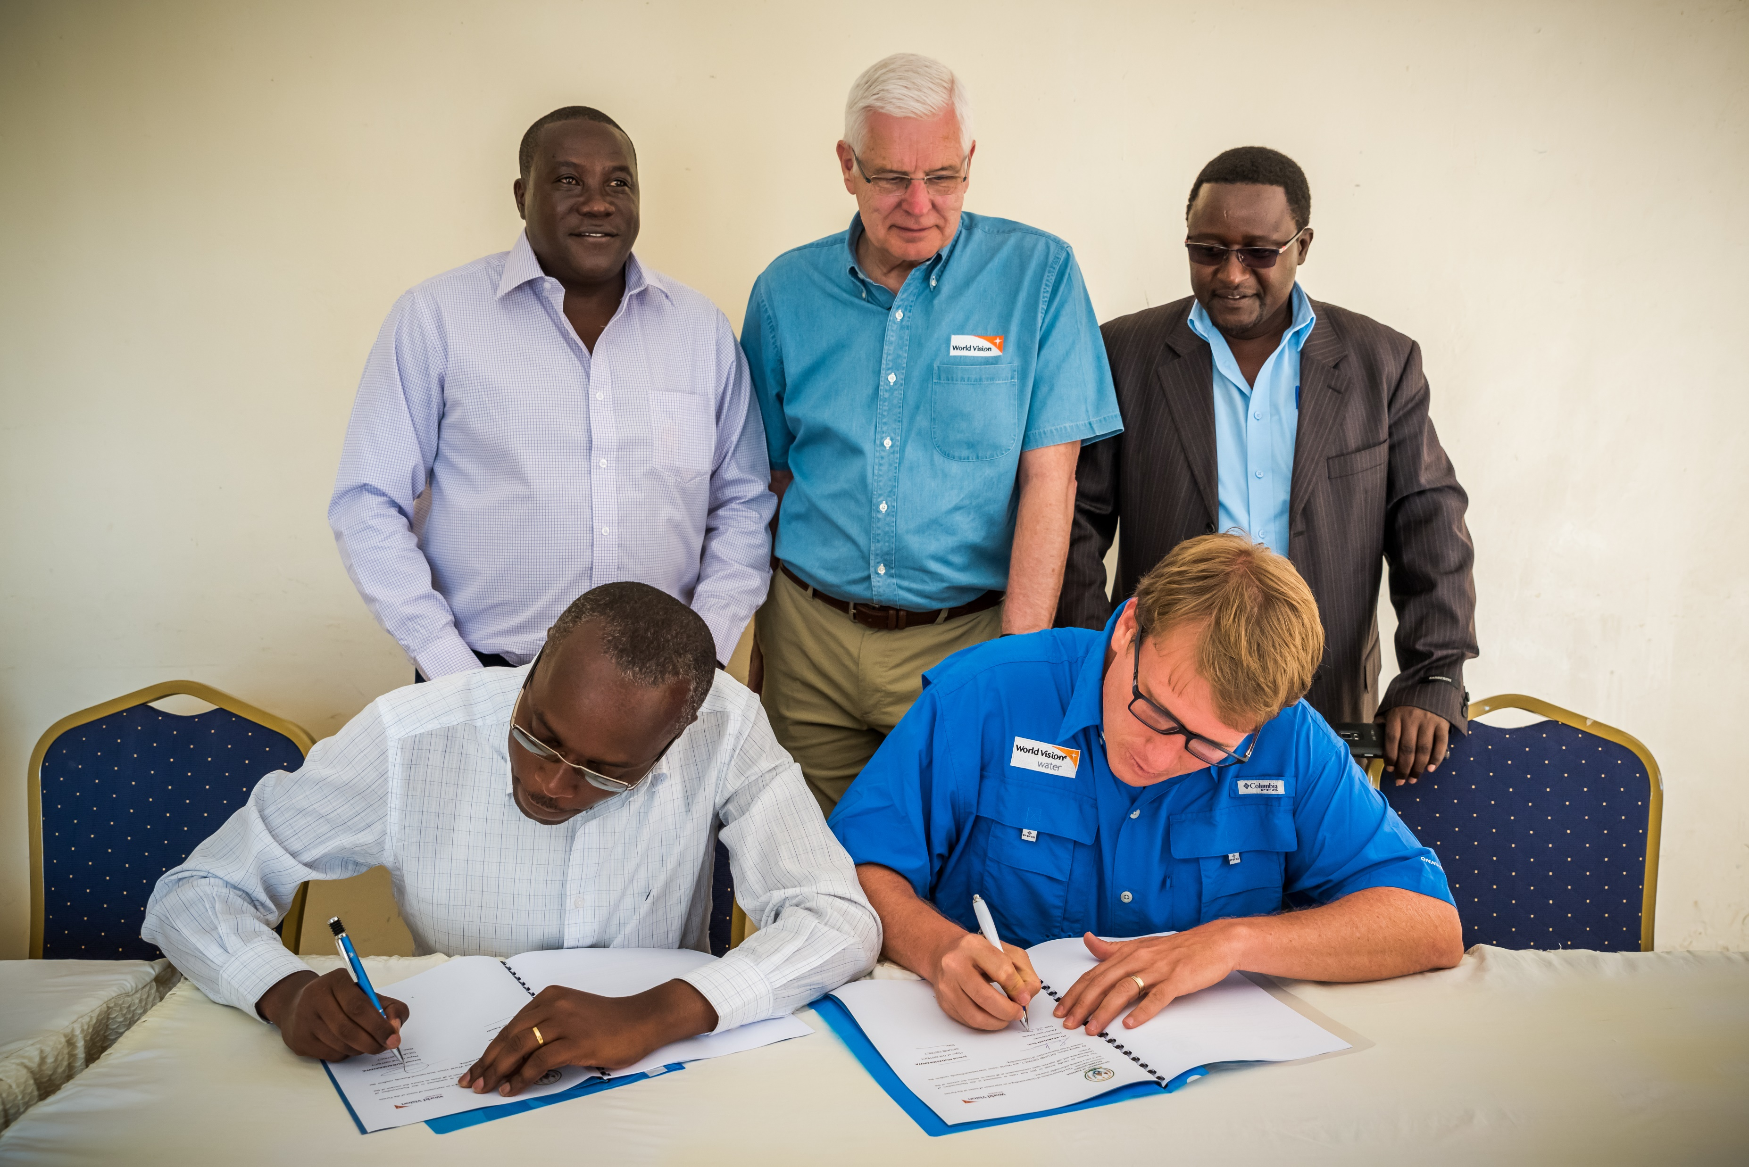
High-Level Engagement From the Beginning
Notes:
Launched project in March 2018 with meeting between WVUS president, WVR ND and Rwandan President. Also signed agreements with each individual district (Gicumbi district pictured) and negotiated investment from WVR and Government.
MoU with LODA is bigger than district MoUs so mention that.

Slide 6
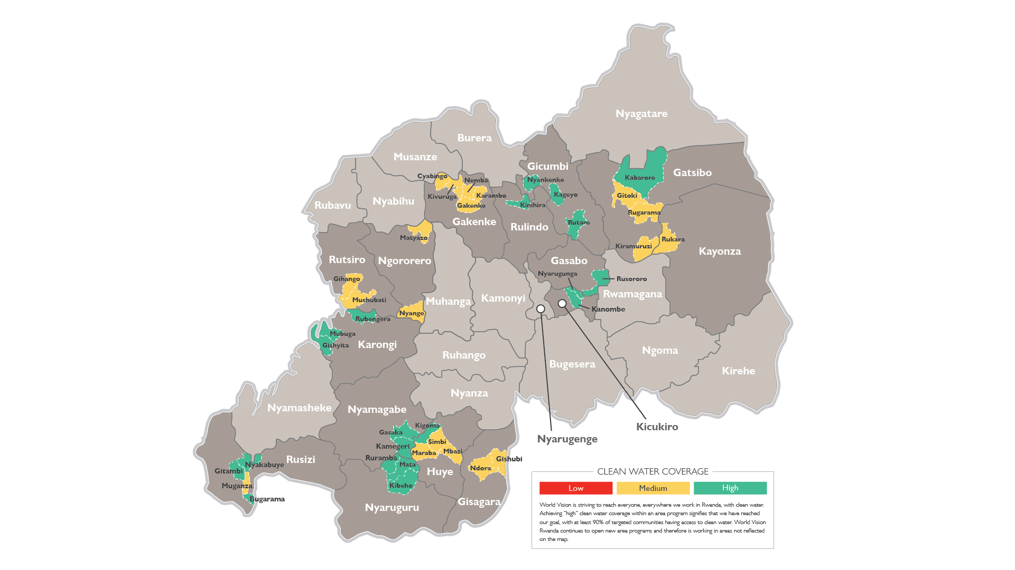
Sector Level Targeting
Notes:
In the future, it might be better to target a district level as this was asked for by district government
Our definition for "finishing the job" is that in endline household surveys, we can show at least 90% of households have water within a 30 minute roundtrip from the household.
*Need to speak on what role the government had in selecting areas and how our FTJ project is supporting an overall Rwanda Government vision
Speak about the before – how sectors were very red – and how the sectors slowly changed to green. We are on track to have all sectors green by the end of September.
Discuss the impact of this work – that the districts are now setting aside more funding for water systems and are looking for other partners to leverage that funding for additional water system construction.

Slide 7
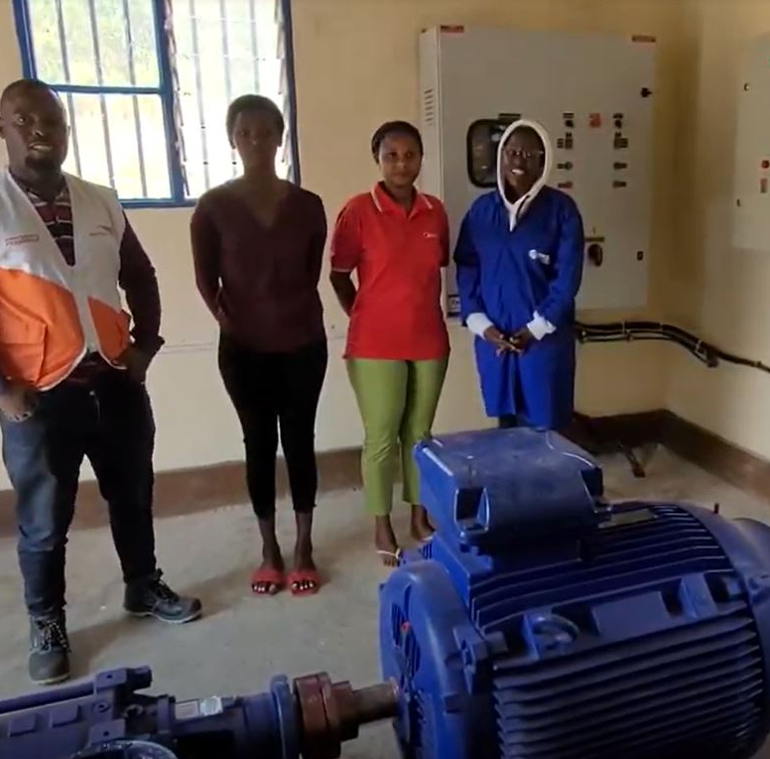
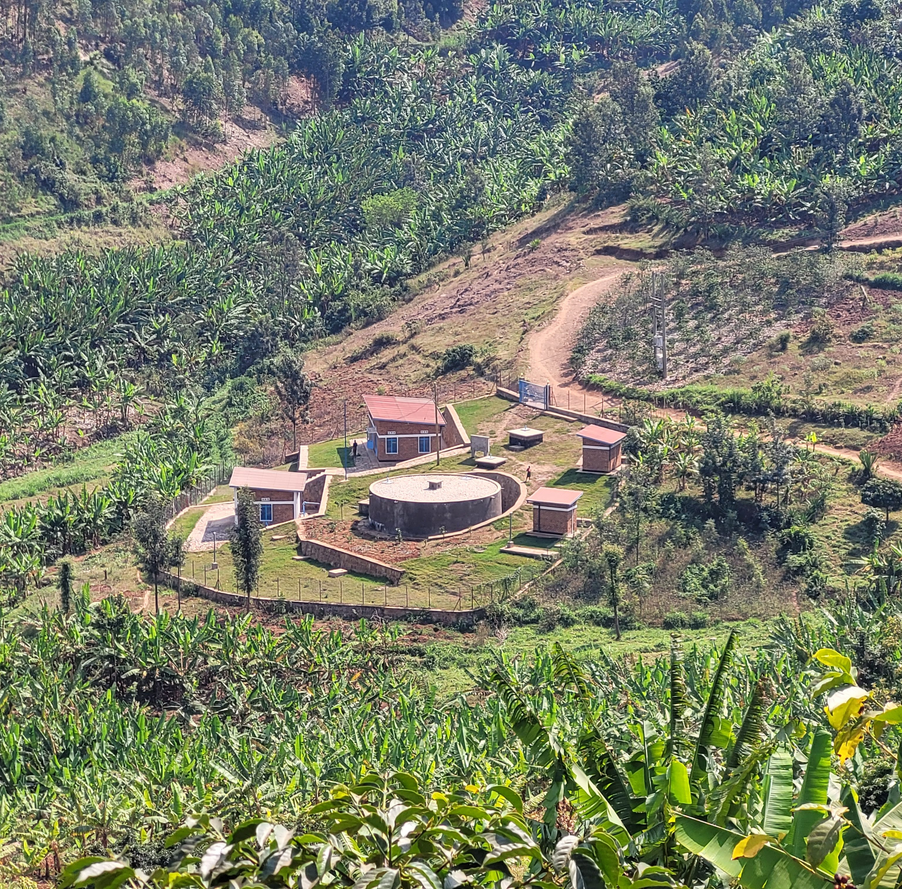
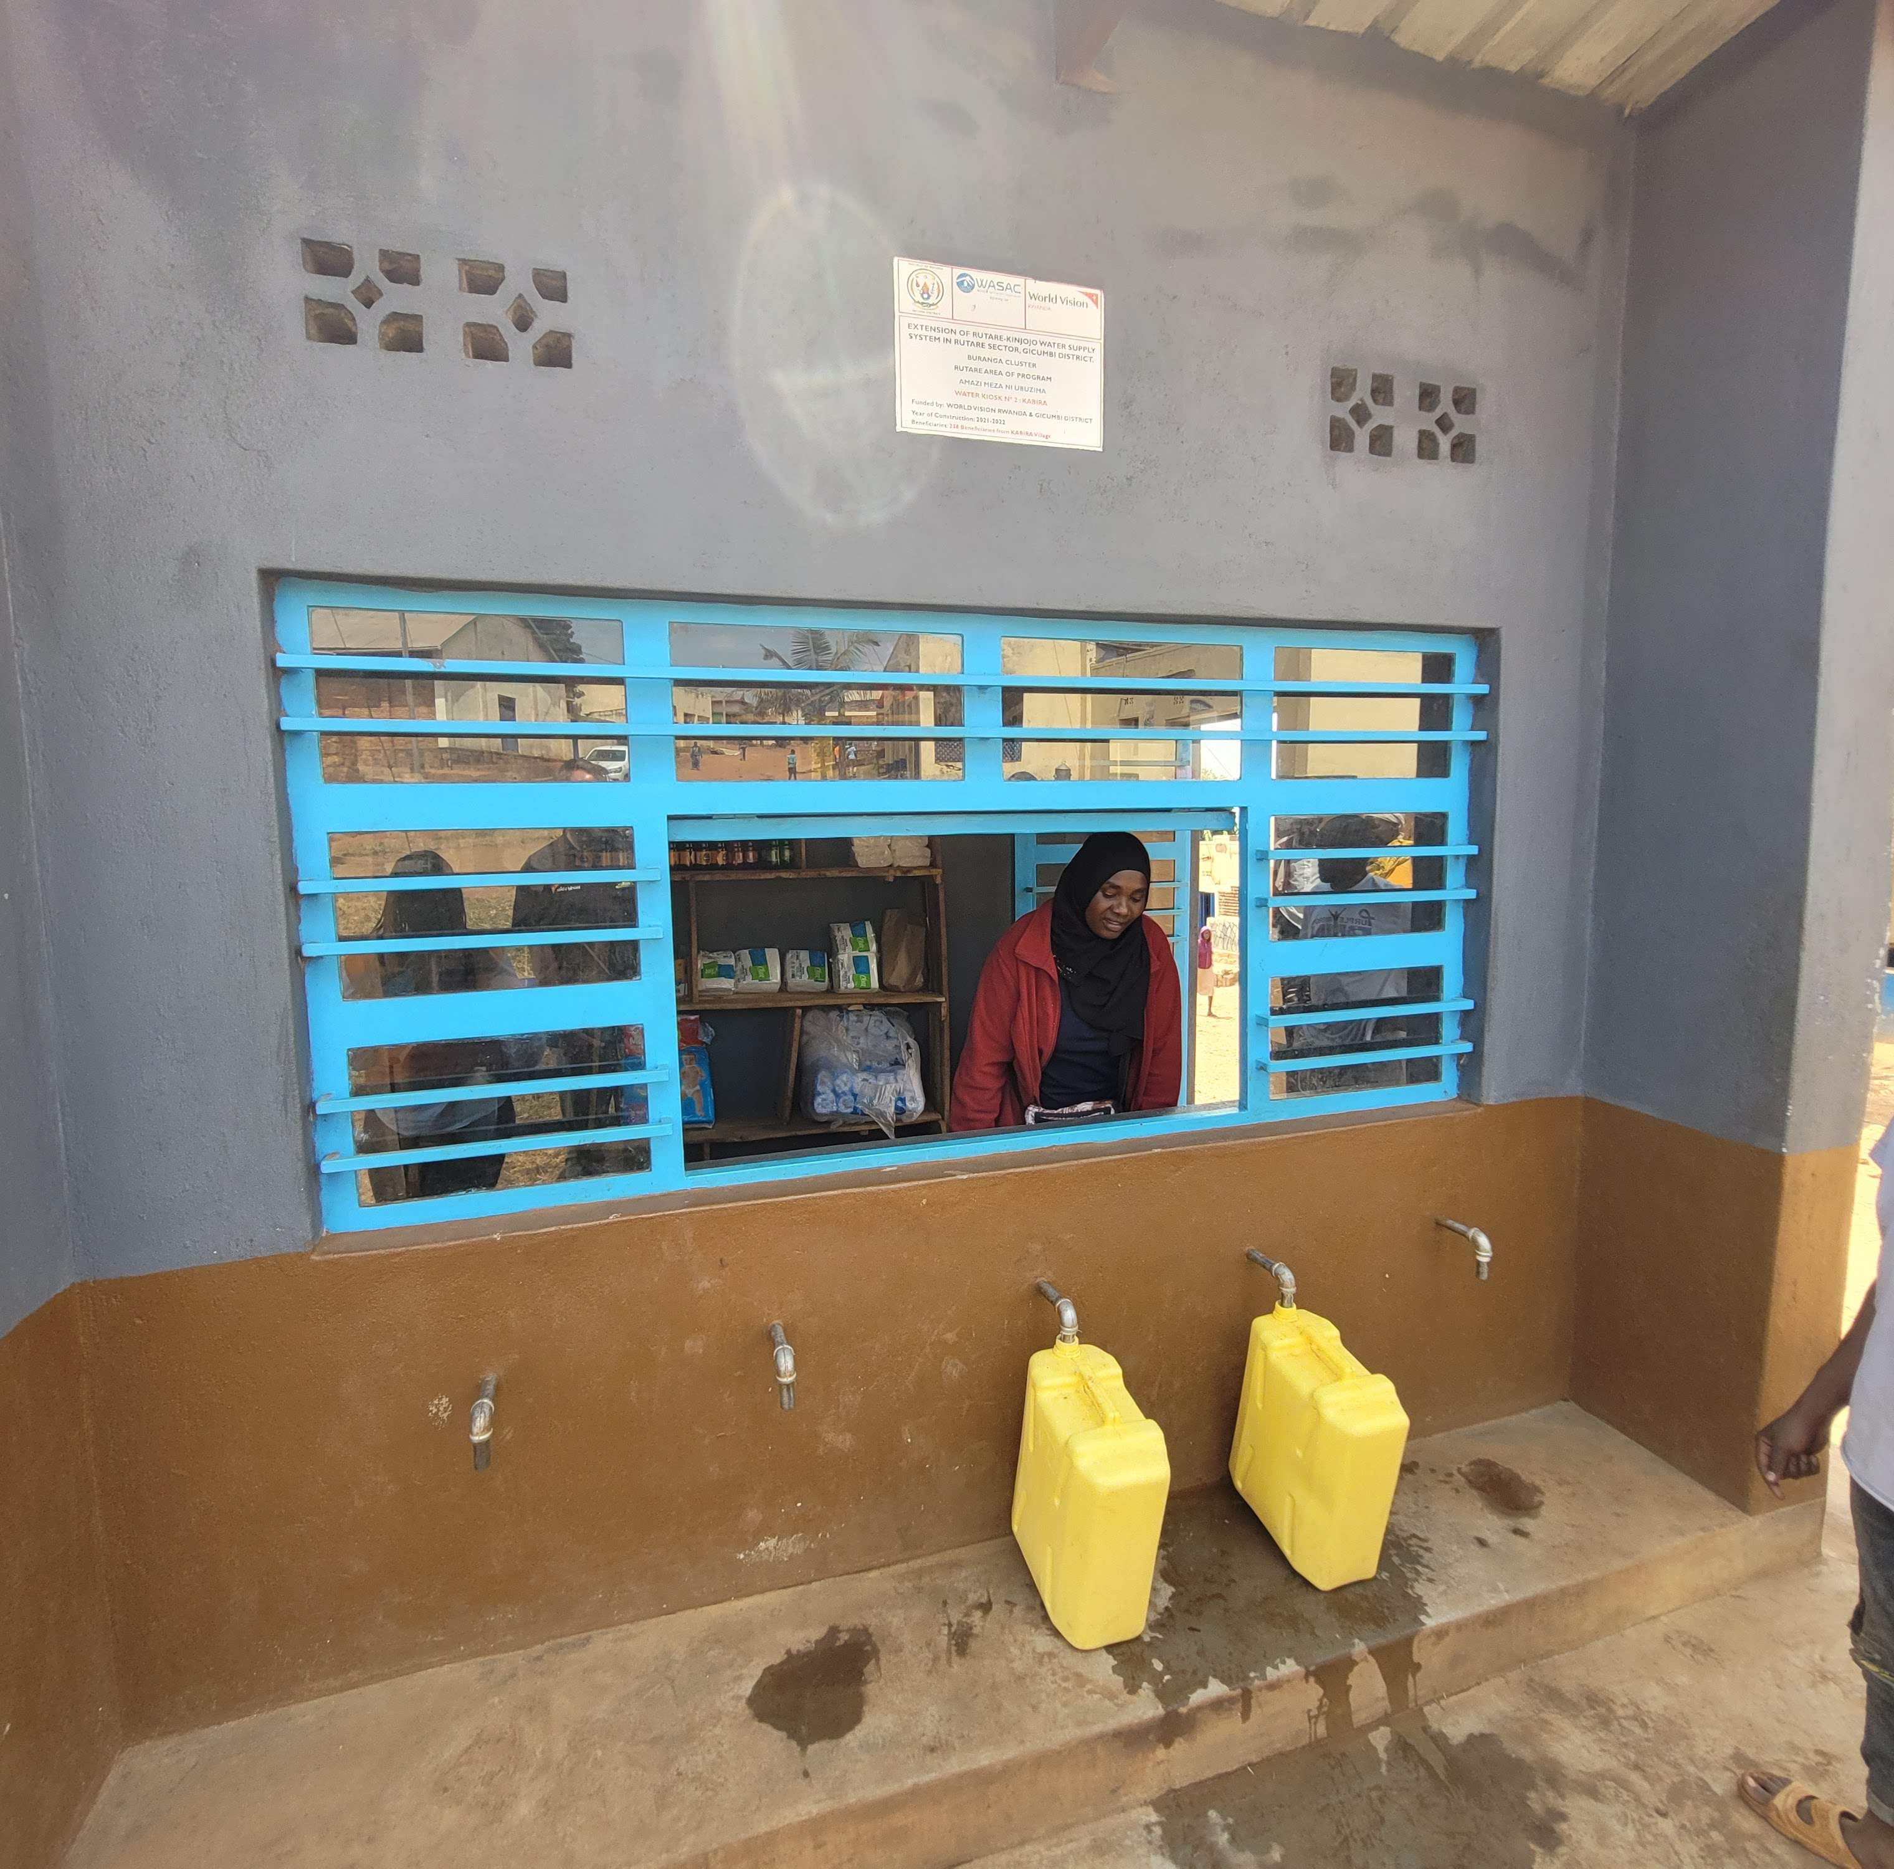
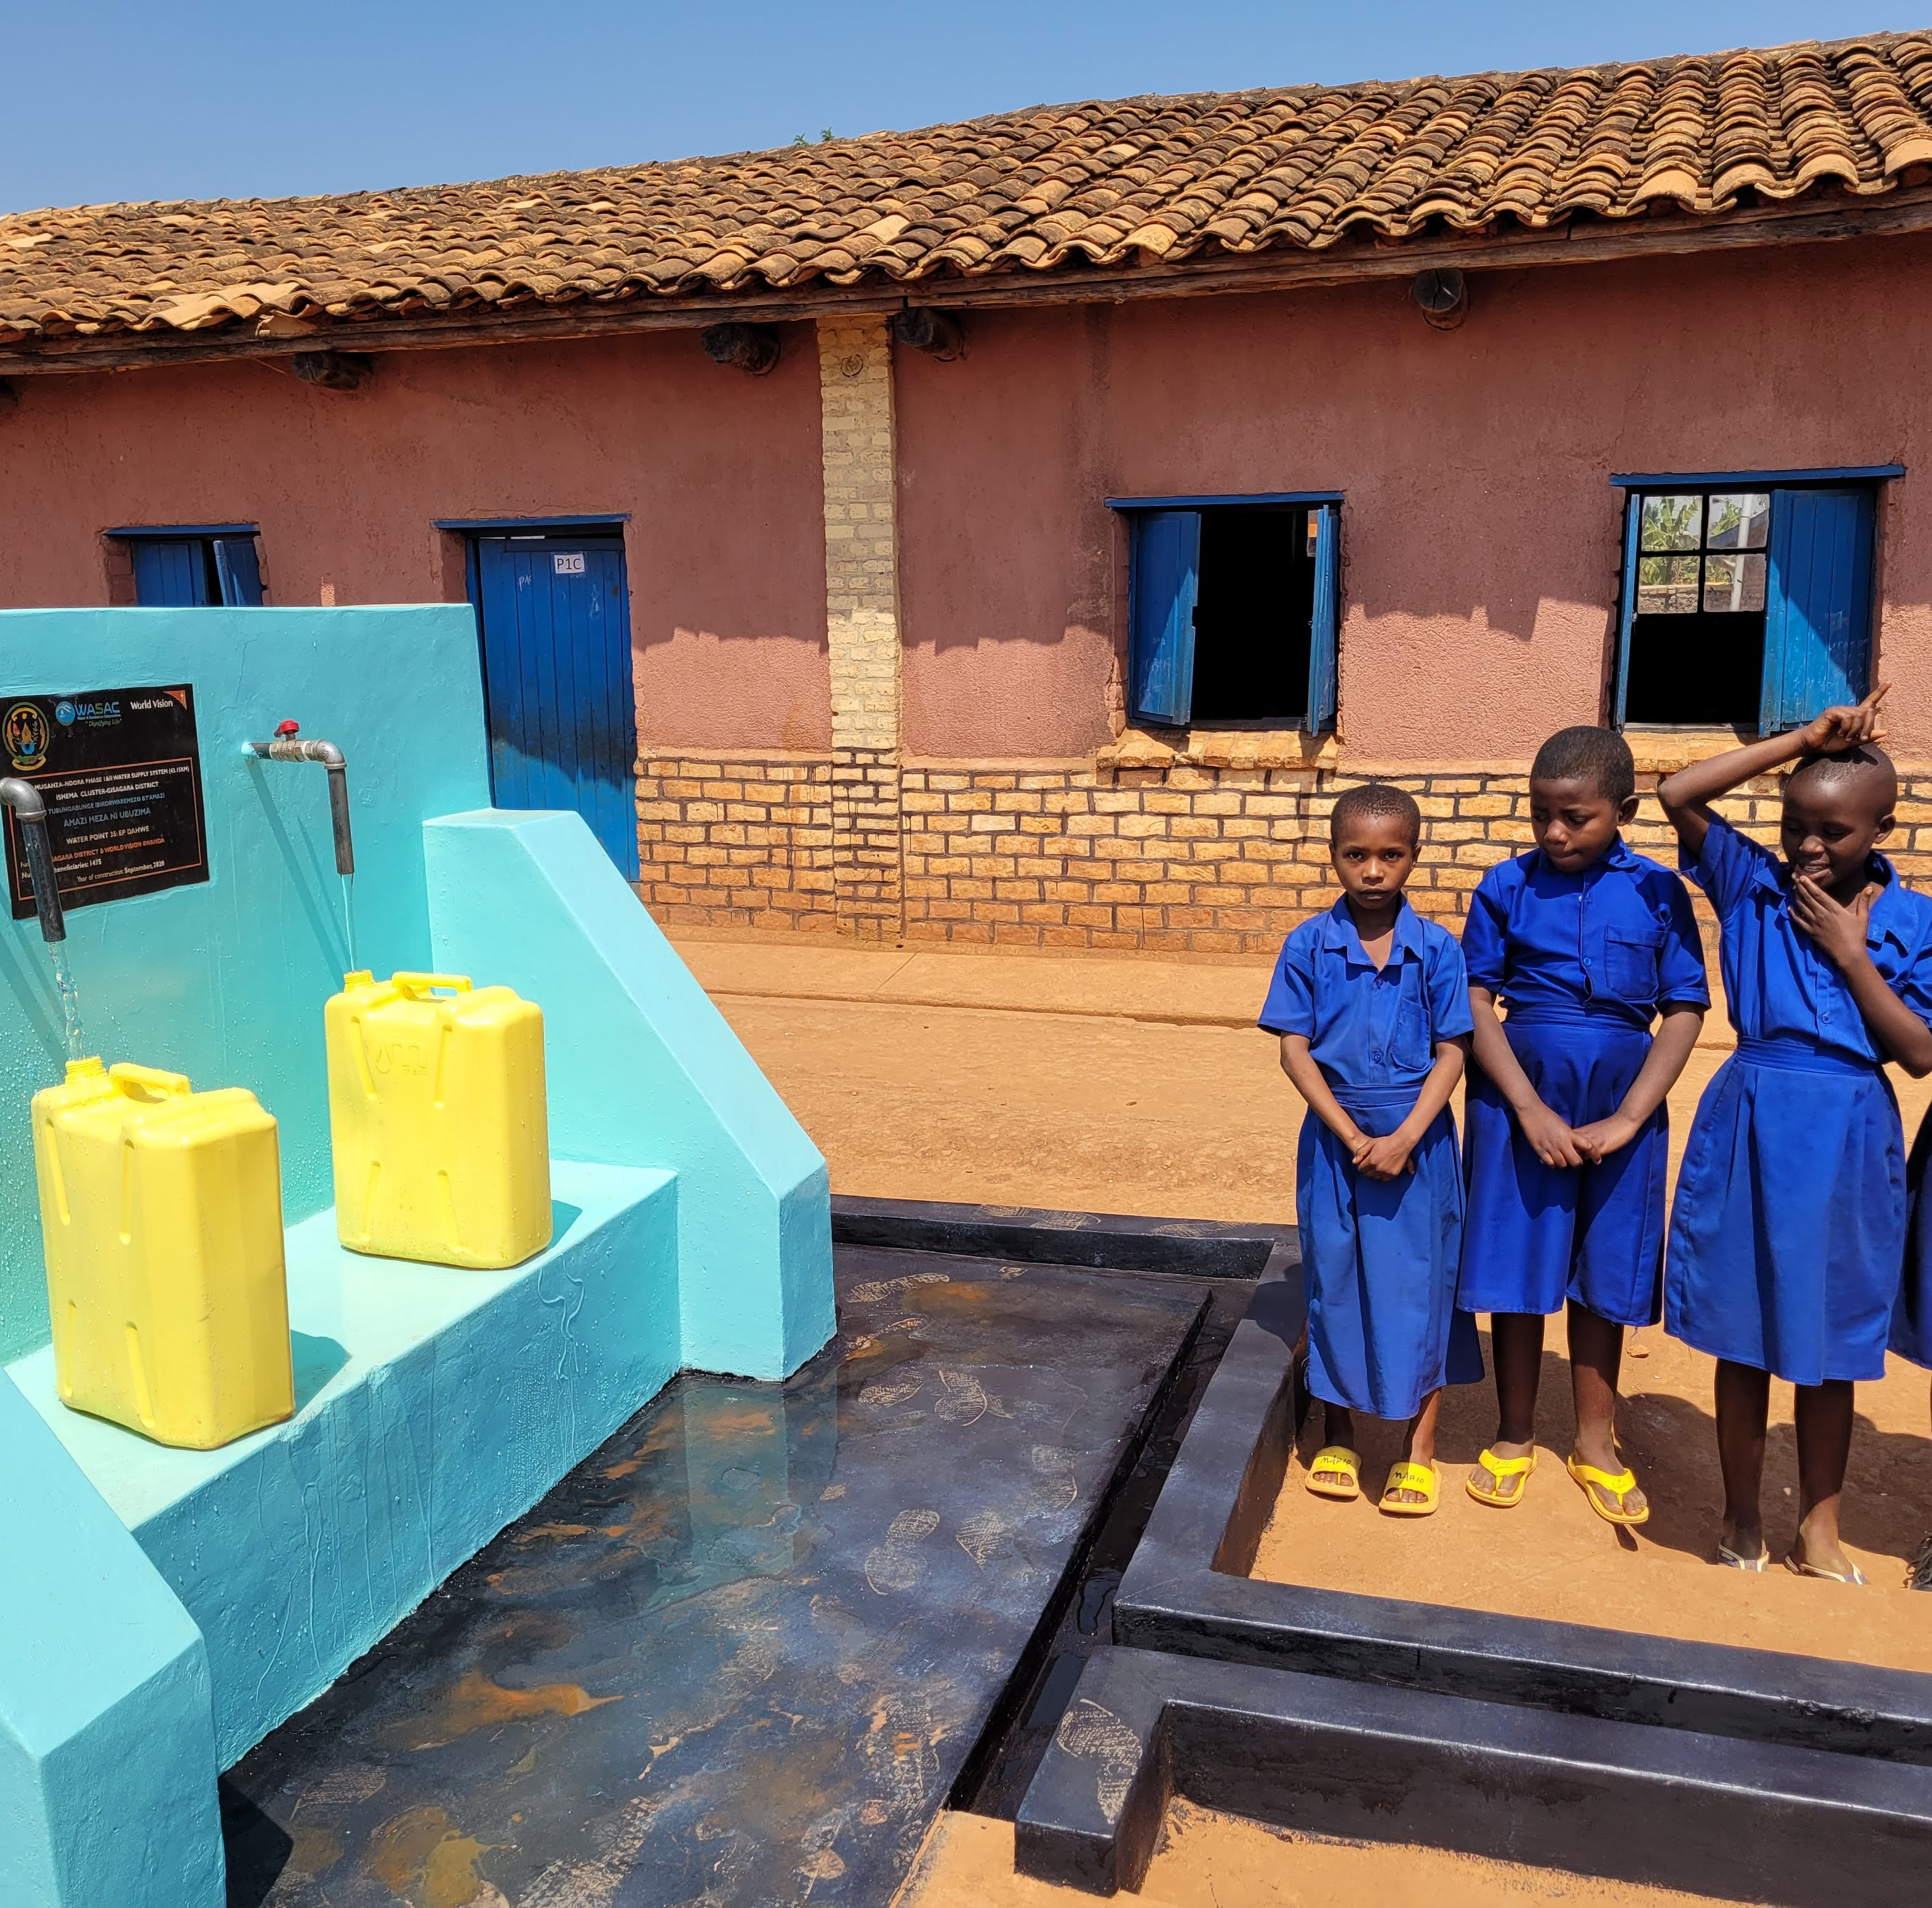
World Vision and Government of Rwanda invest in the system and then hand over to WASAC or Private Operator for Management
Multiple areas where you can run into sustainability issues
Notes:
Top left – investment into WSS infrastructure done by WVR and GoR – illustrates key role of governmnet as a funder
Top Right – Management needed, especially for pumping system (this example is WASAC but could also be a private operator) - illustrates the importance of someone to manage the system – also talk about the governments role in managing the POs
Middle – Last leg in the chain is the water point operator who collects payment
Bottom right – final water user (children in this case)
Describe the areas where an issue could come up –
Lack of technical expertise to run pumping system
Lack of payment by community members to allow for WP caretaker to be there at all times
Closing of water points for extended periods of time

Slide 8
Ensuring Long-Term Sustainability
Improved data sharing between WV, water system managers and Government MIS
    Identical naming conventions needed to allow for ease of data comparison
Water meter installation at all water points with regular reporting to government
    Higher level sensors (i.e. pulse meters) could be used for higher visibility into breakdown and disuse
  Fee collection at all water points
    Automatic payment systems have the potential to provide more hours of access and better accountability for fee collection
  Engagement of water tenants for strong management
    Either water kiosk stores to allow for additional income or incentive payments to improve availability of tenants are options for improvement
Notes:
Highlight the different ideas we are exploring for sustainability in Huye – share what we are learning and where we'd like to take things even further

Slide 9
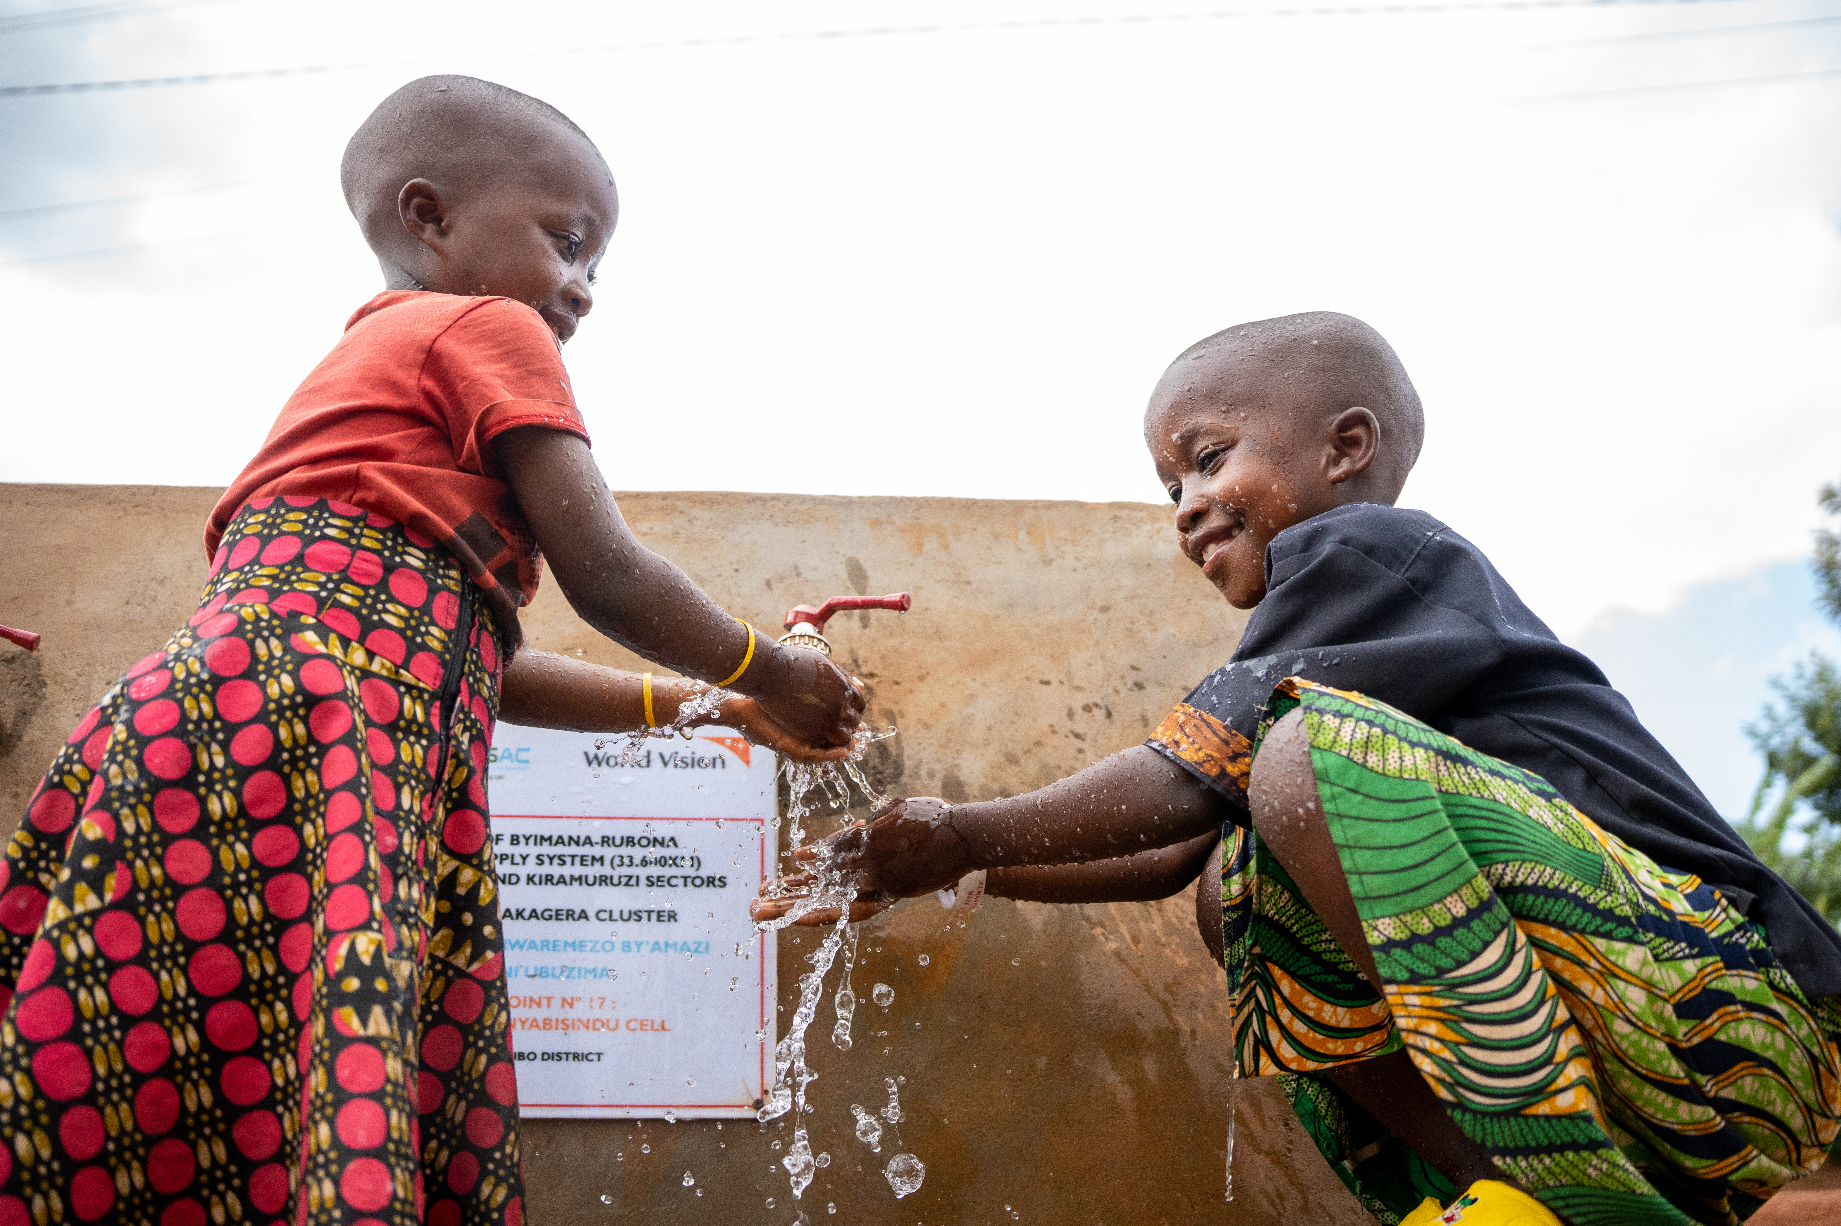

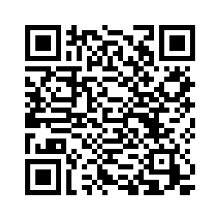

Thank you!
Learn more about the Maraba-Simbi-Mbazi water supply system

Slide 10
Working Across Multiple Sectors to Achieve Universal Coverage
Universal Coverage of WASH services

Slide 11
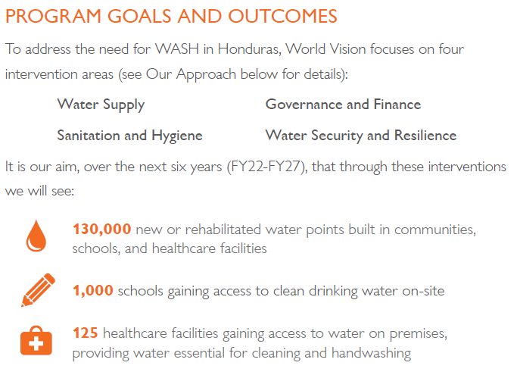
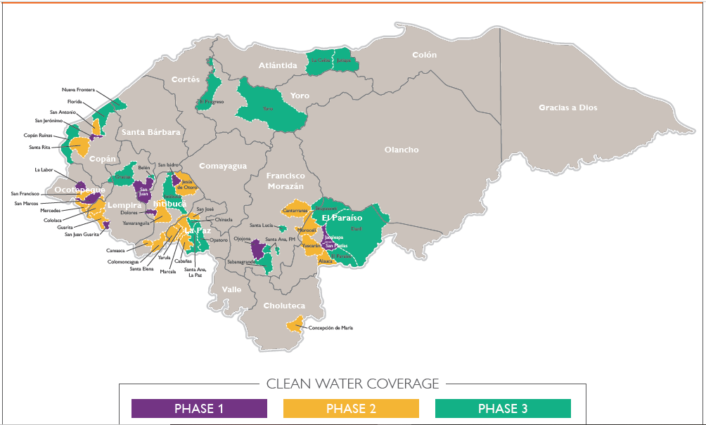
Finish the Job | WV Honduras
Based on the learning of our Finish the Job plan in Rwanda, we are committed to Finish the Job in Honduras with clean water access by 2027. This will mean reaching 650,000 people.
Notes:
focus a bit more on how it has worked with the education and health sector in order to "finish the job", e.g. by identifying and prioritizing the schools and HCFs most in need.

Slide 12
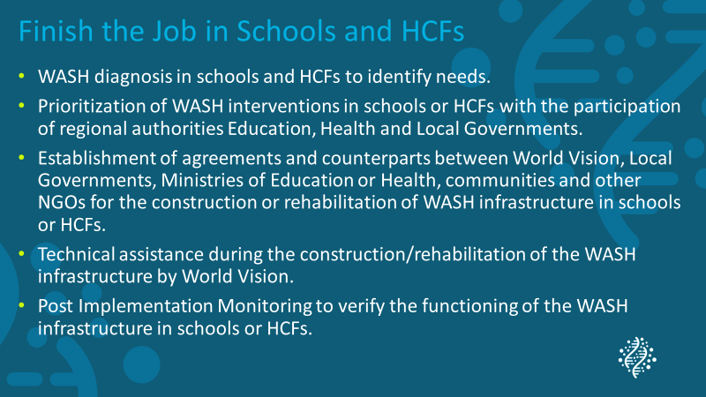

Slide 13
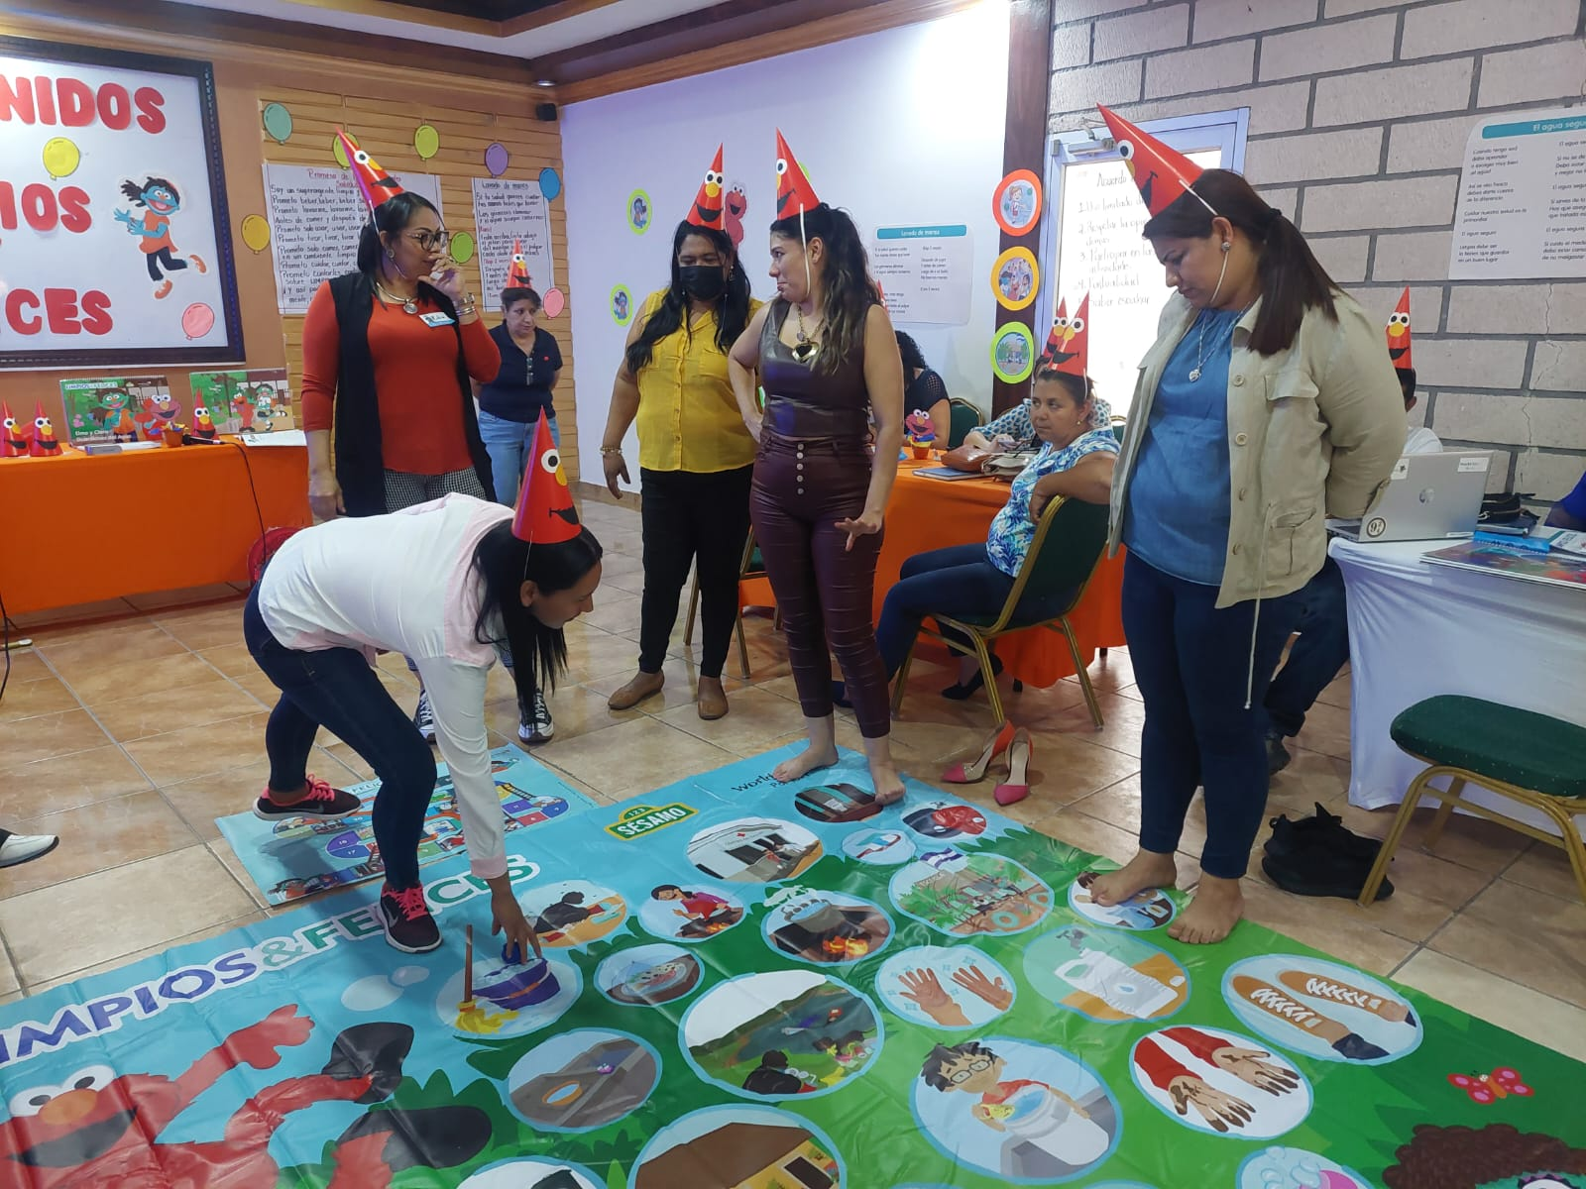
Education Sector
Coordination with the Ministry of Education for:
Mapping of WASH infrastructure needs in schools.
Formulation of Strategy to achieve the sustainability of WASH services.
Insertion of the ¹ESCASAL and WASH UP! methodologies in the education curriculum.
Training workshops for teachers through the ESCASAL and WASH UP! methodologies.

Slide 14
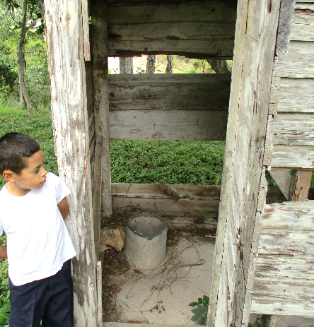
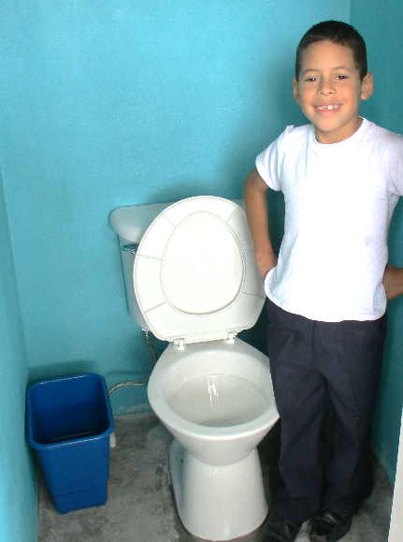
Education Sector
Before
Actions implemented in schools:
Diagnosis of the WASH infrastructure.
Installation of water points (taps).
Construction of sanitation facilities (separate cabins by sex, facilities for ¹MHM and for people with limited mobility).
Construction of handwashing facilities
Training for children through the ESCASAL and WASH UP! methodologies.
Celebration of important dates (World Water Day, World Handwashing Day)
After

Slide 15
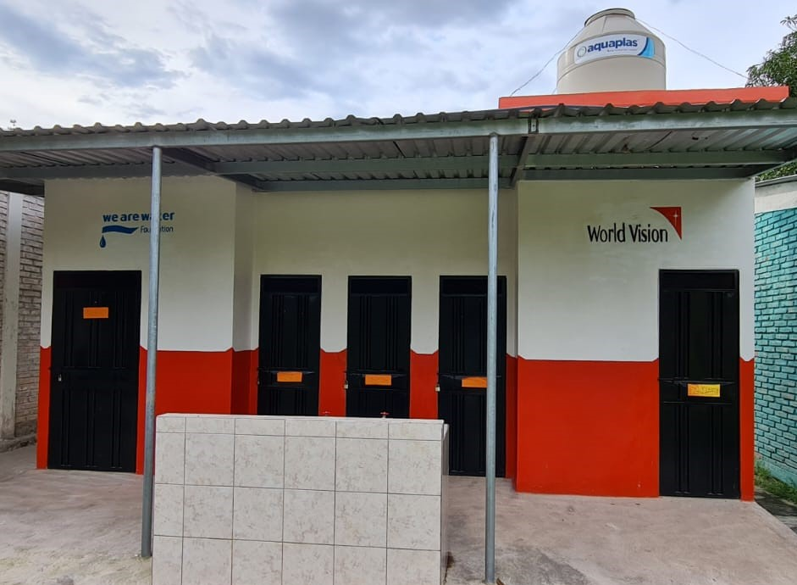
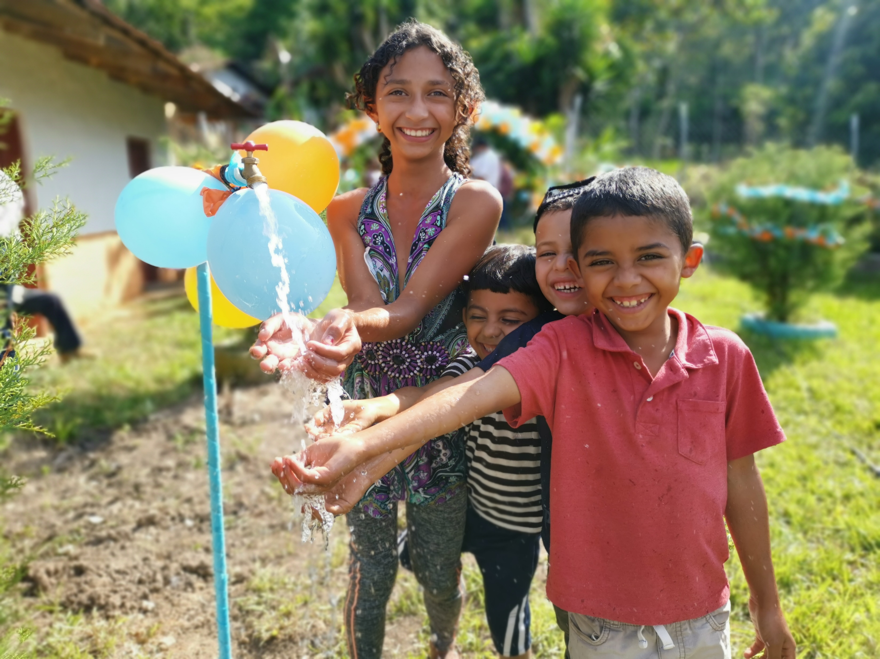
WASH Infrastructure in Schools
Access to sanitation facilities
Access to clean water
Access to handwashing facilities

Slide 16
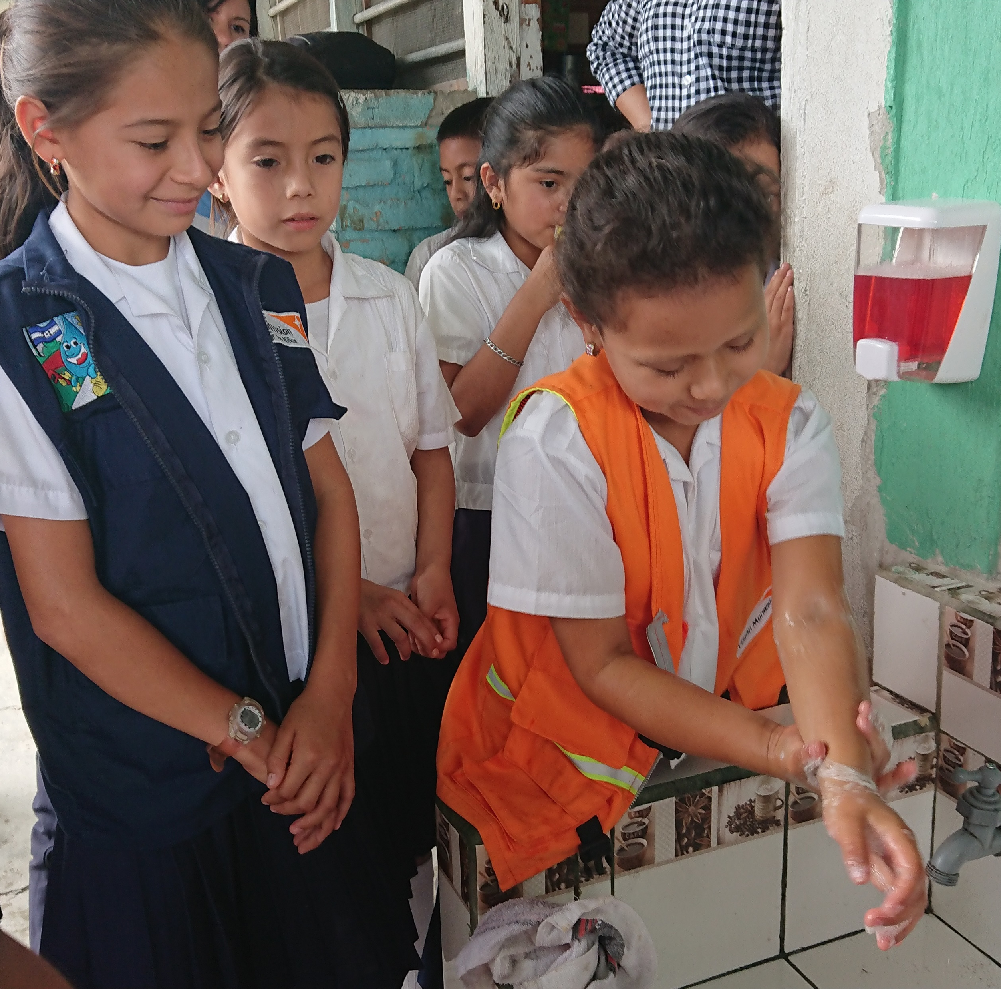
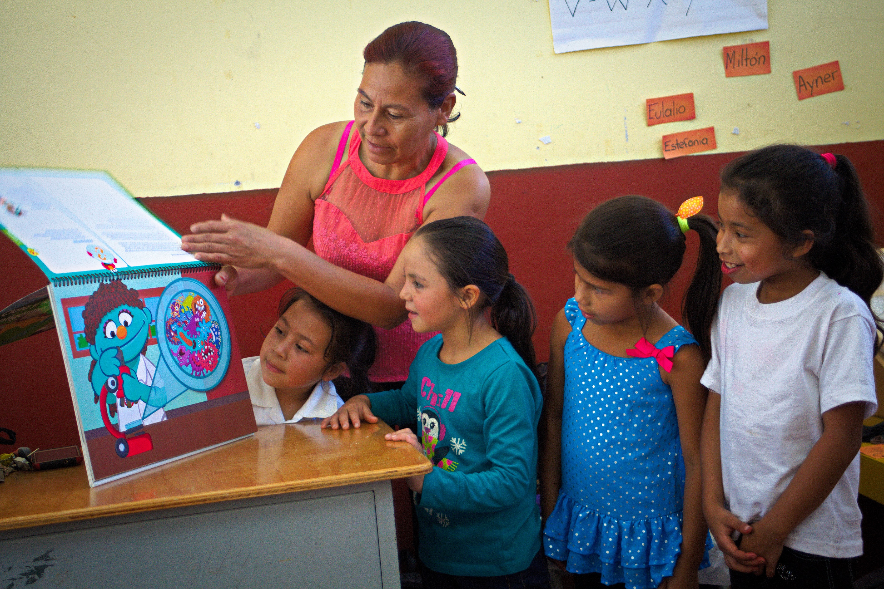
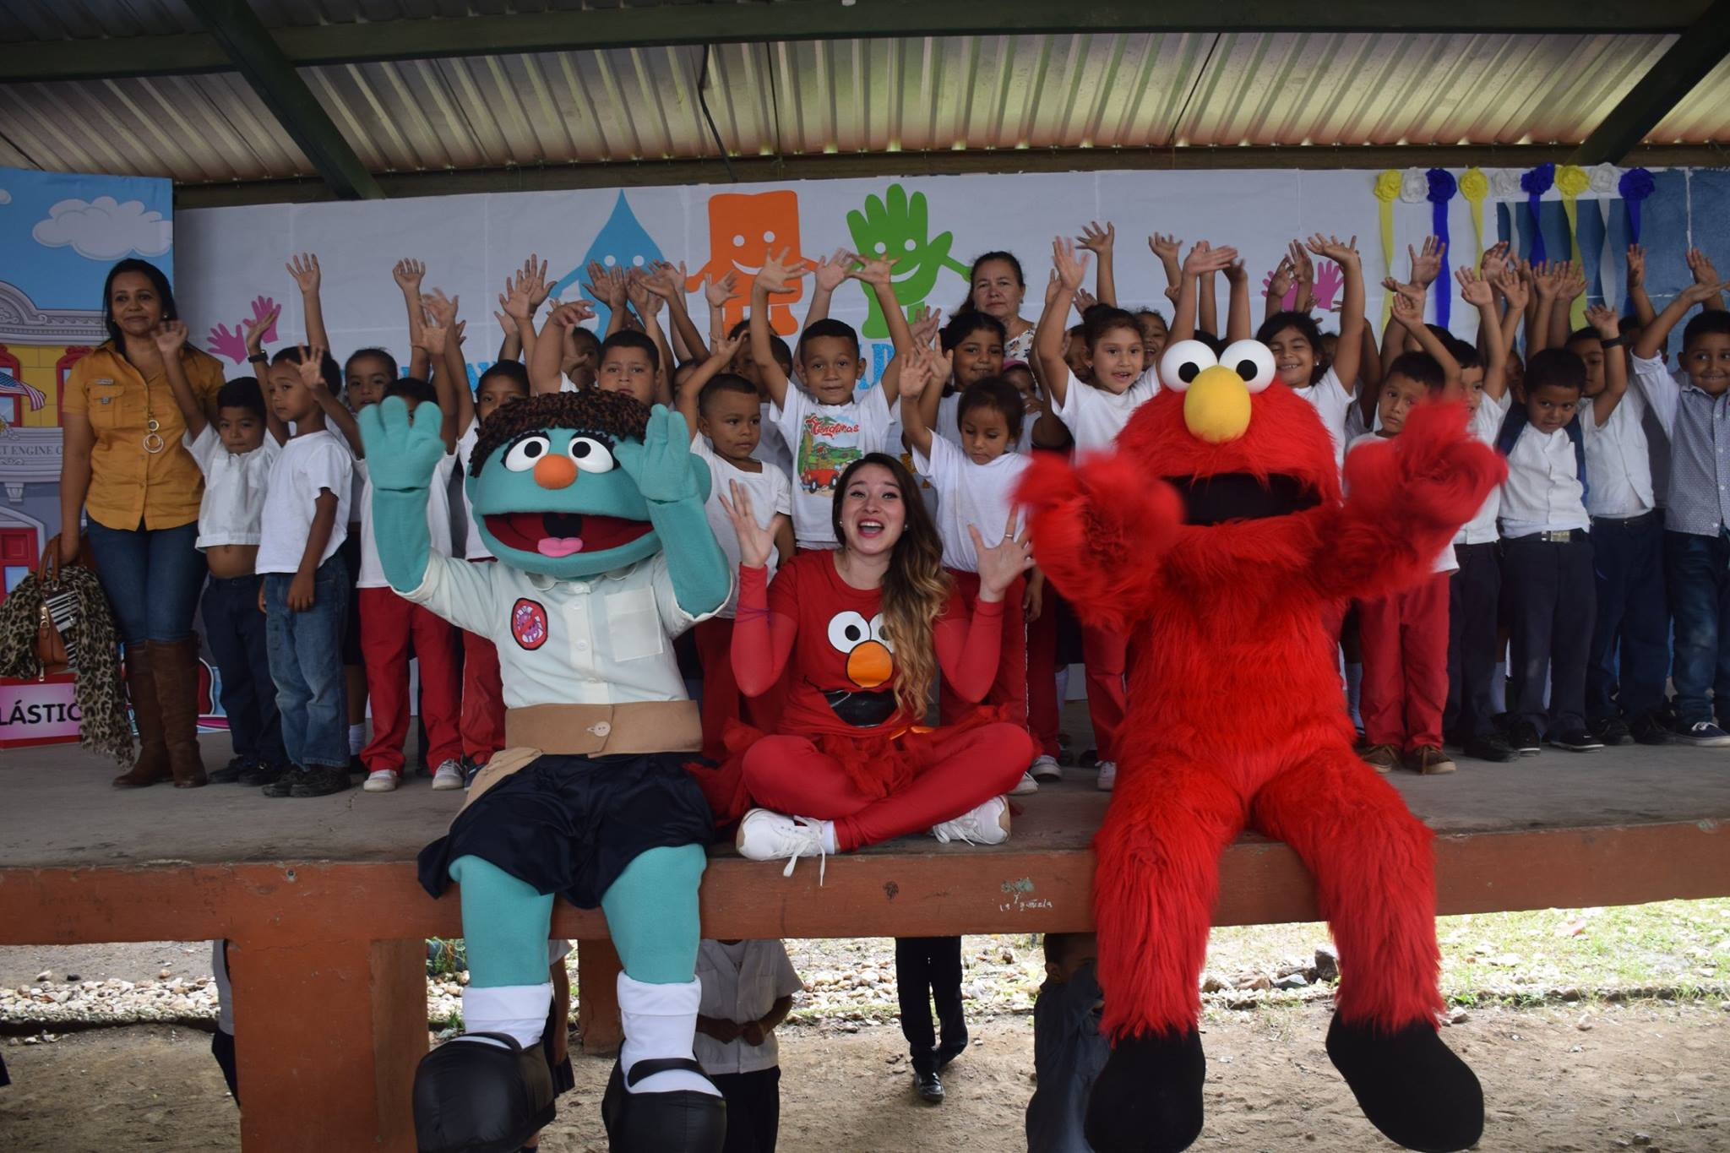
WASH Promotion in Schools
Child-to-child handwashing training
Handwashing World Day
WASH UP! session directed by the teacher

Slide 17
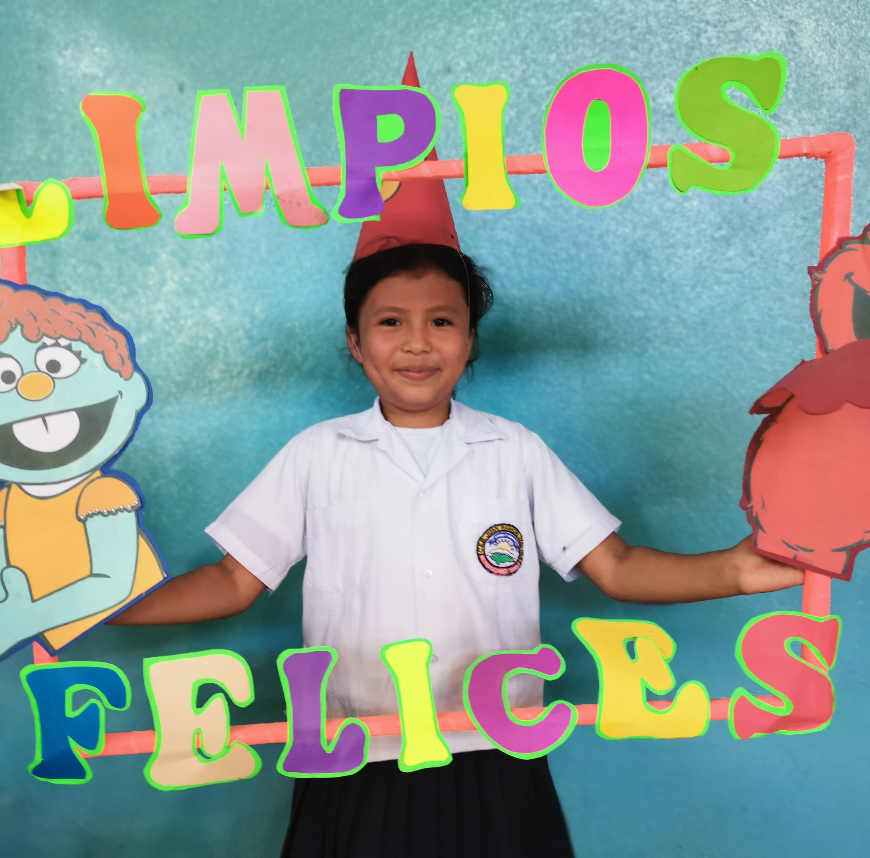
Story:
'Clean and Happy' in My School
"I want the WASH UP! methodology to reach all schools in Honduras, because just as I was able to learn about hygiene in a fun way, I want other children to do it too"
Lesly Flores (10 years old)
Juan Molina School
Matazano Community,
Jamastran AP, Honduras

Slide 18
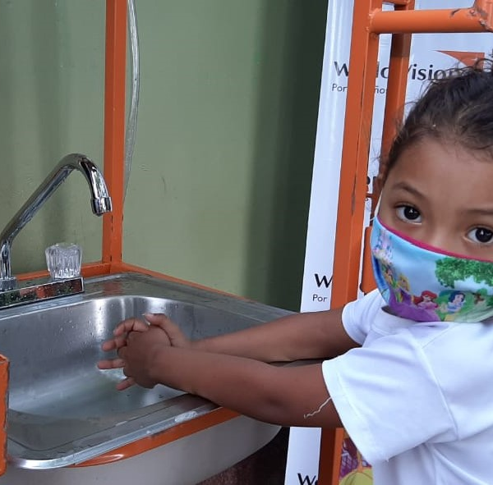
Health Sector
Coordination with the Ministry of Health
Mapping of WASH infrastructure needs in ¹HCFs.
Installation of water points (taps).
Construction of sanitation facilities (separate cabins by sex, facilities for MHM and for people with limited mobility).
Construction of handwashing facilities and waste management.
Construction of women's showers in the postnatal care area.
Training on cleaning procedures for staff.
Coordination with HCF staff to monitor water quality, Campaigns to sensitize HHs and environmental sanitation.

Slide 19
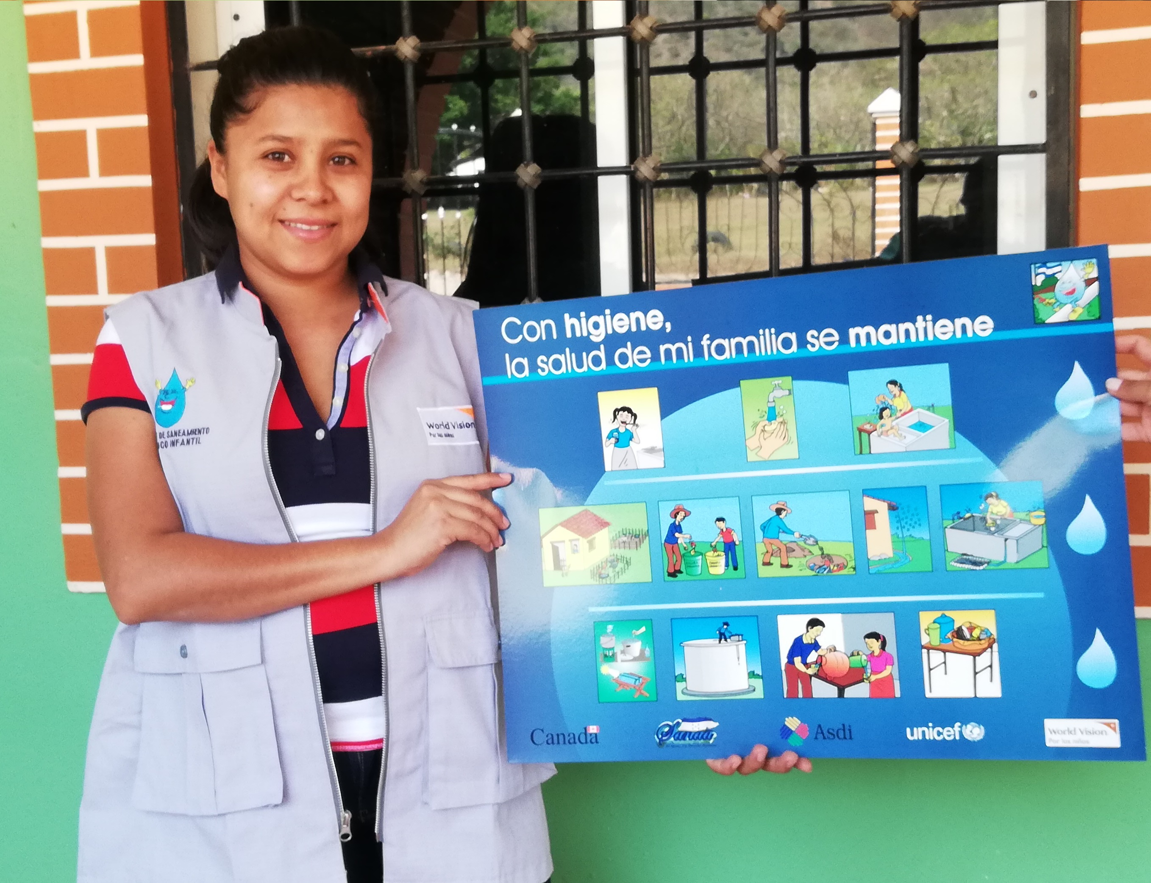
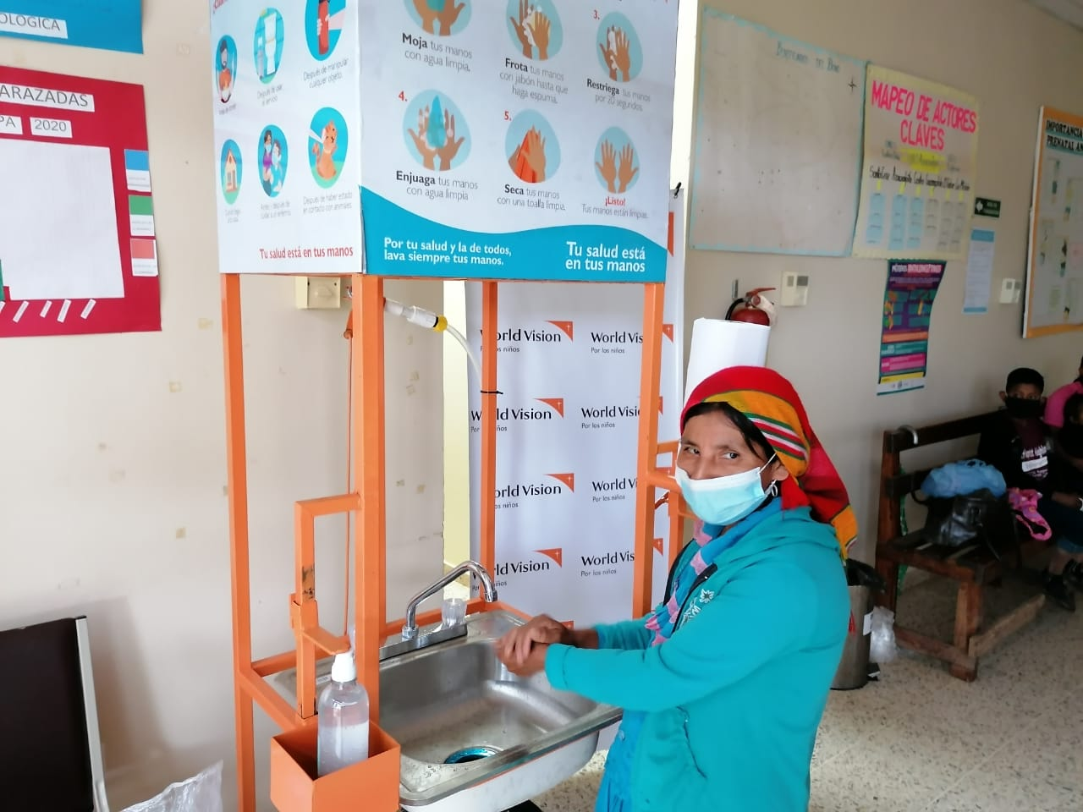
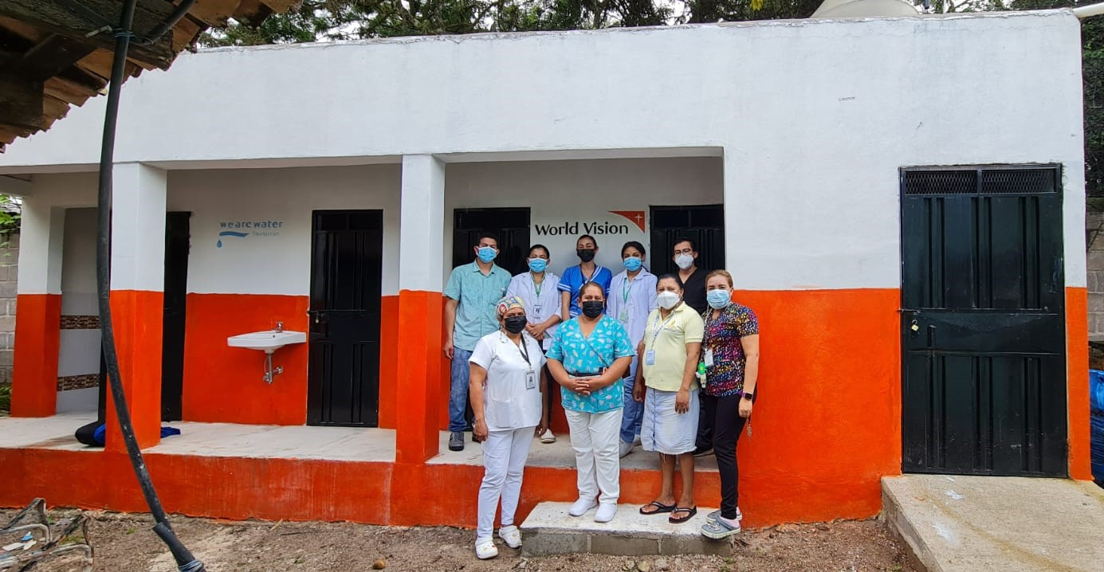
WASH in HCFs
Campaigns to sensitize HHs
Installation of handwashing facilities
Construction of sanitation facilities

Slide 20
Finish The Job and mWater Mapping in Zambia
World Vision Zambia
Maybin Ngambi
Jessy Samuyachi
Notes:
It would be great if this case presentation could focus a bit stronger on the technical approach, especially the focus on piped schemes and collaboration with utilities.

Slide 21
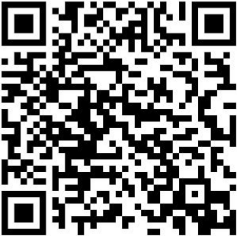
Contents slide
FTJ the Overview
World Vision Technical Approach
WASH Interventions and Impact
Additional impact photos

Slide 22
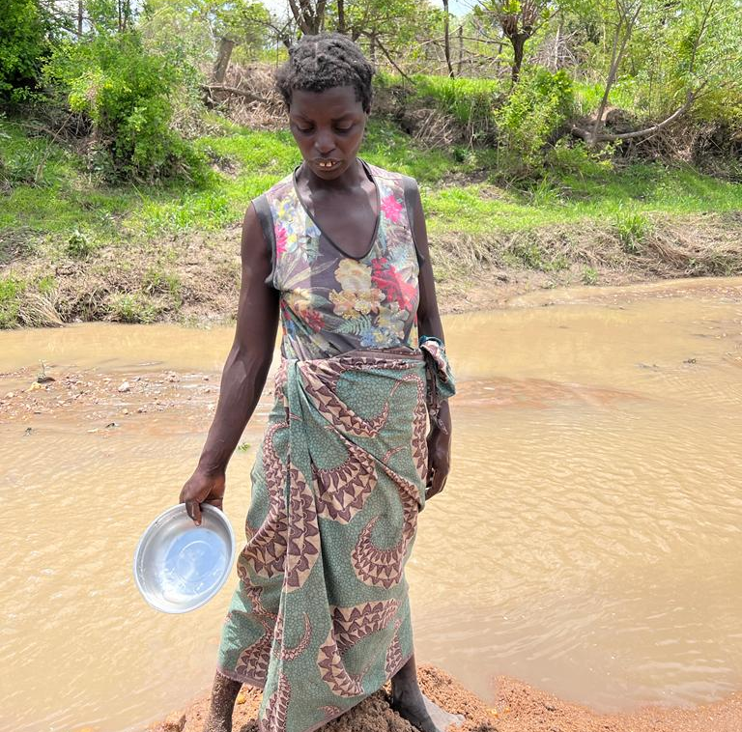
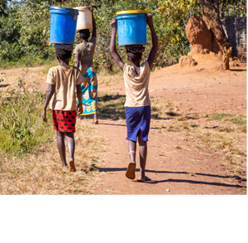
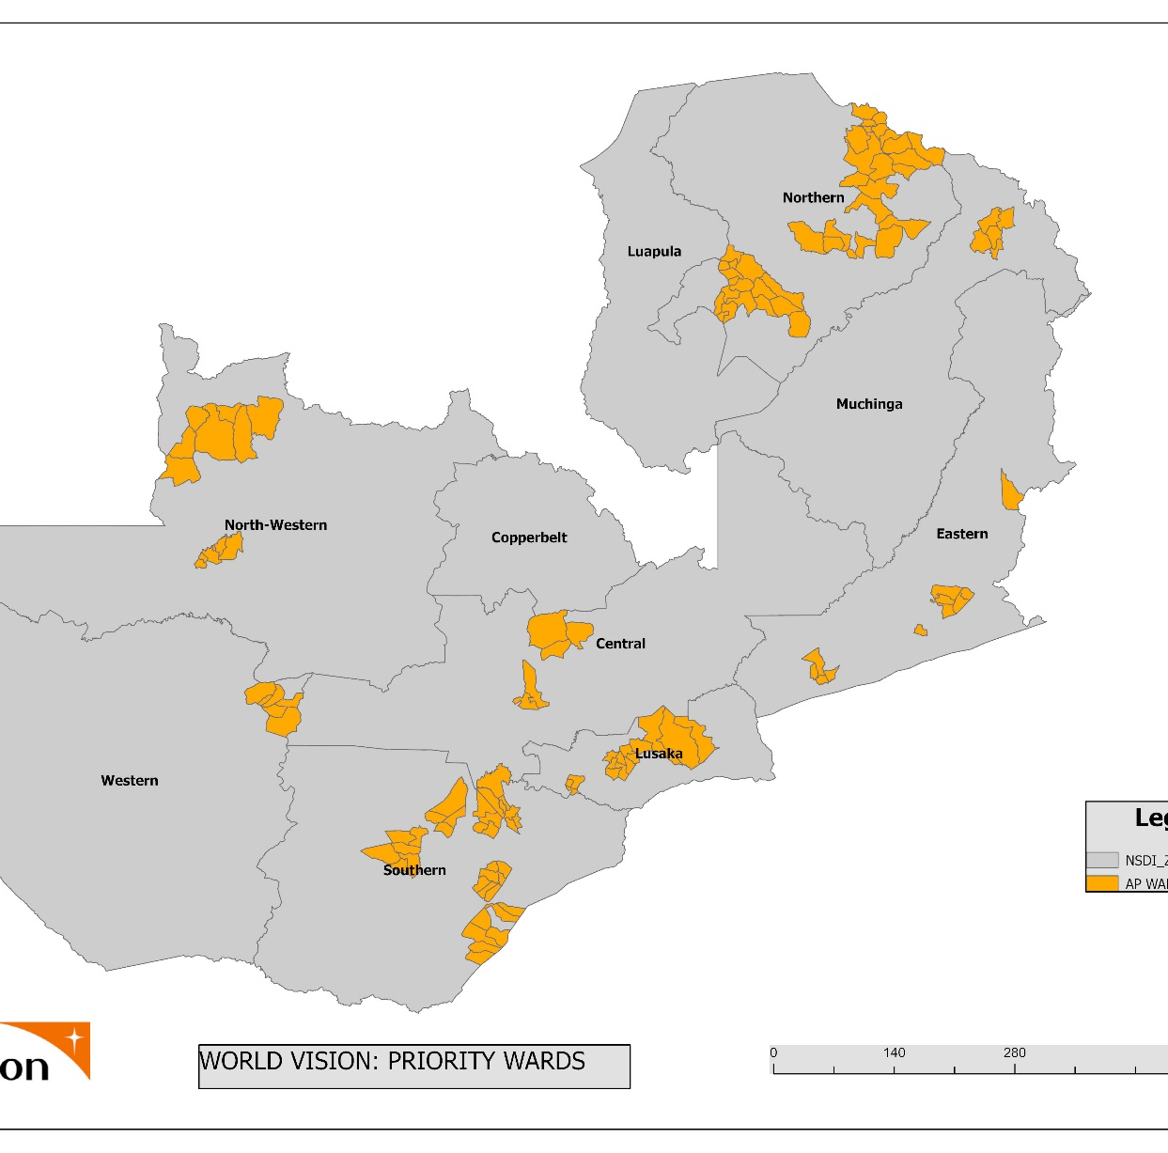
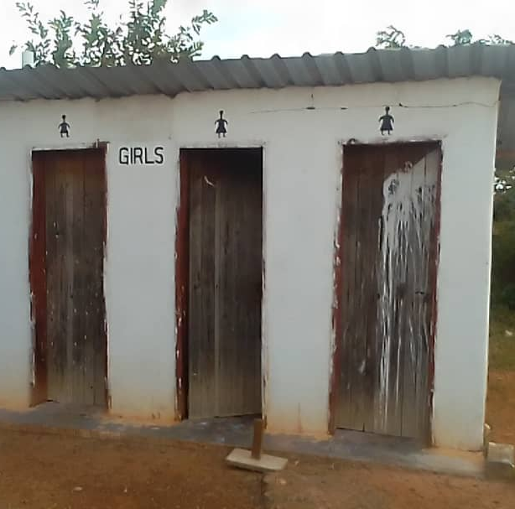
Zambia is one of the few countries selected for the finish the job (FTJ) focused on reaching more people with WASH services and also ensure universal access to water supply, sanitation and hygiene for all .
The FTJ initiative is to reach around 800,000 people with access to water supply with a projected funding of US$63million by 2025
Reach 125 healthcare facilities servicing more than 1 million people and 350 schools by 2025

Slide 23
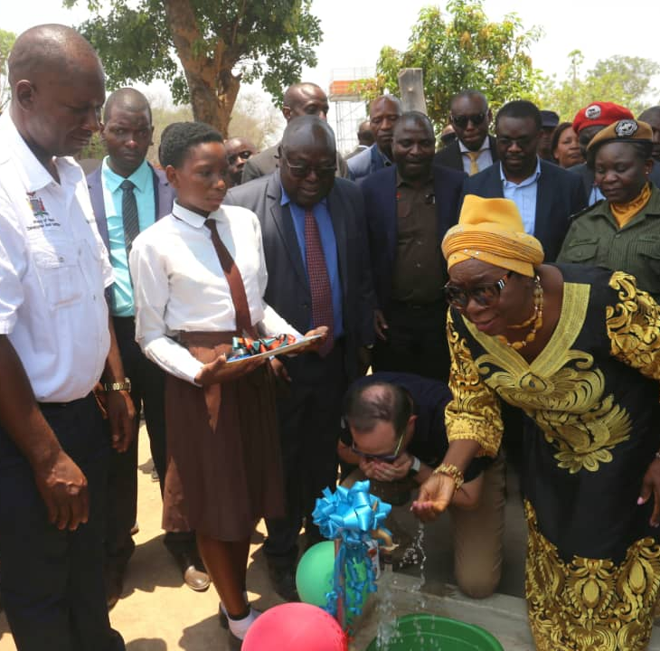
World Vision has been reaching on average.
  200,000 people per year with access to clean water in the last 2 years
  40 HCFs installed with piped water on premise
  73 wards across the country with water, Sanitation and Hygiene.
  184 schools with water, sanitation and hygiene. With a total of 95,131 children reached.

Slide 24
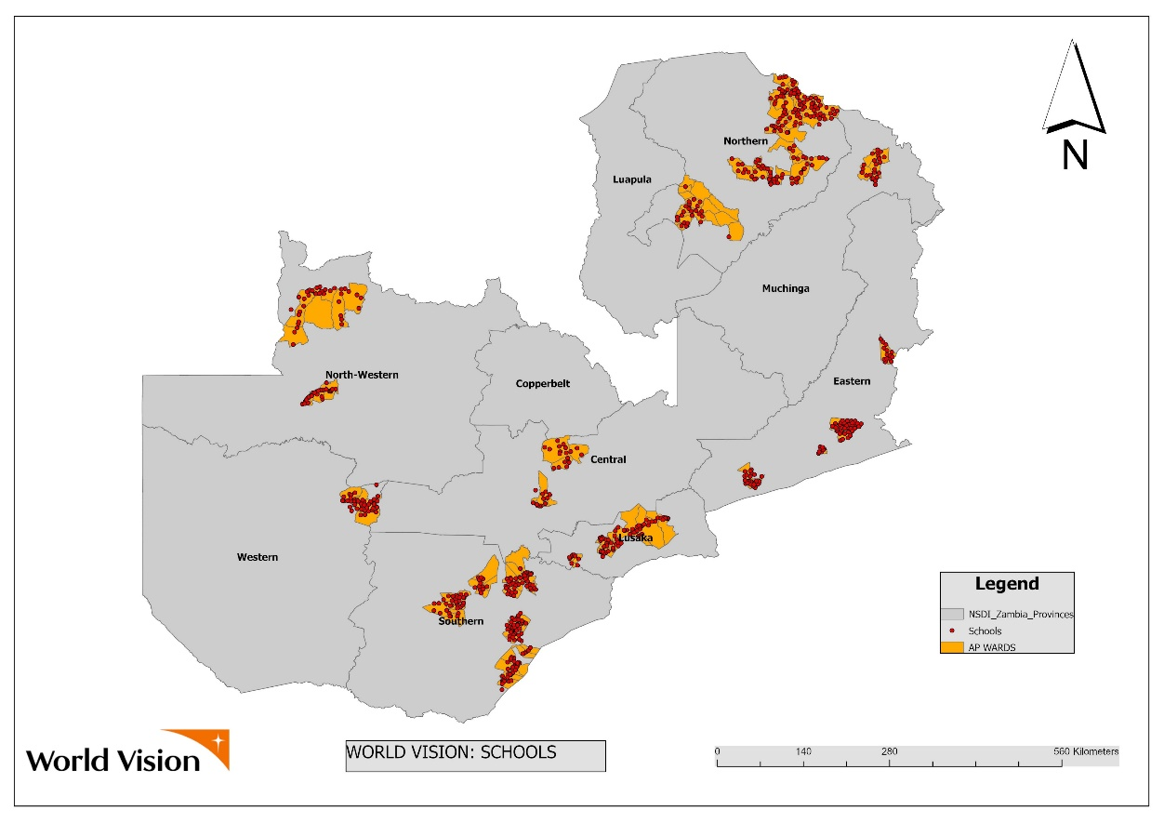
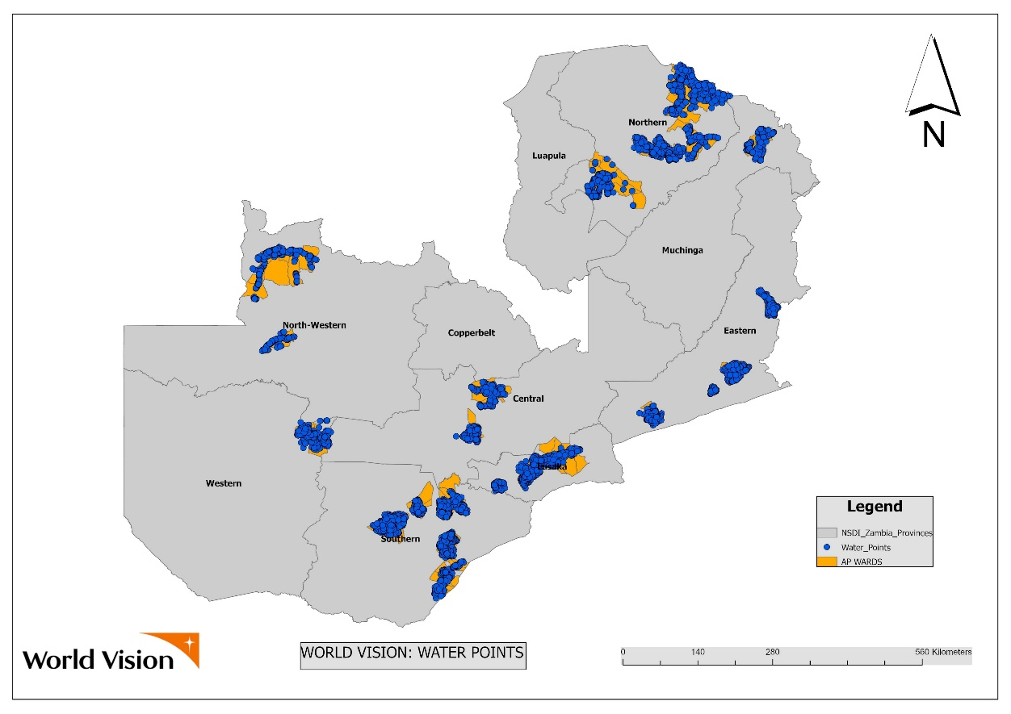
73 Wards reached with HCF with Water

Slide 25
World Vision Technical Approach
122 wards which are sub-district units were selected with a focus in reaching universal coverage in Health Care Facilities, Schools and Community WASH;
WASH infrastructure construction includes hand pumps, piped water systems on-grid power and those on solar arrays (renewable energy);
This approach resulted in increased installation of piped water systems thereby reducing on the hand pumps resulting in increased water collection points;
Strengthen partnerships with water utility companies which enable reach more people through installation of taps at household level; revenue collection, and enhanced co-financing.
The program is also working with an insurance company for mechanized piped water systems to provide for premium in case of a breakdown. This initiative has strengthened the sustainability of piped water systems across the country.
Notes:
This is great and should be the focus of this case presentation. Consider focusing on 3 technical approaches to "finish the job":
1) installation of piped schemes (including who is supposed to be managing these? How are capacities and systems for this put in place and / or strengthened?)
2) Strengthen partnerships with utilities
3) Insurance for mechanised piped schemes for ensuring sustainability
It would be great if you could work out these 3 points in a it more detail, possibly by presenting then on separate slides.
Although "WASH" is mentioned, focus seems to be on water. Is that right? If so (which is perfectly fine with me and makes sense), please refer to "water supply" instead of "WASH"

Slide 26
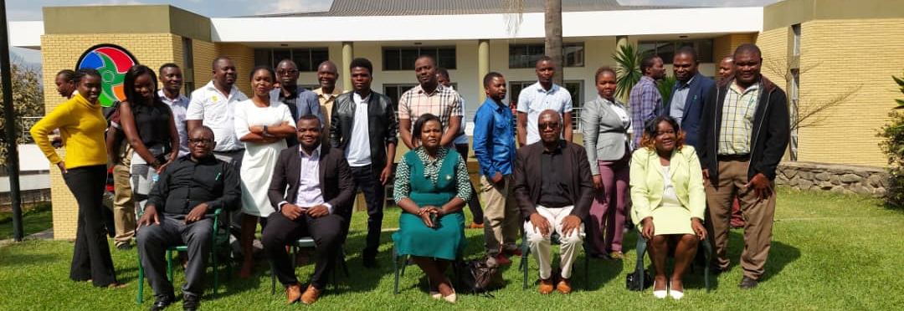
Partnership with Water for People and Government on implementing a WASH for everyone Project

Slide 27
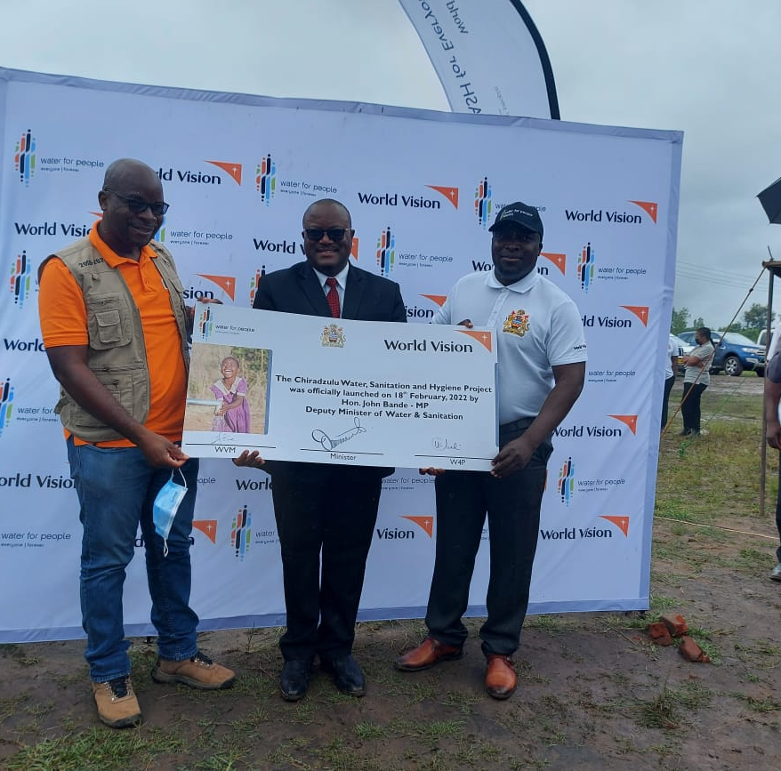
World Vision Partnered with Water for people and the government to implement WASH for everyone project in Chiradzulu District

Slide 28

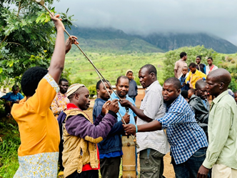
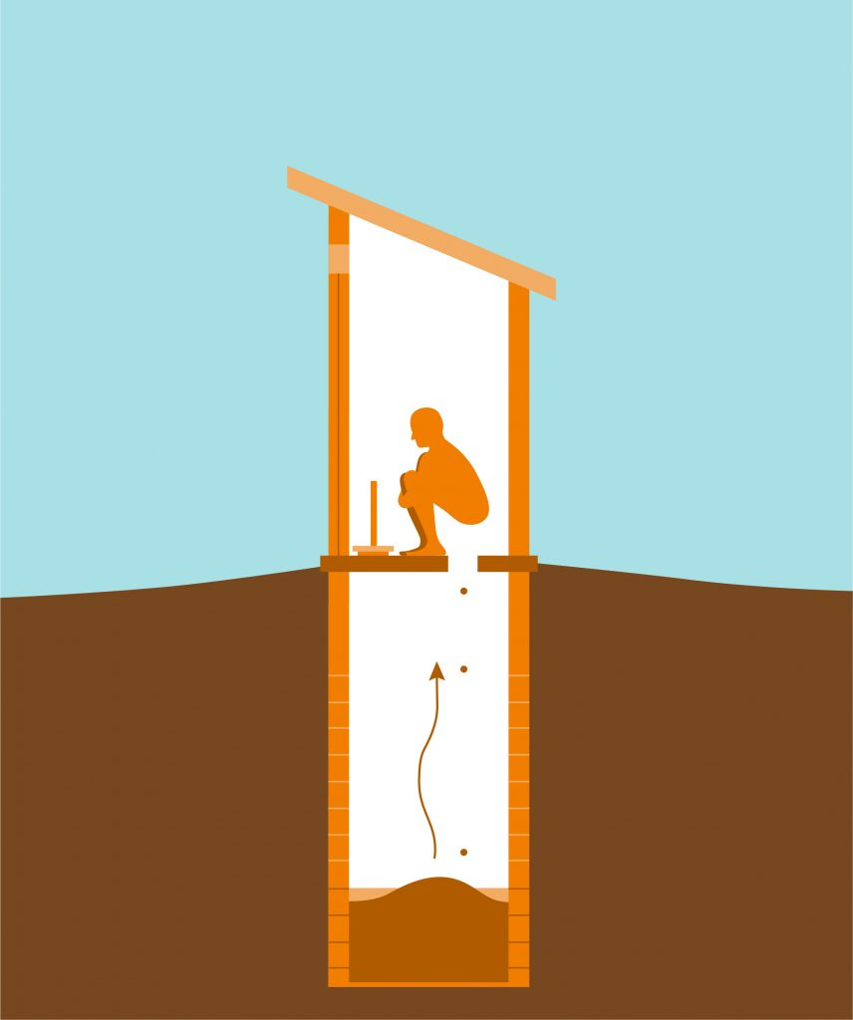

Do you know that in Chiradzulu:
54% of rural households do not have access to basic drinking water services
94% of the rural population do not have access to an improved toilet
93% of the rural population do not have access to handwashing facilities with soap.

Slide 29
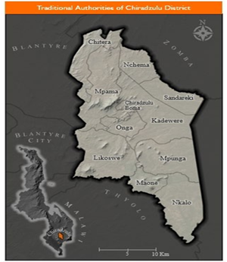
Implementation overview
The Project is being implemented in all 10 traditional authorities (district wide) in the Chiradzulu​

Slide 30
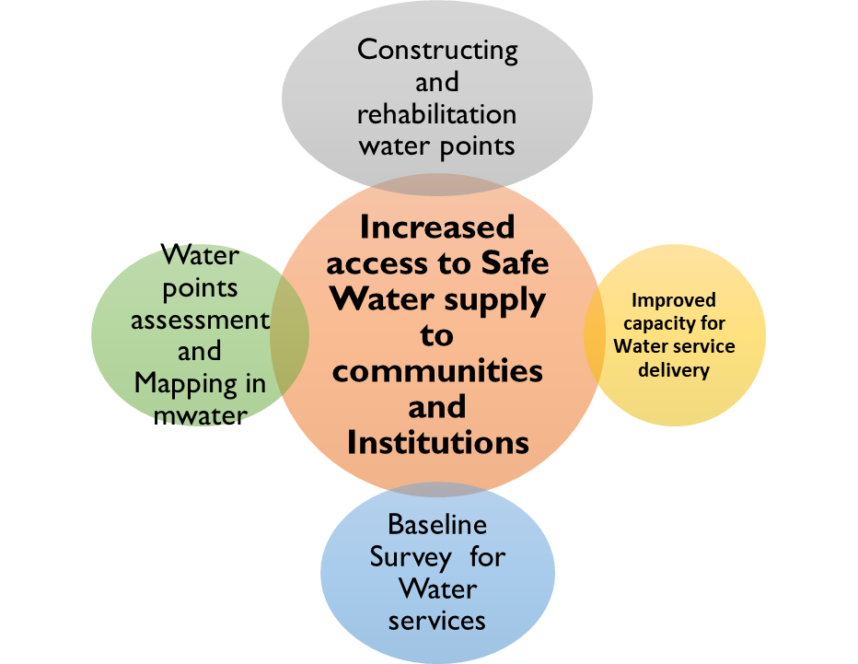
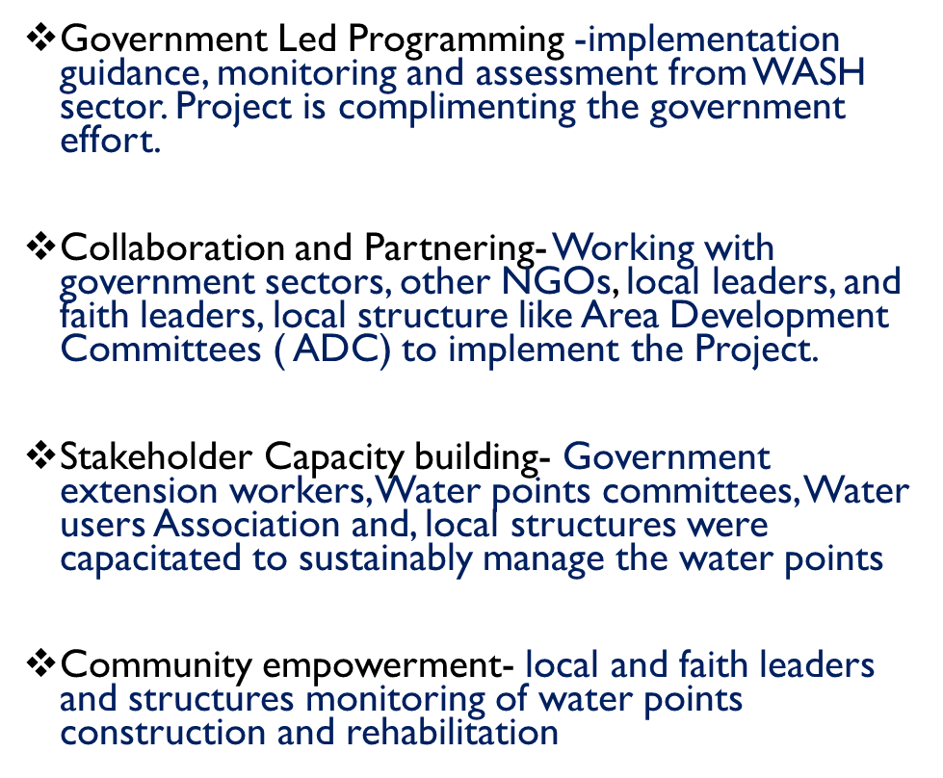
Unique Implementation Approaches

Slide 31
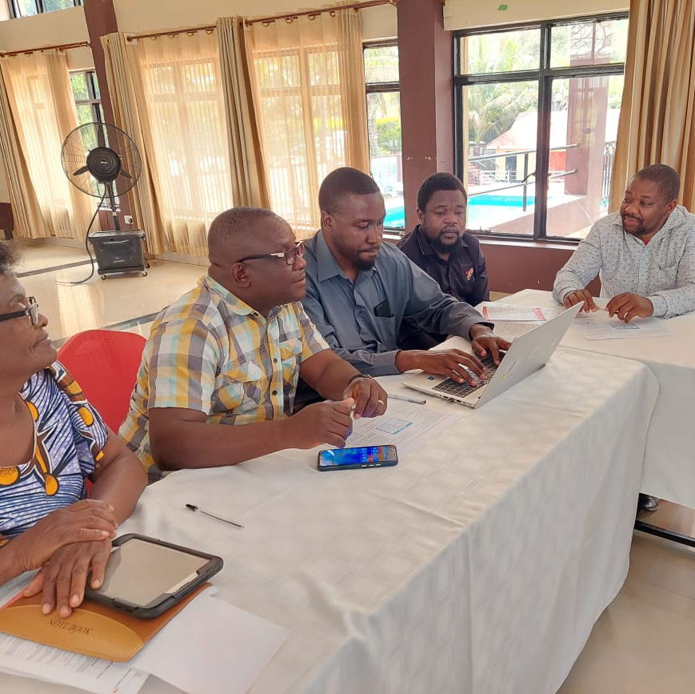
Implementation Approach
This begins a plan, implement, monitor, and report cycle in 2 of 10 traditional authorities in year 1, followed by gap assessment and formative research, to allow for adaptation into years 2 and 3. to reach universal WASH access in households, schools, and healthcare facilities.

Slide 32
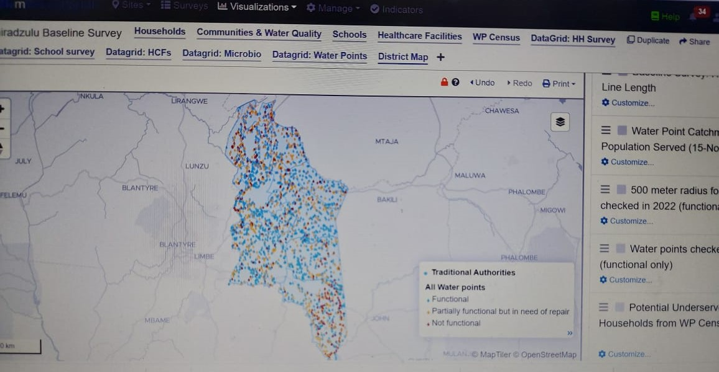
Geospatial Analysis and Modelling for Water Points Allocation

Slide 33
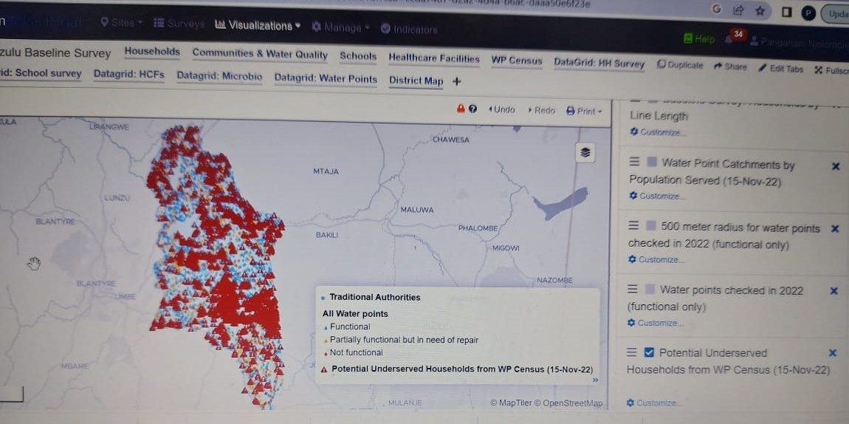
Geospatial Analysis and Modelling for Water Points Allocation
used to update water system planning.

Slide 34
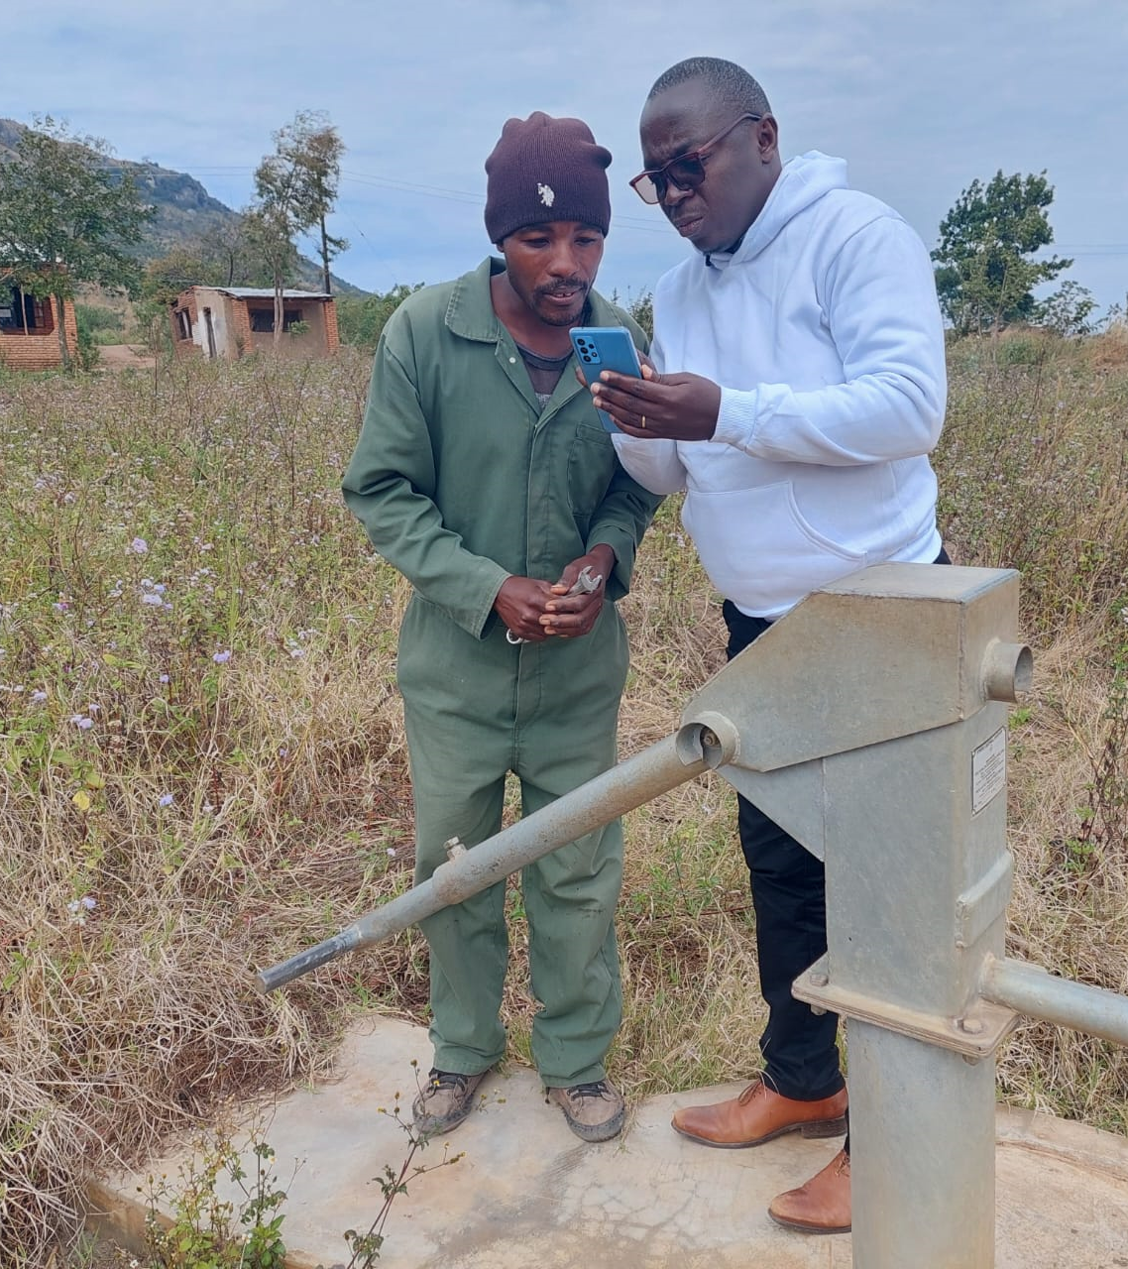
Learnings and Adaptation
The communities to be targeted with water points were identified through baseline results and WP mapping.
Baseline and WP mapping identified needy TAs and communities.
The district water office physically verified all the sites identified through mWater.
The 500m boundary used to define “basic” is not sufficient, as we learned during the baseline, that many people have water within 500m but not within 30 minutes roundtrip
Notes:
What worked well? What were challenges? How was local government involved in this?

Slide 35
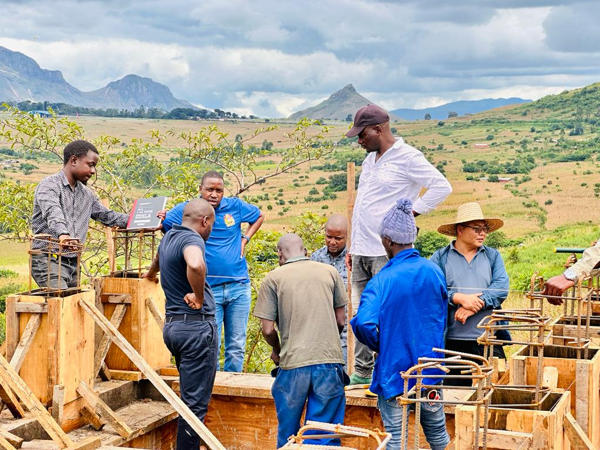
What Worked Well
A total of 15 government staff members were trained and conducted census of over 2118 water points
All nonfunctional boreholes that passed the rehab assessment were proposed for possible rehabilitation.
Underserved populations were identified through mWater and supported with 6 water systems and Boreholes
This approach of using a baseline survey and mWater mapping helped the project to intervene in areas that did not have better access.
Over 45000 people gained access to safe water through construction of 6 water systems ,40 new boreholes and 29 rehabilitated boreholes in year one.

Slide 36
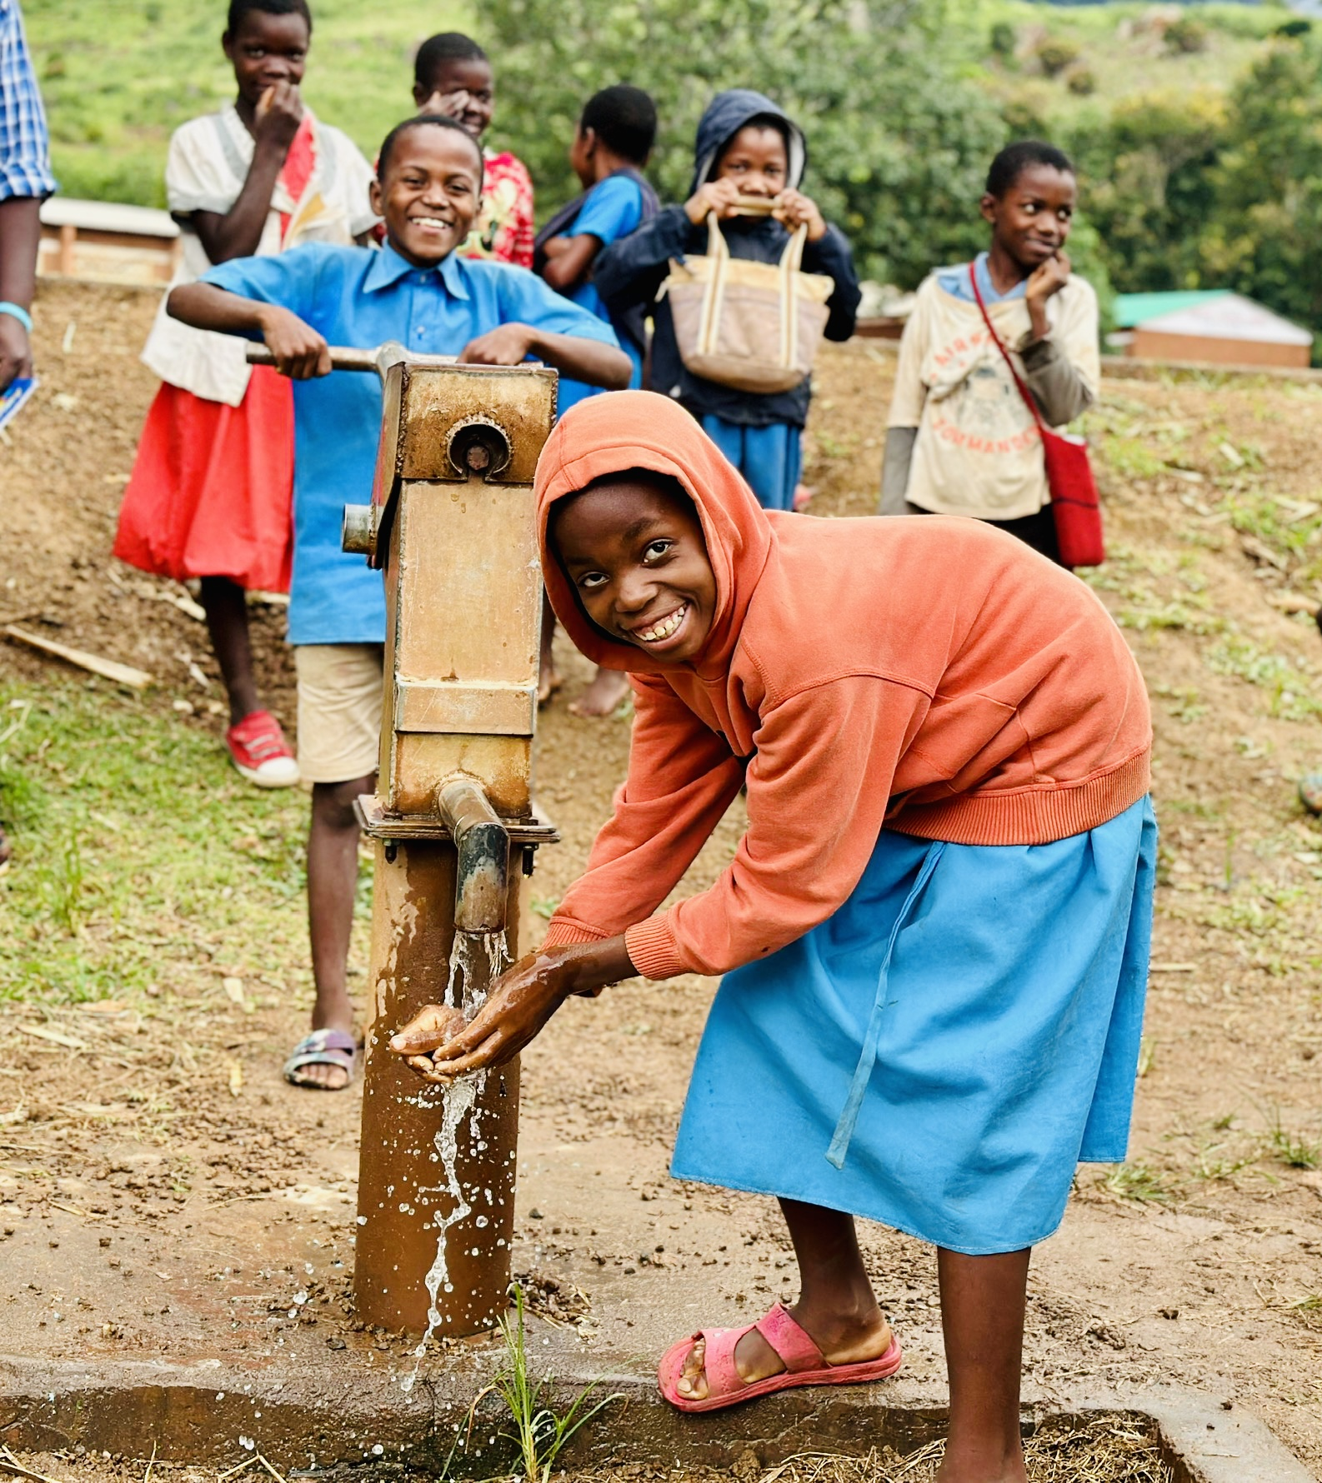
What Worked Well
The project collaborated frequently with the district council to share data and learnings from the water point mapping exercise.
The district council also allocated its extension workers to support the project. Likewise, communities in the project area recognize and trust both organizations, which boosted their participation in project activities.
The team continued working closely together to ensure strong WASH systems and behaviors are sustained beyond project period.

Slide 37
Challenges Faced and Solutions
Staffing challenges at District water office to support Water points Mapping and monitoring.(3 Water monitoring Assistants against 10 Traditional Authorities)
The district Council recruited 7 Water Monitoring Assistants. The project will support the staff for two years and District council will absorb them after 2 years

Slide 38
Conclusion
System Strengthening and achieving universal WASH access requires collaboration with partners and communities, and unique blend of demand and supply creation for interventions

Slide 39
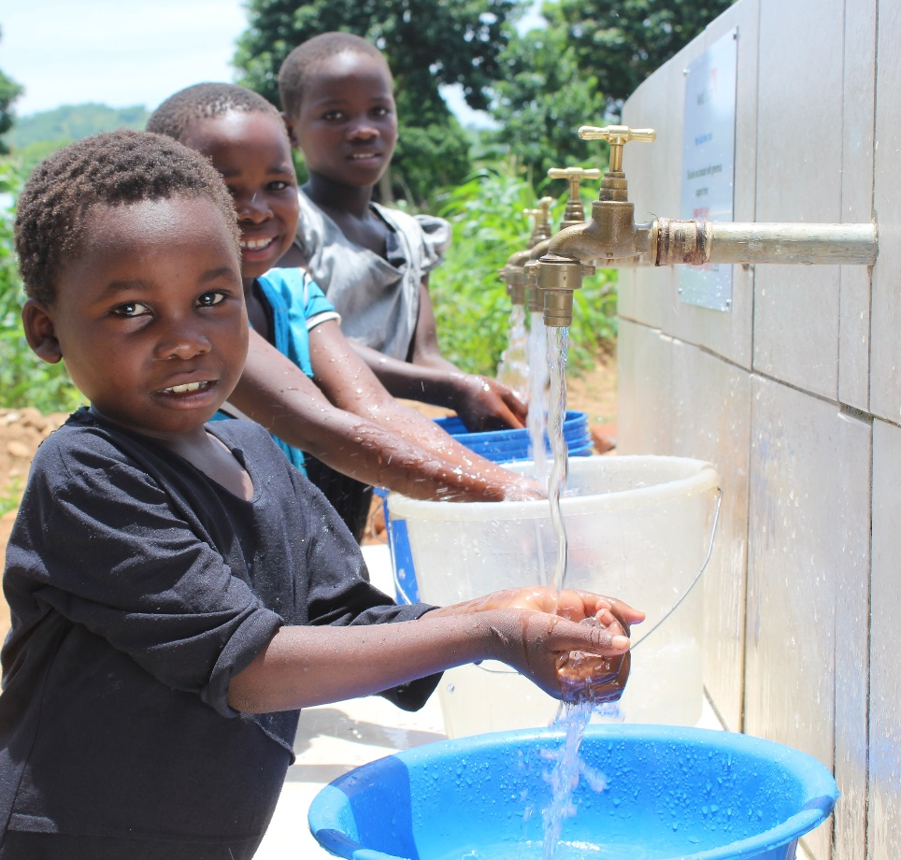

THANK YOU FOR YOUR ATTENTION!

Slide 40


Questions?
Comments?

Slide 41
Contact Information
Name | Title | Country | Email
Channing Carney-Filmore | WASH Program Manager | United States | Ccarneyfilmore@worldvision.org
Tupac Mejia | WASH Program Director | Honduras | Tupac_mejia@wvi.org
Jessy Samuyachi Mahongo | Monitoring & Evaluation Specialist | Zambia | Jessy_Samuyachi@wvi.org
Maybin Ng'ambi | Technical WASH Program Manager | Zambia | Maybin_ngambi@wvi.org
Alice Muhimpundu | WASH Behavior Change Communications Manager | Rwanda | Alice_Muhimpundu@wvi.org
Panganani Njolomole | WASH Project Manager, Chiradzulu District | Malawi | Panganani_Njolomole@wvi.org

