Slide 1



Slide 2
Young people, jobs and lifelong learning for
WASH professionals
Tuesday 2 May, 13:45
Amazon, World Forum

Slide 3



















Partners/ Co-conveners

Slide 4
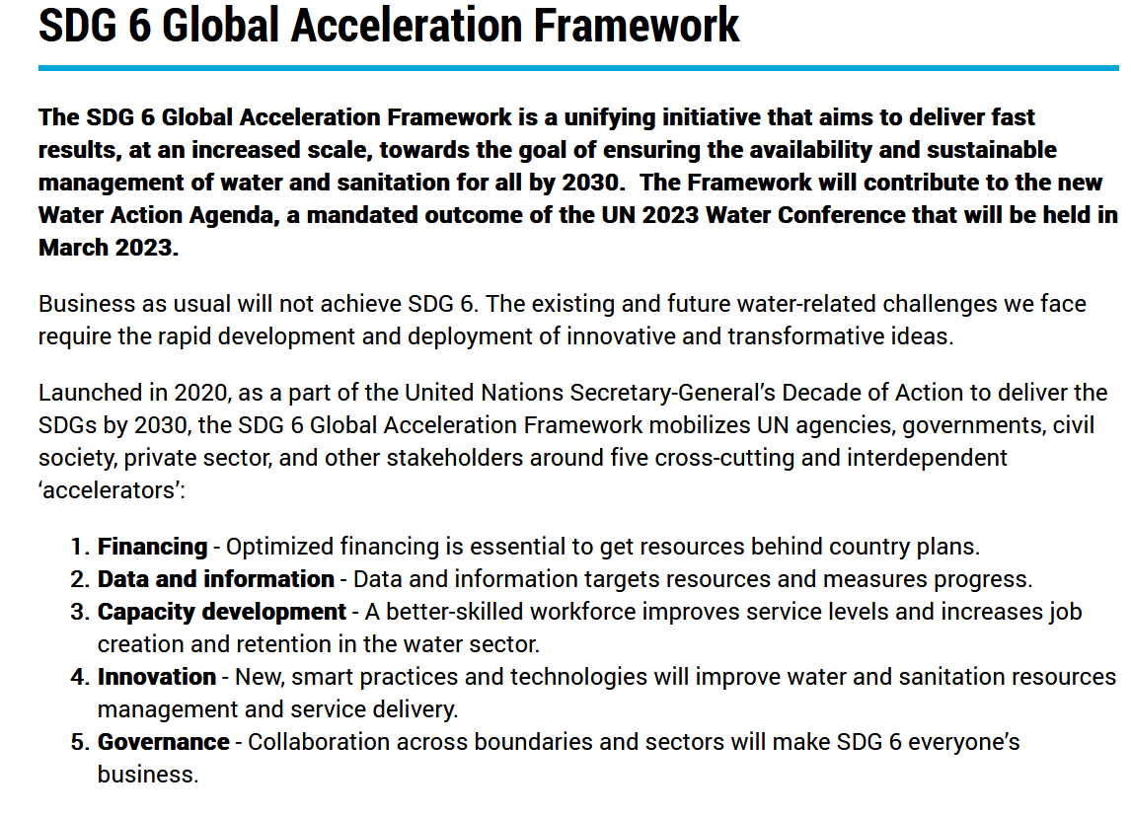
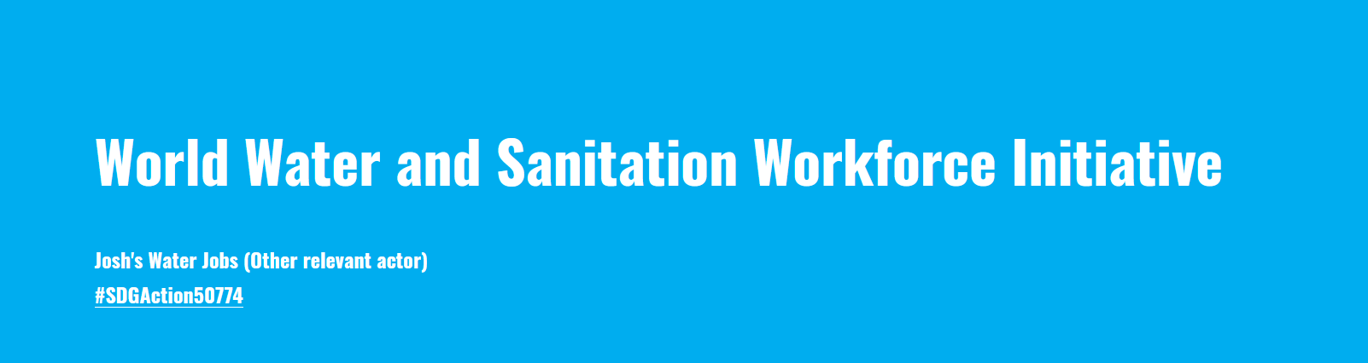
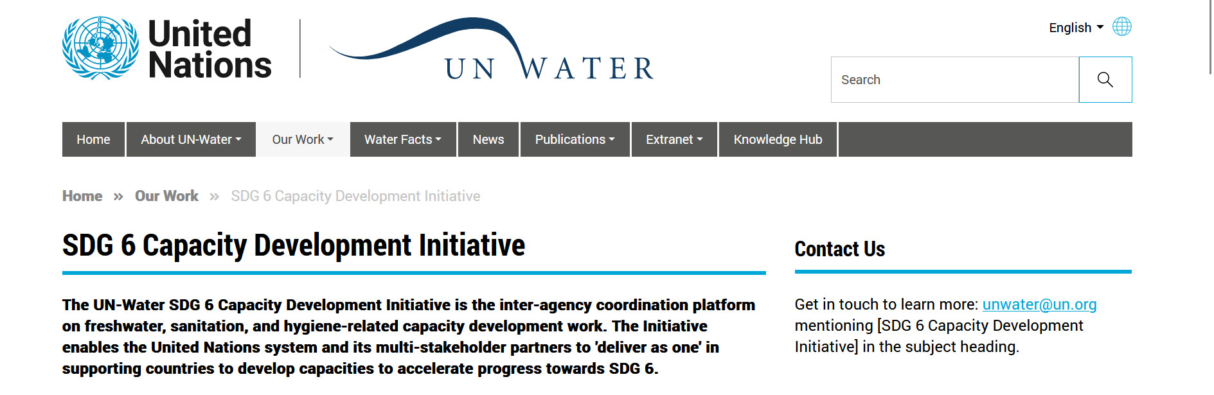
Why this session?
Main objective is to connect across the water & education to go to scale on sector professional/ capacity-development & build a coalition around:
Diversifying the water workforce,
with a focus on women and young professionals
Developing people and skills at the scale needed to realise SDG6
Notes:
Main objective is to connect across the water & education sectors to go to scale on sector professional/ capacity-development & build a coalition around:
Diversifying the water workforce, with a focus on women and young professionals
Developing people and skills at the scale needed to realise SDG6
Everyone talks about capacity development in the WASH / water sector – but who is doing what? And how do the various capacity-development initiatives fit into & contribute to strategic global capacity development initiatives?
At RWSN, we think we have an important role to play in advancing learning for the sector, but our role is limited in scope and in scale. There are several initiatives at the global level meant to reinforce/ expand capacity development. One is the UN Water SDG6 Capacity Development Initiative, launched in 2021. And another is the World Water and Sanitation Workforce Initiative, launched at the UN Water conference last March. Here to give us a short briefing on these two initiatives, how they fit together, and how the sector can contribute to them, are Maren Heuvels (GIZ) and Gaetano Casale (IHE Delft).
Connect across sectors – water & education, and across levels: operational & strategic
Map out the current offer of professional to identify comprehensive pathways for lifelong learning in the WASH sector;
Form a coalition of organisations interested in attracting diversity to the WASH jobs, particularly women and young professionals;

Slide 5
Session outline
When | What
0-15’ | Interactive intro
15-60’ | Pitches from organisations working on: Diversifying the water workforce (focus on young professionals and women) Supporting water/ WASH professionals once they are in the sector & creating more coherent professional development pathways for sector professionals
60-75’: | Key highlights and wrap-up

Slide 6

Go to
www.pigeonhole.at
Enter passcode
RWSN23
Notes:
In this session, we also want you – the participants – to have an active role and be involved in the group discussions. To get to know each other better, we have designed a short interactive exercise using your mobile phone.
Projector panel: https://pigeonhole.at/672478/access/NTXC2GR7NX/p
Admin panel: https://pigeonhole.at/672478/access/GSFA6TY2MB/a
Moderator panel: https://pigeonhole.at/672478/access/5KPS4SU3S3/m

Slide 7

Go to
www.pigeonhole.at
Enter passcode
RWSN23
Notes:
Who is a young professional (under the age of 35)? (stand up)
Who here identifies as female? (raise your hand)
How many years of experience in the WASH sector do you have? less than 5, 5-10, more than 10
When learning new skills and competences at work, what have you benefited most from: formal training (short courses, long courses) or informal training (mentoring, communities of practice...)?
What has prevented you from undertaking training opportunities? Time, money, both, other, I am not sure what training I need, I don’t need any additional training.
What barriers have you faced in getting the jobs you wanted in the WASH sector? Rank by importance: Lack of skills, personal constraints (eg relocation or caring responsibilities), lack of personal network, lack of motivation, lack of time, other (please specify)
What tools/ approaches have helped you gain a job in the WASH sector? Open text

Slide 8
Session outline
When | What
0-15’ | Interactive intro
15-60’ | Pitches from organisations working on: Diversifying the water workforce (focus on young professionals and women) Supporting water/ WASH professionals once they are in the sector & creating more coherent professional development pathways for sector professionals
60-75’: | Key highlights and wrap-up

Slide 9
Group 1: Diversifying the water workforce (focus on young professionals and women)
Guiding questions:
How do we support young people to develop their professional potential, find jobs and opportunities in the water/ WASH sector?
How can the water/ WASH workforce better retain women and increase their representation in leadership roles?
Participants are encouraged to ask questions/ contribute their experiences.
Short pitches (3-5 min each) from:
Agenda for Change (Alec Shannon)
Rural Water Supply Network (Meleesa Naughton)
Women for Water Partnership (Lesha Witmer)
Water Youth Network (Temple Oraeki)
SuSanA/ GIZ Stronger Together Water and Sanitation Job access for women and young professionals (Maren Heuvels)
Valuing Water Initiative (Joe Ray)
Notes:
The group discussions are about presenting experiences where the WASH sector has been innovative in (i) attracting and connecting young people to WASH employment; (ii) supporting WASH professionals (including women) with on the job training and career progression and (iii) creating a more coherent professional development pathway for people in the WASH sector.

Slide 10
Group 2: Focus on continuous professional development for WASH professionals
Guiding questions:
How do we support WASH professionals once they are in the sector? Who pays?
How do we create a more coherent professional development pathway for people in the WASH sector?
How do we better evaluate the capacity of individuals?
Participants are encouraged to ask questions/ contribute their experiences
Short pitches (3-5 min each) from:
Eawag (Christoph Luethi)
Ask for Water/ RWSN (Kerstin Danert)
IRC WASH Academy (Jeske Verhoeven)
Global Water Center (Eileen Jarnholt)
Cranfield University (Alison Parker)
IHE Delft (Konstantina Velkushanova)
Notes:
The next session, which is about presenting experiences where the WASH sector has been innovative in (i) attracting and connecting young people to WASH employment; (ii) supporting WASH professionals (including women) with on the job training and career progression and (iii) creating a more coherent professional development pathway for people in the WASH sector.

Slide 11
Key highlights from group discussions
1. Diversifying the water workforce
How do we support young people to get jobs in the WASH sector?
How can the WASH workforce better retain women and increase their representation in leadership?
2. Supporting continuous professional development
How to support WASH professionals once in
the sector? Who pays?
How do we create more coherent professional development pathways?
How do we better evaluate the capacity
of individuals?

Slide 12
Contact details:
Please connect with us to join forces on young people, jobs and lifelong learning
for WASH professionals
meleesa.naughton@skat-foundation.ch aline.saraiva@skat-foundation.ch sean.furey@skat-foundation.ch

