Slide 1


Advancing WASH Success Through Customer Service
Notes:
Good day everyone,
Welcome to this presentation on the future of investments in WASH and ensuring the sustainability of WASH projects to meet the needs of the communities they serve. In the next few minutes, we will delve into some key questions that are crucial in determining the success and sustainability of WASH initiatives.
One of the questions we will be addressing today is: what will be the fate of ongoing investments in WASH in the next five years? With increasing attention and investments in WASH, it is essential to examine the trajectory of these investments and what it means for the future of WASH.
We will also be exploring how we can ensure the sustainability of WASH projects to meet the needs of the communities they serve. It is not enough to initiate a WASH project; ensuring its sustainability is equally important for its long-term impact. We will examine different approaches to achieving sustainability and how we can implement them effectively.
Another key question we will address today is how to develop a customer service function for our WASH initiatives. Customer service is crucial in ensuring that WASH projects meet the needs of the communities they serve. We will explore the benefits of using a customer service approach and learn how to develop and implement it in our WASH initiatives.
So, sit back, relax, and let's dive into the world of WASH investments and sustainability.

Slide 2

netcentriccampaigns
MOTIVATION + ORGANIZATION = SOCIAL CHANGE
Social Change
Notes:
We’re all familiar with the model for social change here – when you have a motivated population (either because of a shocking event or report, a powerful message, a celebrity, or all combined) and you apply the power of a traditional organization you can create social change – we see this every day with policy change – you all do this with your communications department effectively.
What we are seeing more of increasingly is that you can also produce social change when you have a highly functional, loose action network working on a shared motivation.

Slide 3
netcentriccampaigns
MOTIVATION + NETWORK CAPACITY = SOCIAL CHANGE
Social Change
Notes:
We’re all familiar with the model for social change here – when you have a motivated population (either because of a shocking event or report, a powerful message, a celebrity, or all combined) and you apply the power of a traditional organization you can create social change – we see this every day with policy change – you all do this with your communications department effectively.
What we are seeing more of increasingly is that you can also produce social change when you have a highly functional, loose action network working on a shared motivation.

Slide 4
SEEKING NETWORK EFFECTS
:15
Notes:
We think about networks in a very particular way. This session shares an overview of what we have learned about networks and social change. We talk about when networks are a good fit for a challenge and why building networks and network capacity can help contribute to solutions to complex wicked and messy issues.
We will discuss the work of participants about their work, the ways they see networks in action, and we will talk about developing the skills needed to build, strengthen, and manage networks.
We will focus lessons applied in Asutifi North, Ghana and provide an overview of the work there which resulted in organizing the network around “customer service” as a network framework to build resources, drive information exchanges, and enhance accountability.
They can be positive or netgative like traffic congestions: A network effect (also called network externality or demand-side economies of scale) is the effect described in economics and business that an additional user of goods or services has on the value of that product to others. When a network effect is present, the value of a product or service increases according to the number of others using it.^{[1]}
The classic example is the telephone, where a greater number of users increases the value to each. A positive externality is created when a telephone is purchased without its owner intending to create value for other users, but does so regardless. Online social networks work similarly, with sites like Twitter and Facebook increasing in value to each member as more users join.
The network effect can create a bandwagon effect as the network becomes more valuable and more people join, resulting in a positive feedback loop.

Slide 5
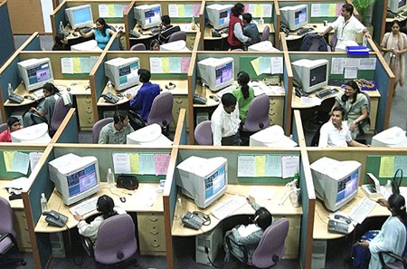
Call Center
netcentriccampaigns
Notes:
The neat thing about working with someone like Bank of America is they track all kinds of data. On the left axis here you can see as network scores increased there is a slight relationship between denser scores and quicker call times to resolve the customer call because of knowledge sharing. So in this world of connections a networked workforce was more collaborative and more effective. They worked with Sandy Pentland to assess the network and build network power in one of the call centers.

Slide 6
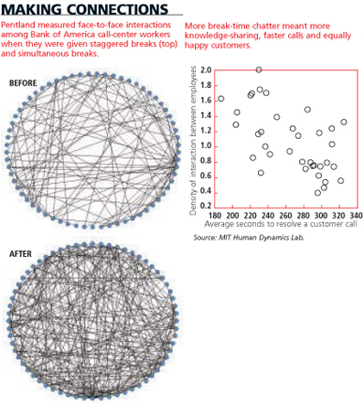
netcentriccampaigns
Networks Effects
Notes:
The neat thing about working with someone like Bank of America is they track all kinds of data. On the left axis here you can see as network scores increased there is a slight relationship between denser scores and quicker call times to resolve the customer call because of knowledge sharing. So in this world of connections a networked workforce was more collaborative and more effective.
He wanted to map how well the people in the call center knew each other by name, what they worked on. And how often people in the call center interacted or chatted with each other. Just for a point of reference this is a Bank of America call center when the workers are given staggered brakes. Meaning one crew goes for half hour than the next crew goes for a half hour so on. One of the things Sandy wanted to do to build connectivity was to create more opportunities for people to mix up with each other.
So with a simple change everybody had their breaks and calls and lunches at the same time

Slide 7
netcentriccampaigns
Networks Effects
Notes:
The neat thing about working with someone like Bank of America is they track all kinds of data. On the left axis here you can see as network scores increased there is a slight relationship between denser scores and quicker call times to resolve the customer call because of knowledge sharing. So in this world of connections a networked workforce was more collaborative and more effective.

Slide 8
Network Effects
netcentriccampaigns
Networks Effects
Notes:
The neat thing about working with someone like Bank of America is they track all kinds of data. On the left axis here you can see as network scores increased there is a slight relationship between denser scores and quicker call times to resolve the customer call because of knowledge sharing. So in this world of connections a networked workforce was more collaborative and more effective.

Slide 9

netcentriccampaigns
Networks Effects
Notes:
Not only are we connected, but the density of those connections really matters. Here is an example of a fire (think of it like the perfect message. ) it moves like “just do it” it travels like fire. We have played with this in different ways but the example here tells the story most cleanly. The perfect message matters but it is not sufficient. The more we connect (more density) then the fire burns the entuire thing down every time.

Slide 10
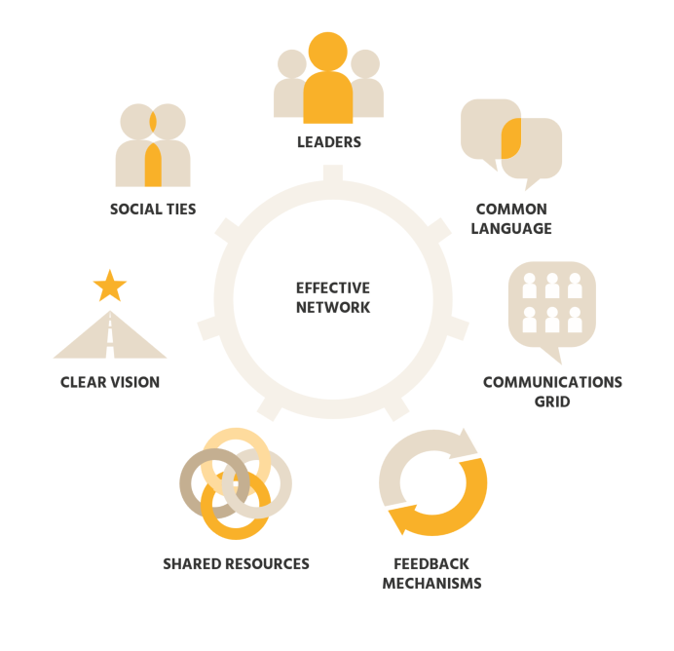
Mission
netcentriccampaigns
Transform the success of nonprofits and foundations by mobilizing networks of people to move change forward effectively and efficiently.
Guide
Notes:
35

Slide 11
Seven Elements of Healthy Network
netcentriccampaigns

Slide 12
Vision
netcentriccampaigns
“In the course of planning and implementation of the district-based initiative, a stakeholder-focused network will be created using both existing and new platforms to support WASH and allied actions, advocacy, and engagement to influence behaviour and attitudinal change. Communication messages will be couched around ‘Equity and inclusion in WASH delivery’; ‘Payment of tariff for WASH services’; ‘Funding and prioritisation of WASH’; ‘Business opportunities in WASH’; and ‘Financial accountability of duty bearers and right holders’.
The main communication tools will be face-to-face interactions, hosting of websites, the use of social media, radio, video and television (TV), newspapers, community durbar, Town Hall meetings, among others. These will be deployed on a case-by-case basis, and in a manner that will ensure they produce the desired outcomes.” –
- – NETWORK DISTRICT Master Plan
Seven Elements

Slide 13
Customer Service
Networked customer service in the context of WASH projects.
Benefits of using this approach.
How to develop a networked customer service function for WASH initiatives.

Slide 14
The Role of the Public in WASH Systems?
netcentriccampaigns
The people that use water systems are critical to sustainable water management and governance.

Slide 15
The Role of the Public in WASH Systems?
netcentriccampaigns
The people that use water systems are critical to sustainable water management and governance.
They provide water utility feedback to detect operational failures, including changes in source water quality.

Slide 16
The Role of the Public in WASH Systems?
netcentriccampaigns
The people that use water systems are critical to sustainable water management and governance.
They provide water utility feedback to detect operational failures, including changes in source water quality.
They sense illegal connections and report to utilities.

Slide 17
The Role of the Public in WASH Systems?
netcentriccampaigns
The people that use water systems are critical to sustainable water management and governance.
They provide water utility feedback to detect operational failures, including changes in source water quality.
They sense illegal connections and report to utilities.
They sense and detect certain classes of chemical compounds.

Slide 18
The Role of the Public in WASH Systems?
netcentriccampaigns
The people that use water systems are critical to sustainable water management and governance.
They provide water utility feedback to detect operational failures, including changes in source water quality.
They sense illegal connections and report to utilities.
They sense and detect certain classes of chemical compounds.
The users amplify the health, economic, hygiene, and sanitation value produced by systems.

Slide 19
The Role of the Public in WASH Systems?
netcentriccampaigns
The people that use water systems are critical to sustainable water management and governance.
They provide water utility feedback to detect operational failures, including changes in source water quality.
They sense illegal connections and report to utilities.
They sense and detect certain classes of chemical compounds.
The users amplify the health, economic, hygiene, and sanitation value produced by systems.
The people provide a bulk of the money required for the daily operations and maintenance of water supply infrastructure.

Slide 20
Seven Elements of Healthy Network
netcentriccampaigns

Slide 21
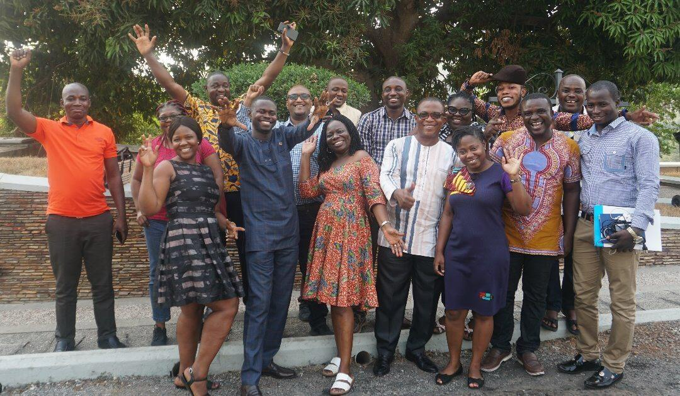
netcentriccampaigns
Social Ties
Supporting Core Group and community gatherings.
Supporting commons spaces.
Journalism and radio to expand story sharing help build social connections.
Establish a toll-free number for WASH customer service.
Application in Asutifi North

Slide 22
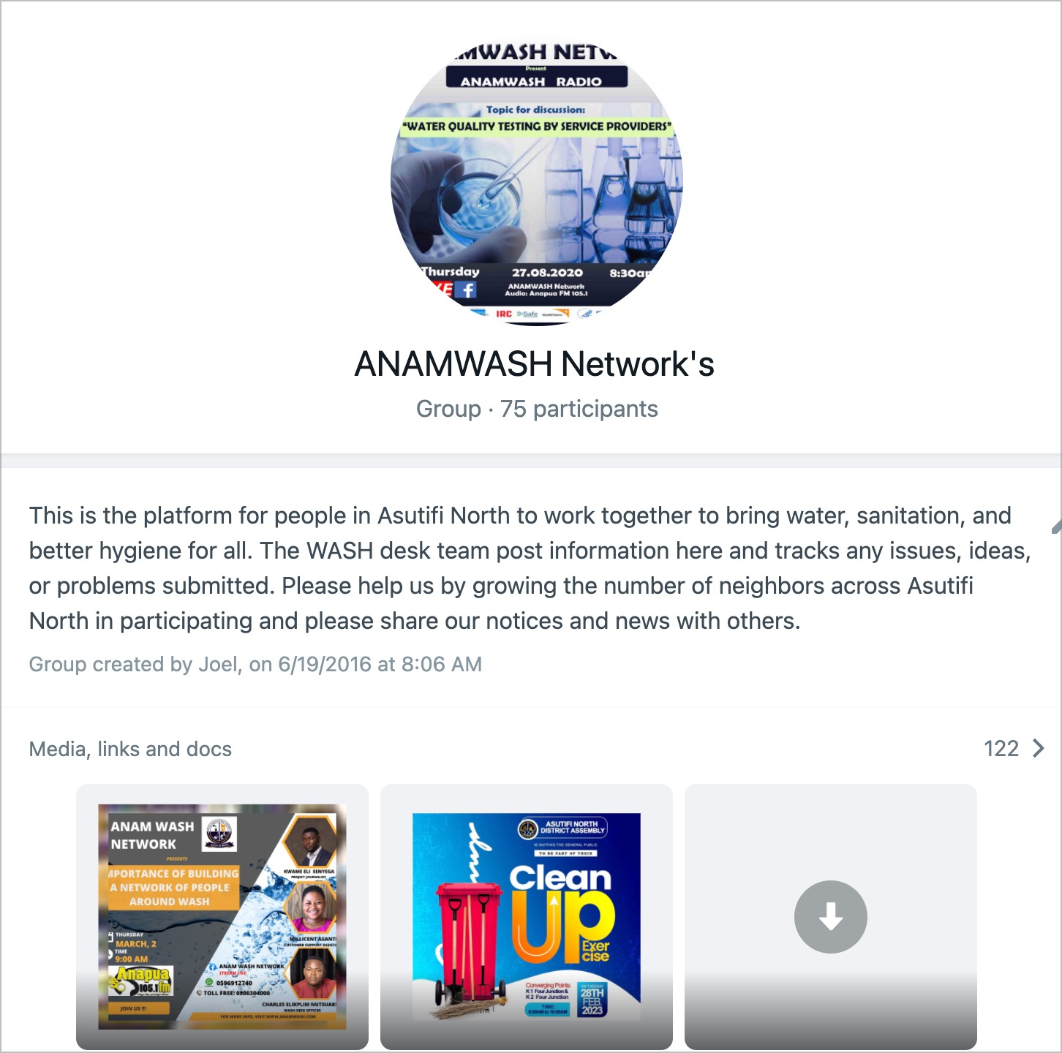
netcentriccampaigns
Communications Grid
Supporting new and existing ways for people in the District to find each other and send messages- giving them a flat communications channel they wouldn’t have otherwise.
  They can also learn more about one another through profile pages on the site.
Application in Asutifi North
Notes:
Live watch on the Radio Program also reaching 300+ people

Slide 23

netcentriccampaigns
Communications Grid
Supporting new and existing ways for people in the District to find each other and send messages- giving them a flat communications channel they wouldn’t have otherwise.
  They can also learn more about one another through profile pages on the site.
Application in Asutifi North

Slide 24
netcentriccampaigns
Feedback
The network receives feedback in the form of updates on campaign successes and shortcomings.
  They can also check real-time statistics on network growth and activity on the website, map and on social media channels.
Application in Asutifi North

Slide 25
Walk In | Radio – Phone in | Call to Wash Desk | Website | Total
12 | 35 | 30 | 12 | 89
netcentriccampaigns
Feedback
The network receives feedback in the form of updates on campaign successes and shortcomings.
  They can also check real-time statistics on network growth and activity on the website, map and on social media channels.
Feedback Sources
Male | Female
38 | 51
Toll free: 0800304000
Application in Asutifi North

Slide 26
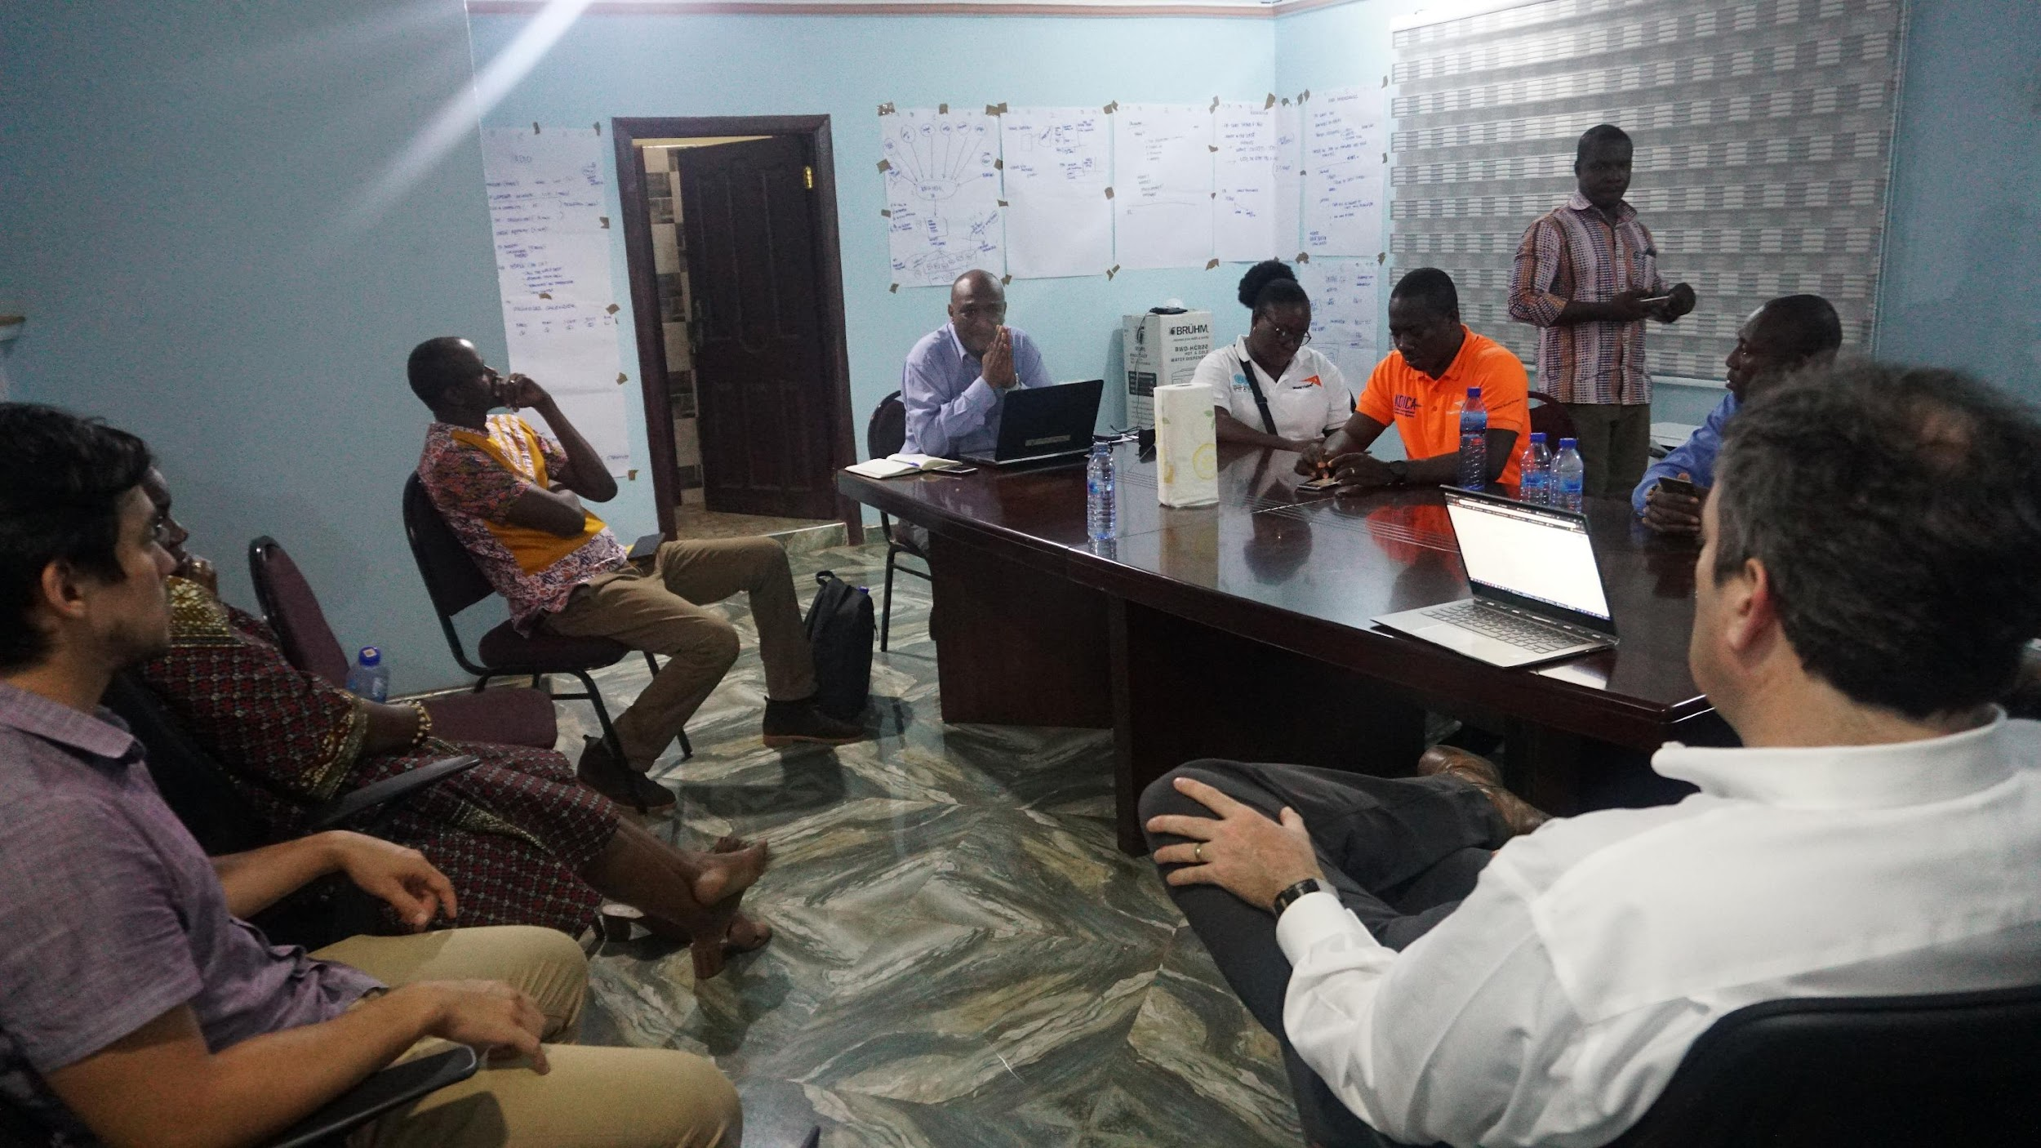
netcentriccampaigns
ANAMWASH in Action
The network building activities has help to reduced dependency on the District Assembly.
Reduced cost of community mobilization.
Increased demand for WASH services.
Citizens trust the WASH DESK to address complaints.
.
Application in Asutifi North

Slide 27
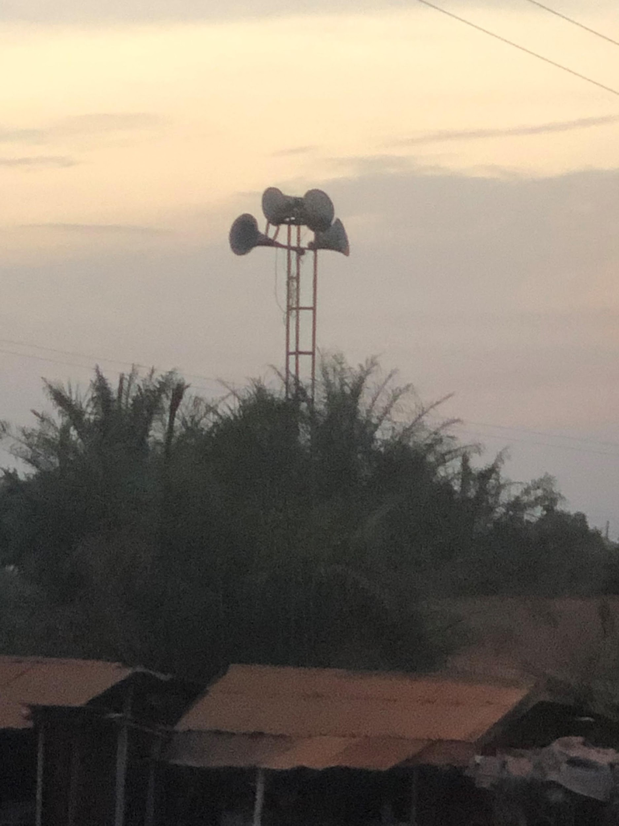
netcentriccampaigns
ANAMWASH CHALLENGES
Core Group Building.
Pace of set up.
Data Management.
Team Turnover.
Broadcast Channels Need Work.
Nonlinear Development Curve is Frustrating.
Communications from WASH Sector.
“Customer Service”.
Finding a Sustainable Host and Department.
Application in Asutifi North

Slide 28



Our Help – Washdesk
  Resources– Checklist and Training
  Consultative Help – Project reviews
  Webinars – Discuss Projects
  Community - Post Questions and Say Hello!
  Questions?
  Get in touch:
    Benjamin@washdesk.org marty@netcentriccampaigns.org
  +1 202-487-1887
  Learn more
  Set up a time to talk with Ben visit www.washdesk.org

Slide 29
Martin Kearns
Executive Director
Netcentric Campaigns
2024871887
marty@netcentriccampaigns.org
www.netcentriccampaigns.org

