Slide 1


Slide 2
Rights, Inclusion & Regulation for System Strengthening
Rights, inclusion and regulation for
system strengthening

Slide 3



Objectives
Highlighting the opportunities for GEDSI to transform WASH systems and for WASH to contribute to GEDSI transformation in the places where we work.
Provide space for participants to share their own project experiences on rights, inclusion and GEDSI in WASH systems strengthening.
Inspire action from participants to improve diversity and inclusion in their WASH systems programming.

Slide 4
Part 1 Session Introduction
Highlighting the opportunities for GEDSI to transform WASH systems and for WASH to contribute to GEDSI transformation in the places where
we work

Slide 5


Gender equality, disability and social inclusion
Sex
The biological categorization of a person as male, female, or intersex.¹
Sex is assigned at birth based on biological indicators, including hormones, sex chromosomes, internal reproductive organs, and external genitalia.
Gender
The socially and culturally constructed ideas of what it is to be male or female in a specific context. ¹
Roles, responsibilities, attitudes, behaviors that a society expects & considers appropriate for males & females, independent of individual’s own identity/ expression.
Learned, changeable over time, variable across cultures, sanctions for non-adherence to expectations, exclusion.

Slide 6


Gender equality, disability and social inclusion
Gender Equality
The state of being equal in status, rights and opportunities, and of being valued equally, regardless of sex or gender identity and/or expression.
In a state of gender equality, people are free to develop their personal
abilities and make choices without the limitations set by stereotypes, gender norms, or prejudices.
Persons with disabilities
Include those who have long-term physical, mental, intellectual or sensory impairments. In interaction with various barriers, disability may hinder full and effective participation in society on an equal basis with others
Notes:
Gender Equality
The state of being equal in status, rights and opportunities, and of being valued equally, regardless of sex or gender identity and/or expression.
In a state of gender equality, people are free to develop their personal abilities and make choices without the limitations set by stereotypes, gender norms, or prejudices. Gender equality is widely recognized as a fundamental human rights concern and a precondition for advancing development, reducing poverty, and promoting sustainable development. Gender equality implies that the interests, needs and priorities of both women and men are taken into consideration and that achievement of development outcomes does not depend on an individual’s sex or gender identity and/or expression.
Also def of equity:
Gender Equity
Fairness in treatment of all people regardless of sex or gender identity and/or expression.
The concept of gender equity recognizes that individuals have different needs and power based on their sex or gender identity and/or expression, and that these differences should be identified and addressed in a manner that rectifies inequities. To ensure fairness, affirmative action is often used to remedy gaps and compensate for historical and social disadvantages that prevent individuals from otherwise operating as equals. Gender equity is a strategy that can lead to gender equality using targeted time-bound policies.

Slide 7




Gender equality, disability and social inclusion
Intersectionality
Notes:
Intersect with other factors (race, class, age)
to compound discrimination.

Slide 8
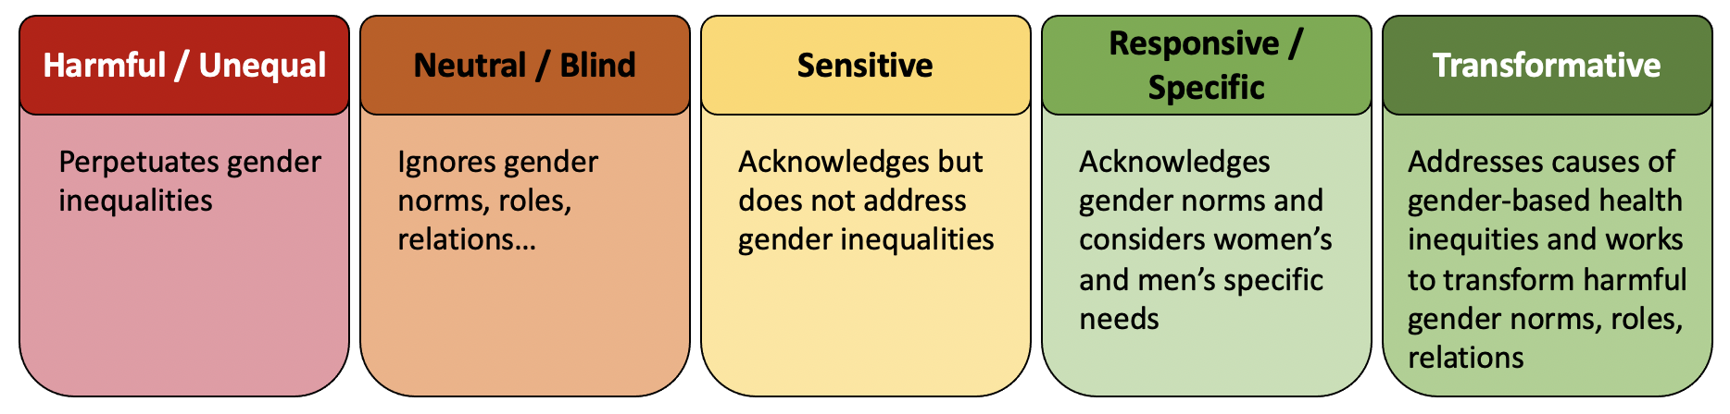
Transformation
Notes:
Intersect with other factors (race, class, age)
to compound discrimination.

Slide 9
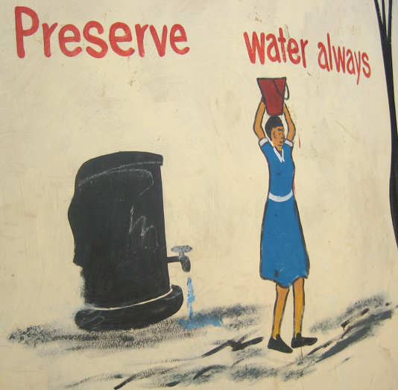
Notes:
Intersect with other factors (race, class, age)
to compound discrimination.

Slide 10
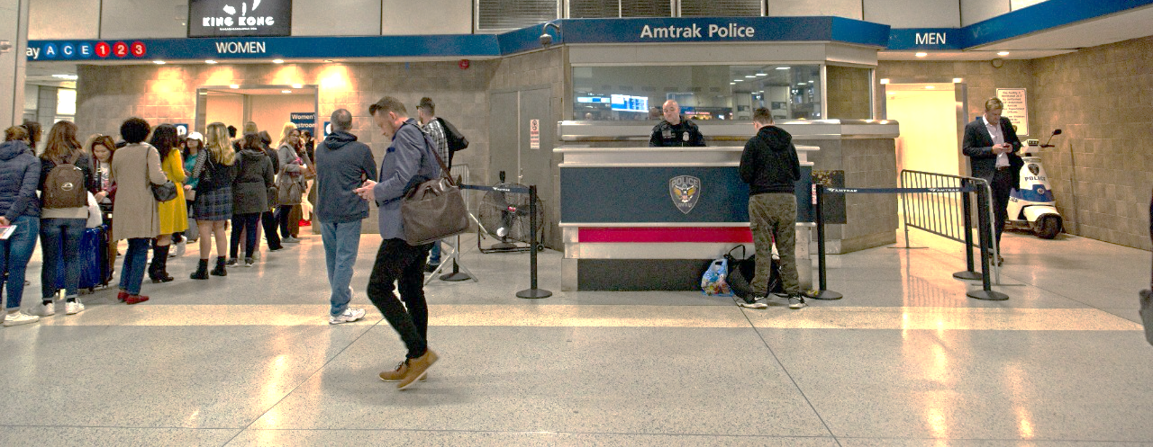
Notes:
Intersect with other factors (race, class, age)
to compound discrimination.

Slide 11


Notes:
Intersect with other factors (race, class, age)
to compound discrimination.

Slide 12
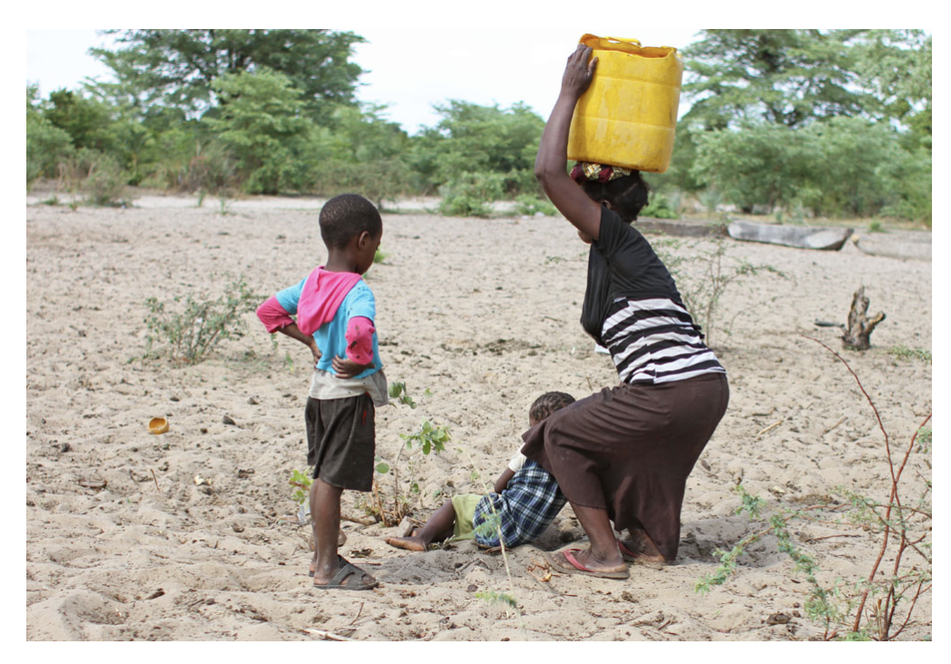
Notes:
Intersect with other factors (race, class, age)
to compound discrimination.

Slide 13
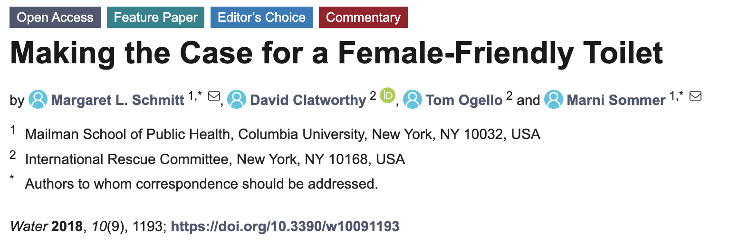
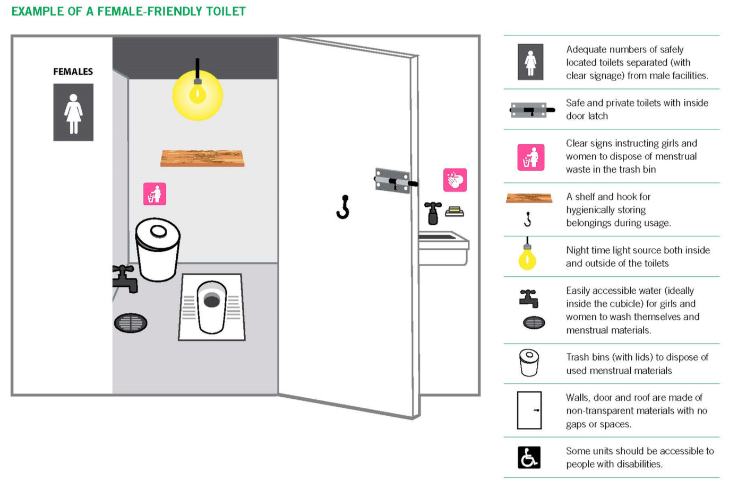
Notes:
Intersect with other factors (race, class, age)
to compound discrimination.

Slide 14

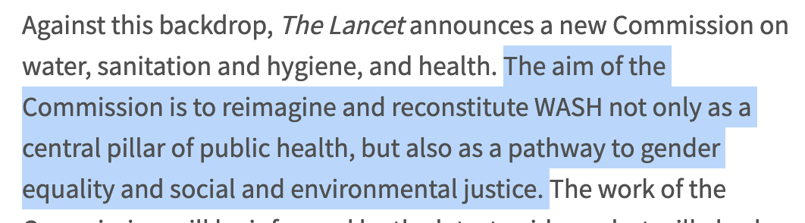
That this is ‘reimagined’ sheds light on how transformation has not been the norm in the sector
Notes:
Intersect with other factors (race, class, age)
to compound discrimination.

Slide 15
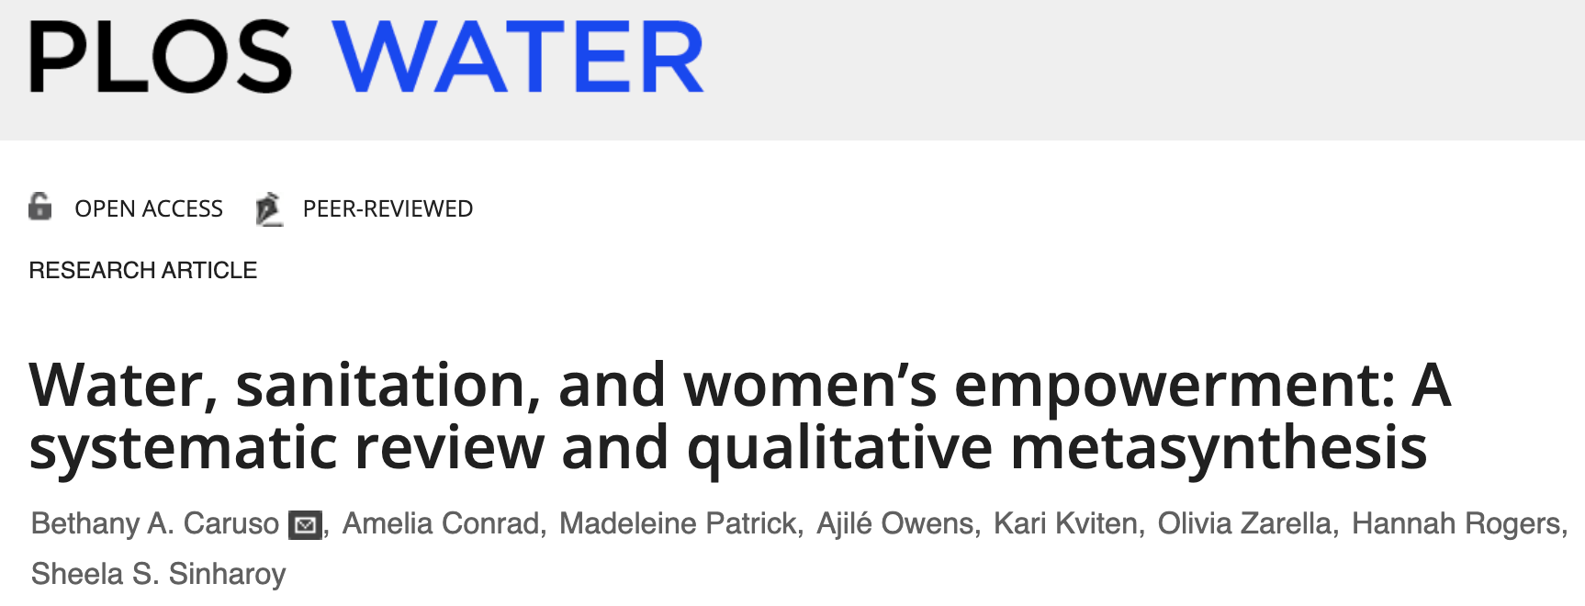
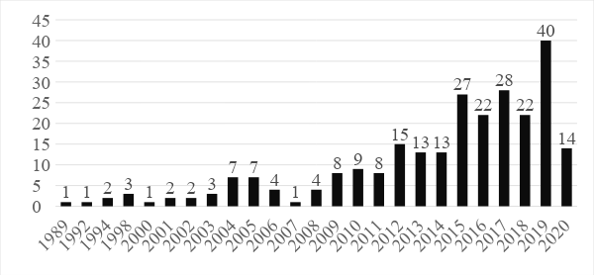
It is not that we do not know what to do…
257 Articles (up to May 2020)
                82% (211) published since 2010
                60% (153) published since 2015
                More published in past 3 years
Notes:
Intersect with other factors (race, class, age)
to compound discrimination.

Slide 16



It is not that we do not know what to do…
🡪 Lots of research on WASH & Empowerment
Scant WASH programs to improve empowerment
Why? Not Prioritized? Not worth investing?...
Notes:
Intersect with other factors (race, class, age)
to compound discrimination.

Slide 17
It is not that we do not know what to do…
Notes:
Intersect with other factors (race, class, age)
to compound discrimination.

Slide 18

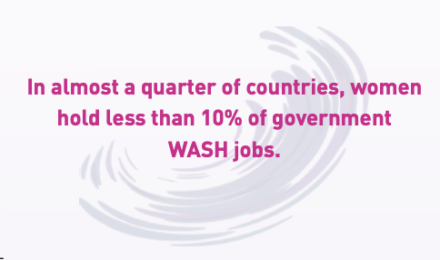
It is not that we do not know what to do…
Notes:
Intersect with other factors (race, class, age)
to compound discrimination.

Slide 19
Part 2: Let’s Discuss
Provide space for participants to share their own project experiences on rights, inclusion and GEDSI in WASH systems strengthening.

Slide 20
Part 2: Now what?
Inspire action from participants to
improve diversity and inclusion in their
WASH systems programming.

Slide 22



Beyond access: A more transformative approach to
WASH through integration, systems and intentional learning
Lessons from World Vision and Emory University

Slide 23
Beyond access: strong women strong world
Guatemala, Honduras, Kenya and Zimbabwe
Integrated and sequenced interventions focusing on a dignifying enabling environment, opportunities to learn and use skills, and resiliency and growth
Intentional learning focusing on formative research and process evaluation
Notes:
The first title starts with ‘beyond access’ so changed order here for consistency
Add a picture?

Slide 24

Beyond access: vision
VISION:
The sustainable empowerment of women and girls through transformative WASH, Economic Empowerment and Access to Microfinance
Empowerment means that women and girls experience an increased sense of self-worth, ability to determine their own choices, & right to influence social change for themselves & others
Notes:
Keep 2 or 3 bullets on each slide
Can we add a picture?

Slide 25
Beyond access: vision
VISION:
The sustainable empowerment of women and girls through transformative WASH, Economic Empowerment and Access to Microfinance
Empowerment means that women and girls experience an increased sense of self-worth, ability to determine their own choices, & right to influence social change for themselves & others
GESI Lens Transformed mindsets
STEP 1: A dignifying enabling environment
that promotes safety and health for women and girls
Mindset change
  Channels of Hope for Gender
  Empowered Worldview
WASH
  Household Water Access
  School WASH Infrastructure
Economic Empowerment
  Training and forming S4T groups
STEP 2: Opportunities for women and girls to learn and use skills
Mindset change
  Citizen Voice and Action (CVA)
WASH
  HH sanitation and hygiene
  Nurturing Care Groups or behavior change (Households)
  WASHUP! And Girl Talk! (Schools)
Economic Empowerment
  Financial literacy and business management training
  Income-generating activities
STEP 3: Resiliency and growth for women and girls
Access to microcredit
Support and sustain
Notes:
Keep 2 or 3 bullets on each slide
Can we add a picture?

Slide 26
Beyond access: key questions
How do we model equity
and inclusion?
What is representation among our staff?
How do we build equitable and inclusive mindsets within and across our teams?
How do we identify and address bias in internal decision making and operational process?
How do we support empowered mindsets in the communities where we work?
How do we identify the
most vulnerable?
What processes do we use to ensure we engage the most vulnerable in all phases of
the program?
How do we ensure input from the most vulnerable incorporated into program design and implementation?
How do we ensure it is followed with integrity?
What do we do when input might require deviating from an “approved” design?
Grounded in empowered mindsets
Characterized by context and consultation
Implemented with quality, agility and humility
What is our process for identifying and documenting change?
How do we identify risk and avoid unintentional harm?
Notes:
Small adjustments to text and some order moving of Qs
This Q needs more clarity: How do we ensure it is followed with integrity?

Slide 27
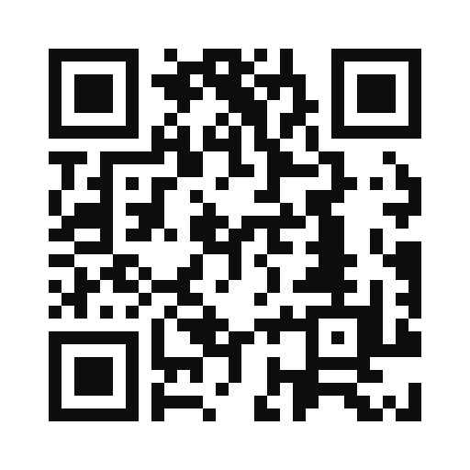

Diverse voices and representation for stronger systems
Lessons from the Water for Women Fund

Slide 28
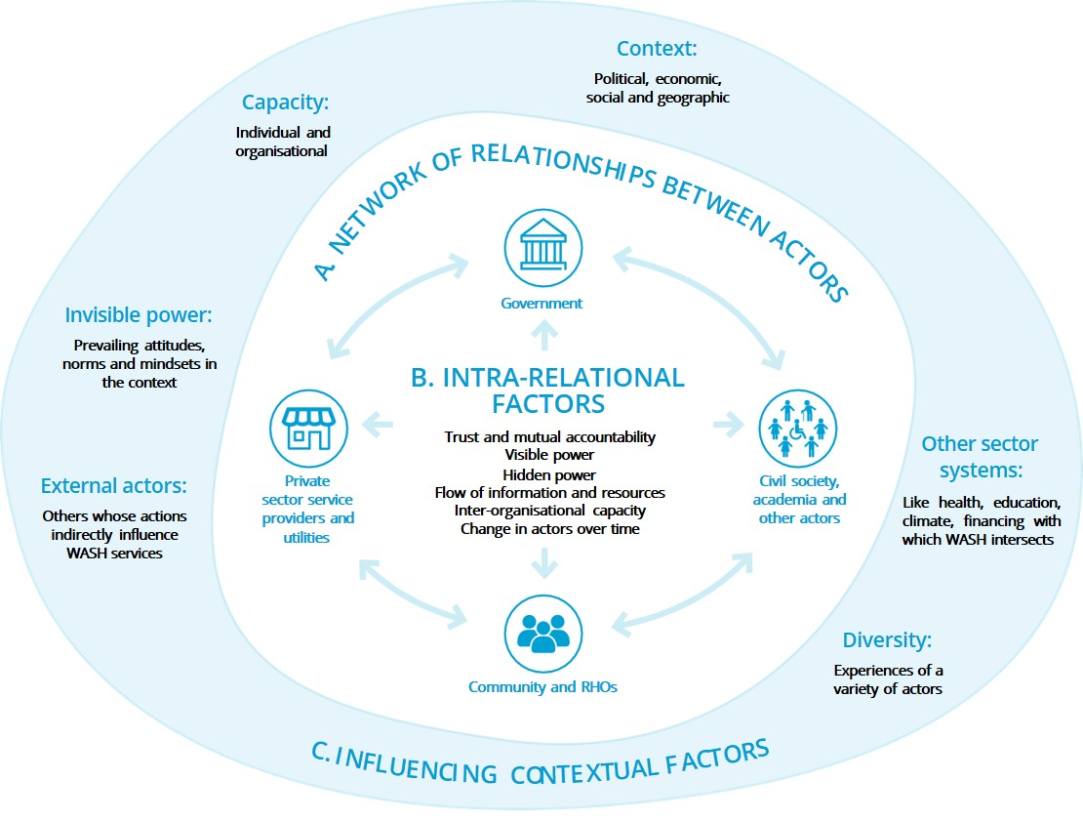

WASH systems as social systems
When we consider that WASH systems are networks of people and institutions, we cannot ignore dimensions of :
Power
Capacity
Prevailing norms and mindsets

Slide 29
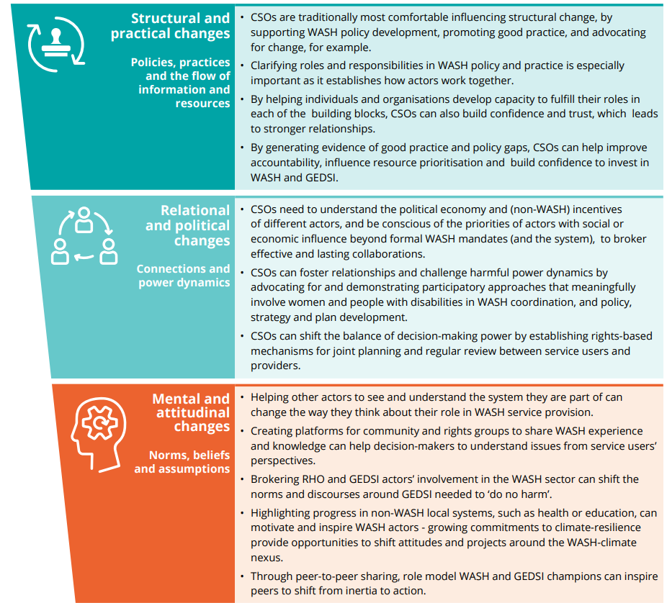
Key lessons learnt
Addressing barriers to inclusive WASH requires us to move beyond the structures and functions of WASH systems to focus on underlying power dynamics and systemic norms.
Collective action to surface and address harmful norms
can shift WASH systems and services towards inclusion
and equity.
Civil Society Organisations can support diversity, representation and agency through brokering relationships, developing WASH and GEDSI capacity and ensuring safe spaces for collaboration.
Table case studies: Fraser Goff, WaterAid:
Papua New Guinea, Nadira Khawaja, SNV: Nepal

Slide 30
Social Inclusion in Water Governance in Bolivia
Water For People’s experience supporting a participatory, community-driven process for the development of policy in four municipalities in Bolivia

Slide 31

Case highlights
Background
    Municipal WASH milestones in Bolivia: Everyone and Forever
    How social inclusion has been key to reach WASH milestones.
    A local policy as a way to sustain the milestones.

Slide 32
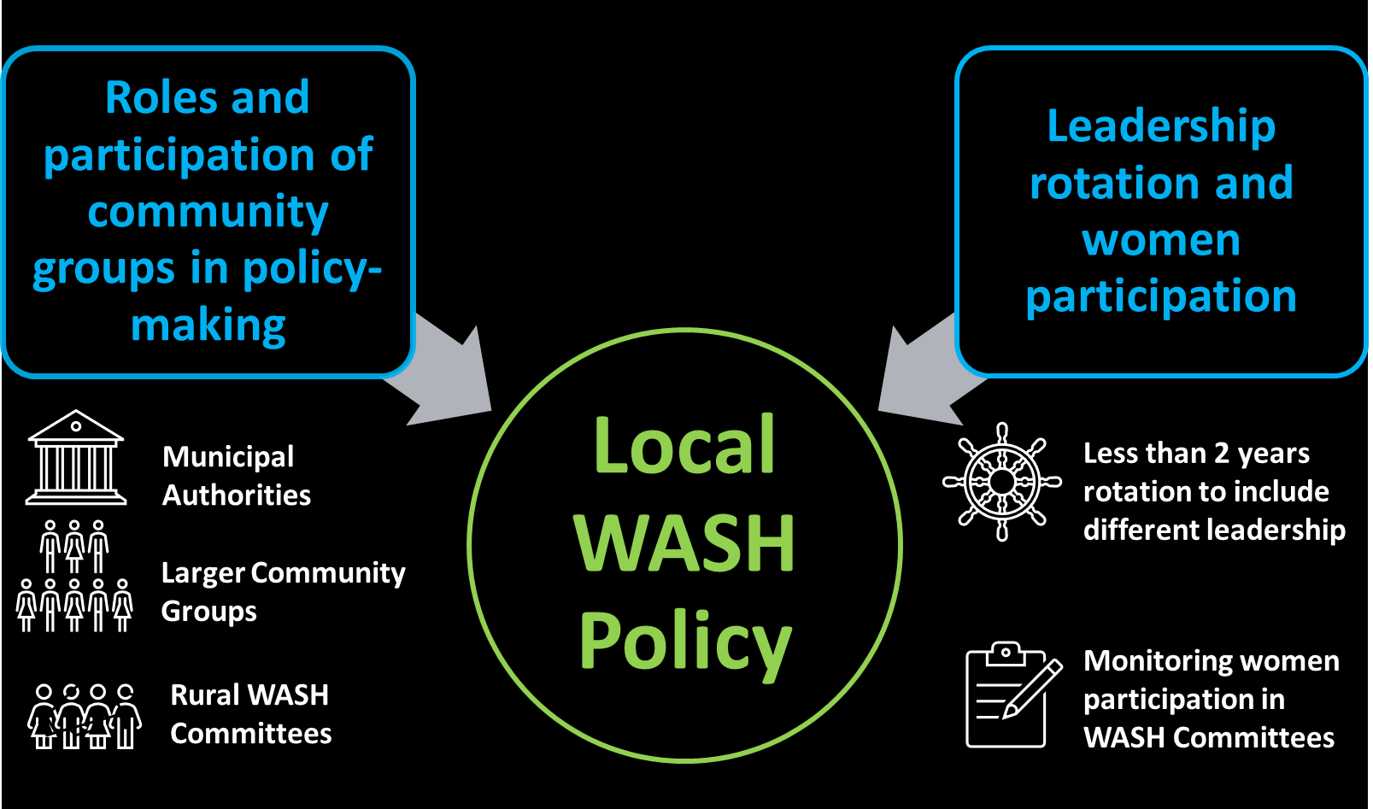

Slide 33


















All Systems Connect 2023 is made possible thanks to the generous support of our partners including the World Health Organization and :

