Slide 1

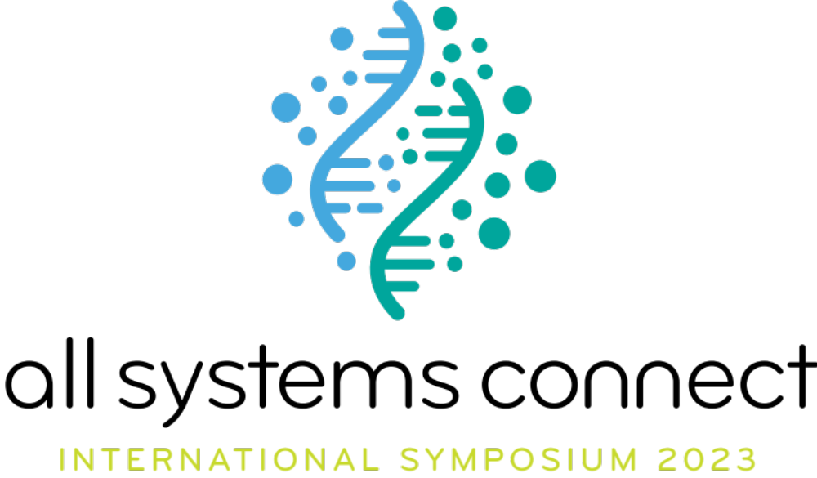

Slide 2
Theme 5:
Systems Change and Collective Action
Overview

Slide 3
Theme 5: main objectives
Universal stories for universal access
Systems changes requires co-creation and locally led solutions
Applying systems thinking and collective action at a strategic and practical level
Notes:
Miguel

Slide 4
Theme 5 sessions
Session 1: Decolonizing the WASH narrative to localize systems change,
part 1: Disrupting the single story
Session 2: Decolonizing the WASH narrative to localize systems change,
part 2: Changing the narrative
Session 3: WASH systems thinking in fragile contexts and humanitarian settings
Session 4: WASH in Institutions: Case studies for systems thinking for WASH
in institution
Sessions 5 & 6: Collective Action to tackle SDG6
Session 7: A gallery walk for your systems backpack
Notes:
Miguel

Slide 5
Session 4: WASH in Institutions: Case Studies for Systems Thinking
Theme 5: Systems Change and Collective Action

Slide 6
Leading Question for Session 4
How do we integrate WASH in institutions?
How can WASH support institutional systems success?
How can WASH be a driver of better health and education outcomes?
Notes:
Miguel

Slide 7
Introduction to Breakout Groups
There will be a total of three breakout groups:
  Group 1: WASH in Healthcare Facilities
  Group 2: WASH in Healthcare Facilities
  Group 3: WASH in Schools
The audience will have the opportunity to join a total of two groups (each for 30 minutes, 60 minutes total), with a 10 minute report back at the end
Each group will have two presenters and will discuss three questions as a group Some presenters will have handouts, photos, and/or activities
A rapporteur will be selected from the audience for each breakout group and will be asked to report back to the larger group at the end of the session
After the first group, you will switch to your second group
Notes:
Miguel

Slide 8
Breakout Group 1 - WASH in Healthcare Facilities
  Maybin Ngambi, World Vision Zambia
    Improved WASH interventions in healthcare facilities (World Vision’s technical approach in Zambia)
  Robel Wamisho, World Vision Ghana
    Findings of an assessment done across 197 healthcare facilities in six districts of Ghana
Notes:
To help the audience get a better sense of the different breakout groups, refer to the titles of the different case studies.

Slide 9
Breakout Group 2 - WASH in Healthcare Facilities
  Mita Sirait, Wahana Visi Indonesia
    Pilot project on provision of basic WASH in healthcare facilities to reduce maternal mortality rate in Sintang, Indonesia
  Miguel Gutiérrez, World Vision El Salvador
    Connecting stakeholders and interventions from a WASH perspective for early childhood: A BabyWASH case study from El Salvador
Notes:
Miguel

Slide 10
Breakout Group 3 - WASH in Schools
  Smorden Tomoka, United Purpose/Self Help Africa, Malawi
    Strengthening WASH systems in schools for sustainable and accountable WASH services: experiences and lessons from Malawi
  Giri Khatri, Welthungerhilfe, Nepal
    Reformulating the action to address WASH in Schools in the
    context of COVID-19 era
Notes:
Miguel

Slide 11
Breakout Groups
In each breakout group, each presenter will present a case study addressing the following questions:
How do we integrate WASH in institutions?
How can WASH support institutional systems success?
How can we do it better? Recommendations and action items
Once both presenters finish presenting their case study, the breakout group will discuss the following question: what’s your experience working in WASH in institutions (is it comparable or different)? How can WASH be a driver of better health and education outcomes?
Notes:
Miguel

Slide 12
Breakout Groups
During the 10 minute rapporteur readout at the end of the session, be prepared to have your group share your discussion to the following question:
How can WASH be a driver of better health and/or education outcomes?
Notes:
Miguel

Slide 13
Breakout Groups
Divide into your groups based on your interests now!
You’ll have 30 minutes in the first breakout group
(15 minutes per presenter)
Notes:
Miguel

Slide 14
Rapporteur Readout (10 minutes)
If you were assigned as a rapporteur, quickly (in 2-3 minutes) share your groups discussion on the following question:
How can WASH be a driver of better health and education outcomes?

Slide 15
Presenter contact information
Maybin Ng'ámbi, World Vision Zambia, maybin_ngambi@wvi.org
Robel Wamisho, World Vision Ghana, robel_lambisso_wamisho@wvi.org
Miguel Gutiérrez, World Vision El Salvador, miguel_gutierrez@wvi.org
Mita Sirait, Wahana Visi Indonesia, mita_sirait@wvi.org
Smorden Tomoka, United Purpose/Self Help Africa, smorden.tomoka@united-purpose.org
Giri Khatri, Welthungerhilfe, giri.khatri@welthungerhilfe.de

Slide 16
Supplemental Slides for Breakout Groups (if needed)
Notes:
Miguel

Slide 17

Improved WASH Intervention in
Health Facilities
Overview

Slide 18
Contents slide
WASH needs in HCFs
World Vision Technical Approach
World Vision WASH in HCF coverage
Additional impact photos

Slide 19
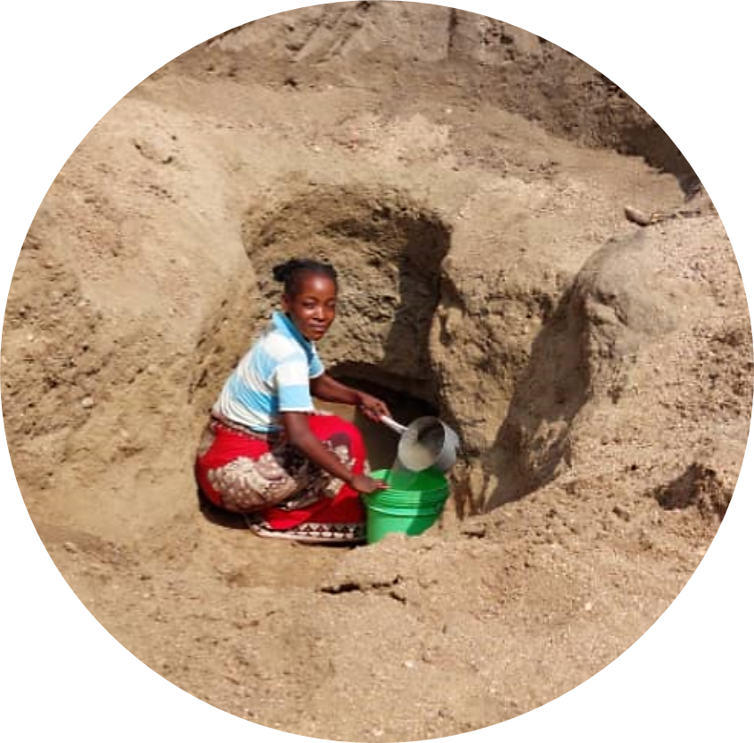
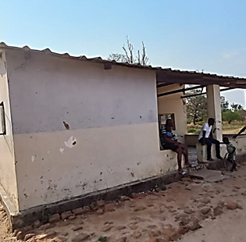
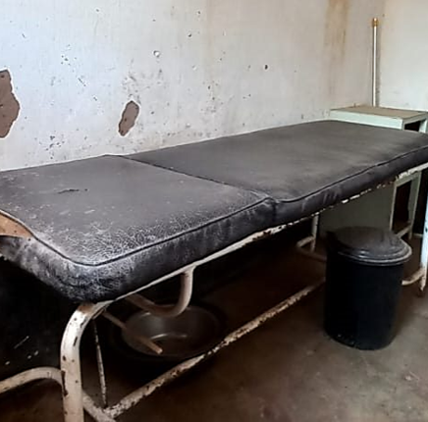
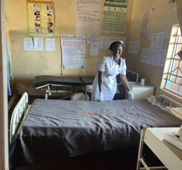
Zambian National statistics indicates that at least 60% of HCFs do not have access to basic drinking water service;
Mothers and health care workers collect water from unsafe water sources such as shallow wells for use at health care facility;
Most HCF in Zambia do not have access to clean water.
Only 1 in 3 Health care facilities had functional basic handwashing facilities
Only 1 in 3 health care facilities had basic sanitation.
Pregnant women bring their own water to the health care facility for bathing and also
for their newborn babies

Slide 20
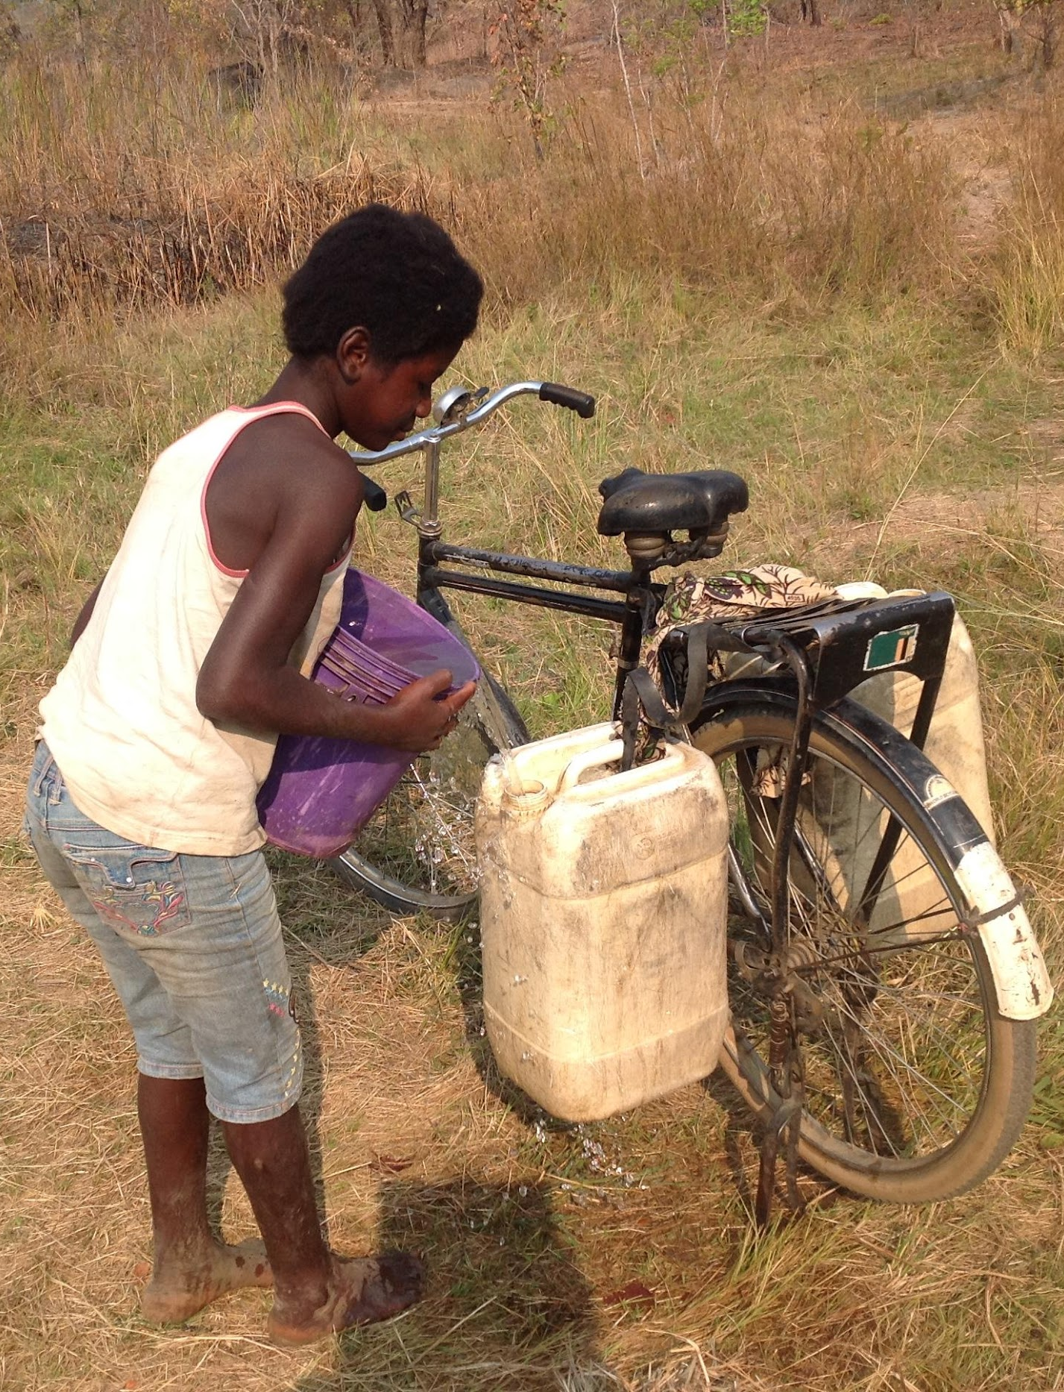
Challenges in health care facilities
Lack of drinking water or availability of safe sanitation facilities in hospitals and clinics may compound the situation; discouraging women from giving birth in facilities, contribute to delays in seeking care and contribute to staff absenteeism.
In case of any breakdown of the WASH infrastructure, most if not all the health care facilities do not have the financial capacity to repair and maintain the WASH facilities for continued operations. In some instances, even just the provision of hand washing liquid soap becomes a challenge for the health facility to replenish or replace a broken tap.
Some health care facilities become inaccessible especially in the rainy season due to bad terrains. This makes it difficult for pregnant women to deliver from health care facilities especially when the health facility does not have a mother’s shelter stay as they wait on their due date, then they would prefer to deliver from their home.

Slide 21
Technical approach
WV construct piped water systems, maternity annexes and sanitation facilities with water born toilets which encourages and motivates pregnant women to deliver from health care facilities everywhere World Vision works;
    This results in a positive impact of reduced neonatal and maternal death because mothers are attended by trained personal when in labour;
Focus on raising awareness on the importance of good hygiene practices and use of sanitation facilities among pregnant mothers and training health care workers in infection, prevention and control to reduce infections;
    This prevents and protects new born babies, mothers and staff from infectious diseases;
Provision of hand washing facilities with soap at critical points of care;
    Hand washing reduces the spread of infections during and after
    delivery for mothers in labour;
    Prevents infectious agents from being deposited into the uterus by contaminated instruments or hands during deliveries that are performed under unhygienic
    conditions and procedures.

Slide 22
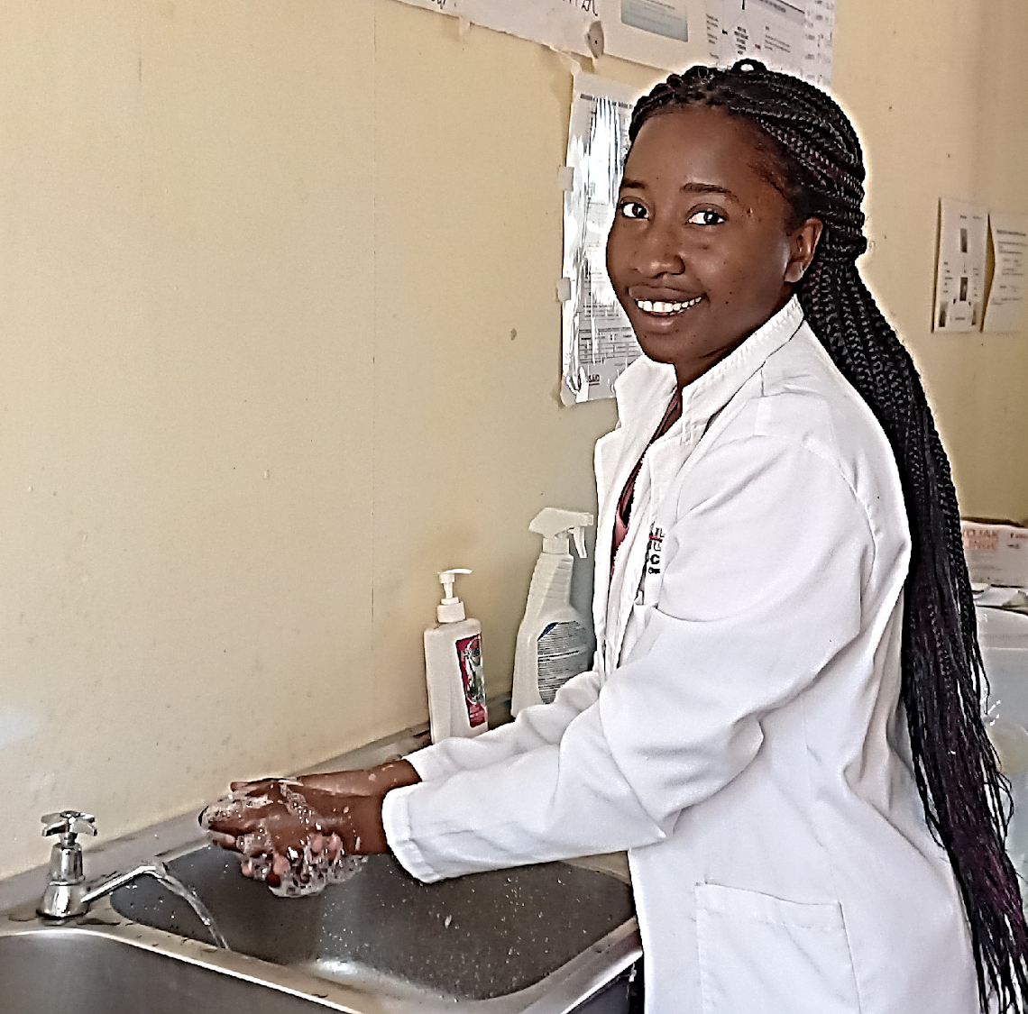
Results
201 out 249 HCFs have piped water on premise.
The remaining 48 have been planned to be reached with access to piped water in the next 3 years
Reduced home deliveries: there has been an increase in the number of institutional deliveries as a result of WASH interventions in all the health facilities where World Vision has improved the WASH services. For example, at Kavumbo HCF in Mbala district, before WASH interventions the facility recorded 30 deliveries on average per month and currently institutional deliveries have increased to 45 on average per month after the installation of the piped water system
at the facility”.
Reduced neonatal and maternal death: through the WASH interventions, there has been a significant increase in the number of women who prefer to deliver from the health facilities with improved water supply, sanitation and hygiene conditions. This is because water is inside the facilities, hence during and after labor women don’t have to walk long distances from the health facility to look for water.

Slide 23
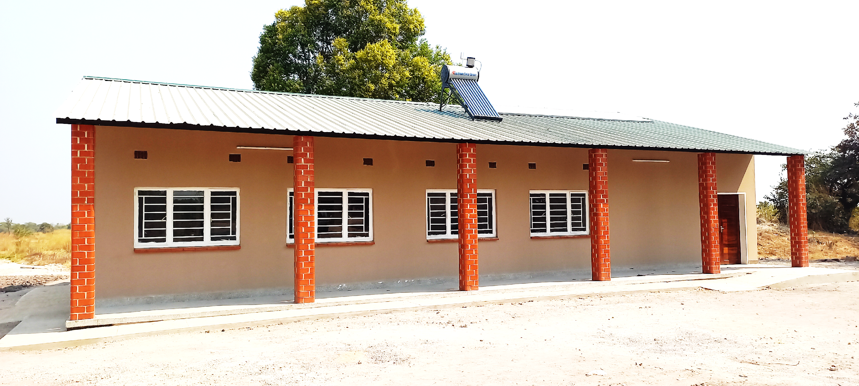
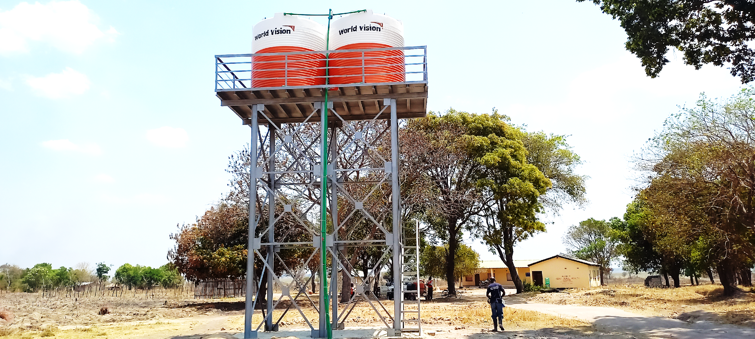
Additional impact photos
Typical Piped water system in Health Care Facilities
Typical Maternity Annex constructed in Health Care Facilities

Slide 24
WASH in institutions: case studies for systems thinking for WASH in institutions'
Findings of an assessment done across 197 HCFs in 6 districts of Ghana

Slide 25
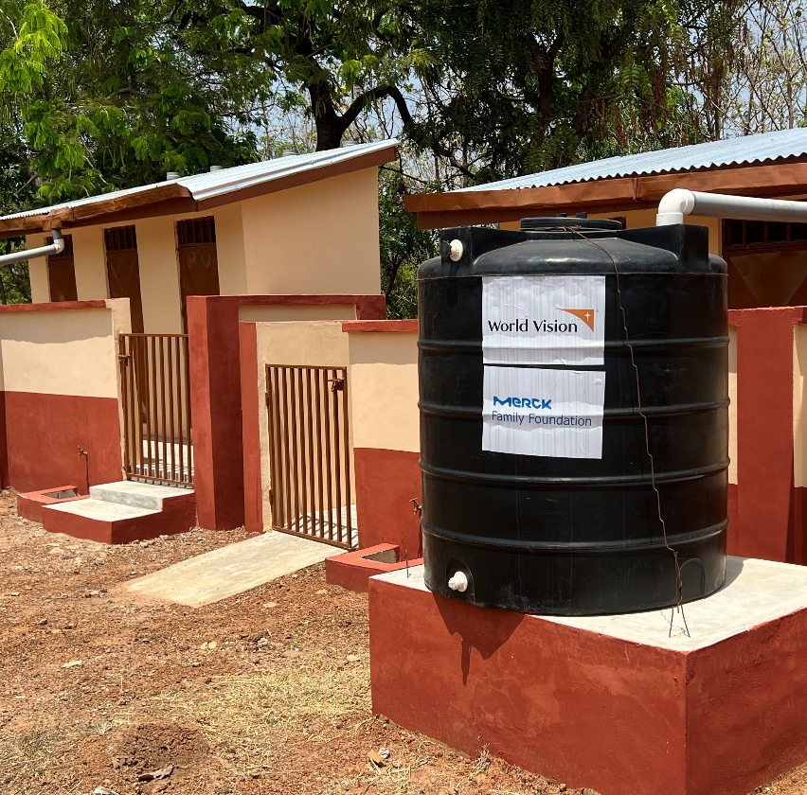
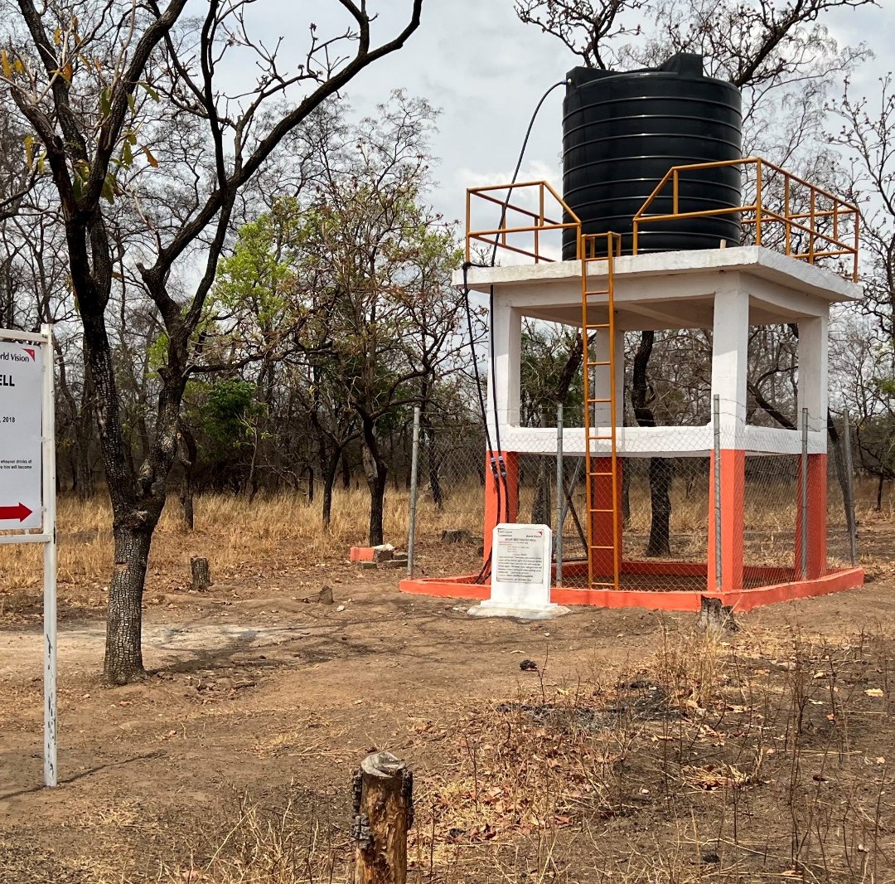
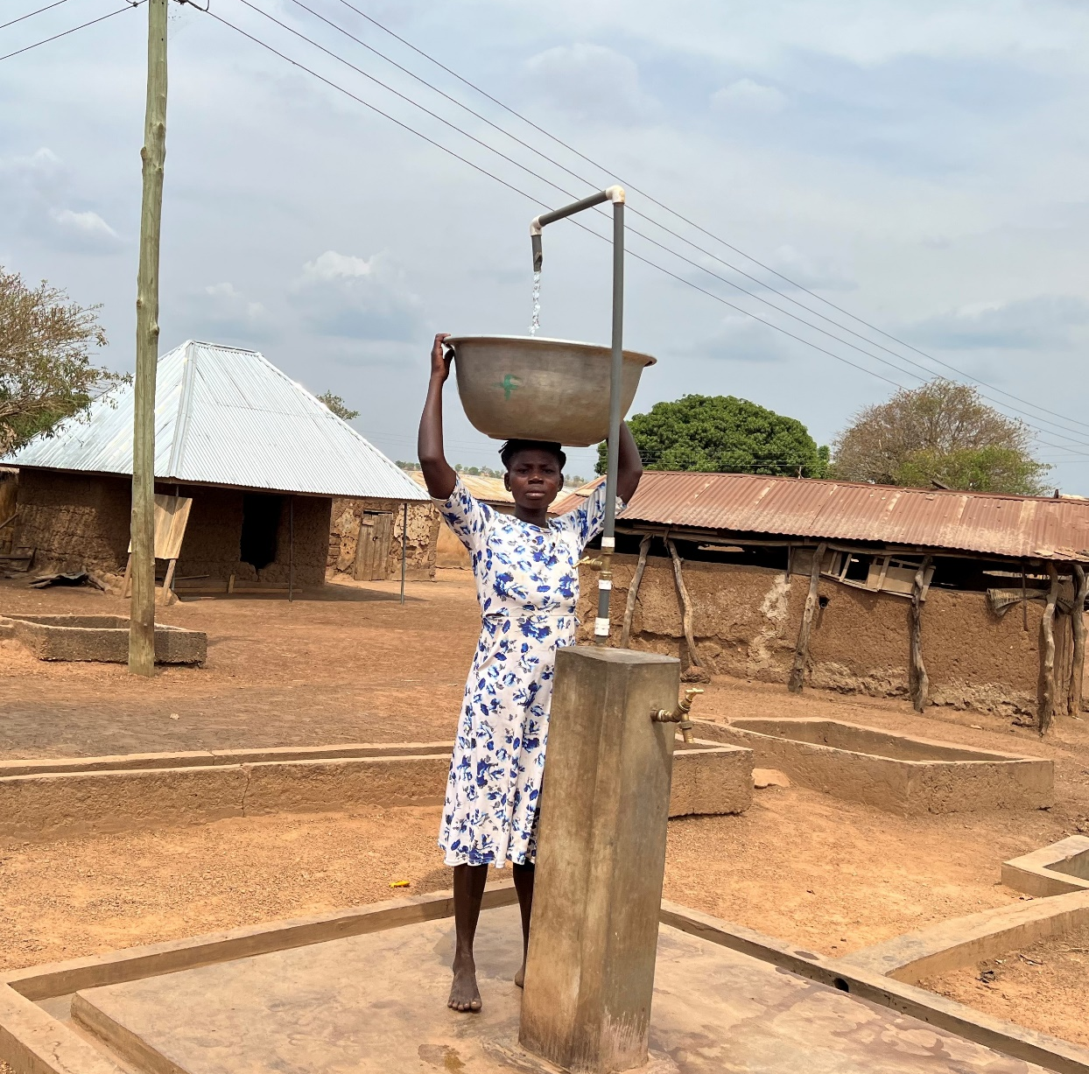
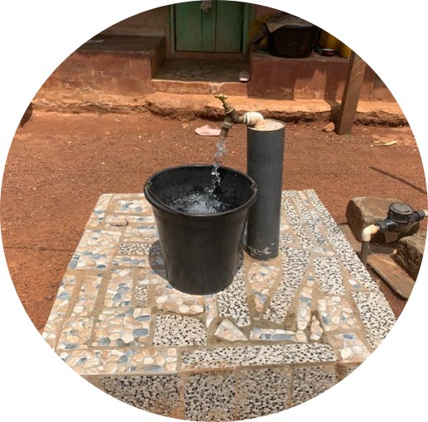
KVIP Latrine at Krachi West Area Program
A community member collecting water at Zabzugu District

Slide 26
Objectives of Study
This study was supported by the Merck Global Health Institute and it aims to achieve the following key objectives in the 6 schistosomiasis endemic districts of the Oti and Upper East Regions of Ghana:
To determine the basic water, sanitation and hygiene service levels in the Health Care Facilities
To assess the quality of water from water facilities in all Health Care Facilities
To understand the WASH challenges in Health Care Facilities (and communities) and recommend possible solutions
To develop local implementation plans to address WASH gaps identified in all
Health Care Facilities

Slide 27
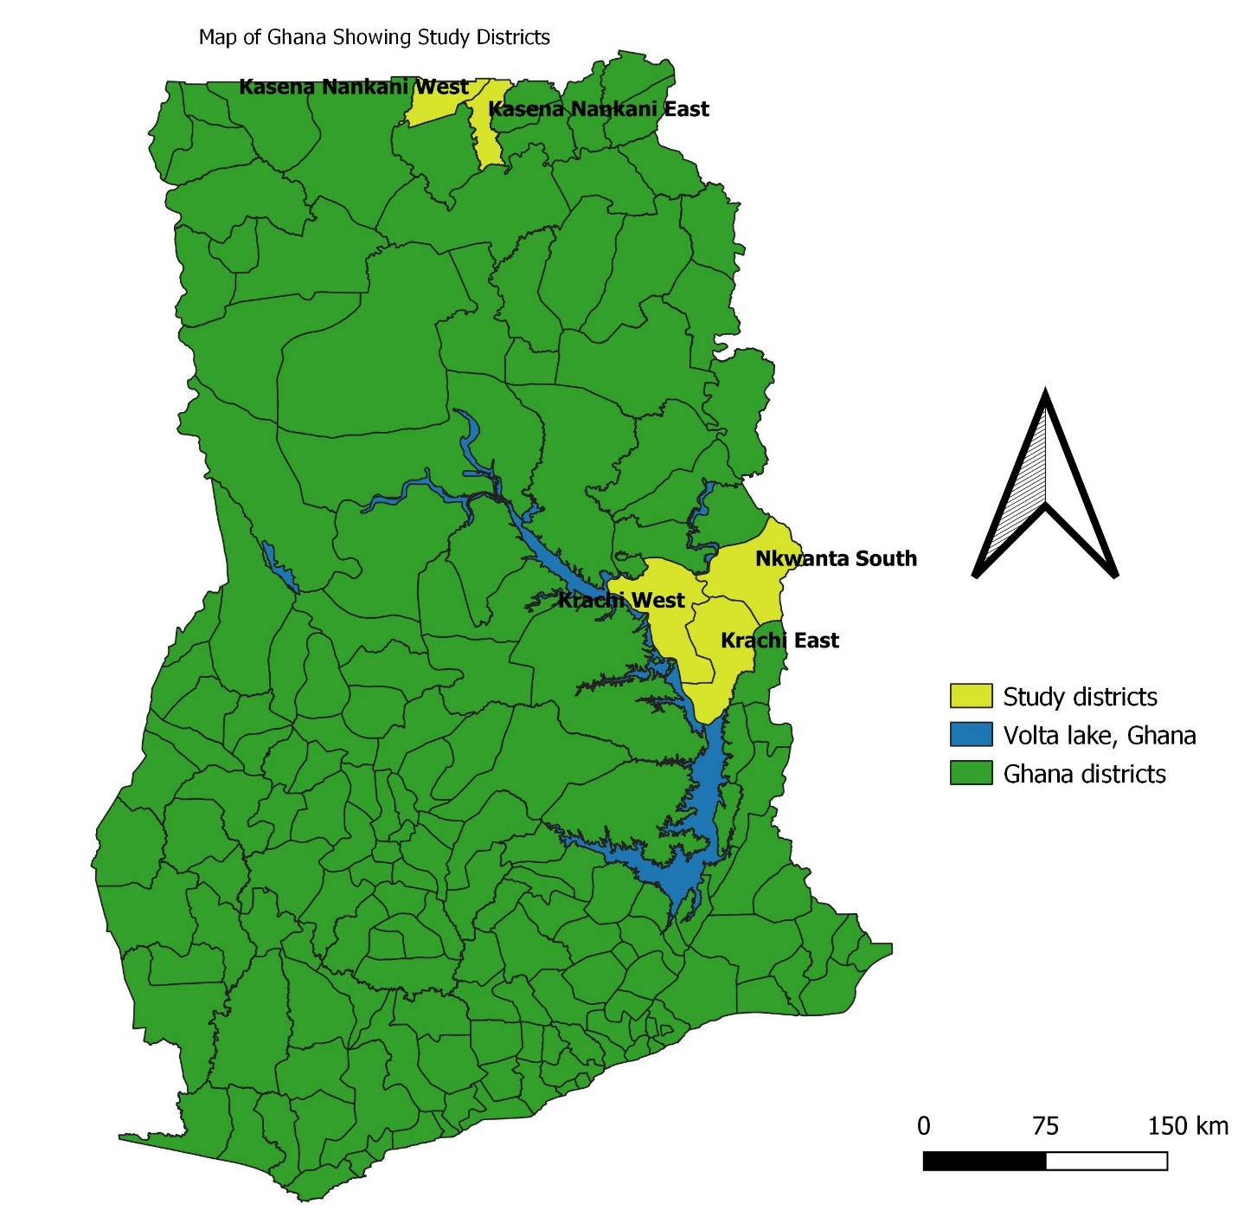
Study area
Upper East Region;
Kassena Nankana West
Kassena Nankana East
Builsa South
Oti Region;
Krachi East
Krachi West
Nkwanta South
District selected based on;
Prevalence of Schistosomiasis
Proximity to WVG project areas

Slide 28
Study methodology
Mixed methods
  Census of all HCFs in study districts: i.e 197 HCFs using WASHFIT
  Community focused group discussions
  Key informant interviews
  Direct observations

Slide 29
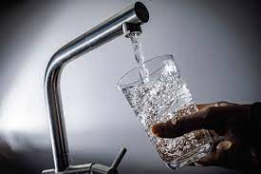
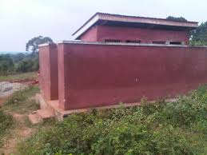
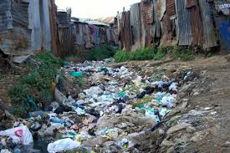
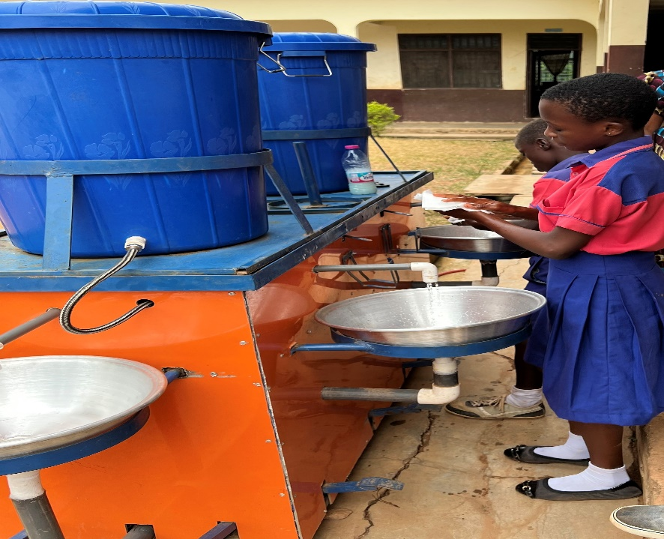
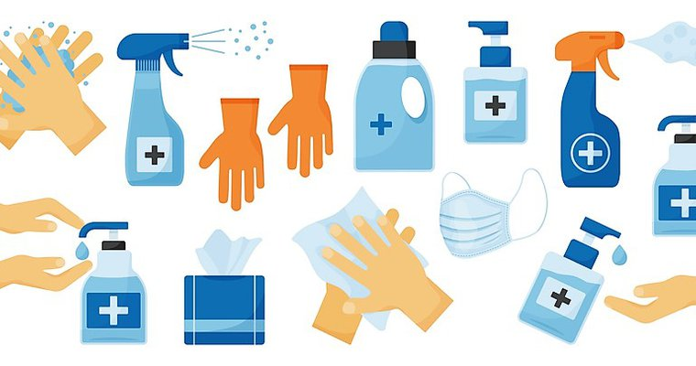


Domains of WASHFIT
1. Safe Water
2. Sanitation
3. Healthcare Waste
4. Hand Hygiene
5. Environmental Cleaning
6. Management and work force
7. Energy & Environment

Slide 30
Types of HCFs assessed
Region | Districts | CHPS | Health Centre | Hospital | Total
Upper East Region | Builsa South | 21 | 3 | 0 | 24
 | Kassena Nankana East | 36 | 4 | 1 | 41
 | Kassena Nankana West | 50 | 9 | 1 | 60
Oti Region | Krachi East | 15 | 7 | 0 | 22
 | Krachi West | 15 | 3 | 2 | 20
 | Nkwanta South | 27 | 1 | 2 | 30
 | Total | 164 | 27 | 6 | 197

Slide 31
Water supply
KEY FINDINGS
22.3% of HCFs across the 6 districts don’t have improved water source accessible on premises
33% of HCFs in Ghana (55% in rural) have no improved water facility on premise. JMP 2022
17% of HCFs in Bongo & KNW have piped water in facility. WaterAid 2015

Slide 32
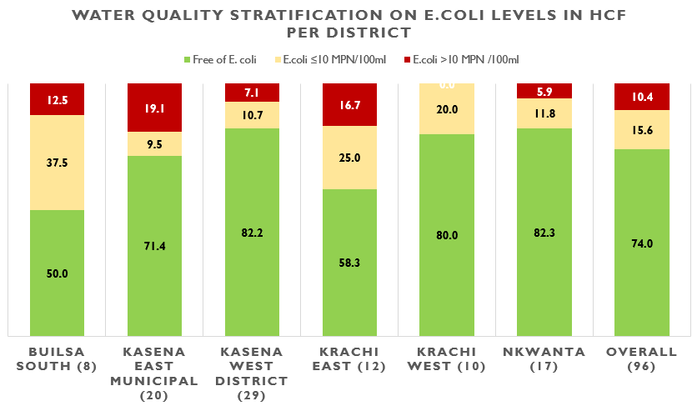
Water quality
FINDINGS
About 26% of water points in HCFs sampled had e.coli presence
Risk of Contamination Assessment
11% of water points ranked as medium risk of possible contamination. 30% medium risk in KNE

Slide 33
Sanitation
FINDINGS
About 47.7% of HCFs do not have sufficient number of improved toilet facilities/ toilets are unimproved
52% of HCFs have no toilets in Bongo & KNW districts. Water Aid 2015
Only 2% of HCFs in rural Ghana have basic sanitation service. JMP 2020

Slide 34
Healthcare waste
Functional waste collection containers are available in close proximity to all waste generation points for general waste, infectious waste and sharps waste
KEY FINDINGS
67.5% of HCFs do not have functional waste collection containers for segregating waste, at all waste generation points; most of which are CHPS.
49% (79% in rural) of HCFs in Ghana do have basic waste management service. JMP 2022

Slide 35
Hand hygiene
KEY FINDINGS
About 71% of HCFs surveyed do not have hand hygiene stations in ALL points of care
93% (80% in rural) of HCFs in Ghana have hand hygiene stations at points of care. JMP 2020

Slide 36
Environmental cleaning
KEY FINDINGS
Most of the HCFs (66.5%) do not have cleaning staff available.
59% of HCFs in rural areas do not have basic env’tal cleaning service (no or limited cleaning staff and protocols).
JMP 2022

Slide 37
Energy and environment

Slide 38
Management & workforce

Slide 39
Management & workforce cont..

Slide 40
Challenges
Budget shortage in HCFs to take care of O&M costs of WASH facilities
Communities managing water systems viewing HCFs as “separate” units-results in sustainability challenges
Lack of ownership at institution level observed
Water quality not monitored regularly

Slide 41
Key recommendations
Systems based approach in the planning & implementation of WASH services in HCFs; this approach brings various stakeholders & defines key roles and responsibilities to address gaps
Properly link staffs in the HCFs with the communities for effective and sustainable management of the water and sanitation facilities
Mechanized/Piped water facilities (into caregiving areas) over hand pumps
Some of the gaps require increased advocacy to address particular indicators like “the required number of cleaning staff or staff with cleaning responsibilities are available in the ward/facility every day”
Focus interventions where the gaps are significant. E.g CHPS compounds
Advocacy to ensure all new HCFs come with auxiliary WASH facilities
Monitor HCFs periodically with reference to the standard indicators
Mechanized systems should be prioritized to hand pumps to allow easy access for sample collection
and disinfection
Partnership for Sustainable Development Goal 6

Slide 42
Pilot project on provision of basic WASH in healthcare facilities to reduce maternal mortality rate in Sintang, Indonesia

Slide 43
Content
Background
Challenges on WASH facilities provision for Health Care facilities (HCFs) in Sintang.
Lesson learned from pilot project on basic WASH facilities provision in Sintang, West Kalimantan, Indonesia.
Recommendations

Slide 44
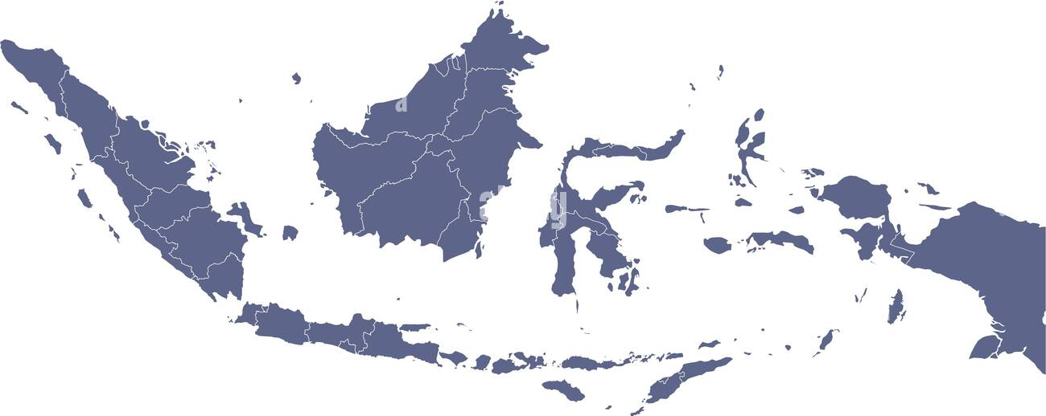
Location of pilot project
Sintang,
West Kalimantan

Slide 45
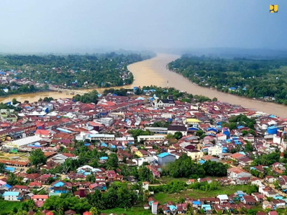
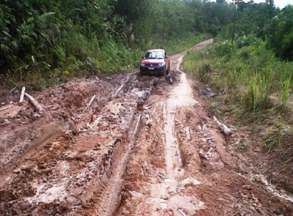
Location of pilot project
Sintang District is located in Kapuas riverbank. Kapuas is the longest river in Indonesia (1.143 kms)
The disrict has 390 villages
Many of these villages have difficult road access, especially in rainy season
Sintang is a flood-prone area
The road access makes it difficult for pregnant mothers in every village to access Puskesmas, primary HCF in sub-district

Slide 46
Sintang, locust of national program MMR reduction in 2020
Indonesia has reduced MMR from 359/100,000 in 2012 to 305/100,000 in 2015, and has target to reduce it to 183/100,000 in 2024
Sintang MMR is with 350/100,000 in 2020, and become locust for national program of Reducing Maternal Mortality rate in 2021.
Polindes is a HCF built by village and community in rural areas to gain access to maternal healthcare.

Slide 47
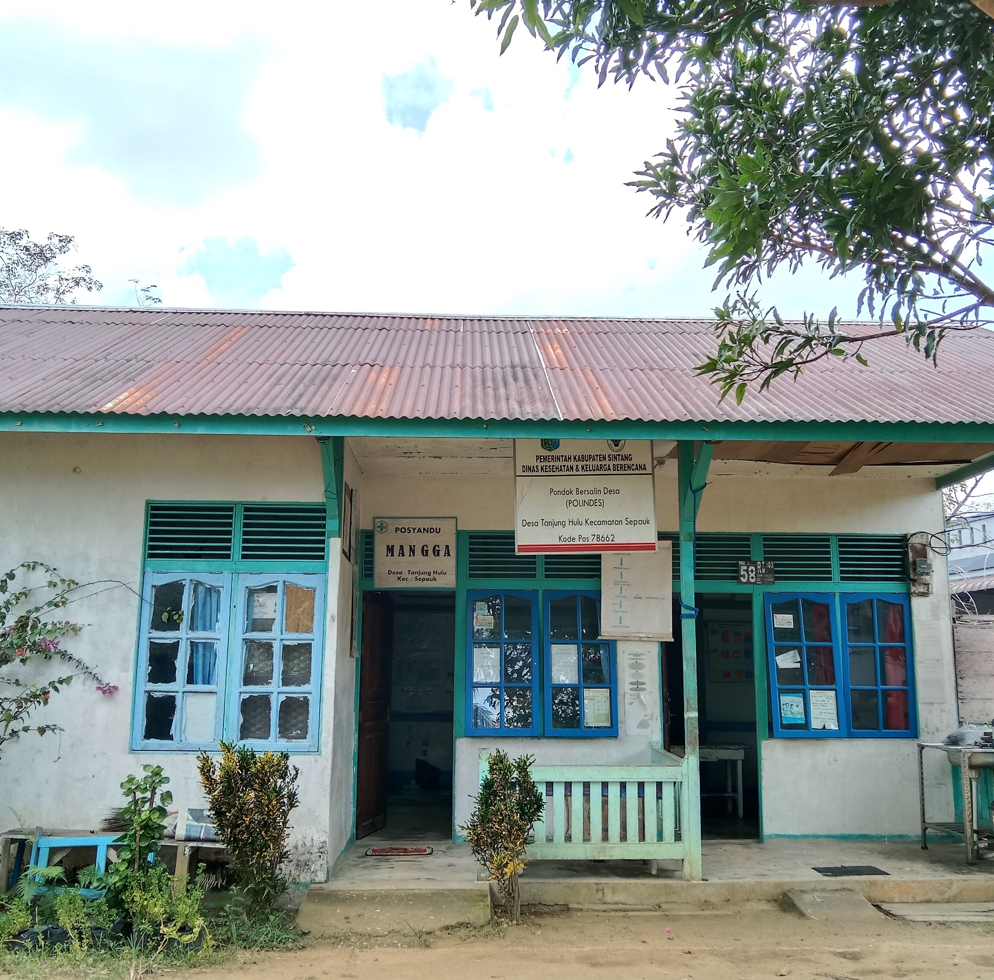
What is Polindes?
Pondok Bersalin Desa (Polindes) is a village level HCF, build using the contribution of the community and village fund. It is purposed to help community in rural area to access maternal healthcare.
Usually, the facilities has 1 midwife, and has minimum WASH facilities. The main function is to handle childbirth.

Slide 48
What are the challenges to provide adequate WASH in Polindes?

Slide 49
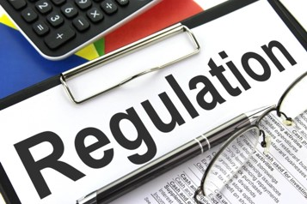
Standard of basic WASH facilities for healthcare facilities in Indonesia and the regulation
National research for healthcare facilities minimum service standard in 2019 did not include Polindes as a HCF in the village level. The lowest HCF level surveyed is Puskesmas in
sub-district level.
There is no minimum standard for WASH facilities in Polindes, since it is built by the community and using village fund.

Slide 50

Absence of technical indicator and monitoring for WASH facilities
No obligation for village-built Polindes to comply to WASH facilities standard, technical indicator and monitoring in government regulation.
Most Polindes is monitored by a higher-level HCF
(i.e., Puskesmas) due to the maternal case assisted
in the facilities.
Polindes WASH facilities are rarely become
monitoring indicator.

Slide 51

Funding issues
Polindes helped by this pilot project was built using village fund and community contributions.
This scheme is not sustainable, since there is no regulation as a standard and foundation to advocate funding from other sources.

Slide 52
Project intervention
In 2 Polindes helped by the project:
Has only one toilet, used by public and patients.
Have only unimproved water source and the supply was not available for 24 hours.
There is no available hand washing facilities near
the toilet.
The project helped 2 Polindes in pilot project:
To have additional toilet and segregated between public toilet and patient toilet.
To have water supply with pump, to supply water for 24 hours in the premise of Polindes
To have handwashing facilities.

Slide 53
Recommendation
There is need for regulation which has technical standard regarding WASH facilities for Polindes in national, province, and/or district level.
There is need to provide alternative source of funding to help the Polindes to have adequate WASH facilities
There is need of technical assistance to assess WASH facilities of Polindes from the government.

Slide 54

Resources and more info slide

Slide 55
Connecting stakeholders and interventions from a WASH perspective for early childhood
A BabyWASH case study from El Salvador

Slide 56
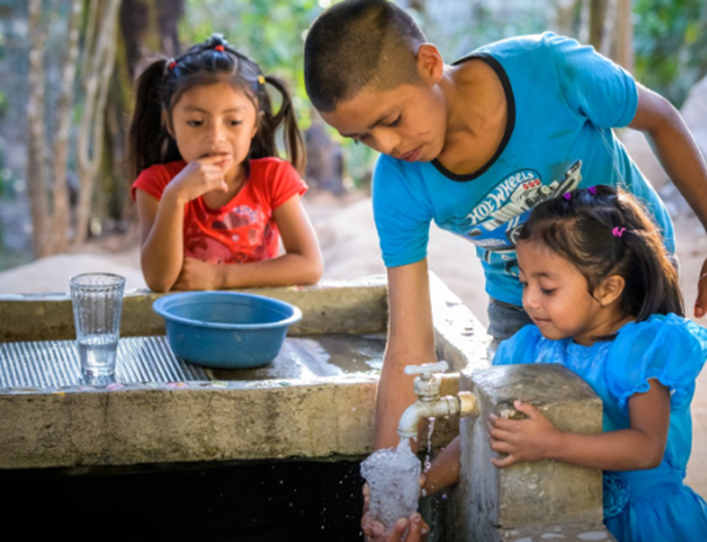
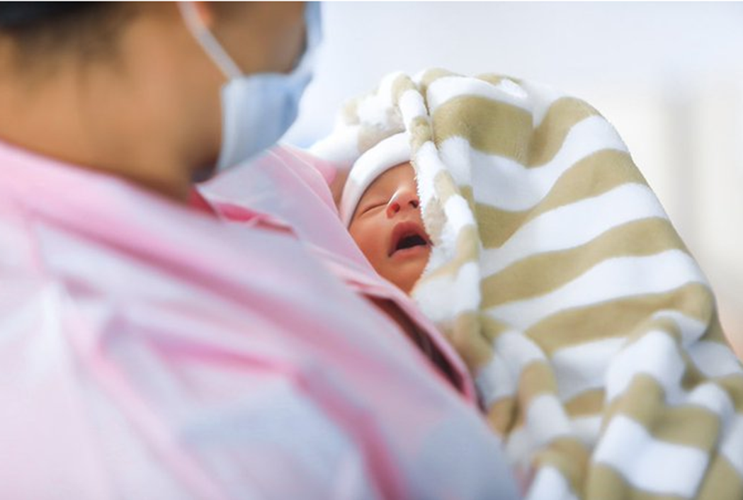
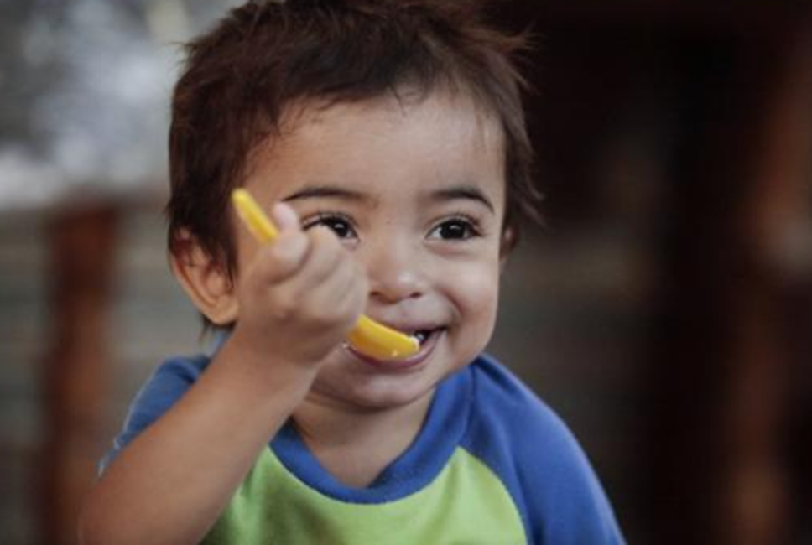
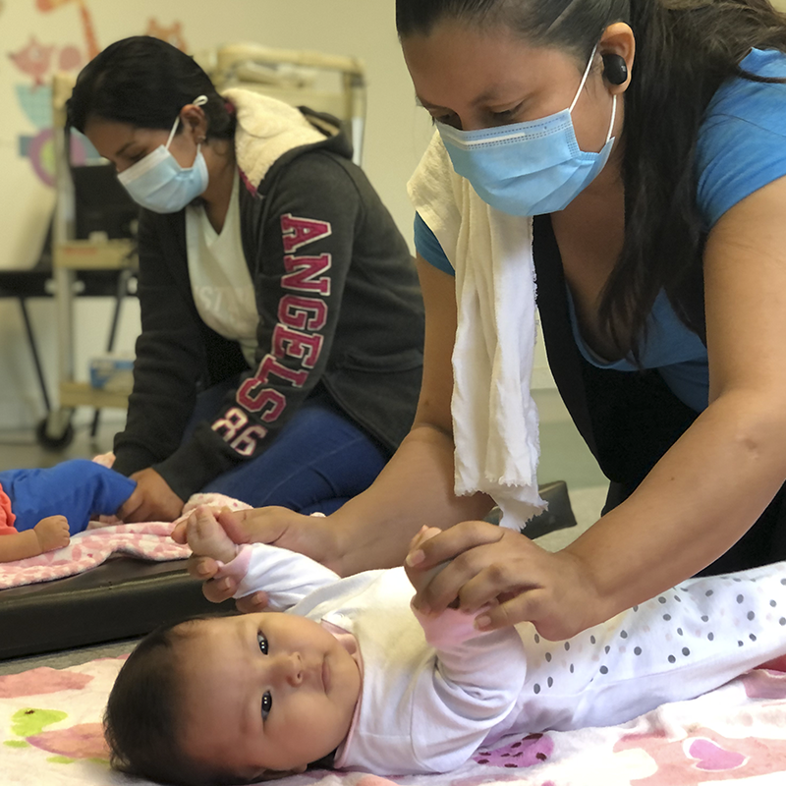
Baby WASH
Baby WASH is a World Vision initiative that aims to improve the integration of Water, Sanitation and Hygiene interventions with Maternal, Newborn and Child Health, Nutrition and Early Childhood Development, to enable a deeper impact on child health outcomes, from 0 to 8 years, with a greater emphasis on the first 1,000 days of life.
4 COMPONENTS
1. Personal hygiene at home and in the community for a healthy life.
2. Healthy, clean and safe spaces for respected childbirth.
3. Adequate nutrition for mother and child for optimal growth and
cognitive function.
4. Loving and sensitive care for optimal brain development.

Slide 57


TIMELINE:
March 2021
WV participates in the validation review process of the "Grow Together” Policy
  The Baby WASH model is presented to high-level decision makers as a possible contribution to Policy
Model is known, reviewed and adopted as a contributory option to the policy
Creation of the National Policy to Support Early Childhood Development "Grow Together”
May 2022
Model review and adaptation workshops: representatives of the Ministry of Health, Ministry of Education, Ministry of Local Development and Office of the First Lady
Prioritization of territories for the start of the model implementation pilot: 8 municipalities selected
Coordination with decision makers at the central level to plan the first local workshops
January 2022
June 2021
Here comes the fun part!
Aug-Sep 2022
  *Key support from the office of the First Lady of the Republic, which recognizes the Baby WASH model as a key tool for contributing to Food Security, Nutrition and WASH strategies for early childhood.

Slide 58


Strengthening WASH systems in Schools for Sustainable and Accountable WASH services: Experiences and Lessons from Malawi

Slide 59



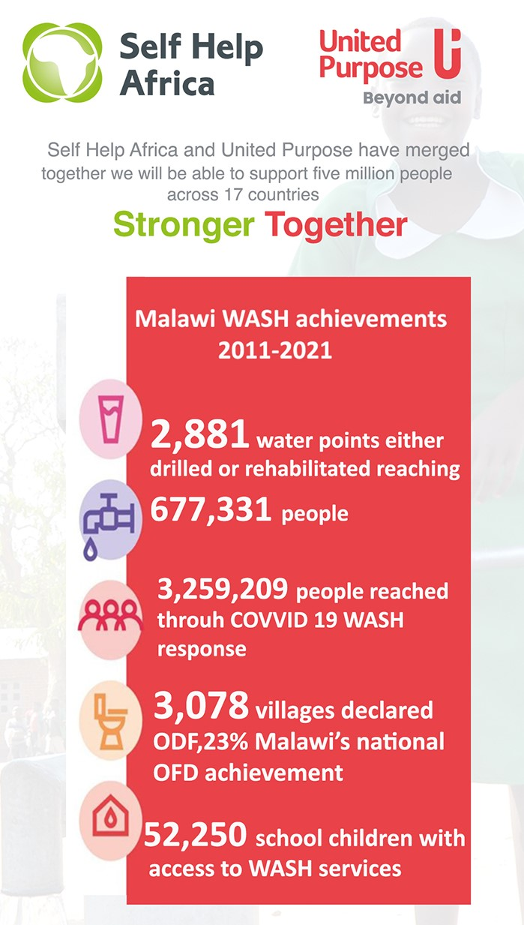
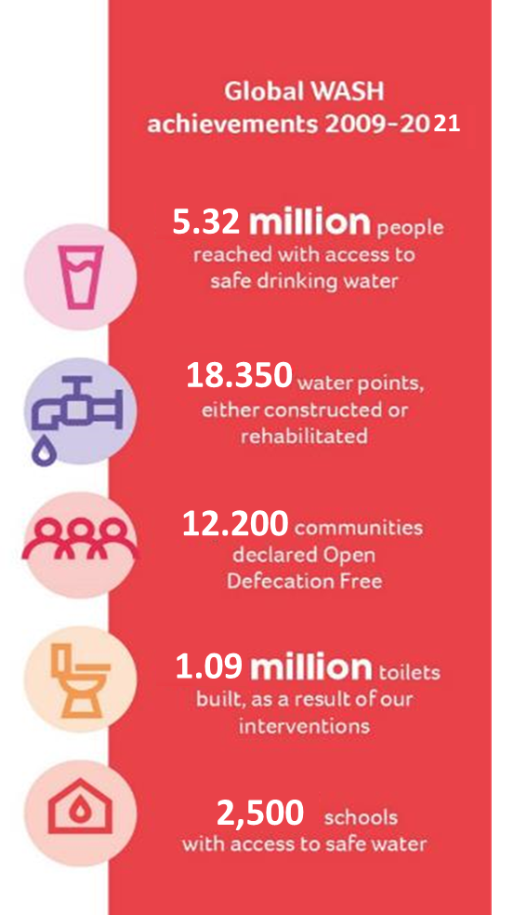
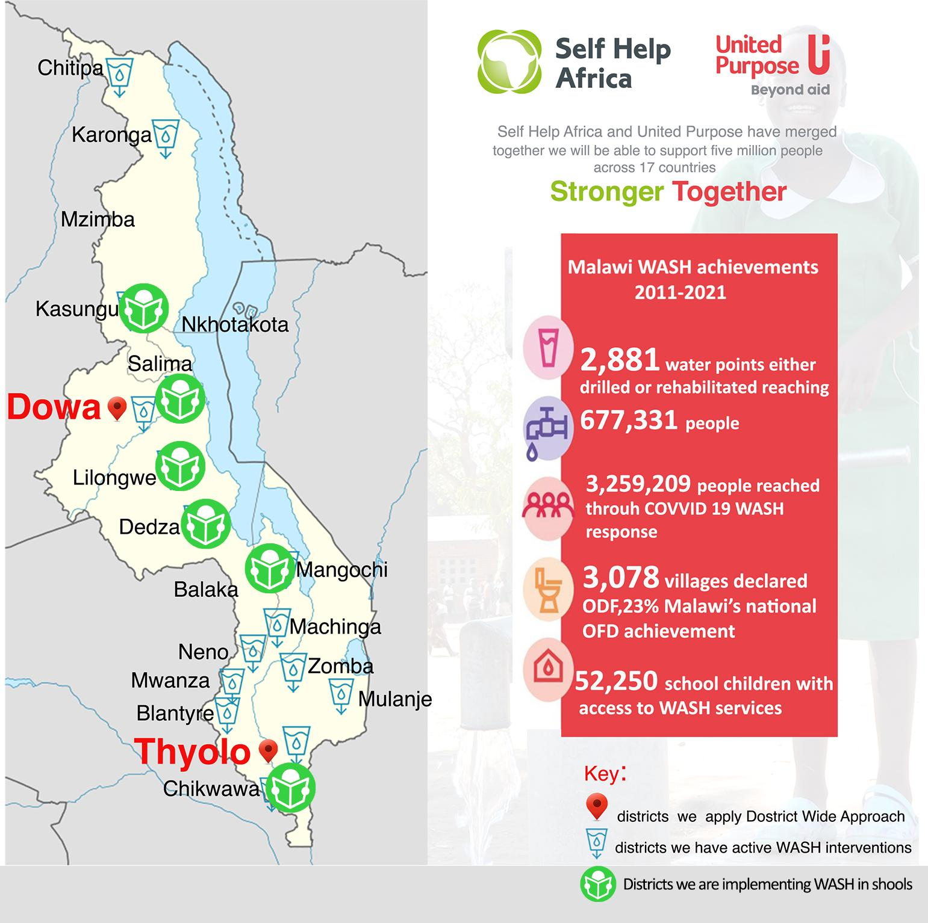
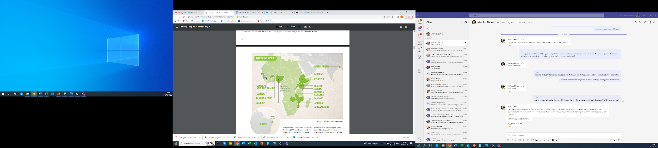
Who we are?
Merger 2021
Rebrand ongoing
Rebrand in 2017
(Established in 1975)
(Established in 1984)
Merged organization approx. 675 staff and annual turnover of approx. €45m
Multi-sectoral INGO: WASH; agriculture; energy; environment and nutrition
Historically, WASH a key component of UP/SHA’s work.
Systems strengthening, key strategic area in merged org
One of largest WASH INGO in Malawi
Long term strategic districts, Systems strengthening
Applied the approach & customized to WinS Project
Notes:
Long term strategic districts, Systems strengthening
Applied the approach & customized to WinS Project
Light touch, short term with high impact
Sustainable, accountable services in 34 schools + district level actions

Slide 60

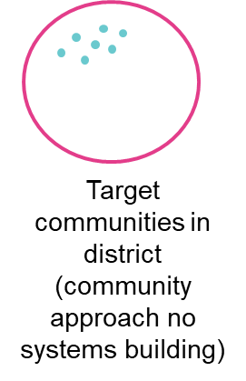
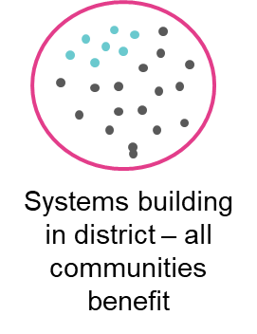
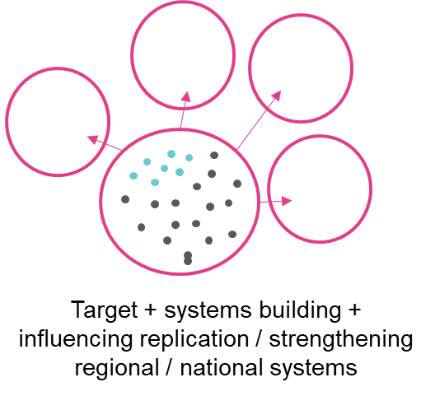
Introduction and context
.
How we integrated WASH in Schools?
WinS infrastructure and O&M plans
Hygiene promotions in extra curriculum activities (sport)
Inclusion of WASH plans and budgets in School plans
Awareness on required WinS standards and responsibilities
Dialogue and accountability processes involving all WinS players
District Plans, including section on WinS and budgets
WinS Project, 1.5 years; 6 districts
Sanitation & Hygiene Infrastructure
Behaviour Change
Systems Strengthening and Accountability
Why WinS Systems Strengthening & Accountability?
Poor WinS services reveal systemic & accountability issues
Working on WinS systems magnifies impact in cost-effective way for indirect benefits across the other schools.
Fig 1: Circle graphics (source Will Tillett, 2018)
Notes:
8% of schools don’t have safe water, 18% don’t have latrines, 76% school children unable to wash their hands with soap (JMP, 2020). Situation reveals systemic issues undermining sustainability of WinS’ services, including poor O&M arrangements, ambiguity in institutional mandates, lack of community advocacy demanding access good standard WASH services and holding service providers accountable, poor government capacity to plan, implement and monitor WASH in Schools services and limited budget allocation.
There >600 schools in target districts, but only 34 were targeted.

Slide 61
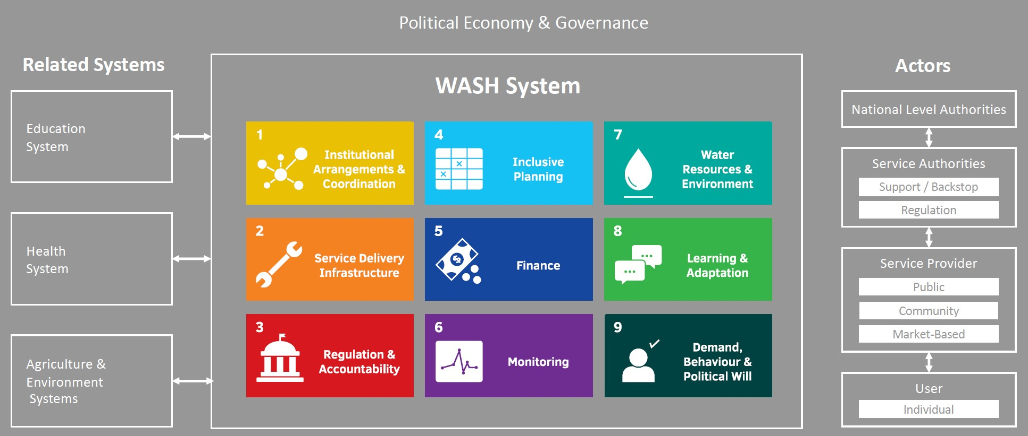
Systems strengthening approach
WASH system framework, focusing on selected Building blocks
Participatory system’s diagnostics at district level to understand barriers to WinS sustainability via workshops and agreeing actions
Fig 2: Conceptual framework for a WASH system (source, Sustainable Services Initiative / WHH, GTO & Agua consult, 2020)
Supported 34 core schools to develop plans and how they will sustain WASH services and Social Accountability at 3 levels:
  1. Student/Student/parent/: Dialogue to raise awareness on what standards
  2. School level: Sustainability plans, maintenance protocol
  3. District level: District systems analysis to create dialogue and identifying systemic issues in a participatory way;
  Between 3 levels: Built links & dialogue, clarifying responsibilities and expectations of each level
Notes:
8% of schools lack access to safe water, 18% do not have latrines, 76% school children unable to wash their hands with soap (JMP, 2020). Situation reveals systemic issues undermining sustainability of WinS’ services, including poor operation and management arrangements, ambiguity in institutional mandates, lack of community advocacy demanding access good standard WASH services and holding service providers accountable, poor government capacity to plan, implement and monitor WASH in Schools services and limited budget allocation.
There >600 schools in target districts, but only 34 were targeted.

Slide 62
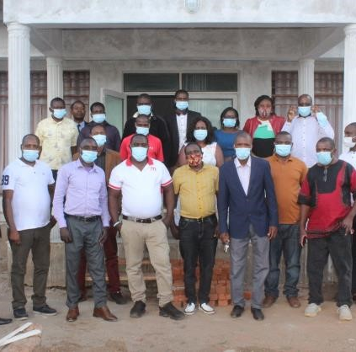
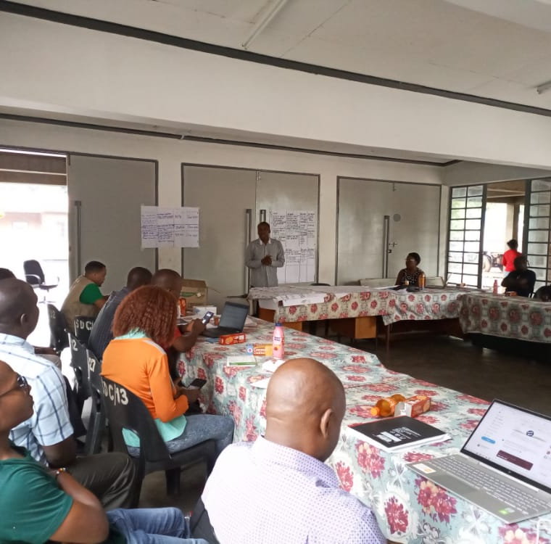
Systems Strengthening Approach
Notes:
8% of schools lack access to safe water, 18% do not have latrines, 76% school children unable to wash their hands with soap (JMP, 2020). Situation reveals systemic issues undermining sustainability of WinS’ services, including poor operation and management arrangements, ambiguity in institutional mandates, lack of community advocacy demanding access good standard WASH services and holding service providers accountable, poor government capacity to plan, implement and monitor WASH in Schools services and limited budget allocation.
There >600 schools in target districts, but only 34 were targeted.

Slide 63
Building blocks analysis results & systems strengthening actions
Used BB checklist to score strength of the WinS systems to set a baseline for monitoring through dialogue
40% overall score, Service delivery infrastructure highest (59%); Finance lowest (14%)
Date of Scoring May 2022 | Institutional Arrangements & Coordination | Service Delivery Infrastructure | Regulation & Accountability | Inclusive Planning | Finance | Monitoring | Water Resources & Environment | Learning & Adaptation | Behaviour & Political Will | Total Score
% | 46% | 59% | 42% | 36% | 14% | 35% | 50% | 50% | 31% | 40%

Slide 64
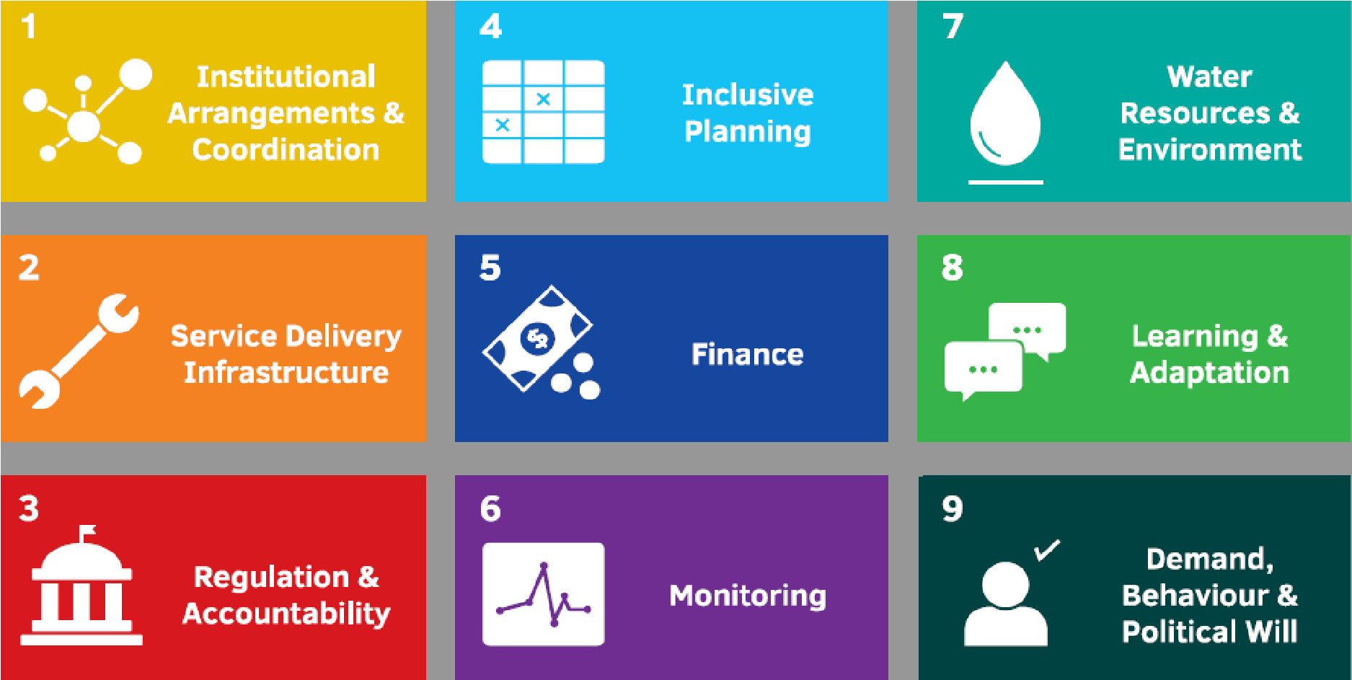
Building blocks analysis results & systems strengthening actions
Examples of how WASH can support schools systems success?
1. Strengthening stakeholder coordination in WinS at district level
Clarify WinS roles between stakeholders and linkages between ‘levels’
4. Advocate for Inclusion of WinS in District wide Plans
WinS inclusion in school sustainability plans
3. Build arrangements for social accountability for adequate WinS at student, school level and district level
Clarifying accountability to ensure provision and upkeep of WASH in Schools
6. Ensure WASH standards are routinely monitored and strengthened by confirming institutional mandates for monitoring

Slide 65
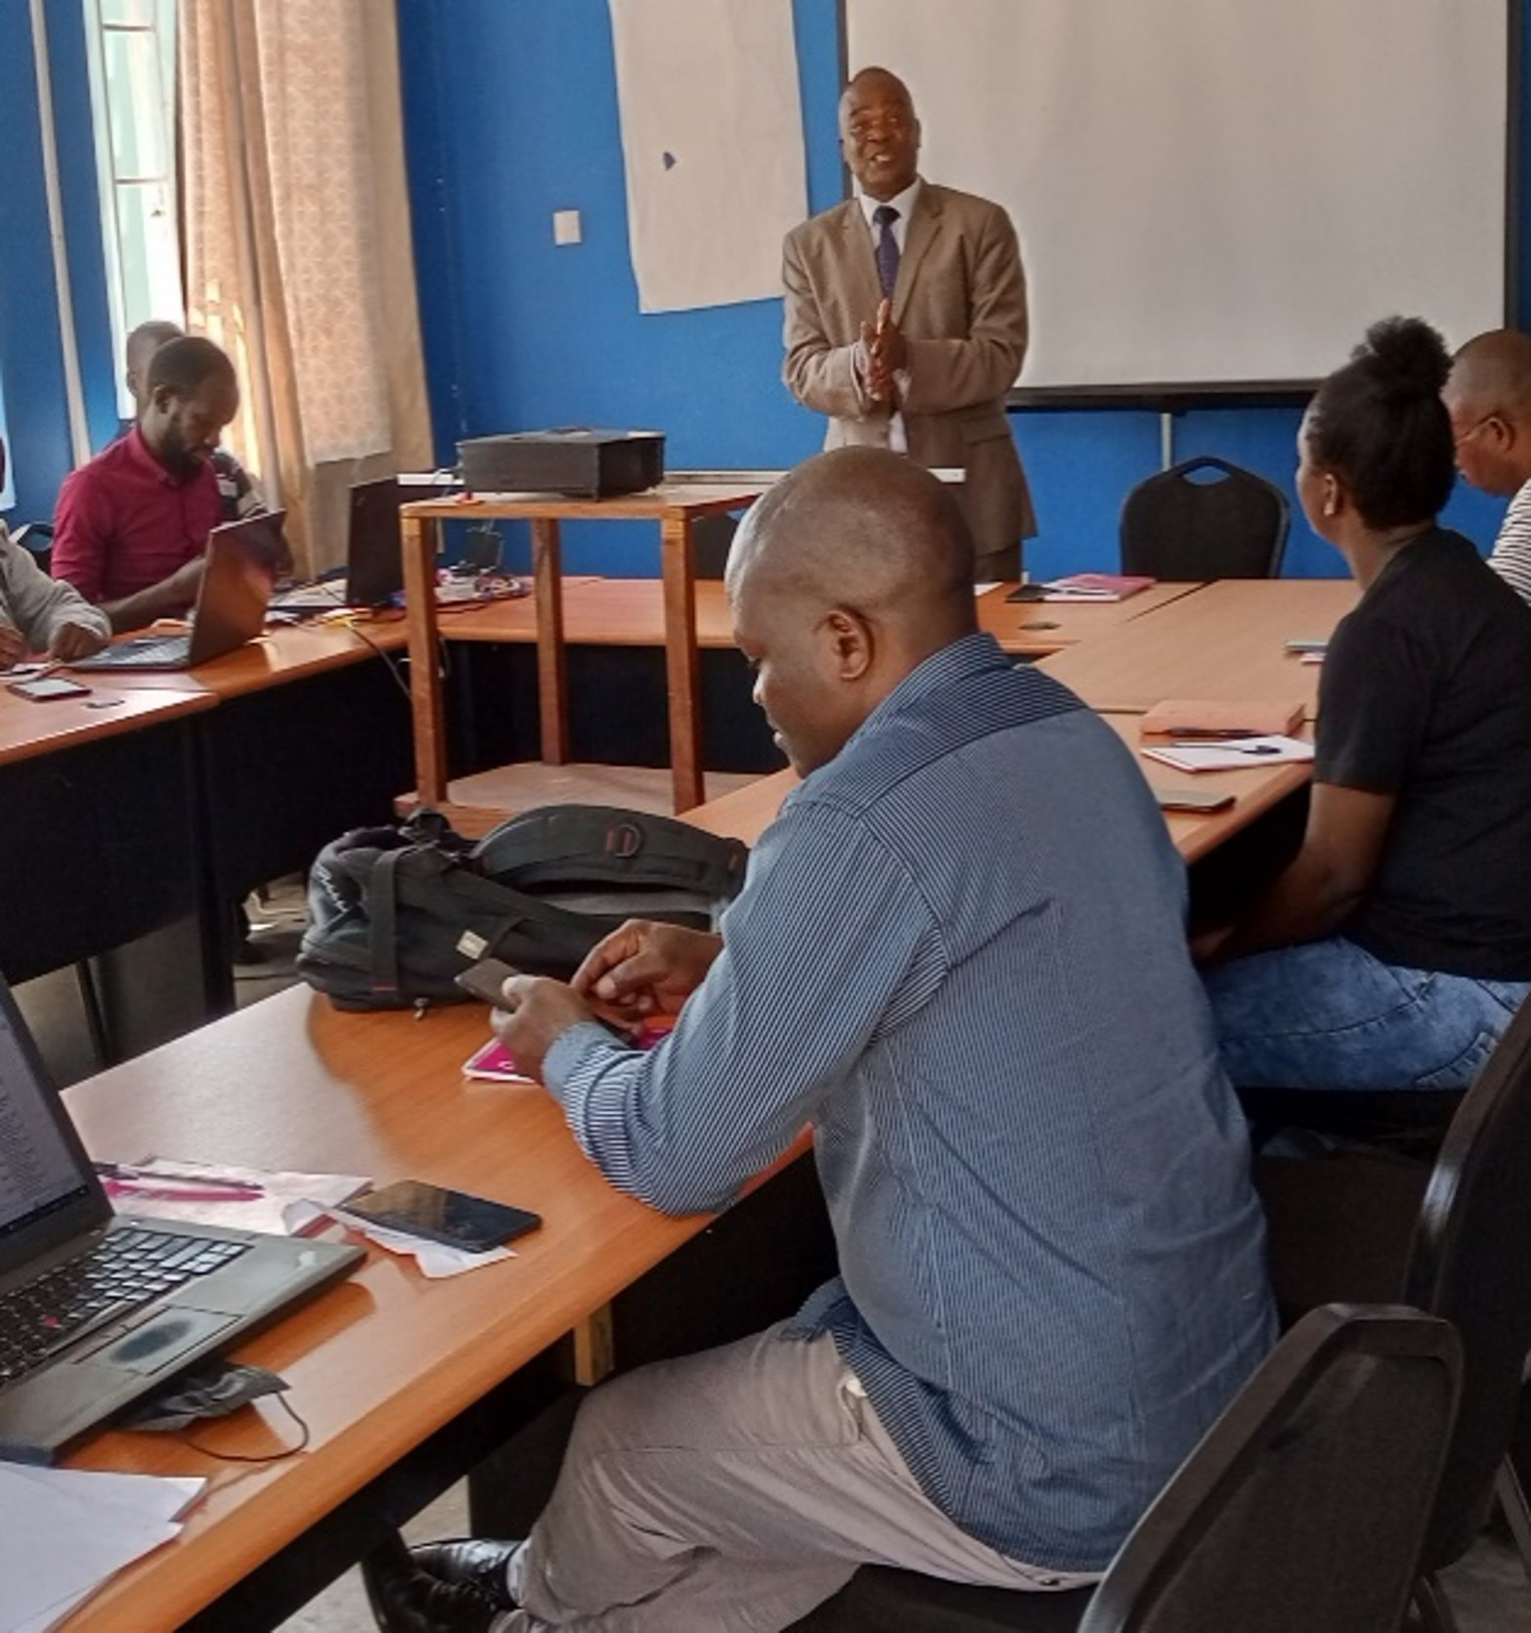
Key learning points/recommendations
Systems strengthening takes time, need to begin with quick wins, particularly for short time frame projects (e.g. workshops that includes BB analysis and dialogue; clarifying institutional mandates, strengthening monitoring
and coordination).
Working on WinS systems strengthening at district level magnifies impacts in
cost-effective way for indirect benefits across the other schools.
WinS improvements starts with the
students, parents and teachers demanding for good services and holding service
providers accountable
Notes:
We can testify that even in a short timeframe and with limited budget focus, it is possible to do something and added value of not only work at school level, but across levels.
- given accountability can be less clear in WinS settings as it is for things like community-water supply

Slide 66
Reformulating the action to address WASH in Schools in the context of COVID19 era
Overview

Slide 67
Context
Nepal constitution explicitly recognizes the “right to water and sanitation” Article 35 (4).; mandate is given to the local government.
WHH (with support of VcA and BMZ) working with the government of Nepal to build stronger WASH systems in place at municipal level in Madhesh Province
An assessment conducted shows that only 49 (total 55 school) are without having user friendly toilets, and only 8% schools have handwashing with soap facilities
At the midst of COVID19 pandemic, these Schools were used as quarantine and isolation centers
WHH closely worked with the local government to respond COVID19 crisis and supported to provide safe drinking water and sanitation and handwashing facilities.

Slide 68
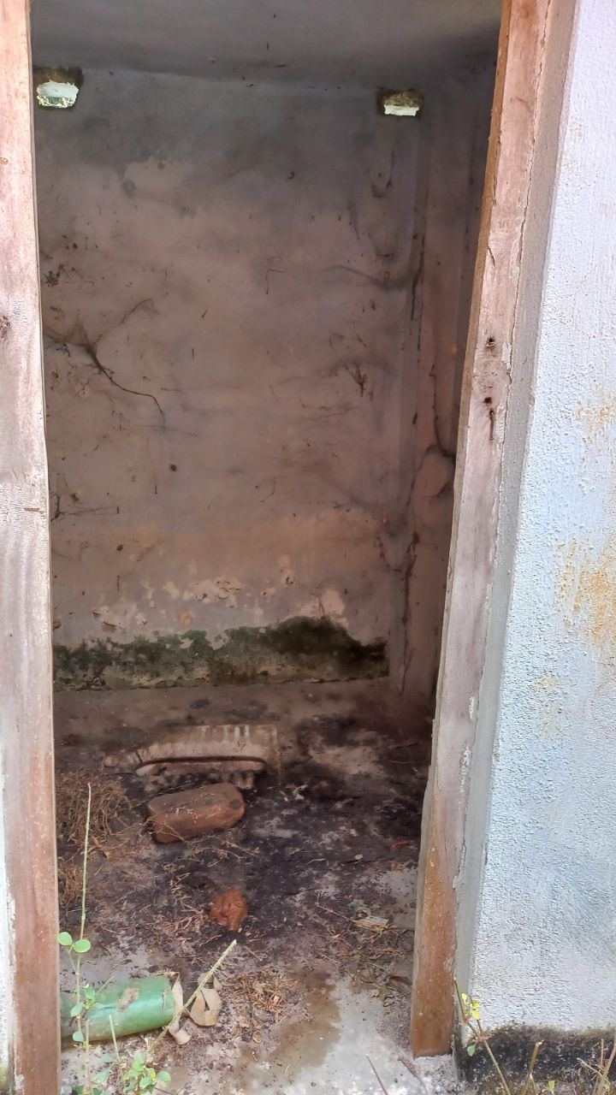
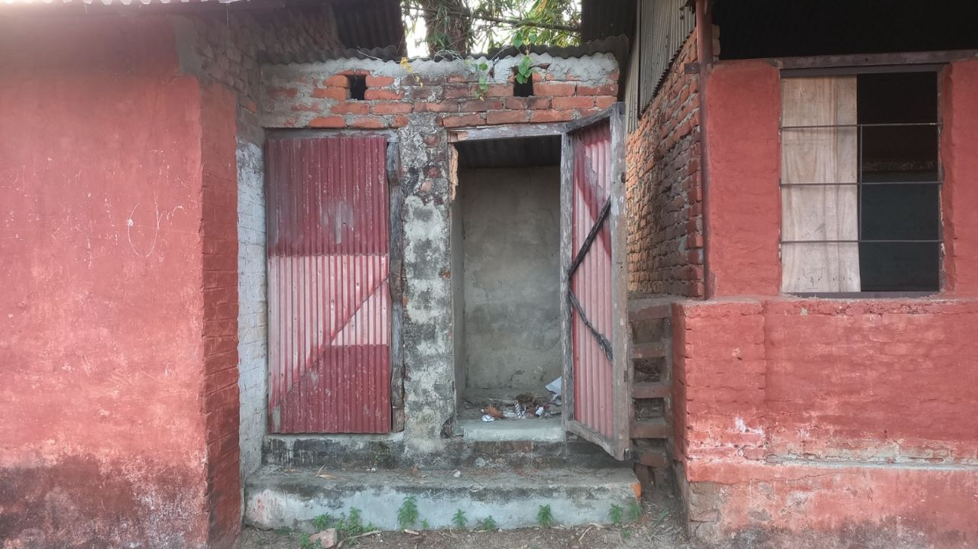
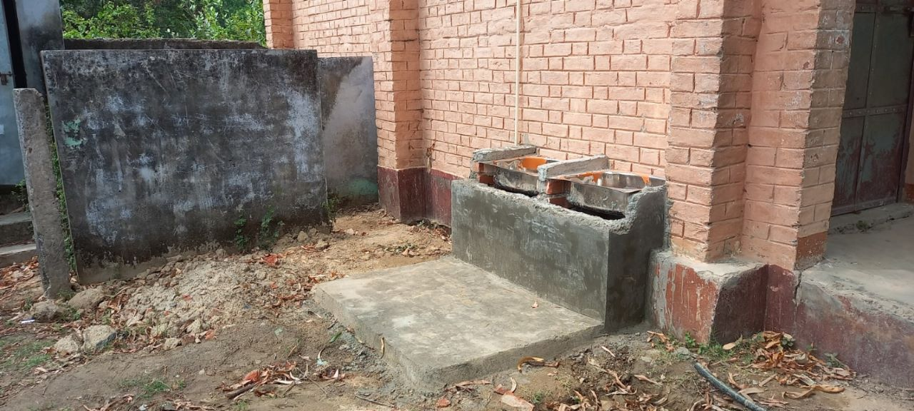
Why re-formulation of project?
School re-opening after the first wave of Corona virus was big concern of the government
A quick assessment done by WHH in Siraha resulted 49% (total 55) schools were without having user friendly WASH facilities
Just 8% schools were with handwashing facility with soap and water.
Threat of spreading Corona virus due to poor WASH facilities at schools
Re-formulate project activities in 2021 onward and priority to School

Slide 69
Key intervention
WASH in Schools intervention in 23 high priority schools- selected from
municipal WASH plans.
User friendly toilets, MHM facilities – with pad changing room
Provision of hand washing stations with 24/7 water supply
Provision of safely managed drinking water- (UV/UF water filter & Bio-sand installation and supply systems) in all schools
Sanitation and Hygiene awareness event among students in the schools- adopting universal languages approach.
School caretaker trained on Operation and maintenance of WASH facilities
Training to schoolteachers and school management committee member on WASH in school procedures, including 3-star approach.
Technical support to prepare school WASH plans as as per 3-star approaches

Slide 70
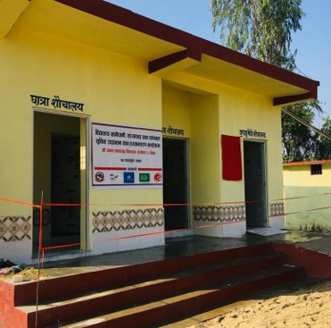
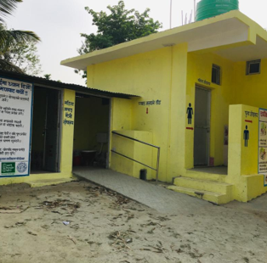
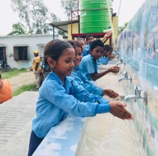
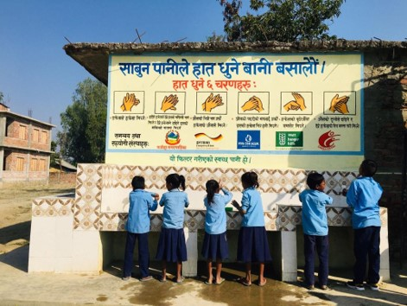
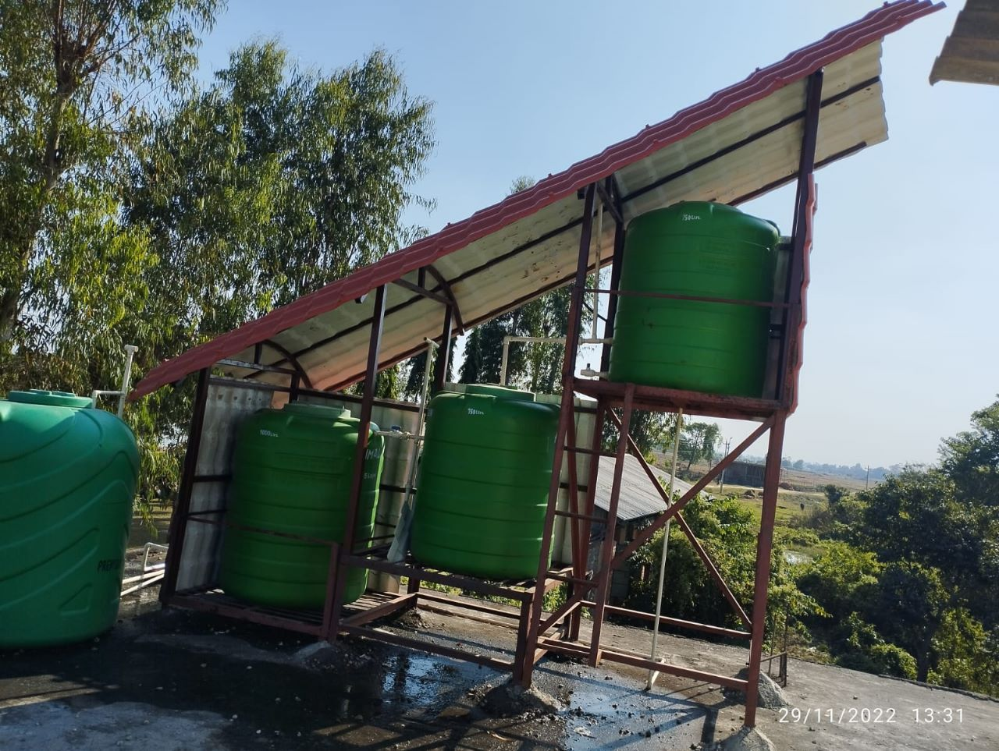

Slide 71

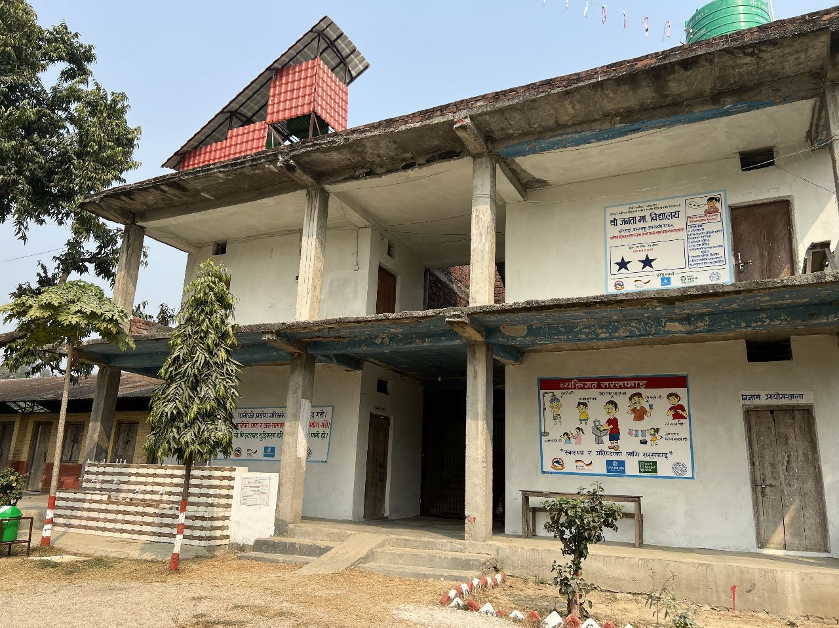






Achievements
WASH facilities improvement 23 Schools
8 schools received 2 STAR status
13412 students (54% girls) benefited
167K Euro total investment
& 20% cost from municipality
WASH behavior change sessions using universal languages

Slide 72

Key learnings:
Government line agencies engagement in planning, intervention and monitoring is crucial- that enhance ownership and long term sustainability.
Alignment projects activities with the government priority- COVID19 pandemic really played crucial role to prioritise WASH in school intervention.
Showcasing/modelling and demonstration of good practices is really helpful to built trust among government, donors and other stakeholders.
Universal languages approach is very effective to promote WASH behaviour among students and teachers- results possible due to continuous engagement of students.
Flexibility in donor funding is really matter to combat the crisis; e.g. COVID19 pandemic.
Connects Inter-government line ministries and departments, including the like minded organizations to make stronger systems in place

