Slide 1
Water Integrity Global Outlook
Following the money
  Catarina Fonseca
The Hague, 15th April 2016
Notes:
I will be talking to you about following the money
Which is a chapter in the Outlook Report
I will be illustrating my main messages with one specific country - Tanzania

Slide 2
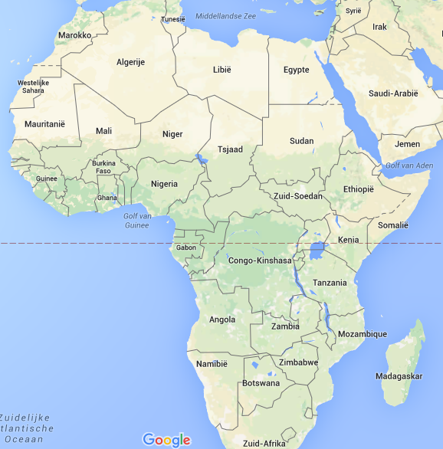
Notes:
For those that don’t know Tanzania,
It’s a country in Sub-saharan Africa with with 53 and a half million people
Rural water supply is provided mostly through piped schemes (half gravity, half pumped)

Slide 3
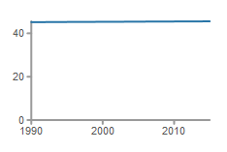

Rural water coverage stagnating and declining
45.5%
Notes:
it has one of the lowest coverage rates or rural water supply in the World
These are the official statistics – an internal report last month points to 30% coverage

Slide 4
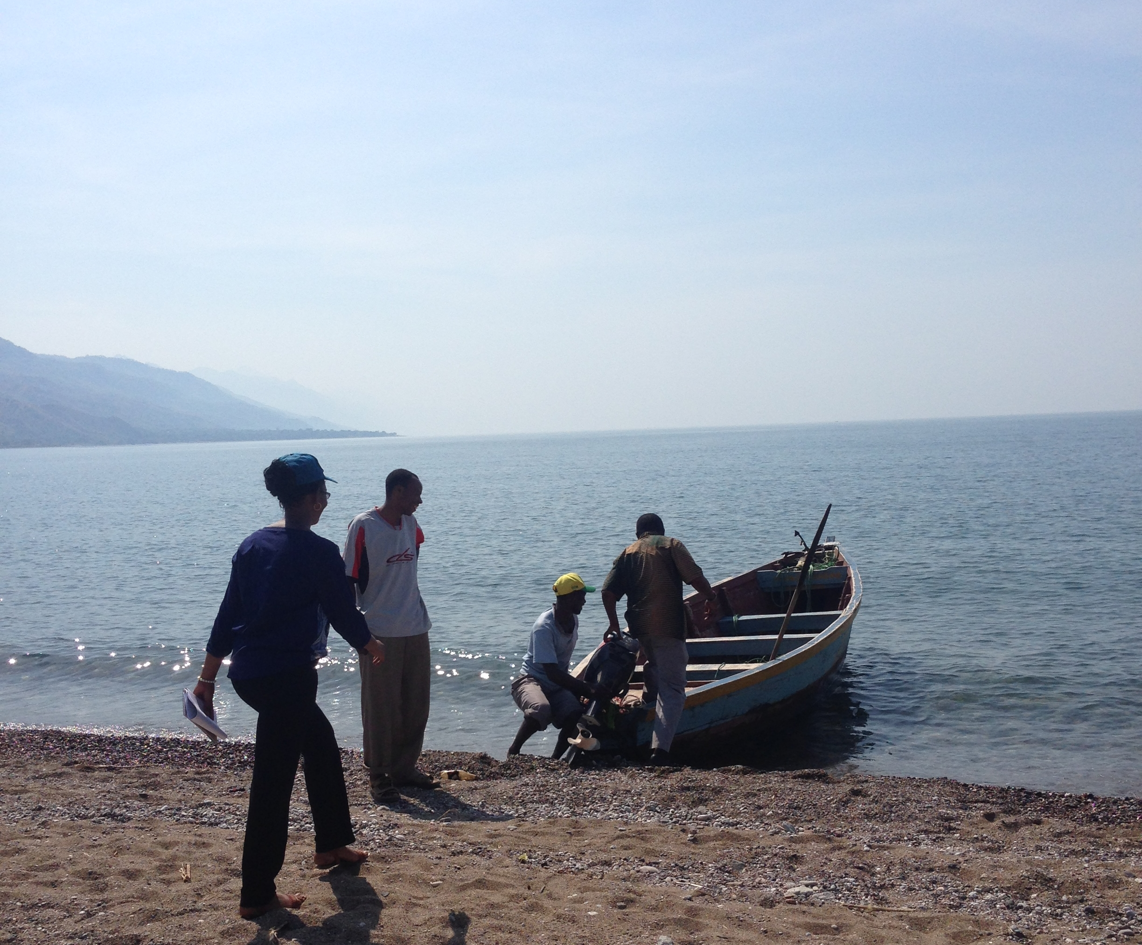

Slide 5
2007-2014 Water Sector Development Programme
USD 486,357,432
Source: GoT, Water Sector Status Report, 2015
Notes:
Why value for money?
GoT developed a Water Sector Development Programme to improve the lives of 8 million people in rural Tanzania.
The programme was funded by a basket funding totaling almost half a billion dollars
(and representing 75% of overall investments in the sector)
What is happening? Why is coverage not increasing?
The money is not enough, is it misused?

Slide 6
Value for money =
Money + Functioning infrastructure + Number of people benefiting from services
Notes:
What does value for money entail?
In a simplified formula you track:
The money
You check the infrastructure is actually functioning
You check the number of people benefiting from the services

Slide 7
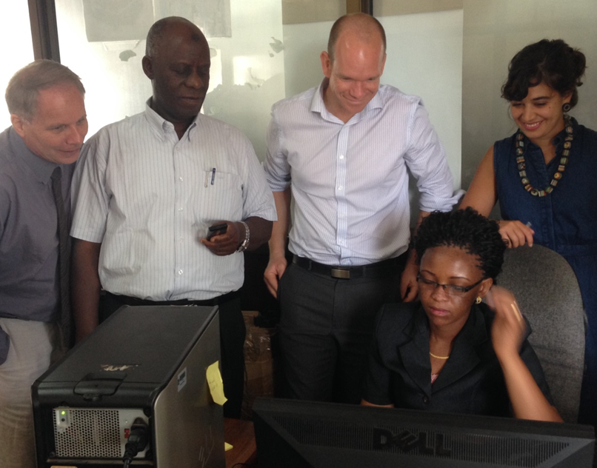

Slide 8
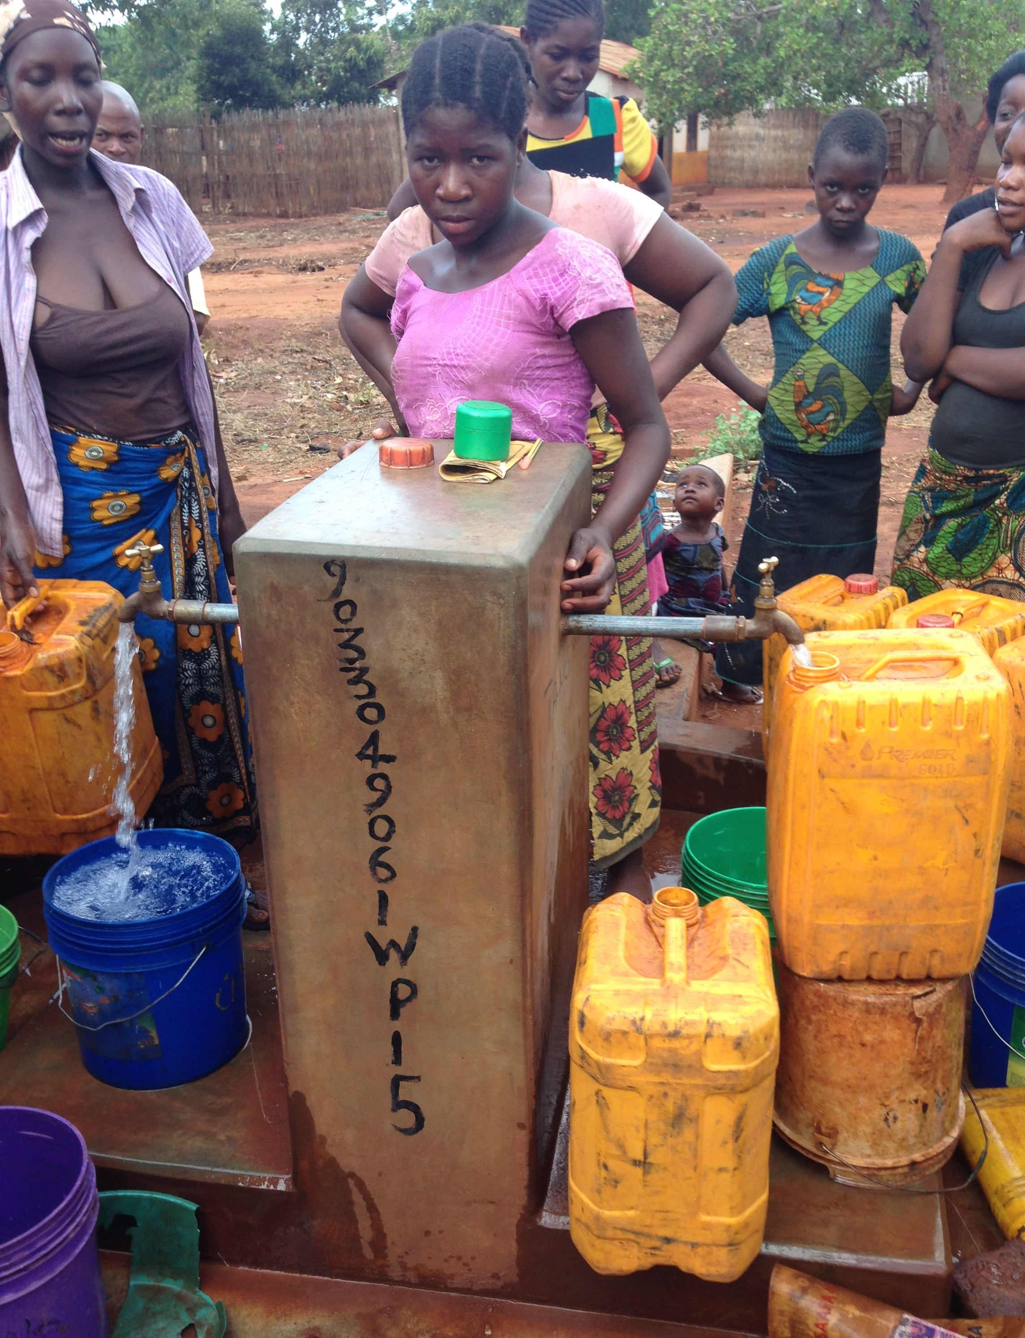

Slide 9
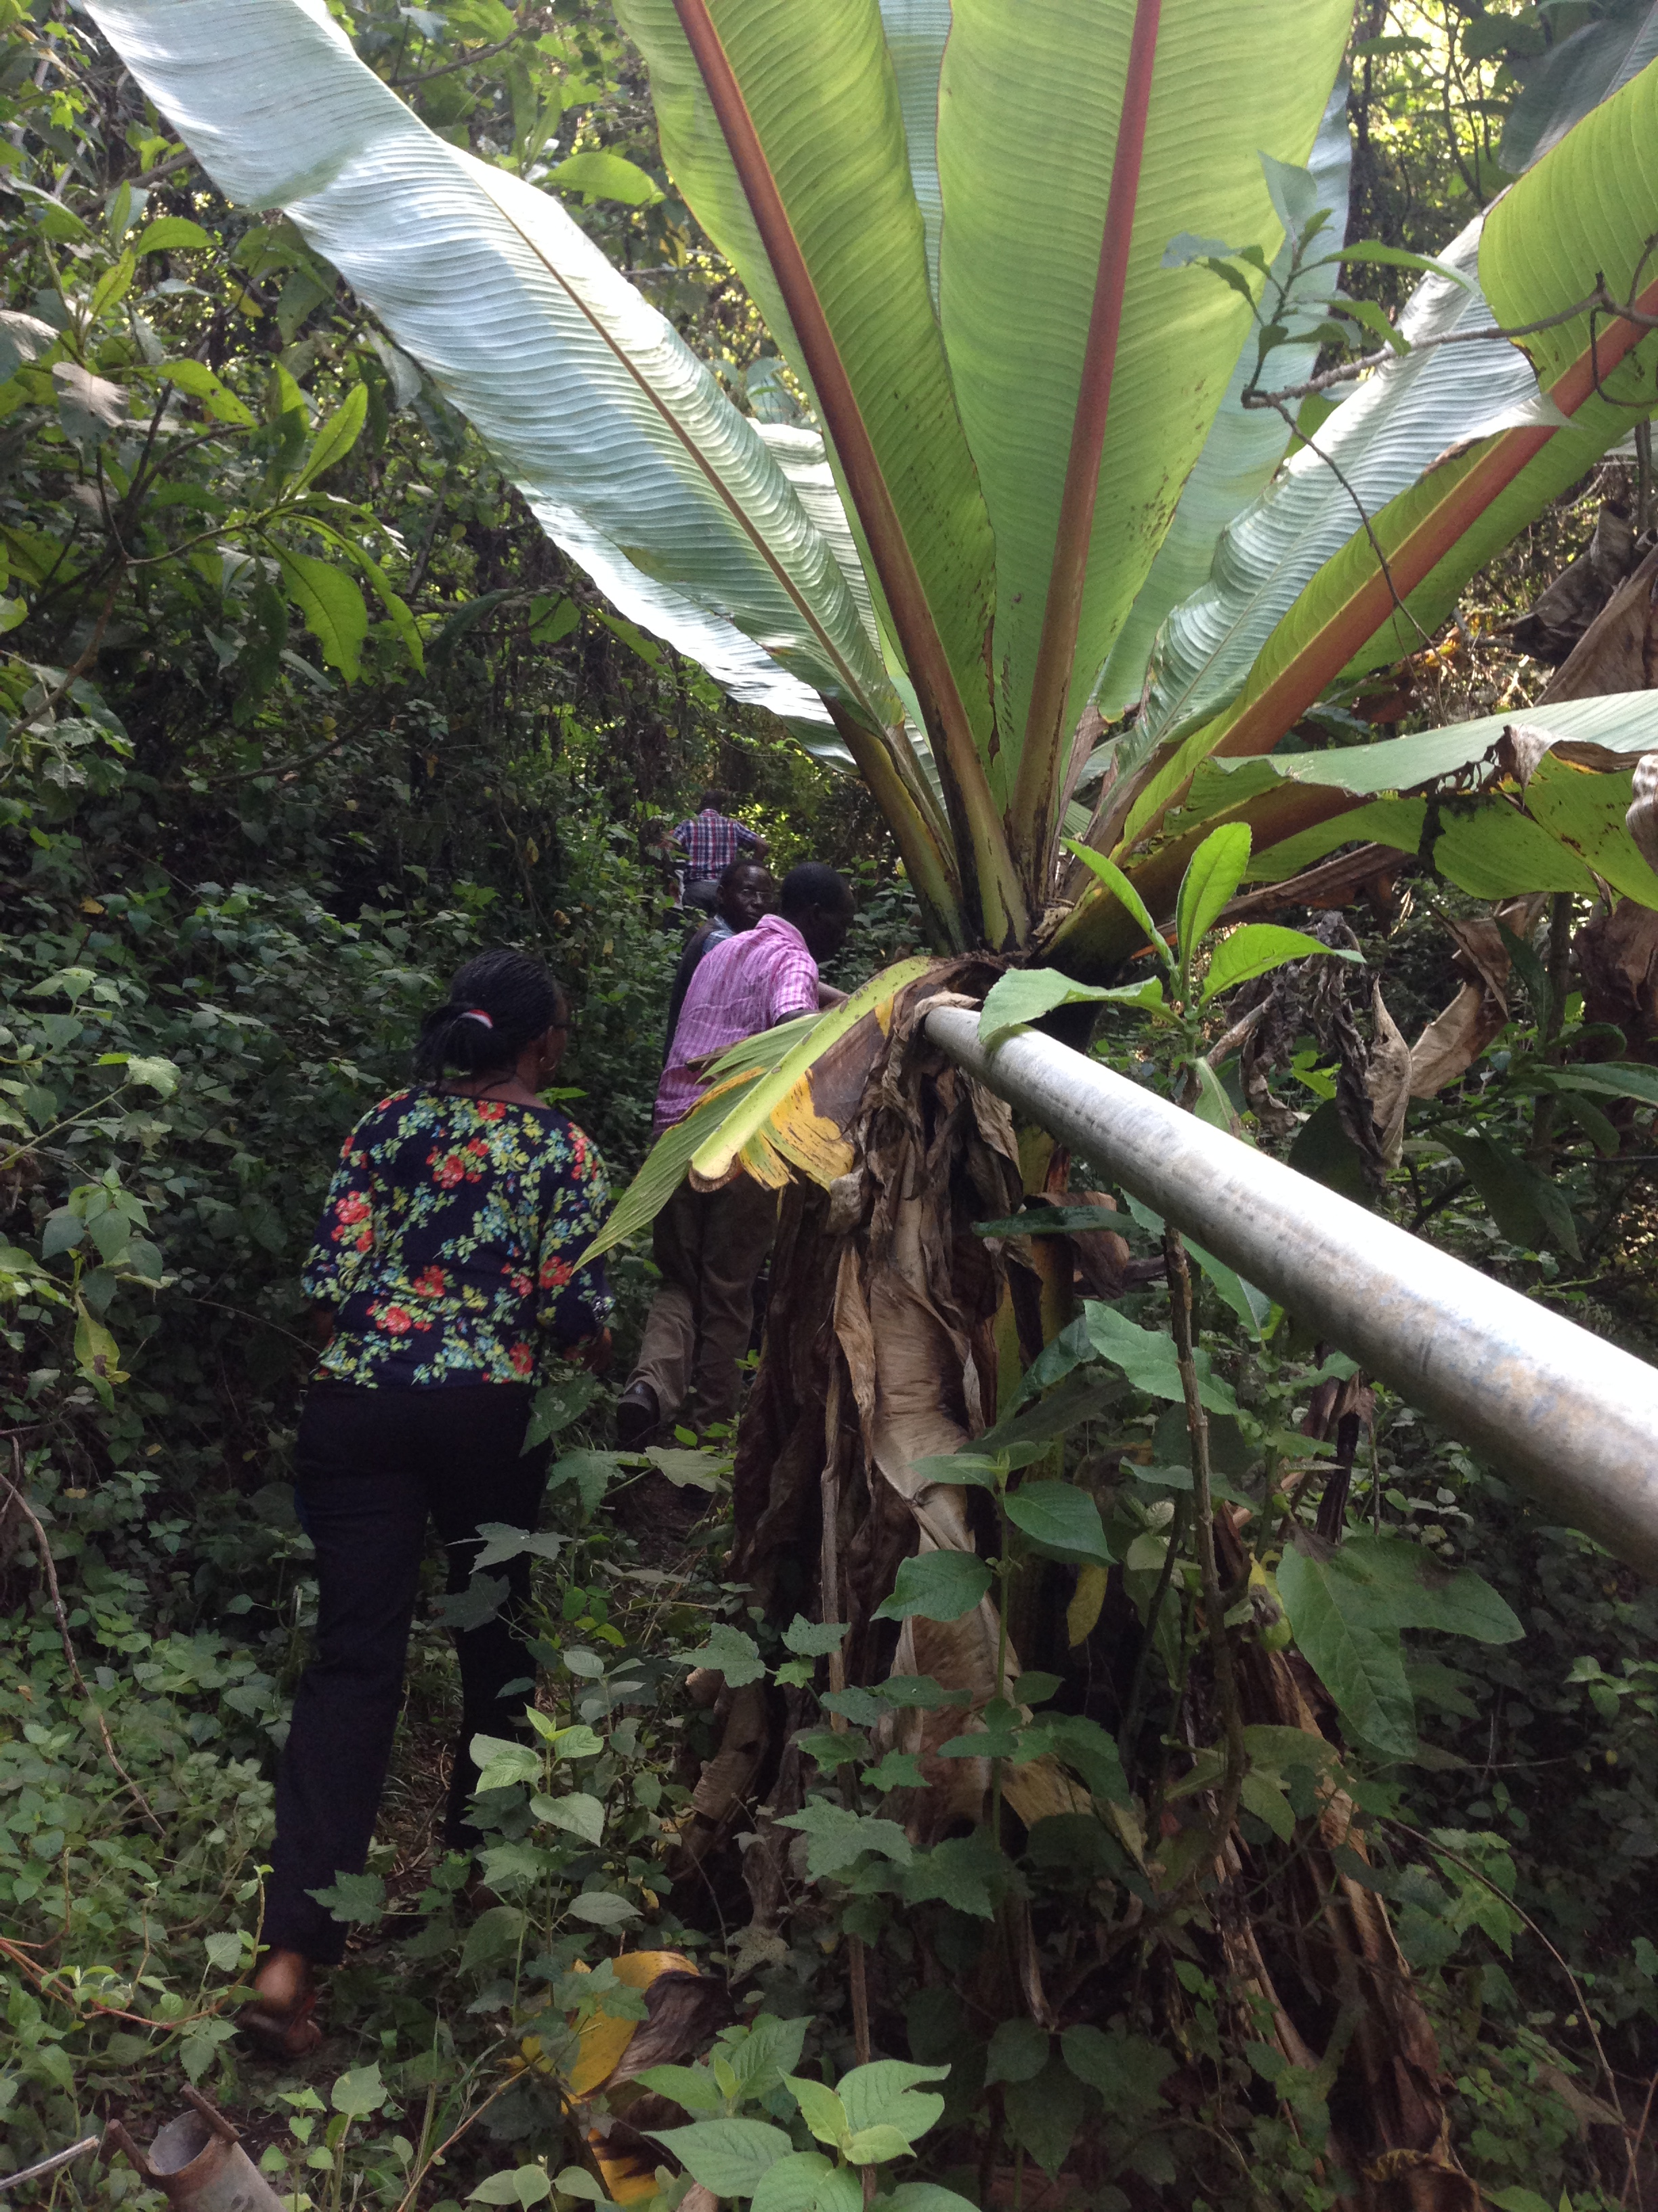

Slide 10
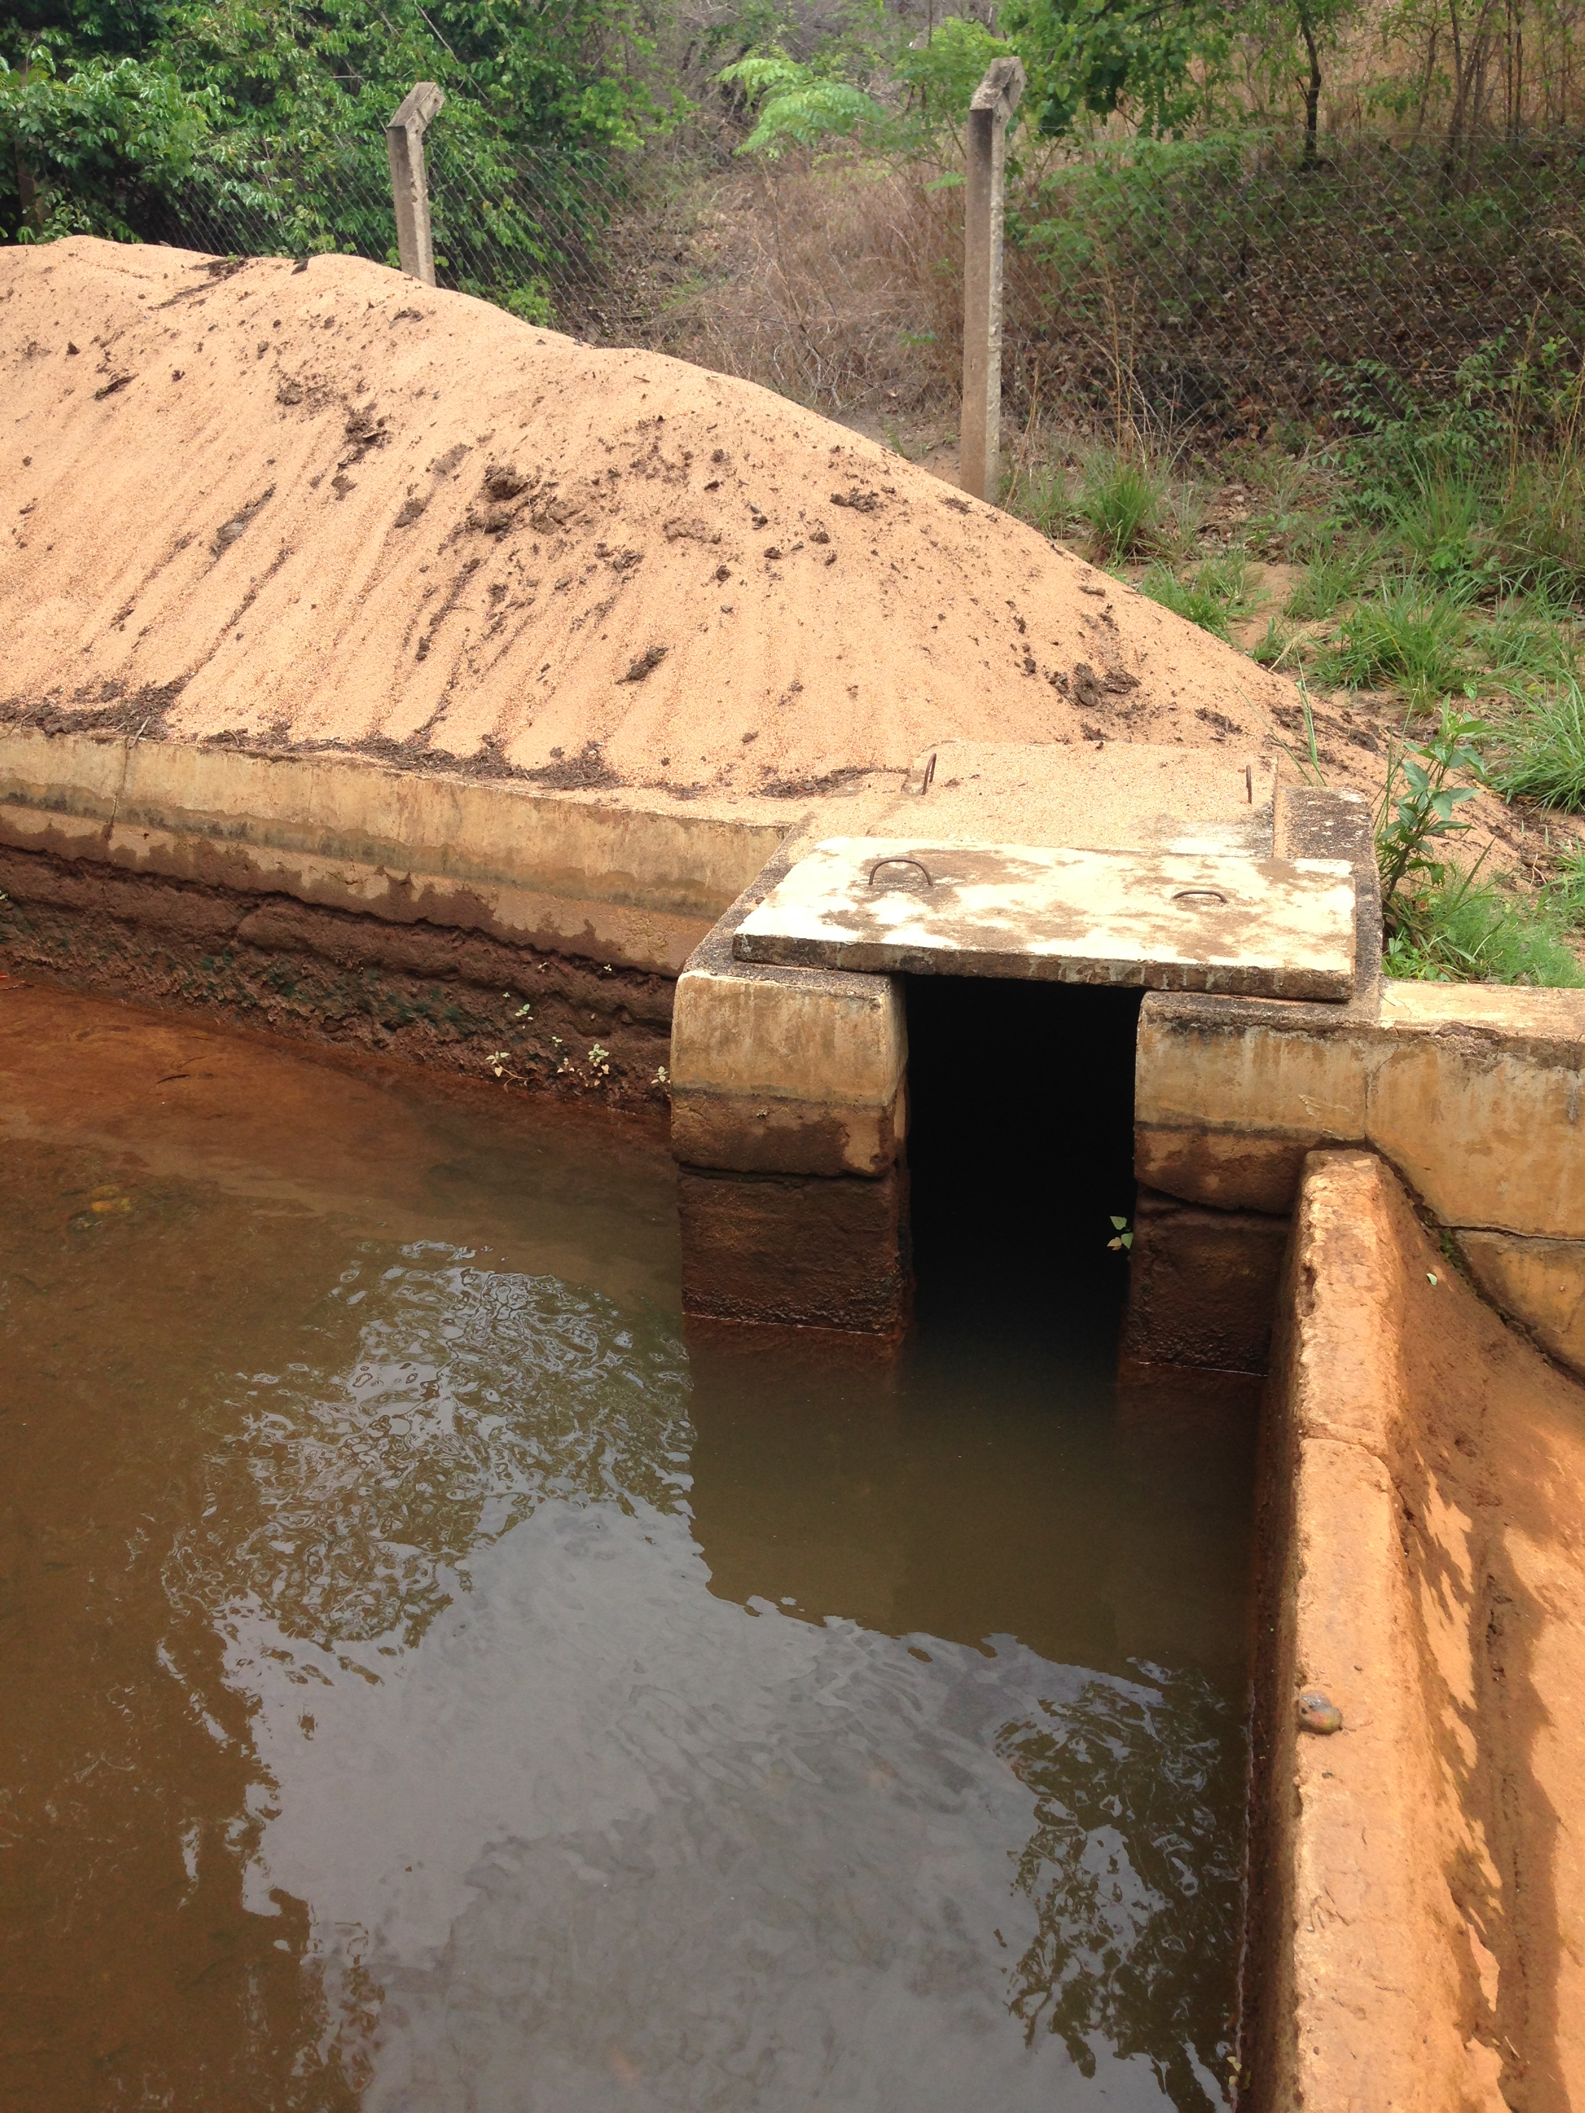

Slide 11
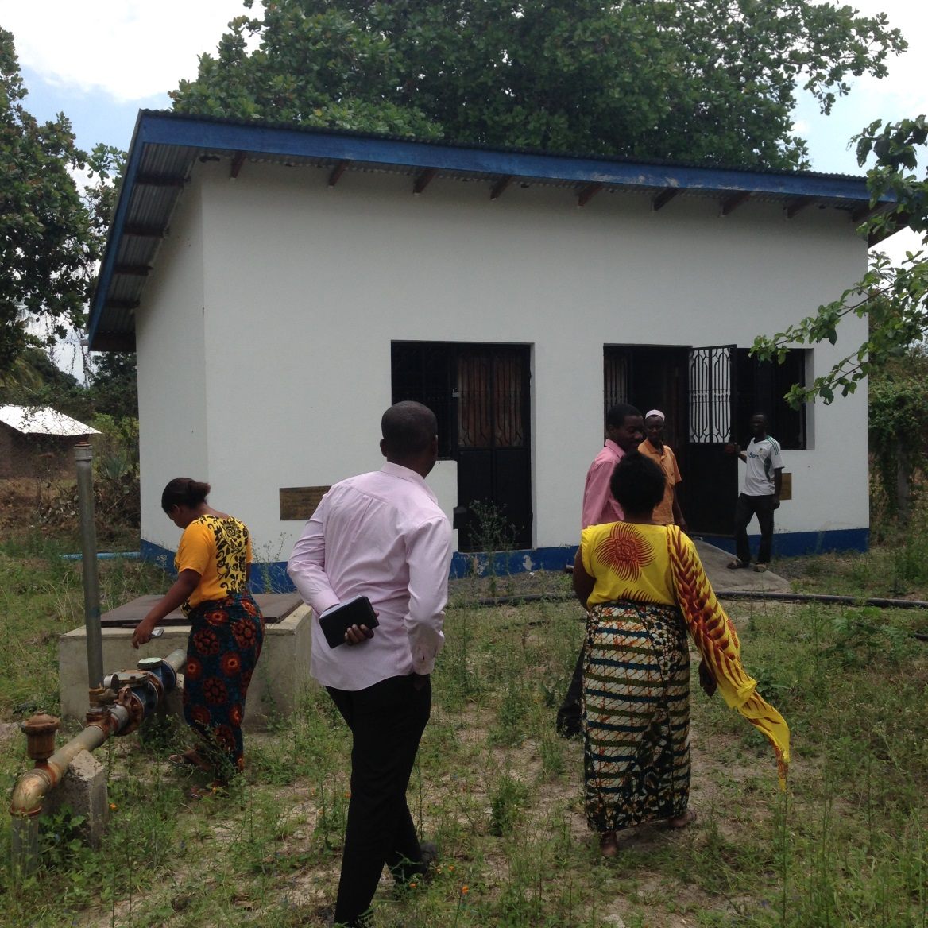
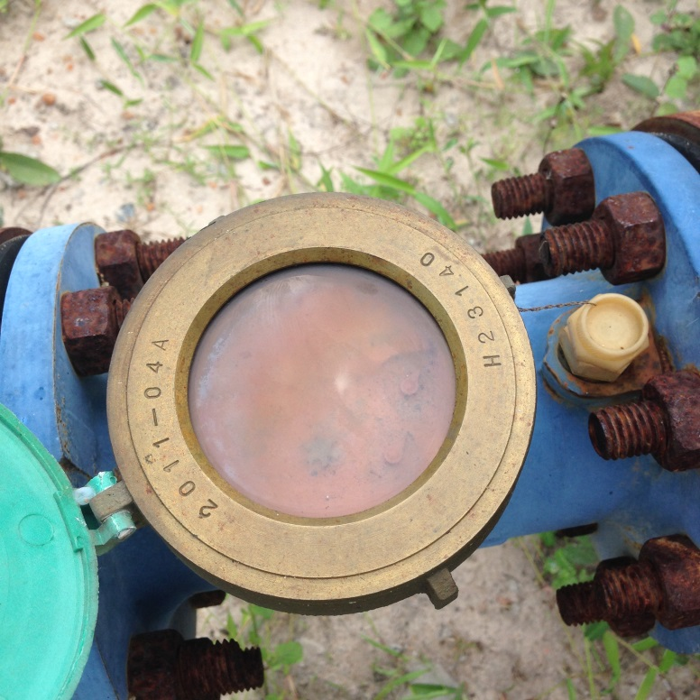

Slide 12
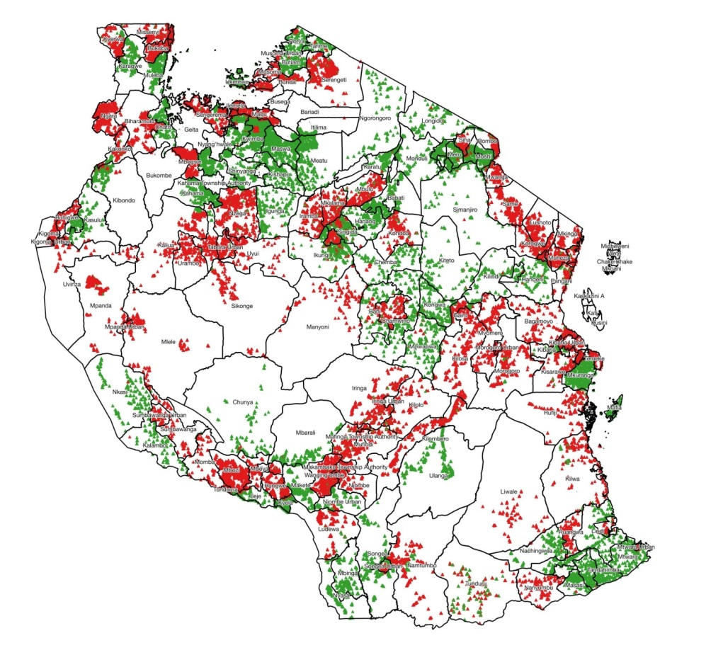
“There is no accuracy or quality of data within the rural water point inventory in Tanzania” – IRC Consult for DFID

Slide 13
Money + Functioning infrastructure + Number of people benefiting from services
“The fact that it is impossible to link funds with location, functionality of schemes and population served, seriously undermines accountability for the funds spent in the sector.”

Slide 14
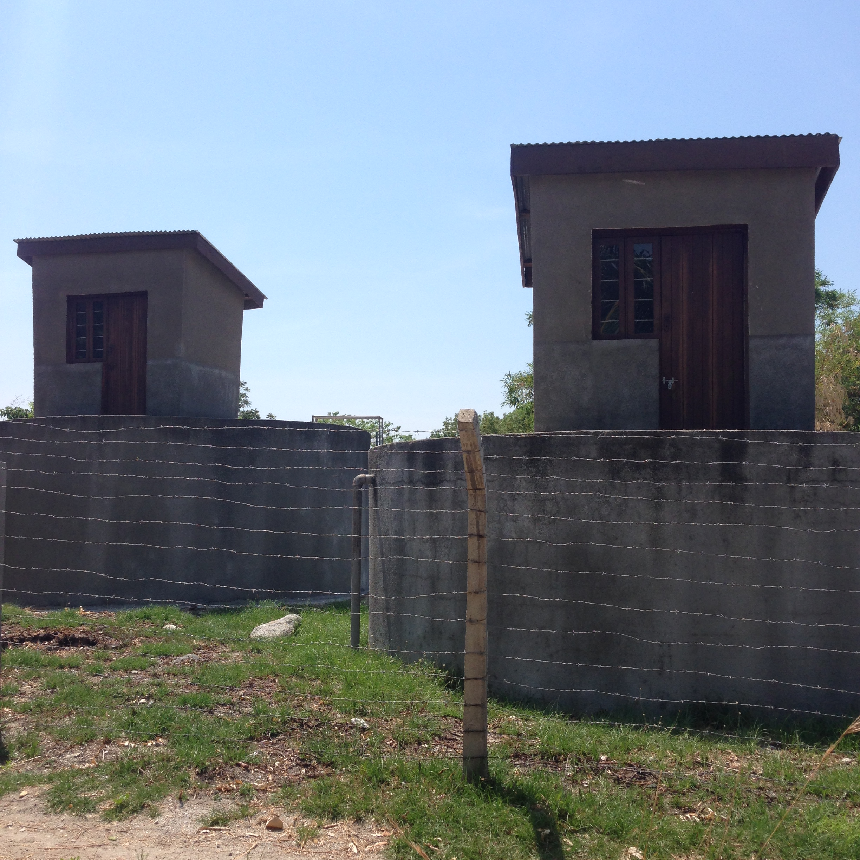

Slide 15
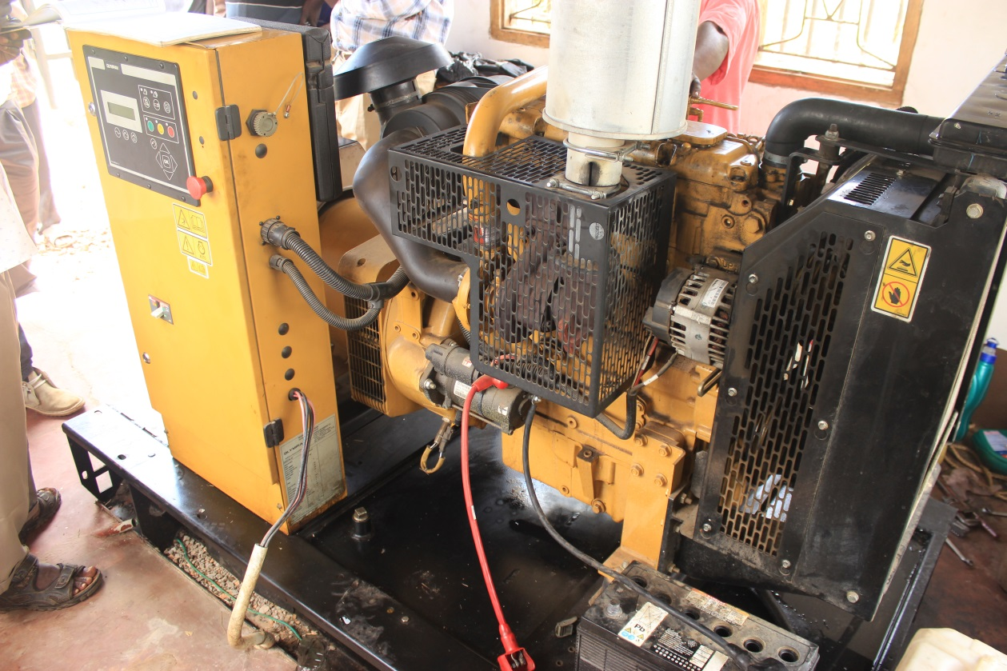

Slide 16
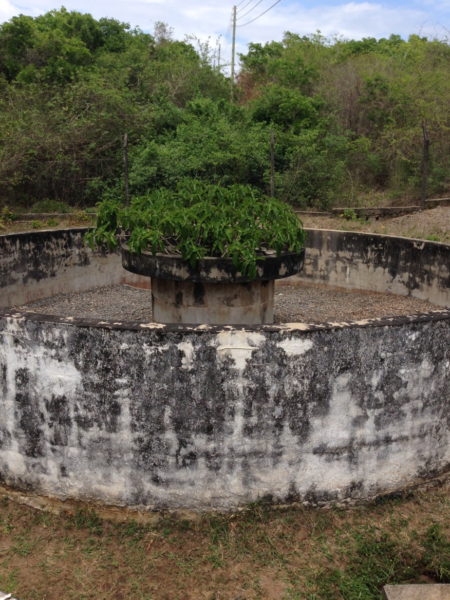

Slide 17
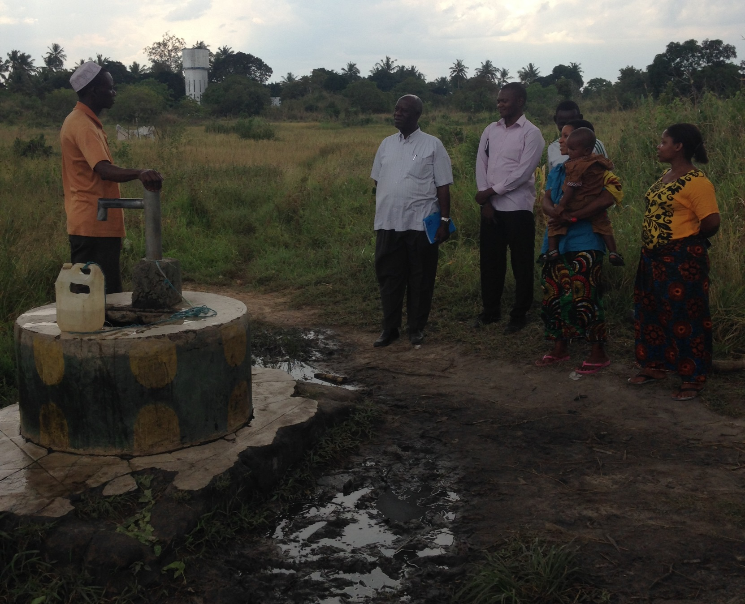

Slide 18
Who is to blame?
Notes:
This is an example from several countries and I’m sure many of you have similar examples.

Slide 19
We are not asking the hard questions:
Has the money been spent where it is needed?
Is it spent effectively?
Does it actually lead to an improvement in services?
Most programme evaluation reports, mid-term reviews and costing studies are not published.
Notes:
I think we are to blame.
We civil society, we donors, we NGOs…
We are not asking the hard questions

Slide 20
2007-2014 Water Sector Development Programme
USD 486,357,432
Source: GoT, Water Sector Status Report, 2015
Notes:
Arguably the amount of money lost in inefficiencies is much higher than corruption
These inefficiencies can only be addressed with increasing accountability and transparency…

Slide 21
Thank you

