Slide 1


Slide 2
Estimating groundwater recharge following soil-use change
The case of Arbieto, Bolivia

Slide 3
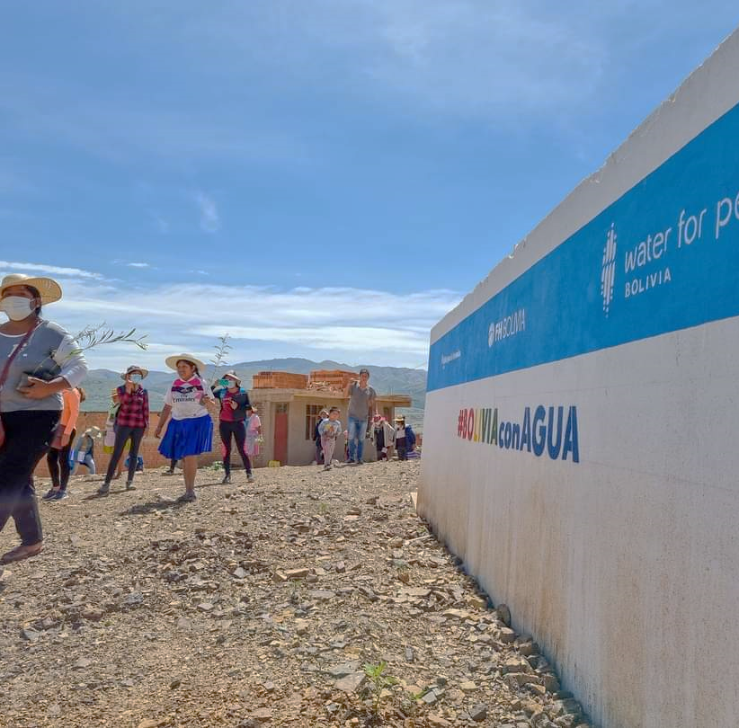
We must value the origin of water sources
We cannot continue to only look for new water sources to meet our increasing demand

Slide 4
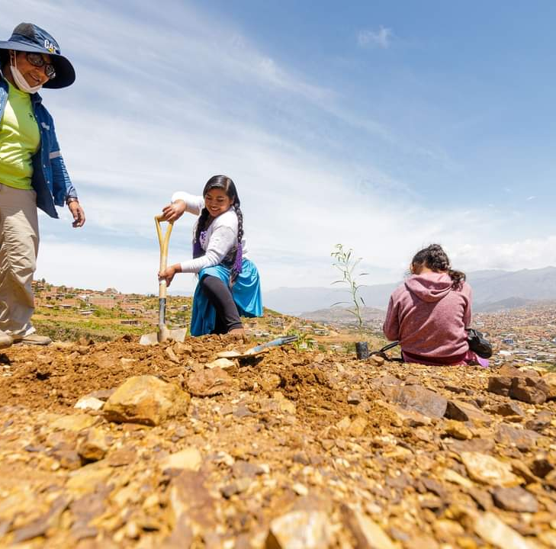
The case of Arbieto:
The use of the soil has changed over time, leading to decreased saturation
Examples include:
  Urbanization
  Agricultural use
  Deforestation
  Water intensive plants

Slide 5
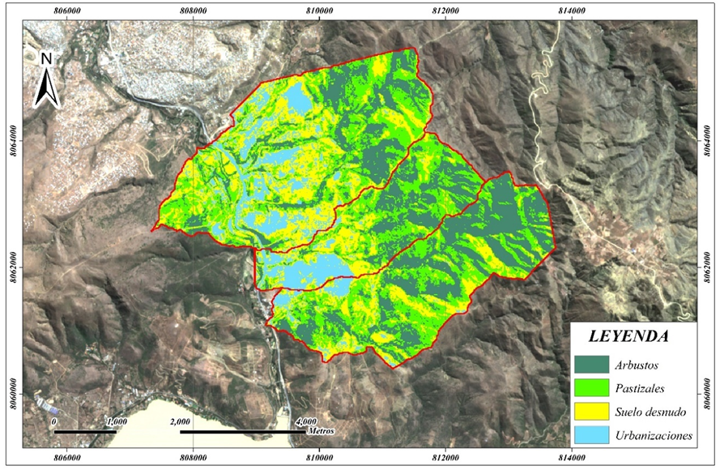
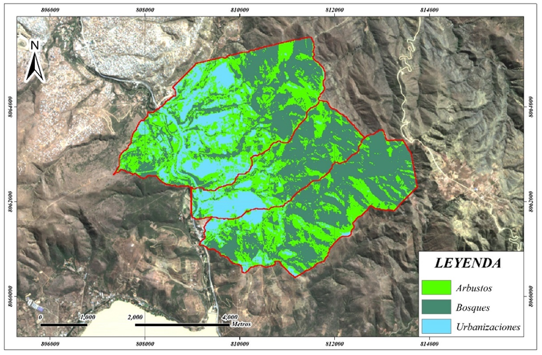
With geographic information systems, the Soil Conservation Service Curve Number (SCS-CN) Methodology uses satellite imagery to identify current land use, estimate the level of infiltration per area, and the species of trees

Slide 6

What are the innovations?
    Using the methodology in different geographical contexts
    The social processes: collaboration with municipalities, community organizations, water committees, academia, and local stakeholders

