Slide 1



Slide 2
Forest incentives as instruments that contribute to WASH sustainability in Guatemala
The case of El Quiché, Guatemala

Slide 3
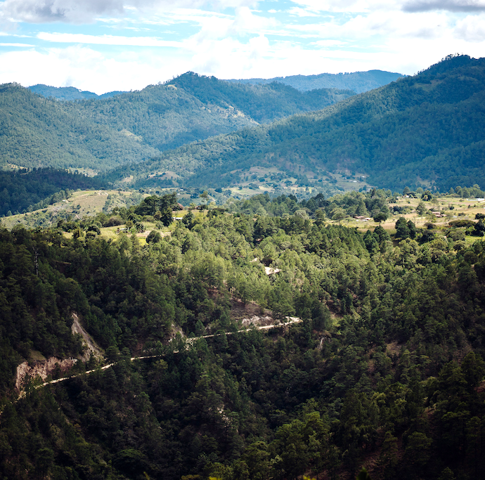
Guatemala has two forestry incentive programs (PINPEP and PROBOSQUE) with State funds for the protection and conservation of water recharge forest zones
We should make better use of

Slide 4
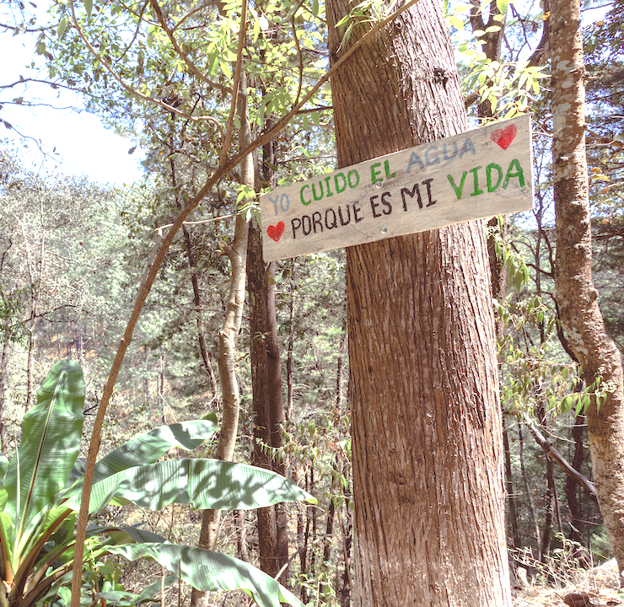
So, we carried out a study to prioritize the conversion of 2,674 hectares of forest where it was shown that there is a great annual loss in the water recharge zone

Slide 5
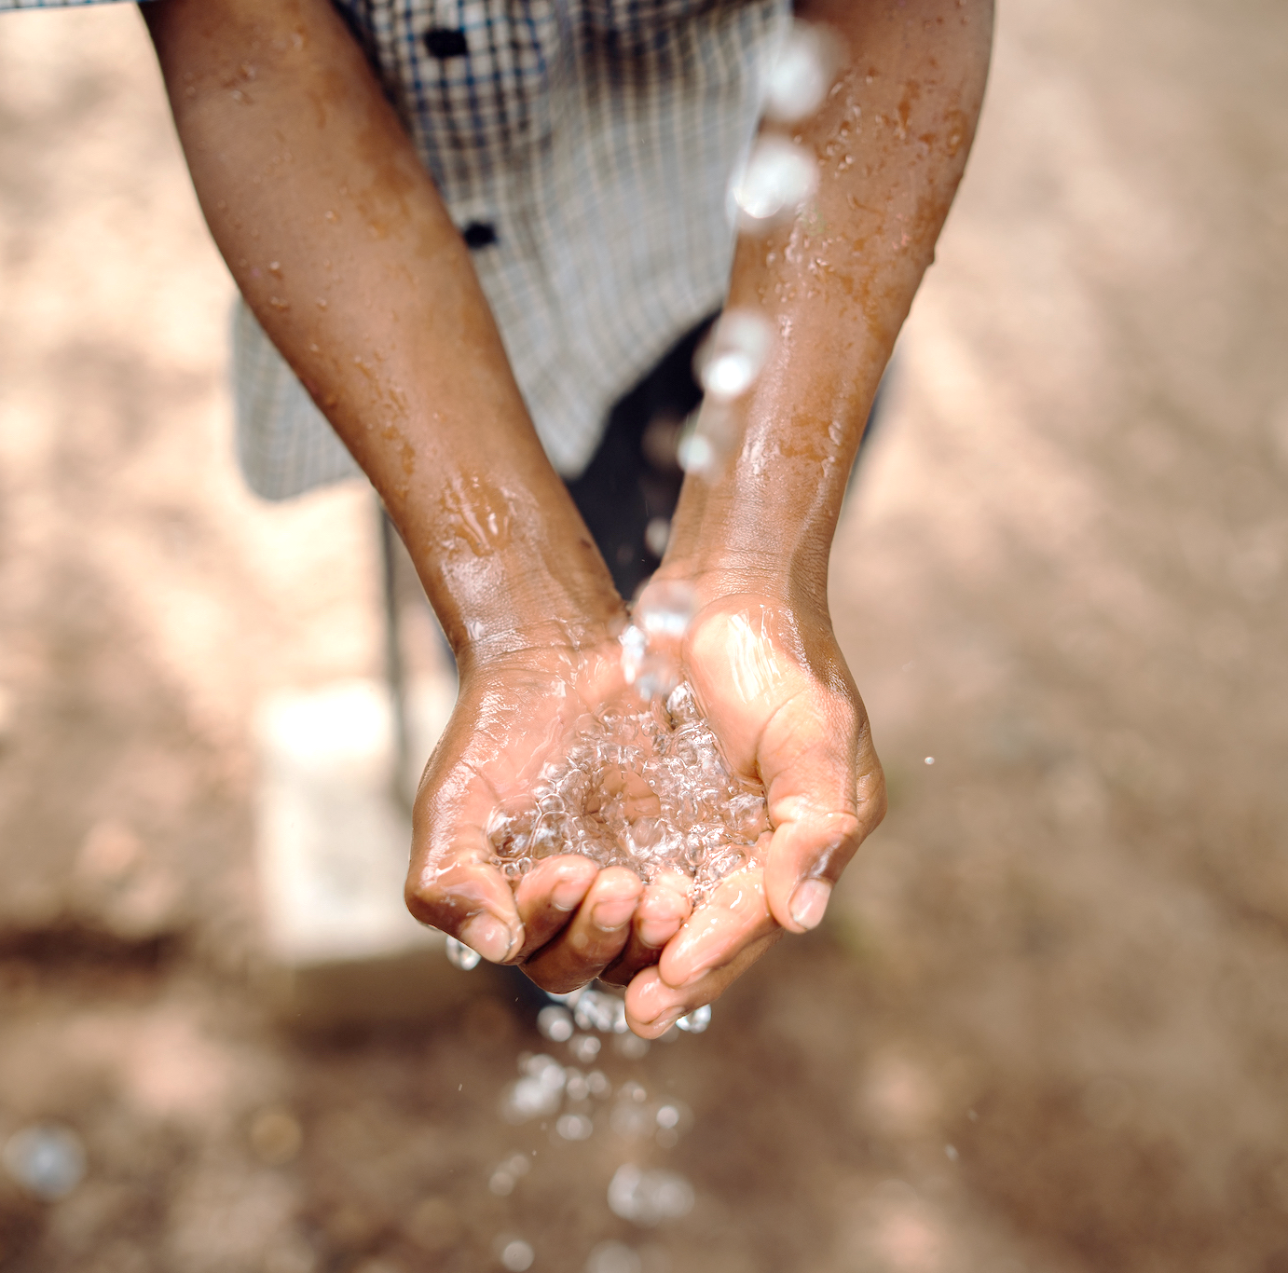
This study made it possible
to prioritize forest incentive projects to ensure the protection and conservation of the forests that supply
water to the communities where work

Slide 6
What are the innovations?
    The study helped speed up the approval of the incentives.
    Forestry incentives generate income for farmers.
    Water sources are protected by implementing state funds.

